Slide 1
Calculus I for MGMT – Preliminaries Numbers & Inequalities
Mathematics for Management
Supplementary Electronic Materials
Preliminaries
Numbers & Inequalities
Exponential & Logarithmic Expressions
The Cartesian Coordinate System
Factorizing Polynomials &
Solving Systems of Equations

Slide 2
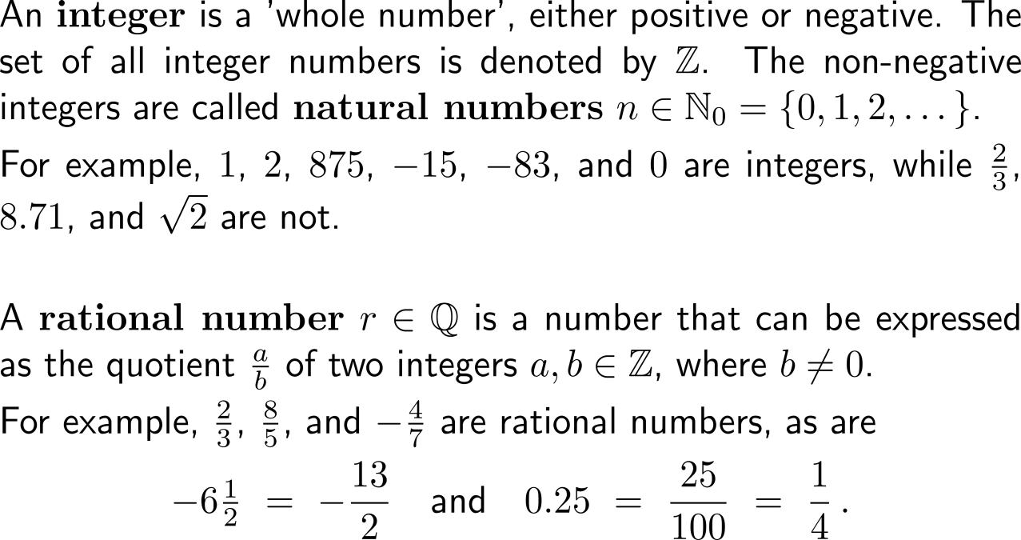
Our number system consists of natural, integer, and rational numbers …
natural numbers
integer numbers
rational numbers
irrational numbers
real numbers

Slide 3
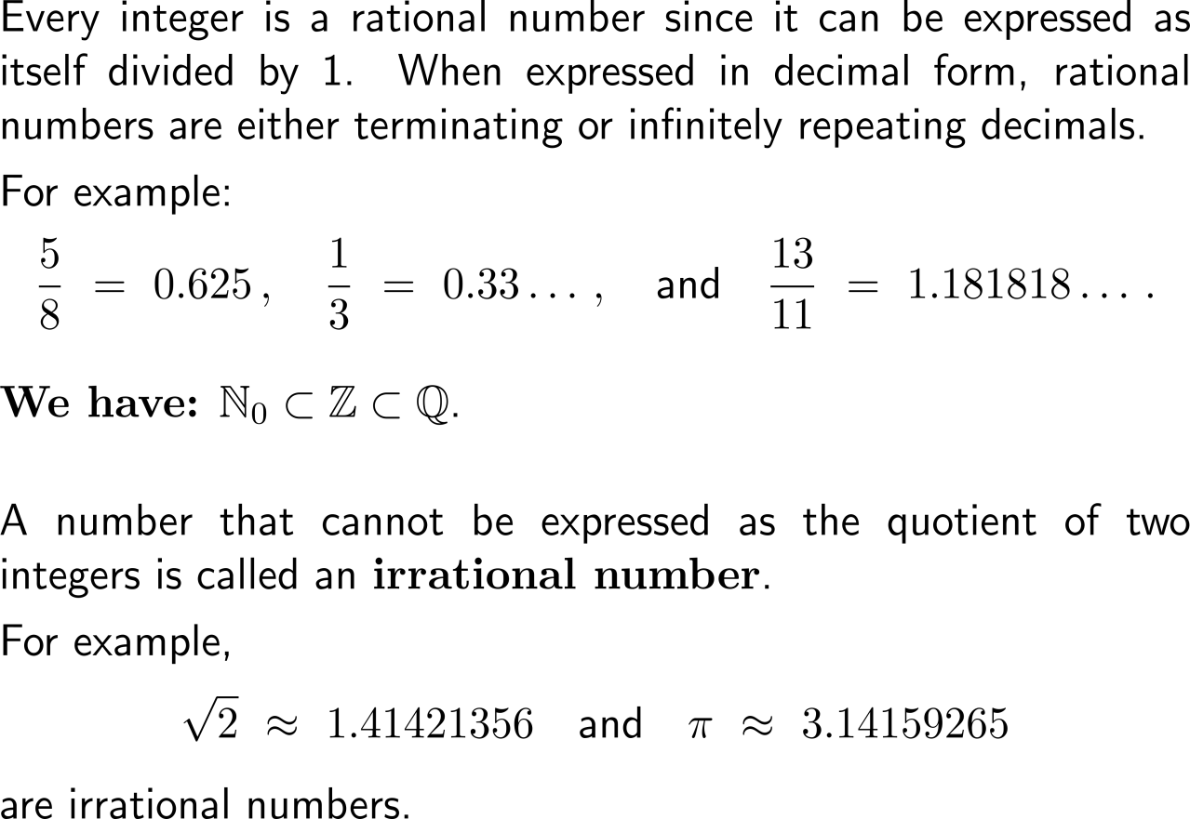
… as well as irrational numbers
natural numbers
integer numbers
rational numbers
irrational numbers
real numbers

Slide 4
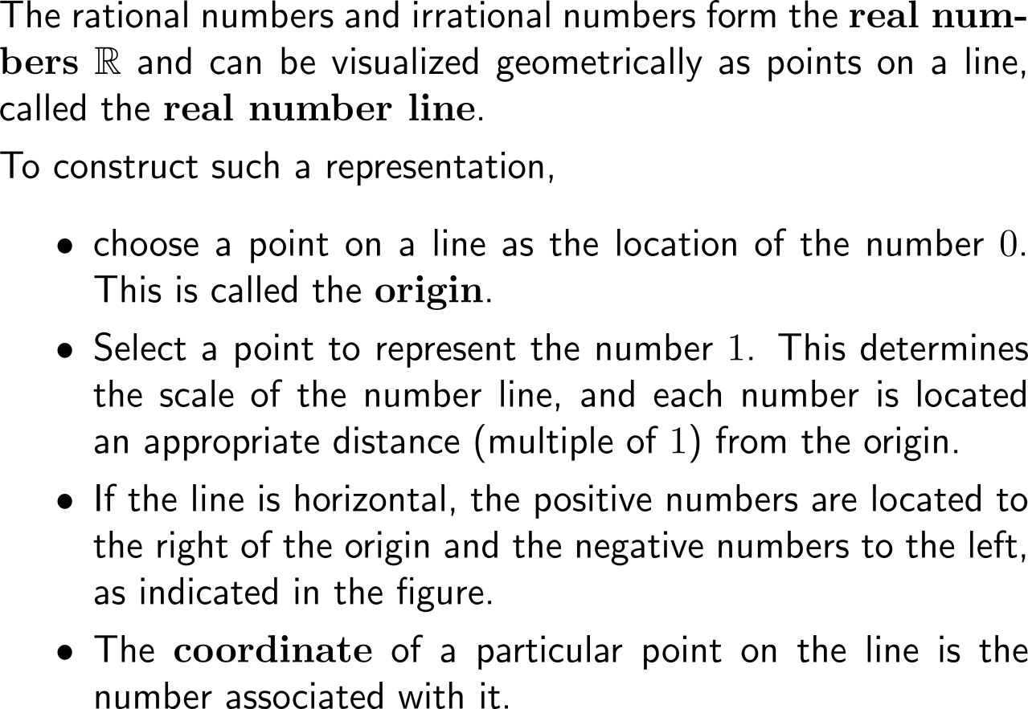
Together these number sets comprise the set of real numbers which can e.g. be illustrated by the real number line
real numbers
negative numbers
positive numbers
origin
0
-3
-1
1
3
-4.5
1.5
5.25

Slide 5
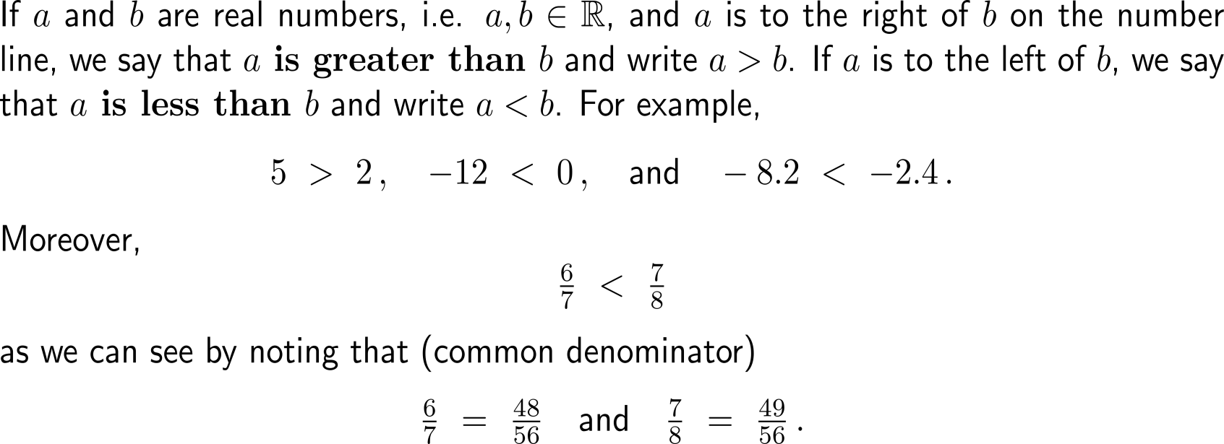
Due to their mutual position on the real number line we can distinguish the greater (lesser) of two numbers

Slide 6
Such inequalities between two numbers share important properties

Slide 7
In particular, an identity or inequality is said to be solved when all numbers that satisfy it have been found

Slide 8
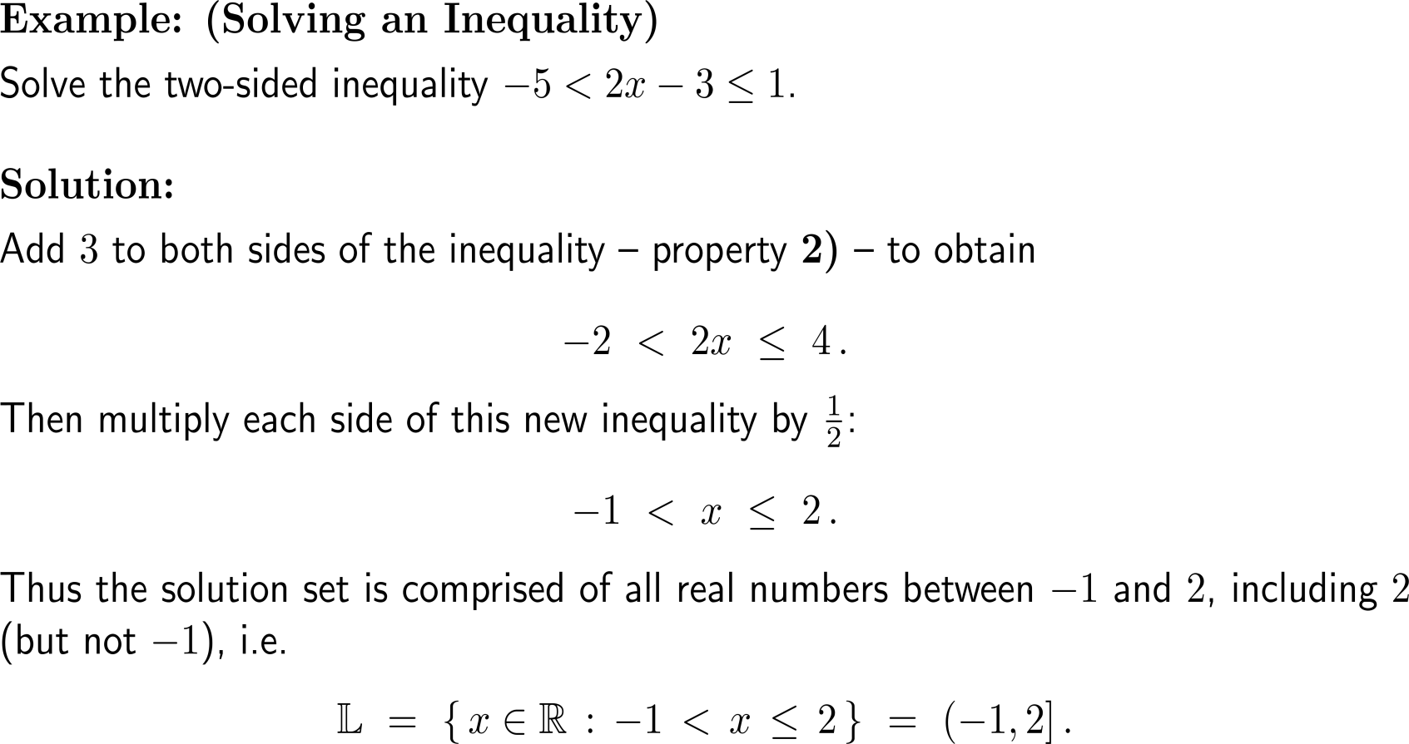
Example: Solving a two-sided inequality

Slide 9
A set of real numbers that can be represented on the number line by a line segment is called an interval

Slide 10
Intervals may be finite or infinite in extent and may or may not contain either endpoint

Slide 11
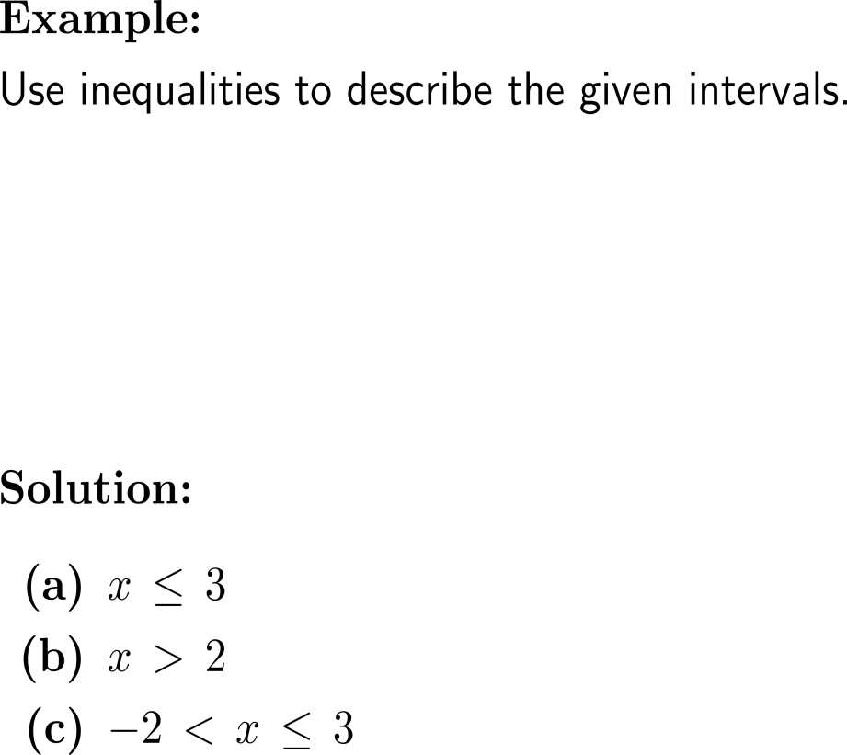
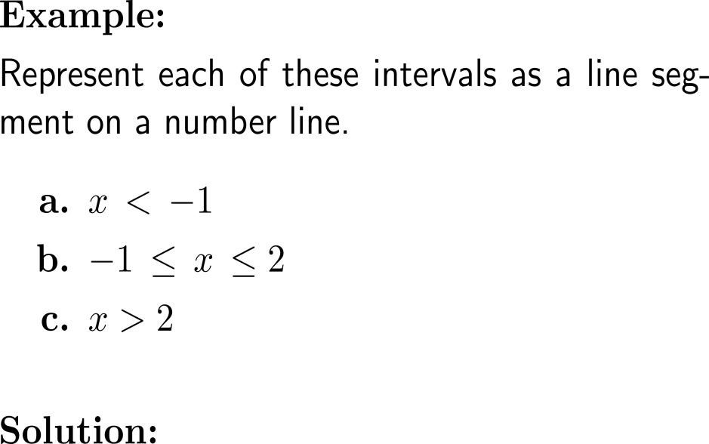
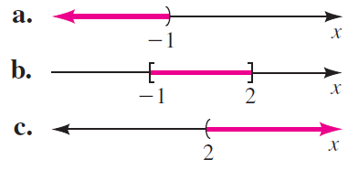
Example: Describing & graphing intervals with inequalities

Slide 12
Geometrically, the absolute value of a real number is its distance from the origin on the number line

Slide 13
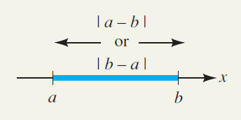
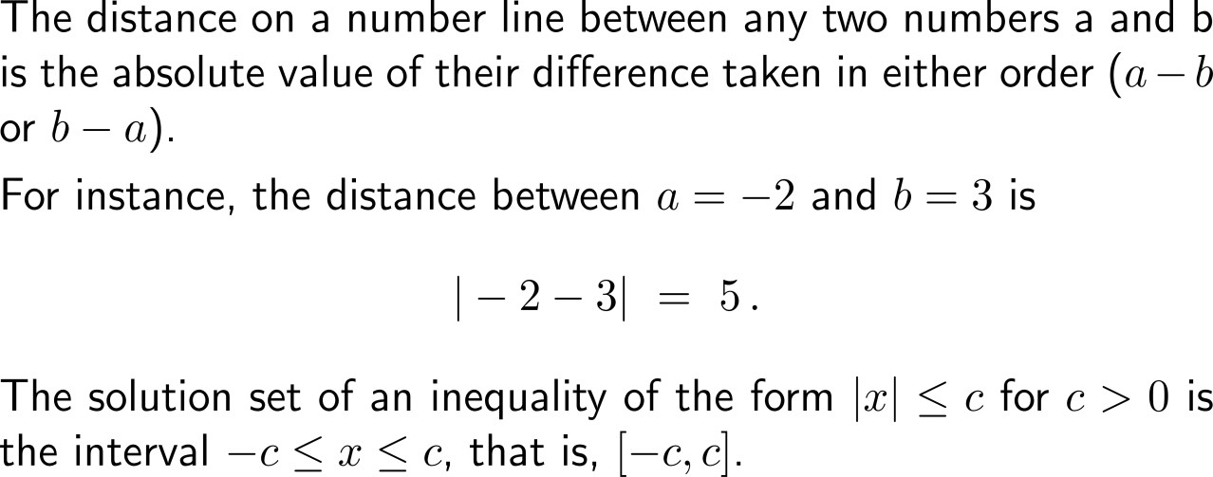
The distance between any two numbers on the number line is the absolute value of their difference

Slide 14
Example: Solving an absolute value inequality

Slide 15
Example: Solving an absolute value inequality

Slide 16
Calculus I for Management

