Slide 1
Calculus I for MGMT – Preliminaries Factorizing Polynomials & Solving Systems of Equations
Mathematics for Management
Supplementary Electronic Materials
Preliminaries
Numbers & Inequalities
Exponential & Logarithmic Expressions
The Cartesian Coordinate System
Factorizing Polynomials &
Solving Systems of Equations

Slide 2
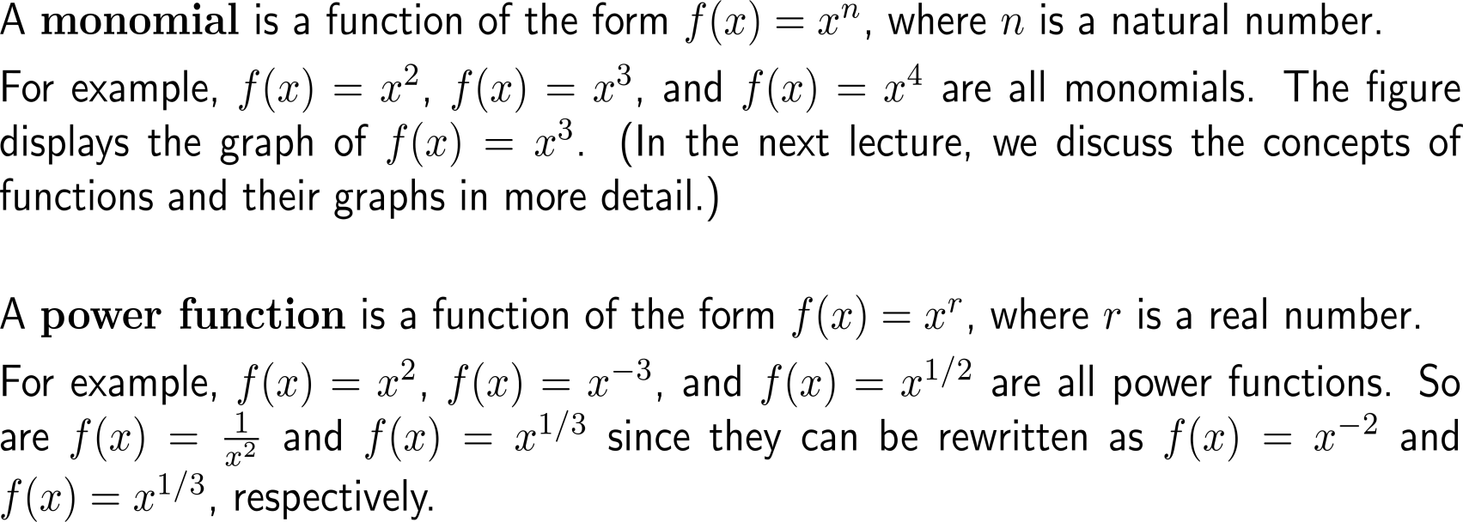
Monomials are special power functions that serve as building blocks for polynomials

Slide 3
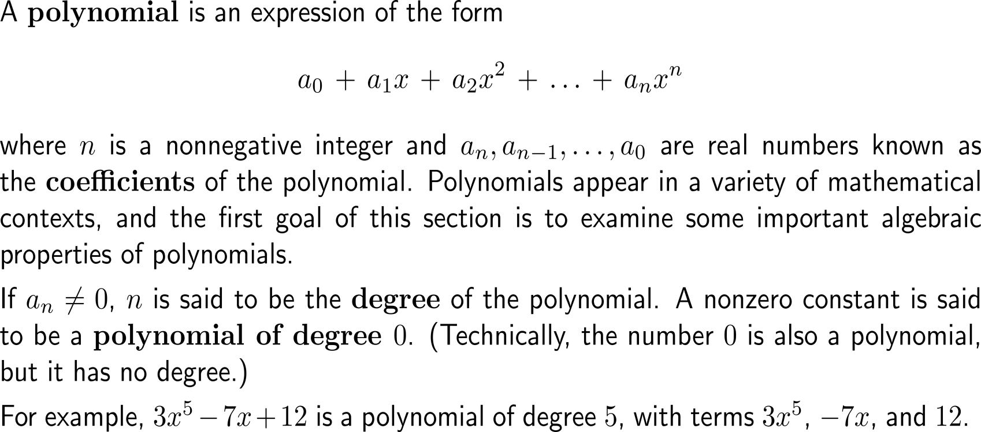
A polynomial is an expression of the form a₀ + a₁x + a₂x² + … + a_{n}x^{n} with real coefficients a_{k} and degree n if an is not vanishing

Slide 4
Similar terms in two polynomials are terms with the same degree

Slide 5
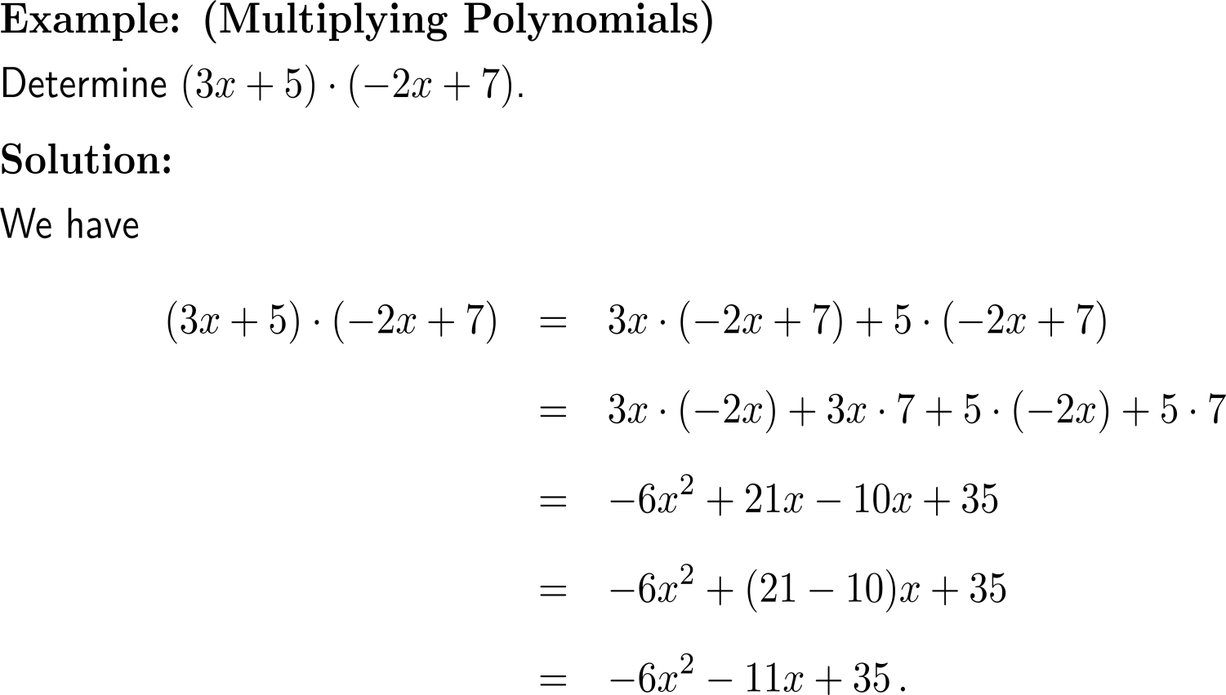
Example: Multiplying Polynomials

Slide 6
For quadratic polynomials we can use the solution formula for quadratic polynomials to find their linear factors

Slide 7
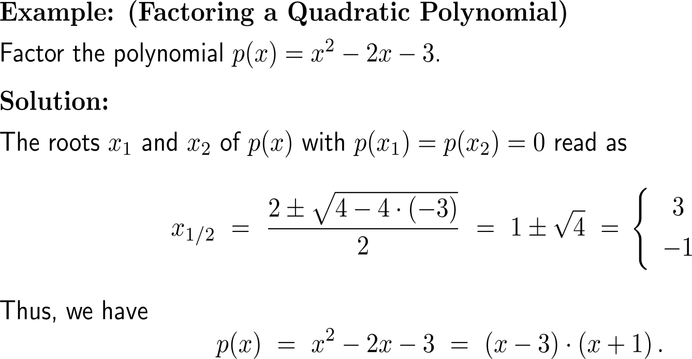
Example: Factoring a quadratic polynomial

Slide 8
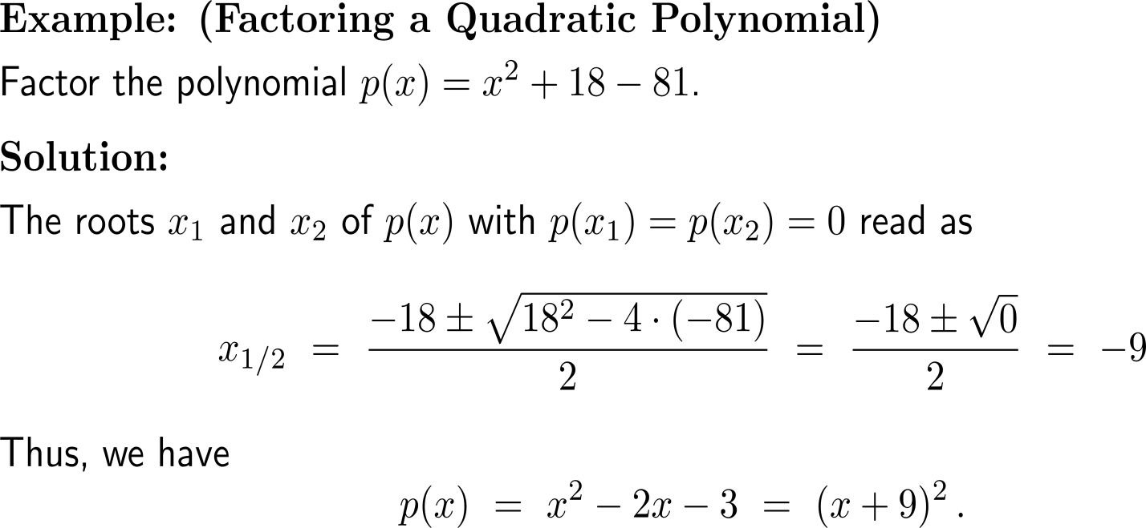
Example: Factoring a quadratic polynomial

Slide 9
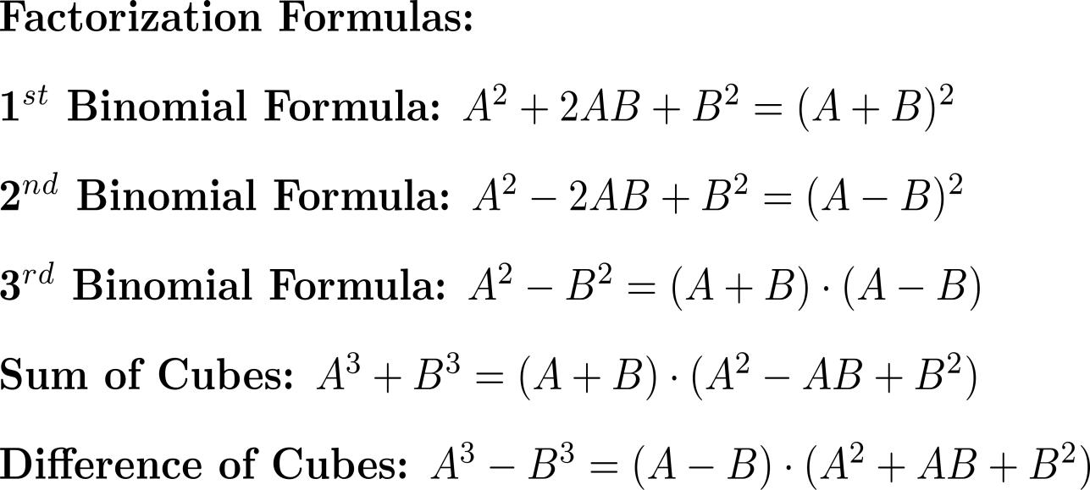
Certain polynomial types occur so often that it is useful to memorize the formulas for factoring them

Slide 10
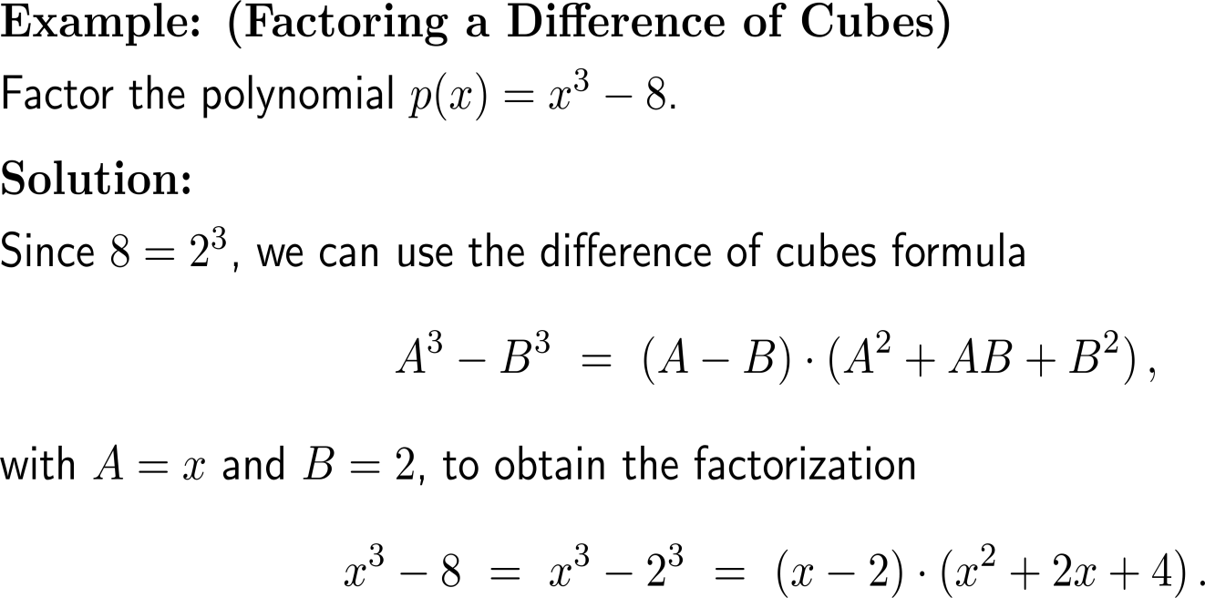
Example: Factoring a difference of cubes

Slide 11
Long division helps us to successively factorize more complicated polynomials (1/ 2)

Slide 12
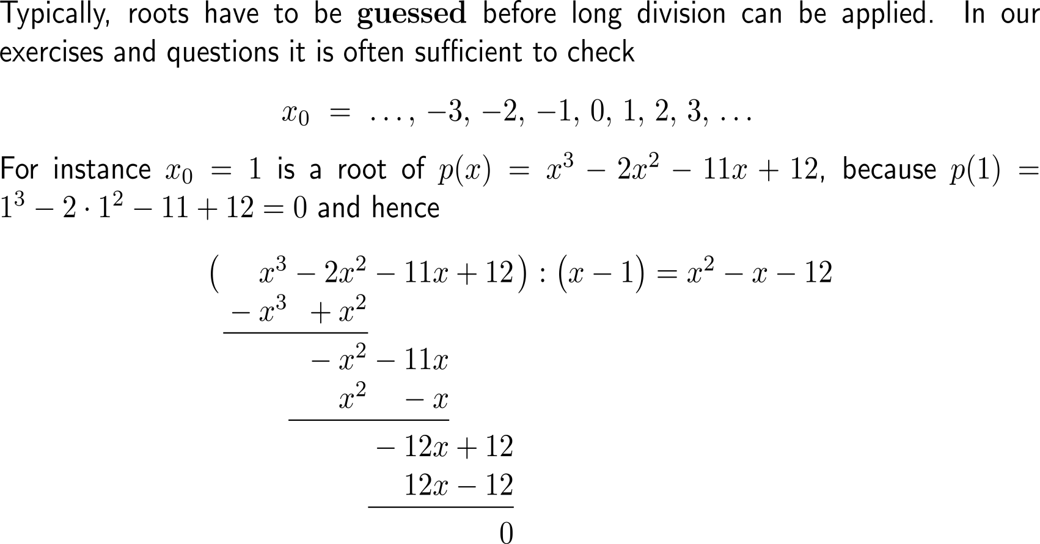
Long division helps us to successively factorize more complicated polynomials (2/ 2)

Slide 13
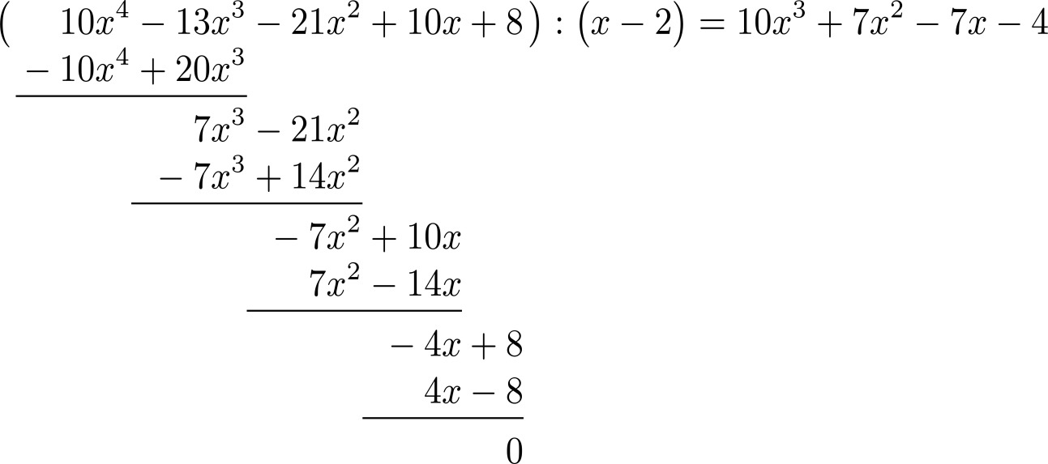
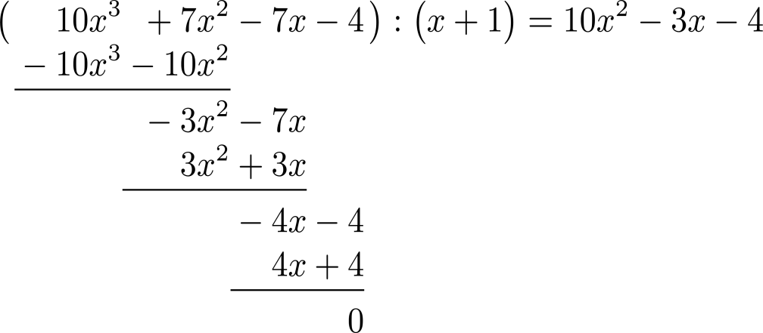
Example: Long division

Slide 14
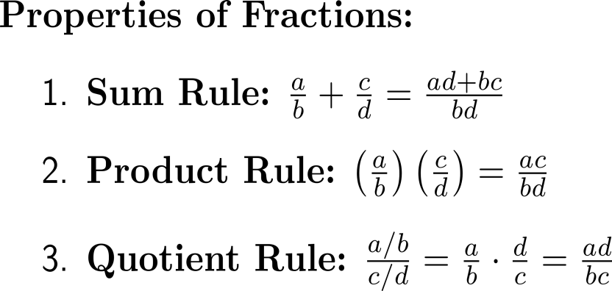
Useful properties of rational expressions comprise the sum rule, the product rule, and the quotient rule

Slide 15
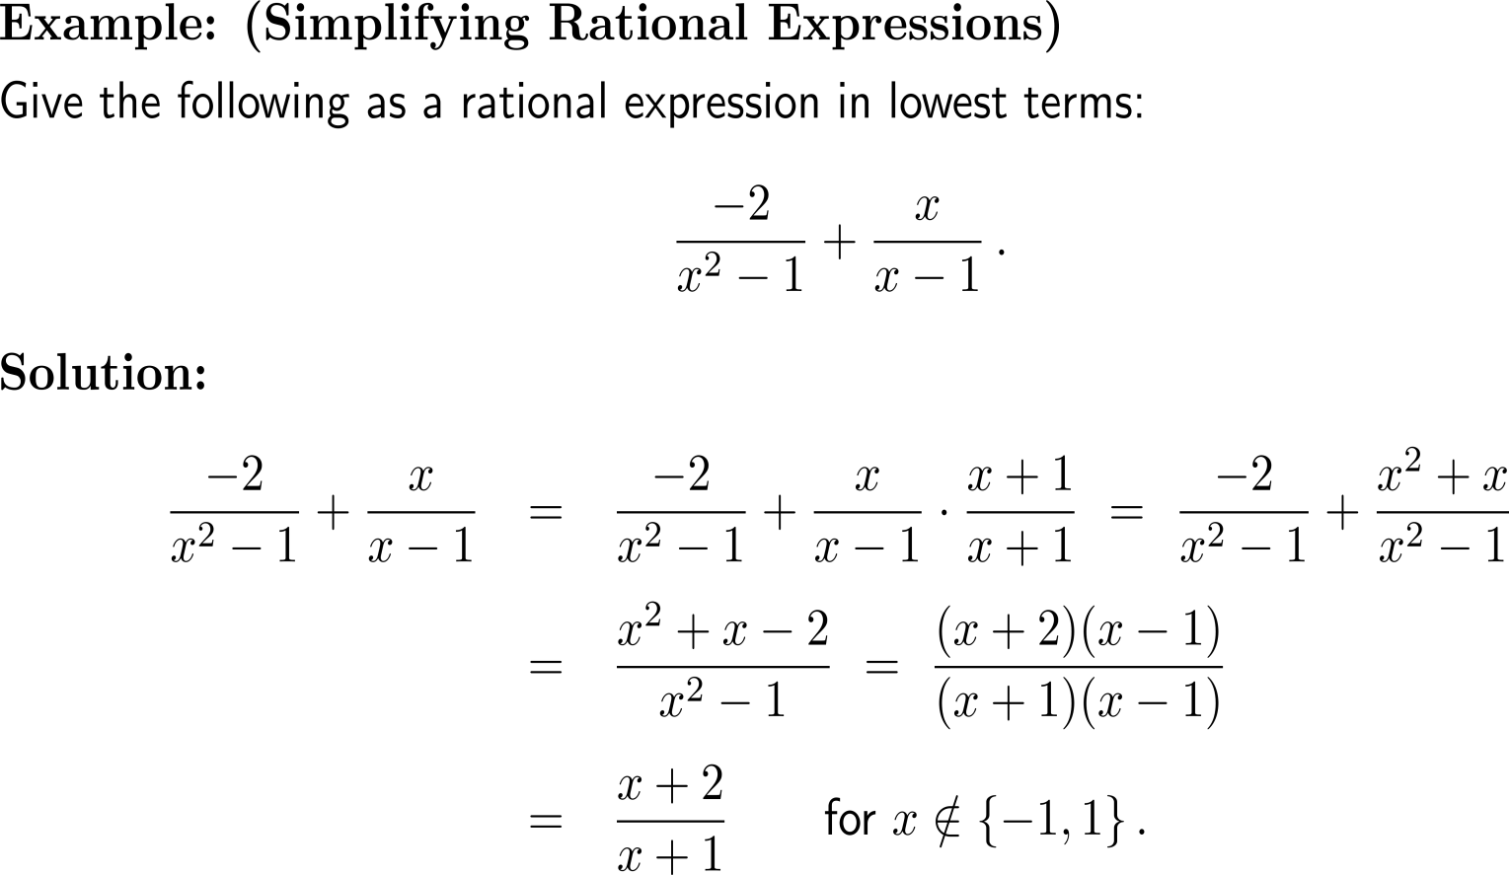
Example: Simplifying rational expressions

Slide 16
Example: Simplifying a compound fraction

Slide 17
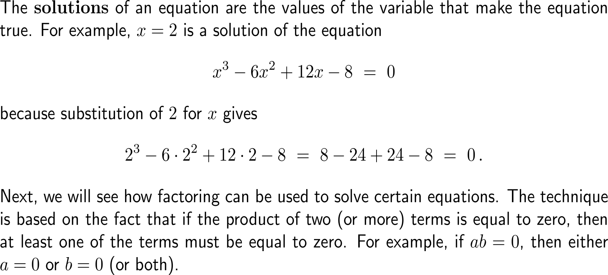
As previously noted, the solutions of an equation are the values of the variable that make the equation true

Slide 18
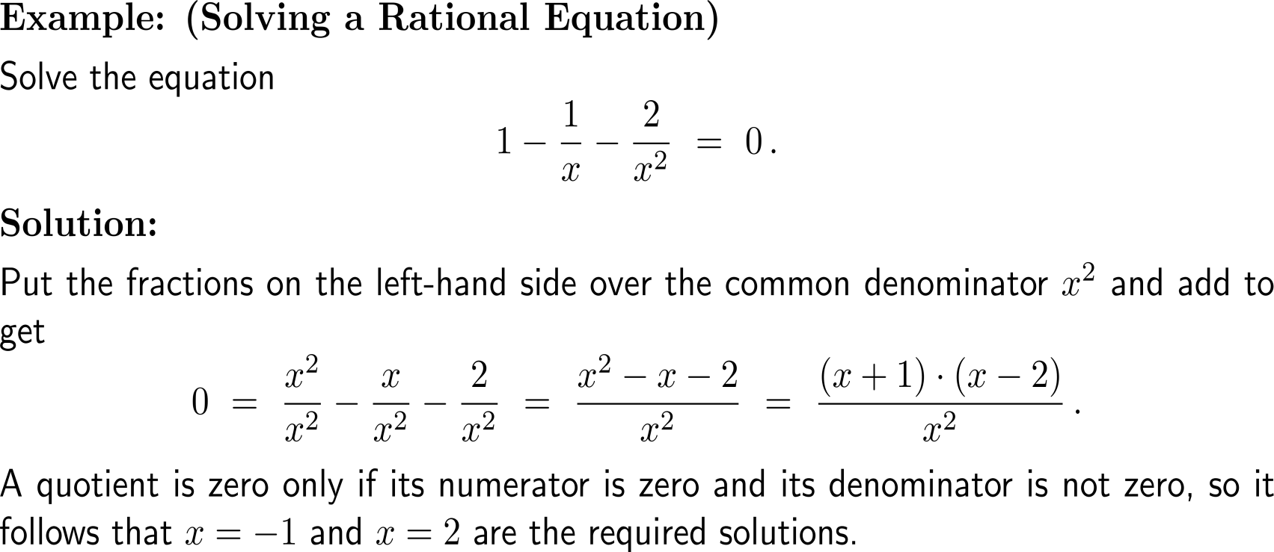
Example: Solving a rational equation

Slide 19
A collection of equations that are to be solved simultaneously is called a system of equations

Slide 20
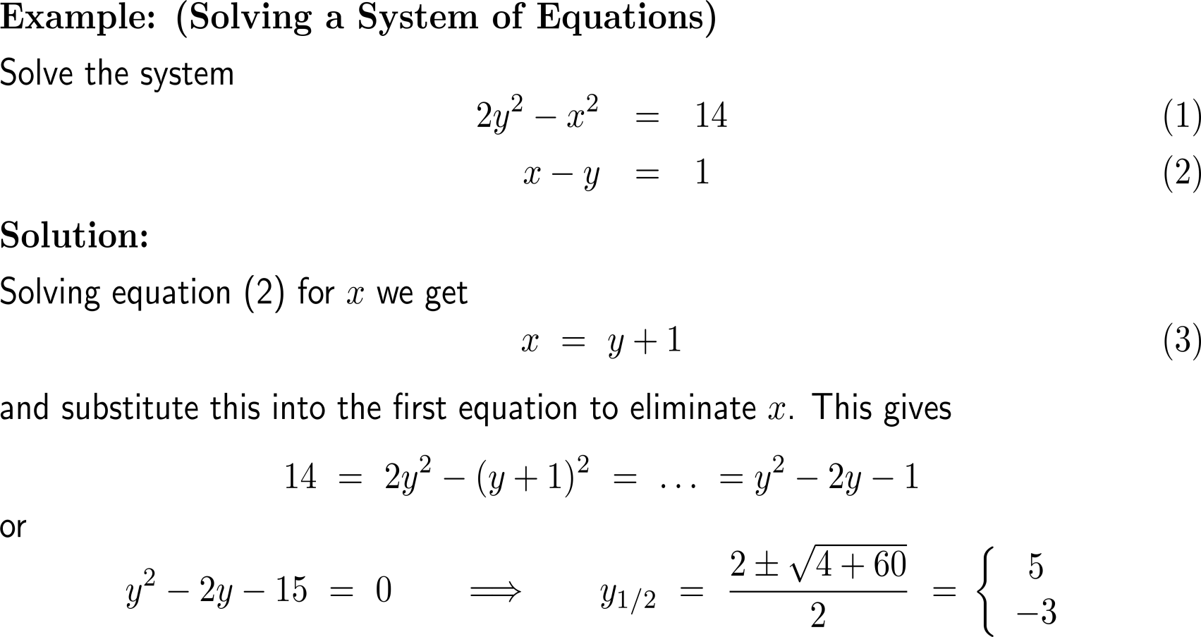
Example: Solving a System of Equations

Slide 21
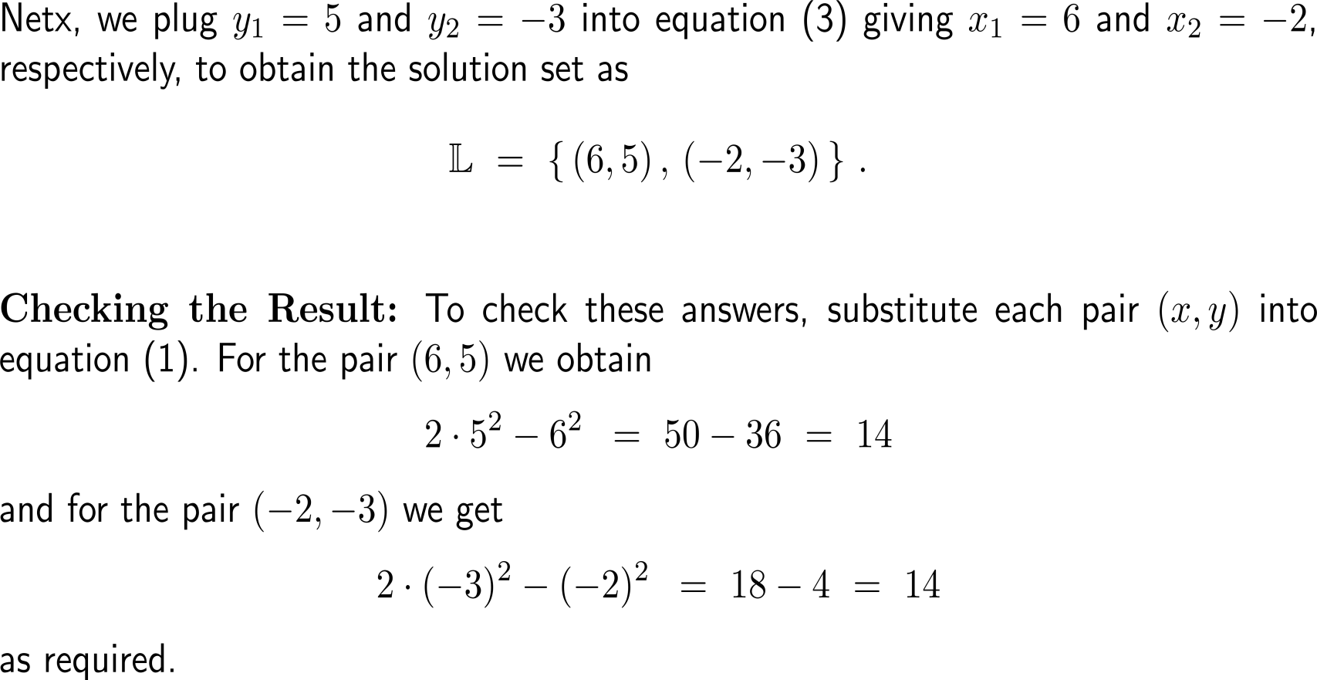
Example: Solving a System of Equations

Slide 22
Calculus I for Management

