Slide 1
Calculus I for Management
Preliminaries
(recap of high school topics)
Lecture
Numbers & inequalities
Exponential & logarithmic expressions
The Cartesian coordinate system
Factorizing polynomials and solving systems of equations

Slide 2
Topics
Numbers & Inequalities
Exponential & Logarithmic Expressions
The Cartesian Coordinate System
Factorizing Polynomials & Solving Systems of Equations

Slide 3
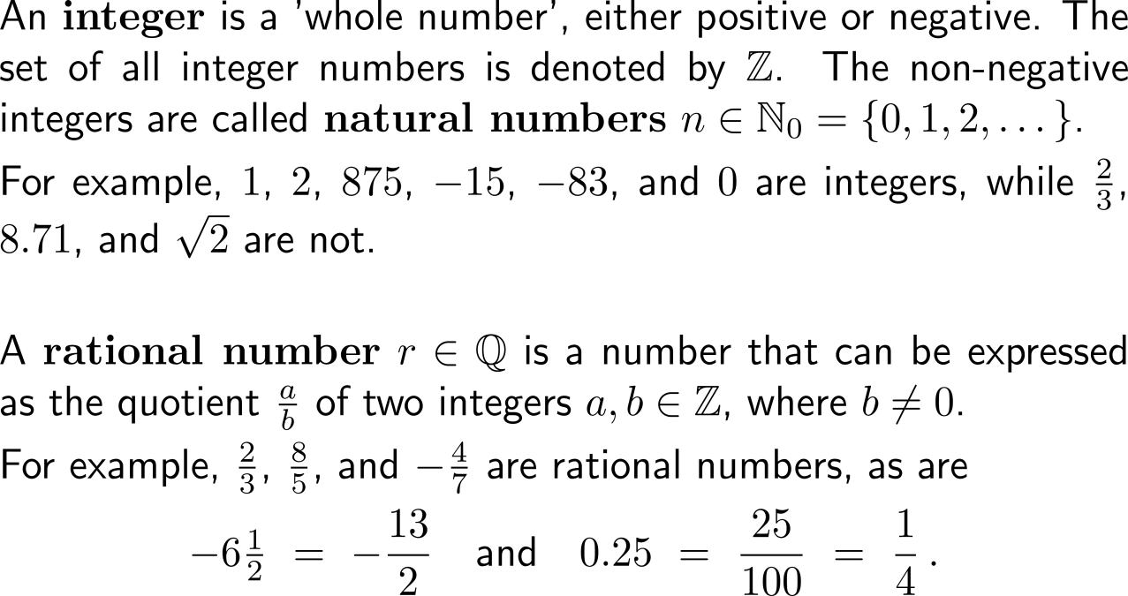
Our number system consists of natural, integer, and rational numbers …
natural numbers
integer numbers
rational numbers
irrational numbers
real numbers

Slide 4
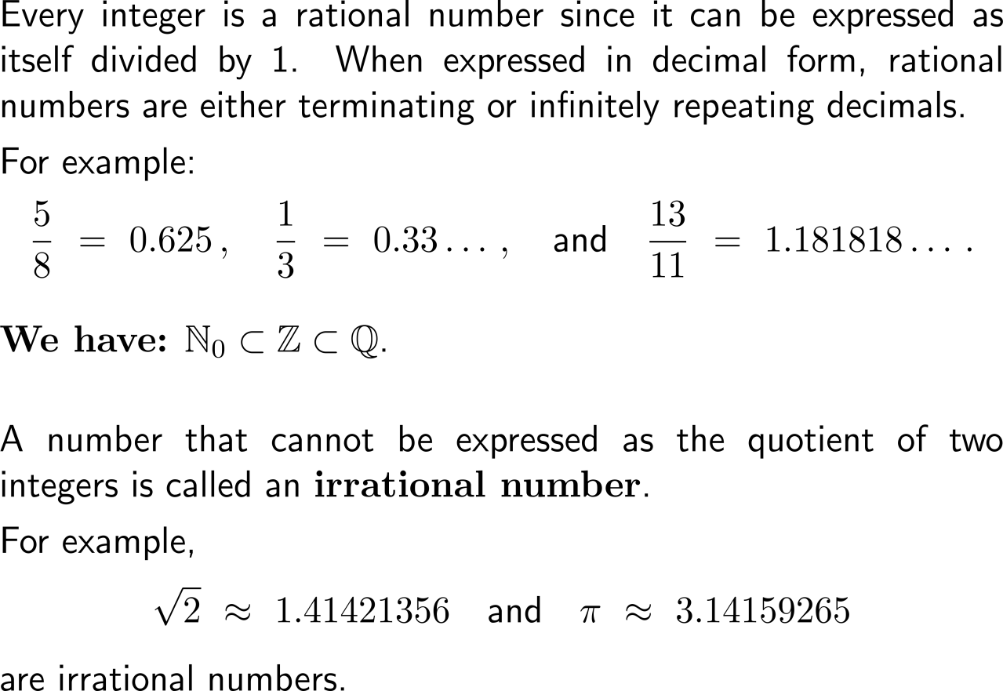
… as well as irrational numbers
natural numbers
integer numbers
rational numbers
irrational numbers
real numbers

Slide 5
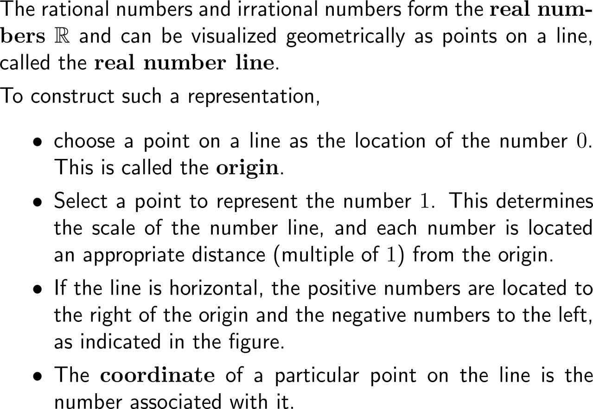
Together these number sets comprise the set of real numbers which can e.g. be illustrated by the real number line
real numbers
negative numbers
positive numbers
origin
0
-3
-1
1
3
-4.5
1.5
5.25

Slide 6
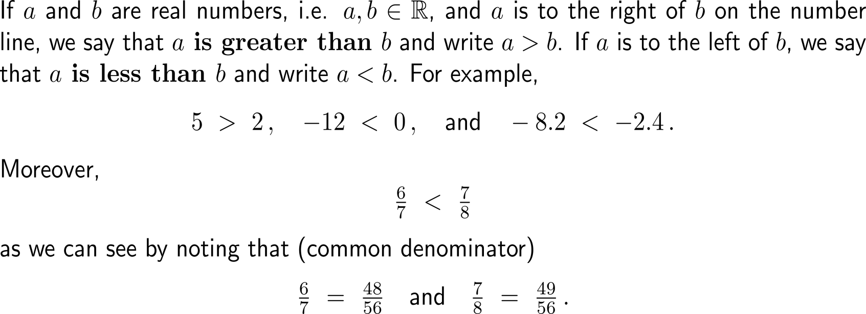
Due to their mutual position on the real number line we can distinguish the greater (lesser) of two numbers

Slide 7
Such inequalities between two numbers share important properties

Slide 8
In particular, an identity or inequality is said to be solved when all numbers that satisfy it have been found

Slide 9
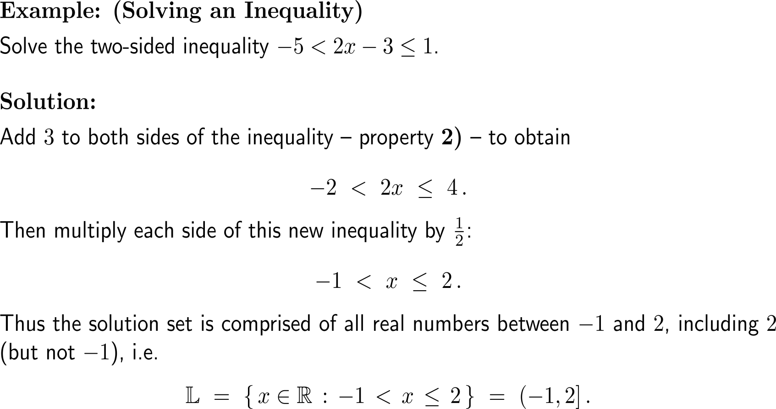
Example: Solving a two-sided inequality

Slide 10
A set of real numbers that can be represented on the number line by a line segment is called an interval

Slide 11
Intervals may be finite or infinite in extent and may or may not contain either endpoint

Slide 12
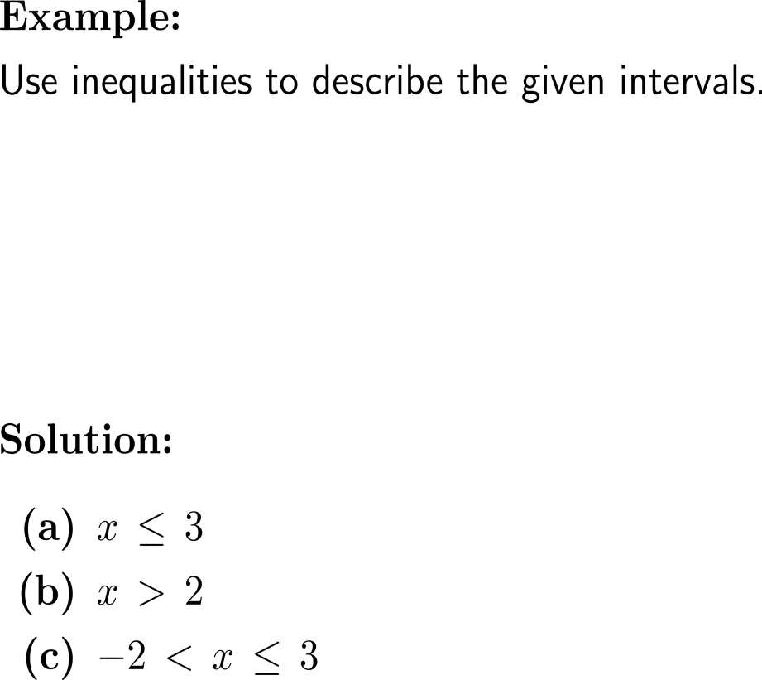
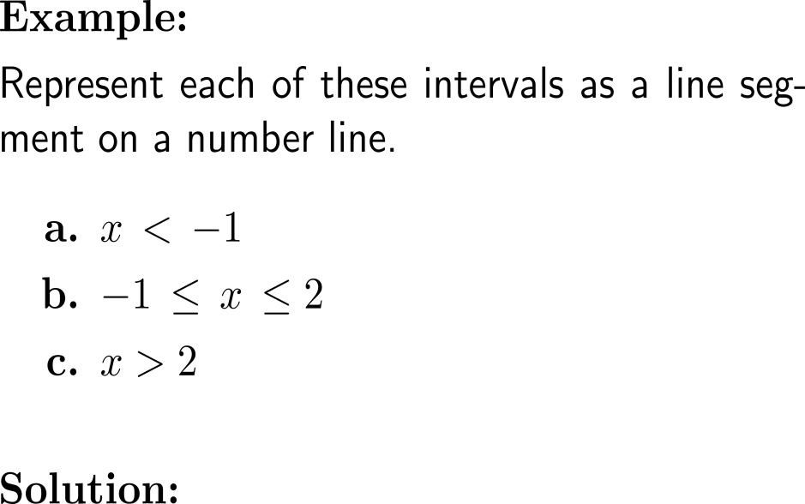
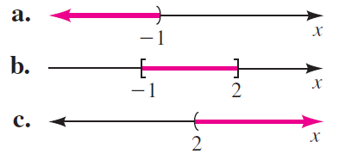
Example: Describing & graphing intervals with inequalities

Slide 13
Geometrically, the absolute value of a real number is its distance from the origin on the number line

Slide 14
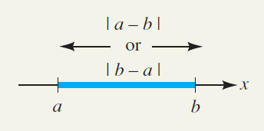
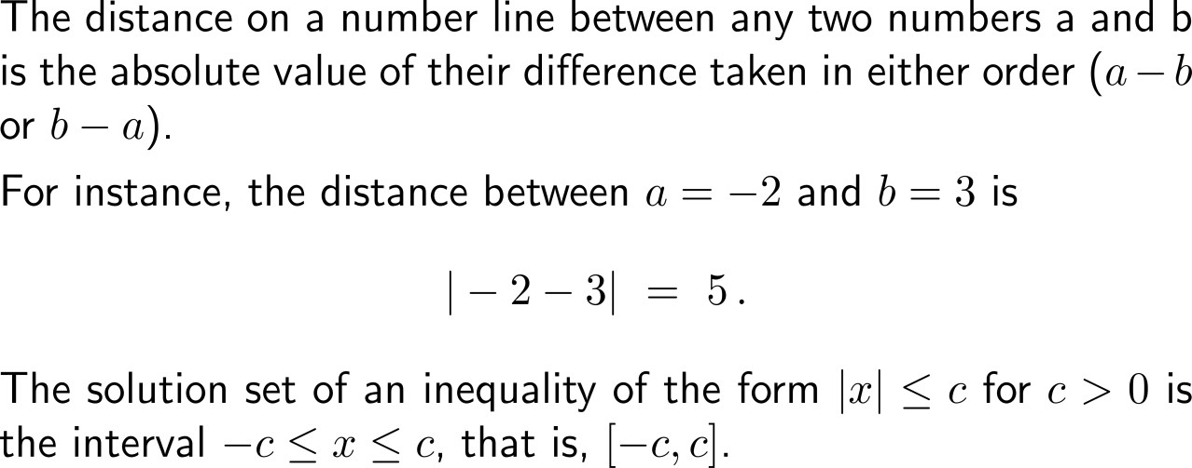
The distance between any two numbers on the number line is the absolute value of their difference

Slide 15
Example: Solving an absolute value inequality

Slide 16
Example: Solving an absolute value inequality

Slide 17
Topics
Numbers & Inequalities
Exponential & Logarithmic Expressions
The Cartesian Coordinate System
Factorizing Polynomials & Solving Systems of Equations

Slide 18
There are four types of exponential expressions: (i) integer powers, (ii) negative integer powers , …

Slide 19
… (iii) reciprocal integer powers or roots, …

Slide 20
… and (iv) powers with fractional exponents

Slide 21
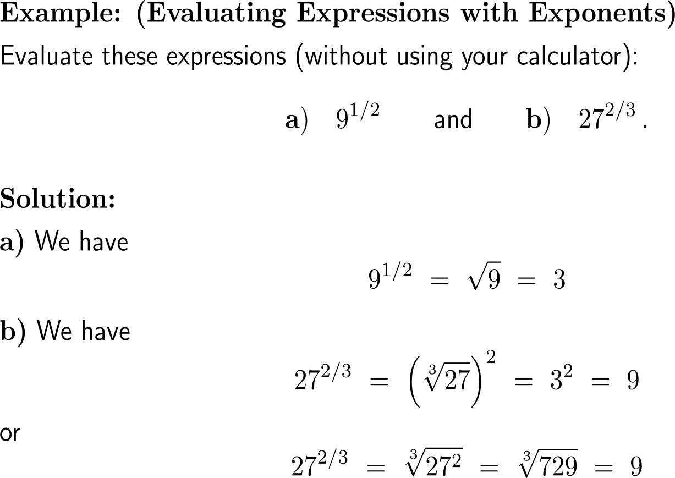
Example: Evaluating expressions with exponents

Slide 22
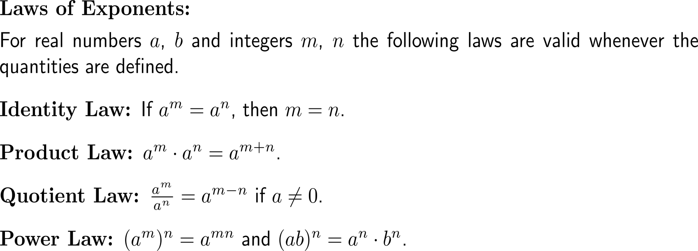
Exponents obey a set of laws that are very useful to find shortcuts during computations

Slide 23
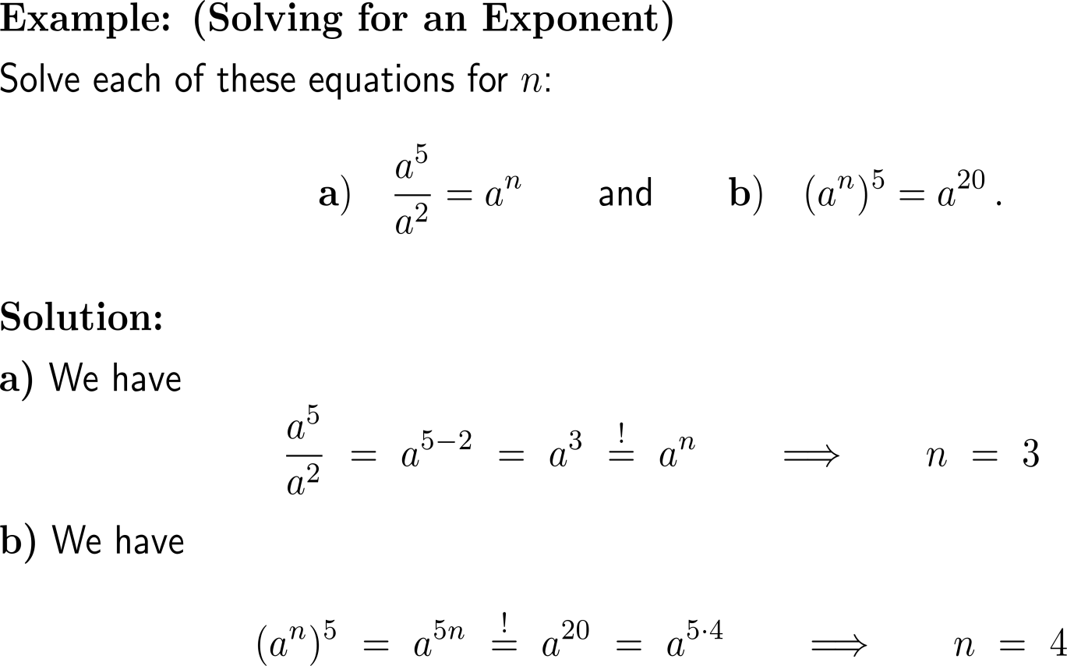
Example: Solving for an exponent

Slide 24
Rationalizing allows to write a fraction such that either the numerator or the denominator contains no roots

Slide 25
A key tool for rationalizing is the Third Binomial Formula

Slide 26
Example: Rationalizing a numerator

Slide 27
Logarithms return the exponent to a given base

Slide 28
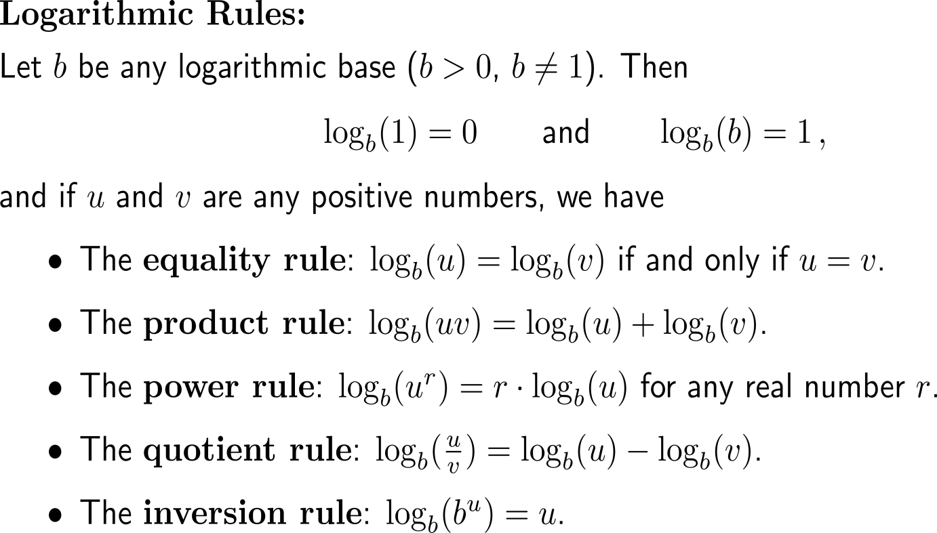
The computation rules for logarithms resemble those for exponents

Slide 29
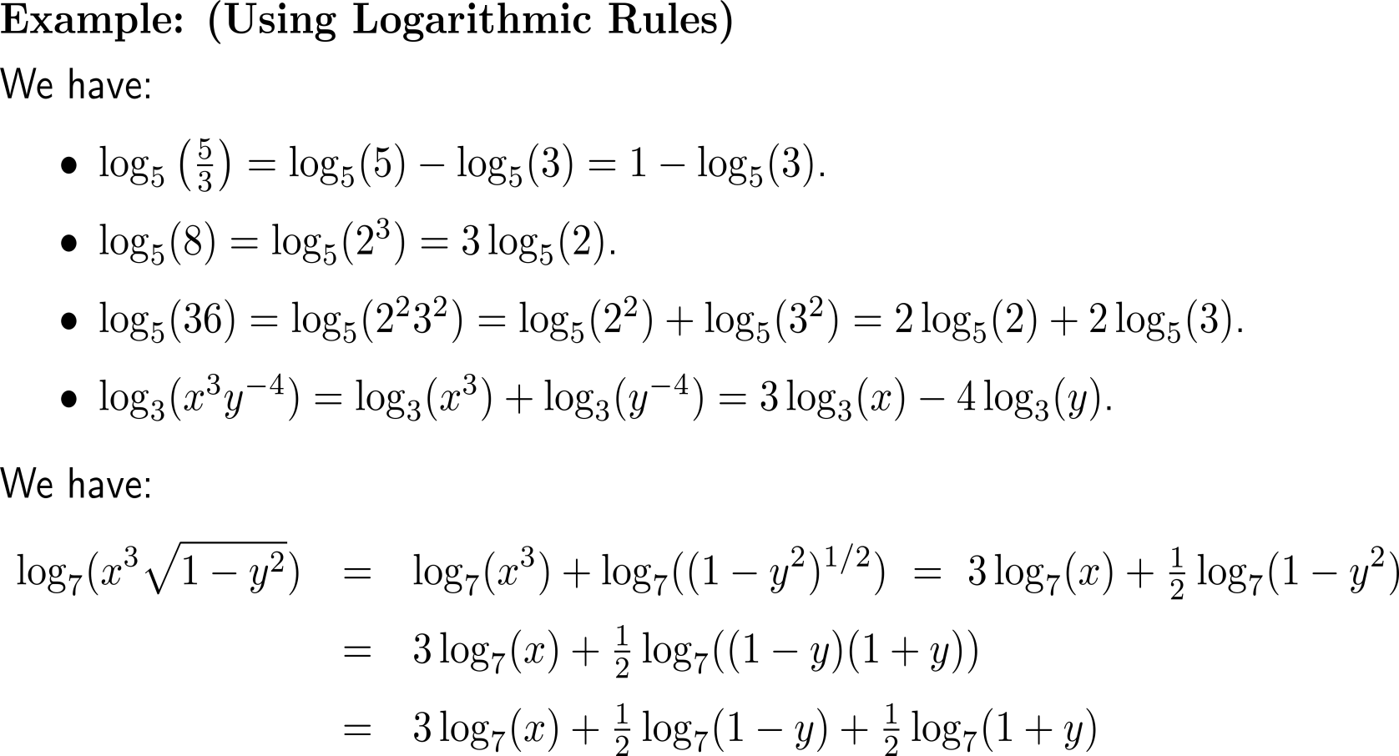
Examples: Using logarithmic rules

Slide 30
Logarithms of one base can be converted into logarithms of another base

Slide 31
Topics
Numbers & Inequalities
Exponential & Logarithmic Expressions
The Cartesian Coordinate System
Factorizing Polynomials & Solving Systems of Equations

Slide 32
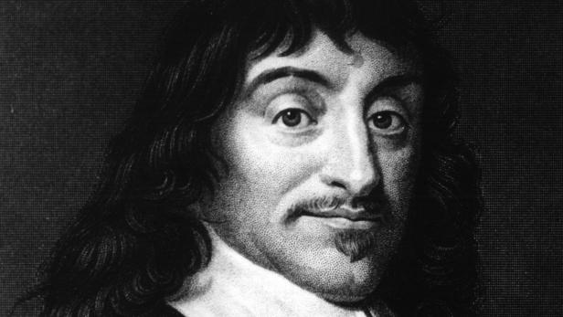
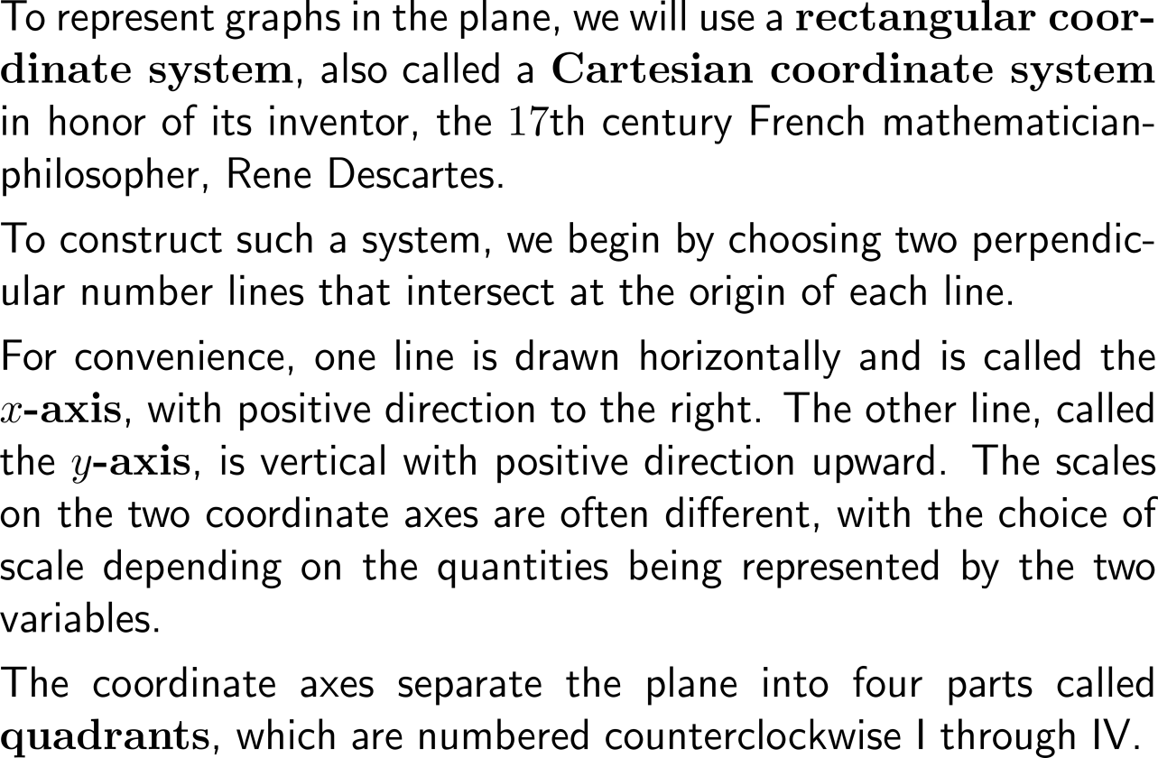
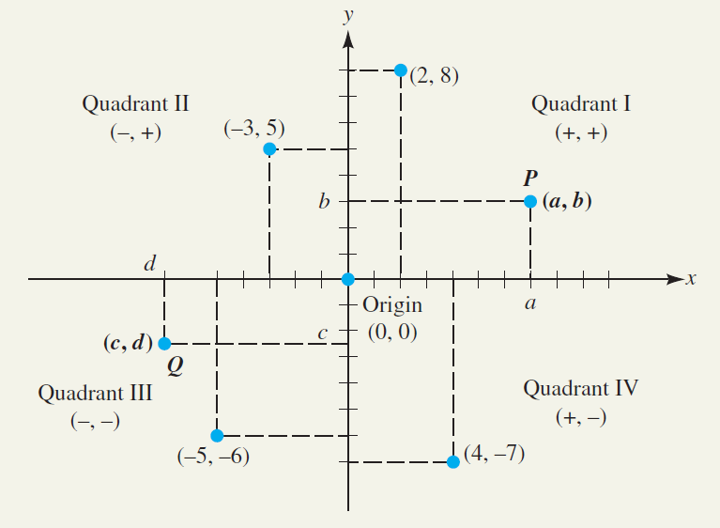
To represent and uniquely address points in a plane, we use a Cartesian coordinate system (1/ 2)
René Descartes
(31.03.1596 – 11.02.1650)

Slide 33
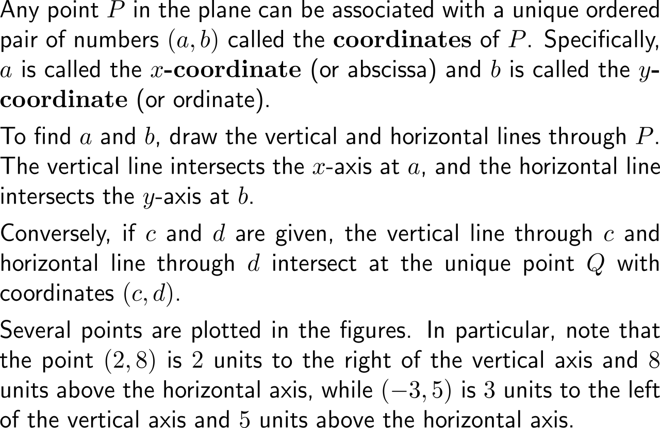
To represent and uniquely address points in a plane, we use a Cartesian coordinate system (2/ 2)

Slide 34
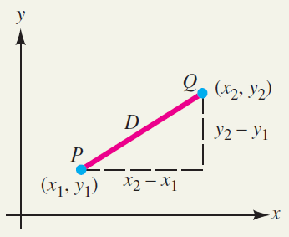
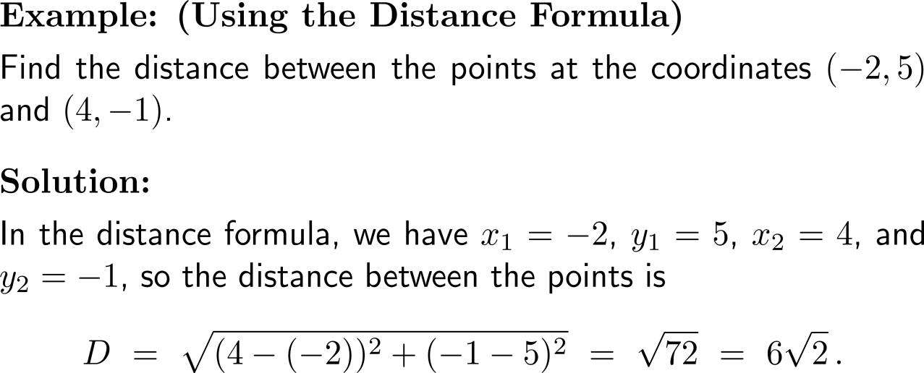
The distance between two points in the plane is provided by means of the Pythagorean Theorem

Slide 35
Example: Specific diagrams in microeconomics
Price-Quantity-Diagram
Payoff-Diagram
Utility-Diagram
price
payoff for player B
utility of player B
payoff space
utility space
demand curve
quantity
payoff for player A
utility of player A
For instance, the price-quantity-space is represented as Cartesian product, and every pair (price, quantity) is an element of this space. Specific elements – those that are realized in a special situation – can form a specific curve, in this case a demand curve.
Analogous situations hold for gains/ payoffs or utilities.

Slide 36
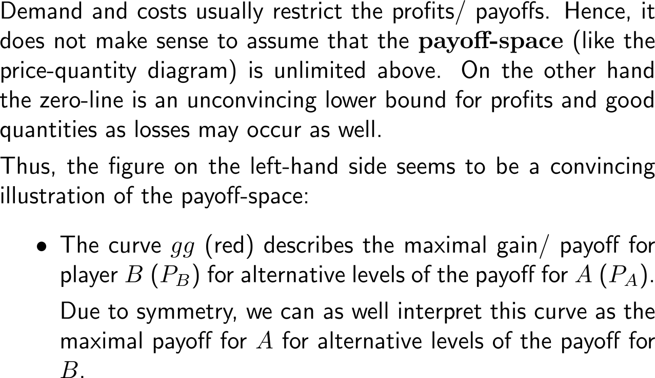
How can we make sense of and illustrate the payoff-space? (1/ 2)
payoff for player B (P_{B})
G
g
payoff space
P_{B}*
P_{A}*
45°
g
G
payoff for player A (P_{A})

Slide 37
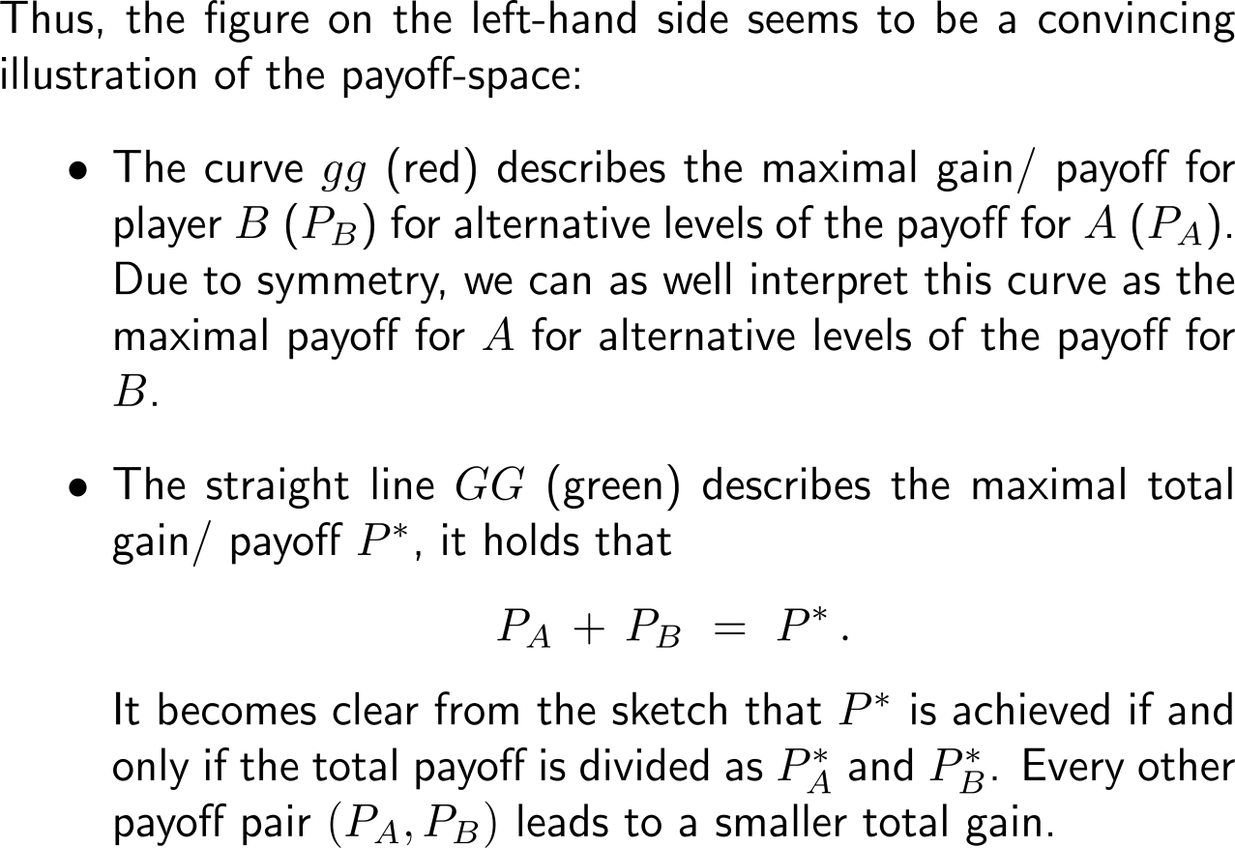
How can we make sense of and illustrate the payoff-space? (2/ 2)
payoff for player B (P_{B})
G
g
payoff space
P_{B}*
P_{A}*
45°
g
G
payoff for player A (P_{A})

Slide 38
Topics
Numbers & Inequalities
Exponential & Logarithmic Expressions
The Cartesian Coordinate System
Factorizing Polynomials & Solving Systems of Equations

Slide 39
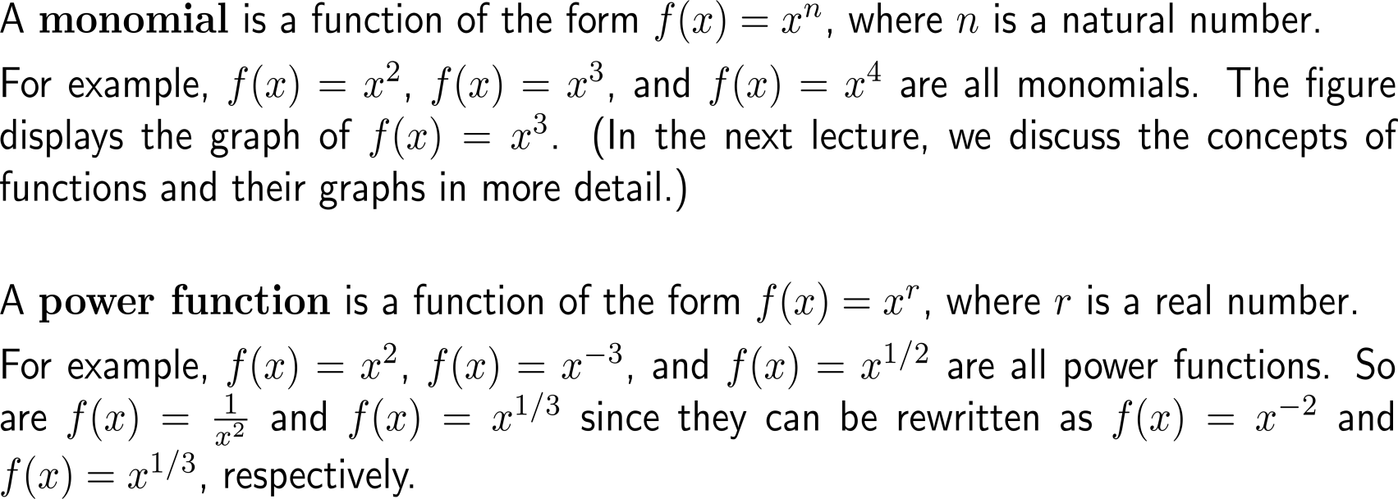
Monomials are special power functions that serve as building blocks for polynomials

Slide 40
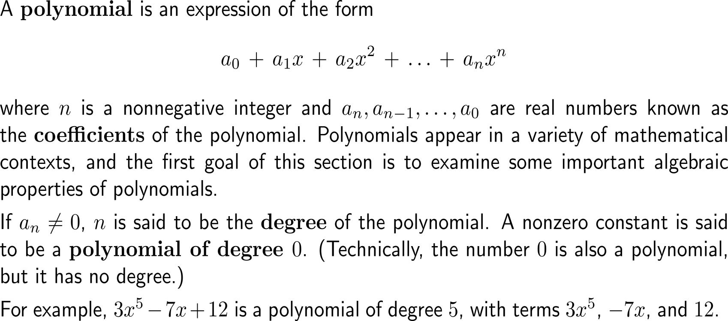
A polynomial is an expression of the form a₀ + a₁x + a₂x² + … + a_{n}x^{n} with real coefficients a_{k} and degree n if an is not vanishing

Slide 41
Similar terms in two polynomials are terms with the same degree

Slide 42
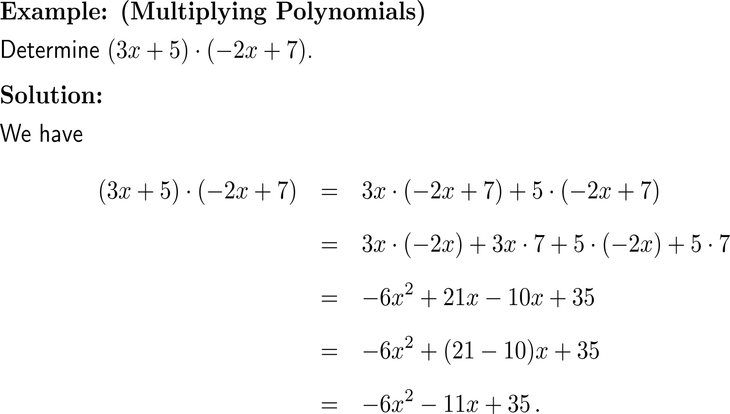
Example: Multiplying Polynomials

Slide 43
For quadratic polynomials we can use the solution formula for quadratic polynomials to find their linear factors

Slide 44
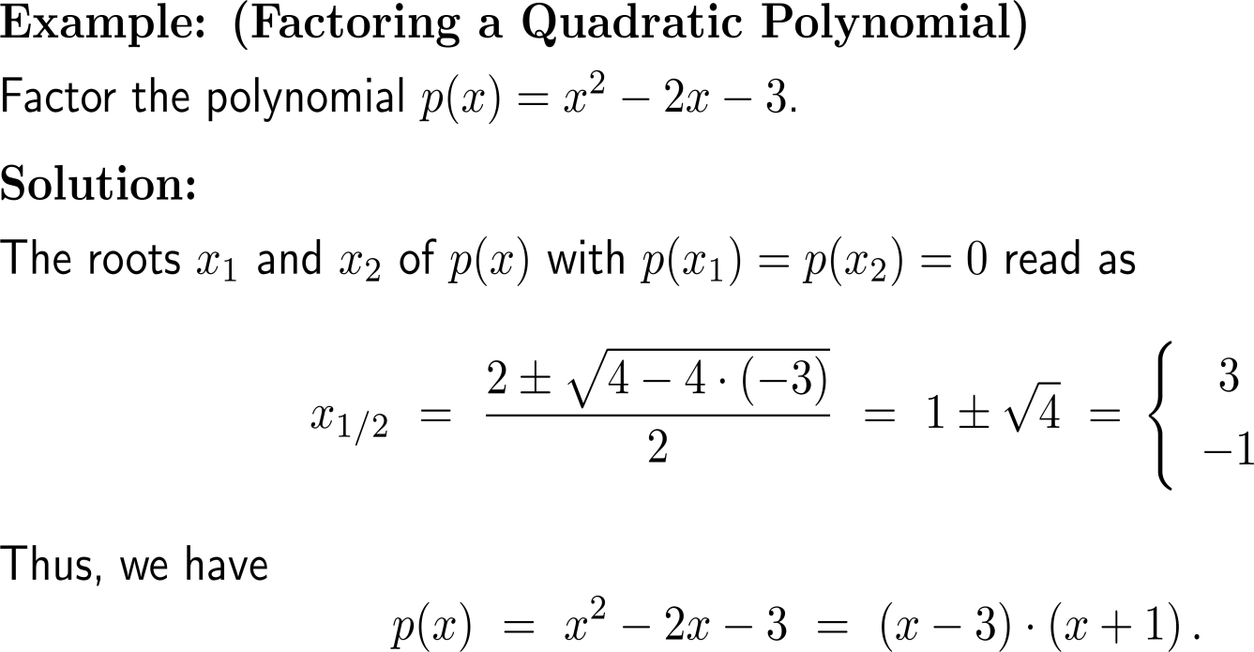
Example: Factoring a quadratic polynomial

Slide 45
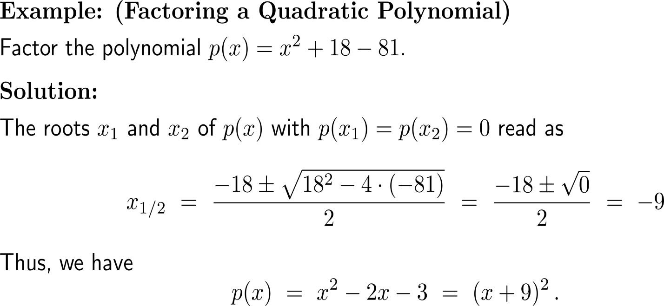
Example: Factoring a quadratic polynomial

Slide 46
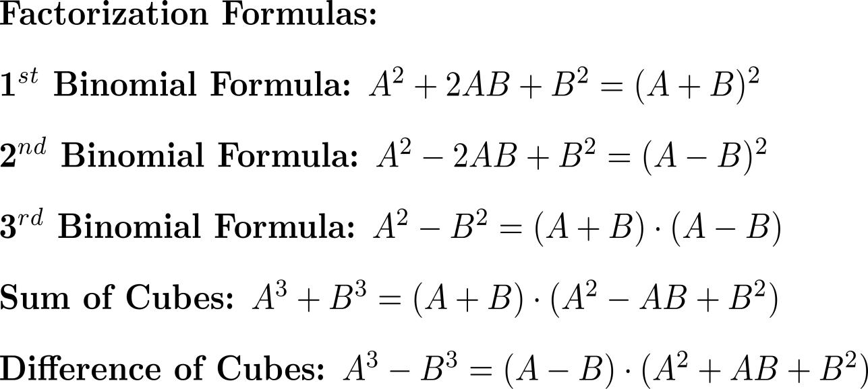
Certain polynomial types occur so often that it is useful to memorize the formulas for factoring them

Slide 47
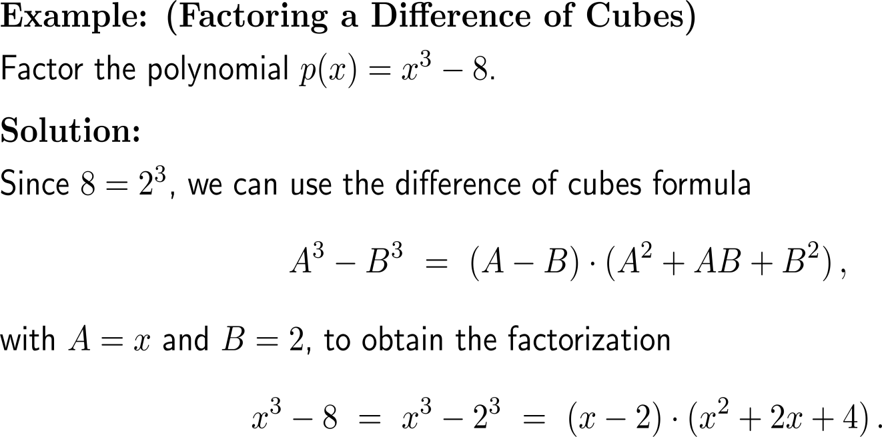
Example: Factoring a difference of cubes

Slide 48
Long division helps us to successively factorize more complicated polynomials (1/ 2)

Slide 49
Worked out example: long division
Example:
By paying attention to the required steps, let us carry out the long division
(x³ + 2x² – x – 2) : (x – 1) .
Procedure:
Analogous to the division of numbers we aim to find a multiple of divisor (x – 1) such that the highest occurring power x³ in the dividend can be annihilated by subtraction.
Multiplying (x – 1) by x² gives x³ – x². When subtracting this from the dividend we get rid of the x³ term.
What remains is 3x² – x – 2 which means
x³ + 2x² – x – 2 = (x – 1) x² + 3x² – x – 2
(
x³
+
2
x²
–
x
–
2
)
:
(x
–
1)
=
x²
-(
x³
–
x²
)
3
x²

Slide 50
Worked out example: long division
The next step is to figure out how many times (x – 1) occurs in 3x² – x – 2.
As (x – 1) has only two terms it is enough to note 3x² – x in the next line of the division.
Now, we need to multiply (x – 1) by 3x which leads to 3x² – 3x.
With the subtraction
(3x² – x) – (3x² – 3x) = 2x
we have
x³ + 2x² – x – 2 = (x – 1) (x² + 3x) + 2x – 2
(
x³
+
2
x²
–
x
–
2
)
:
(x
–
1)
=
x²
+
3
x
-(
x³
–
x²
)
3
x²
–
x
-(
3
x²
–
3
x
)
2
x

Slide 51
Worked out example: long division
The final step in this example is to figure out how many times (x – 1) occurs in 2x – 2.
The answer is 2 times, such that we obtain the factorization
x³ + 2x² – x – 2 = (x – 1) (x² + 3x + 2)
(
x³
+
2
x²
–
x
–
2
)
:
(x
–
1)
=
x²
+
3
x
+
2
-(
x³
–
x²
)
3
x²
–
x
-(
3
x²
–
3
x
)
2
x
–
2
-(
2
x
–
2
)
0

Slide 52
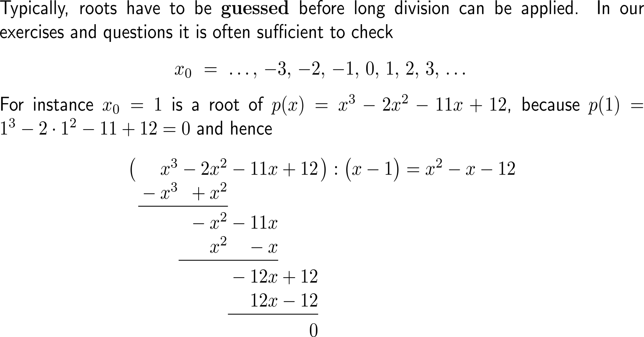
Long division helps us to successively factorize more complicated polynomials (2/ 2)

Slide 53
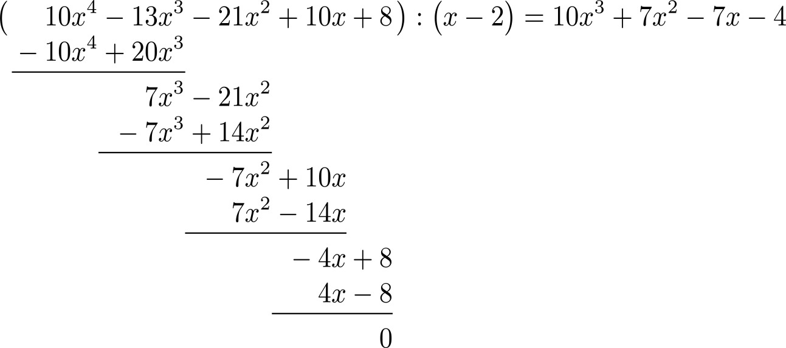
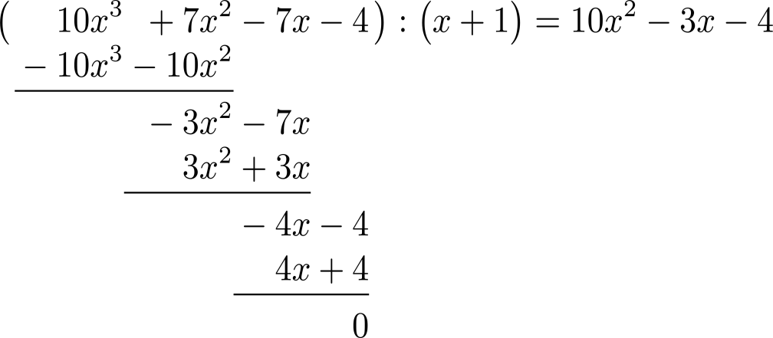
Example: Long division

Slide 54
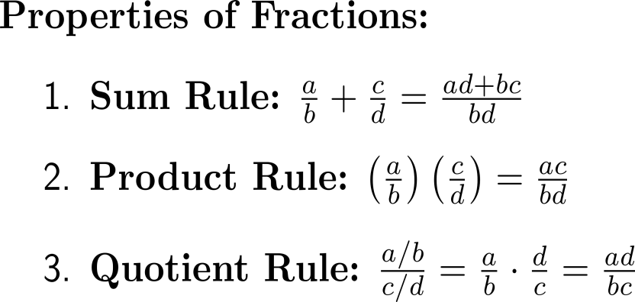
Useful properties of rational expressions comprise the sum rule, the product rule, and the quotient rule

Slide 55
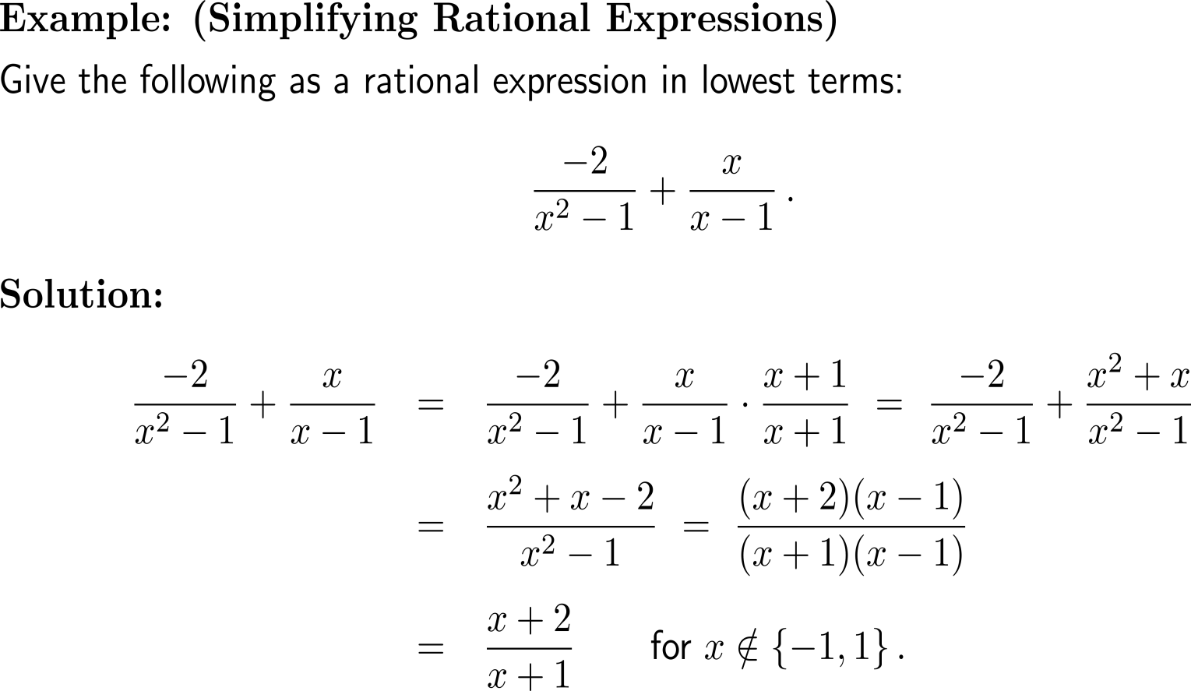
Example: Simplifying rational expressions

Slide 56
Example: Simplifying a compound fraction

Slide 57
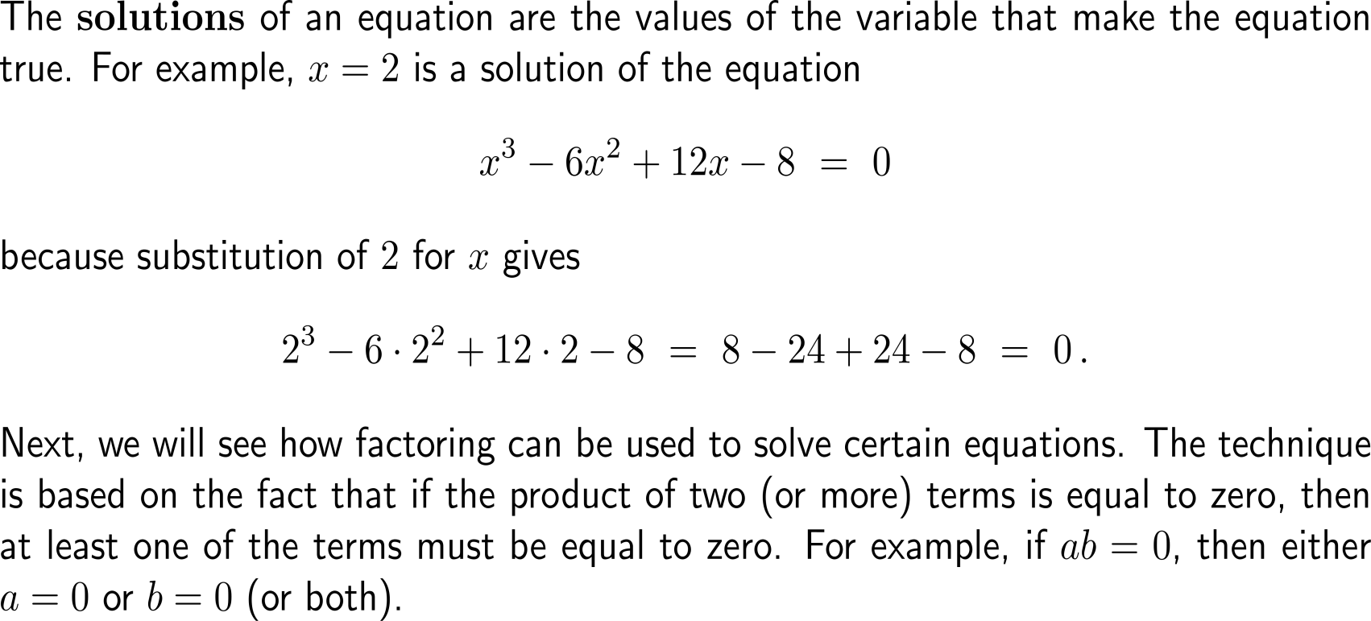
As previously noted, the solutions of an equation are the values of the variable that make the equation true

Slide 58
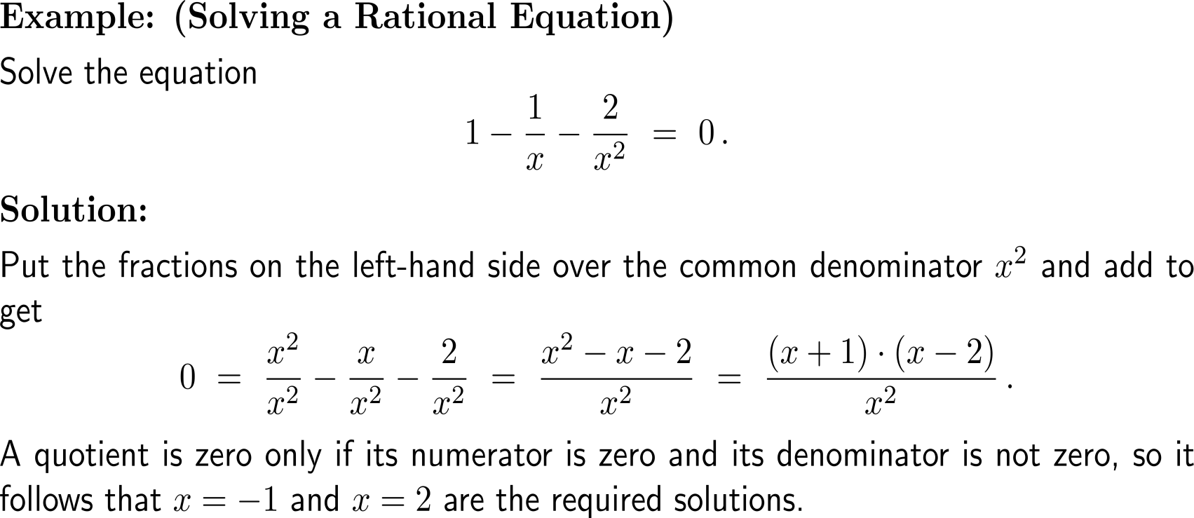
Example: Solving a rational equation

Slide 59
A collection of equations that are to be solved simultaneously is called a system of equations

Slide 60
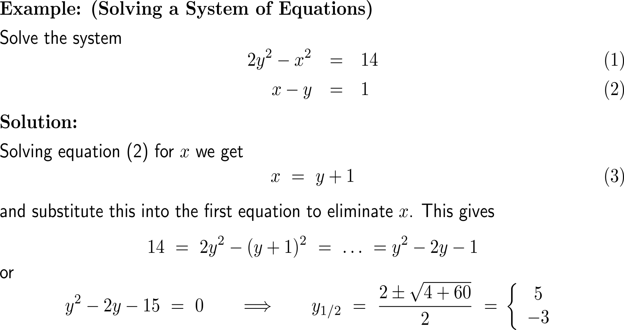
Example: Solving a System of Equations

Slide 61
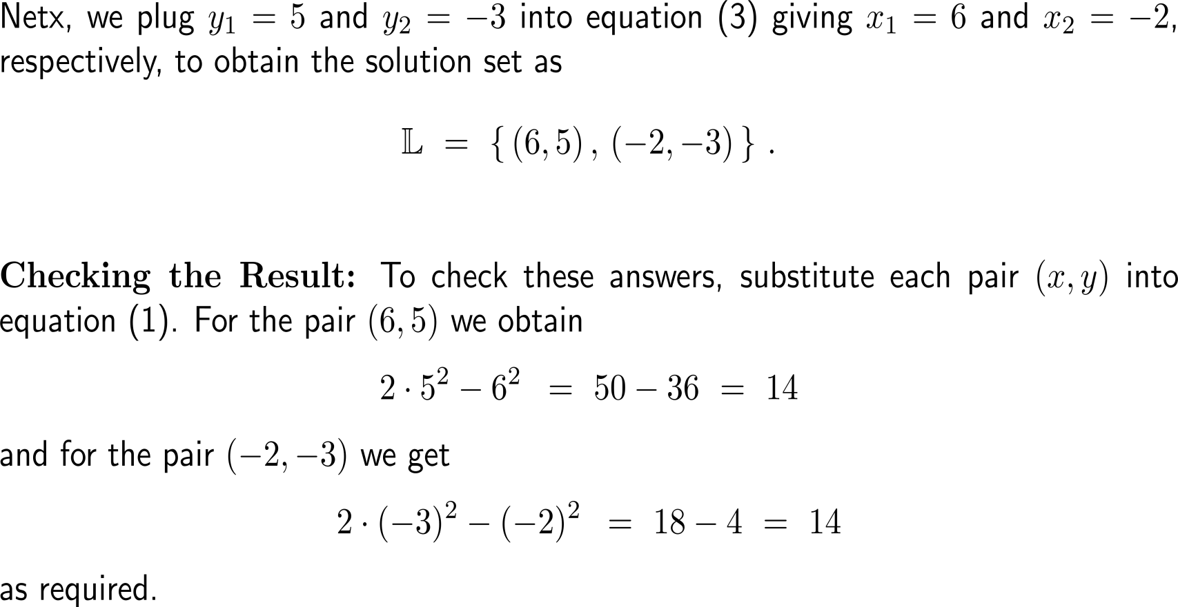
Example: Solving a System of Equations

Slide 62
Further Worked-Out Exercises:
Calculus I for Management
Topics
Expressions with exponents
Rationalizing
Factorizing polynomials
Simplifying rational expressions

Slide 63
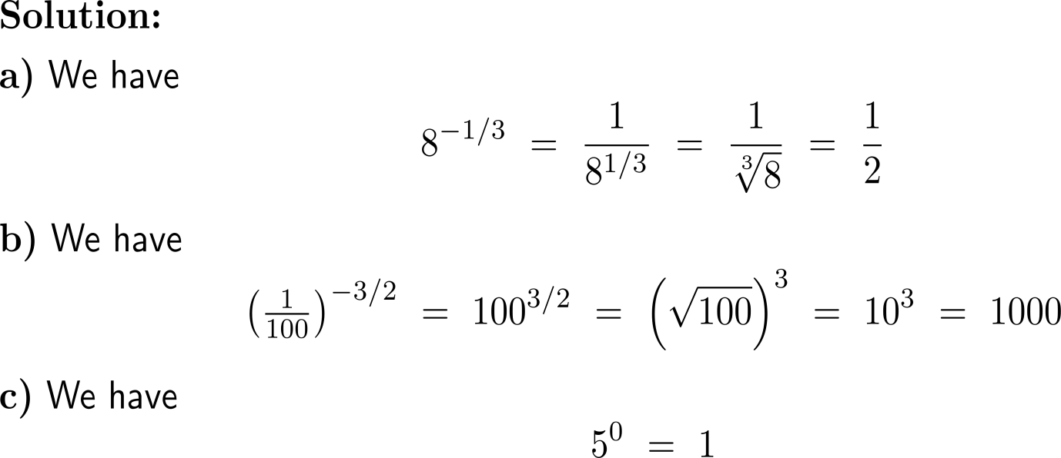
Exercise: Evaluating expressions with exponents

Slide 64
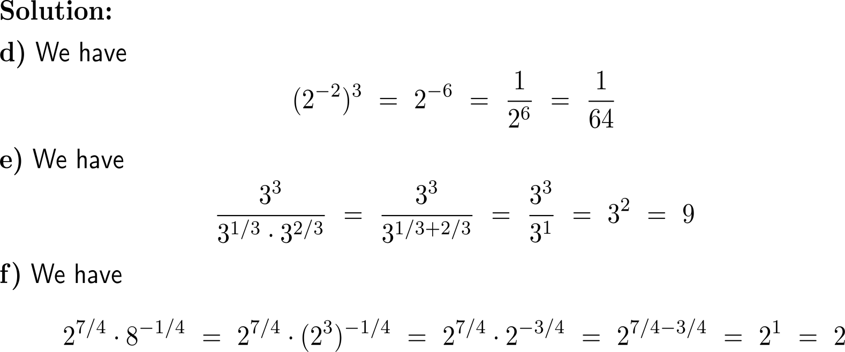
Exercise: Evaluating expressions with exponents
5 minutes
self/ group work
please, upload your solutions to the chat

Slide 65
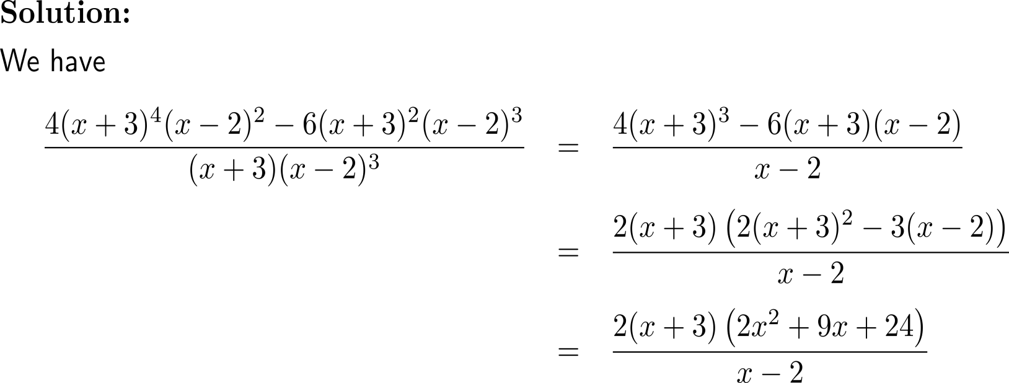
Example: Simplifying an algebraic equation

Slide 66
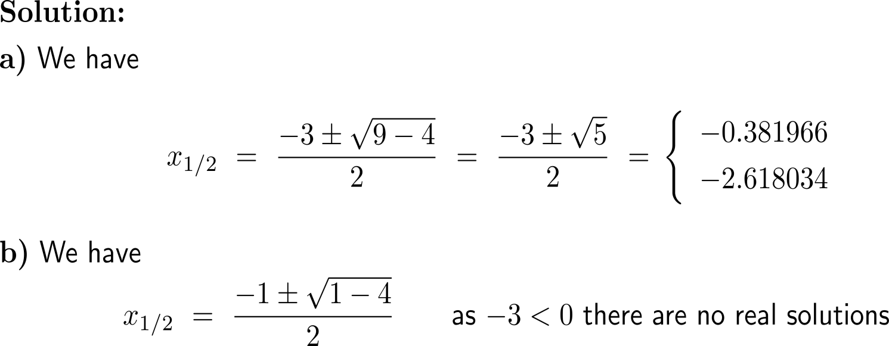
Exercise: Factoring a quadratic polynomial
5 minutes
self/ group work
please, upload your solutions to the chat

Slide 67
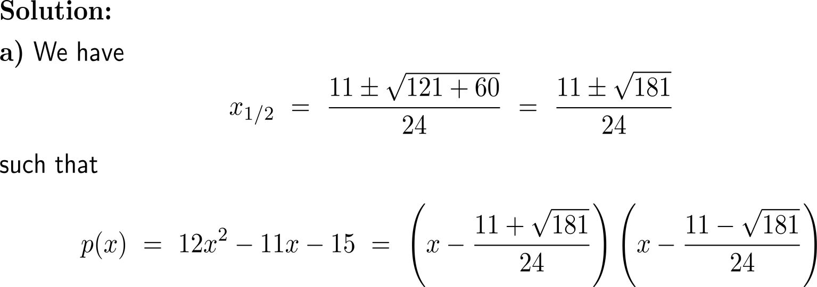
Exercise: Using the root formula for quadratic polynomials

Slide 68
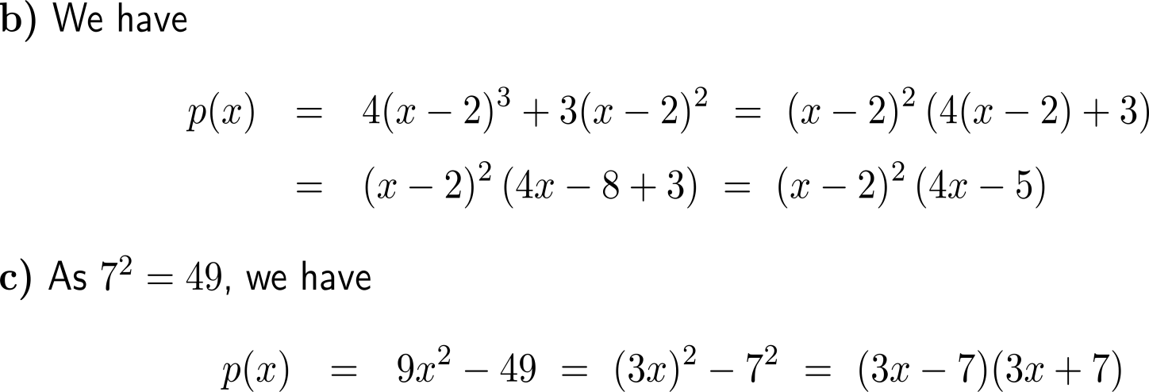
Exercise: Using the root formula for quadratic polynomials

Slide 69
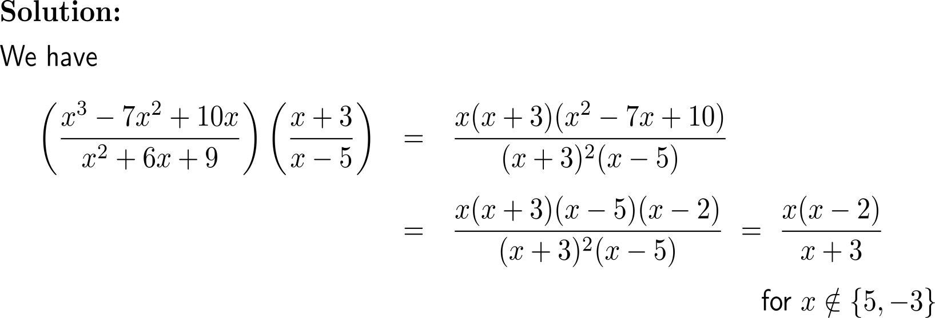
Example: Simplifying rational expressions
10 minutes
self/ group work
please, upload your solutions to the chat

Slide 70
Example: Simplifying rational expressions
10 minutes
self/ group work
please, upload your solutions to the chat

Slide 71
Calculus I for Management

