Slide 1
Calculus I for MGMT – Functions & Graphs Functions
Mathematics for Management
Supplementary Electronic Materials
Functions & Graphs
Functions
The Graph of a Function
Lines & Linear Functions
Functional Models

Slide 2
A function is a rule that assigns to each element in the input set exactly one element in the output set (1/ 2)
In the last lecture, we already reviewed some examples for functions that you know from school, like
monomials
power functions
polynomials

Slide 3
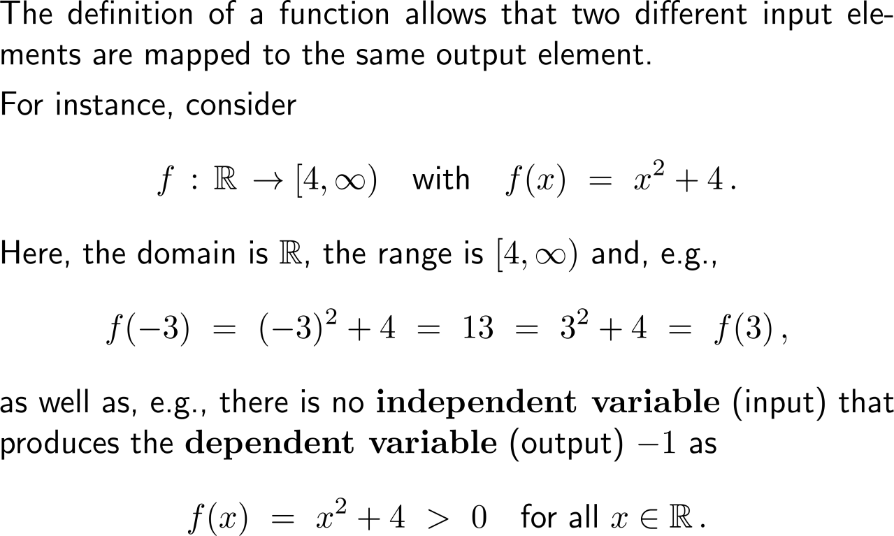
A function is a rule that assigns to each element in the input set exactly one element in the output set (2/ 2)
A: domain
set of inputs
set of independent variables
B: range/ image
set of outputs
set of dependent variables

Slide 4
The natural domain of a function f(x) is the set of all real numbers for which f(x) is defined as a real number

Slide 5
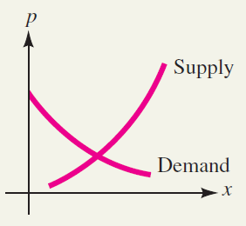
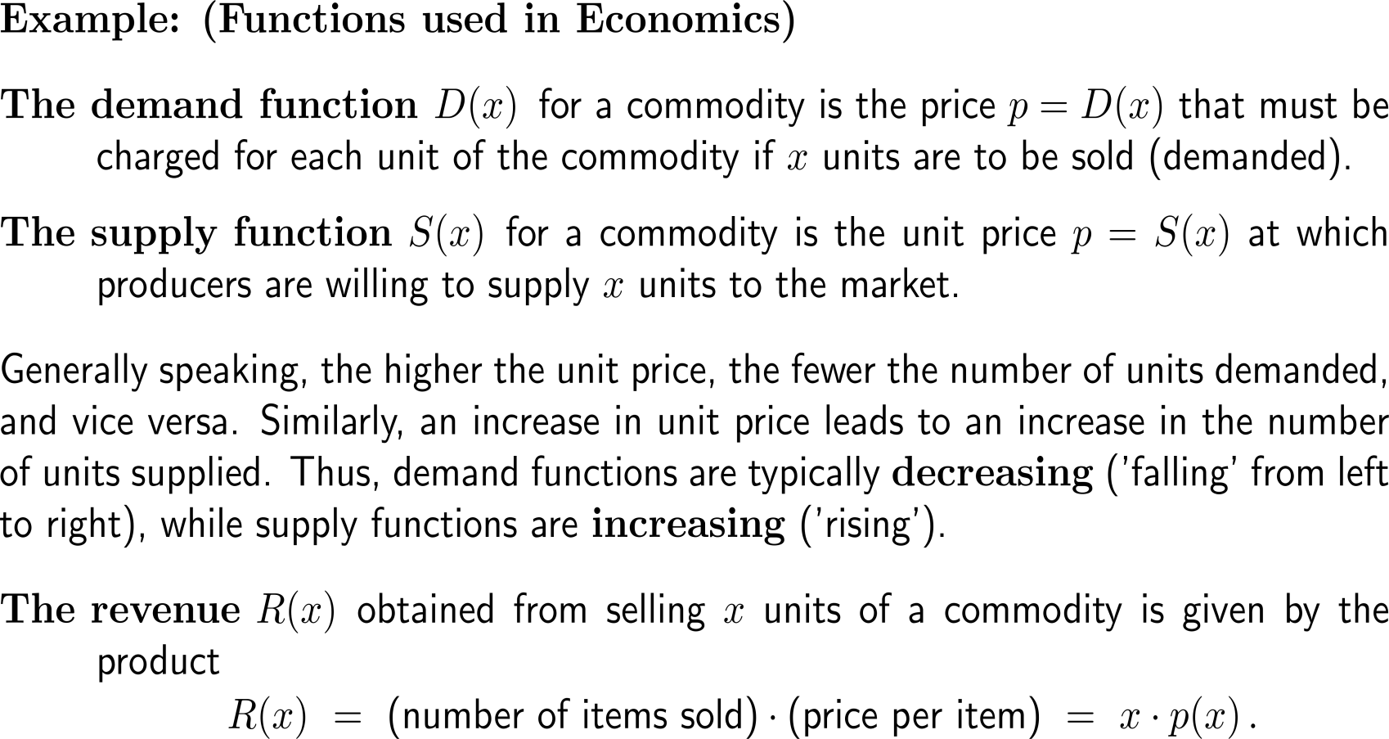
Examples: Functions in economics

Slide 6
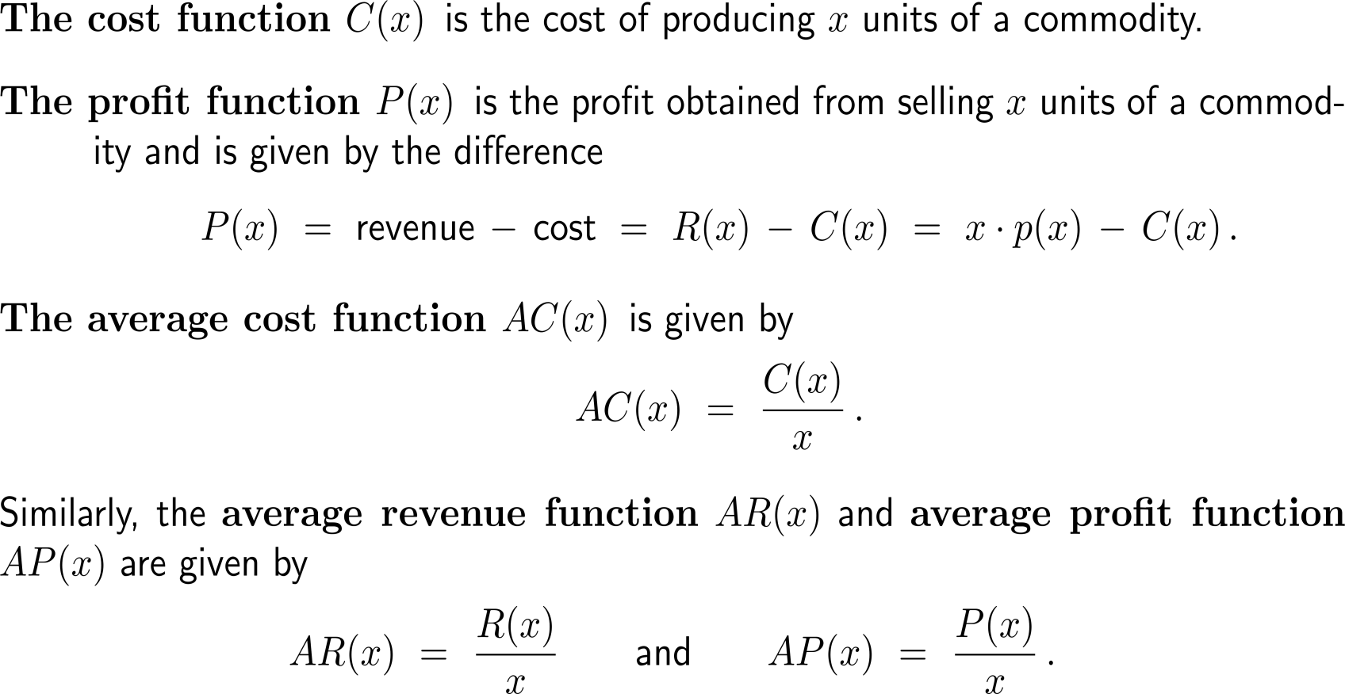
Examples: Functions in economics

Slide 7
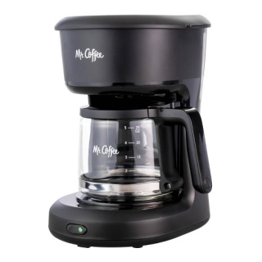
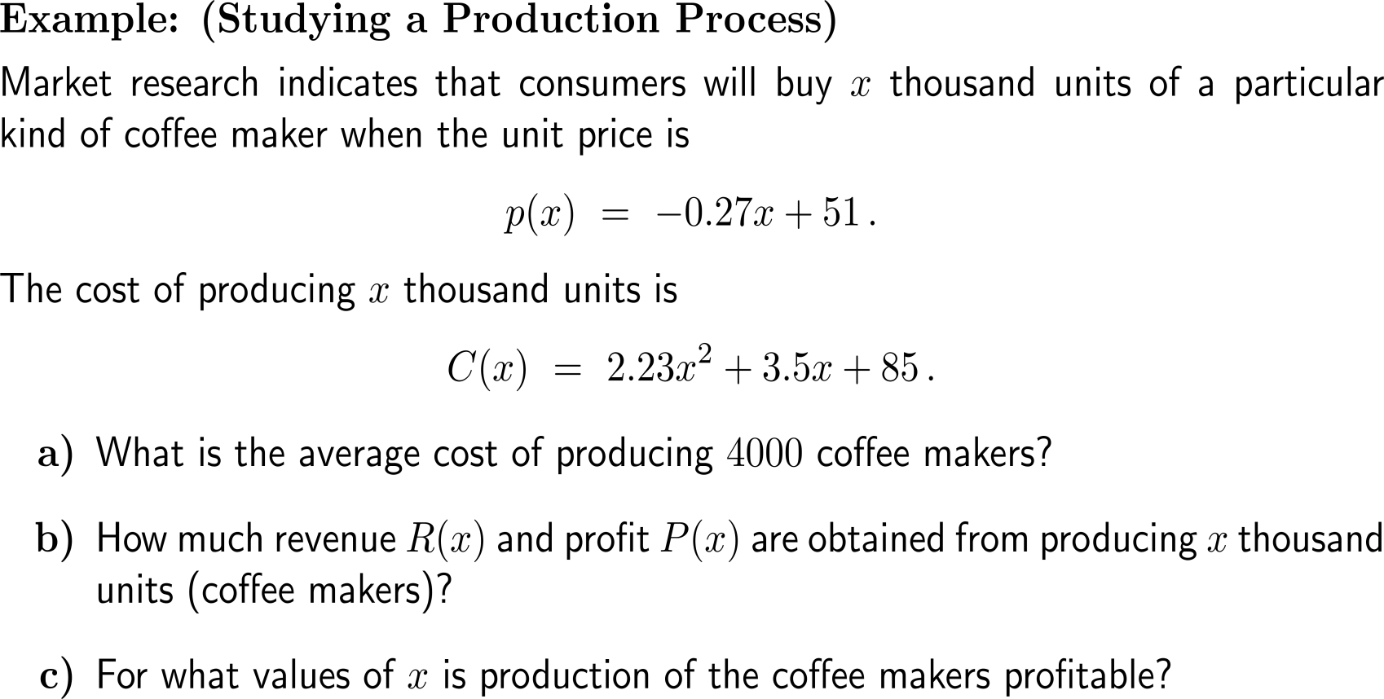
Example: Studying a production process

Slide 8
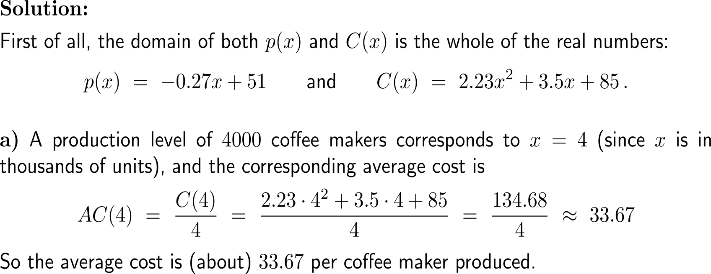
Example: Studying a production process

Slide 9
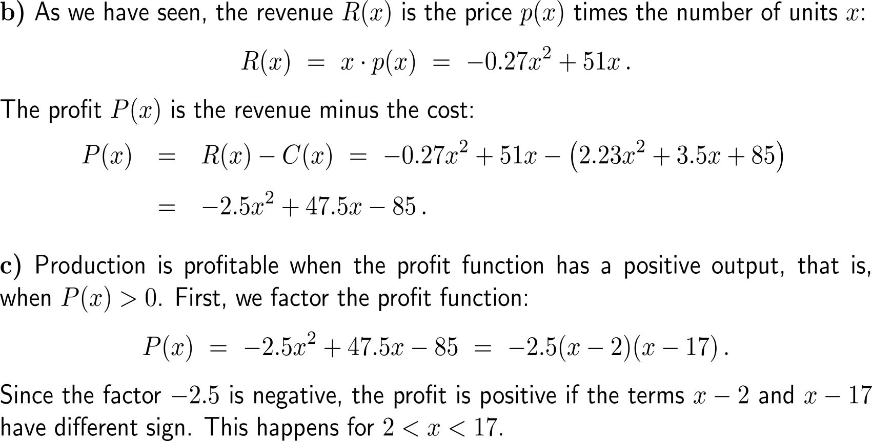
Example: Studying a production process
x
2
17
(x-2)(x-17)

Slide 10
The composition of functions allows to evaluate functions in a consecutive way, e.g. first g(x) = u and then f(u)
Let
g(x) = x + 1
and
f(u) = u² + 3u + 1
Then:
f(g(x)) = (x+1)² + 3(x+1) + 1
= x² + 5x + 5

Slide 11
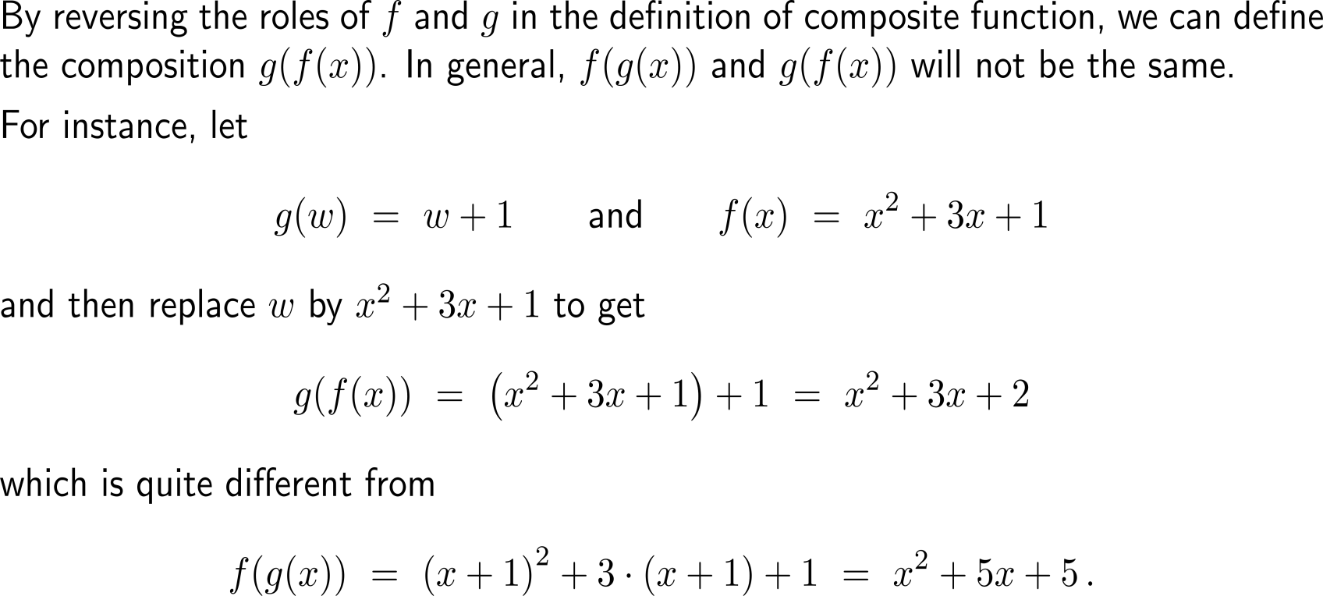
The sequence in the composition matters, as f(g(x)) and g(f(x)) are typically quite different

Slide 12
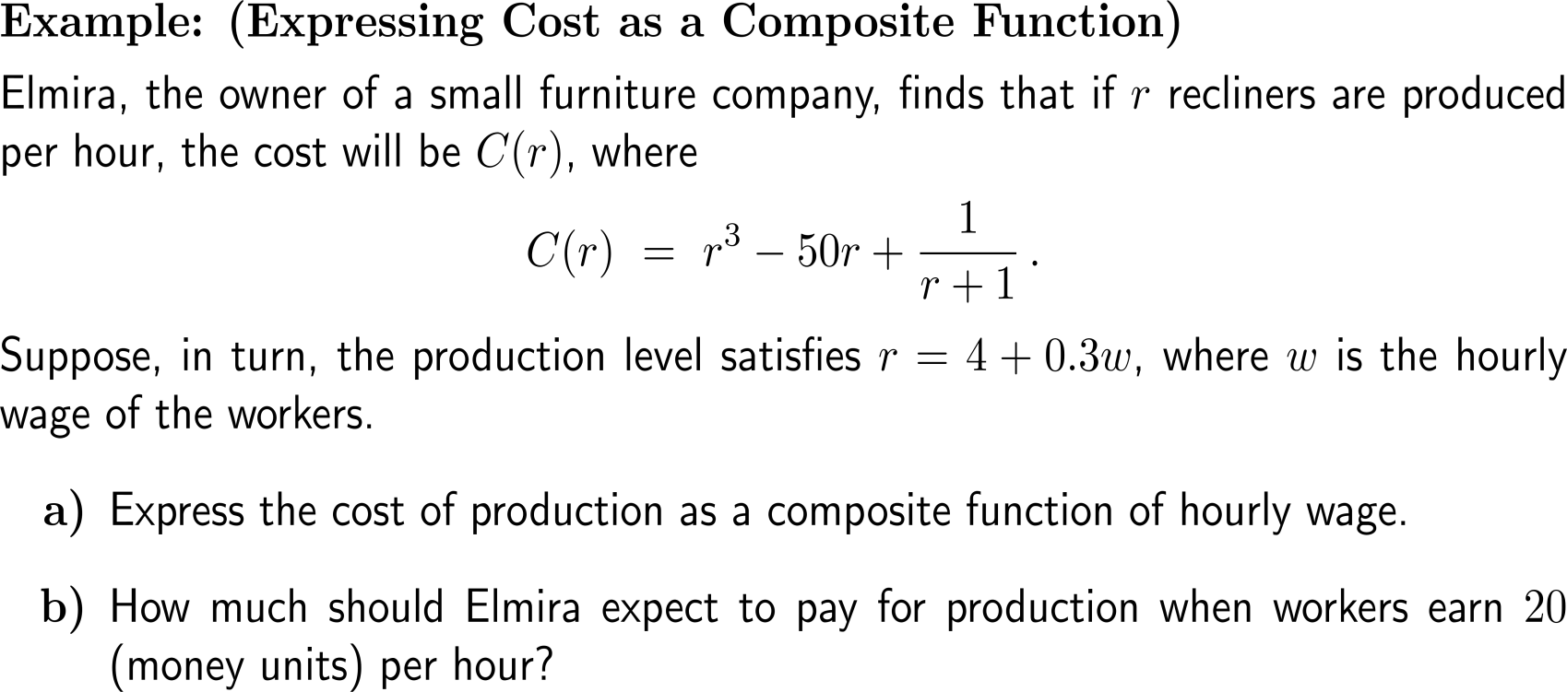
Example: Expressing cost as a composite function

Slide 13
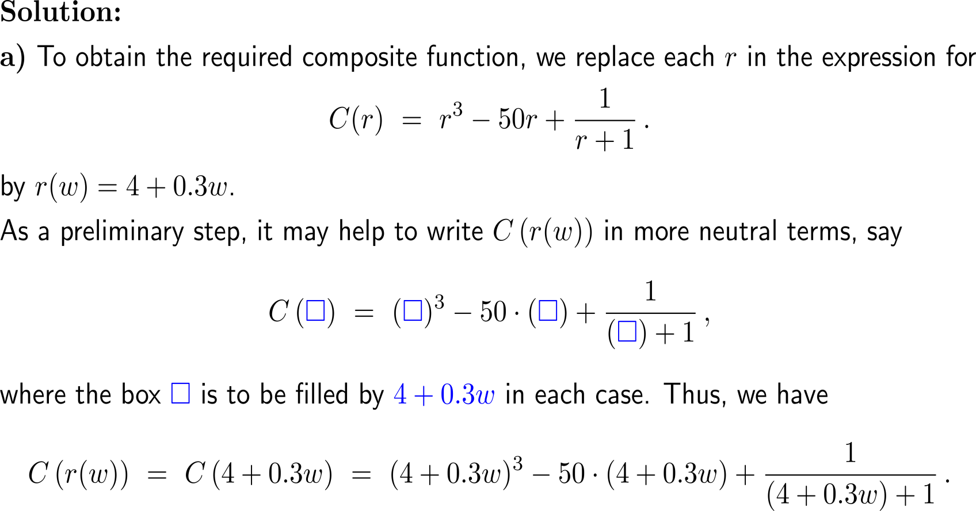
Example: Expressing cost as a composite function

Slide 14
Example: Expressing cost as a composite function

Slide 15
Calculus I for Management

