Slide 1
Calculus I for MGMT – Functions & Graphs The Graph of a Function
Mathematics for Management
Supplementary Electronic Materials
Functions & Graphs
Functions
The Graph of a Function
Lines & Linear Functions
Functional Models

Slide 2
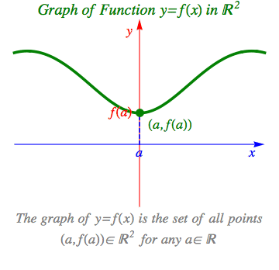
The graph of a function f(x) is a curve in the Cartesian x-y-plane and consist of all points (x, f(x))
animation

Slide 3
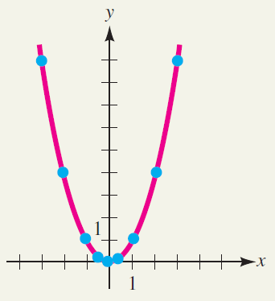
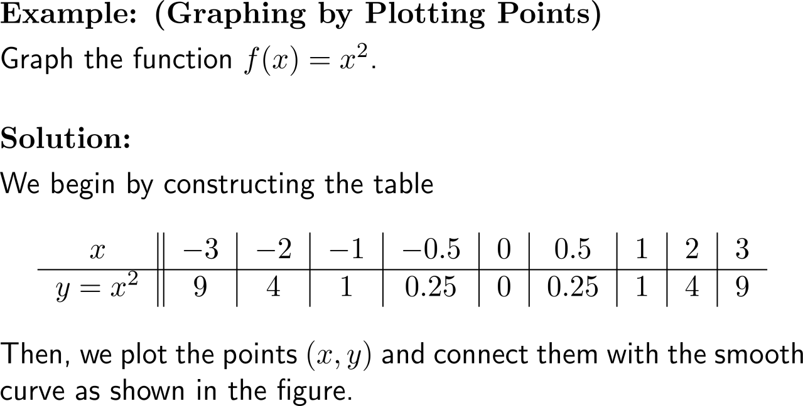
Example: Graphing by plotting points

Slide 4
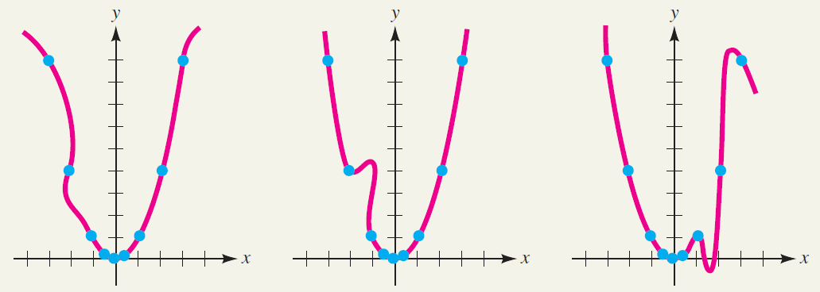
Note, not every curve is a graph
This is not the graph of a function

Slide 5
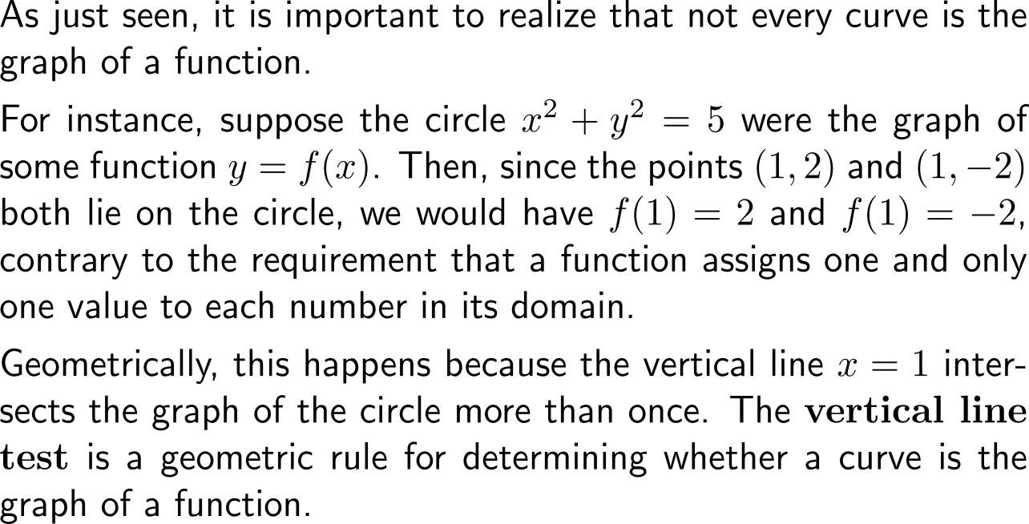
The vertical line test is a geometric rule for determining whether a curve is the graph of a function

Slide 6
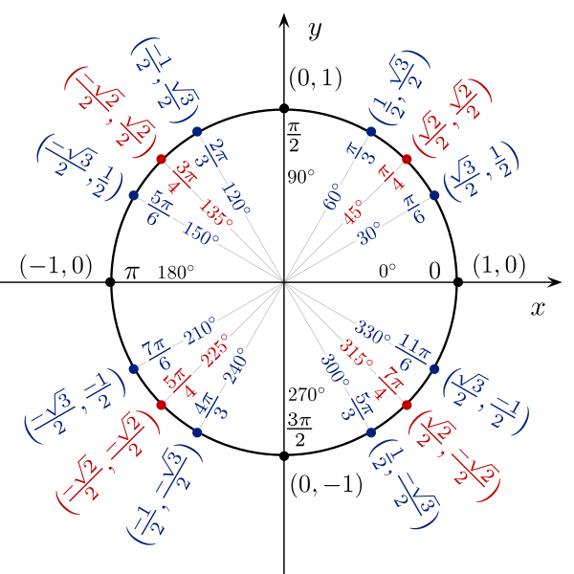
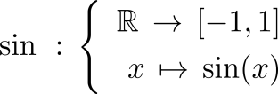
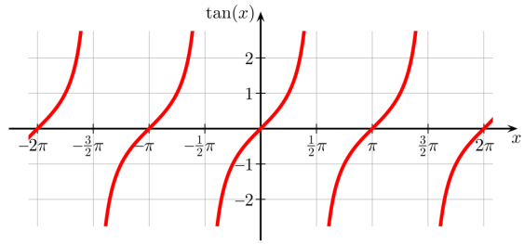
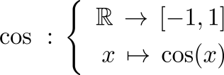
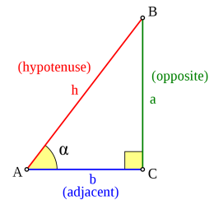
Example: Trigonometric functions
Sine
Tangent
Cosine
(cos(x), sin(x))

Slide 7
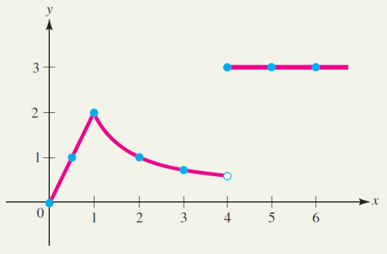
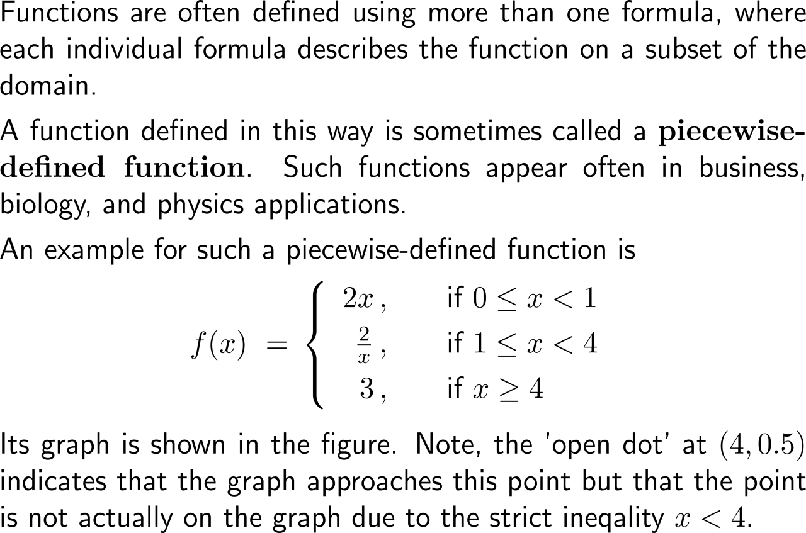
Piecewise-defined functions are using more than one formula, where each individual formula describes the function on a subset of the domain

Slide 8
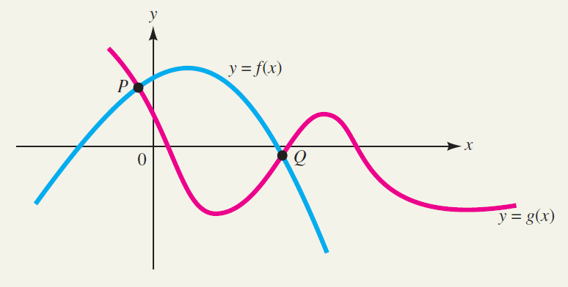
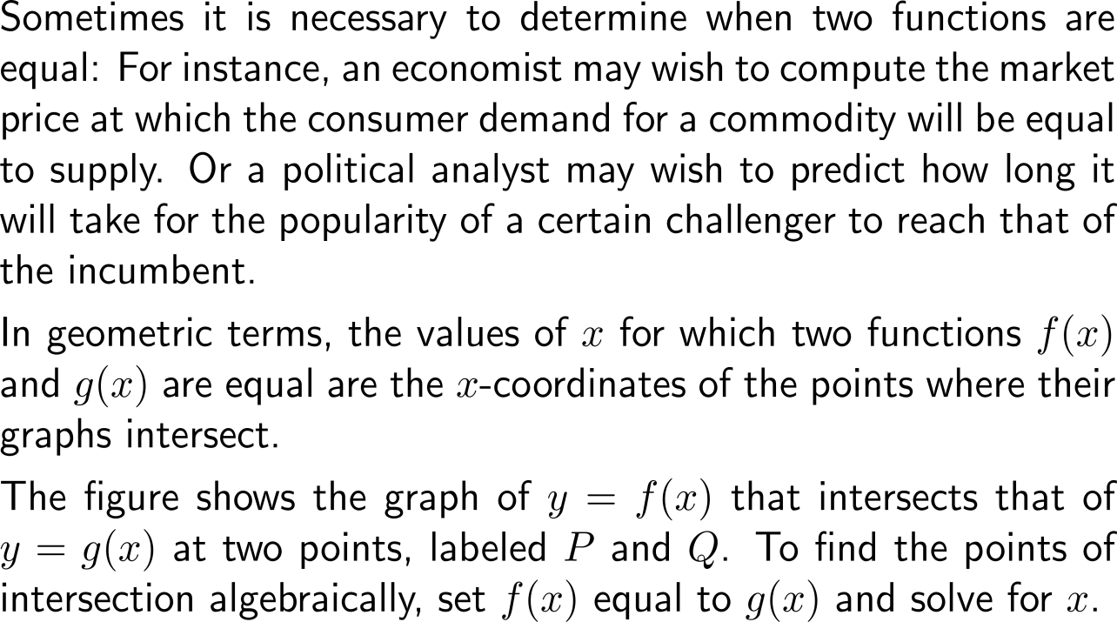
Geometrically, two graphs intersect at an x-coordinate with f(x) = g(x)

Slide 9
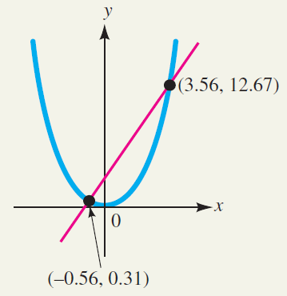
Example: Finding points of intersection

Slide 10
The intersections with the x-axis and the y-axis are called x-intercepts and the y-intercept, respectively

Slide 11
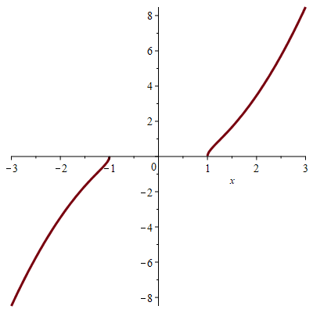
Example: Finding the intercepts of a graph

Slide 12
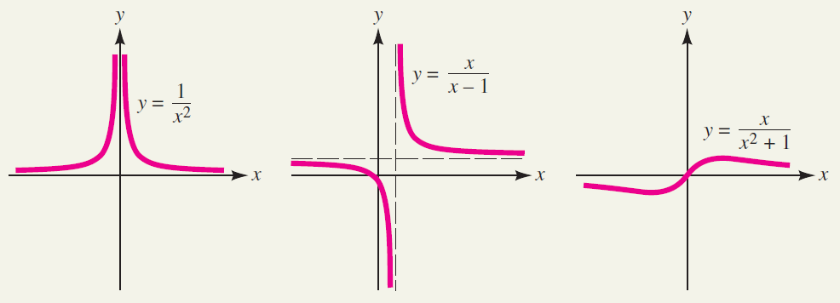
Example: Graphs of monomials, polynomials, rational functions

Slide 13
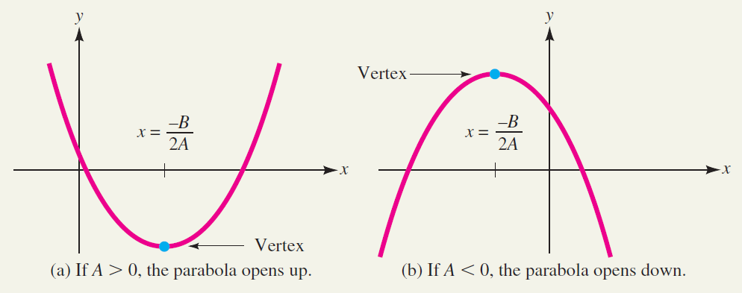
As you know, quadratic functions are of the general form f(x) = Ax² + Bx + C

Slide 14
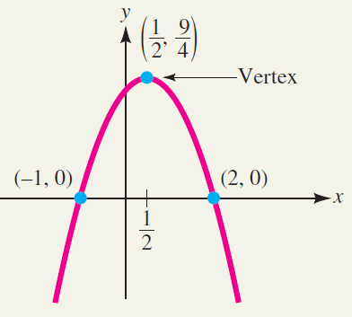
Example: Sketching the graph of a quadratic function

Slide 15
Calculus I for Management

