Slide 1
Calculus I for MGMT – Functions & Graphs Lines & Linear Functions
Mathematics for Management
Supplementary Electronic Materials
Functions & Graphs
Functions
The Graph of a Function
Lines & Linear Functions
Functional Models

Slide 2
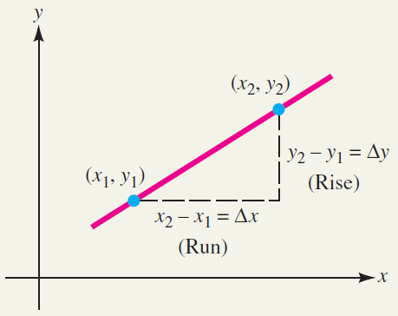
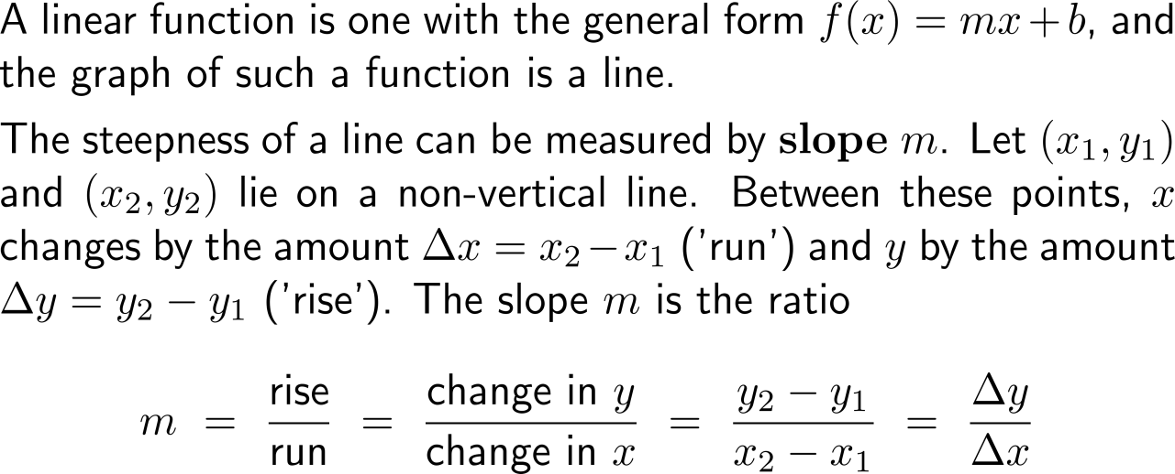
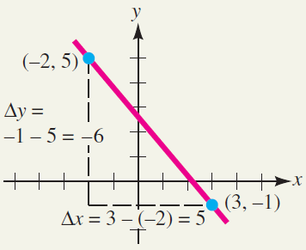
A linear function is one with the general form f(x) = mx + b, and the graph of such a function is a line

Slide 3
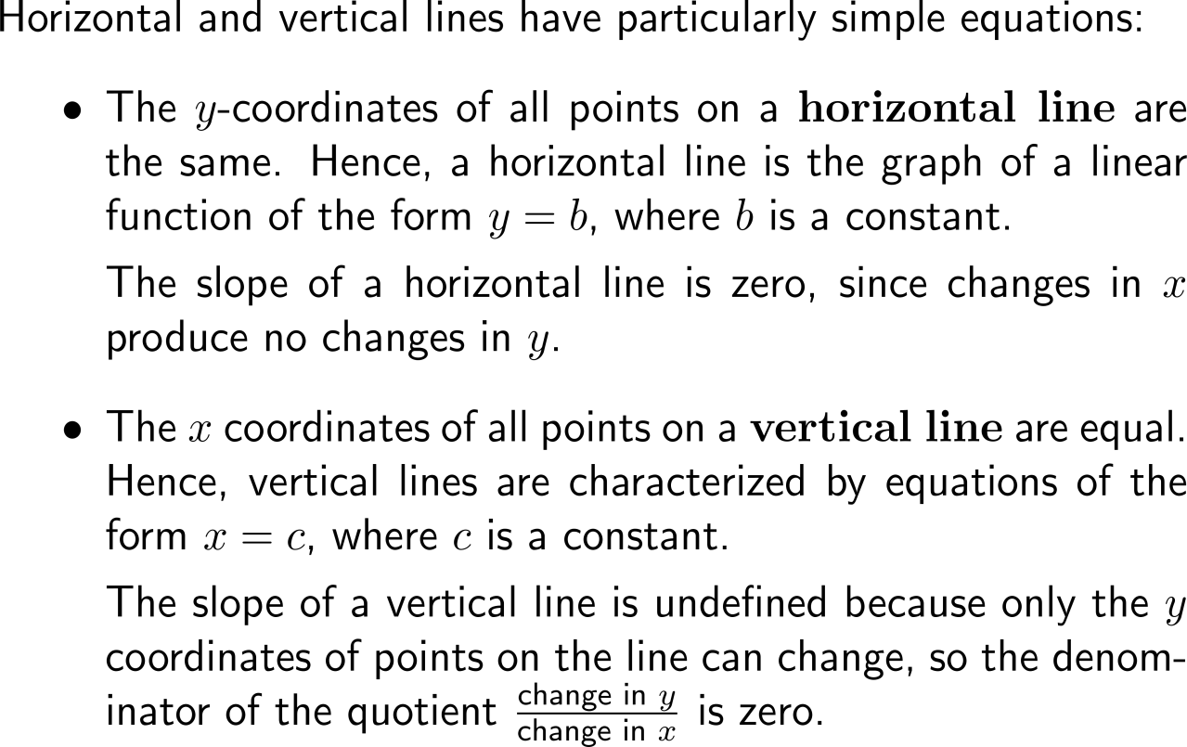
Horizontal and vertical lines are degenerate linear functions that either have zero slope or a not defined slope, respectively

Slide 4
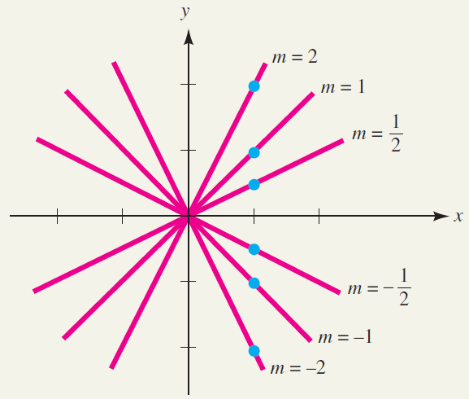
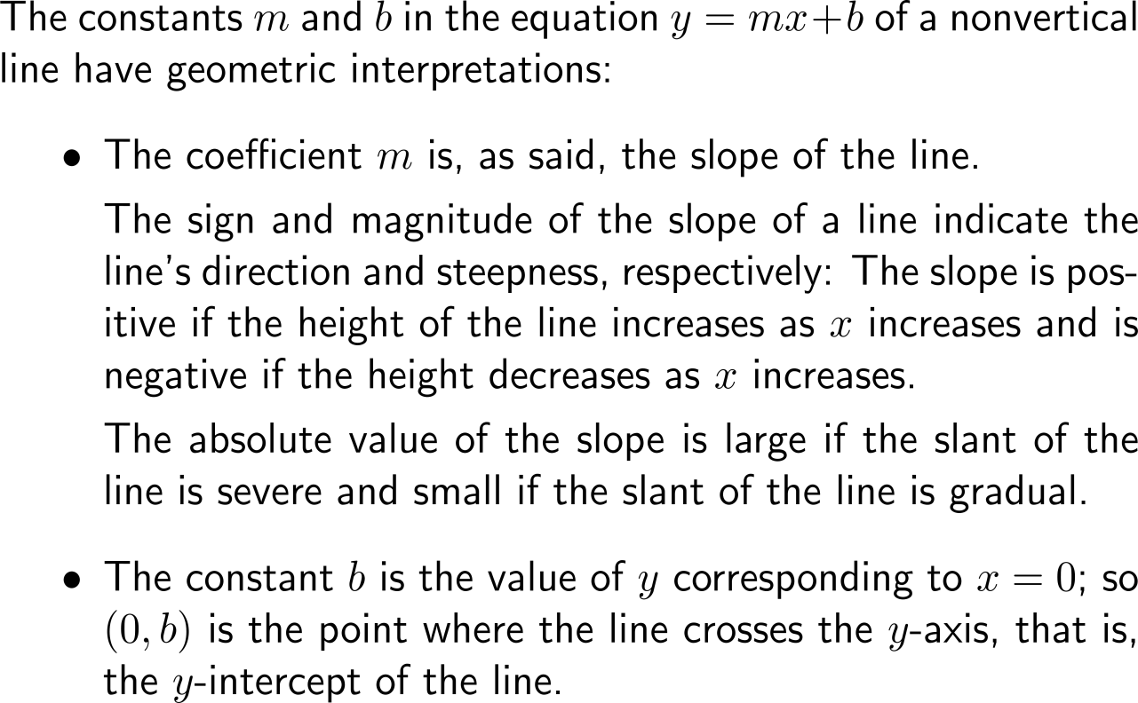
The sign and magnitude of the slope of a line indicate the line's direction and steepness, respectively

Slide 5
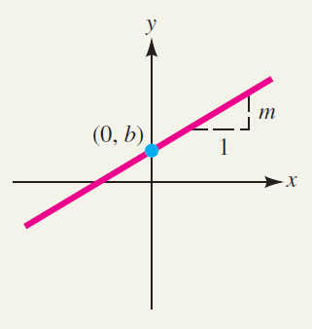
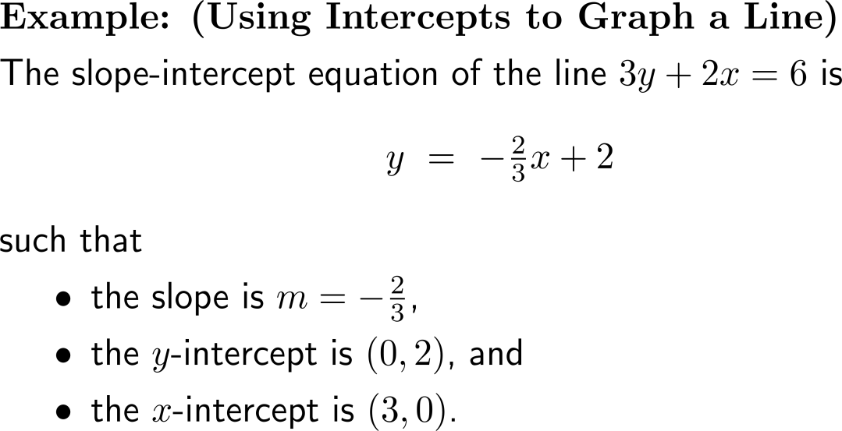
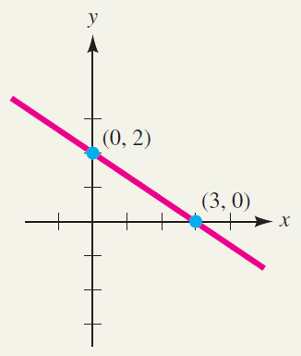
There are two forms that allow the set-up of linear functions: (1) the slope-intercept form …

Slide 6
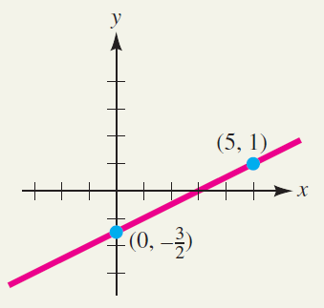
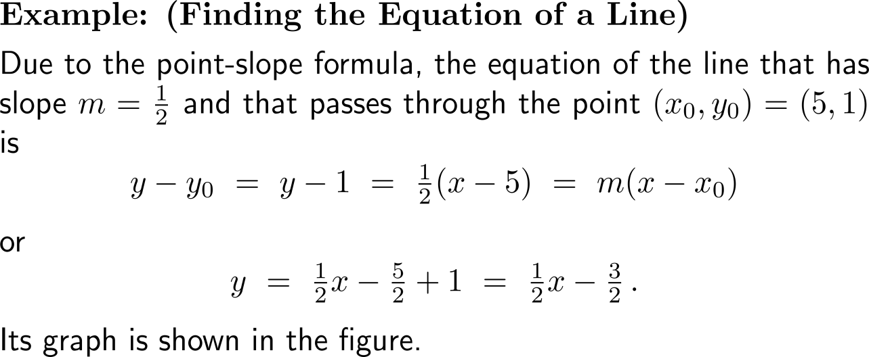
… and (2) the point-slope form

Slide 7
Lines parallel or perpendicular to a given line can easily be constructed with the aid of the given line’s slope

Slide 8
Example: Finding parallel and perpendicular lines

Slide 9
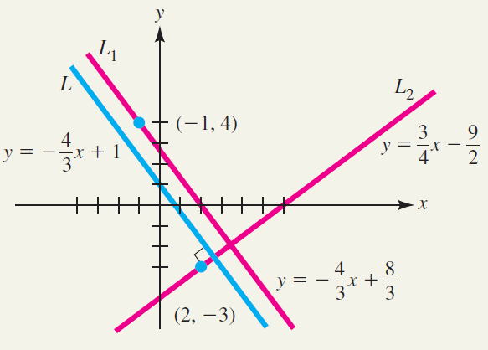
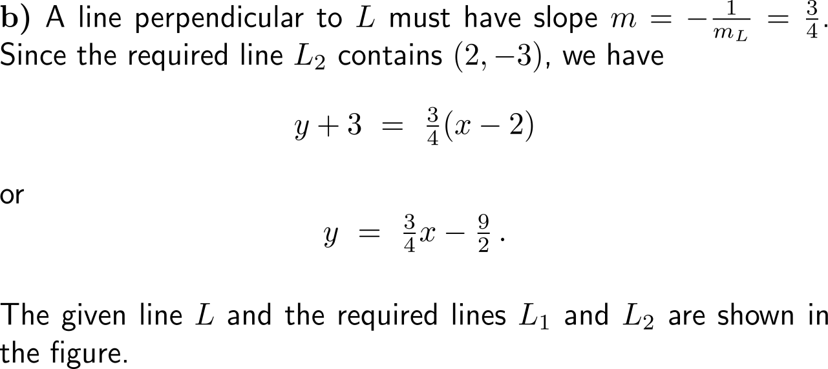
Example: Finding parallel and perpendicular lines

Slide 10
Calculus I for Management

