Slide 1
Calculus I for Management
Functions & Graphs
week 2
Lecture
Functions
The graph of a function
Lines & linear functions
Functional models

Slide 2
Topics
Functions
The Graph of a Function
Lines & Linear Functions
Functional Models

Slide 3
A function is a rule that assigns to each element in the input set exactly one element in the output set (1/ 2)
In the last lecture, we already reviewed some examples for functions that you know from school, like
monomials
power functions
polynomials

Slide 4
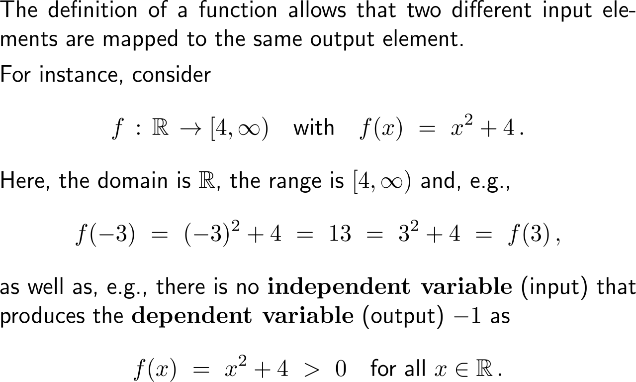
A function is a rule that assigns to each element in the input set exactly one element in the output set (2/ 2)
A: domain
set of inputs
set of independent variables
B: range/ image
set of outputs
set of dependent variables

Slide 5
The natural domain of a function f(x) is the set of all real numbers for which f(x) is defined as a real number

Slide 6
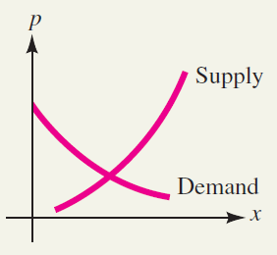
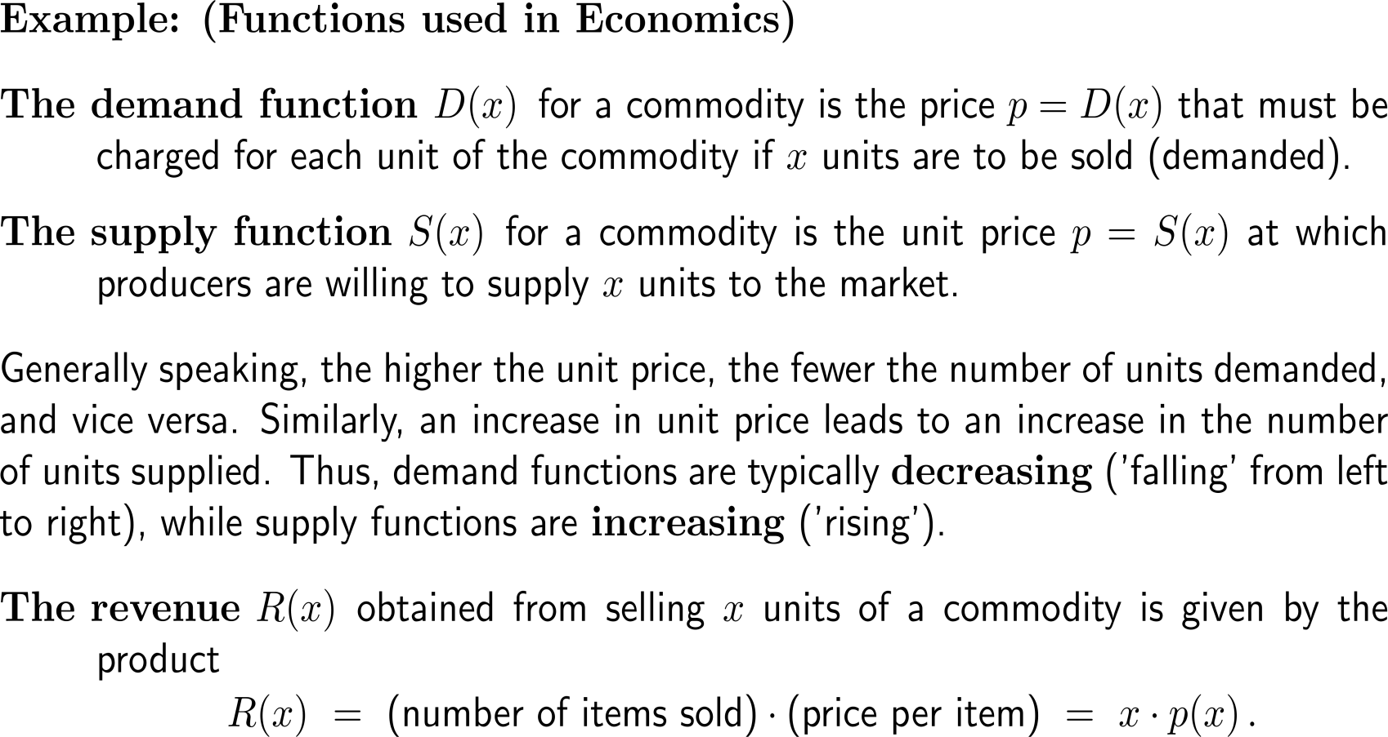
Examples: Functions in economics

Slide 7
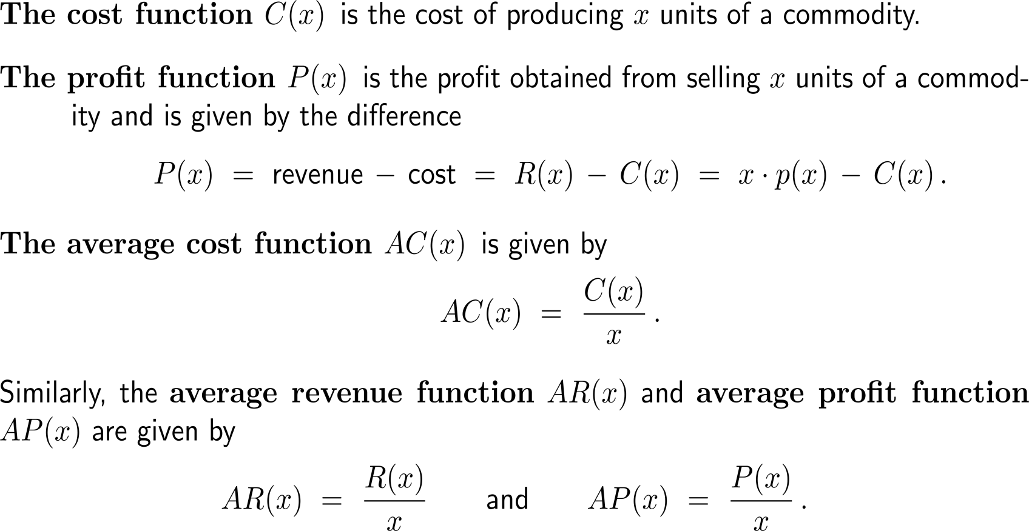
Examples: Functions in economics

Slide 8
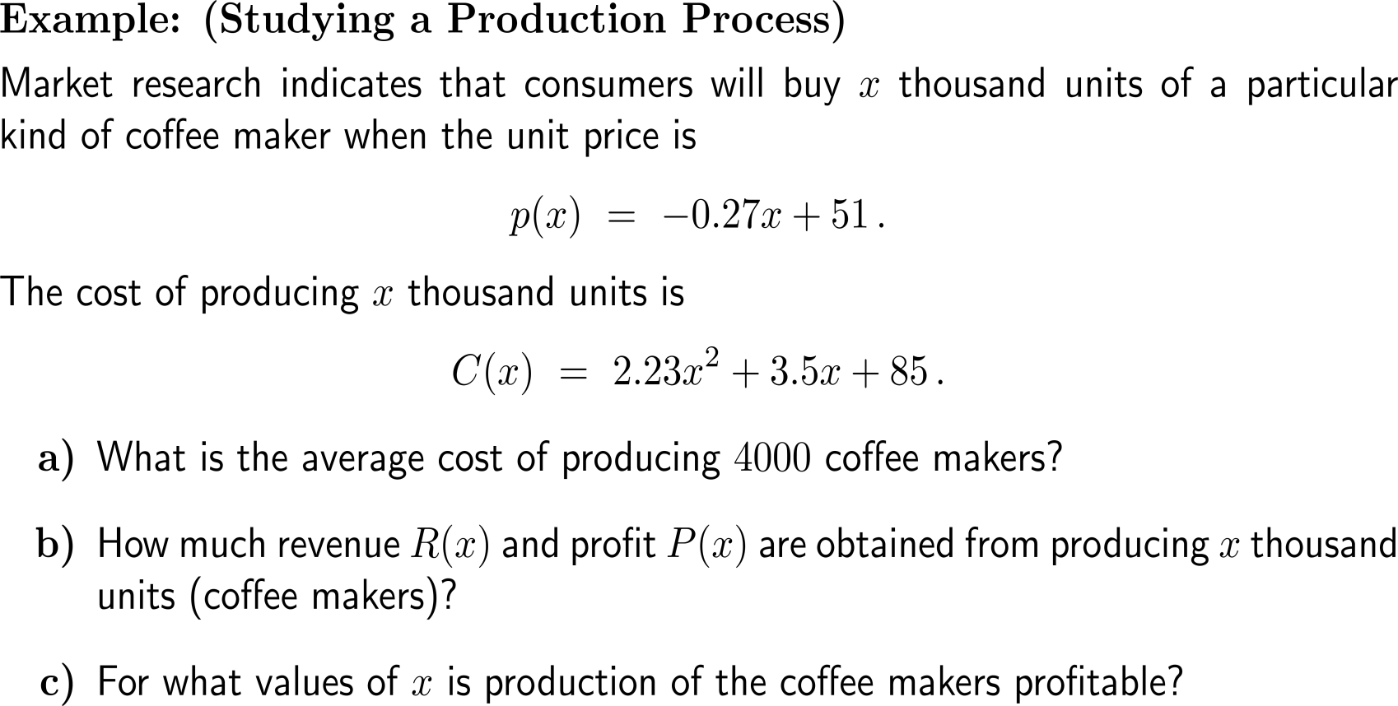
Example: Studying a production process

Slide 9
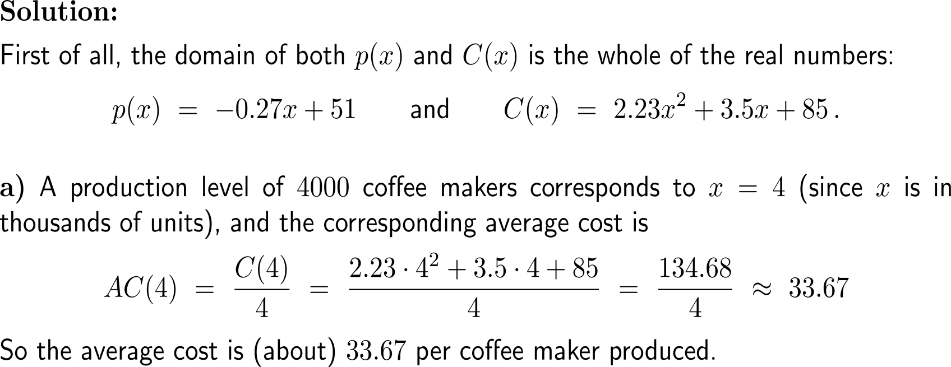
Example: Studying a production process

Slide 10
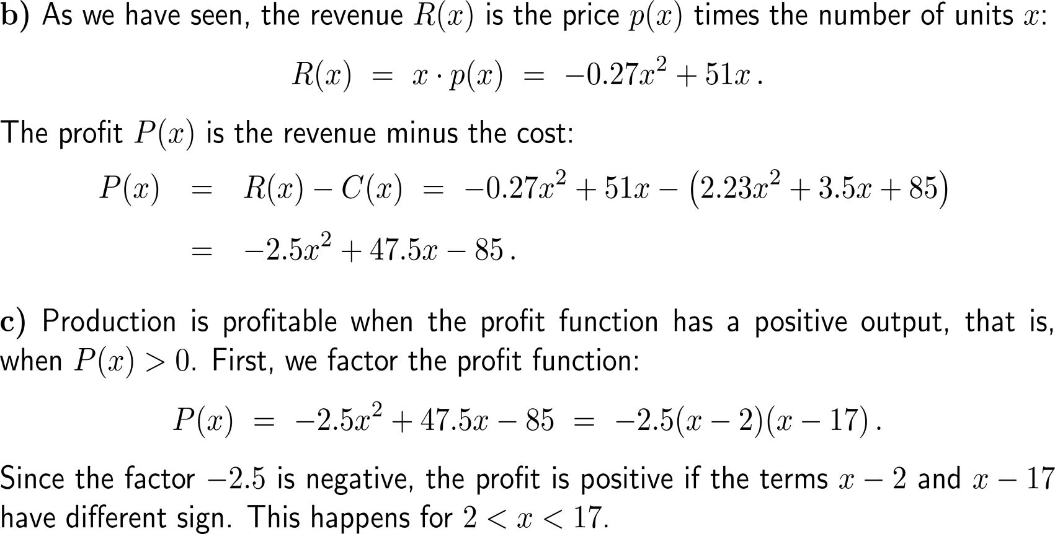
Example: Studying a production process
x
2
17
(x-2)(x-17)

Slide 11
The composition of functions allows to evaluate functions in a consecutive way, e.g. first g(x) = u and then f(u)
Let
g(x) = x + 1
and
f(u) = u² + 3u + 1
Then:
f(g(x)) = (x+1)² + 3(x+1) + 1
= x² + 5x + 5

Slide 12
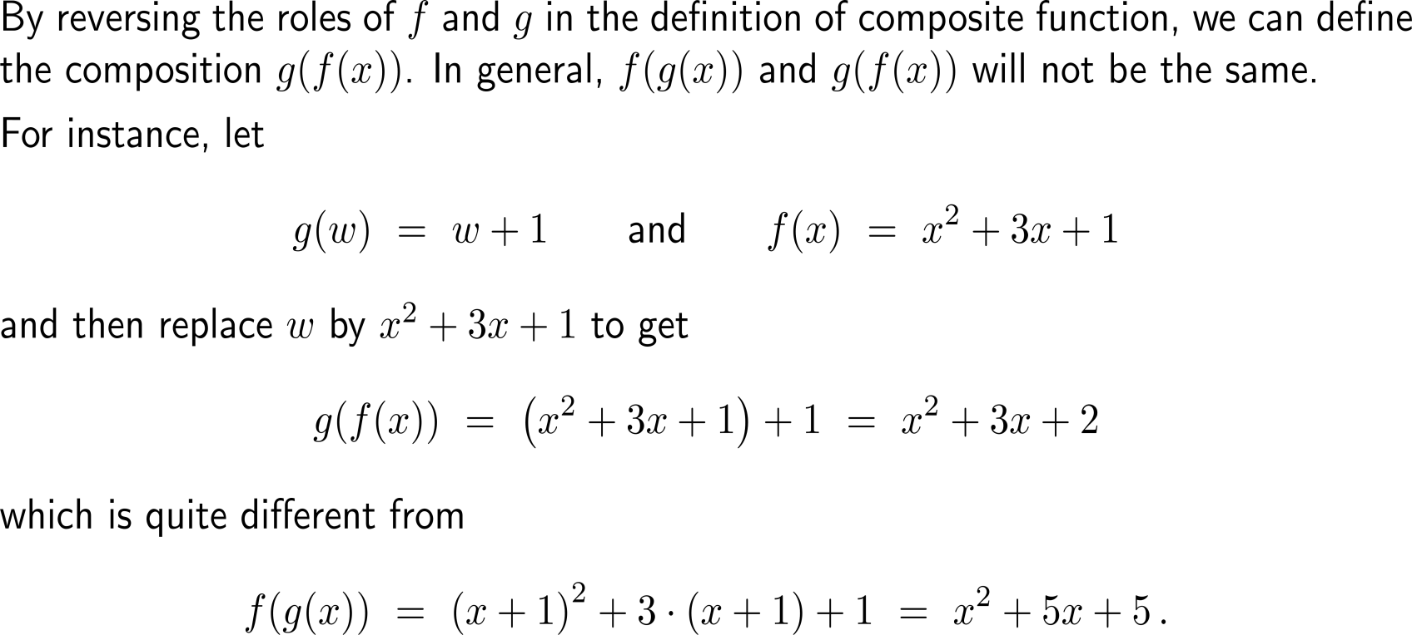
The sequence in the composition matters, as f(g(x)) and g(f(x)) are typically quite different

Slide 13
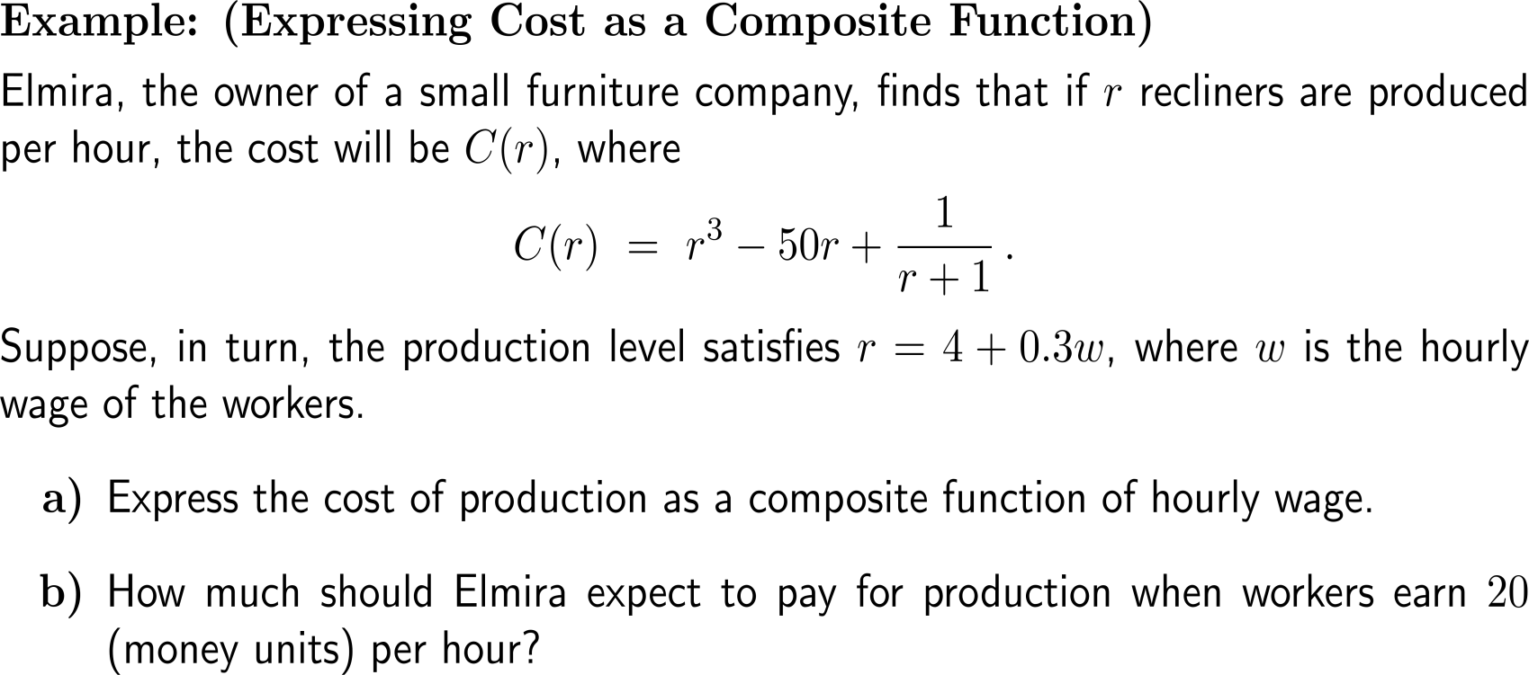
Example: Expressing cost as a composite function

Slide 14
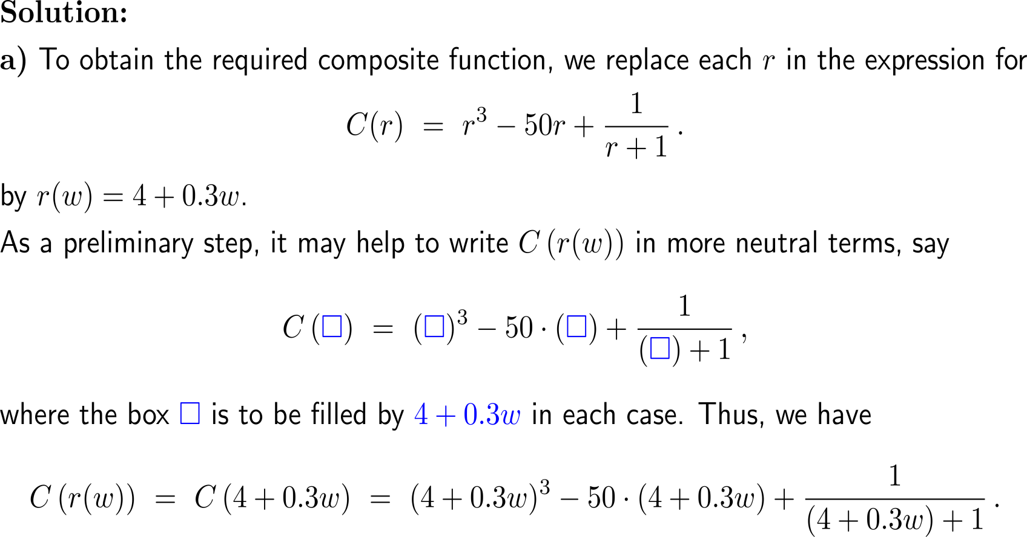
Example: Expressing cost as a composite function

Slide 15
Example: Expressing cost as a composite function

Slide 16
Topics
Functions
The Graph of a Function
Lines & Linear Functions
Functional Models

Slide 17
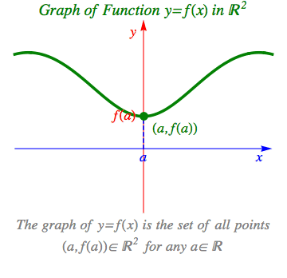
The graph of a function f(x) is a curve in the Cartesian x-y-plane and consist of all points (x, f(x))
animation

Slide 18
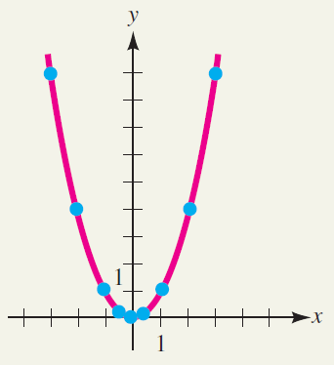
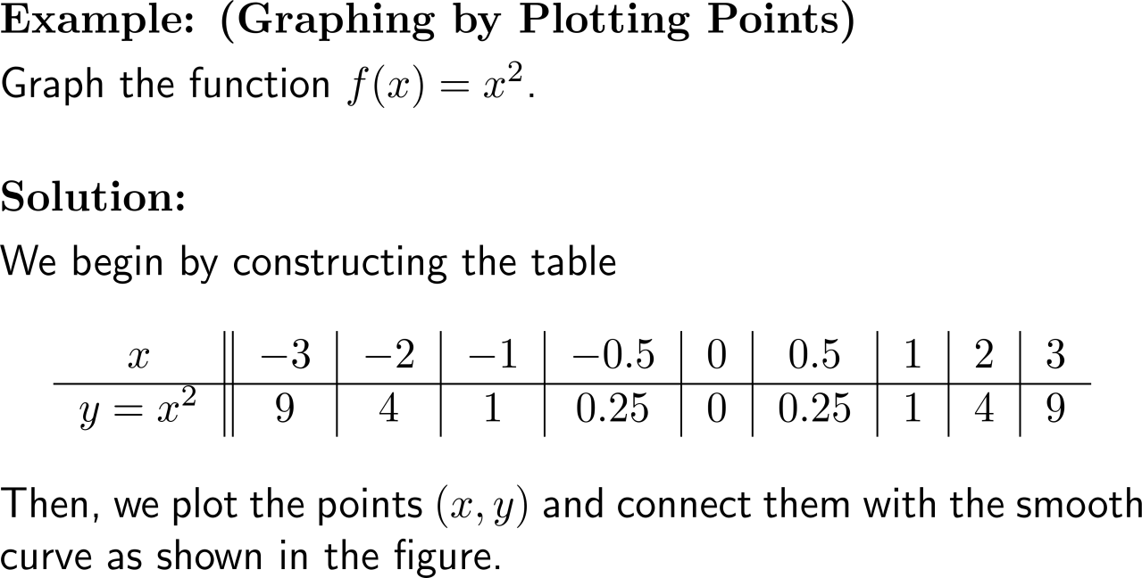
Example: Graphing by plotting points

Slide 19
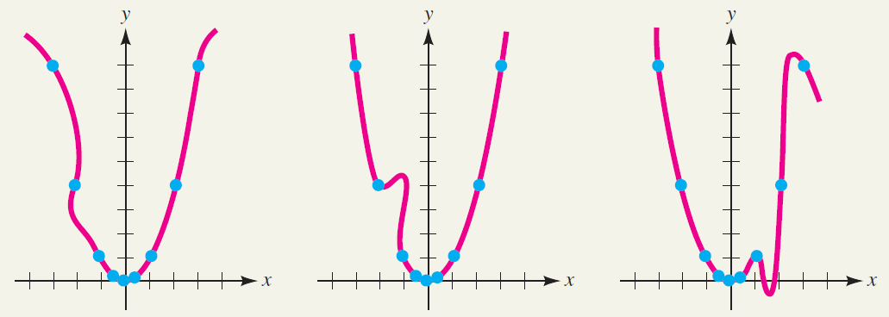
Note, not every curve is a graph
This is not the graph of a function

Slide 20
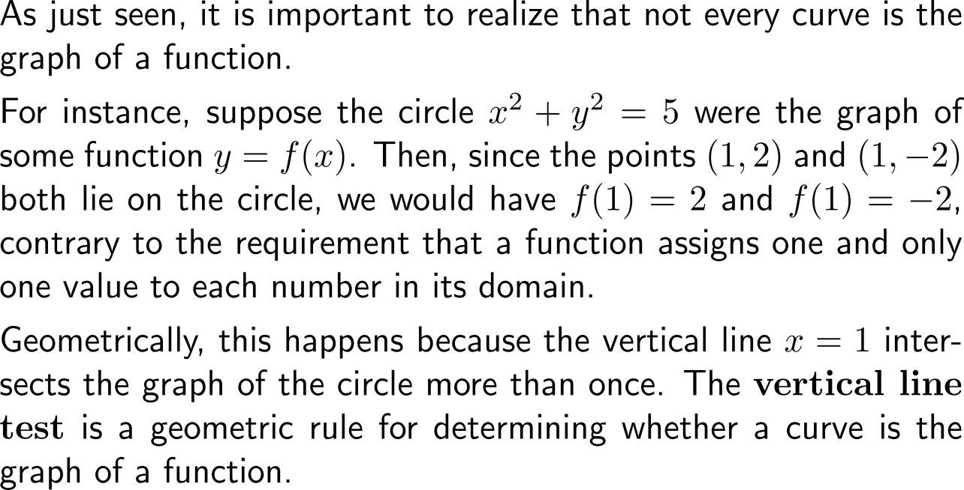
The vertical line test is a geometric rule for determining whether a curve is the graph of a function

Slide 21
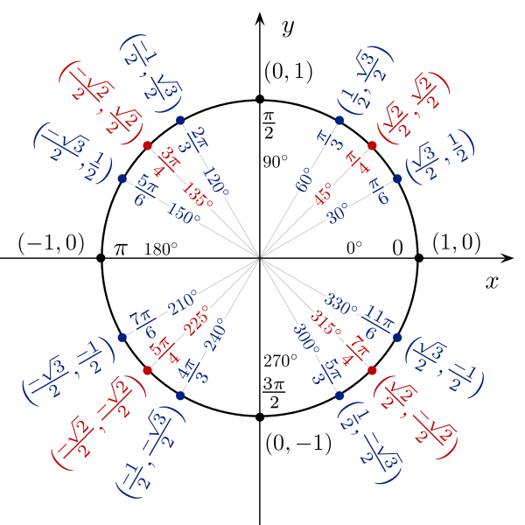
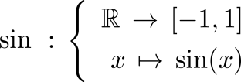
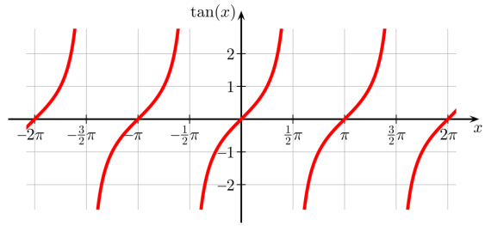
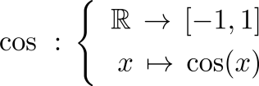
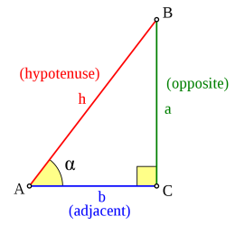
Example: Trigonometric functions
Sine
Tangent
Cosine
(cos(x), sin(x))

Slide 22
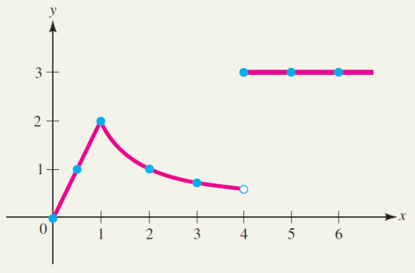
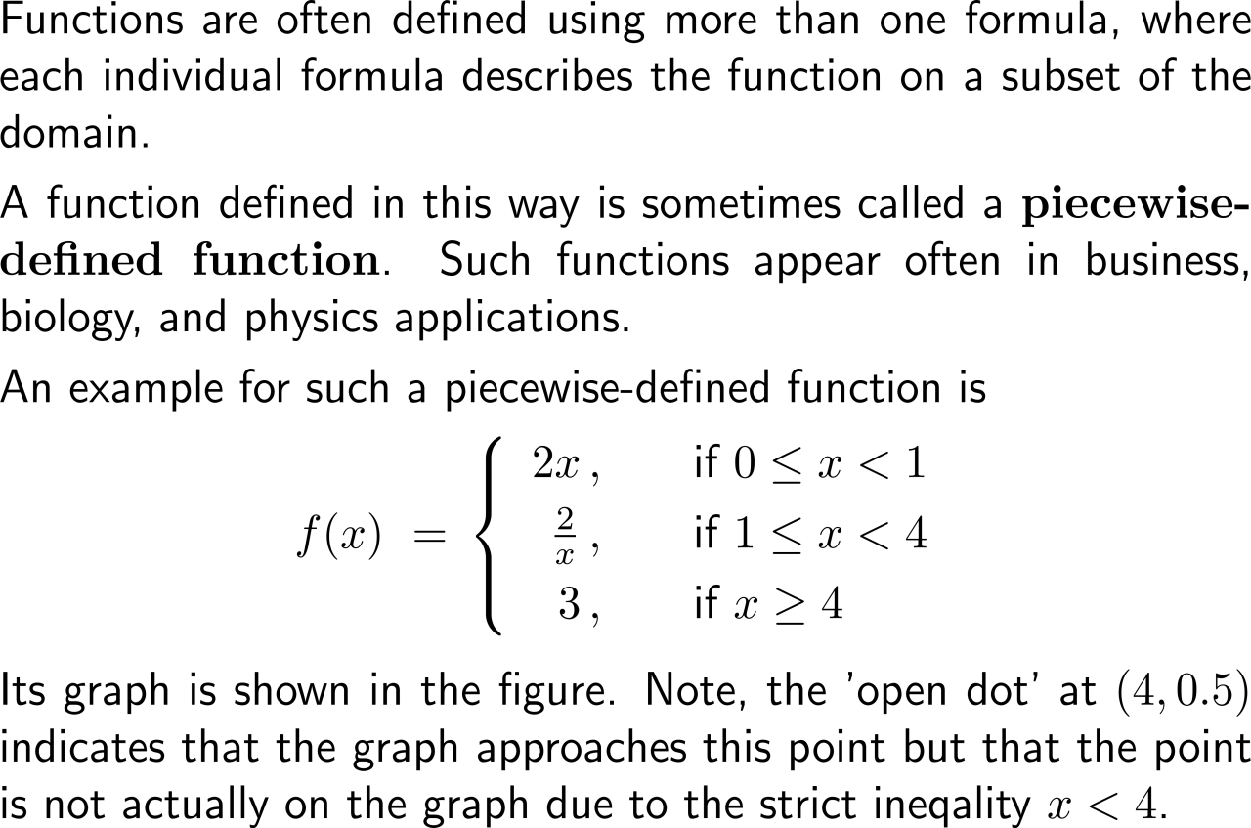
Piecewise-defined functions are using more than one formula, where each individual formula describes the function on a subset of the domain

Slide 23
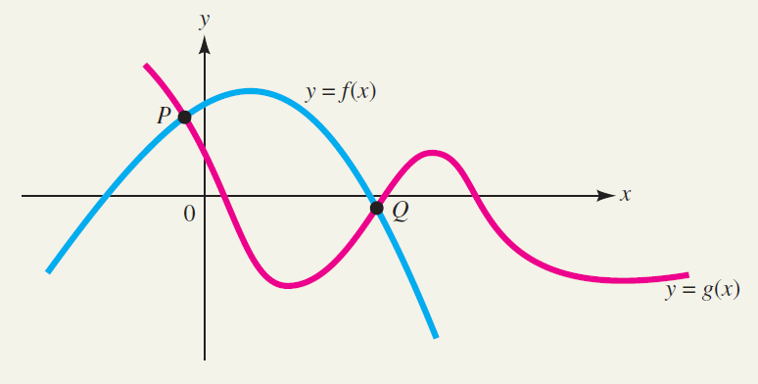
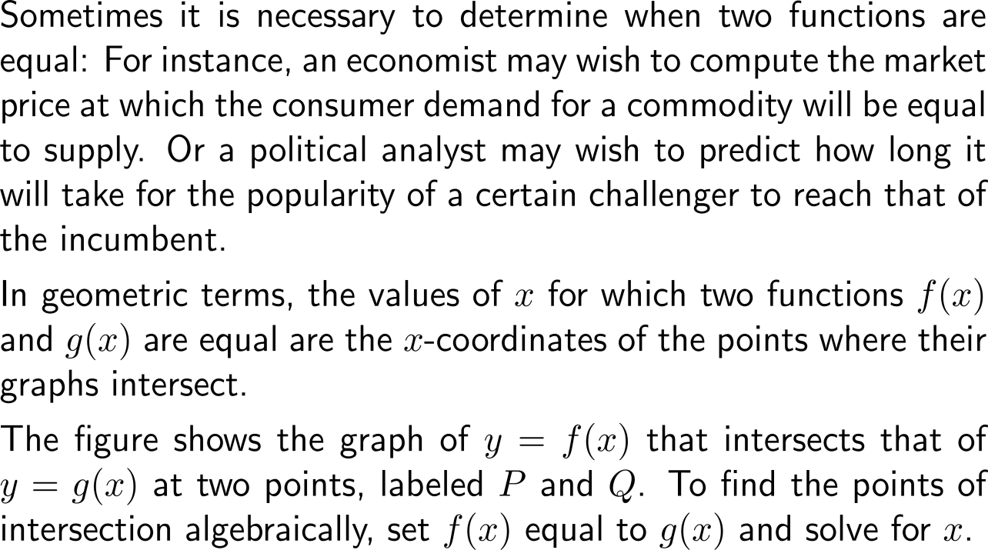
Geometrically, two graphs intersect at an x-coordinate with f(x) = g(x)

Slide 24
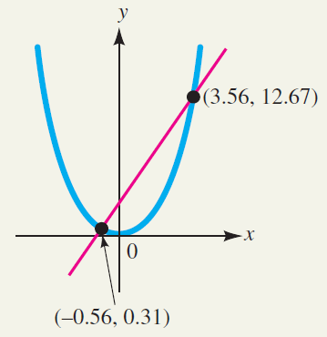
Example: Finding points of intersection

Slide 25
The intersections with the x-axis and the y-axis are called x-intercepts and the y-intercept, respectively

Slide 26
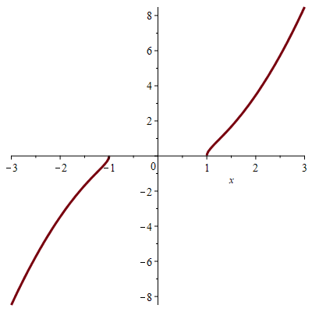
Example: Finding the intercepts of a graph

Slide 27
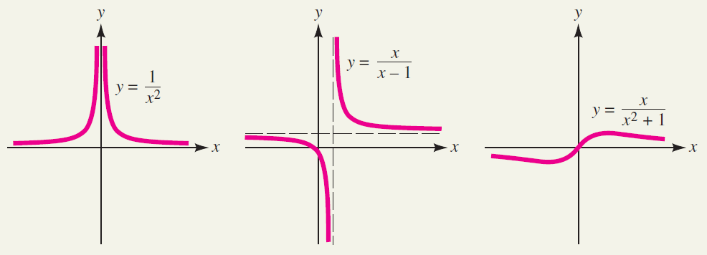
Example: Graphs of monomials, polynomials, rational functions

Slide 28
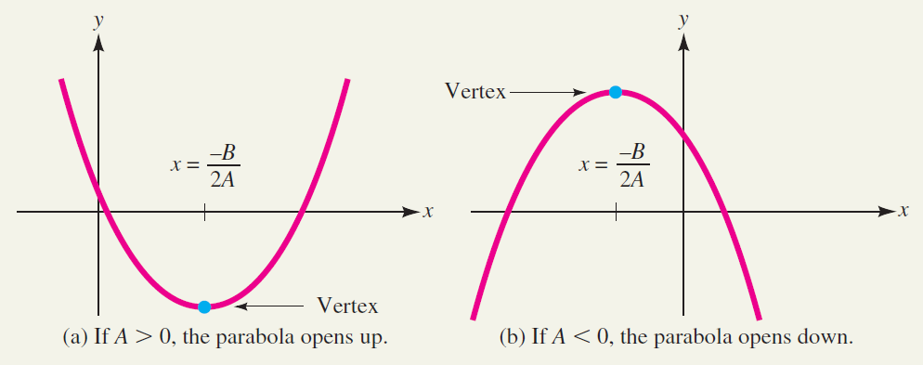
As you know, quadratic functions are of the general form f(x) = Ax² + Bx + C

Slide 29
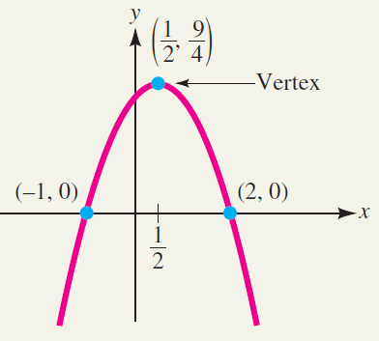
Example: Sketching the graph of a quadratic function

Slide 30
Topics
Functions
The Graph of a Function
Lines & Linear Functions
Functional Models

Slide 31
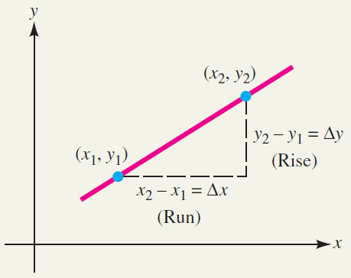
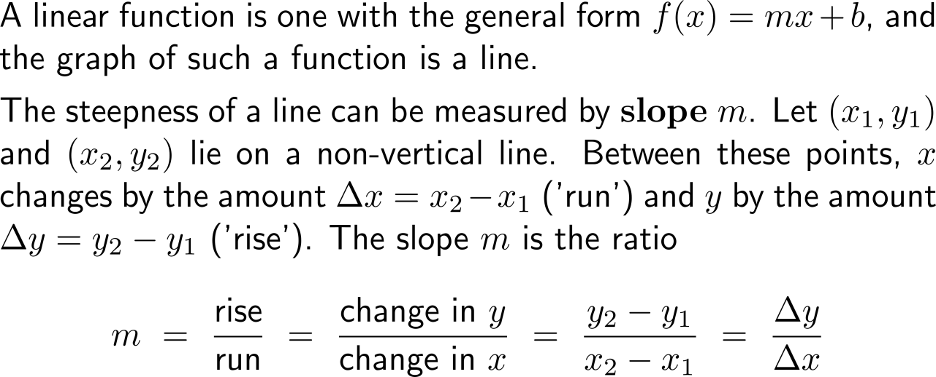
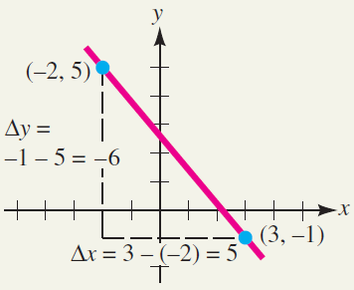
A linear function is one with the general form f(x) = mx + b, and the graph of such a function is a line

Slide 32
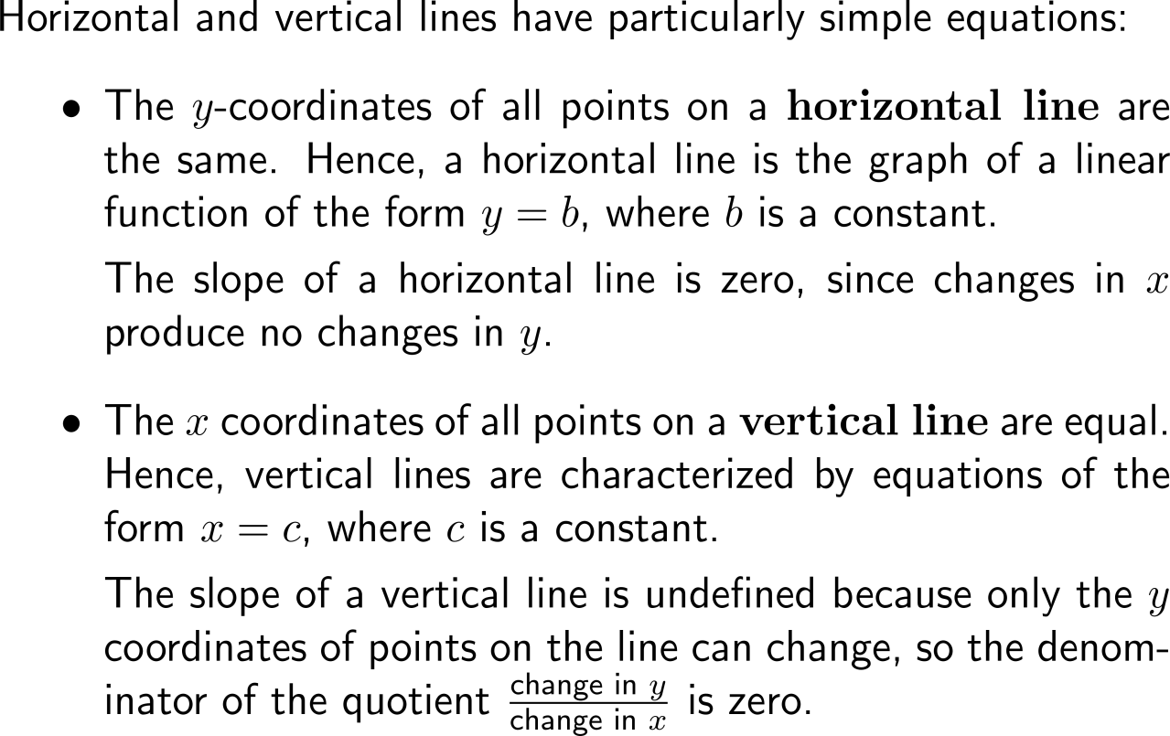
Horizontal and vertical lines are degenerate linear functions that either have zero slope or a not defined slope, respectively

Slide 33
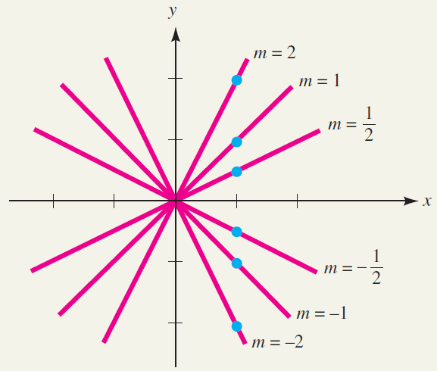
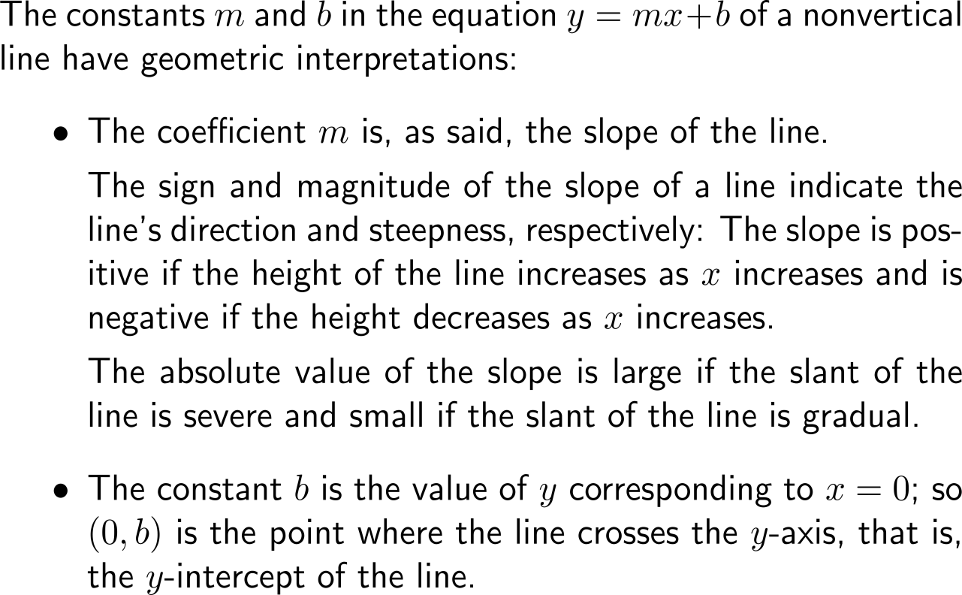
The sign and magnitude of the slope of a line indicate the line's direction and steepness, respectively

Slide 34
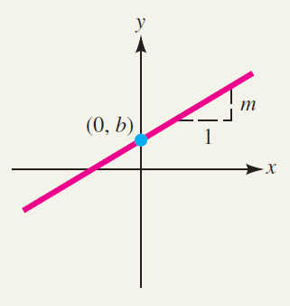
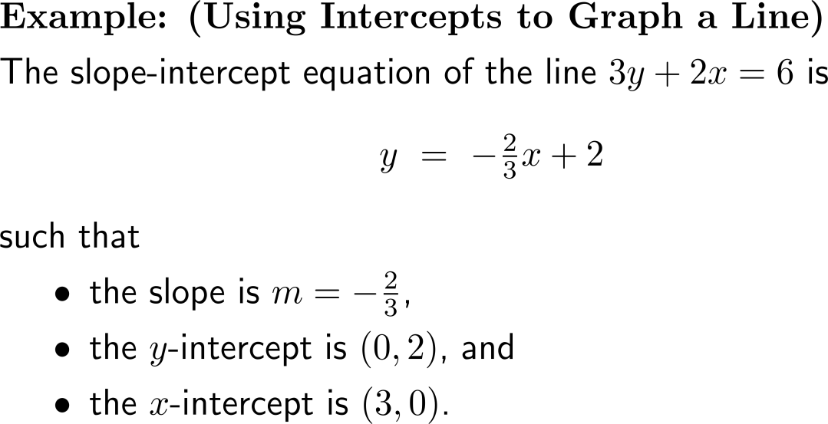
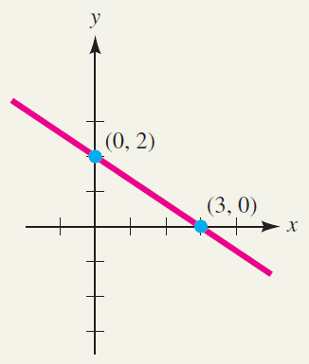
There are two forms that allow the set-up of linear functions: (1) the slope-intercept form …

Slide 35
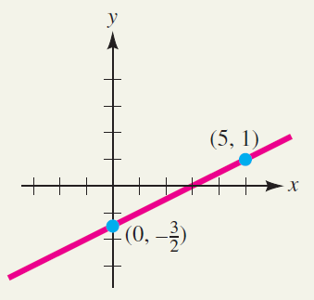
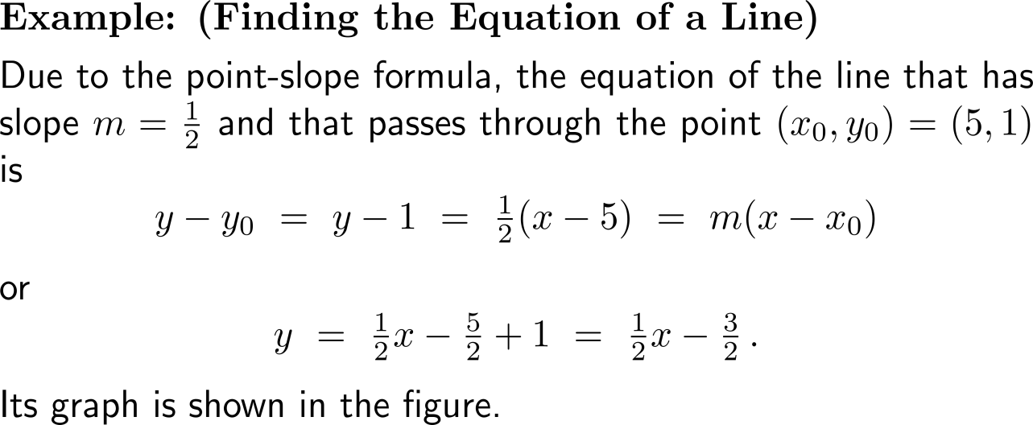
… and (2) the point-slope form

Slide 36
Lines parallel or perpendicular to a given line can easily be constructed with the aid of the given line’s slope

Slide 37
Example: Finding parallel and perpendicular lines

Slide 38
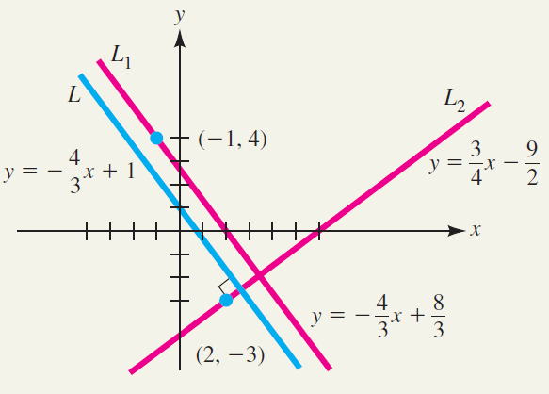
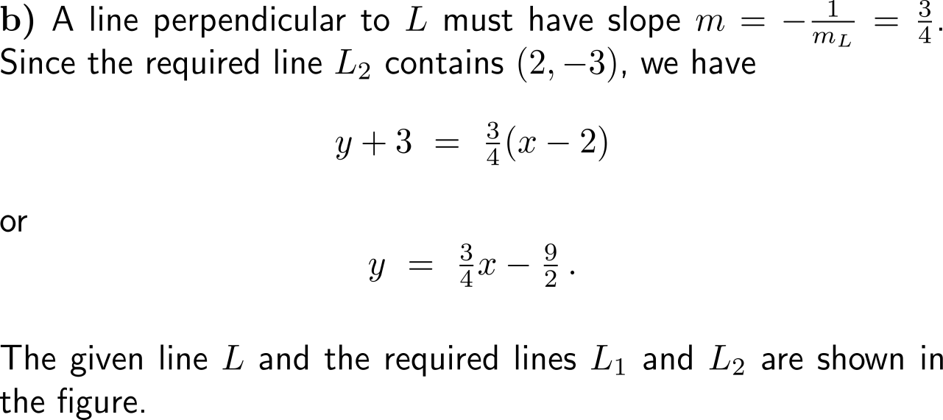
Example: Finding parallel and perpendicular lines

Slide 39
Topics
Functions
The Graph of a Function
Lines & Linear Functions
Functional Models

Slide 40
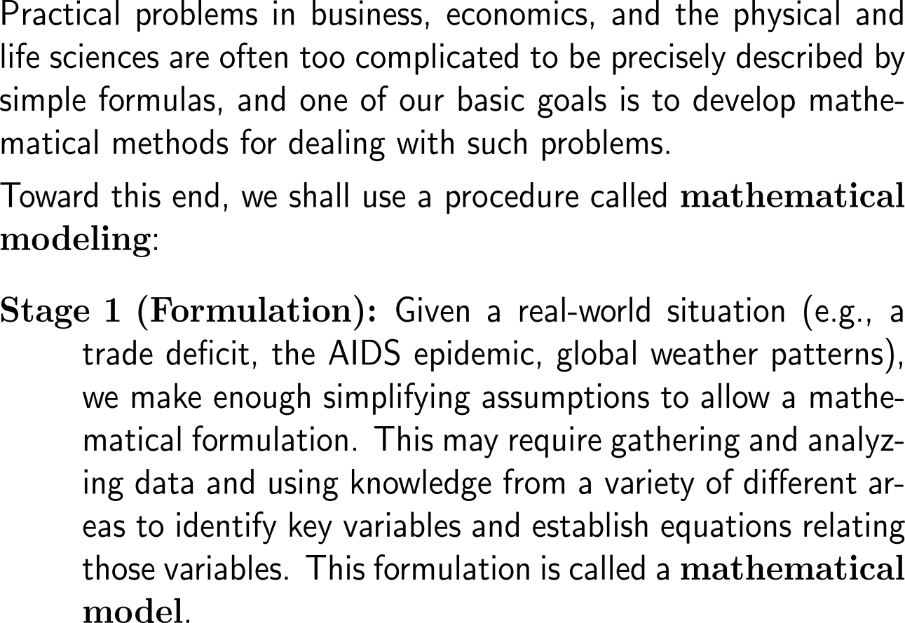
Mathematical modeling covers the process of solving a real-world situation by means of mathematical methods (1/ 3)
Economic
Problem
Formulation
Adjustments
Math. Model
Testing
Analysis
Simulation
Solution
Predictions
Inter-pretation
Communication

Slide 41
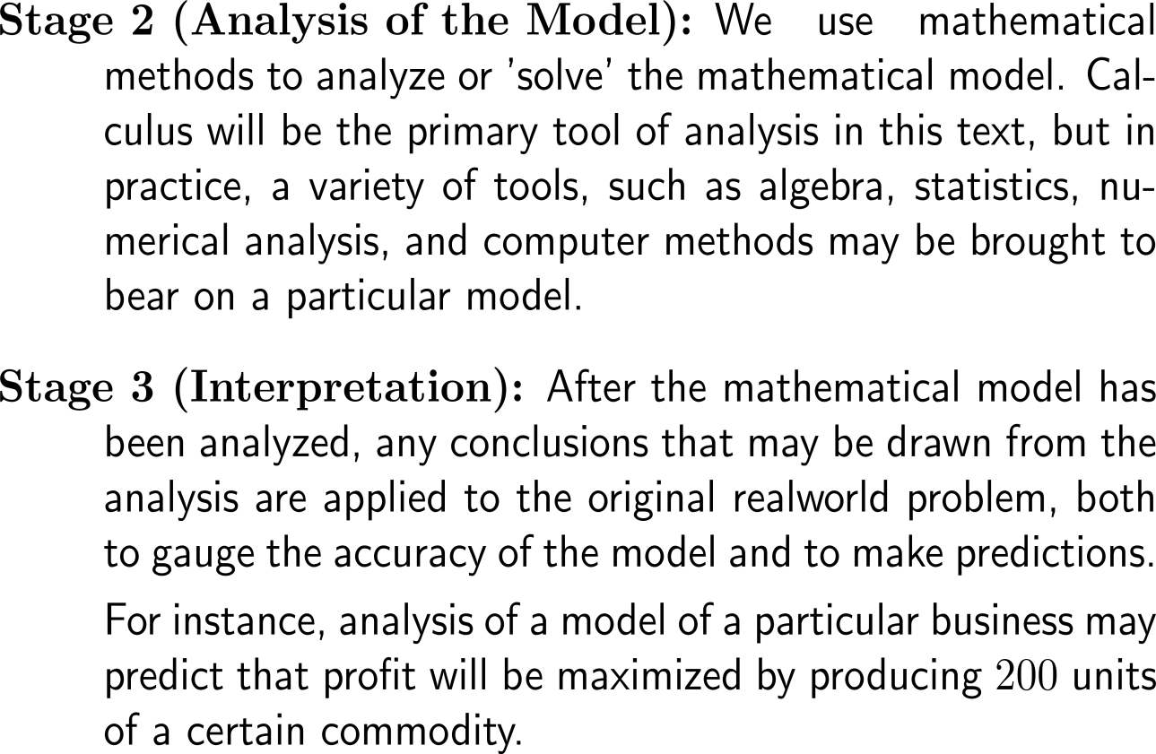
Mathematical modeling covers the process of solving a real-world situation by means of mathematical methods (2/ 3)
Economic
Problem
Formulation
Adjustments
Math. Model
Testing
Analysis
Simulation
Solution
Predictions
Inter-pretation
Communication

Slide 42
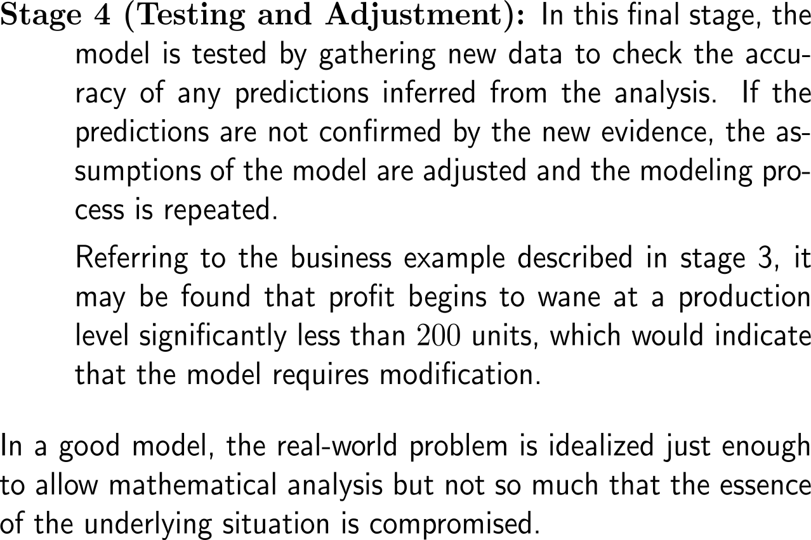
Mathematical modeling covers the process of solving a real-world situation by means of mathematical methods (3/ 3)
Economic
Problem
Formulation
Adjustments
Math. Model
Testing
Analysis
Simulation
Solution
Predictions
Inter-pretation
Communication

Slide 43
Two varying quantities are said to be in a relation of proportionality if their product or ratio yields a constant

Slide 44
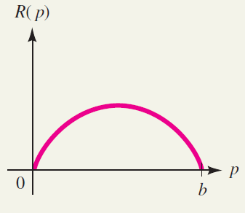
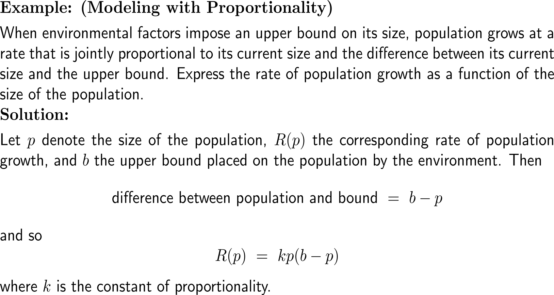
Example: Modeling with Proportionality
The rate of bounded population growth:
R(p) = kp(b – p).

Slide 45
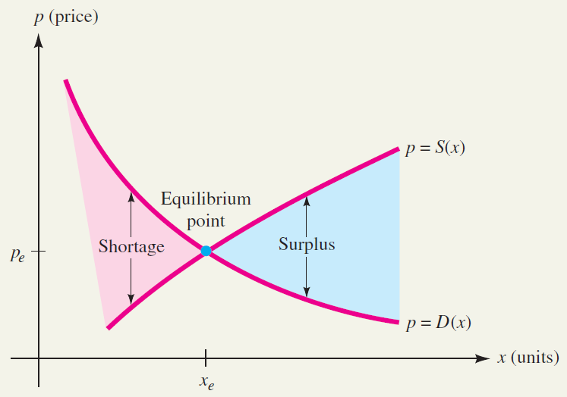
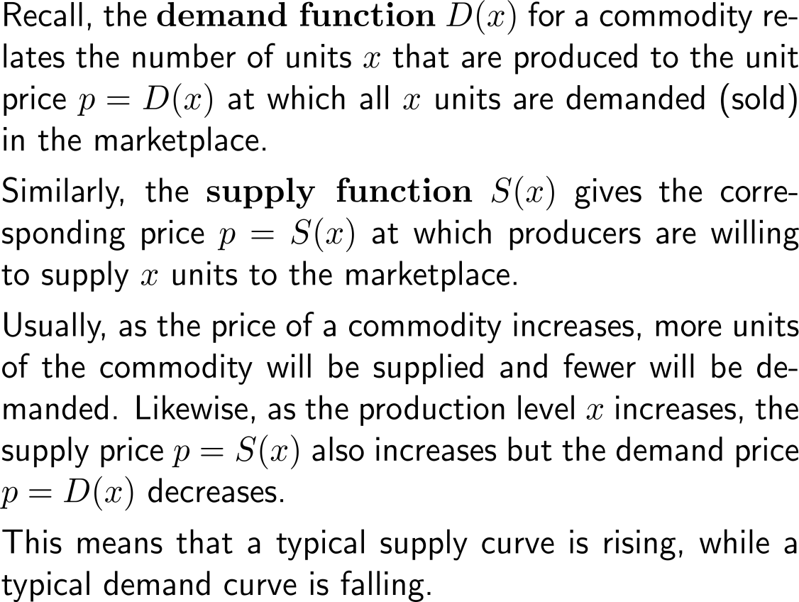
Market equilibrium: in a competitive market environment, supply tends to equal demand (1/ 2)
Market Equilibrium
Market equilibrium occurs when supply equals demand

Slide 46
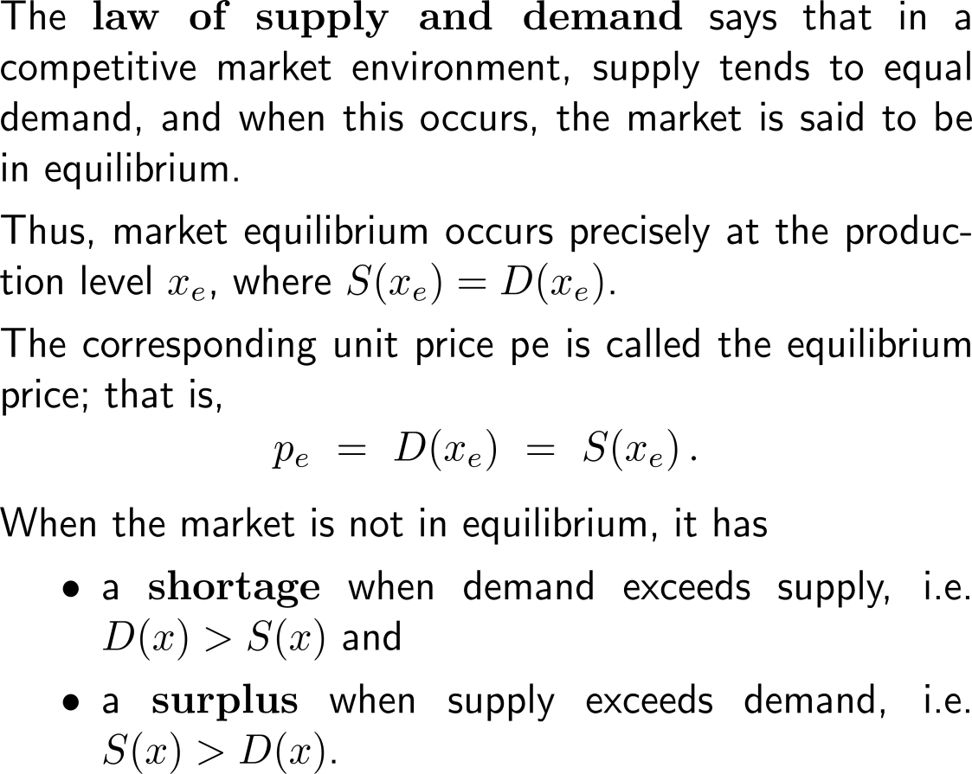
Market equilibrium: in a competitive market environment, supply tends to equal demand (2/ 2)
Market Equilibrium
Market equilibrium occurs when supply equals demand

Slide 47
Example: Modeling market equilibrium

Slide 48
Example: Modeling market equilibrium

Slide 49
Example: Modeling market equilibrium
Supply, demand, and equilibrium point for our example

Slide 50
Break-even analysis: revenue (over) compensates costs
Cost and revenue curves, with a break-even point at P

Slide 51
Example: Break-Even analysis

Slide 52
Example: Break-Even analysis

Slide 53
Example: Break-Even analysis

Slide 54
Example: Break-Even analysis

Slide 55
Example: Comparative cost analysis

Slide 56
Example: Comparative cost analysis

Slide 57
Further Worked-Out Exercises:
Calculus I for Management
Topics
Domain of a function
Evaluating functions
Compositions of functions
Linear functions
Applying functional models

Slide 58
Exercise: Finding the domain of a function
5 minutes
self/ group work
please, upload your solutions to the chat

Slide 59
Exercise: Evaluating a cost function

Slide 60
Exercise: Evaluating a cost function

Slide 61
Exercise: Finding functions that form a given composition

Slide 62
Exercise: Writing a linear cost function
10 minutes
self/ group work
please, upload your solutions to the chat

Slide 63
Exercise: Writing a linear cost function

Slide 64
Exercise: Modeling with a piecewise-defined function

Slide 65
Exercise: Modeling with a piecewise-defined function

Slide 66
Exercise: Modeling with a piecewise-defined function

Slide 67
Calculus I for Management

