Slide 1
Calculus I for MGMT – Limits & Continuity Limits
Mathematics for Management
Supplementary Electronic Materials
Limits & Continuity
Limits
Limits at Infinity
One-Sided Limits
Continuity

Slide 2
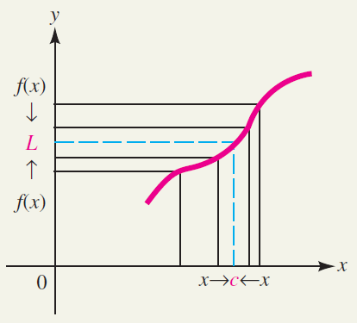
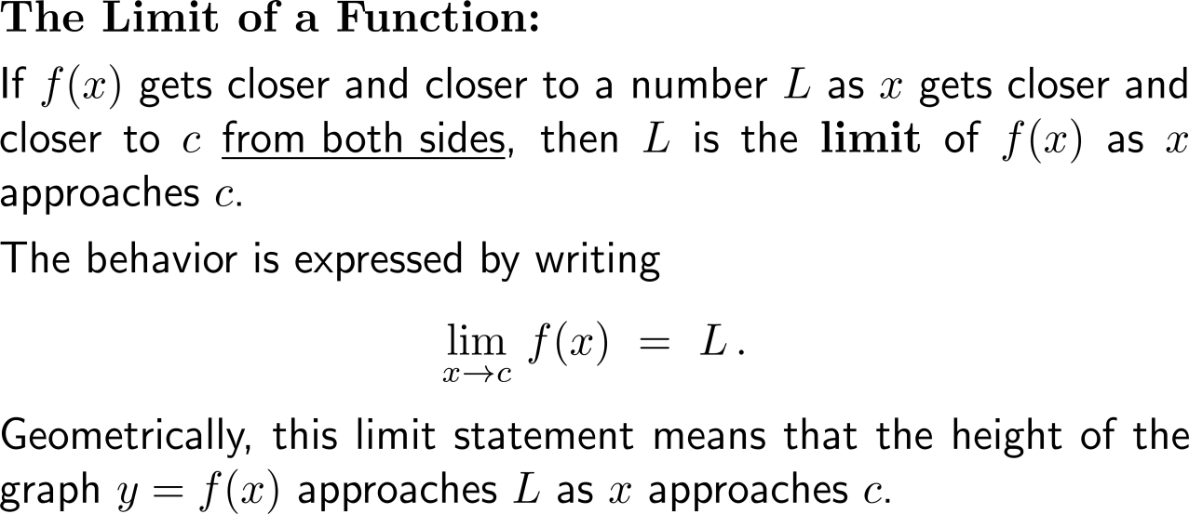
Intuitively speaking, if f(x) gets closer and closer to a number L as x gets closer and closer to c from both sides, then L is the corresponding limit of f

Slide 3
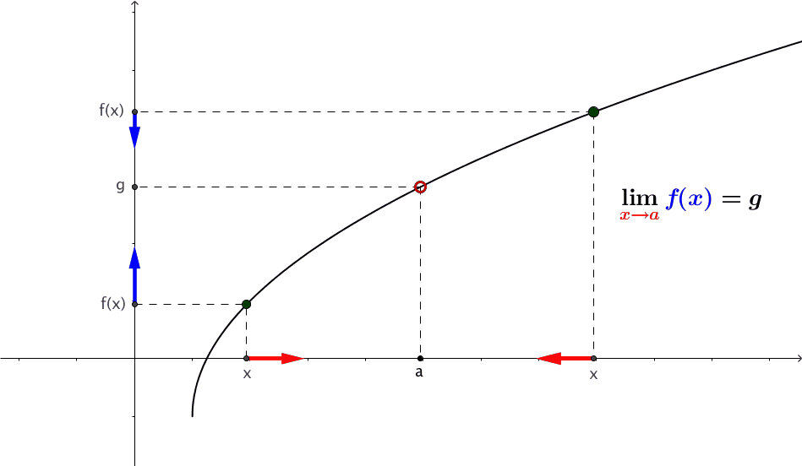
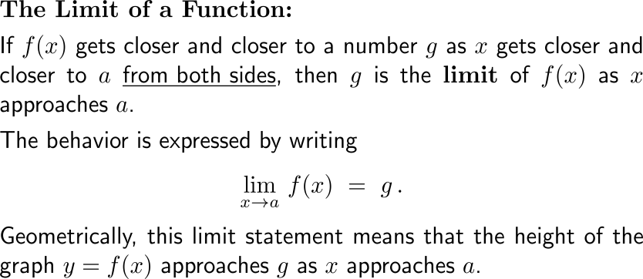
Geometrically, the limit statement means that the height of the graph y = f(x) approaches the limit as x approaches the given x-axis coordinate
https://cnm.pg.edu.pl/mathematics/limits-and-continuity?p_l_id=65013635&p_v_l_s_g_id=0&
animation

Slide 4
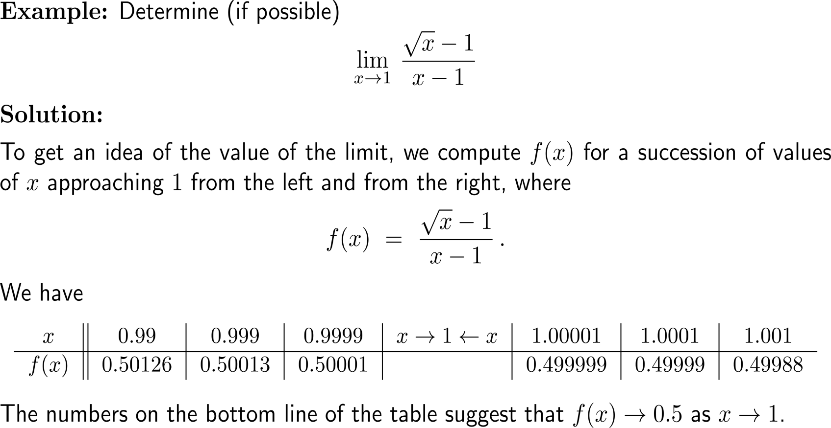
Example: Estimating & computing a limit

Slide 5
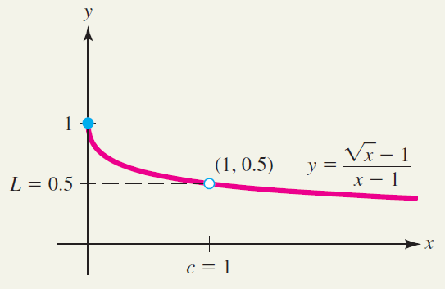
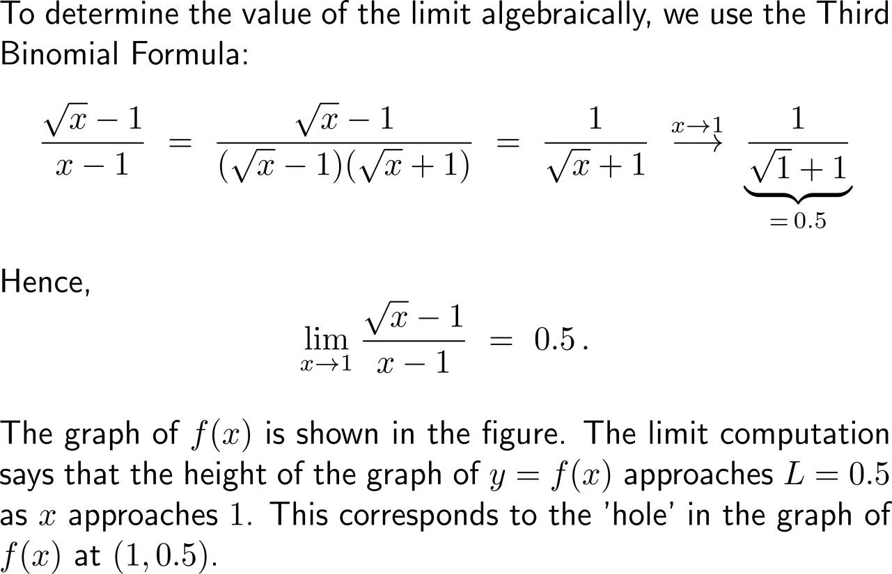
Example: Estimating & computing a limit

Slide 6
Note, limits describe the behavior of a function near a particular point, not necessarily at the point itself

Slide 7
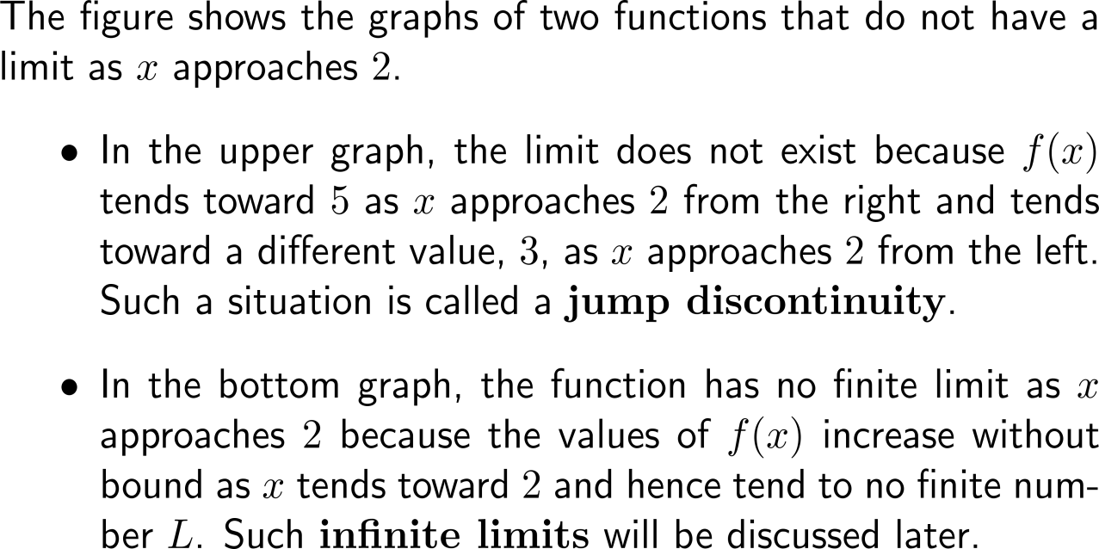
Reasons that limits do not exist are, for instance, that the function has a sudden jump or an infinite limit

Slide 8
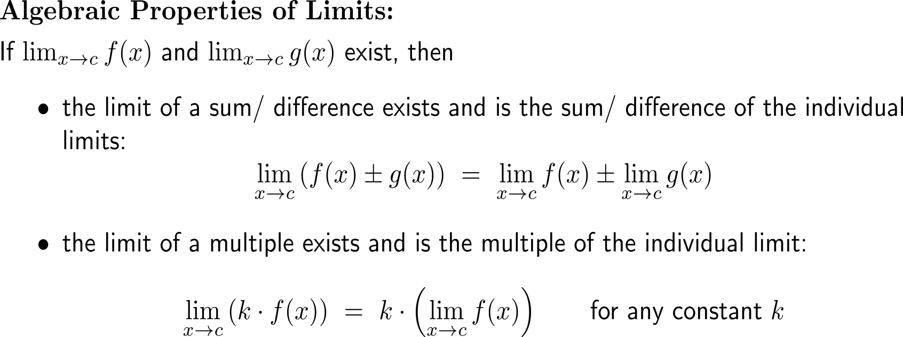
Limits obey certain algebraic rules (1/ 3)

Slide 9
Limits obey certain algebraic rules (2/ 3)

Slide 10
Limits obey certain algebraic rules (3/ 3)

Slide 11
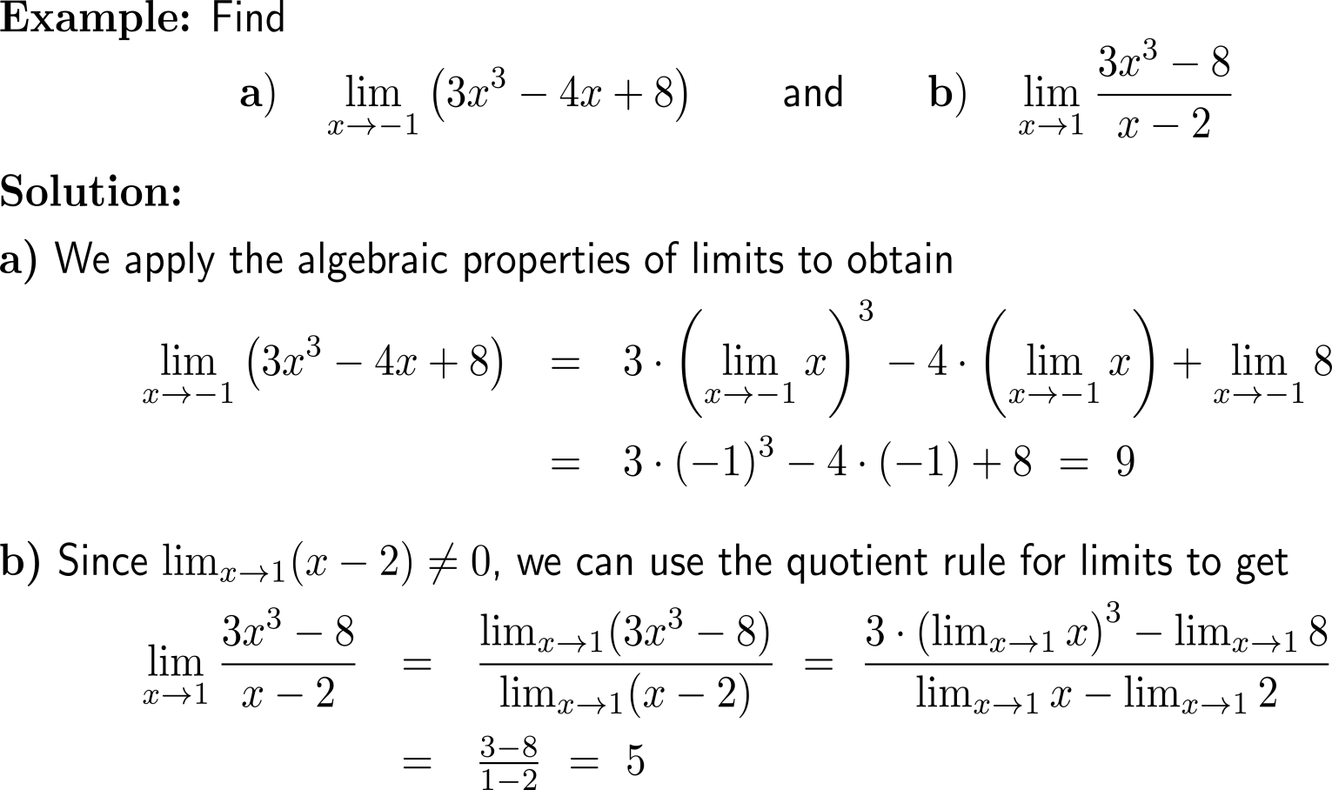
Example: Finding the limit of a polynomial and a rational function

Slide 12
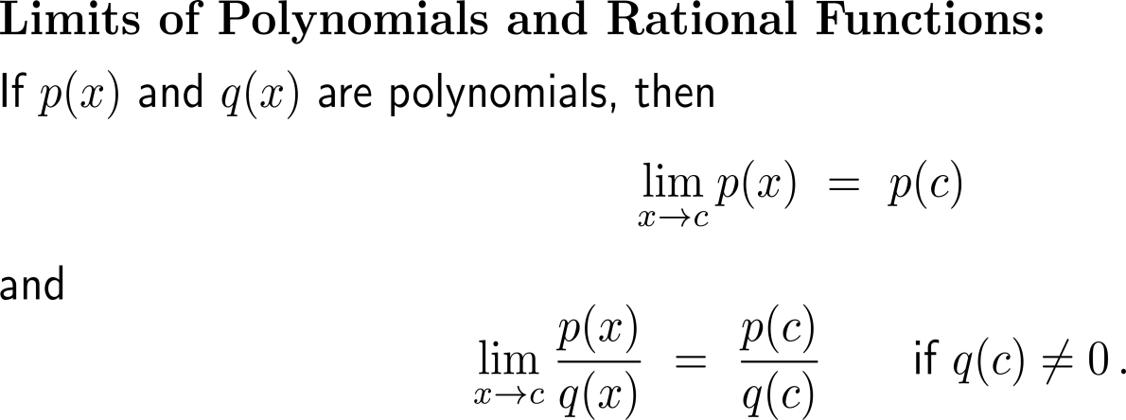
For polynomials and rational functions limits are computed by evaluation (provided the function is defined)

Slide 13
For rational functions there are two special cases: (i) infinite limits and (ii) finite limits that can be obtained by factorization and cancelling

Slide 14
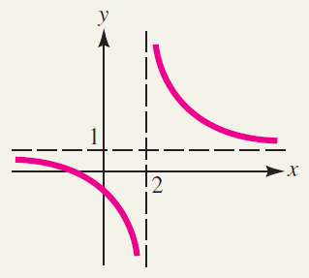
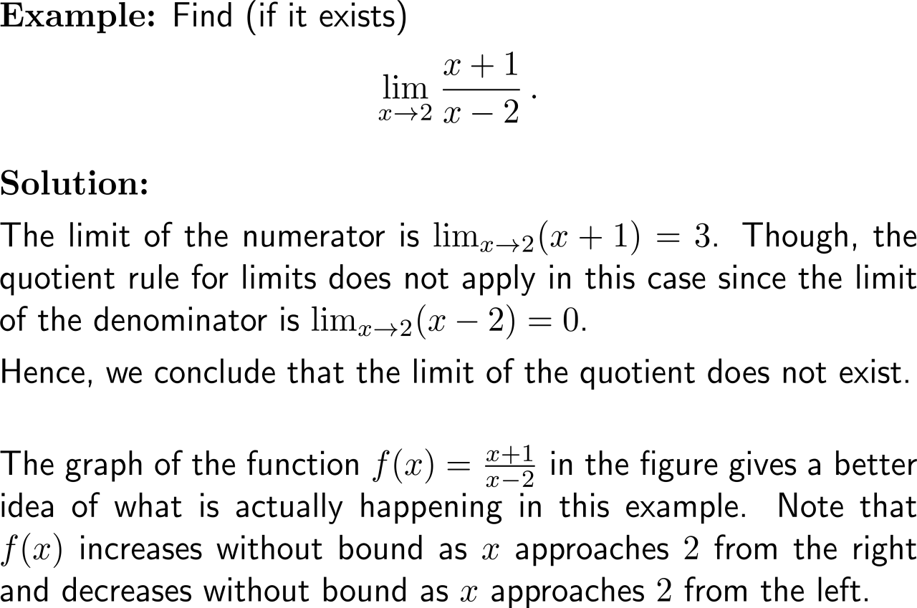
Example: Showing that a limit does not exist

Slide 15
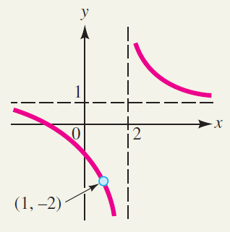
Example: Finding a limit using algebra

Slide 16
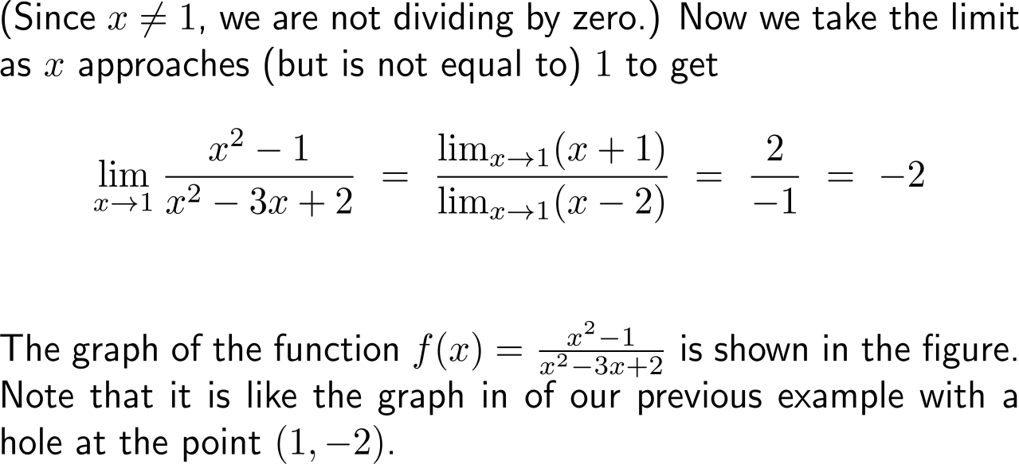
Example: Finding a limit using algebra

Slide 17
Calculus I for Management

