Slide 1
Calculus I for MGMT – Limits & Continuity Limits at Infinity
Mathematics for Management
Supplementary Electronic Materials
Limits & Continuity
Limits
Limits at Infinity
One-Sided Limits
Continuity

Slide 2
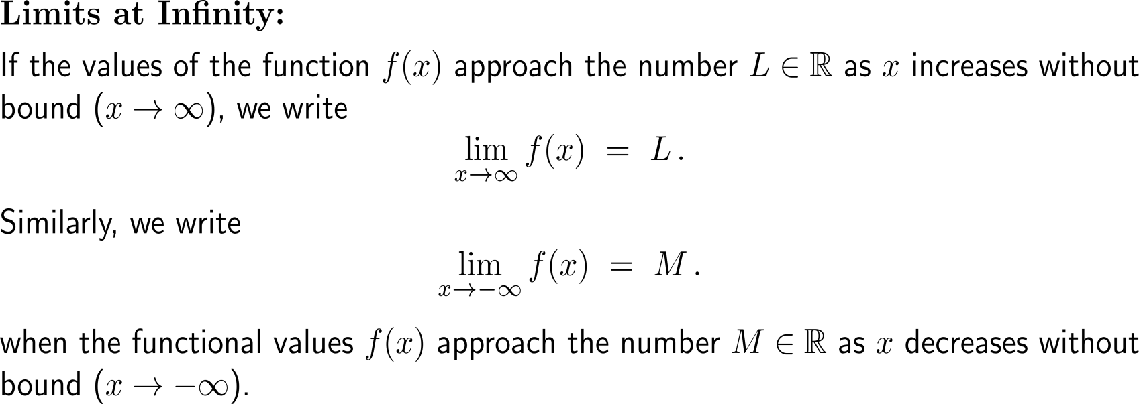
Limits at infinity are limits (i.e. the function takes a number) for x tending towards positive or negative infinity

Slide 3
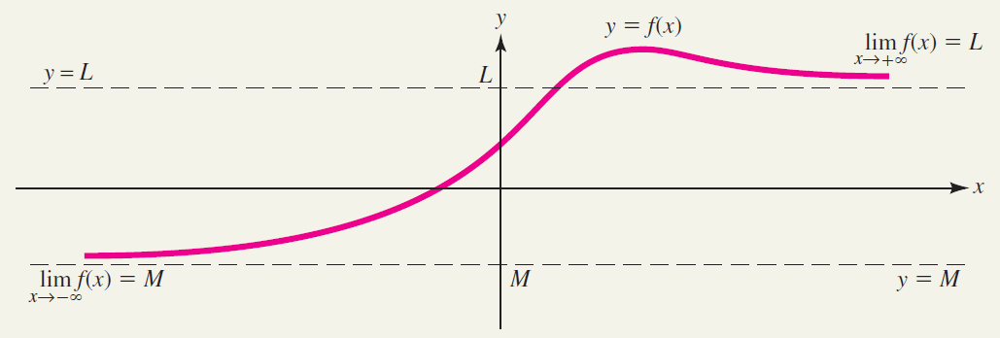
Geometrically, limits at infinity lead to horizontal asymptotes of the corresponding graph (1/ 2)

Slide 4
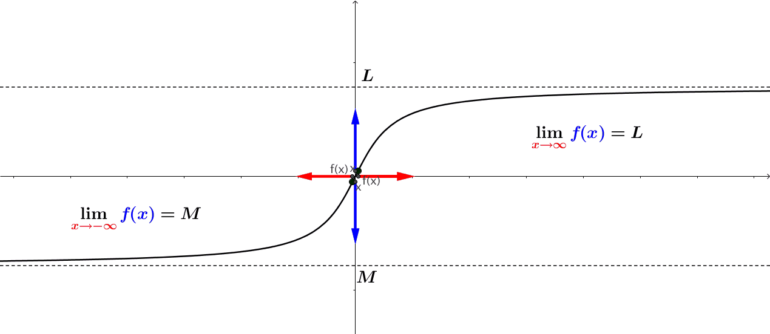
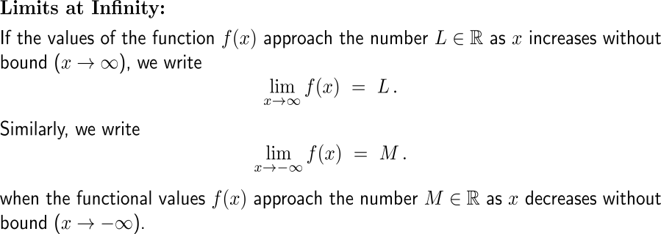
Geometrically, limits at infinity lead to horizontal asymptotes of the corresponding graph (2/ 2)
https://cnm.pg.edu.pl/mathematics/limits-and-continuity?p_l_id=65013635&p_v_l_s_g_id=0&
animation

Slide 5
The limit at (positive and negative) infinity of a reciprocal monomial is zero

Slide 6
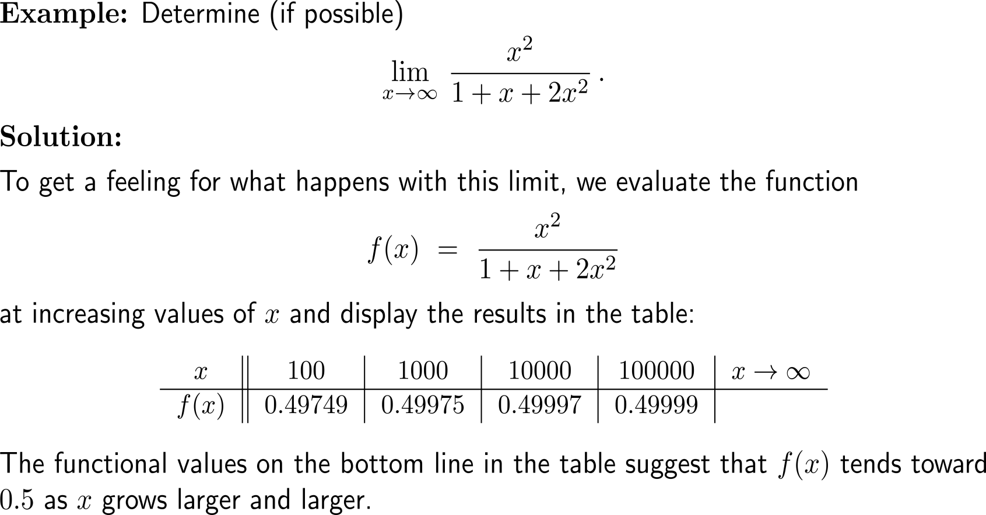
Example: Finding a limit at infinity

Slide 7
Example: Finding a limit at infinity

Slide 8
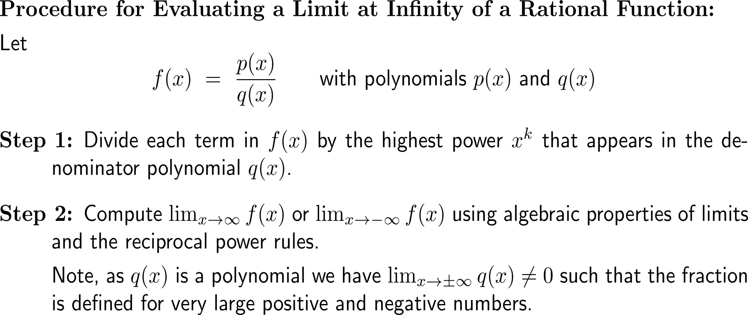
To evaluate a limit at infinity of a rational function we first divide by the highest occurring power and then continue to compute the limit

Slide 9
Example: Finding a limit at infinity

Slide 10
Calculus I for Management

