Slide 1
Calculus I for MGMT – Limits & Continuity One-Sided Limits
Mathematics for Management
Supplementary Electronic Materials
Limits & Continuity
Limits
Limits at Infinity
One-Sided Limits
Continuity

Slide 2
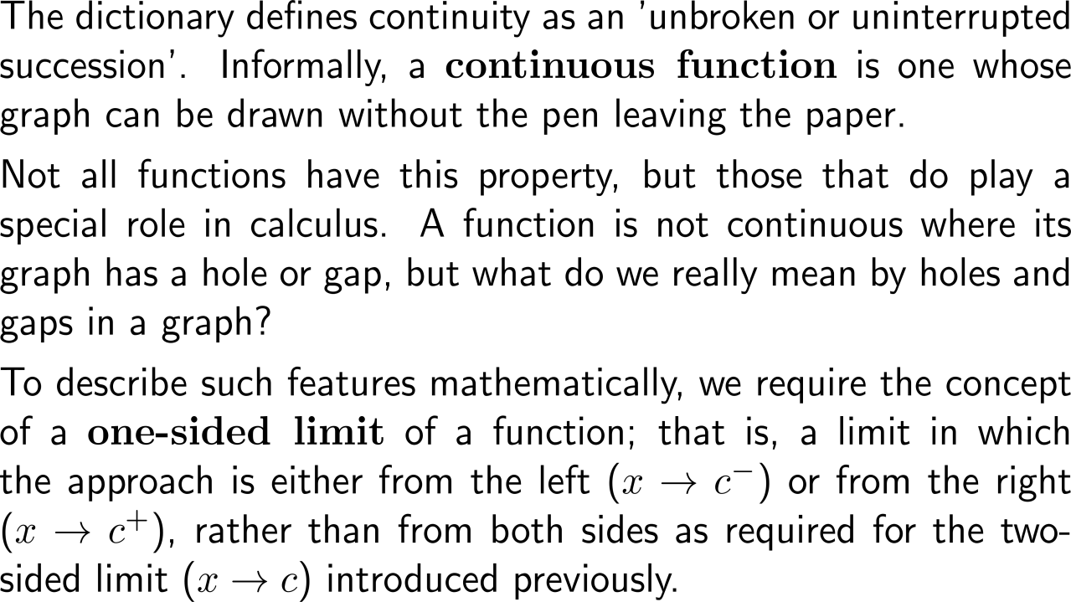
Informally, a continuous function is one whose graph can be drawn without the pen leaving the paper

Slide 3
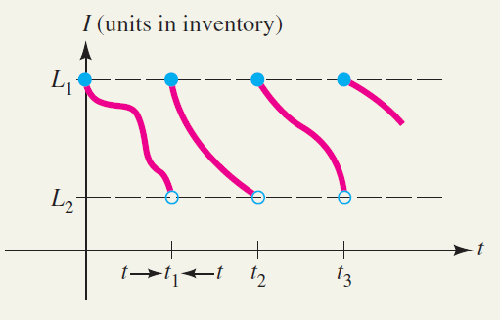
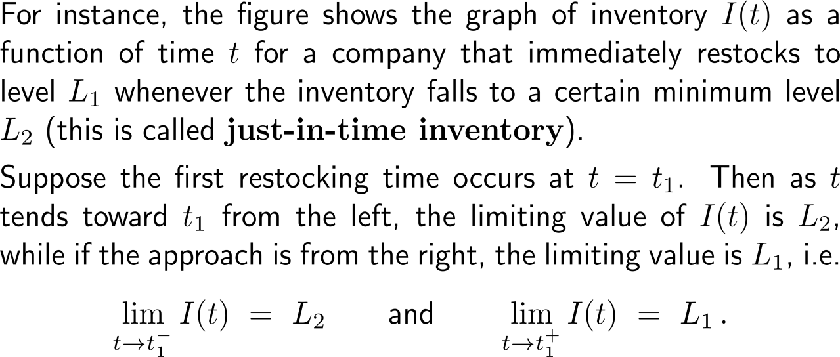
At one-sided limits the limit is evaluated by considering only either a left or right hand approach of x
one-sided limits in a just-in-time inventory example

Slide 4
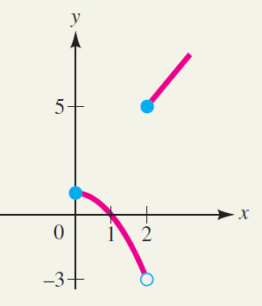
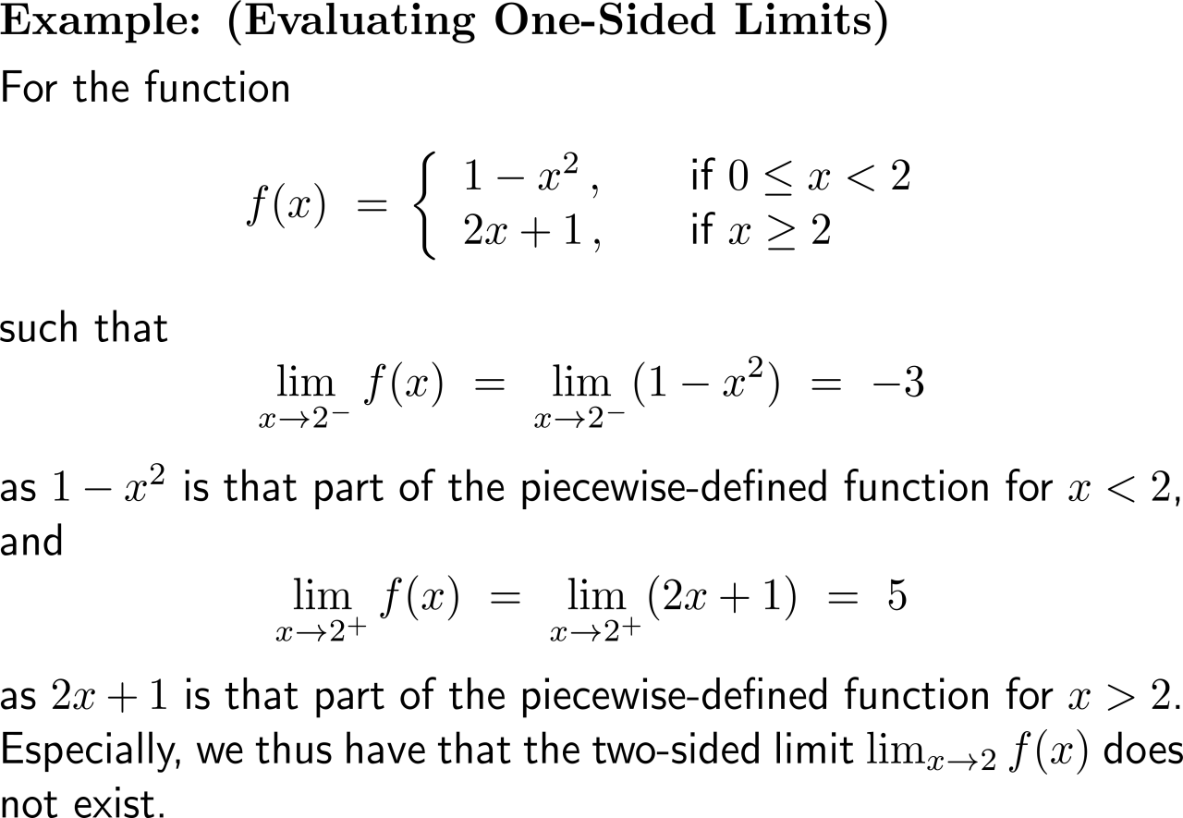
Example: Evaluating One-Sided Limits

Slide 5
The (two-sided) limit exists if and only if the two one-sided limits exist

Slide 6
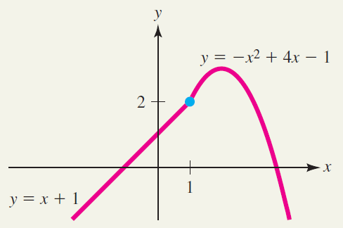
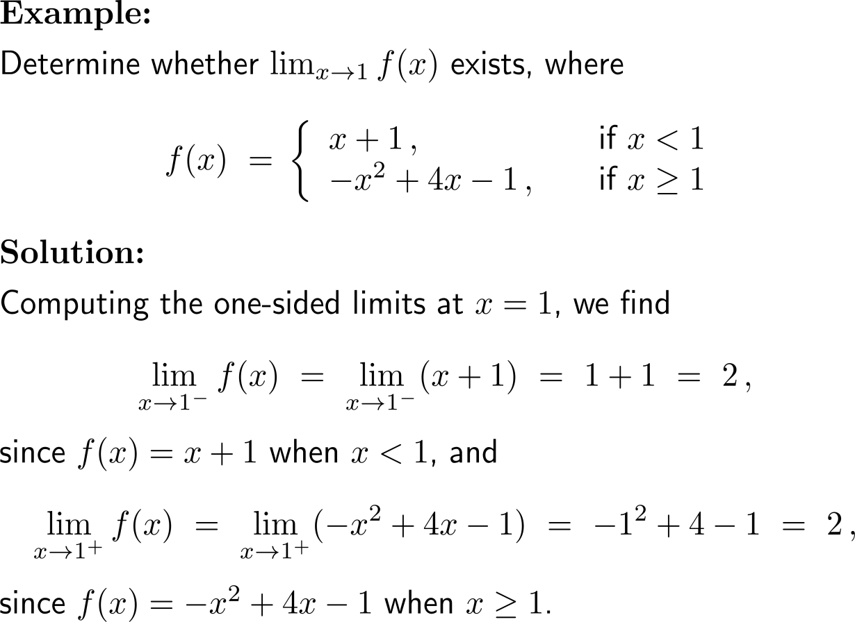
Example: Using one-sided limits to find a two-sided limit

Slide 7
Example: Using one-sided limits to find a two-sided limit

Slide 8
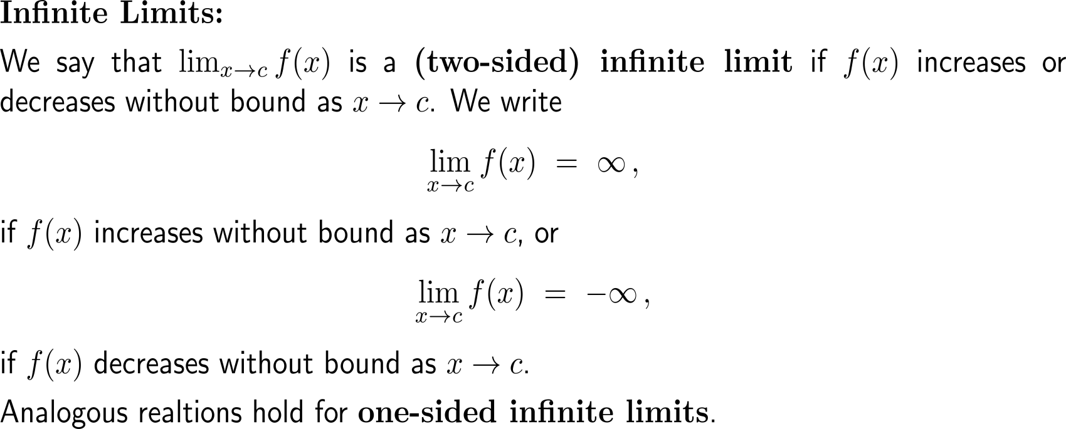
Infinite limits are a special case of limits that do not exist and that induce a vertical asymptote for the corresponding graph

Slide 9
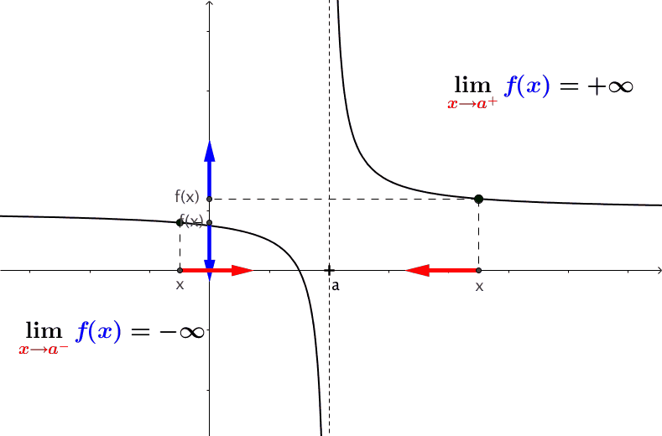
Geometrically, one-sided infinite limits lead to vertical asymptotes of the corresponding graph
https://cnm.pg.edu.pl/mathematics/limits-and-continuity?p_l_id=65013635&p_v_l_s_g_id=0&
animation
Increase and decrease of f(x) for x without bounds at a certain number, geometrically means that the graph of f(x) has a vertical asymptote.
I.e., a two-sided infinite limit or a one-sided infinite limit lead to a vertical asymptote of the corresponding graph.

Slide 10
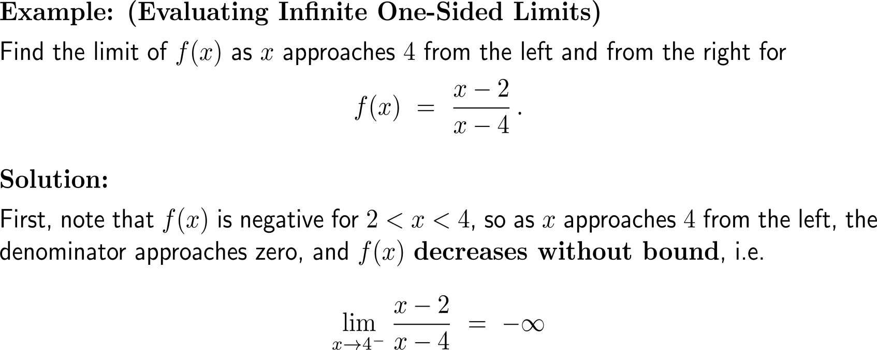
Example: Evaluating infinite one-sided limits

Slide 11
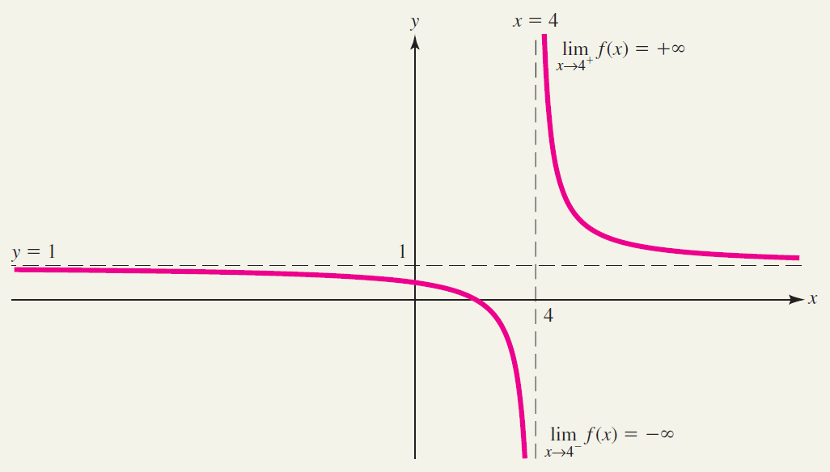
Example: Evaluating infinite one-sided limits

Slide 12
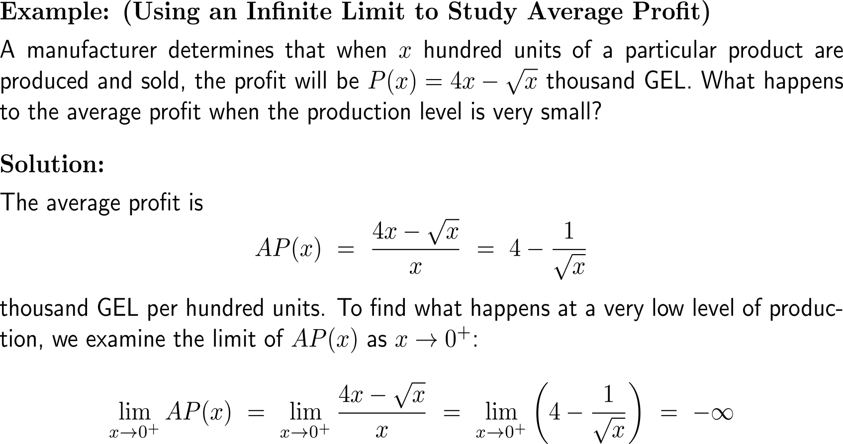
Example: Using an infinite limit to study average profit

Slide 13
Example: Using an infinite limit to study average profit

Slide 14
Calculus I for Management

