Slide 1
Calculus I for MGMT – Limits & Continuity Continuity
Mathematics for Management
Supplementary Electronic Materials
Limits & Continuity
Limits
Limits at Infinity
One-Sided Limits
Continuity

Slide 2
Continuous vs. non-continuous: Three ways the graph of a function can have a hole at x = c

Slide 3
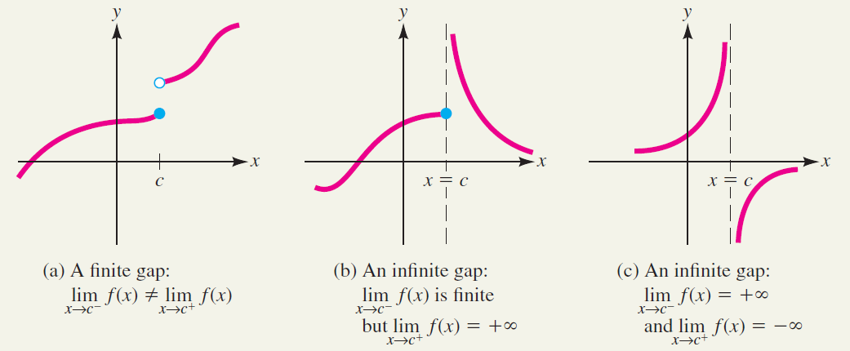
Continuous vs. non-continuous: Three ways for the graph of a function to have a gap at x = c

Slide 4
A function is continuous at a point if it is defined there and the (two-sided) limit at the point equals the functional value there

Slide 5
Polynomials and rational functions are continuous wherever they are defined

Slide 6
Typical functions that you already know from school-days are continuous

Slide 7
Example: Deciding if a function is continuous

Slide 8
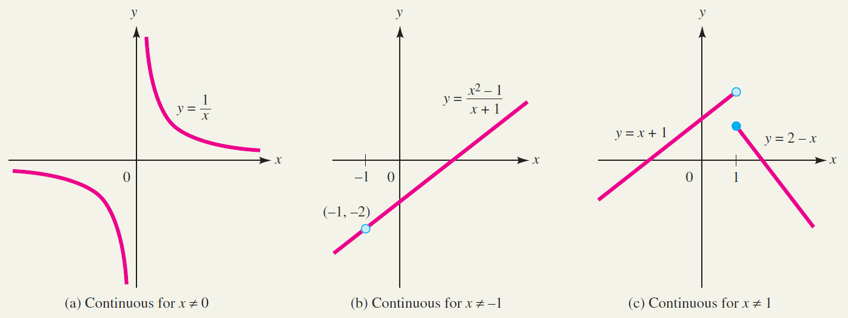
Example: Deciding if a function is continuous
a)
b)
c)

Slide 9
Example: Making a piecewise-defined function continuous

Slide 10
Moreover, a continuous function of a continuous function is a continuous function

Slide 11
A function is continuous on an open (closed) interval if it is continuous at all its points (and the one-sided limits exist at the boundary points)

Slide 12
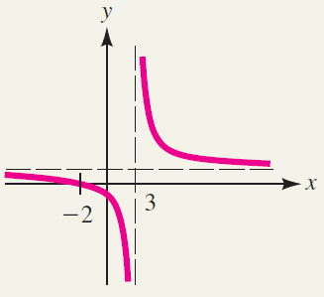
Example: Deciding where a function is continuous

Slide 13
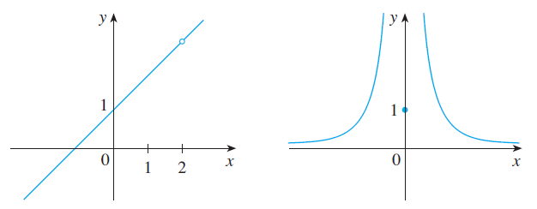
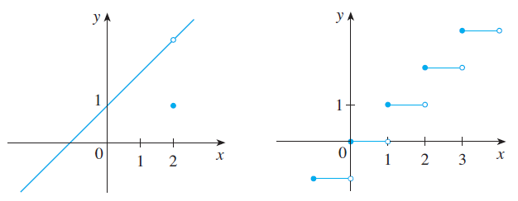
Altogether, we have three types of discontinuities: (i) removable discontinuities, (ii) infinite discontinuities, and (iii) jump discontinuities
removable discontinuity
infinite discontinuity
At these removable discontinuities, we can remove the discontinuity at x = 2 by redefining f at just the single number 2.
The “new” function (continuous extension)
g(x) = x + 1
is continuous at x = 2.
At an infinite discontinuity we have an infinite limit.
jump discontinuity
At a jump discontinuity the function “jumps” from one value to another.

Slide 14
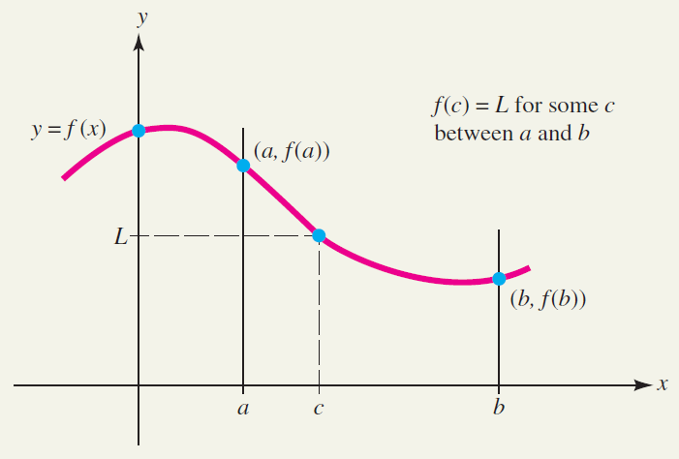
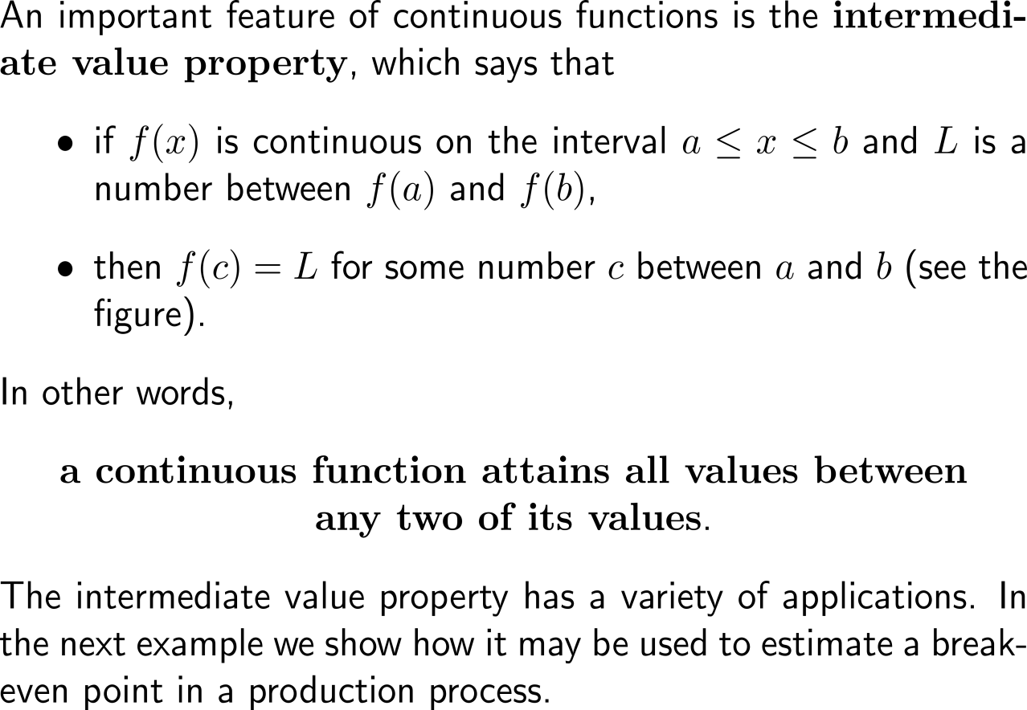
The intermediate value property (IVP) states that a continuous function attains all values between any two of its values
The intermediate value property

Slide 15
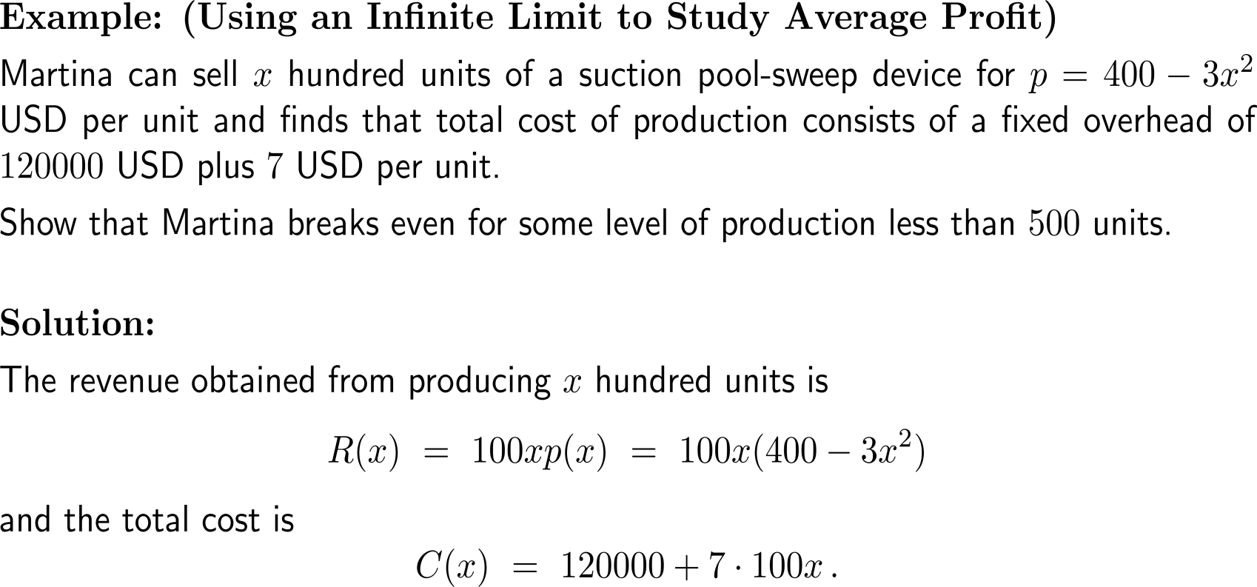
Example: Break-even analysis using an intermediate value

Slide 16
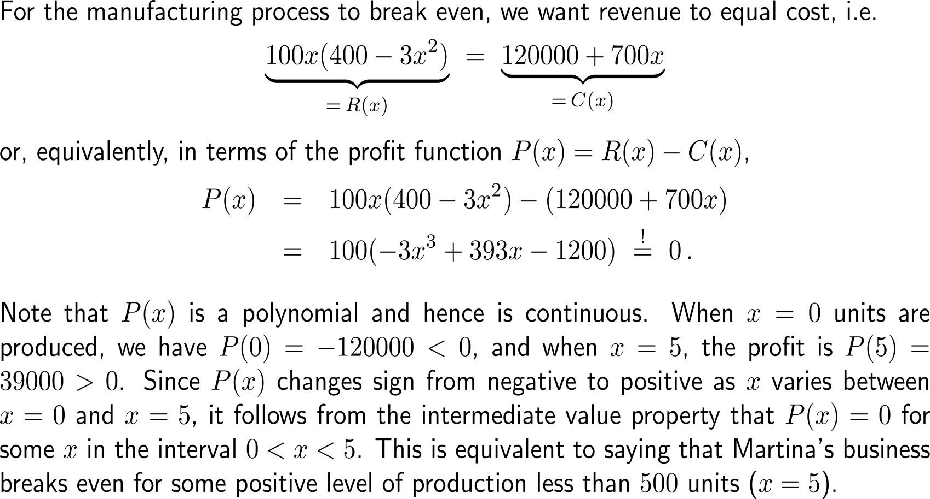
Example: Break-even analysis using an intermediate value
break even
P(5) > 0
P(0) < 0

Slide 17
Calculus I for Management

