Slide 1
Calculus I for Management
Limits & Continuity
week 3
Lecture
Intuitive discussion of:
Limits
Limits at infinity
One-sided limits
Continuity

Slide 2
Topics
Limits
Limits at Infinity
One-Sided Limits
Continuity

Slide 3
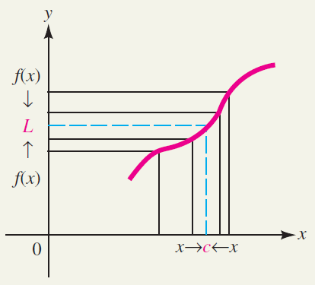
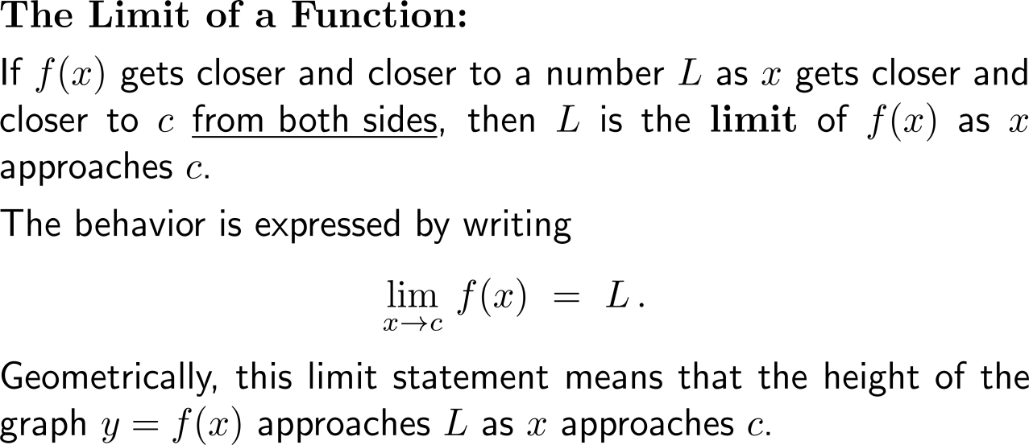
Intuitively speaking, if f(x) gets closer and closer to a number L as x gets closer and closer to c from both sides, then L is the corresponding limit of f

Slide 4
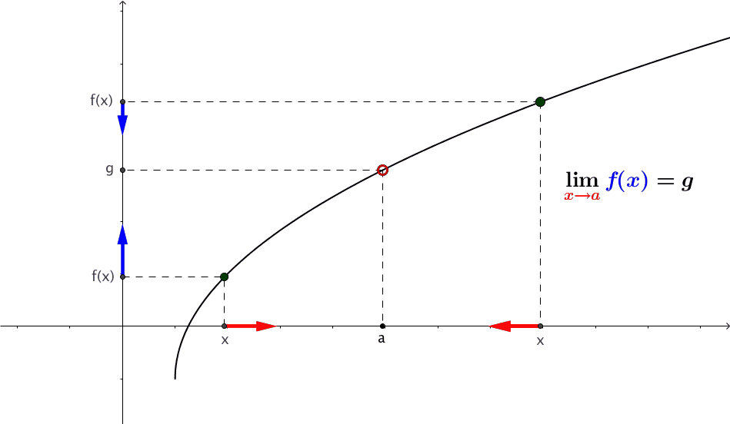
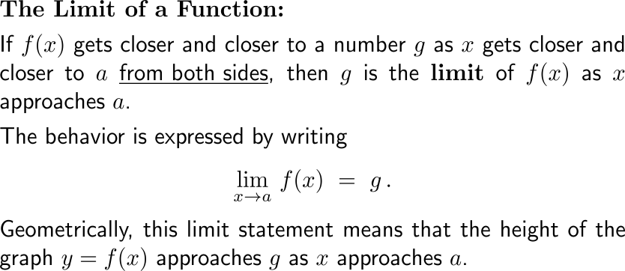
Geometrically, the limit statement means that the height of the graph y = f(x) approaches the limit as x approaches the given x-axis coordinate
https://cnm.pg.edu.pl/mathematics/limits-and-continuity?p_l_id=65013635&p_v_l_s_g_id=0&
animation

Slide 5
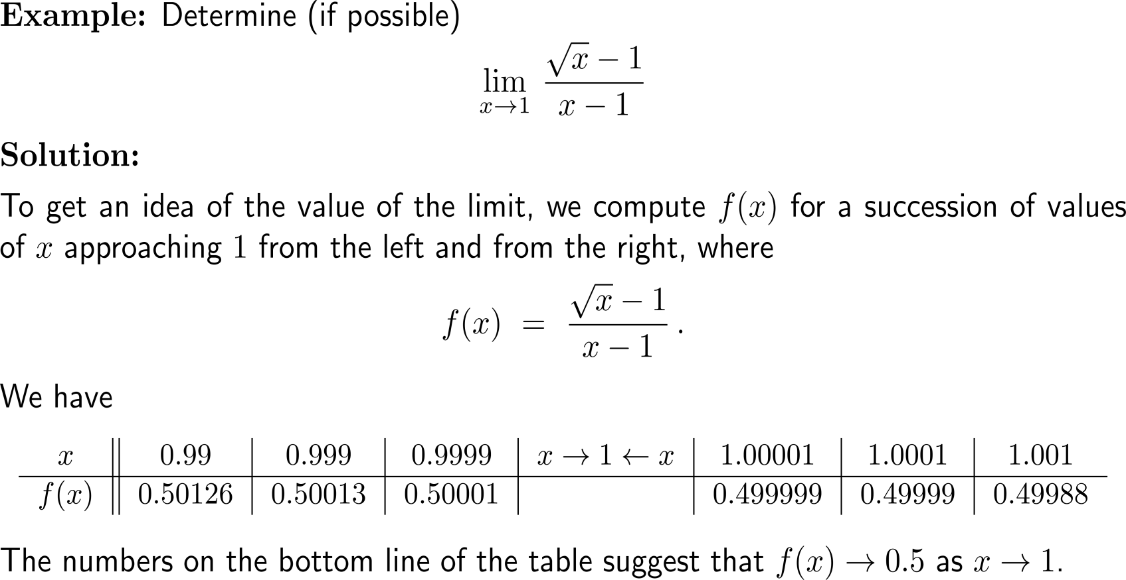
Example: Estimating & computing a limit

Slide 6
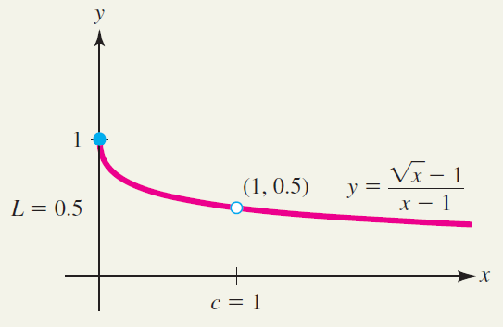
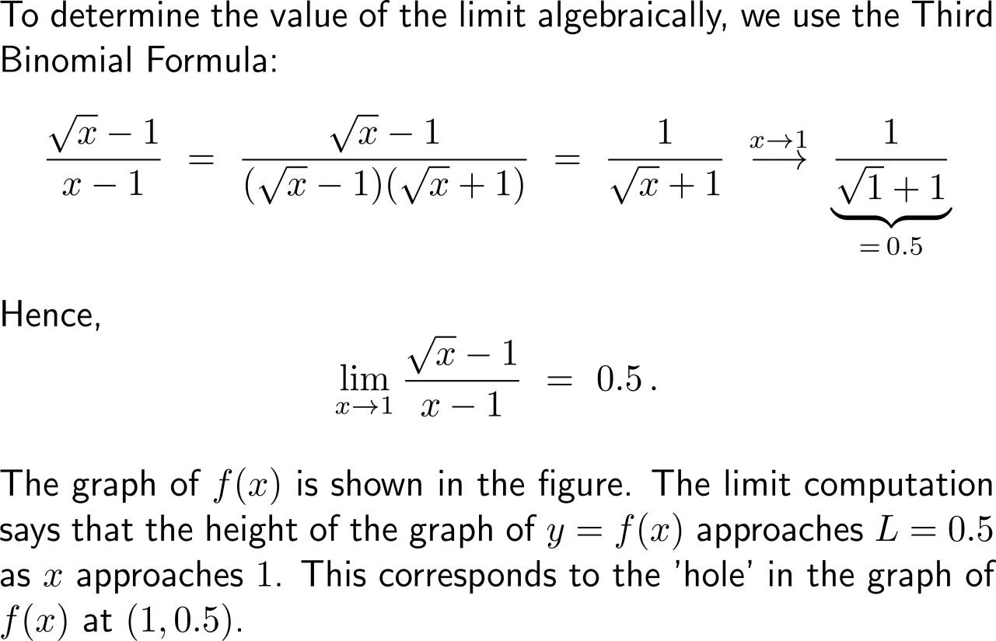
Example: Estimating & computing a limit

Slide 7
Note, limits describe the behavior of a function near a particular point, not necessarily at the point itself

Slide 8
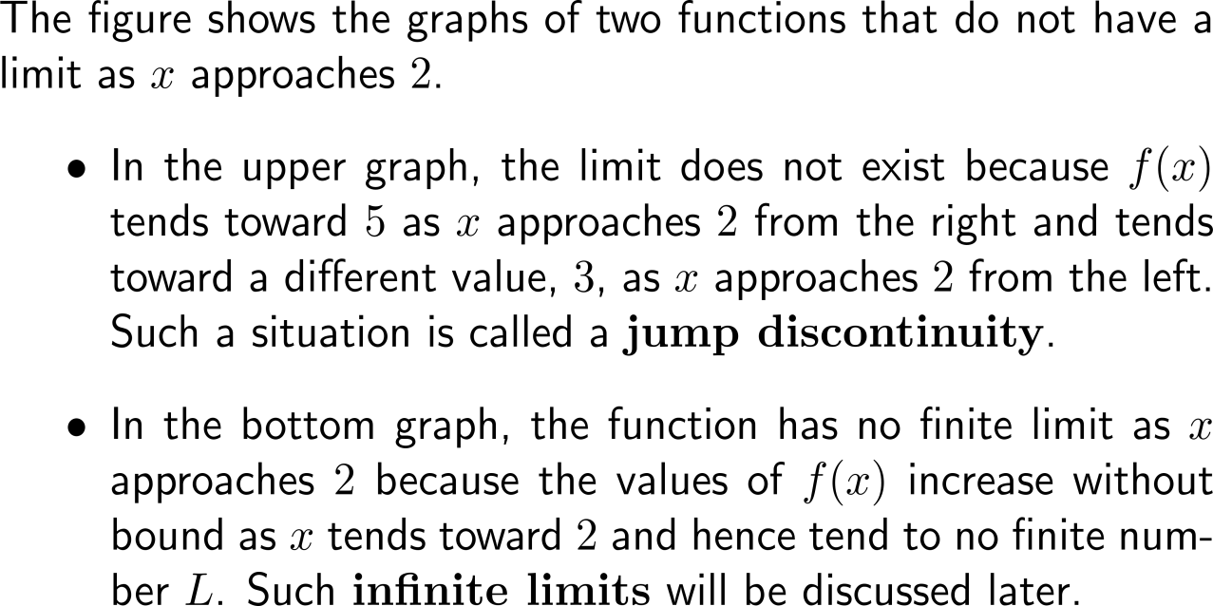
Reasons that limits do not exist are, for instance, that the function has a sudden jump or an infinite limit

Slide 9
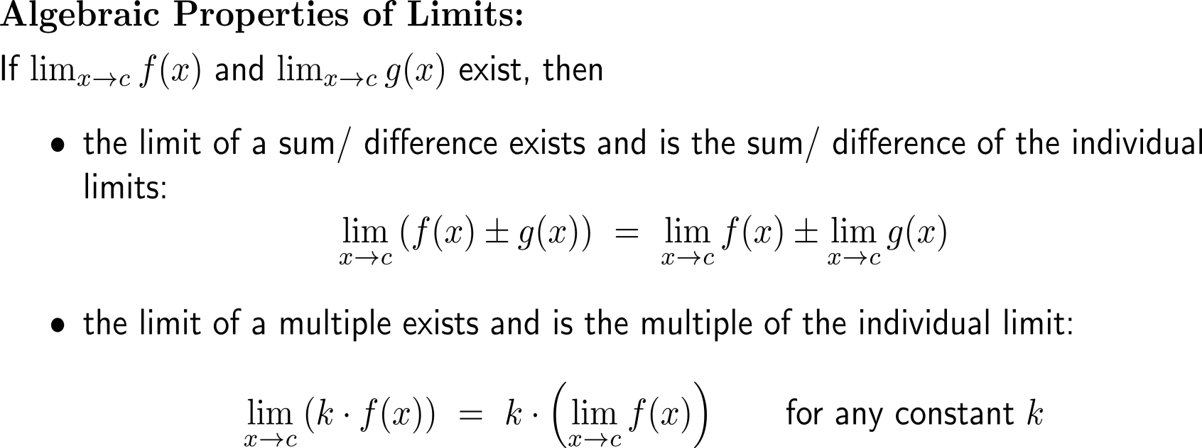
Limits obey certain algebraic rules (1/ 3)

Slide 10
Limits obey certain algebraic rules (2/ 3)

Slide 11
Limits obey certain algebraic rules (3/ 3)

Slide 12
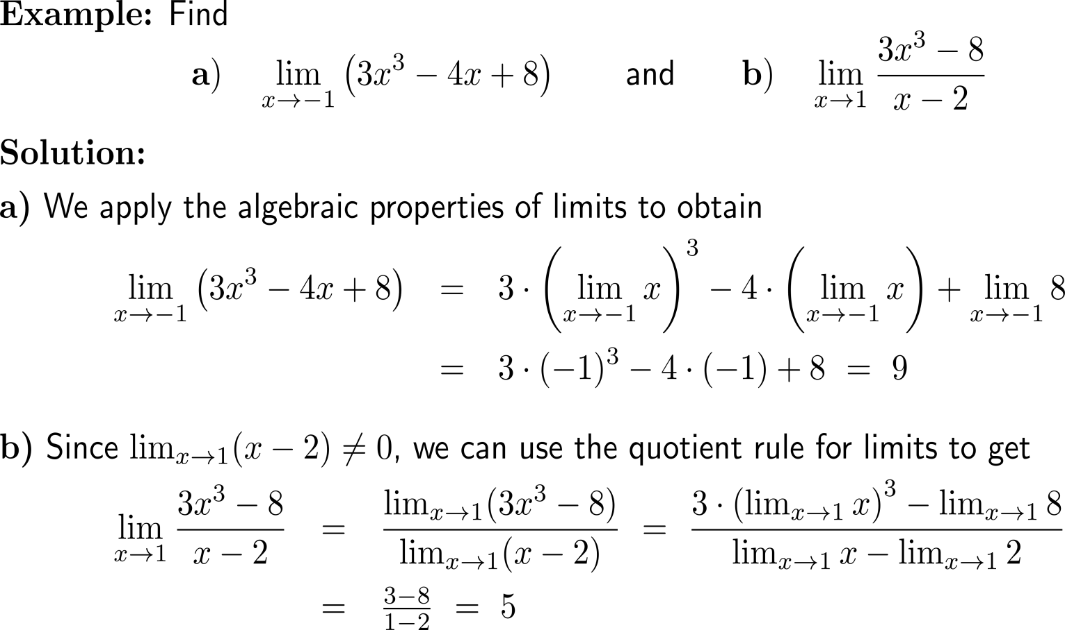
Example: Finding the limit of a polynomial and a rational function

Slide 13
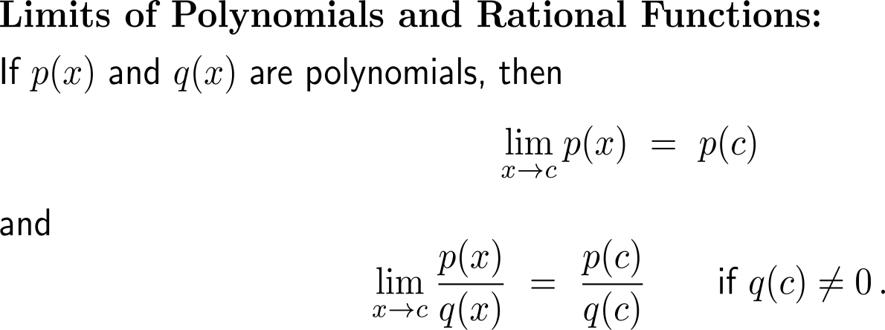
For polynomials and rational functions limits are computed by evaluation (provided the function is defined)

Slide 14
For rational functions there are two special cases: (i) infinite limits and (ii) finite limits that can be obtained by factorization and cancelling

Slide 15
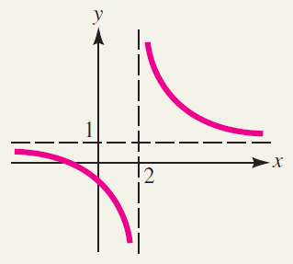
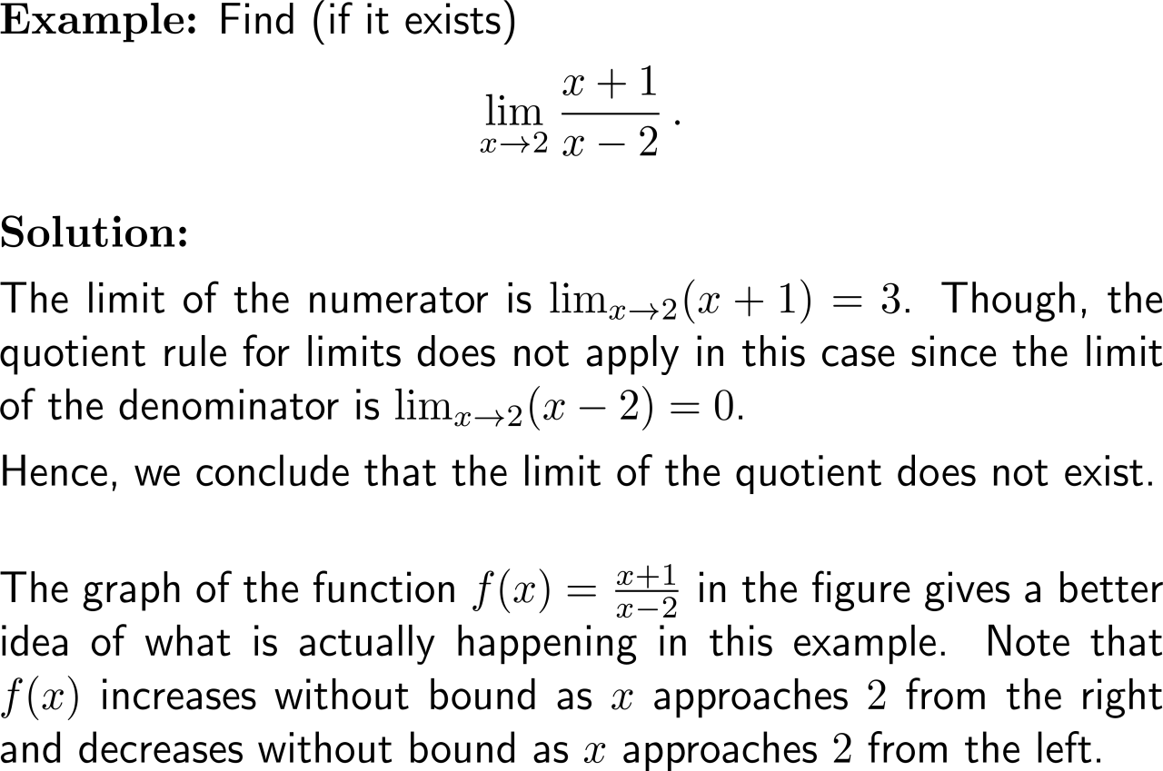
Example: Showing that a limit does not exist

Slide 16
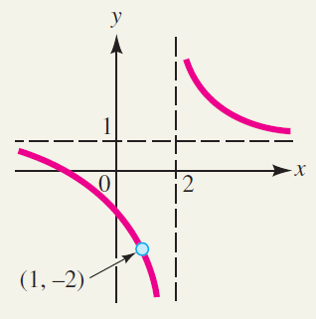
Example: Finding a limit using algebra

Slide 17
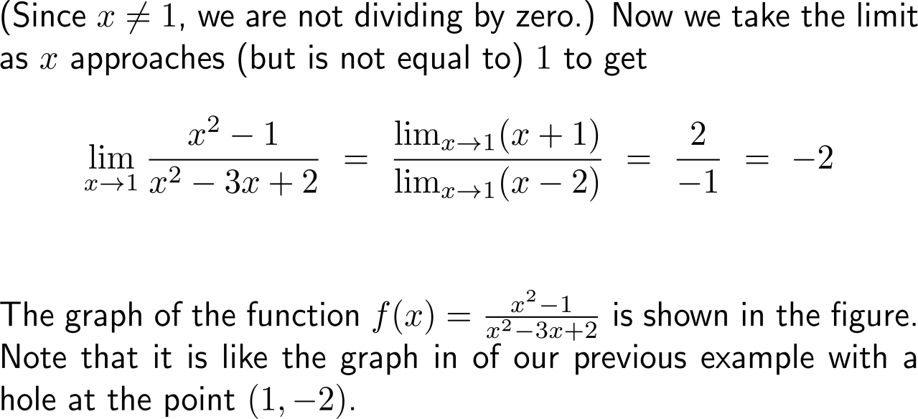
Example: Finding a limit using algebra

Slide 18
Topics
Limits
Limits at Infinity
One-Sided Limits
Continuity
What happens
for x → -∞ ?
What happens
x → ∞ ?

Slide 19
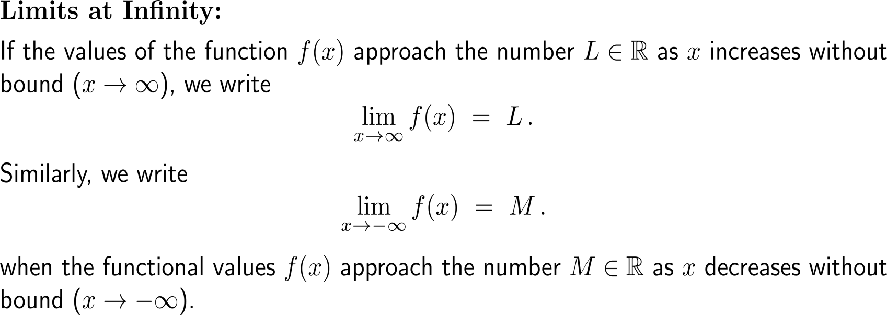
Limits at infinity are limits (i.e. the function takes a number) for x tending towards positive or negative infinity

Slide 20
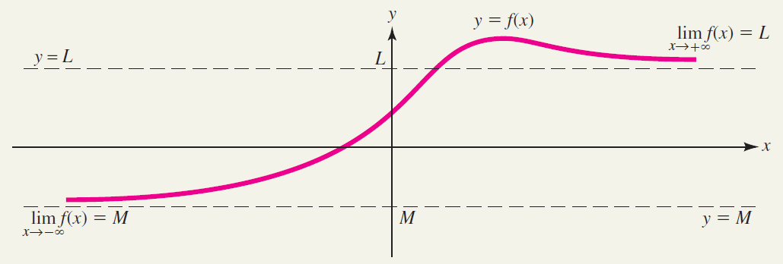
Geometrically, limits at infinity lead to horizontal asymptotes of the corresponding graph (1/ 2)

Slide 21
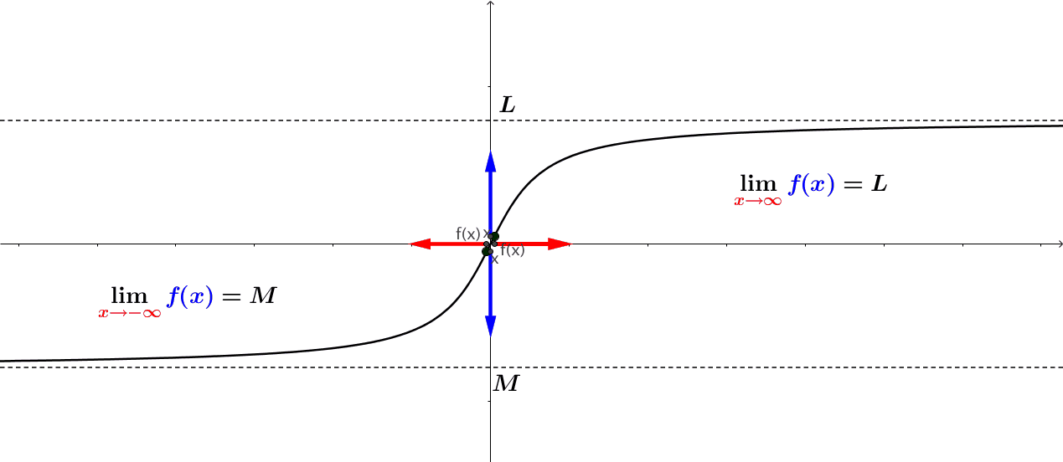
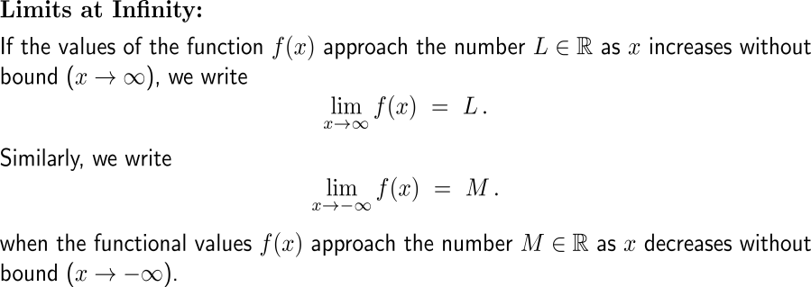
Geometrically, limits at infinity lead to horizontal asymptotes of the corresponding graph (2/ 2)
https://cnm.pg.edu.pl/mathematics/limits-and-continuity?p_l_id=65013635&p_v_l_s_g_id=0&
animation

Slide 22
The limit at (positive and negative) infinity of a reciprocal monomial is zero

Slide 23
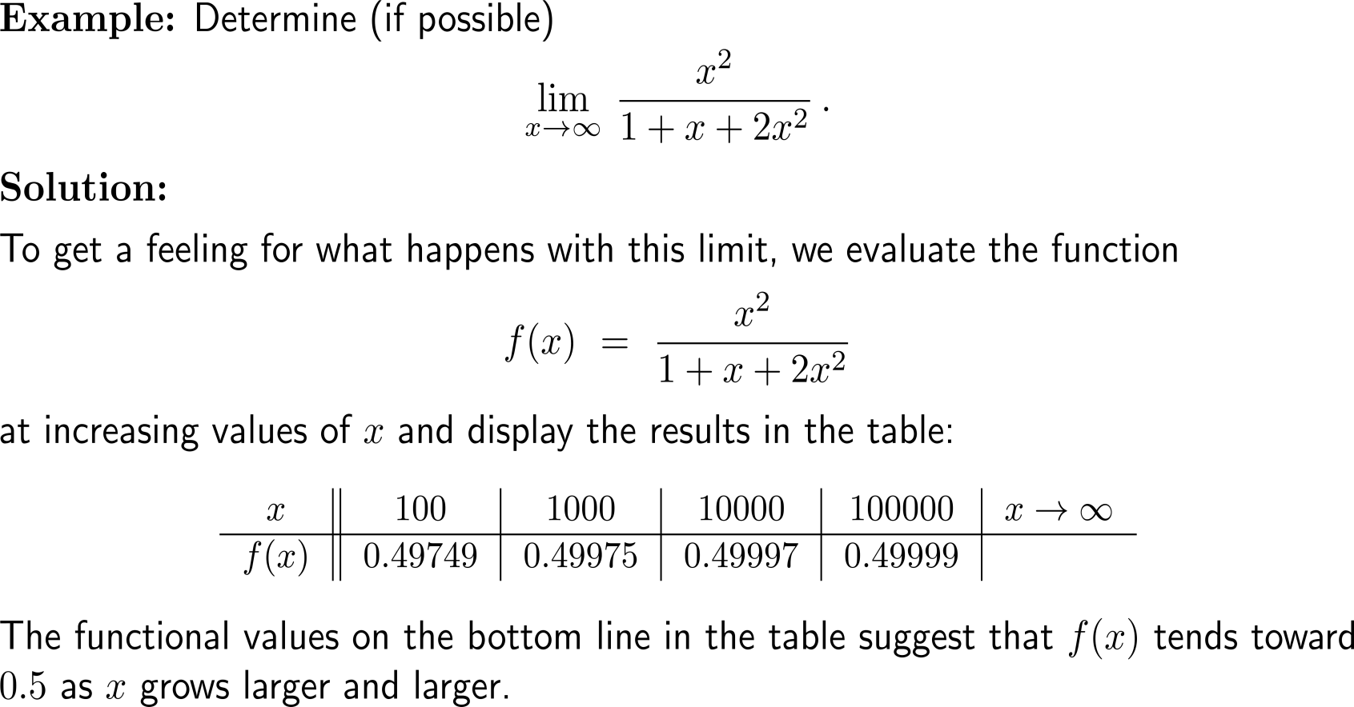
Example: Finding a limit at infinity

Slide 24
Example: Finding a limit at infinity

Slide 25
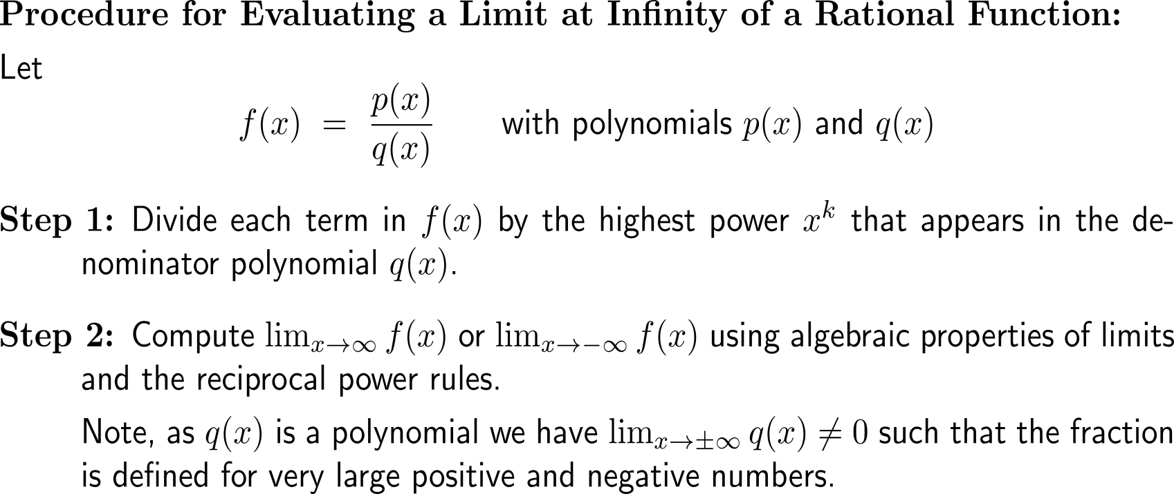
To evaluate a limit at infinity of a rational function we first divide by the highest occurring power and then continue to compute the limit

Slide 26
Example: Finding a limit at infinity

Slide 27
Topics
Limits
Limits at Infinity
One-Sided Limits
Continuity

Slide 28
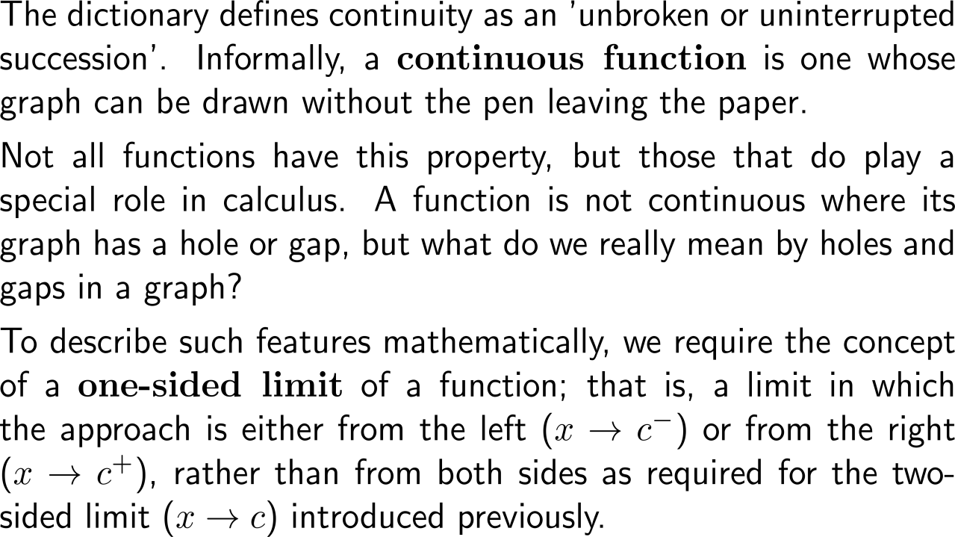
Informally, a continuous function is one whose graph can be drawn without the pen leaving the paper

Slide 29
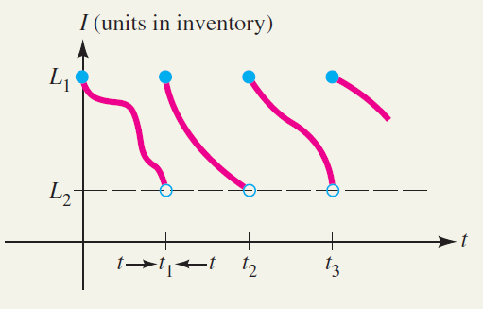
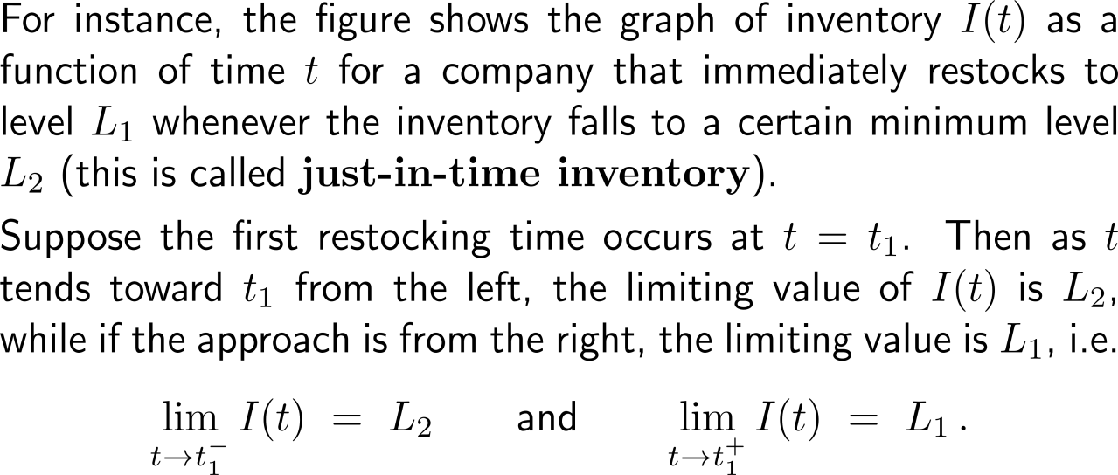
At one-sided limits the limit is evaluated by considering only either a left or right hand approach of x
one-sided limits in a just-in-time inventory example

Slide 30
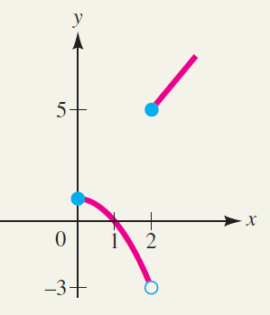
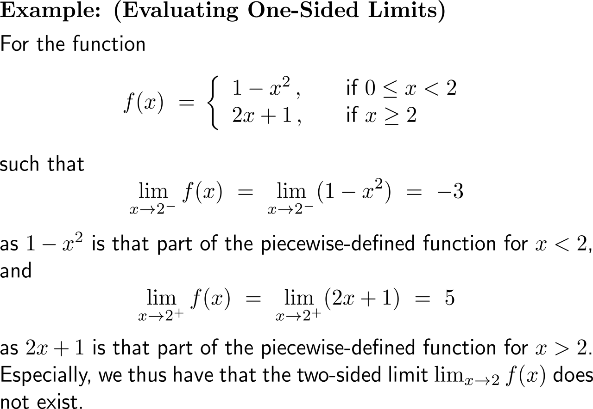
Example: Evaluating One-Sided Limits

Slide 31
The (two-sided) limit exists if and only if the two one-sided limits exist

Slide 32
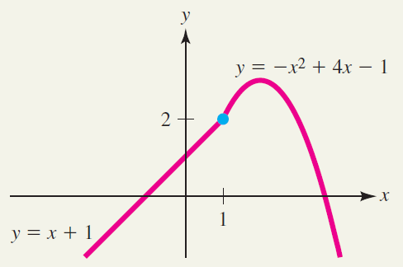
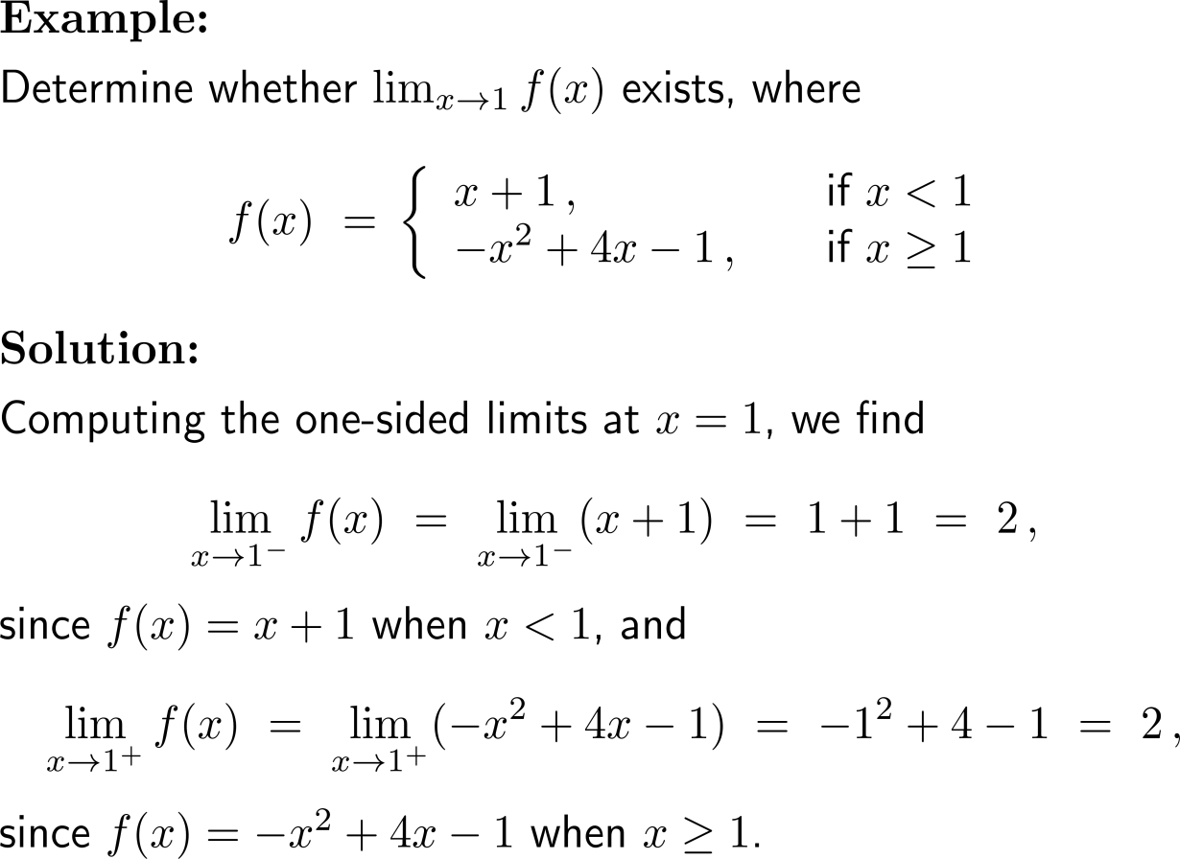
Example: Using one-sided limits to find a two-sided limit

Slide 33
Example: Using one-sided limits to find a two-sided limit

Slide 34
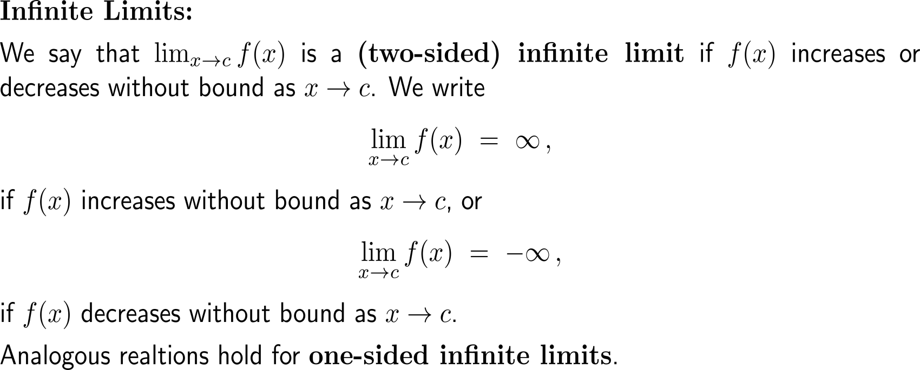
Infinite limits are a special case of limits that do not exist and that induce a vertical asymptote for the corresponding graph

Slide 35
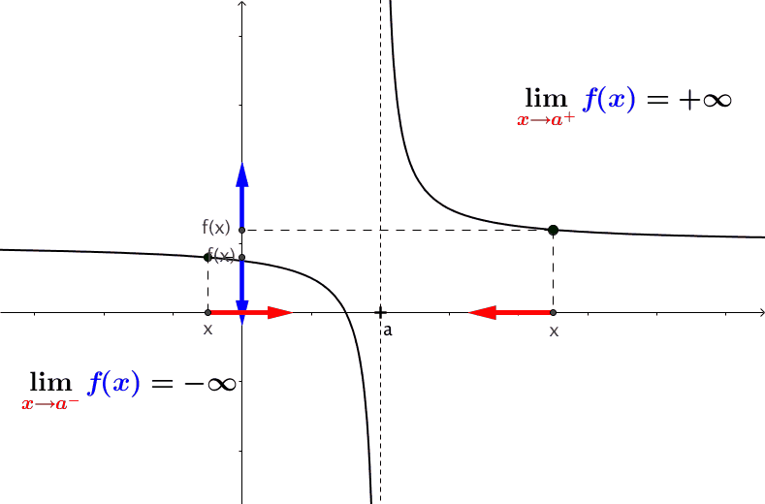
Geometrically, one-sided infinite limits lead to vertical asymptotes of the corresponding graph
https://cnm.pg.edu.pl/mathematics/limits-and-continuity?p_l_id=65013635&p_v_l_s_g_id=0&
animation
Increase and decrease of f(x) for x without bounds at a certain number, geometrically means that the graph of f(x) has a vertical asymptote.
I.e., a two-sided infinite limit or a one-sided infinite limit lead to a vertical asymptote of the corresponding graph.

Slide 36
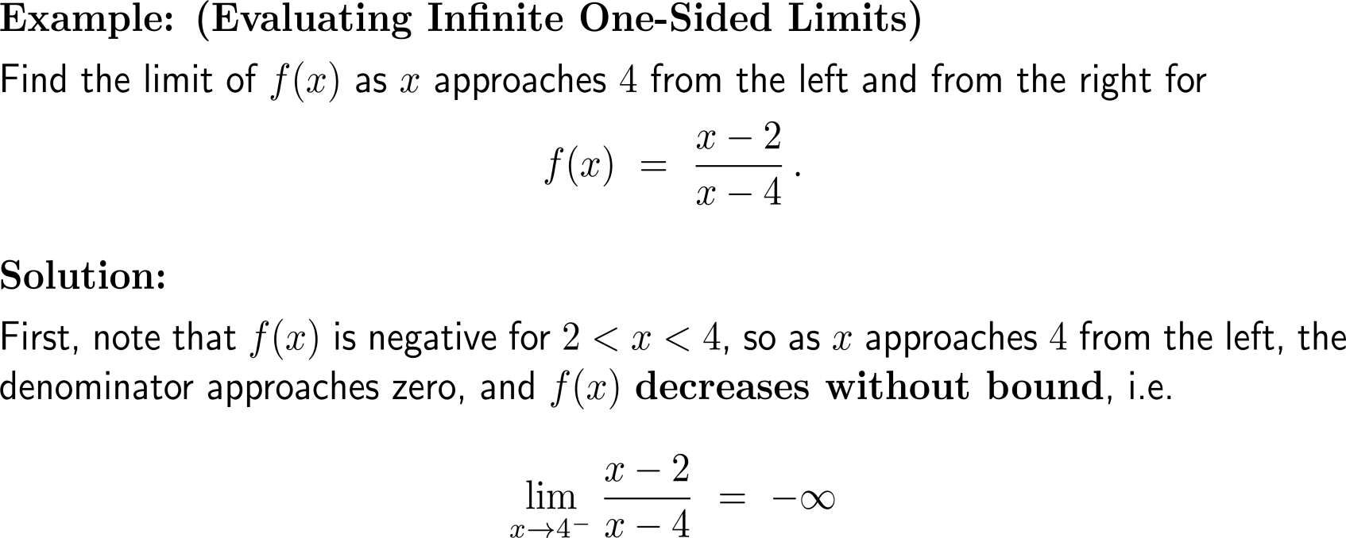
Example: Evaluating infinite one-sided limits

Slide 37
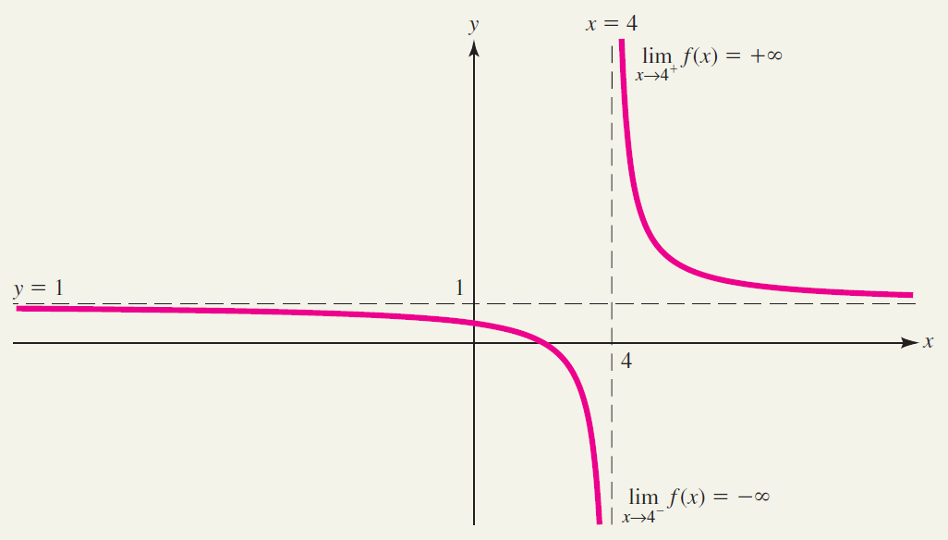
Example: Evaluating infinite one-sided limits

Slide 38
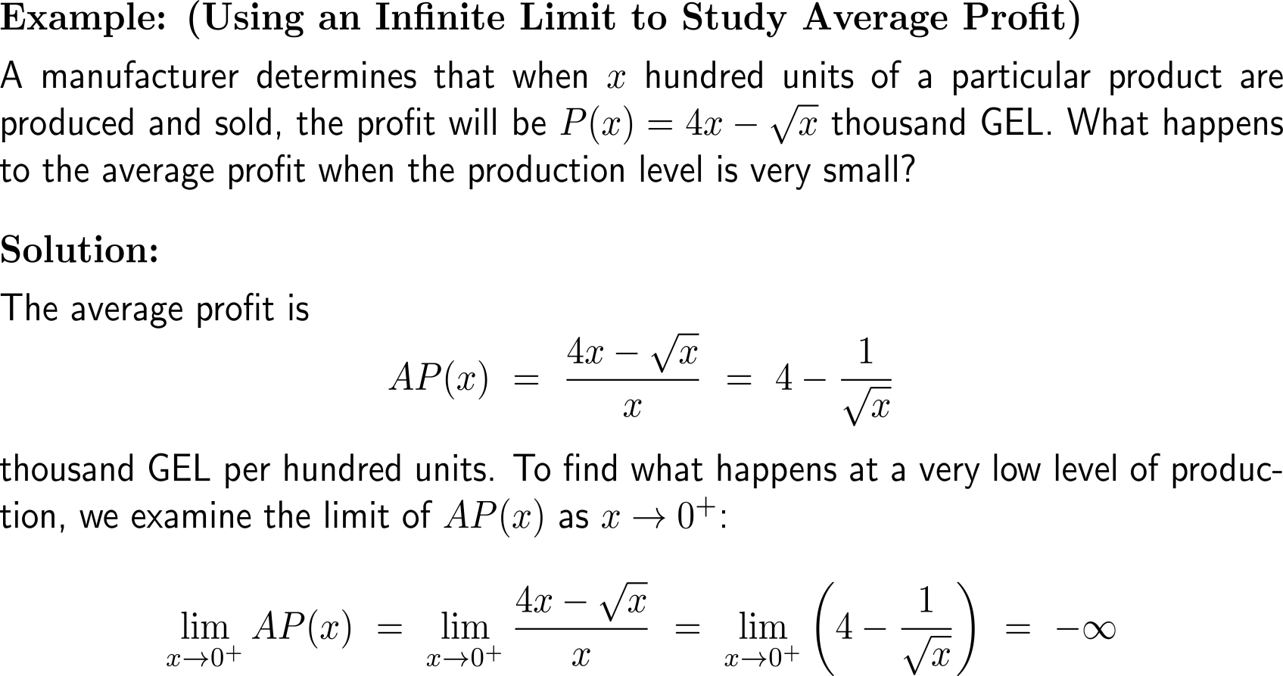
Example: Using an infinite limit to study average profit

Slide 39
Example: Using an infinite limit to study average profit

Slide 40
Topics
Limits
Limits at Infinity
One-Sided Limits
Continuity

Slide 41
Continuous vs. non-continuous: Three ways the graph of a function can have a hole at x = c

Slide 42
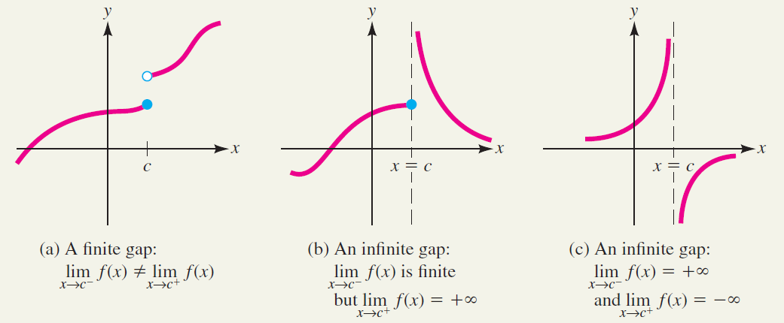
Continuous vs. non-continuous: Three ways for the graph of a function to have a gap at x = c

Slide 43
A function is continuous at a point if it is defined there and the (two-sided) limit at the point equals the functional value there

Slide 44
Polynomials and rational functions are continuous wherever they are defined

Slide 45
Typical functions that you already know from school-days are continuous

Slide 46
Example: Deciding if a function is continuous

Slide 47
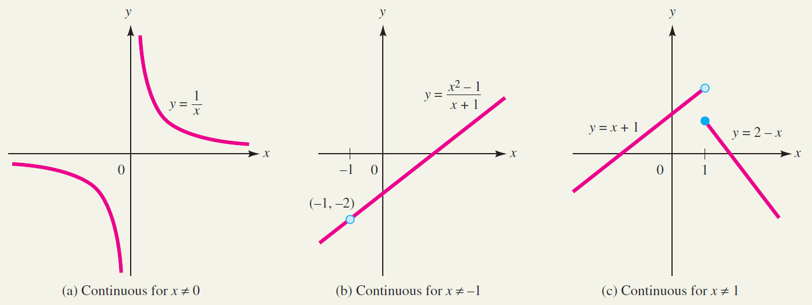
Example: Deciding if a function is continuous
a)
b)
c)

Slide 48
Example: Making a piecewise-defined function continuous

Slide 49
Moreover, a continuous function of a continuous function is a continuous function

Slide 50
A function is continuous on an open (closed) interval if it is continuous at all its points (and the one-sided limits exist at the boundary points)

Slide 51
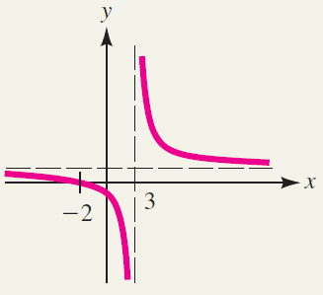
Example: Deciding where a function is continuous

Slide 52
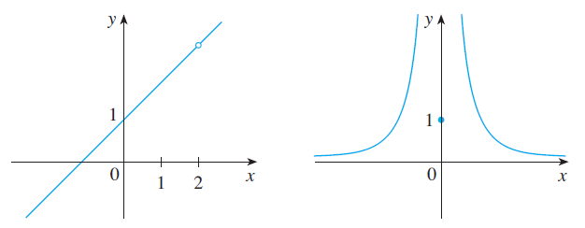
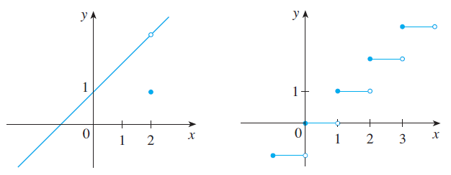
Altogether, we have three types of discontinuities: (i) removable discontinuities, (ii) infinite discontinuities, and (iii) jump discontinuities
removable discontinuity
infinite discontinuity
At these removable discontinuities, we can remove the discontinuity at x = 2 by redefining f at just the single number 2.
The “new” function (continuous extension)
g(x) = x + 1
is continuous at x = 2.
At an infinite discontinuity we have an infinite limit.
jump discontinuity
At a jump discontinuity the function “jumps” from one value to another.

Slide 53
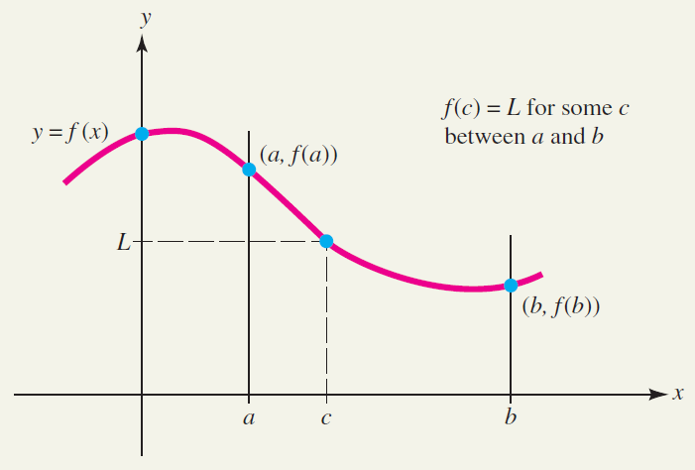
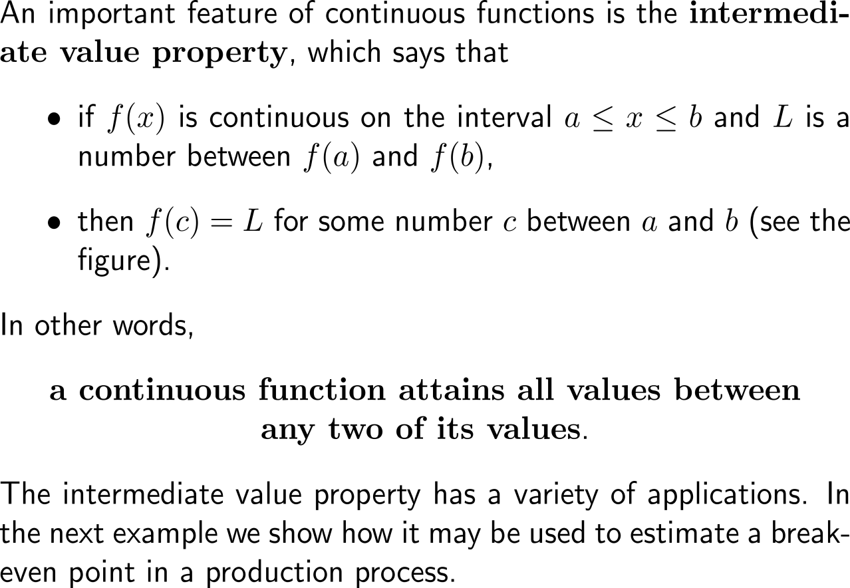
The intermediate value property (IVP) states that a continuous function attains all values between any two of its values
The intermediate value property

Slide 54
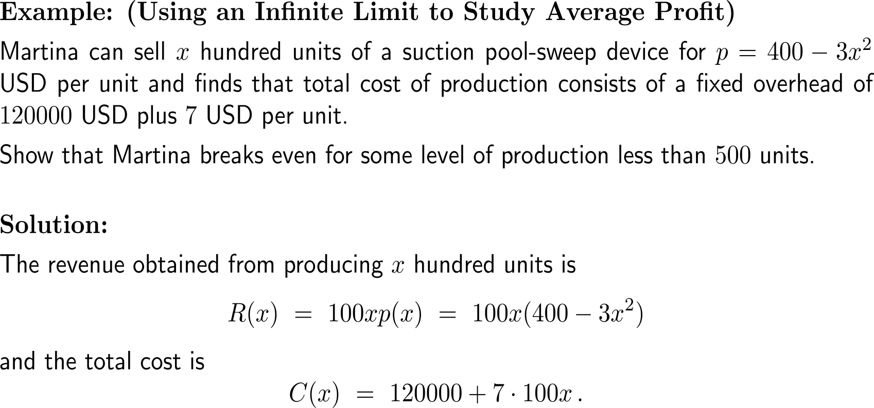
Example: Break-even analysis using an intermediate value

Slide 55
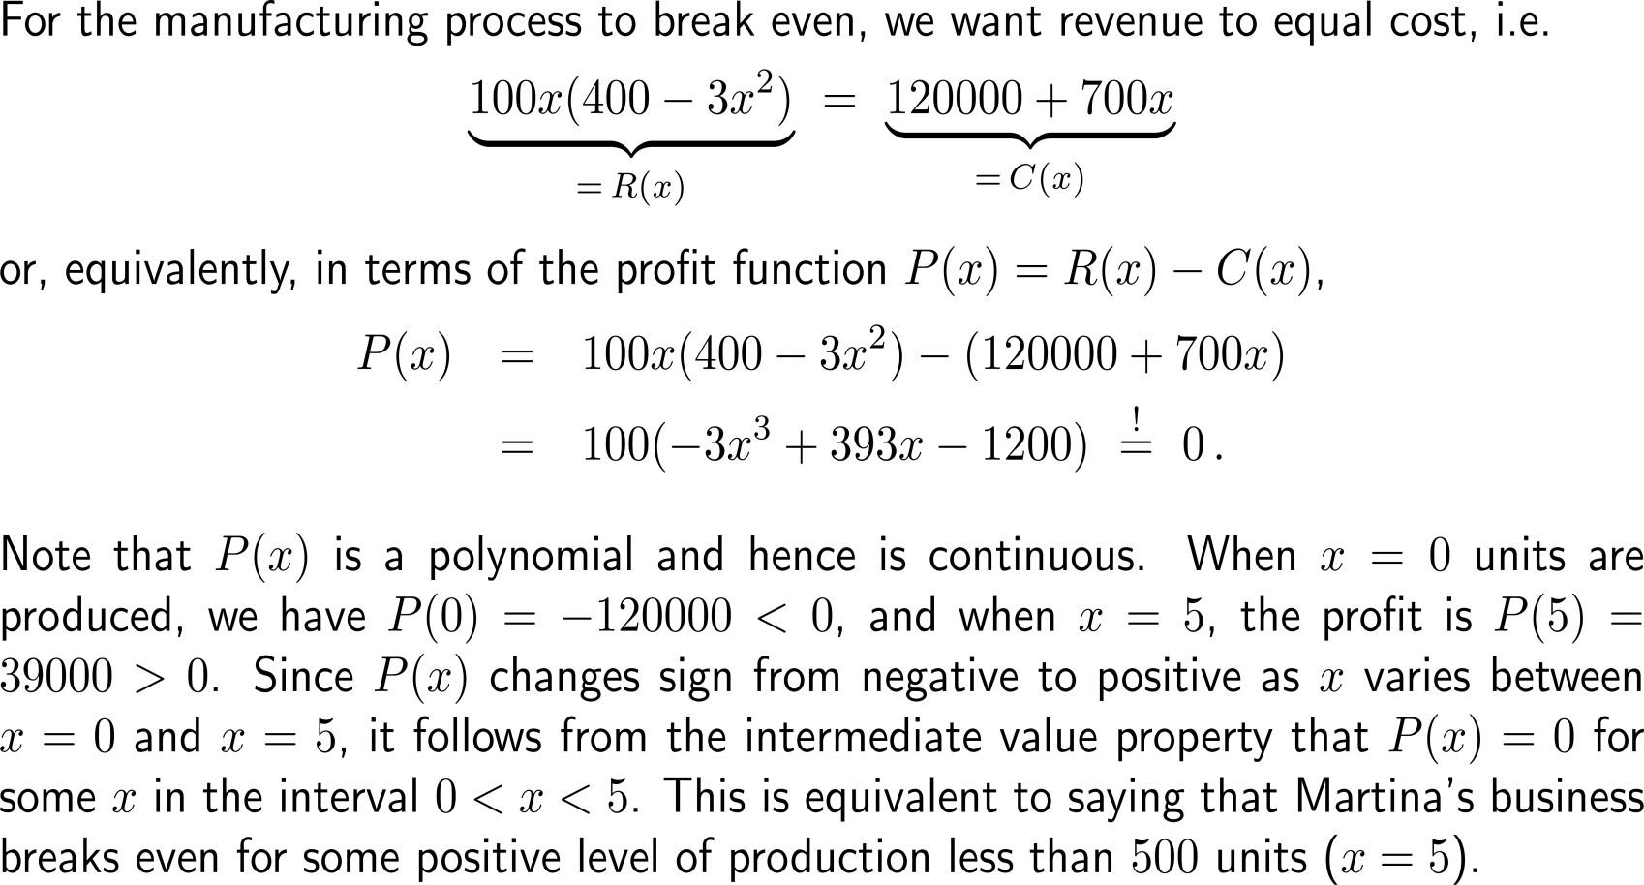
Example: Break-even analysis using an intermediate value
break even
P(5) > 0
P(0) < 0

Slide 56
Further Worked-Out Exercises:
Calculus I for Management
Topics
Two-sides limits
One-sided limits
Limits at infinity
Infinite limits
Continuity

Slide 57
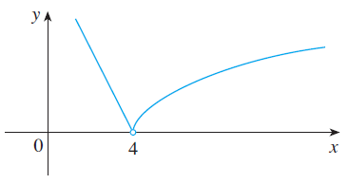
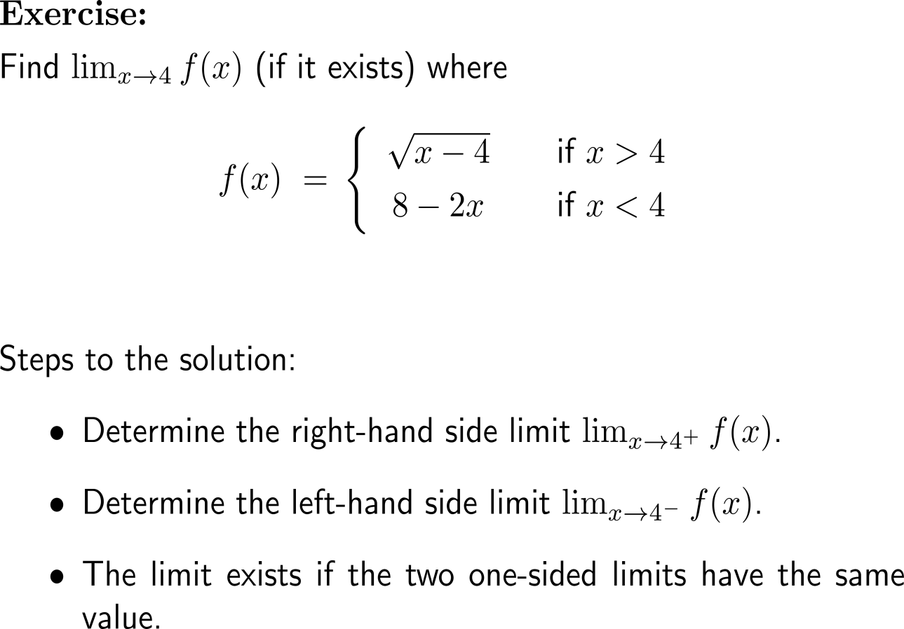
Exercise: Determine the limit if it exists

Slide 58
Exercise: Determine the limit if it exists

Slide 59
Exercise: Evaluating a limit
5 minutes
self/ group work
please, upload your solutions to the chat

Slide 60
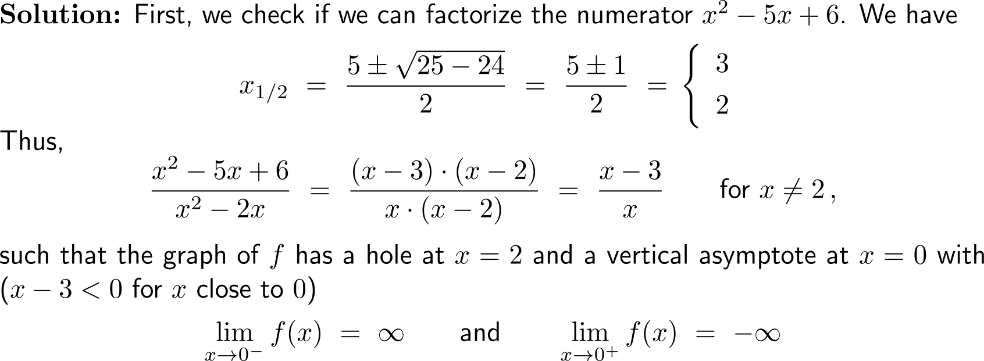
Exercise: Infinite limits and vertical asymptotes

Slide 61
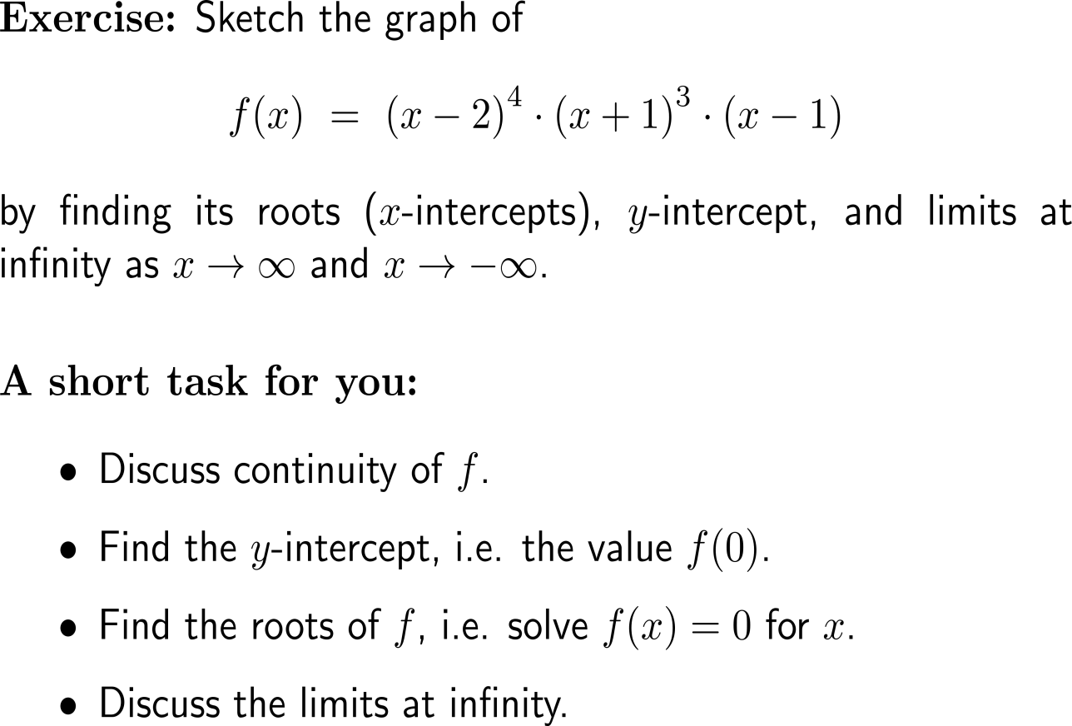
Exercise: Infinite limits at infinity, roots and y-intercept to sketch a graph
y
x

Slide 62
Exercise: Infinite limits at infinity, roots and y-intercept to sketch a graph
y
-1
1
2
x
-16

Slide 63
Exercise: Infinite limits at infinity, roots and y-intercept to sketch a graph
y
-1
1
2
x
-16

Slide 64
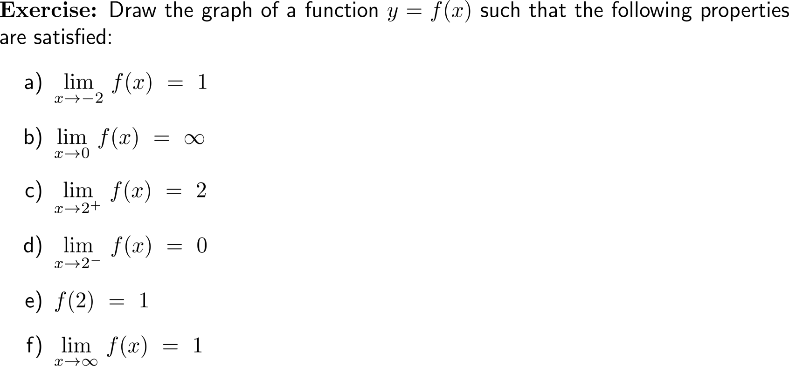
Exercise
5 minutes
self/ group work
please, upload your solutions to the chat

Slide 65
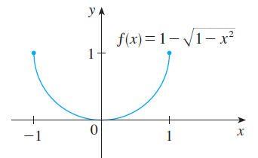
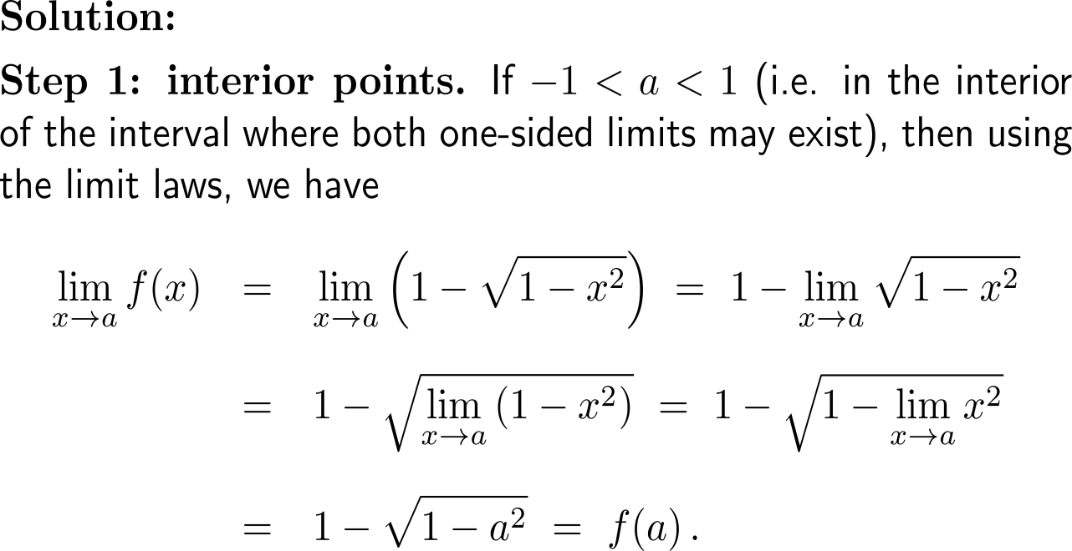
Exercise: A continuous function on a closed interval

Slide 66
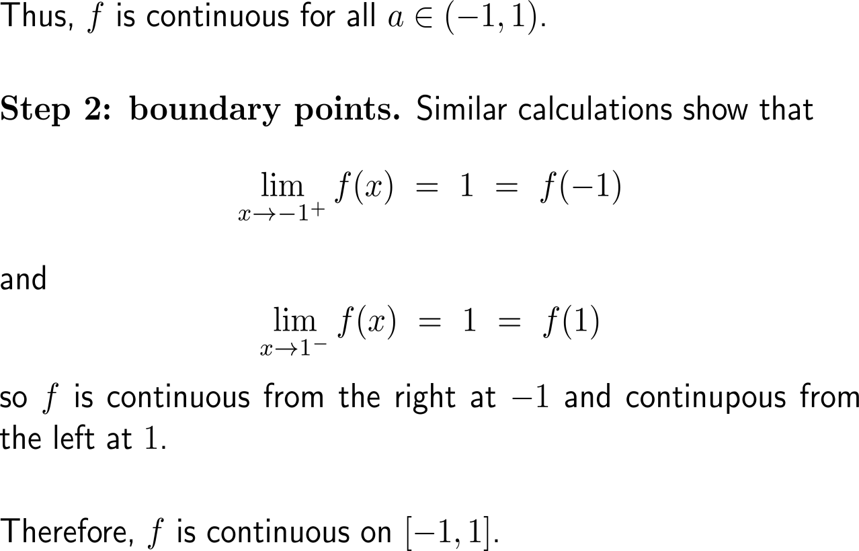
Exercise: A continuous function on a closed interval

Slide 67
Exercise: Application of the intermediate value property (IVP) in locating roots

Slide 68
Example: Application of the intermediate value property (IVP) in locating roots

Slide 69
Calculus I for Management

