Slide 1
Calculus I for Management
Derivatives & Techniques of Differentiation
week 4
Lecture
The derivative
Introductory techniques of differentiation

Slide 2
Before we start, let us take a step back and review what we have done just in the last lectures
meta-structures
based on
definitions
Derivatives & Laws for Derivatives
Intermediate Value Properties
definitions
Laws for Continuous Functions
Don’t forget, we are progressing slowly but steeply.
Don’t fall behind, just because there are so many easy examples that make topics look too harmless.
Continuity
intuitive ideas of a limit
Limit Laws
Two-sided Limit/ One-sided Limit/ Limit at Infinity

Slide 3
We require limits and continuity to define the central concept of calculus: the derivative

Slide 4
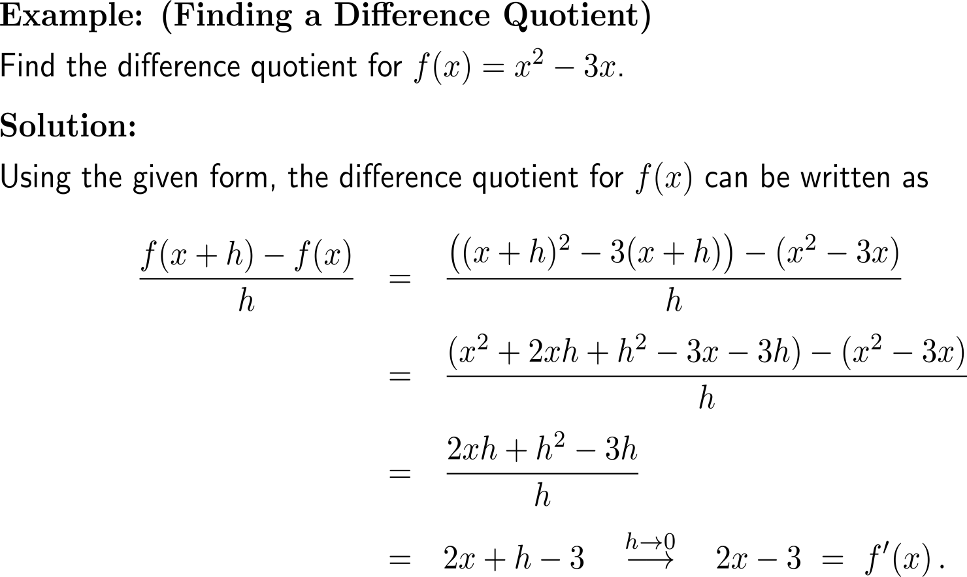
Example: Finding a difference quotient

Slide 5
Topics
The Derivative
Techniques of Differentiation

Slide 6
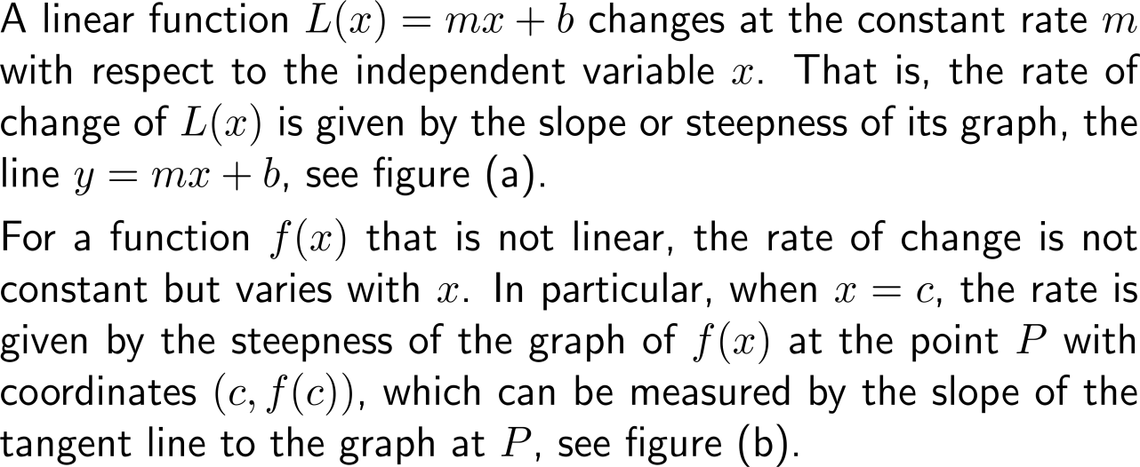
Calculus is the mathematics of change, and the primary tool for studying change is a procedure called differentiation

Slide 7
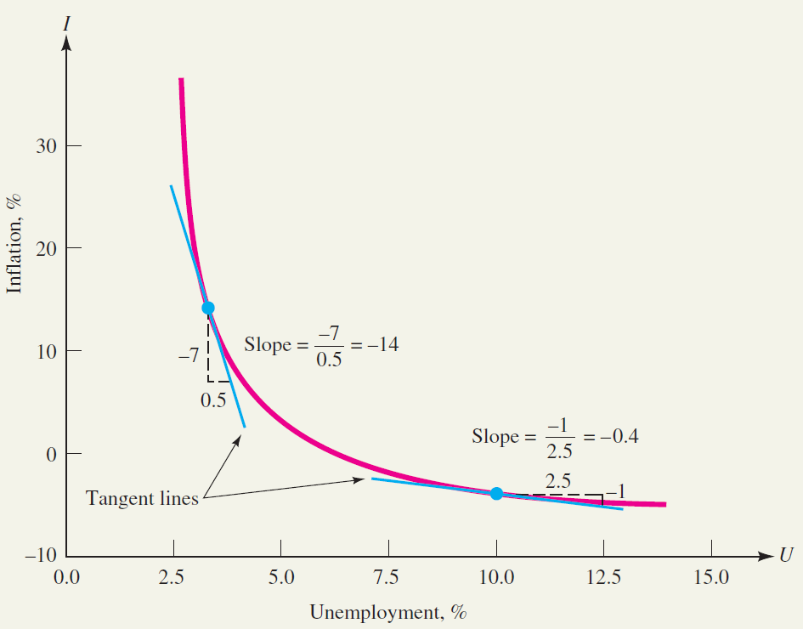
Example: Estimating rates of change
Inflation as a function of unemployment
Source: Adapted from Robert Eisner, The Misunderstood Economy: What Counts and How to Count It, Boston, MA: Harvard Business School Press, 1994, p. 173.

Slide 8
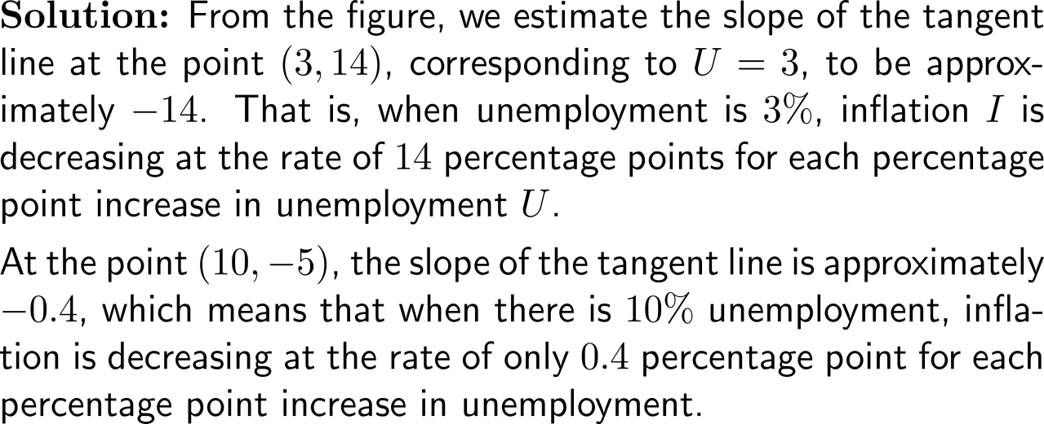
Example: Estimating rates of change
Inflation as a function of unemployment
Source: Adapted from Robert Eisner, The Misunderstood Economy: What Counts and How to Count It, Boston, MA: Harvard Business School Press, 1994, p. 173.

Slide 9
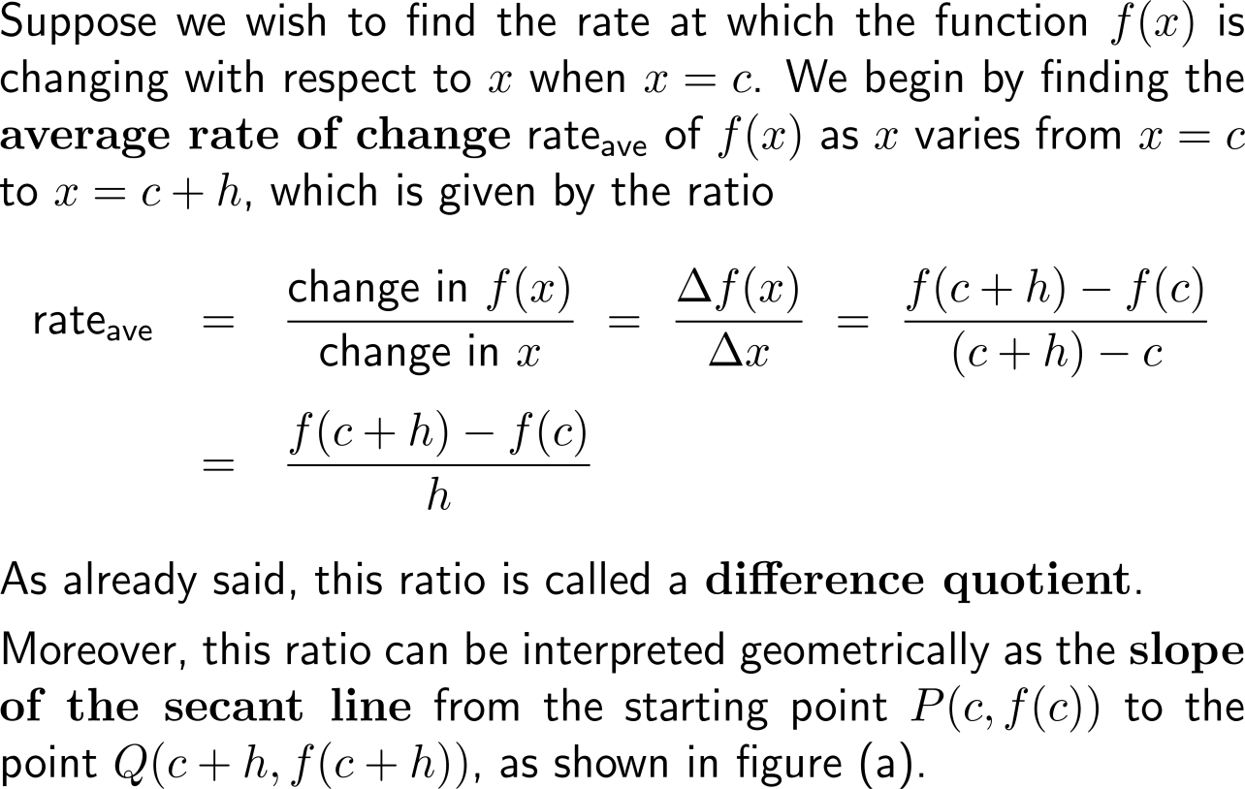
The difference quotient (average rate of change) gives the slope of a secant line …

Slide 10
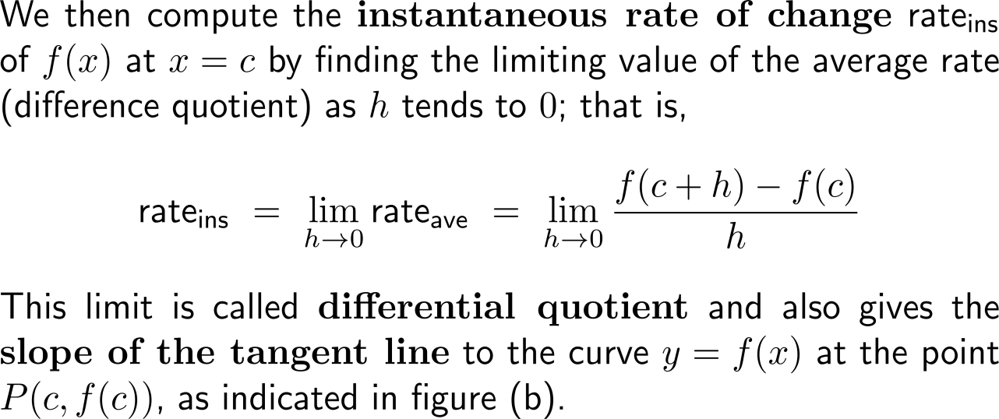
… and its limit – the differential quotient (instantaneous rate of change) – the slope of the corresponding tangent line

Slide 11
The derivate of a function at a point is given by the corresponding differential quotient

Slide 12
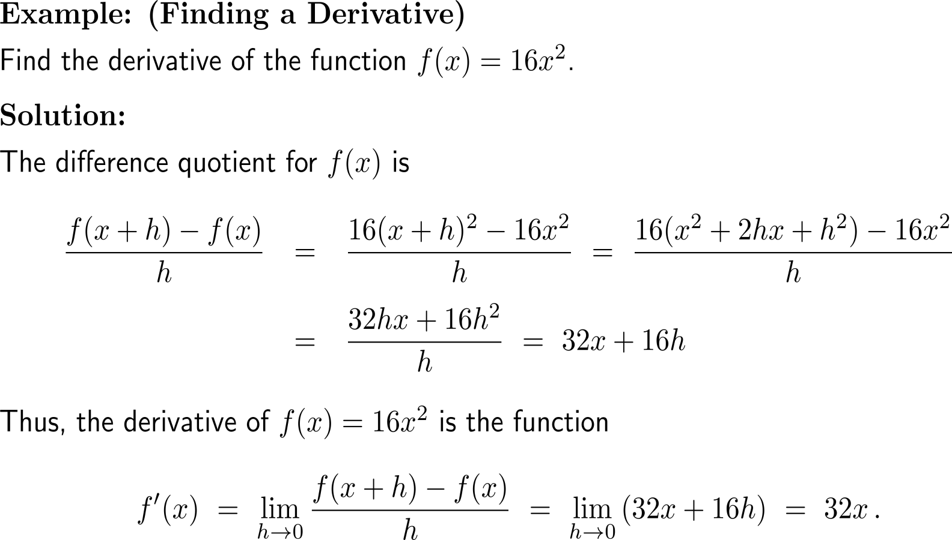
Example: Finding a derivative

Slide 13
Let us summarize our observations about rates of change and slope in terms of the derivative notation

Slide 14
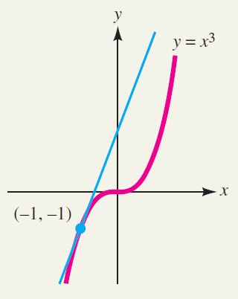
Example: Using a derivative to find the slope of a tangent

Slide 15
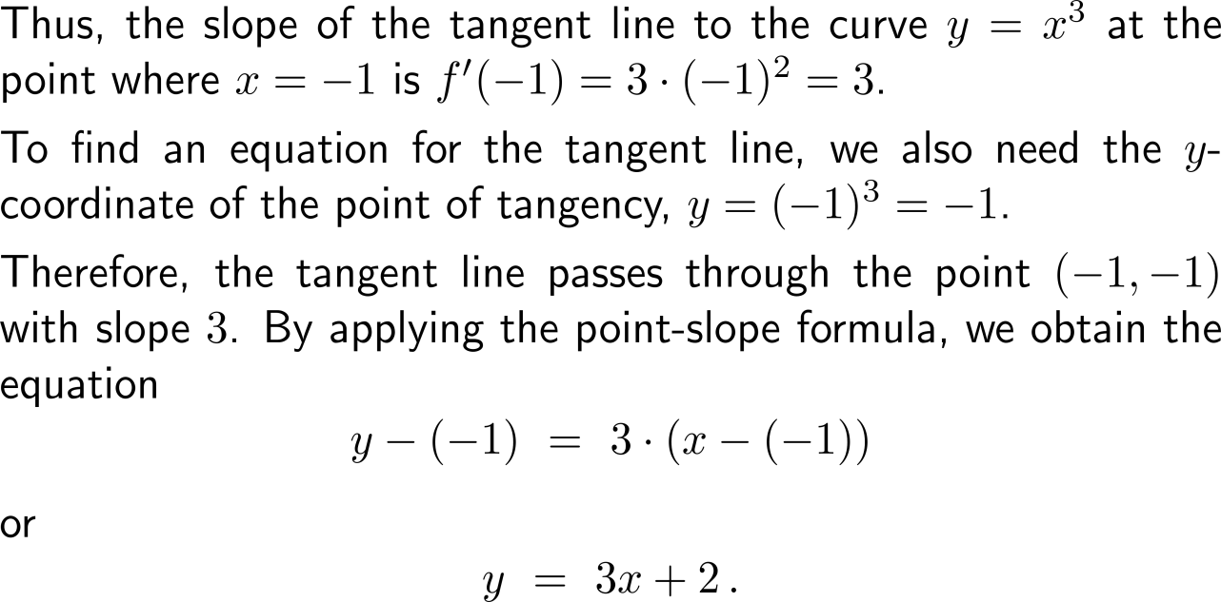
Example: Using a derivative to find the slope of a tangent

Slide 16
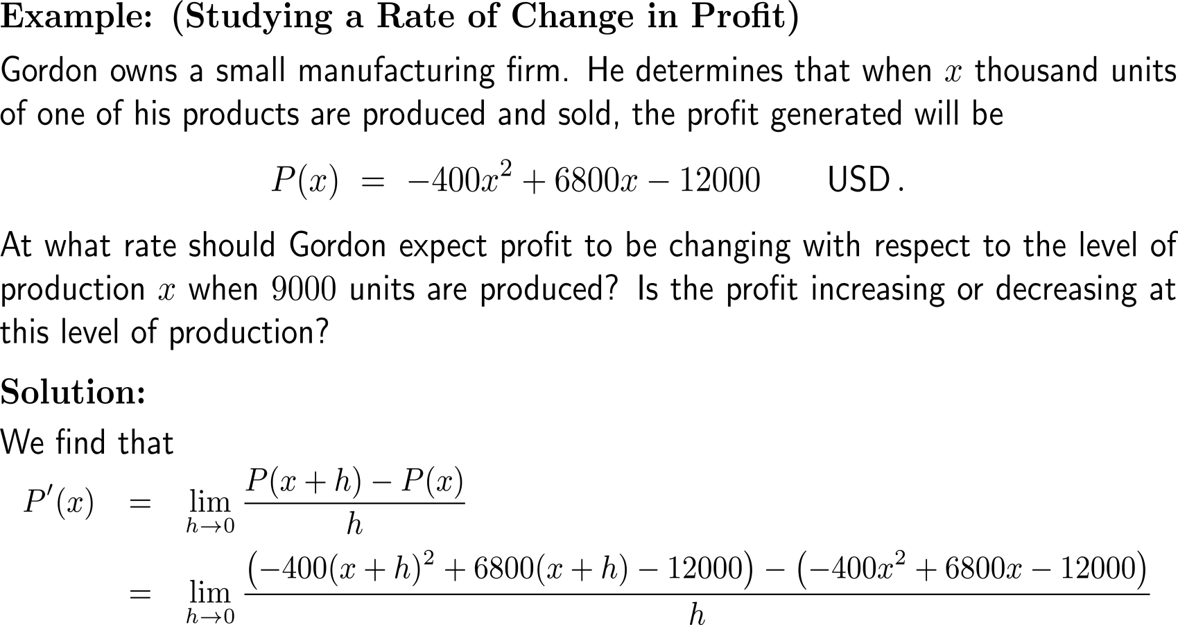
Example: Studying a Rate of Change in Profit

Slide 17
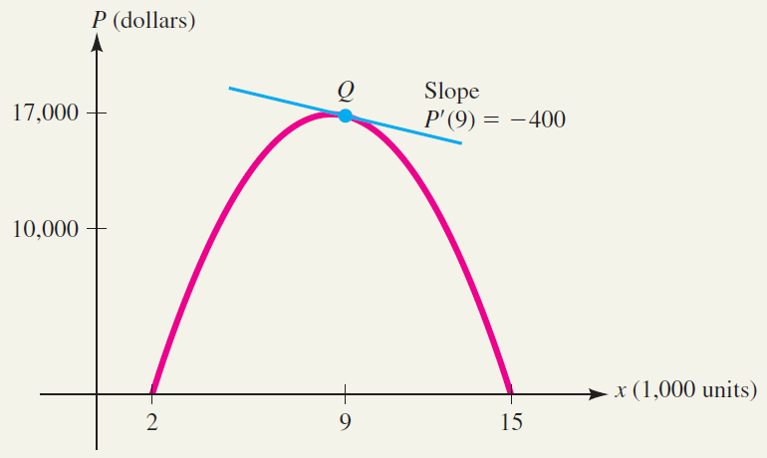
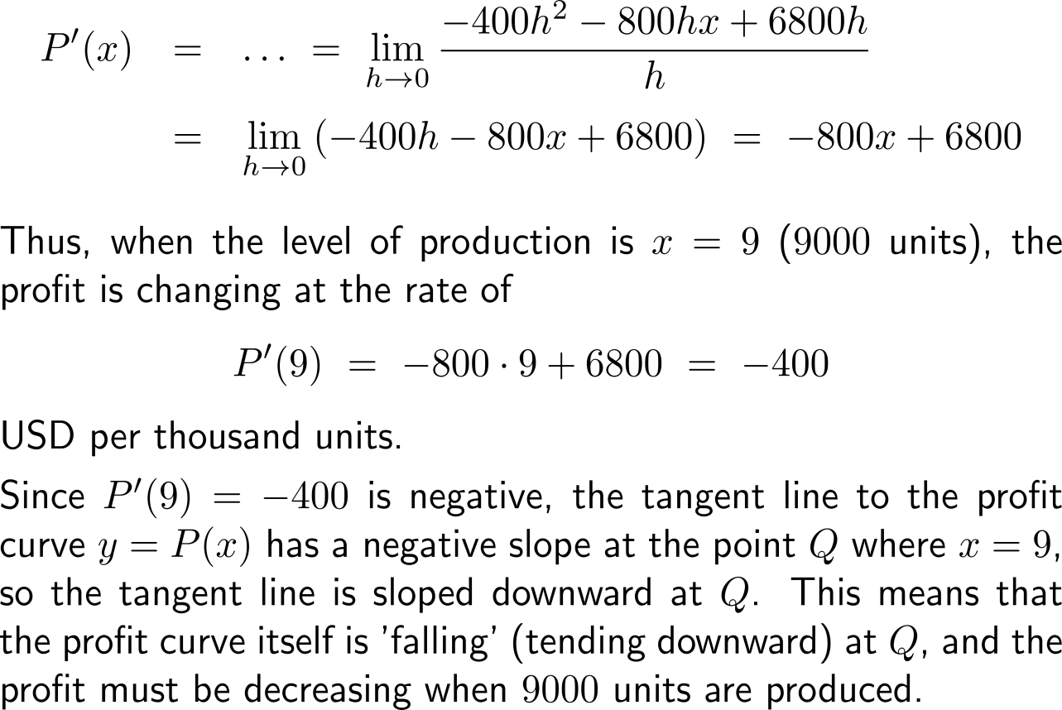
Example: Studying a Rate of Change in Profit

Slide 18
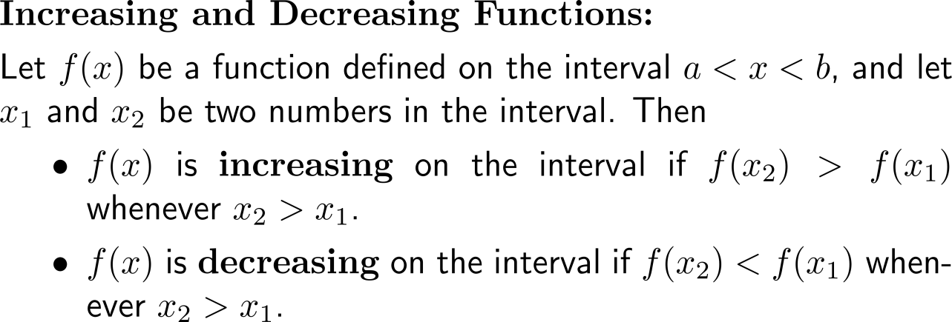
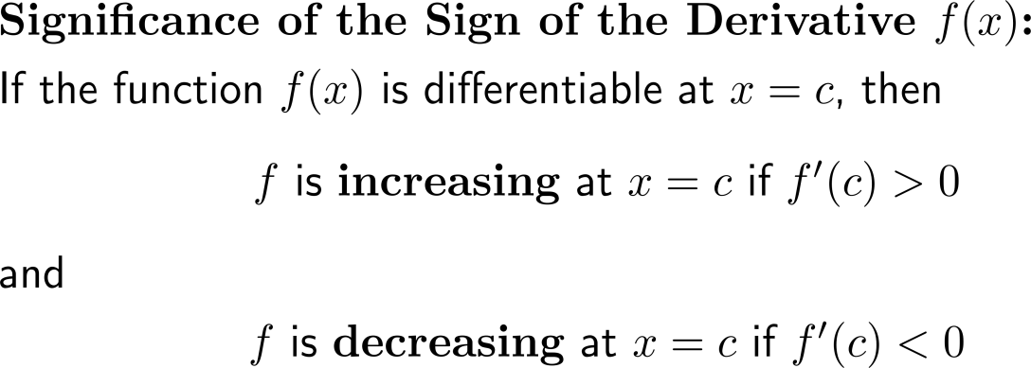
The sign of a derivative indicates if the graph of a function is increasing or decreasing at the corresponding point

Slide 19
The Leibniz notation is an alternative way of writing derivatives and will be handy for denoting higher-order derivatives

Slide 20
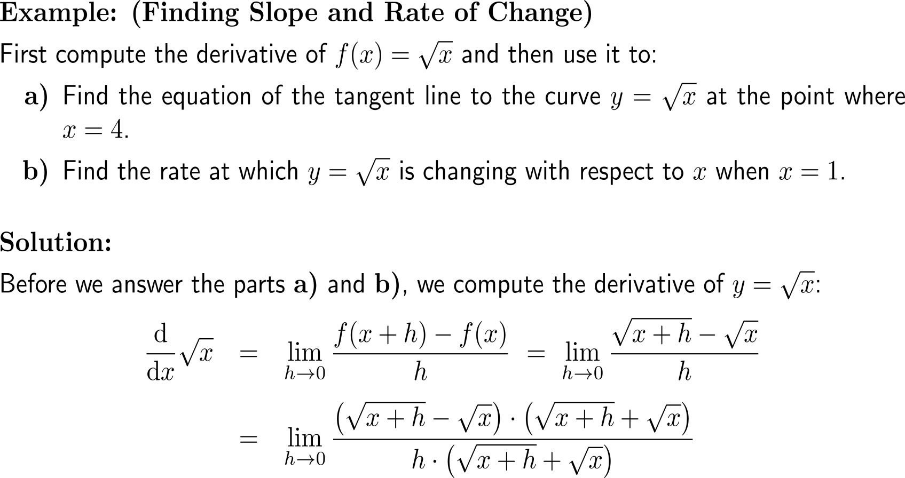
Example: Finding slope and rate of change

Slide 21
Example: Finding slope and rate of change

Slide 22
Example: Finding slope and rate of change

Slide 23
A differentiable function is continuous at all points at which it is differentiable

Slide 24
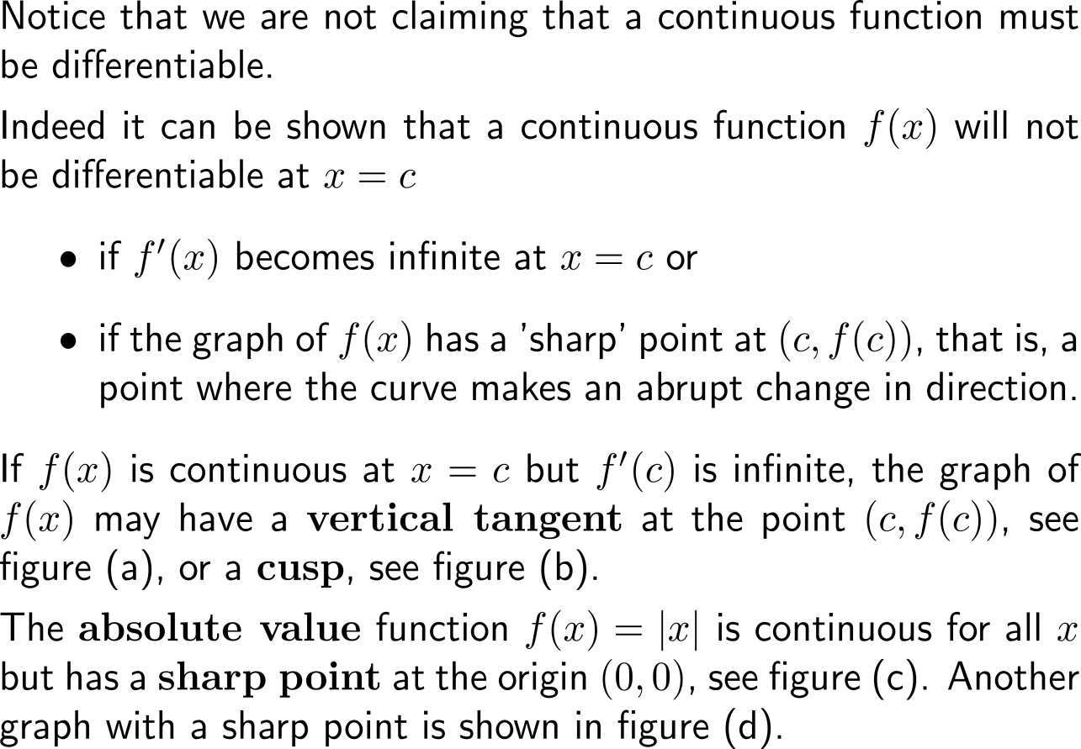
Though, continuity is not enough to ensure differentiability – there are functions that are continuous at a point but not differentiable there

Slide 25
Topics
The Derivative
Techniques of Differentiation

Slide 26
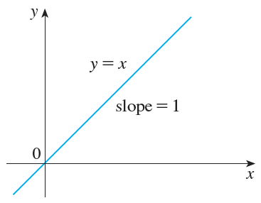
The power rule, …

Slide 27
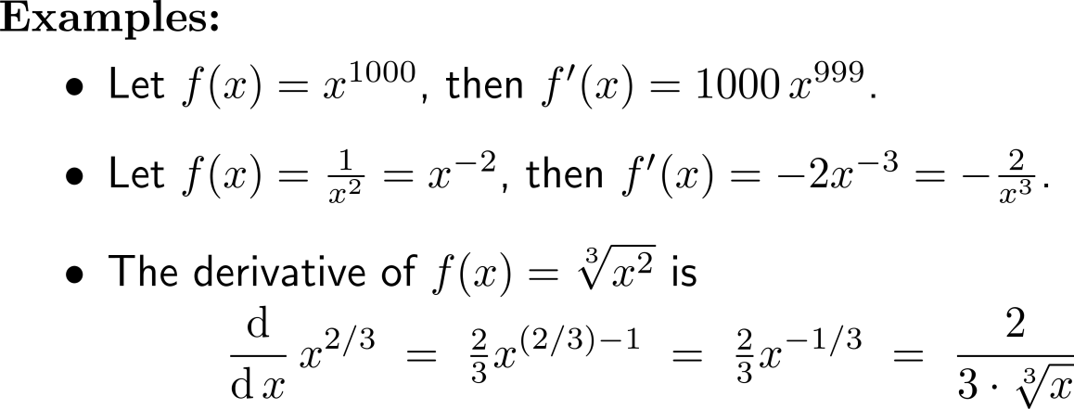
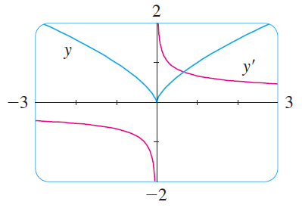
… and its extension to arbitrary non-vanishing powers

Slide 28
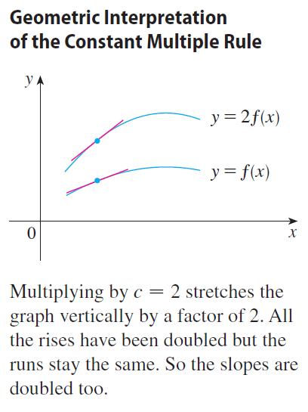
The Constant Multiple Rule: the derivative of a constant times a function is the constant times the derivative of the function

Slide 29
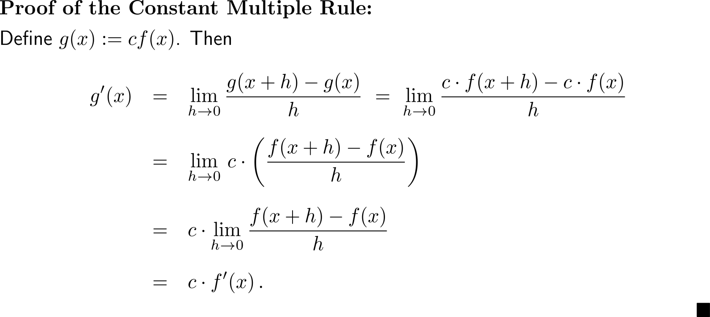
Proof of the Constant Multiple Rule

Slide 30
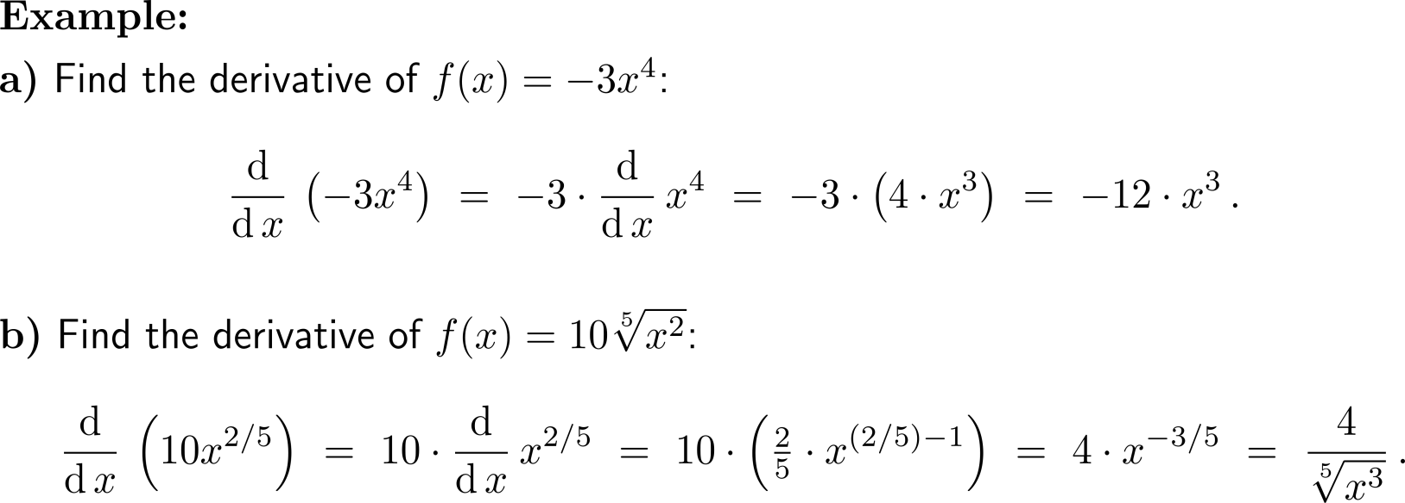
Example: Application of the Power and Constant Multiple Rule

Slide 31
The Sum Rule: the derivative of a sum of functions is the sum of the derivatives

Slide 32
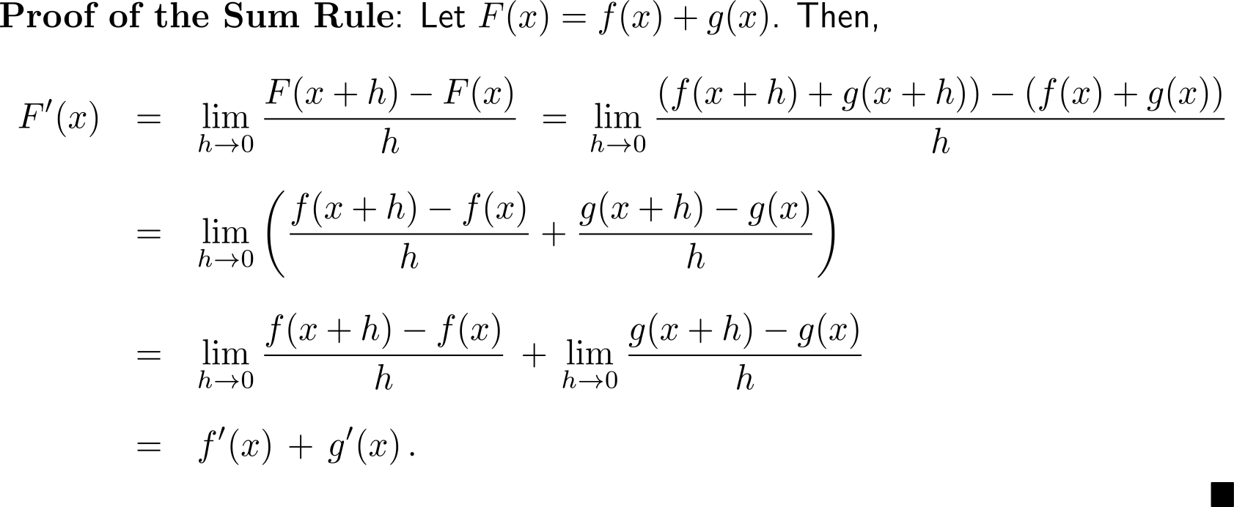
Proof of the Sum Rule

Slide 33
An immediate consequence of the Sum Rule and the Constant Multiple Rule is the Difference Rule

Slide 34
Example: Application of the Power, Constant Multiple, Sum and Difference Rule

Slide 35
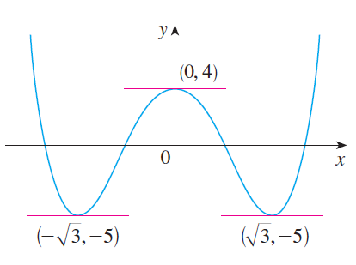
Example: Application of the Power, Constant Multiple, Sum and Difference Rule

Slide 36
Further Worked-Out Exercises:
Calculus I for Management
Topics
Tangents and derivatives
Rate of change
Techniques of differentiation

Slide 37
Exercise

Slide 38
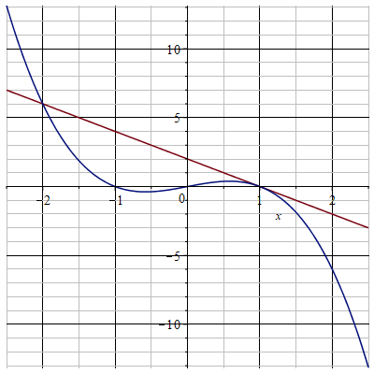
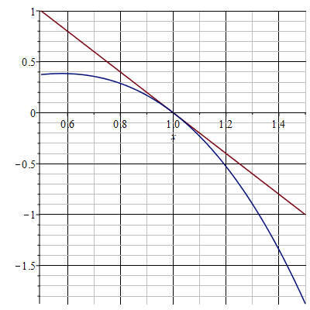
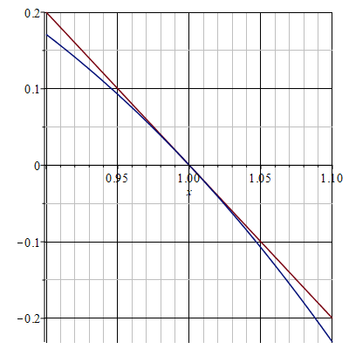
Exercise

Slide 39
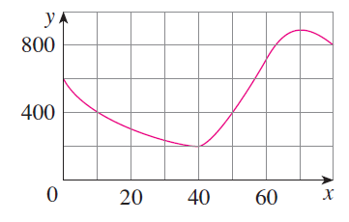
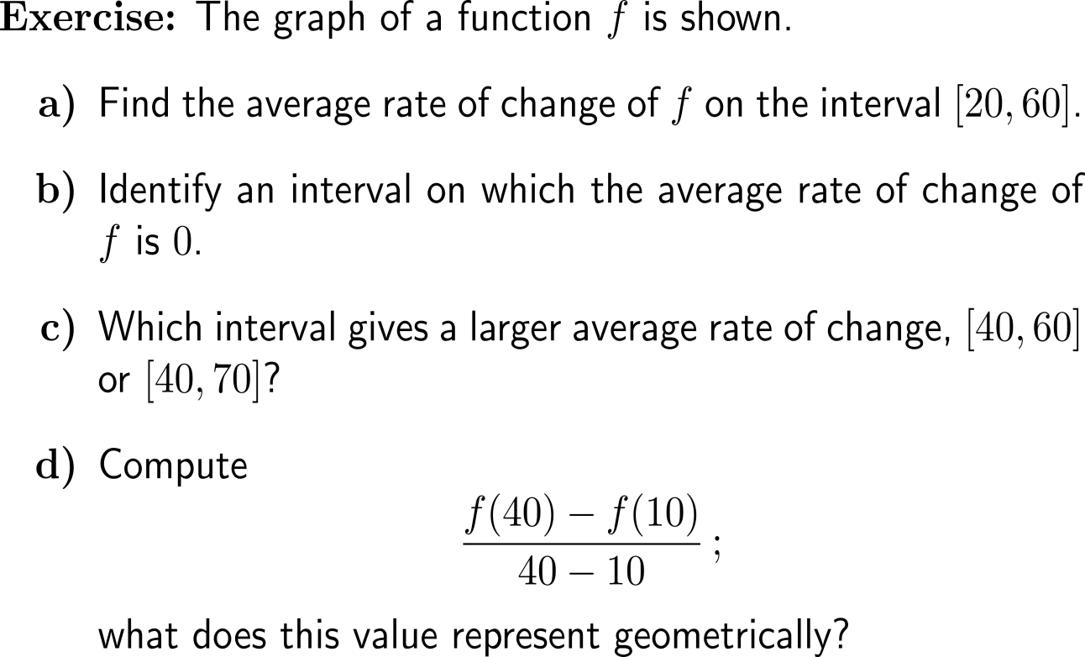
Exercise

Slide 40
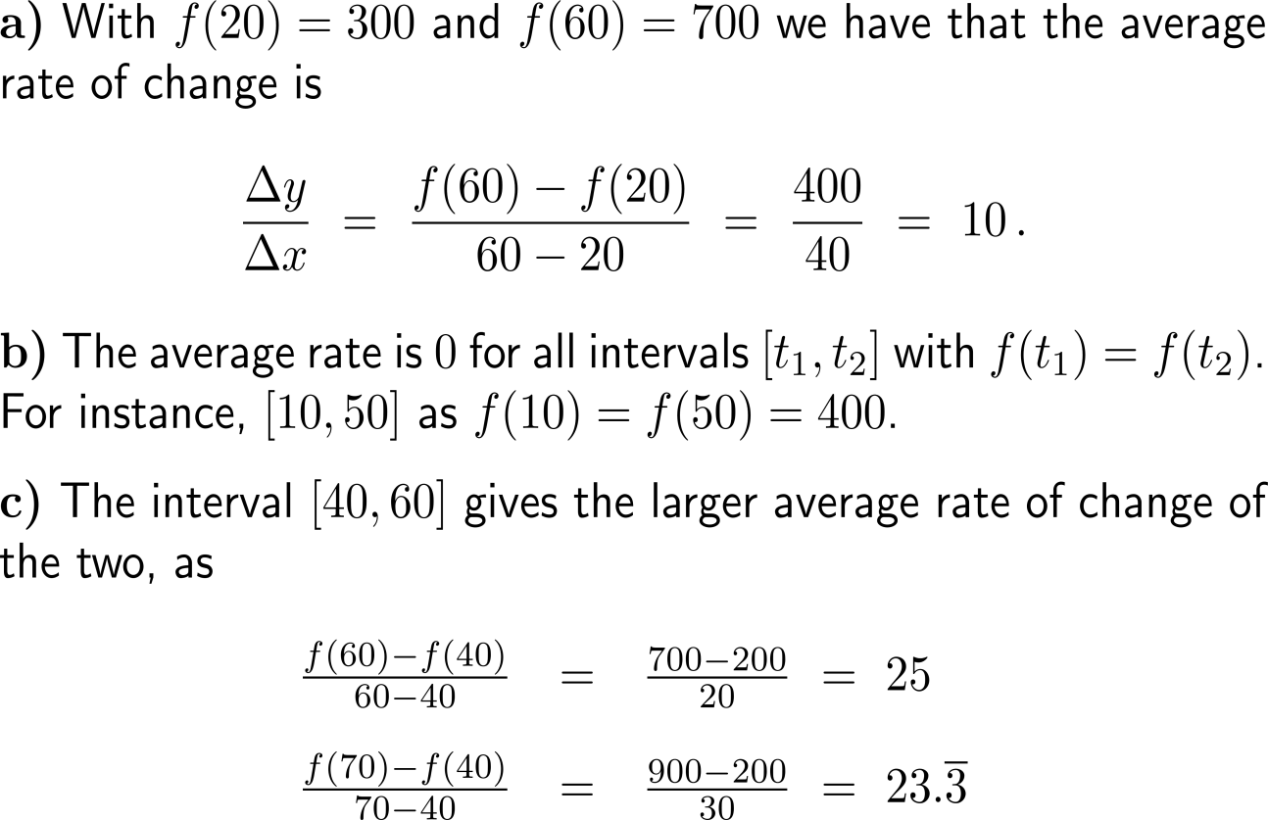
Exercise

Slide 41
Exercise

Slide 42
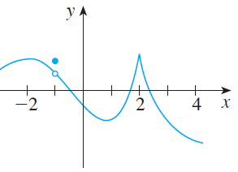
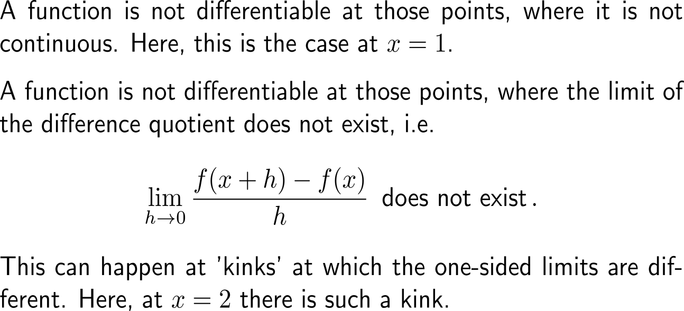
Exercise

Slide 43
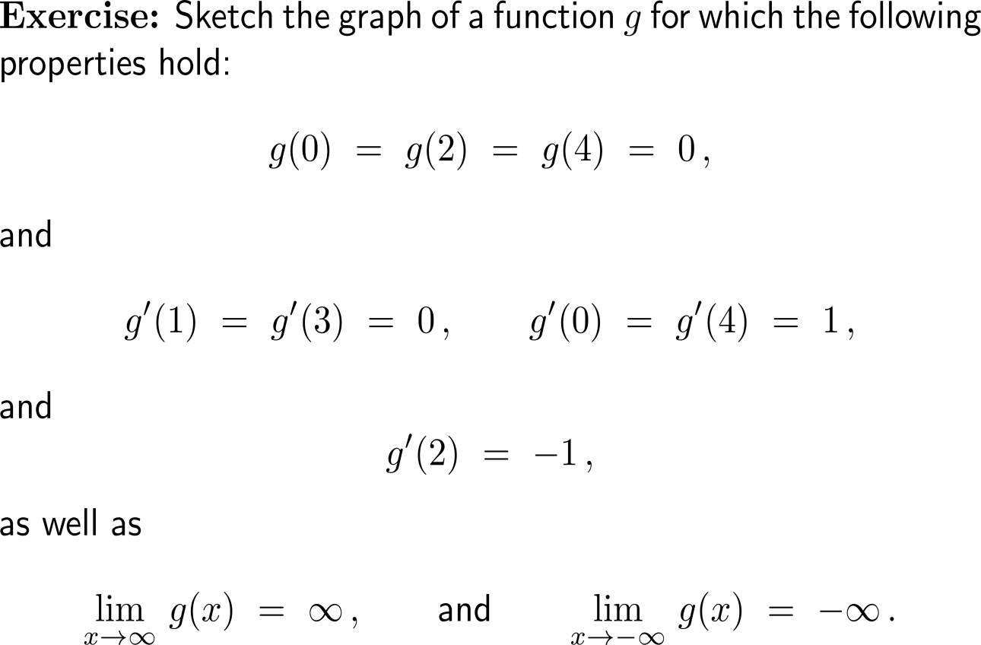
Exercise
5 minutes
self/ group work
please, upload your solutions to the chat
y
Example
1
-1
1
x

Slide 44
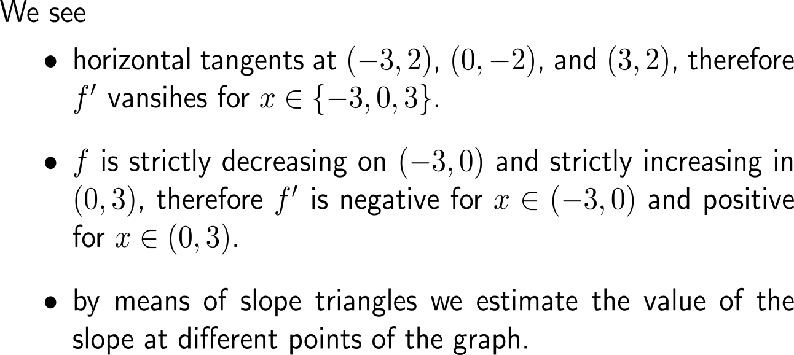
Exercise
y
f
-2.5/1.7 =-1.47
1
-1
1
x
y
1
-1
1
x
f’

Slide 45
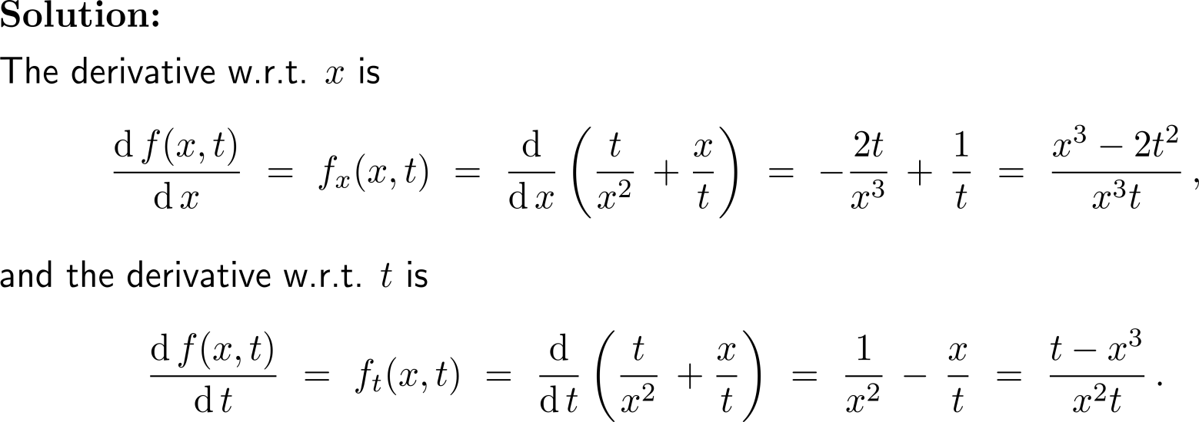
Exercise

Slide 46
Calculus I for Management

