Slide 1
Calculus I for MGMT – Derivatives & Techniques of Differentiation Introductory Techniques of Differentiation
Mathematics for Management
Supplementary Electronic Materials
Derivatives & Techniques
of Differentiation
The Derivative
Introductory Techniques
of Differentiation

Slide 2
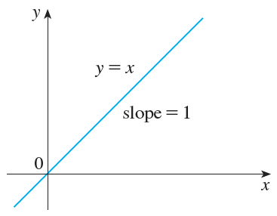
The power rule, …

Slide 3
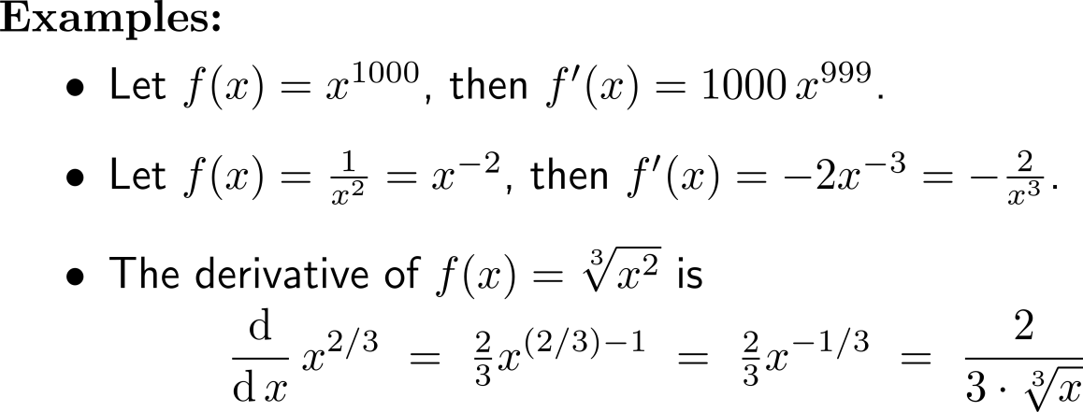
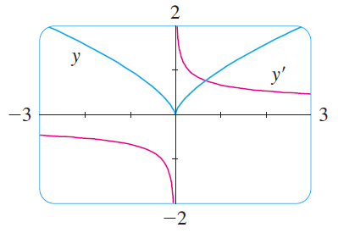
… and its extension to arbitrary non-vanishing powers

Slide 4
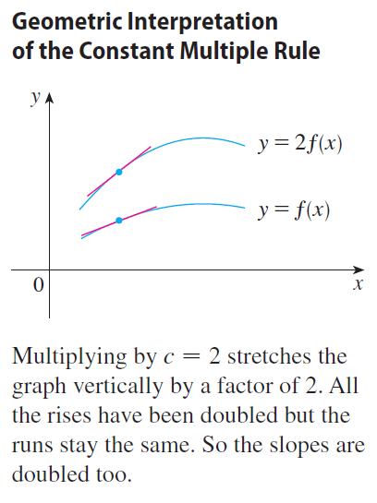
The Constant Multiple Rule: the derivative of a constant times a function is the constant times the derivative of the function

Slide 5
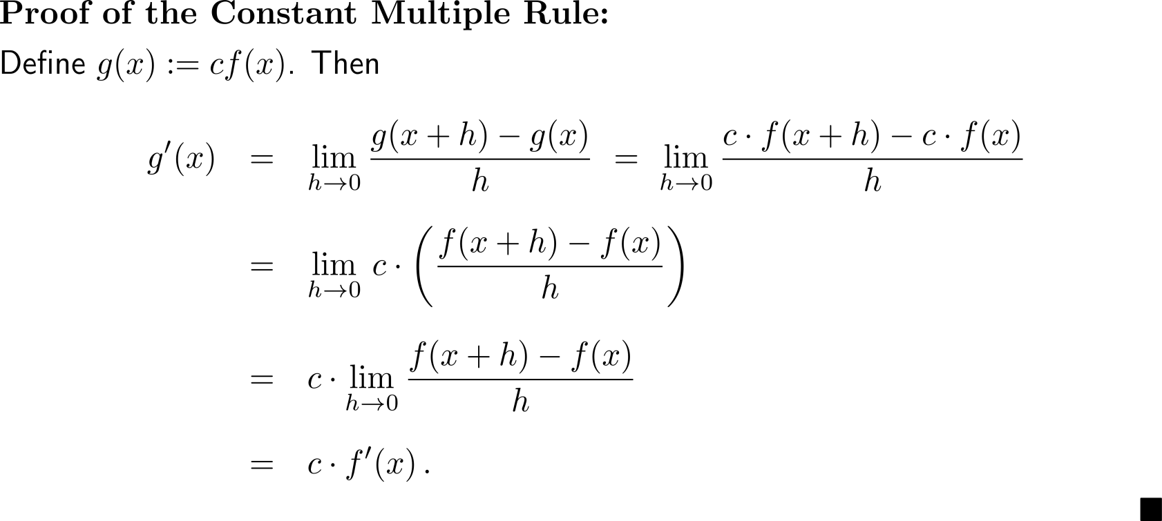
Proof of the Constant Multiple Rule

Slide 6
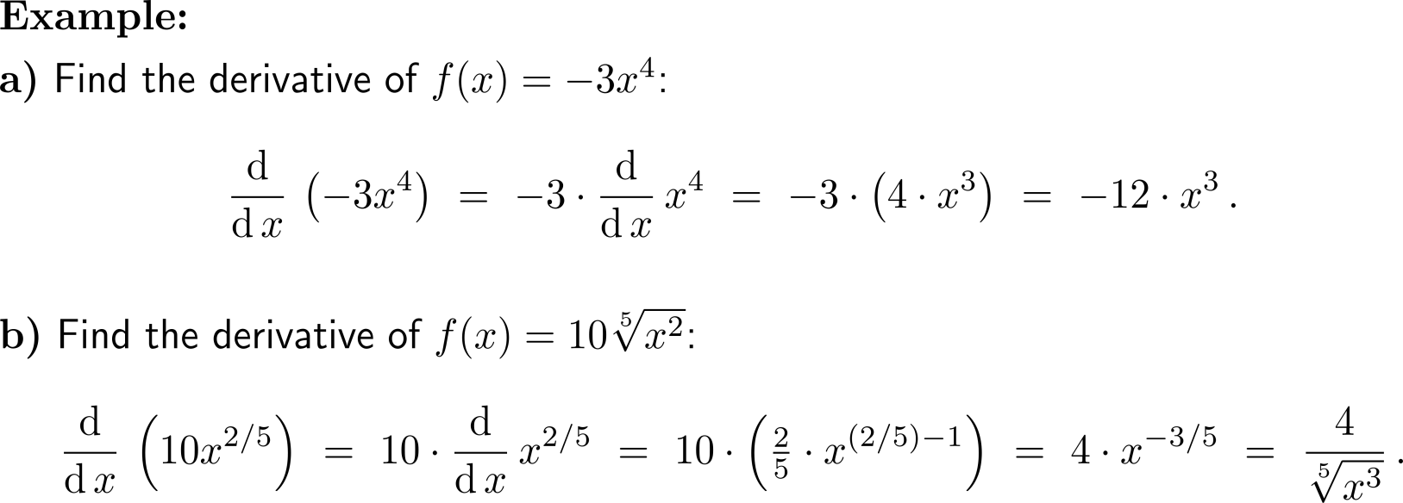
Example: Application of the Power and Constant Multiple Rule

Slide 7
The Sum Rule: the derivative of a sum of functions is the sum of the derivatives

Slide 8
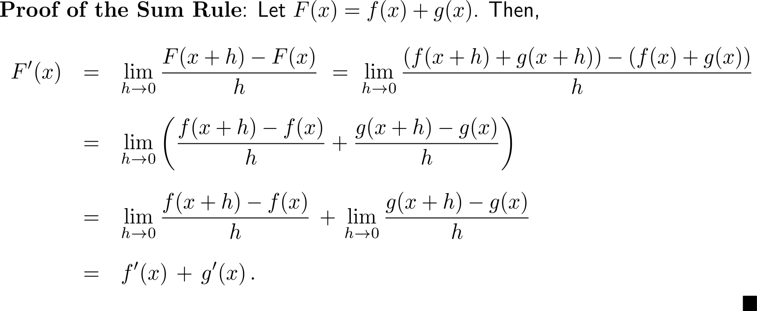
Proof of the Sum Rule

Slide 9
An immediate consequence of the Sum Rule and the Constant Multiple Rule is the Difference Rule

Slide 10
Example: Application of the Power, Constant Multiple, Sum and Difference Rule

Slide 11
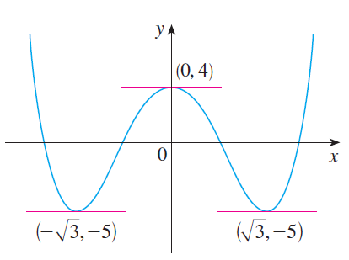
Example: Application of the Power, Constant Multiple, Sum and Difference Rule

Slide 12
Calculus I for Management

