Slide 1
Calculus I for Management
Advanced Differentiation Rules
week 5
Lecture
The derivative of exponential functions
Higher-order derivatives
The Product & Quotient Rule
Derivatives of trigonometric functions

Slide 2
Topics
The Derivative of Exponential Functions
Higher-Order Derivatives
The Product & Quotient Rule
Derivatives of Trigonometric Functions

Slide 3
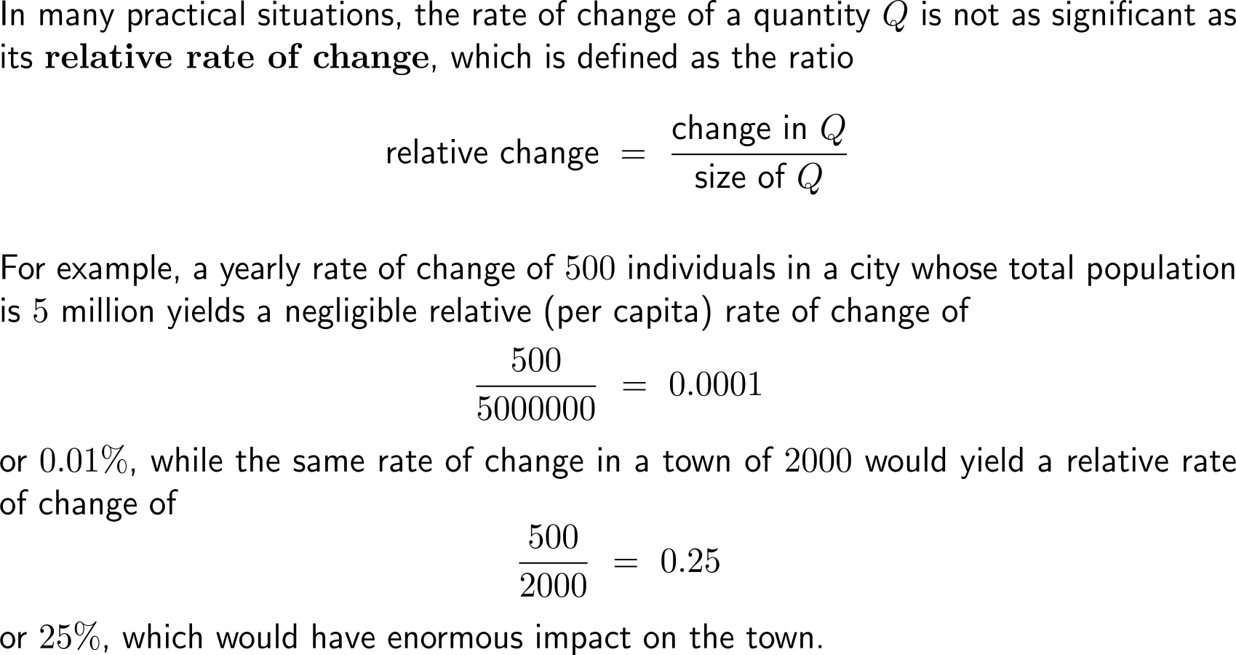
Relative and percentage rates of change are used to describe changes of a quantity w.r.t. the size of this quantity (1/ 2)

Slide 4
Relative and percentage rates of change are used to describe changes of a quantity w.r.t. the size of this quantity (2/ 2)

Slide 5
The derivative of the exponential function …

Slide 6
… gives rise to the definition of a “new” number: the Euler number e

Slide 7
In particular, the natural exponential function with base e is the only non-constant function whose derivative is equal to the function itself

Slide 8
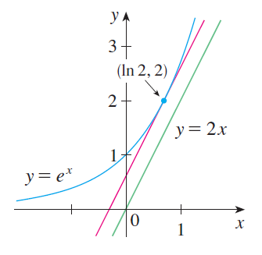
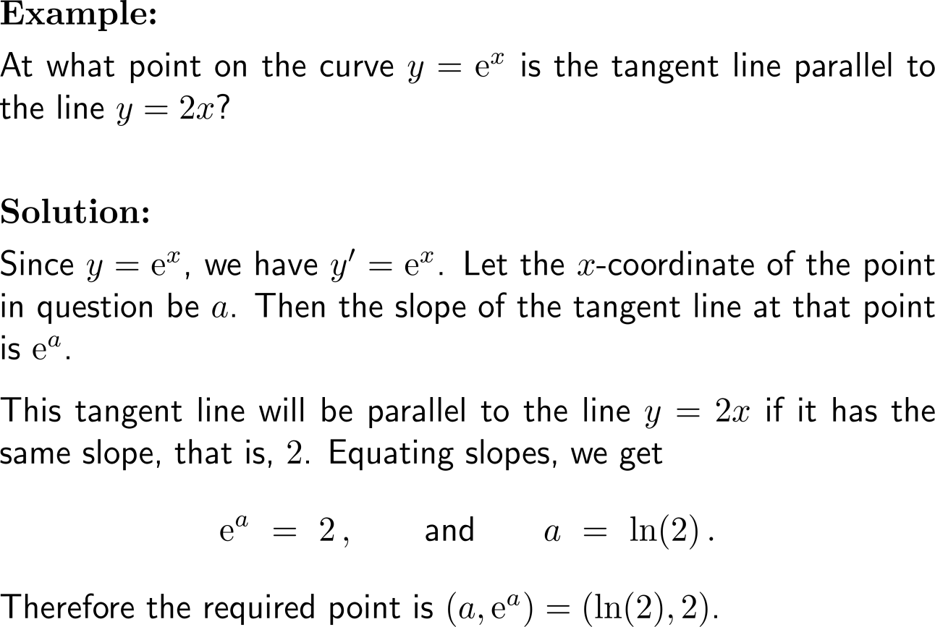
Example: Derivative of the natural exponential function

Slide 9
Topics
The Derivative of Exponential Functions
Higher-Order Derivatives
The Product & Quotient Rule
Derivatives of Trigonometric Functions

Slide 10
Often it is possible to take the derivative of a derivative (i.e. the second derivative) or even derivatives of higher order
derivative
of
first
derivative
second
derivative
the 0-th derivative is the function itself:
f⁽⁰⁾(x) = f(x)

Slide 11
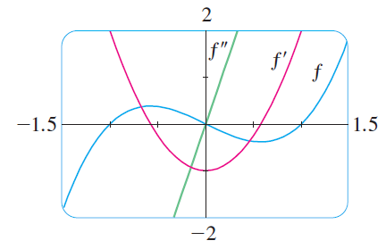
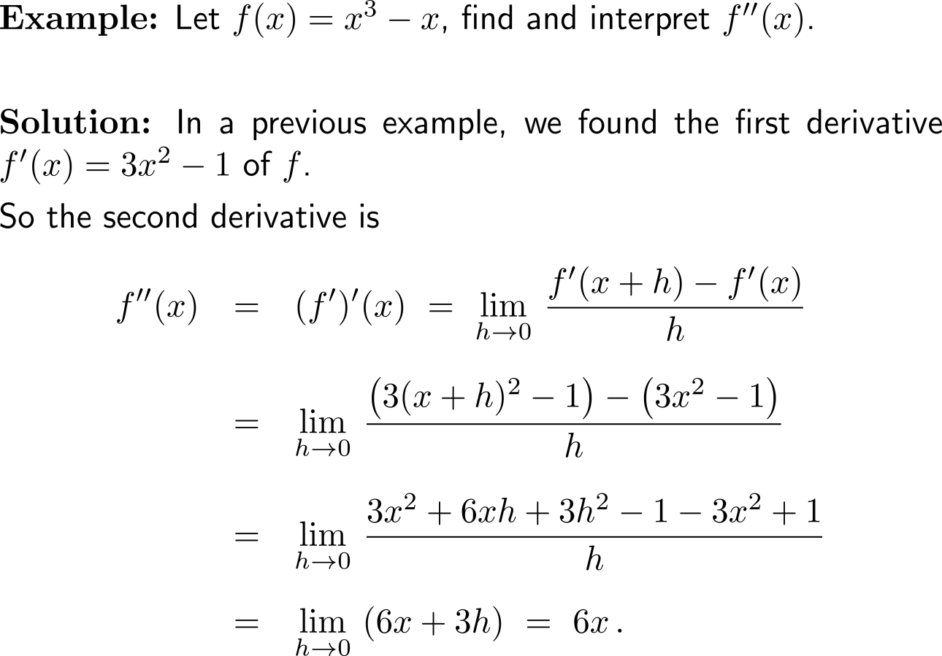
Example: Computation of the second derivative

Slide 12
Example: Computation of the second derivative

Slide 13
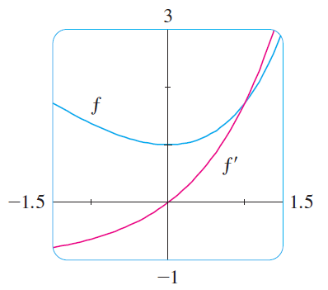
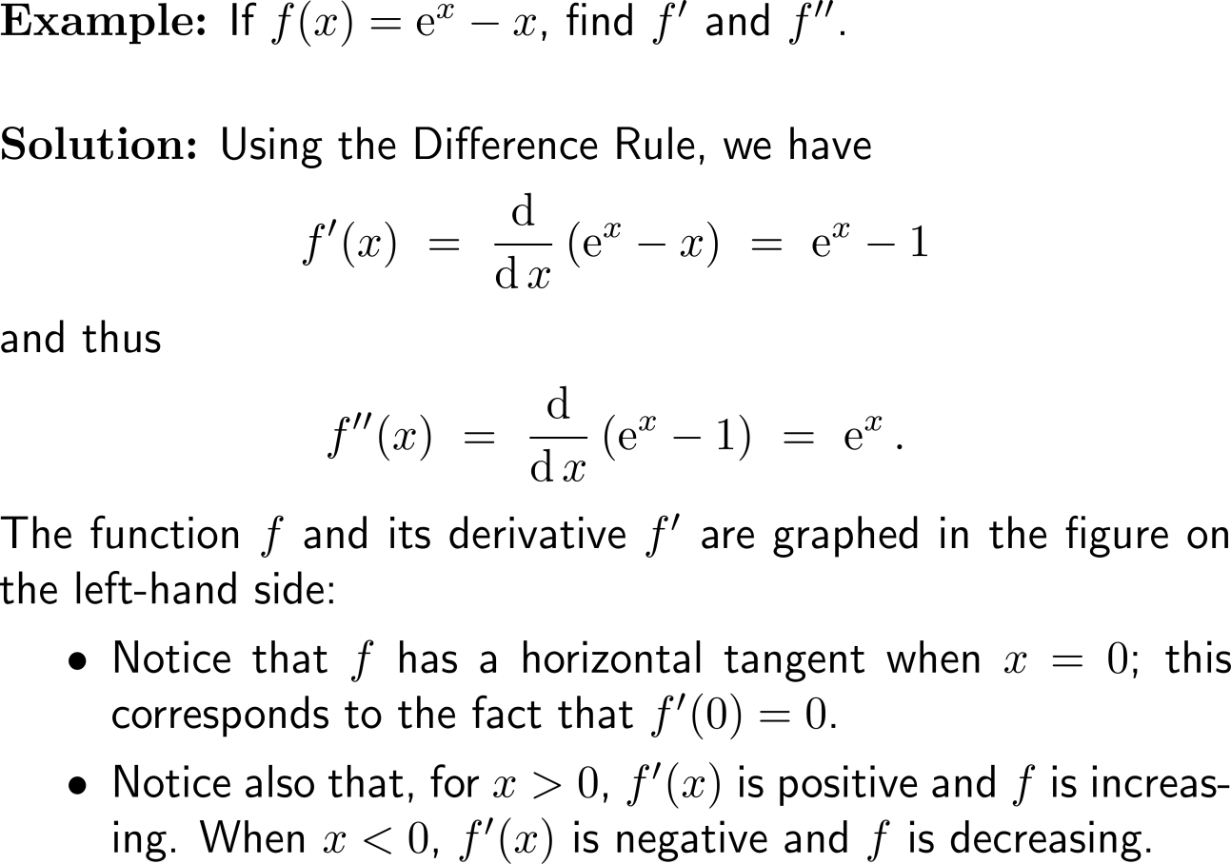
Example: Derivative of the natural exponential function

Slide 14
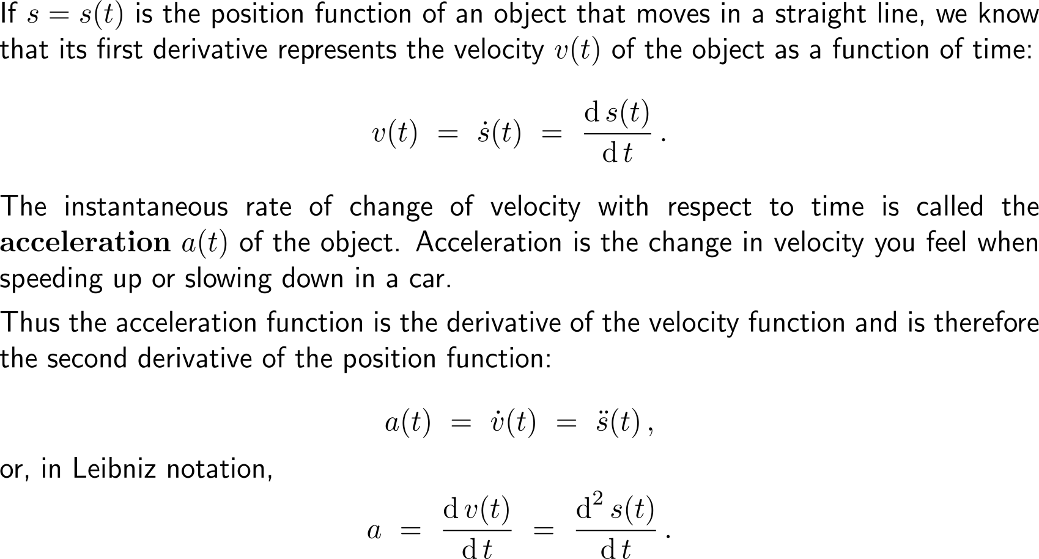
In general, we can interpret a second derivative as a rate of change of a rate of change: the most familiar example of this is acceleration
for time-dependent functions we use the dot-notation to indicate derivatives

Slide 15
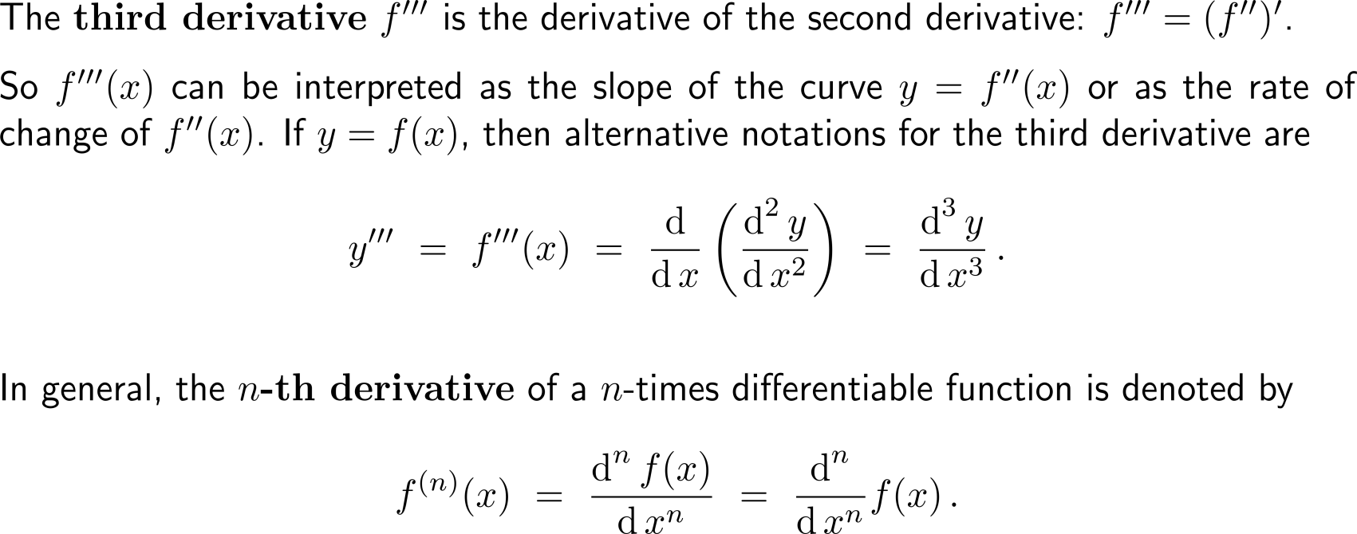
The third derivative and even higher-orders…

Slide 16
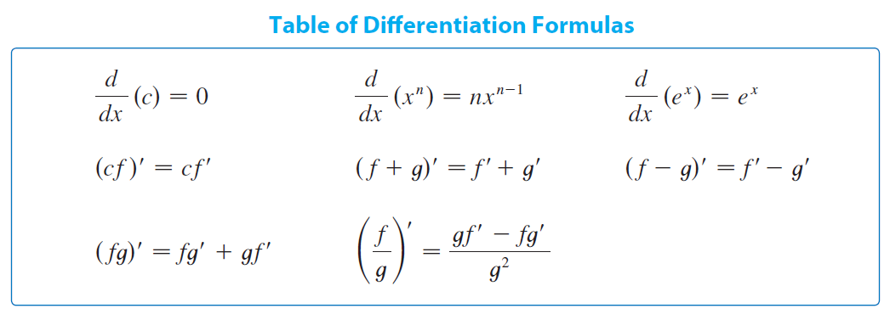
Topics
The Derivative of Exponential Functions
Higher-Order Derivatives
The Product & Quotient Rule
Derivatives of
Trigonometric
Functions

Slide 17
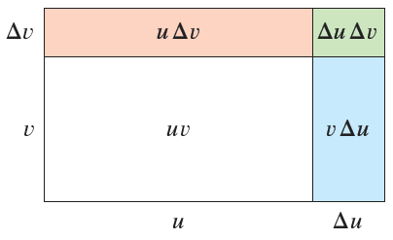
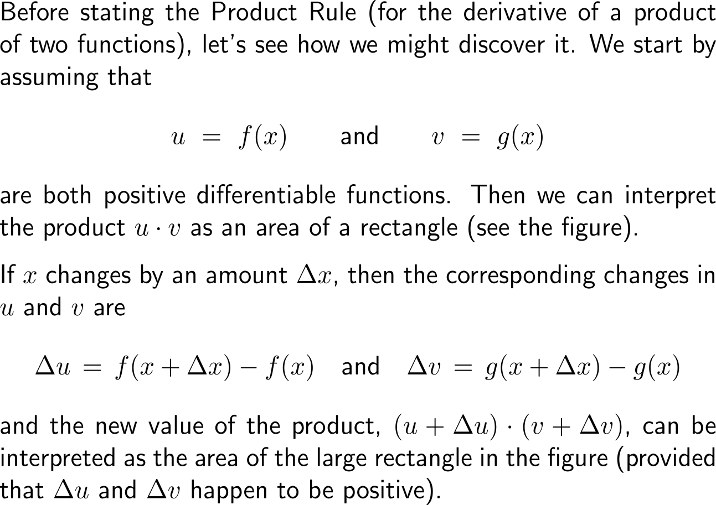
Motivation of the product rule – What is the derivative of a product of differentiable functions? (1/ 3)

Slide 18
Motivation of the product rule – What is the derivative of a product of differentiable functions? (2/ 3)

Slide 19
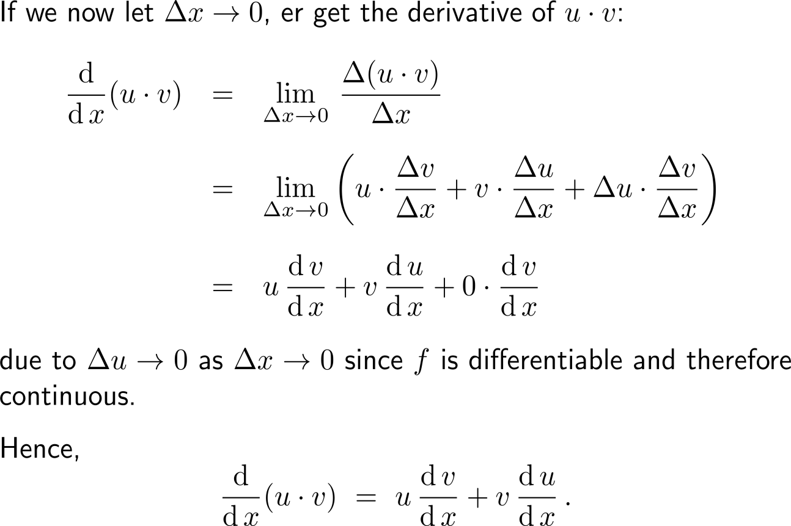
Motivation of the product rule – What is the derivative of a product of differentiable functions? (3/ 3)

Slide 20
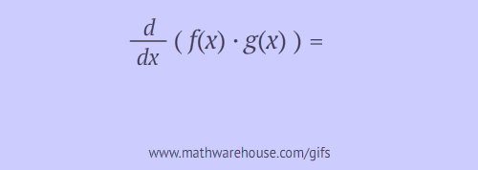
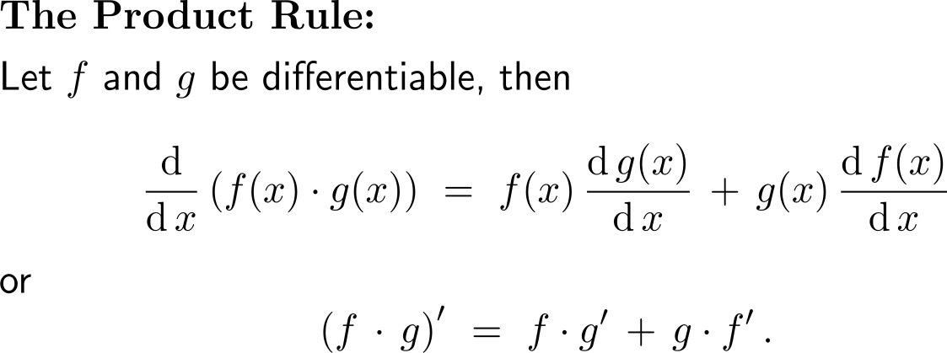
The Product Rule

Slide 21
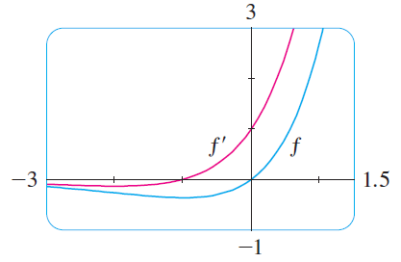
Example: Application of the Product Rule
change in the inclination behavior

Slide 22
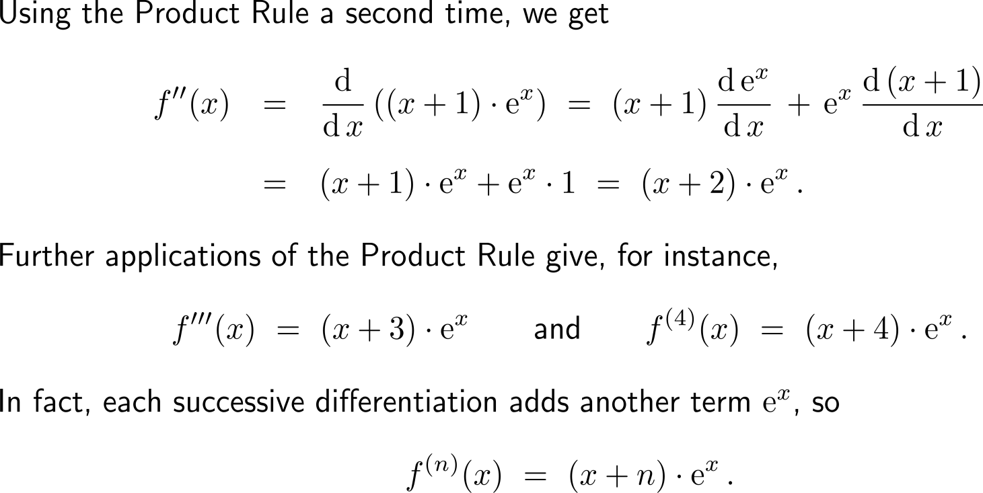
Example: Application of the Product Rule

Slide 23
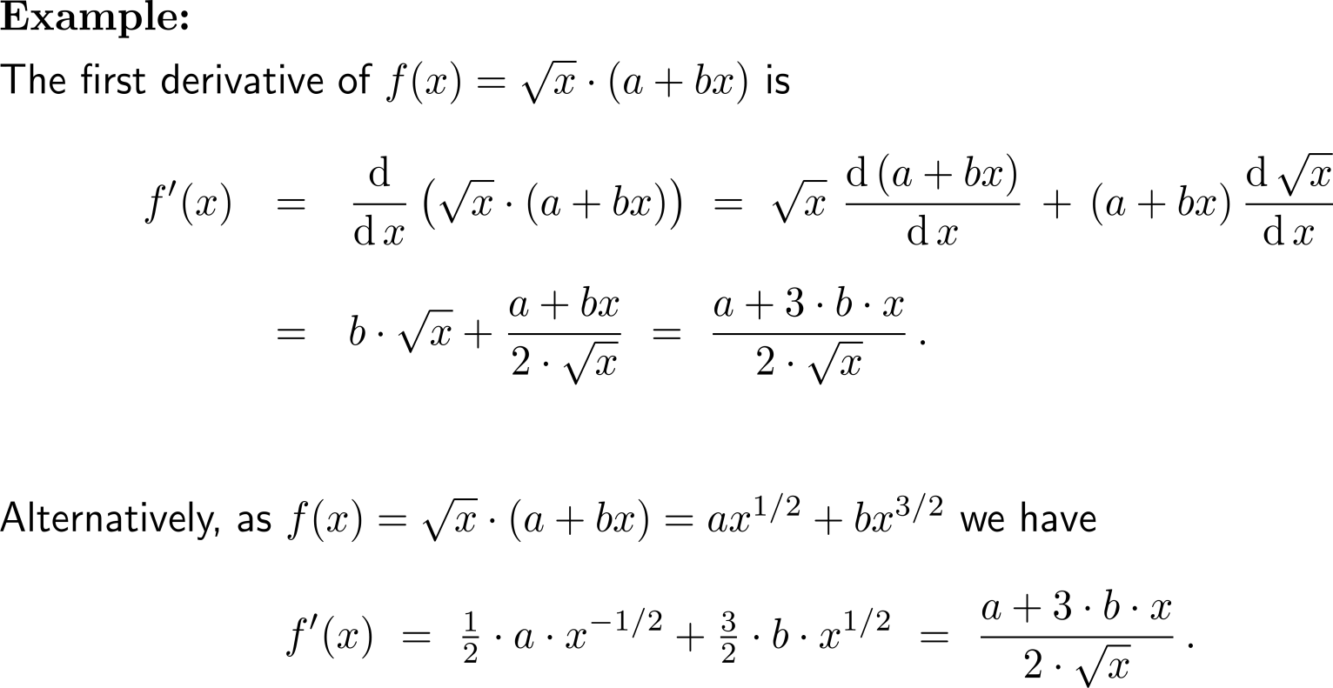
Example: Application of the Product Rule

Slide 24
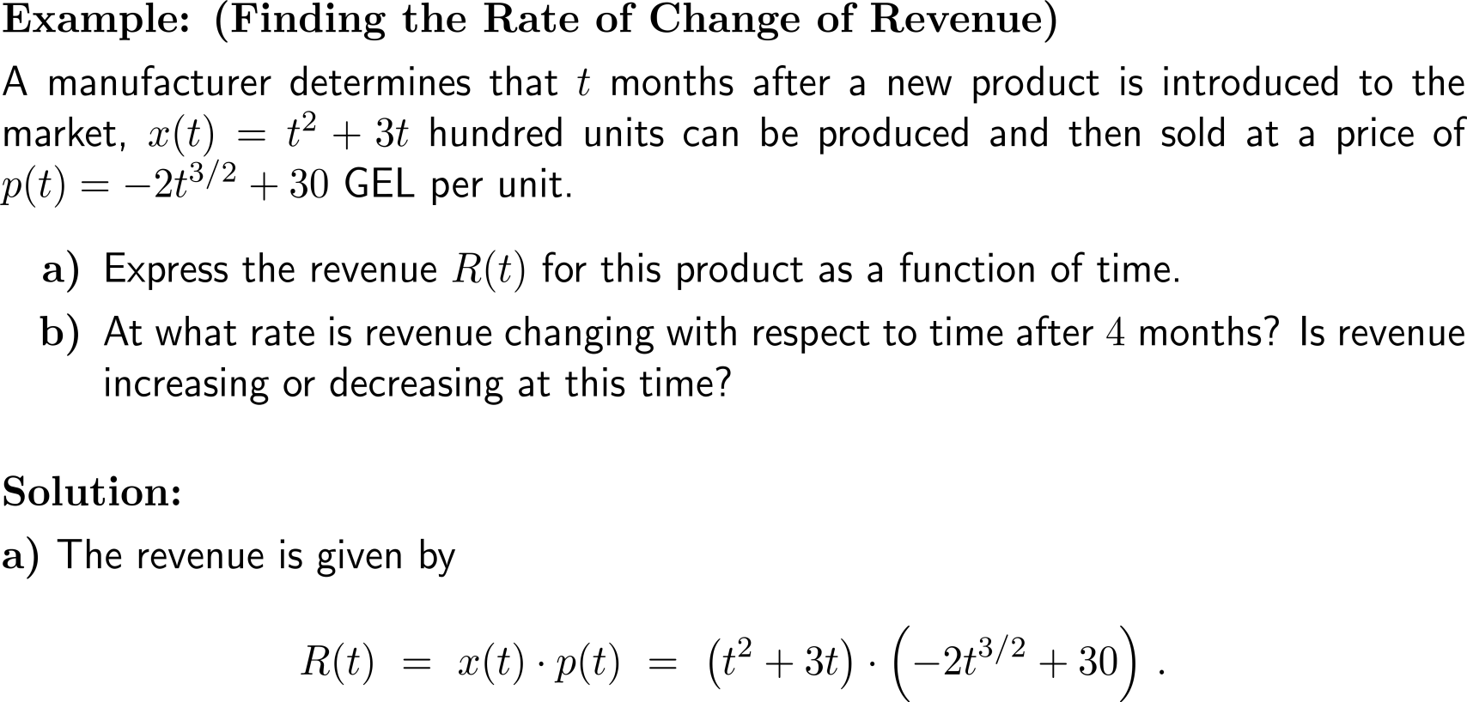
Example: Finding the rate of change of revenue

Slide 25
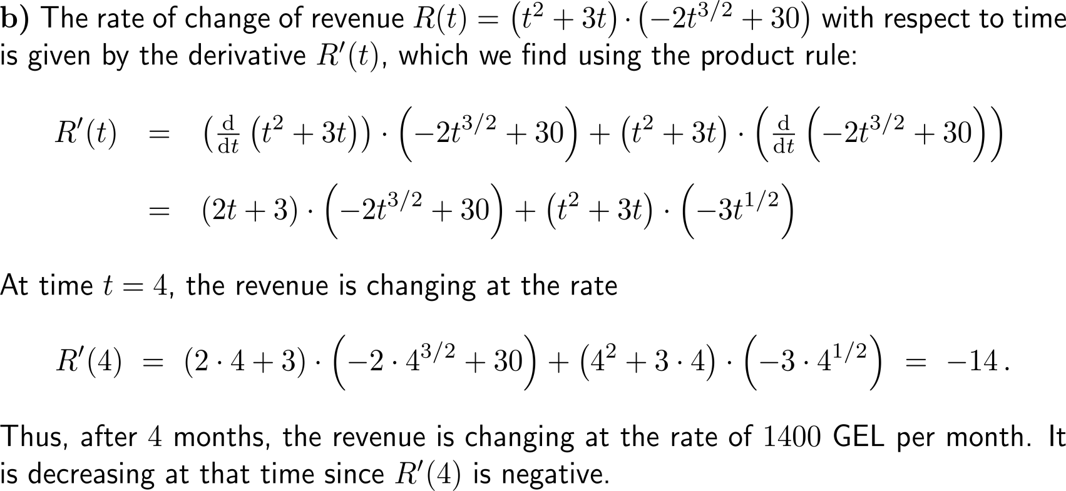
Example: Finding the rate of change of revenue

Slide 26
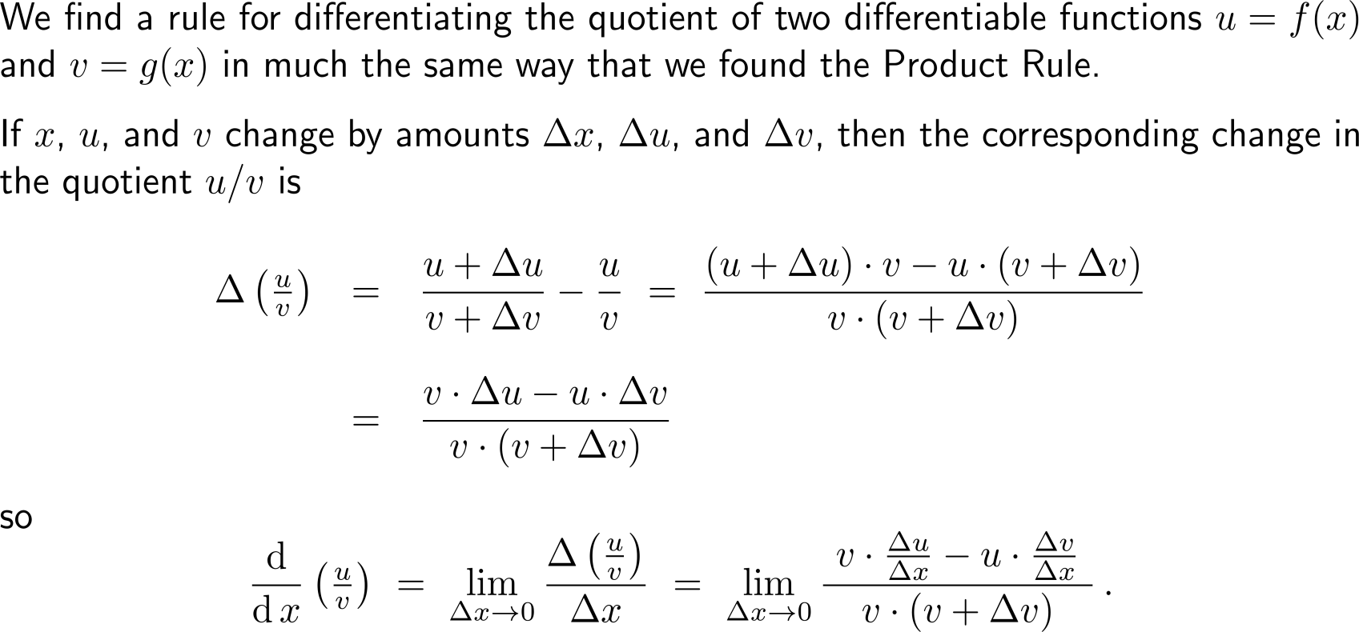
Motivation of the quotient rule – What is the derivative of a quotient of differentiable functions? (1/ 2)

Slide 27
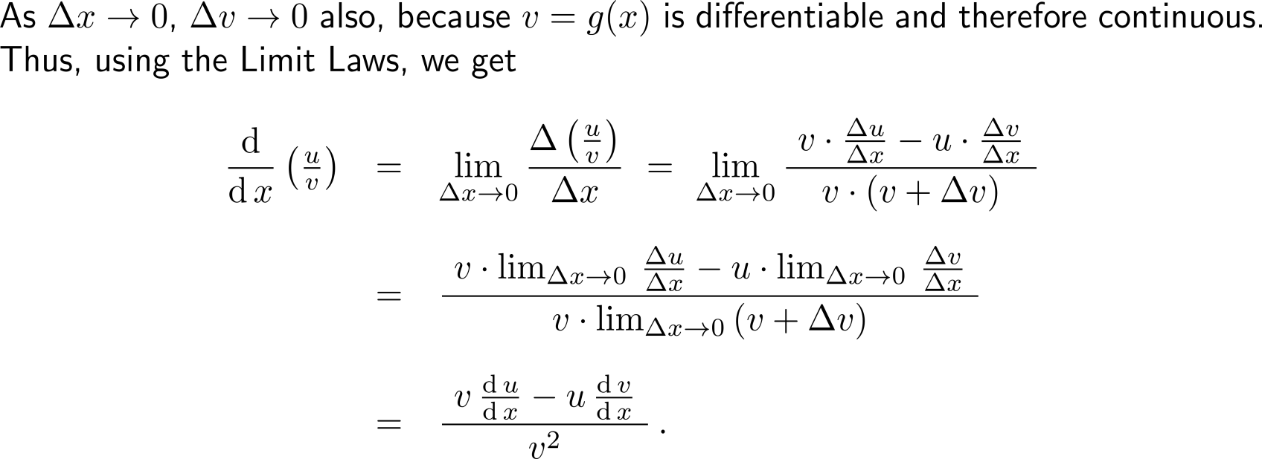
Motivation of the quotient rule – What is the derivative of a quotient of differentiable functions? (2/ 2)

Slide 28
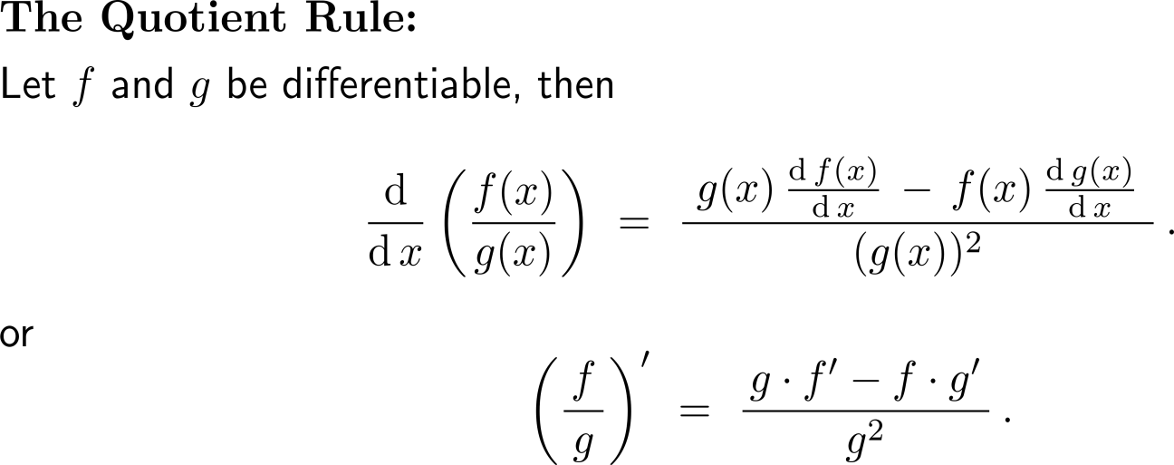
The Quotient Rule

Slide 29
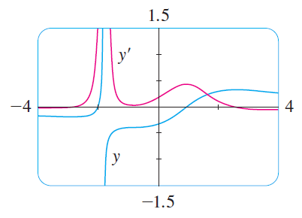
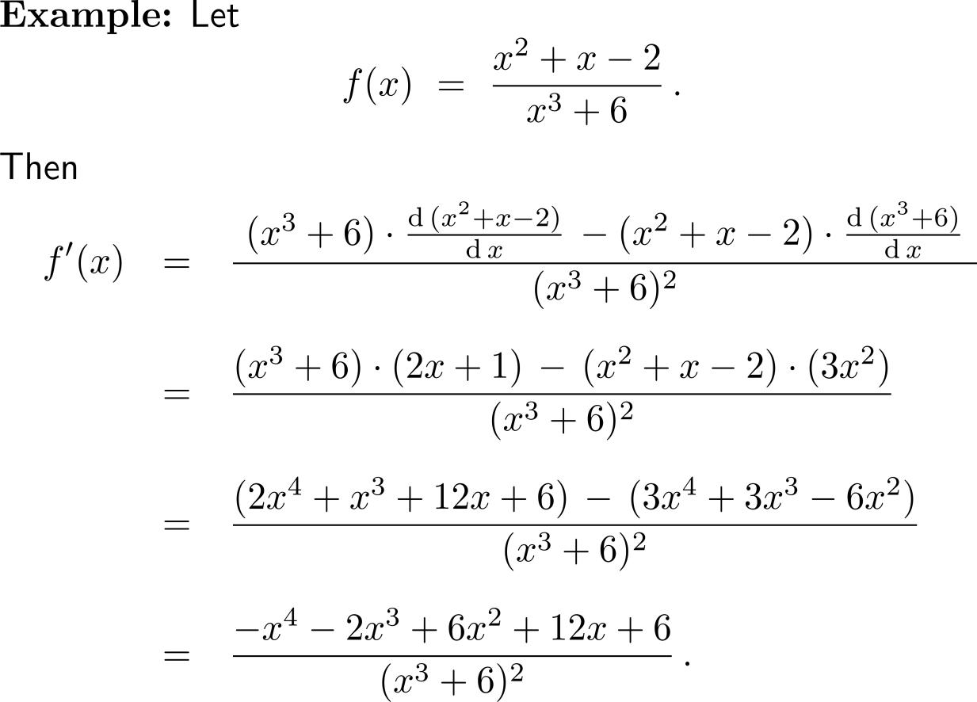
Example: Application of the Quotient Rule
Notice,
when y grows rapidly (near -2), then y’ is large, and
when y grows slowly, then y’ is near 0

Slide 30
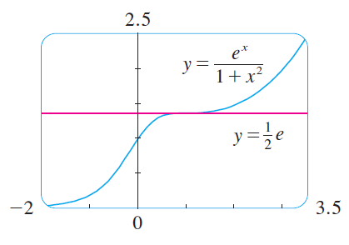
Example: Application of the Quotient Rule

Slide 31
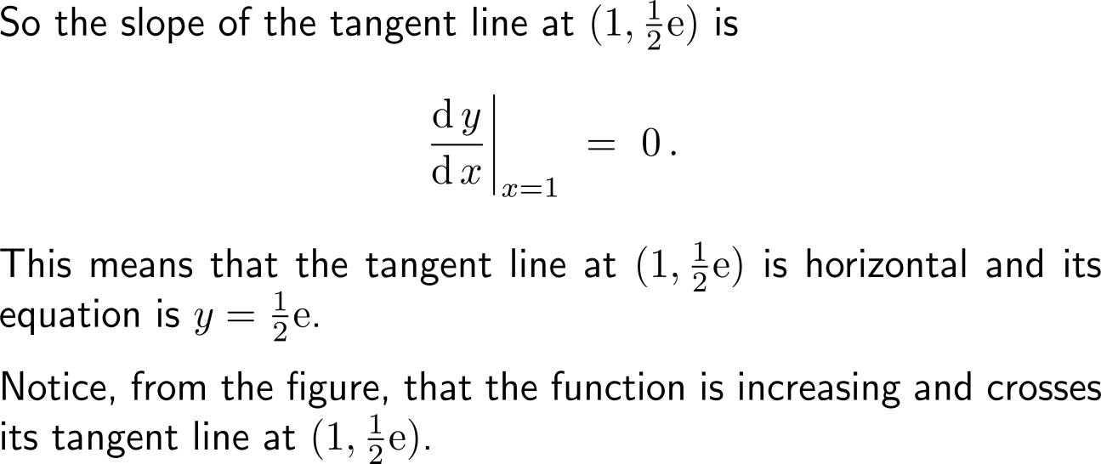
Example: Application of the Quotient Rule

Slide 32
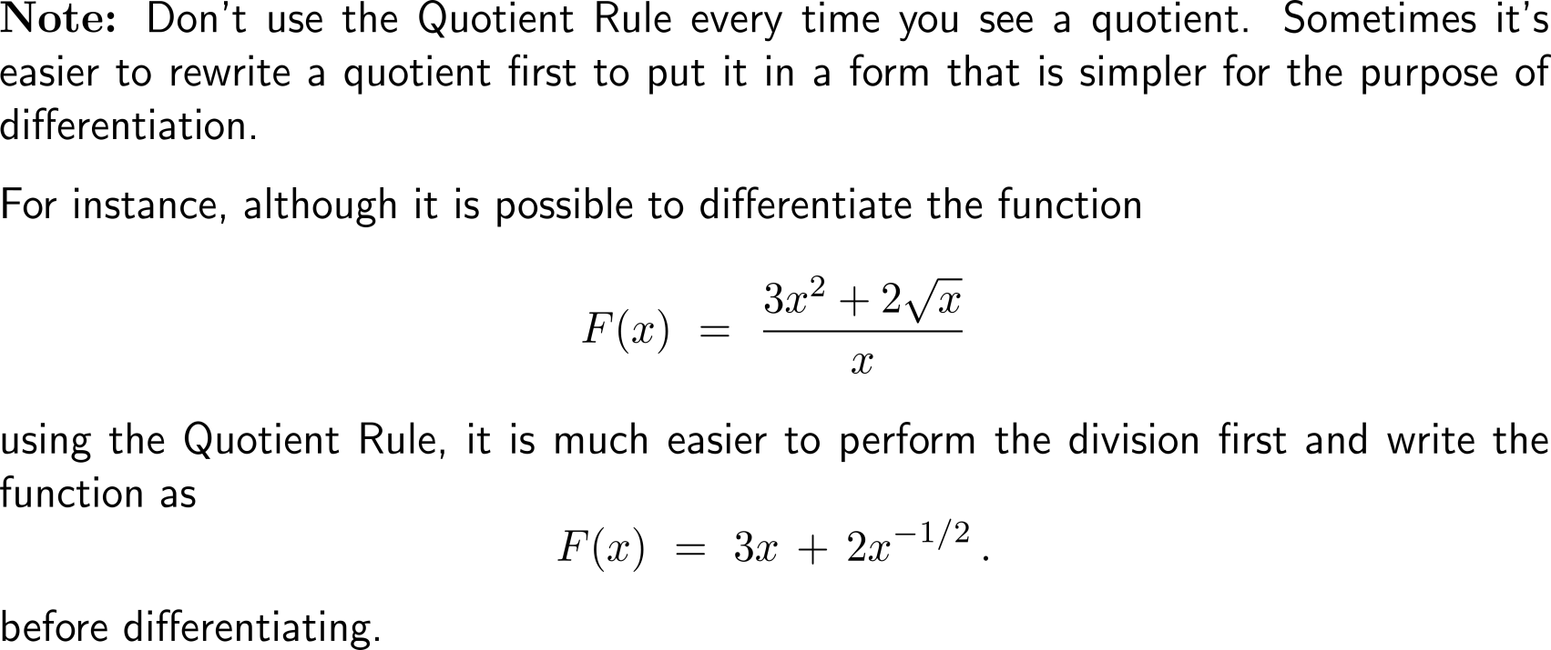
Don’t use the Quotient Rule every time you see a quotient

Slide 33
We summarize the differentiation formulas we have learned so far as follows

Slide 34
Topics
The Derivative of Exponential Functions
Higher-Order Derivatives
The Product & Quotient Rule
Derivatives of Trigonometric Functions

Slide 35
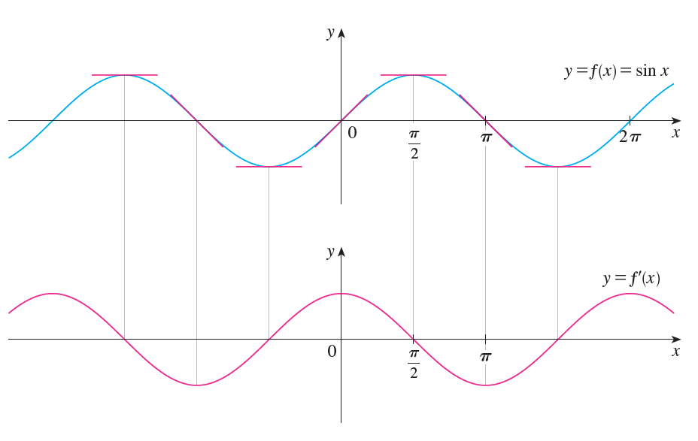
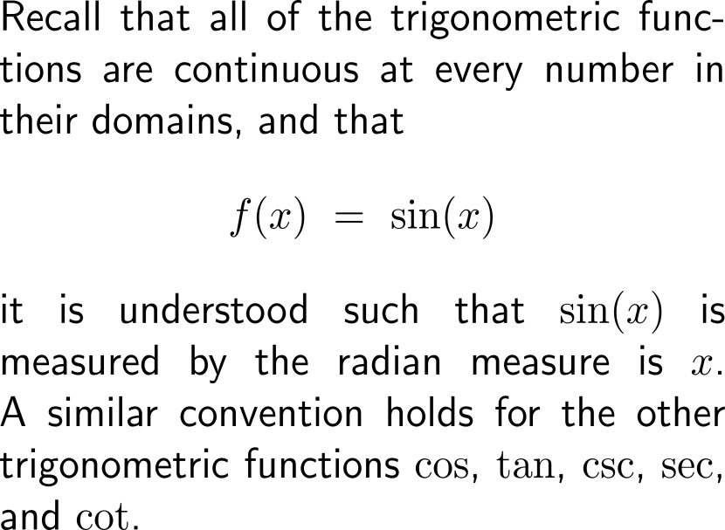
Recall, that the trigonometric functions are considered by means of the radiant measure, and that it seem that the derivative of the sine is cosine

Slide 36
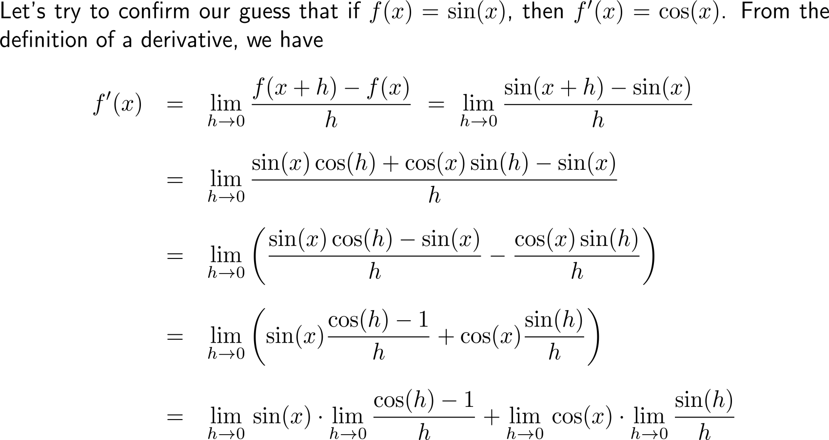
Derivation of the derivative of the sine function (1/ 4)

Slide 37
Derivation of the derivative of the sine function (2/ 4)

Slide 38
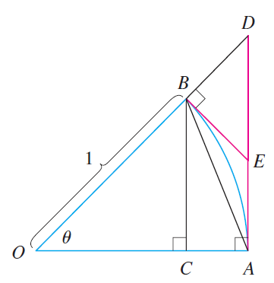
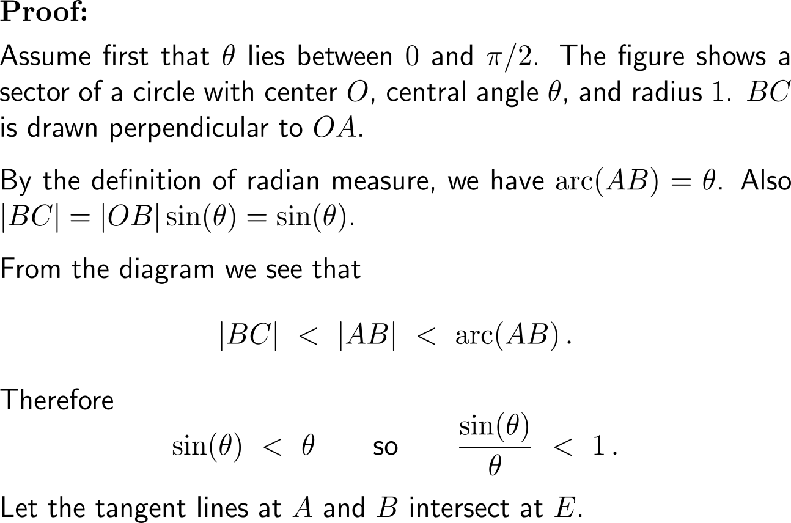
Proof (1/ 3): Behavior of sin(θ) for θ → 0

Slide 39
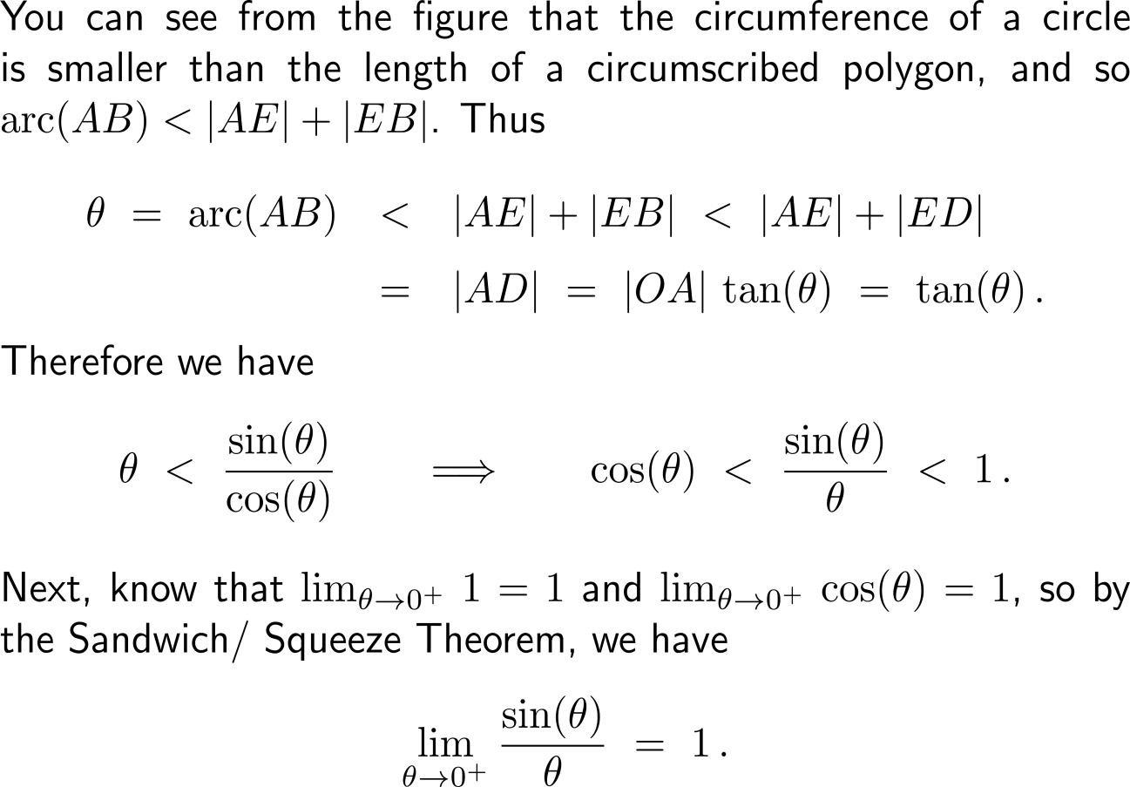
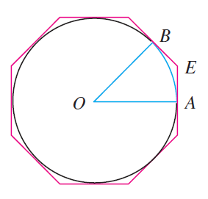
Proof (2/ 3): Behavior of sin(θ) for θ → 0

Slide 40
Proof (3/ 3): Behavior of sin(θ) for θ → 0

Slide 41
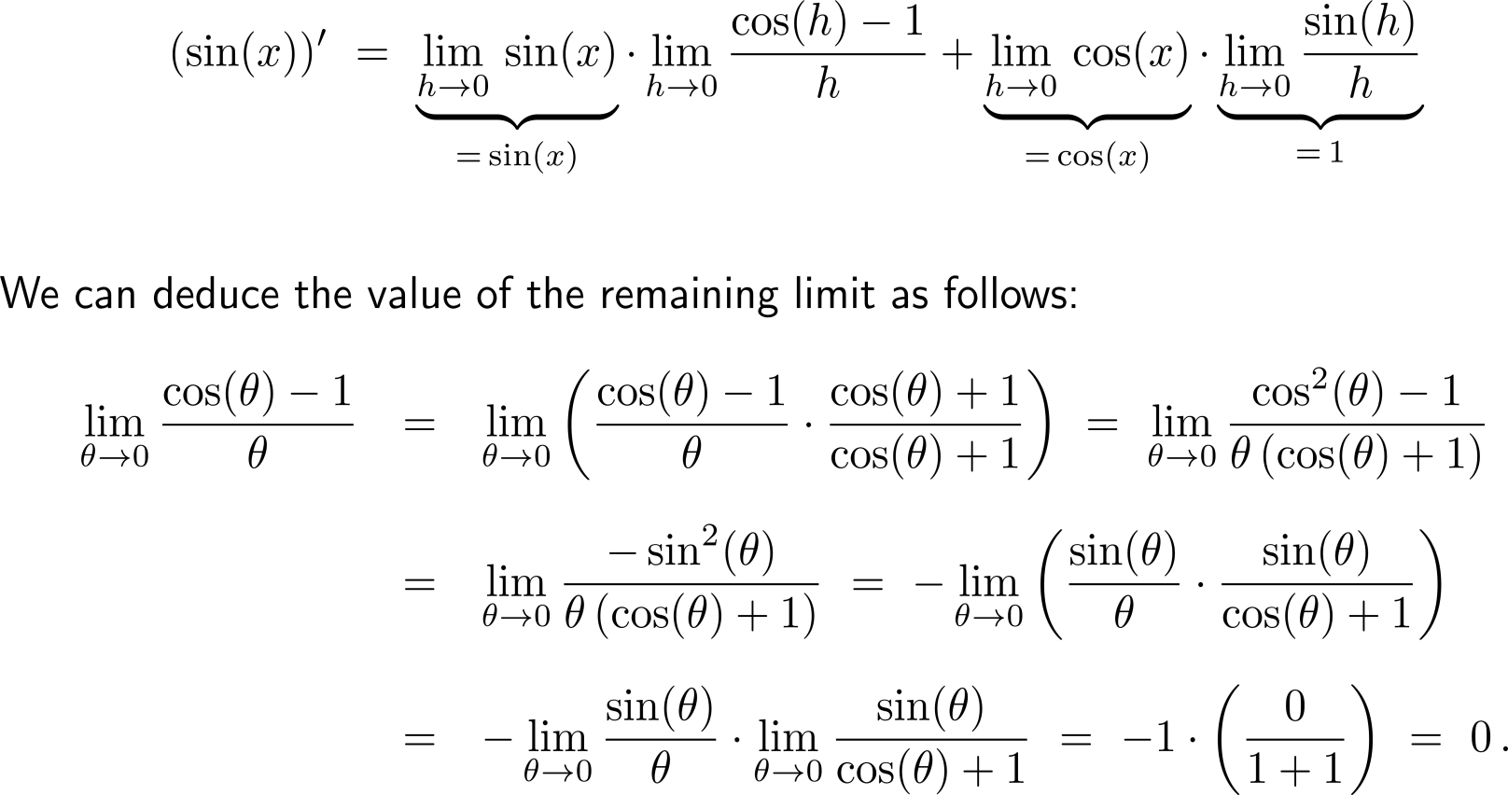
Derivation of the derivative of the sine function (3/ 4)

Slide 42
Derivation of the derivative of the sine function (4/ 4)

Slide 43
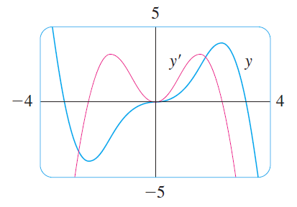
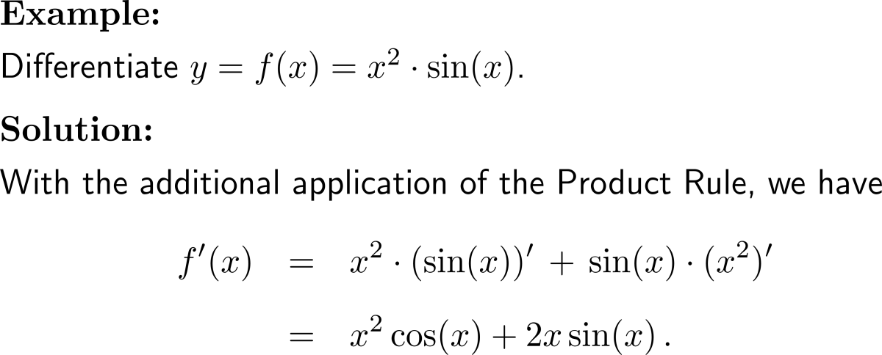
Example: Derivative of sine

Slide 44
Applying the Quotient Rule gives the differentiation formula for the tangent function

Slide 45
We collect all the differentiation formulas for trigonometric functions in the following table
Note, these formula are valid only when x is measured in radians.

Slide 46
Further Worked-Out Exercises:
Calculus I for Management
Topics
Derivative of exponential functions
Higher-order derivatives
The product & quotient rule
Derivatives of trigonometric functions

Slide 47
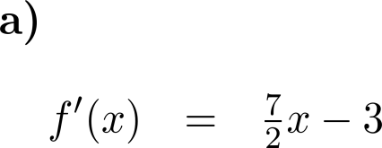
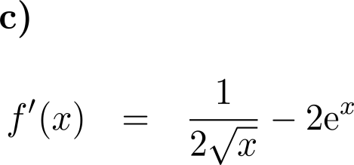
Exercise: Application of Differentiation Rules
5 minutes
self/ group work
please, upload your solutions to the chat

Slide 48
Exercise: Application of Differentiation Rules

Slide 49
Exercise: Application of Differentiation Rules

Slide 50
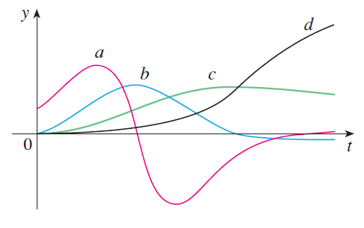
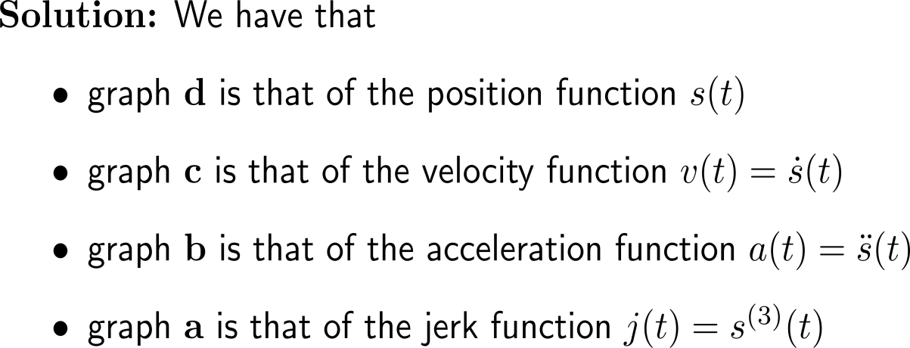
Exercise: Connecting Derivatives and Graphs
Based on how strong the graph of d increases, we see that c the graph of its derivative.
Based on the inclination behavior, we have that the graph of b is that of the derivative of c.
From the previous problem, we have that the graph a is the graph of the derivative of b.

Slide 51
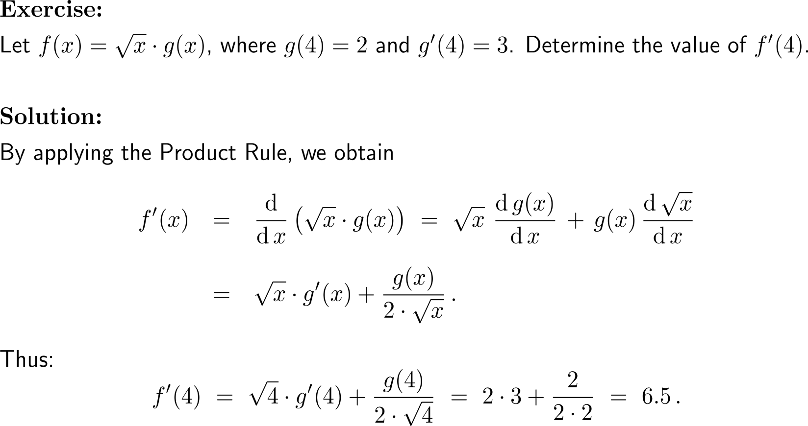
Exercise: Application of the Product Rule

Slide 52
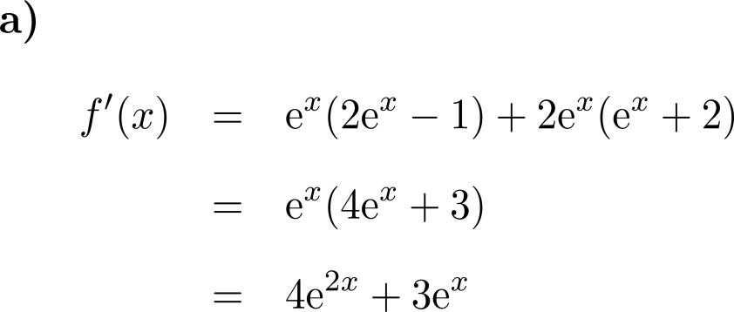
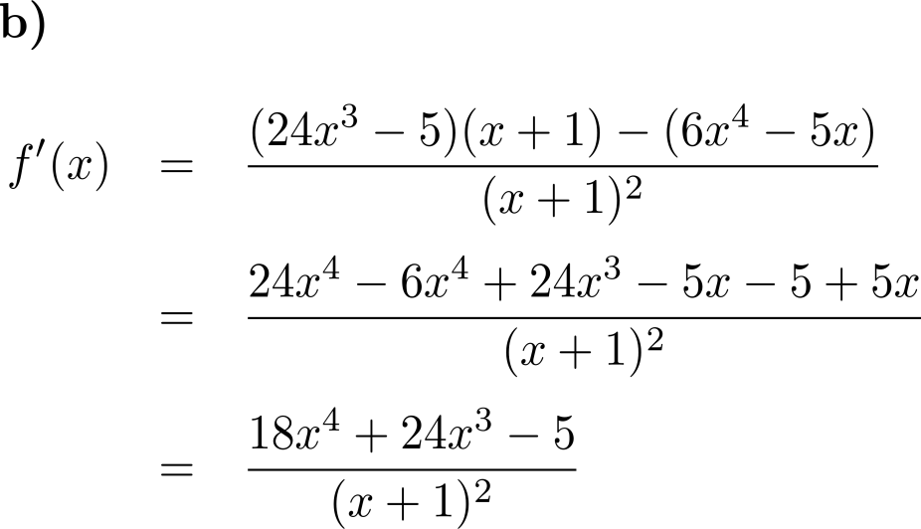
Exercise: Product and Quotient Rule
10 minutes
self/ group work
please, upload your solutions to the chat

Slide 53
Exercise: Application of the Quotient Rule

Slide 54
Calculus I for Management

