Slide 1
Calculus I for MGMT – Advanced Differentiation Rules The Derivative of Exponential Functions
Mathematics for Management
Supplementary Electronic Materials
Advanced
Differentiation Rules
The Derivative of
Exponential Functions
Higher-Order Derivatives
The Product & Quotient Rule
Derivatives of
Trigonometric Functions

Slide 2
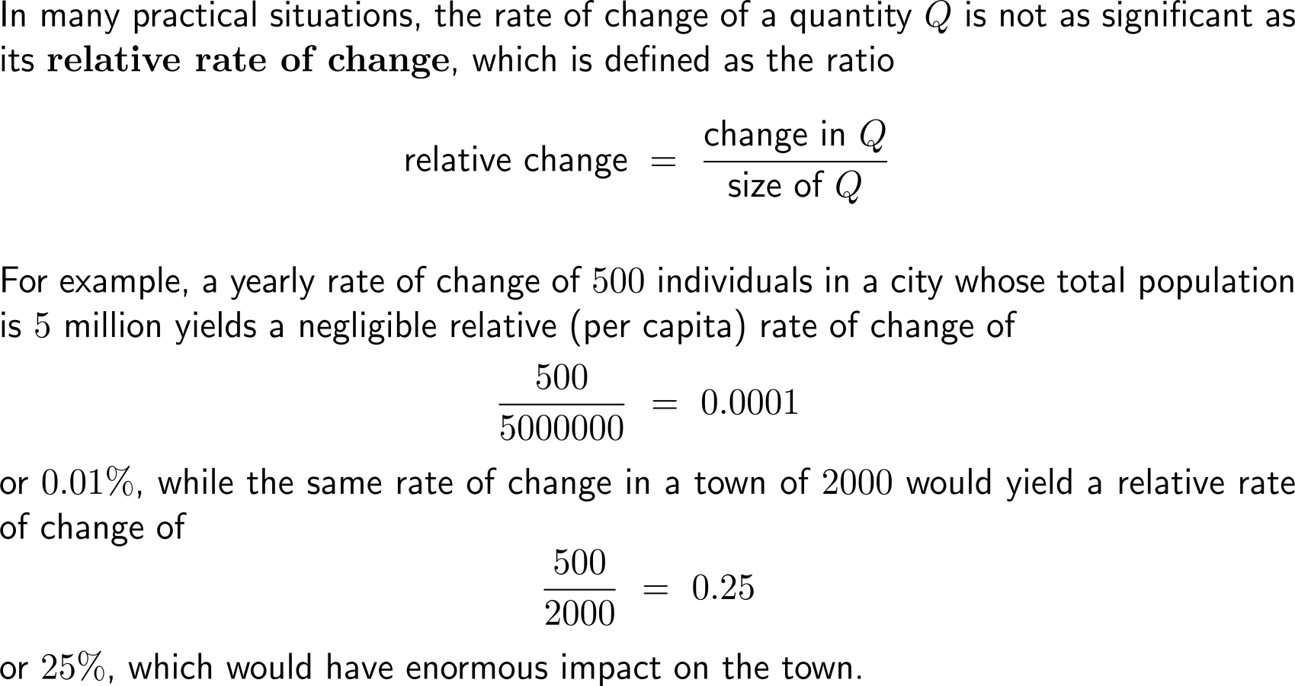
Relative and percentage rates of change are used to describe changes of a quantity w.r.t. the size of this quantity (1/ 2)

Slide 3
Relative and percentage rates of change are used to describe changes of a quantity w.r.t. the size of this quantity (2/ 2)

Slide 4
The derivative of the exponential function …

Slide 5
… gives rise to the definition of a “new” number: the Euler number e

Slide 6
In particular, the natural exponential function with base e is the only non-constant function whose derivative is equal to the function itself

Slide 7
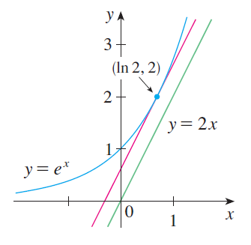
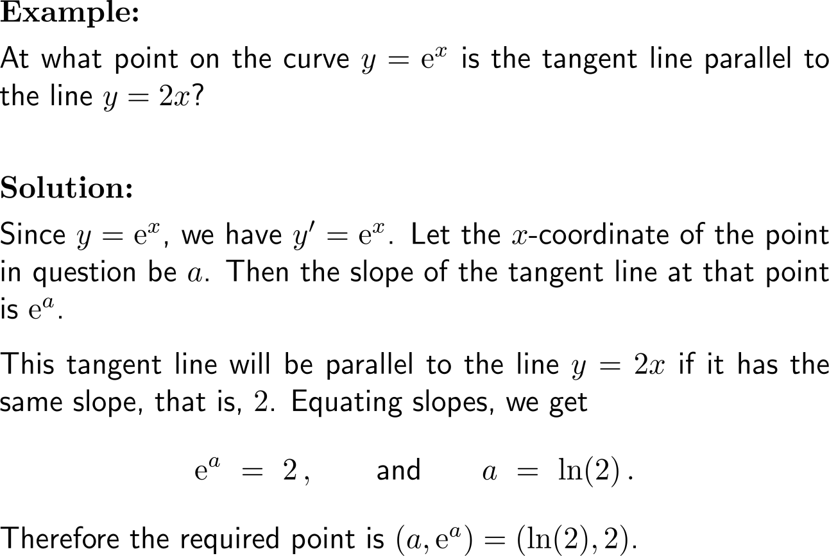
Example: Derivative of the natural exponential function

Slide 8
Calculus I for Management

