Slide 1
Calculus I for MGMT – Advanced Differentiation Rules Higher-Order Derivatives
Mathematics for Management
Supplementary Electronic Materials
Advanced
Differentiation Rules
The Derivative of
Exponential Functions
Higher-Order Derivatives
The Product & Quotient Rule
Derivatives of
Trigonometric Functions

Slide 2
Often it is possible to take the derivative of a derivative (i.e. the second derivative) or even derivatives of higher order
derivative
of
first
derivative
second
derivative
the 0-th derivative is the function itself:
f⁽⁰⁾(x) = f(x)

Slide 3
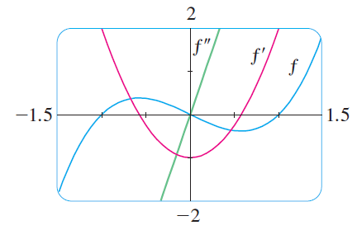
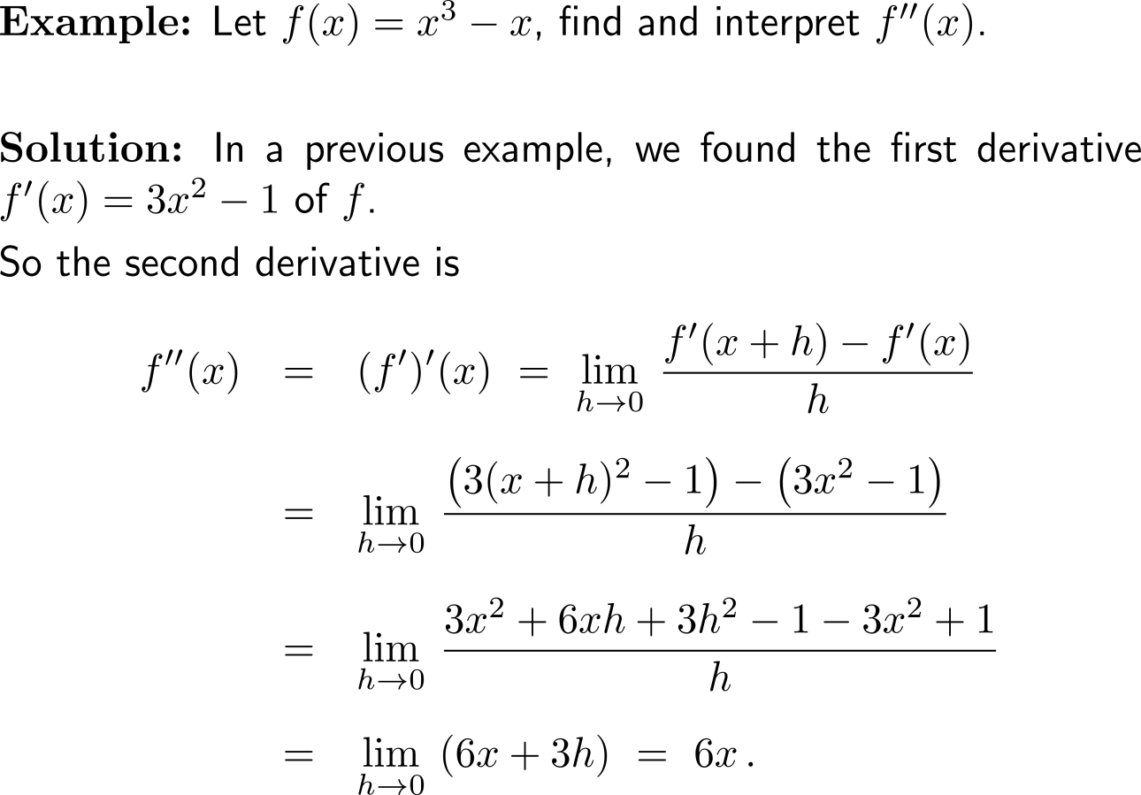
Example: Computation of the second derivative

Slide 4
Example: Computation of the second derivative

Slide 5
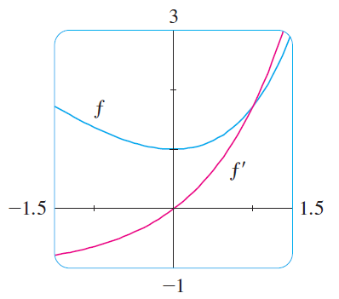
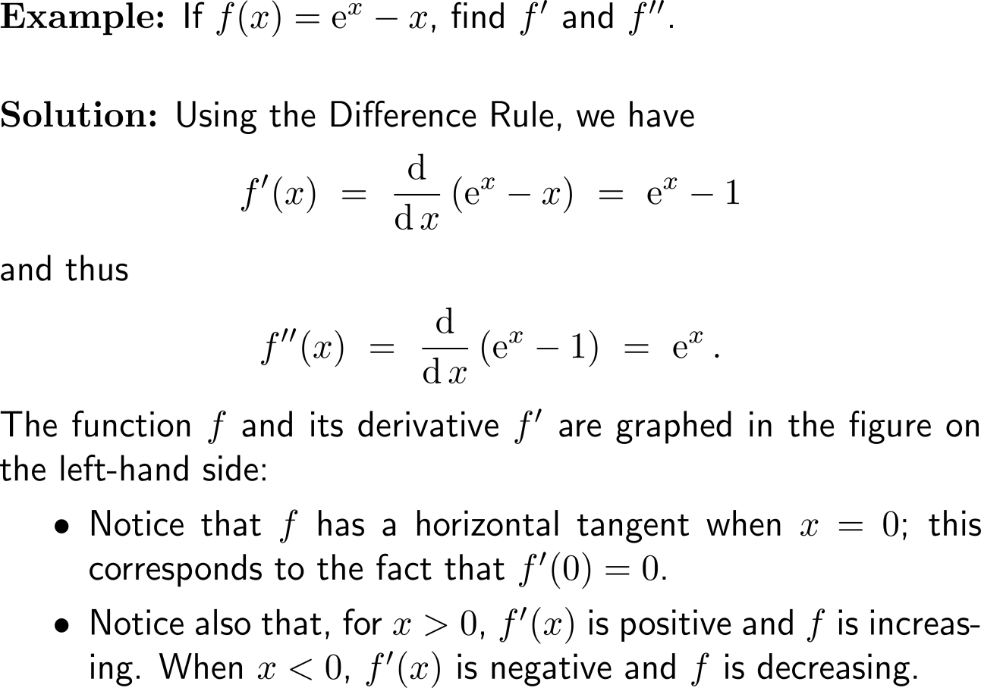
Example: Derivative of the natural exponential function

Slide 6
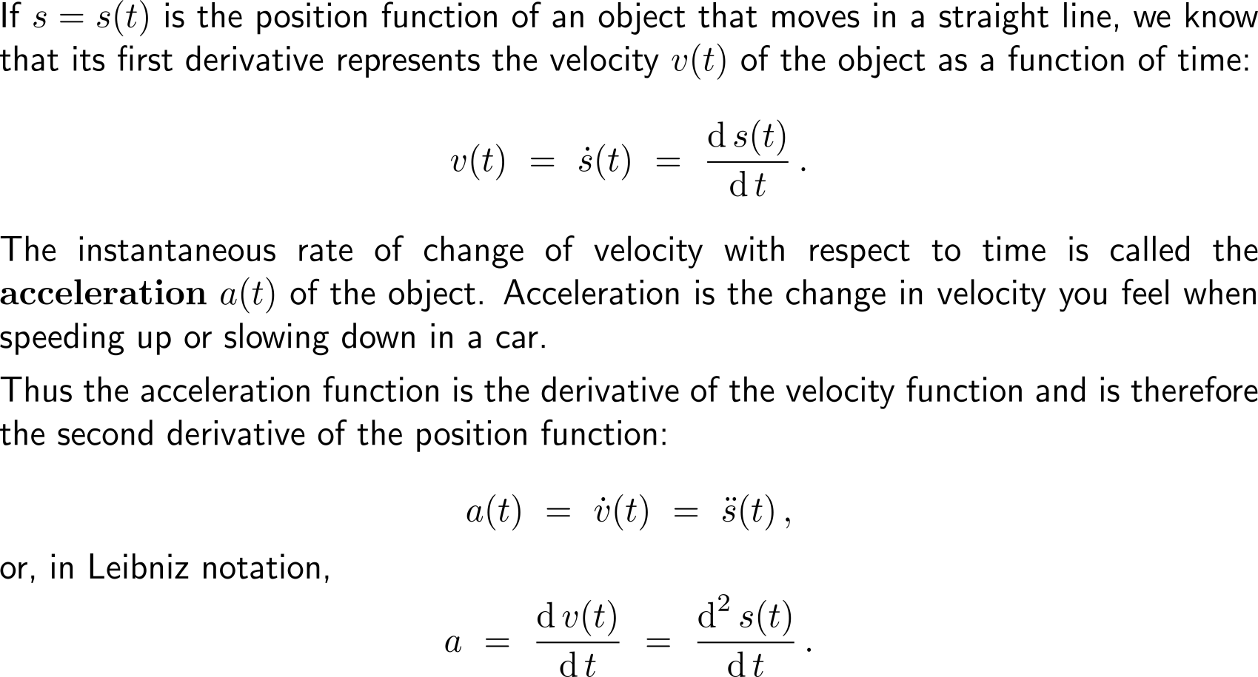
In general, we can interpret a second derivative as a rate of change of a rate of change: the most familiar example of this is acceleration
for time-dependent functions we use the dot-notation to indicate derivatives

Slide 7
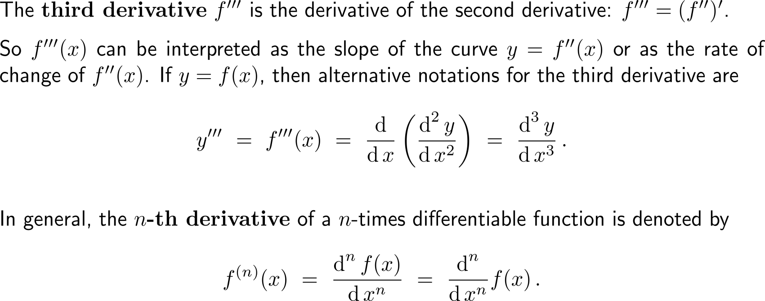
The third derivative and even higher-orders…

Slide 8
Calculus I for Management

