Slide 1
Calculus I for MGMT – Advanced Differentiation Rules Derivatives of Trigonometric Functions
Mathematics for Management
Supplementary Electronic Materials
Advanced
Differentiation Rules
The Derivative of
Exponential Functions
Higher-Order Derivatives
The Product & Quotient Rule
Derivatives of
Trigonometric Functions

Slide 2
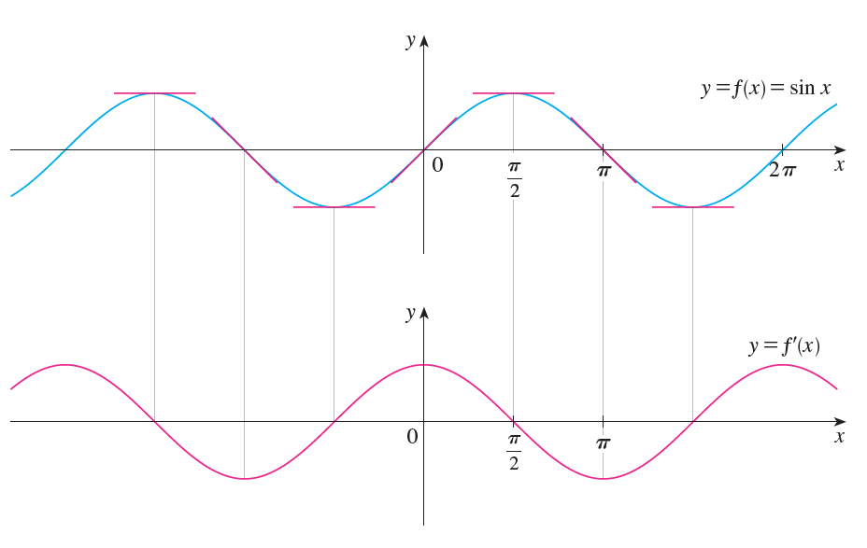
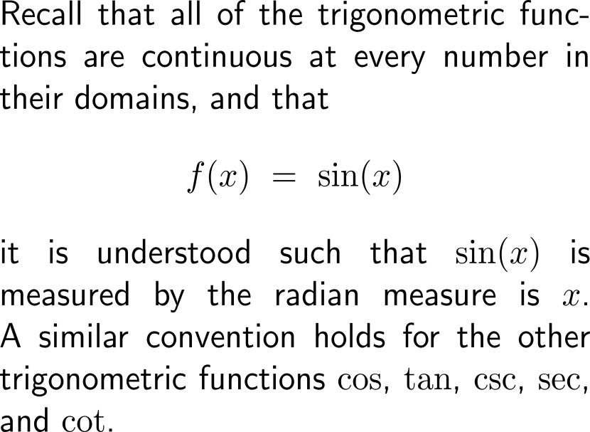
Recall, that the trigonometric functions are considered by means of the radiant measure, and that it seem that the derivative of the sine is cosine

Slide 3
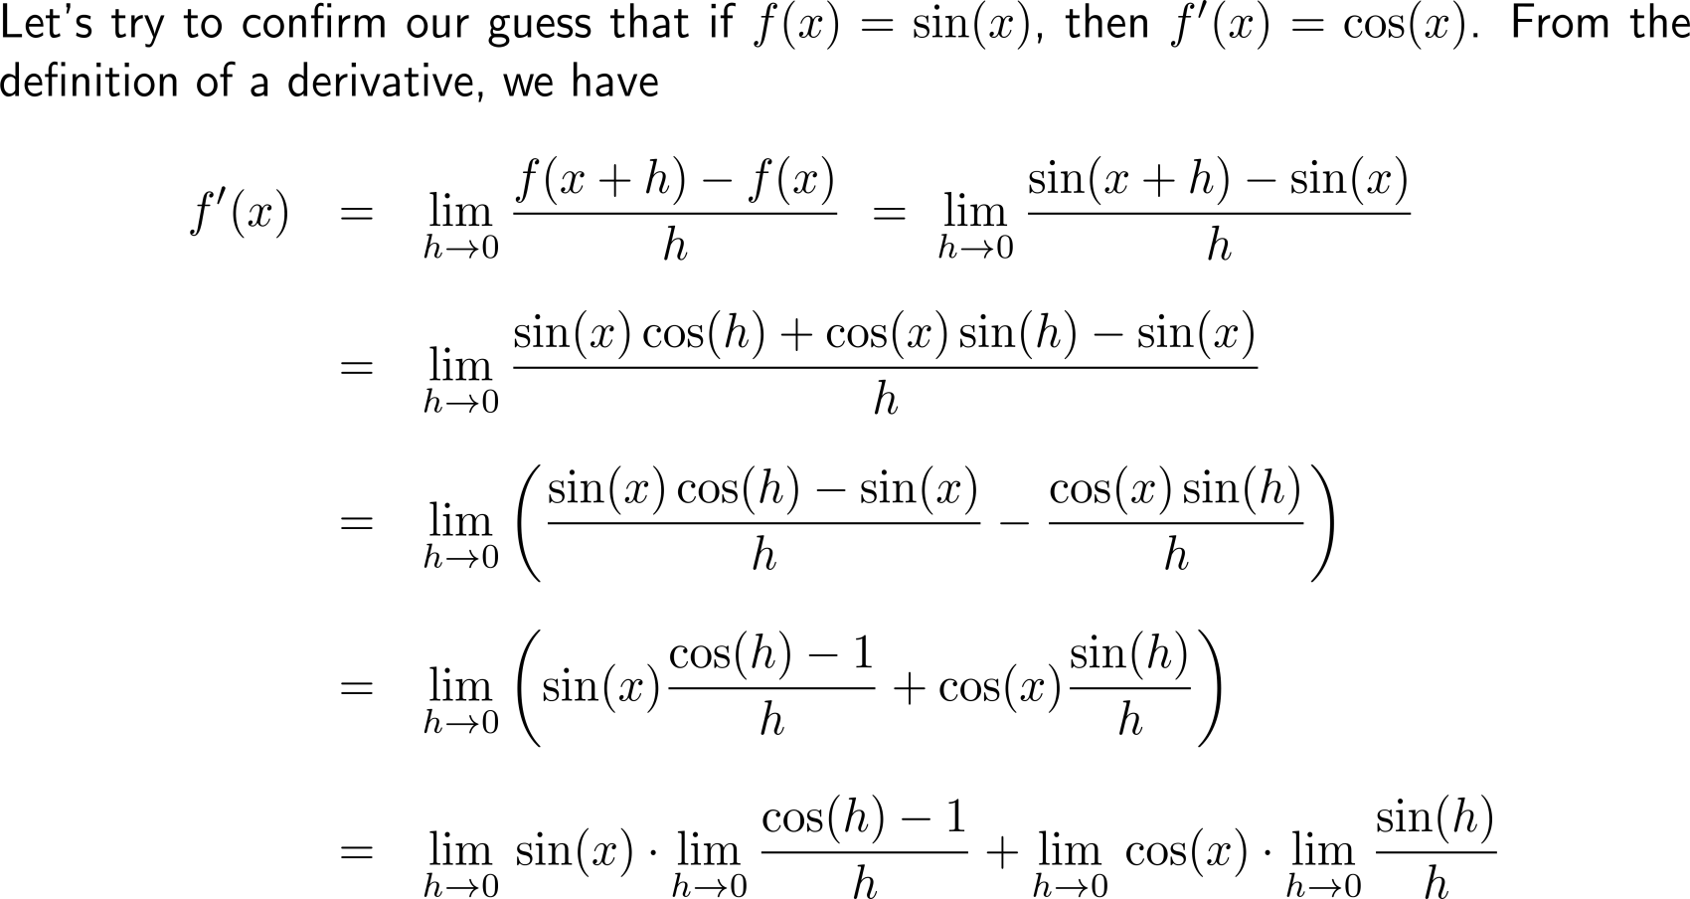
Derivation of the derivative of the sine function (1/ 4)

Slide 4
Derivation of the derivative of the sine function (2/ 4)

Slide 5
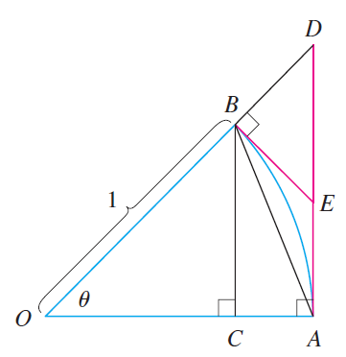
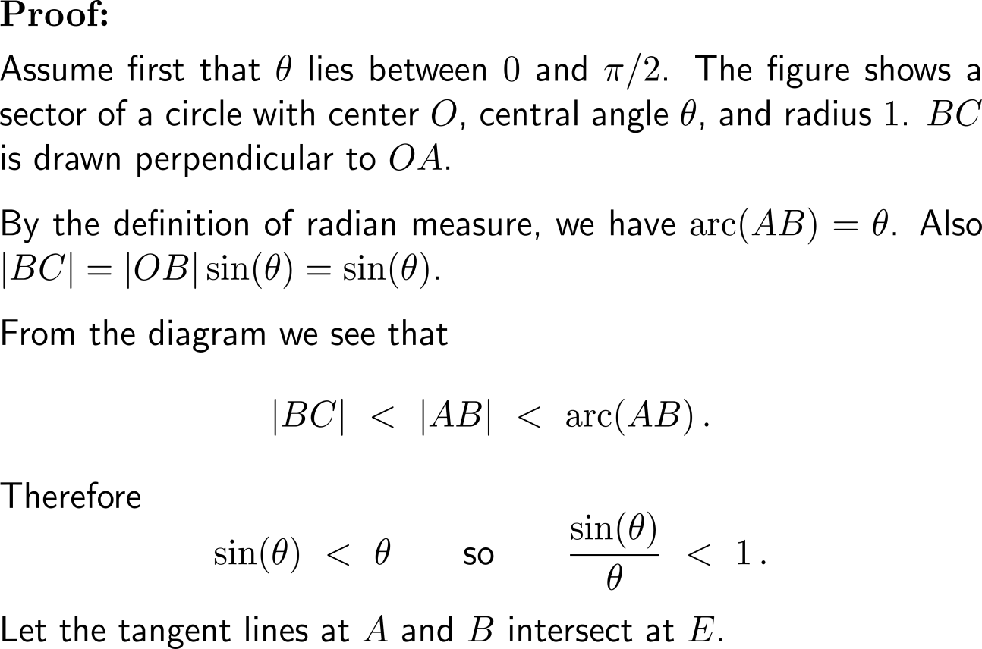
Proof (1/ 3): Behavior of sin(θ) for θ → 0

Slide 6
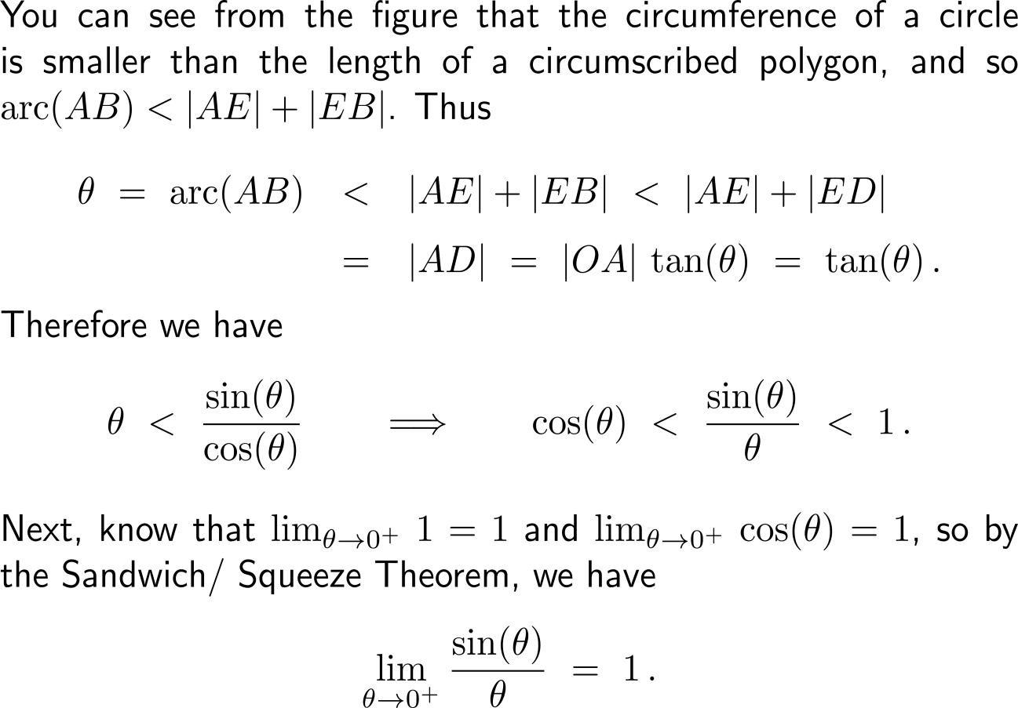
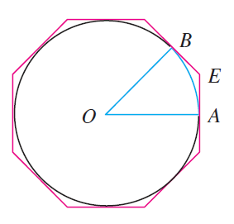
Proof (2/ 3): Behavior of sin(θ) for θ → 0

Slide 7
Proof (3/ 3): Behavior of sin(θ) for θ → 0

Slide 8
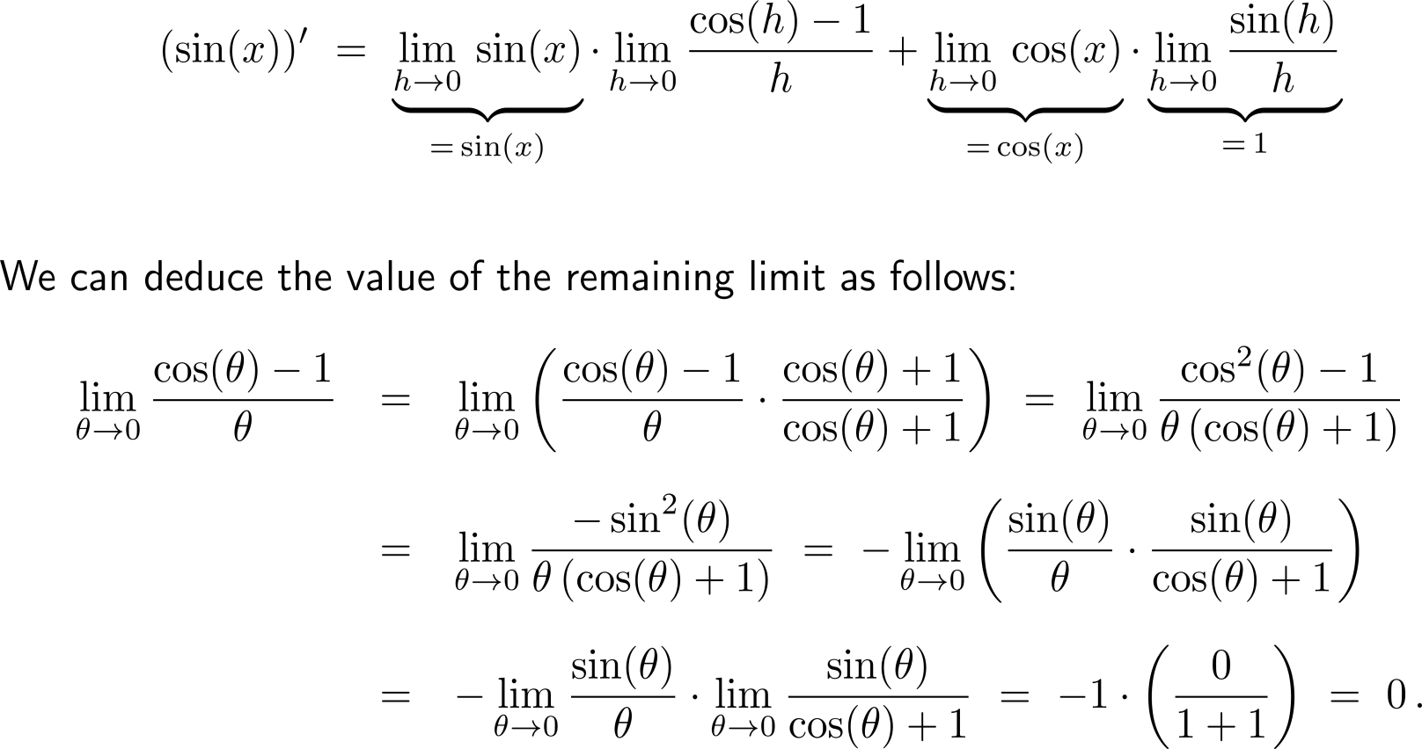
Derivation of the derivative of the sine function (3/ 4)

Slide 9
Derivation of the derivative of the sine function (4/ 4)

Slide 10
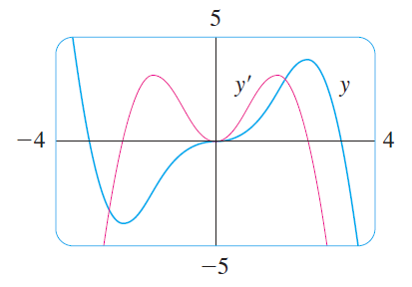
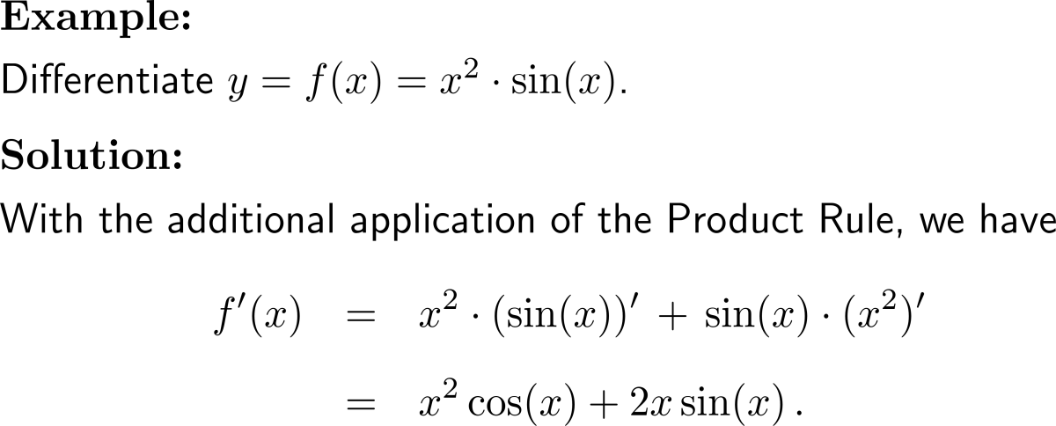
Example: Derivative of sine

Slide 11
Applying the Quotient Rule gives the differentiation formula for the tangent function

Slide 12
We collect all the differentiation formulas for trigonometric functions in the following table
Note, these formula are valid only when x is measured in radians.

Slide 13
Calculus I for Management

