Slide 1
Calculus I for Management
Applications of Differentiation
week 6
Lecture
The Chain Rule
Implicit differentiation
Linear Approximation
L’Hospital’s rules & indeterminate forms

Slide 2
Topics
The Chain Rule
Implicit Differentiation
Linear Approximation
L’Hospital’s Rules

Slide 3
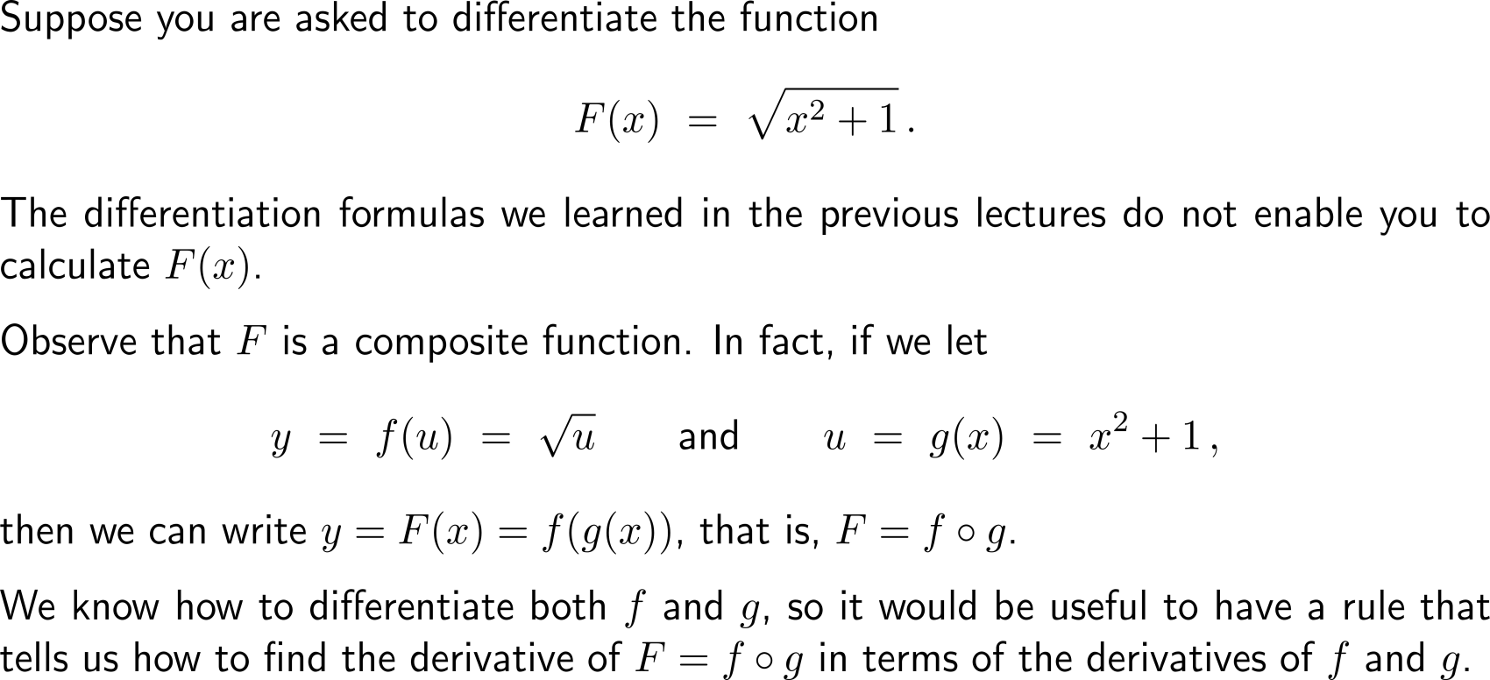
In order to differentiate composite functions …

Slide 4
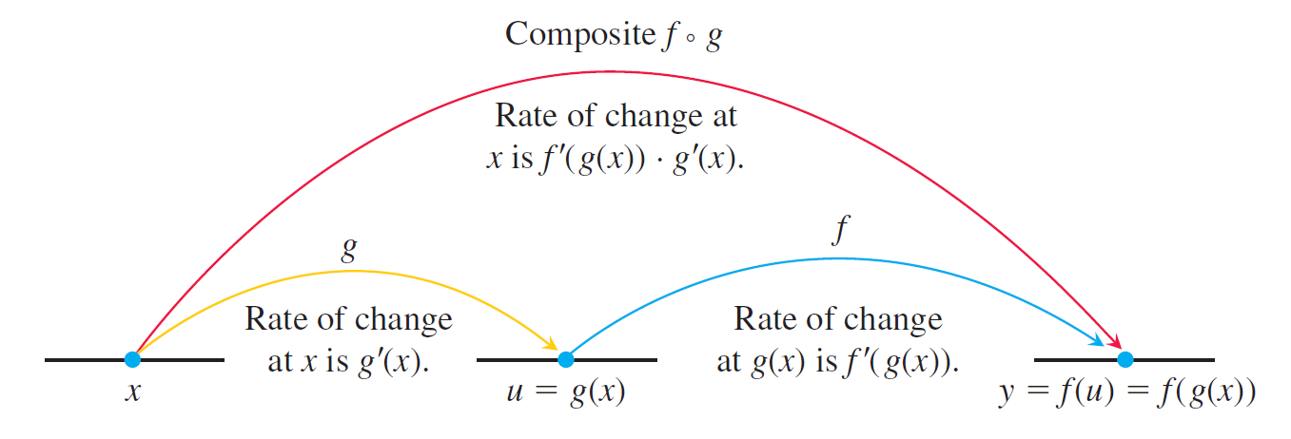
… we need to consider a two step procedure that takes care of the derivatives of the outer and the inner function

Slide 5
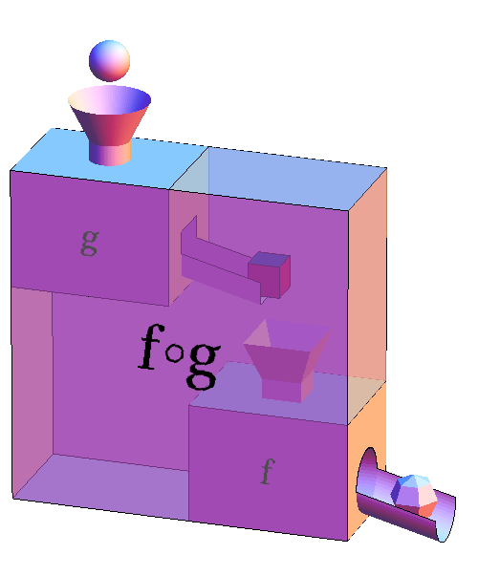
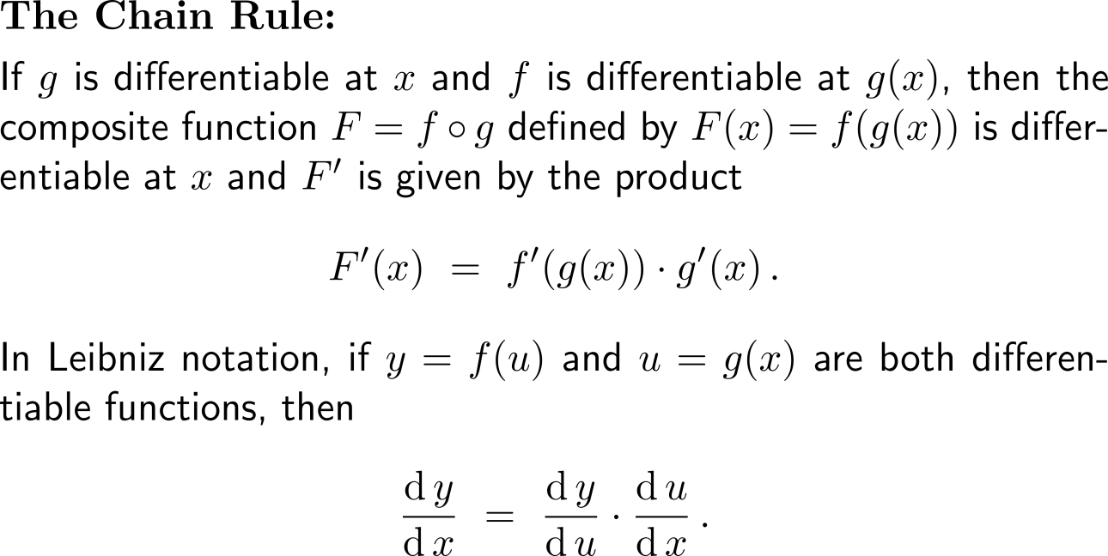
The Chain Rule: the derivative of a composite function is the product of the derivatives of the outer and the inner function

Slide 6
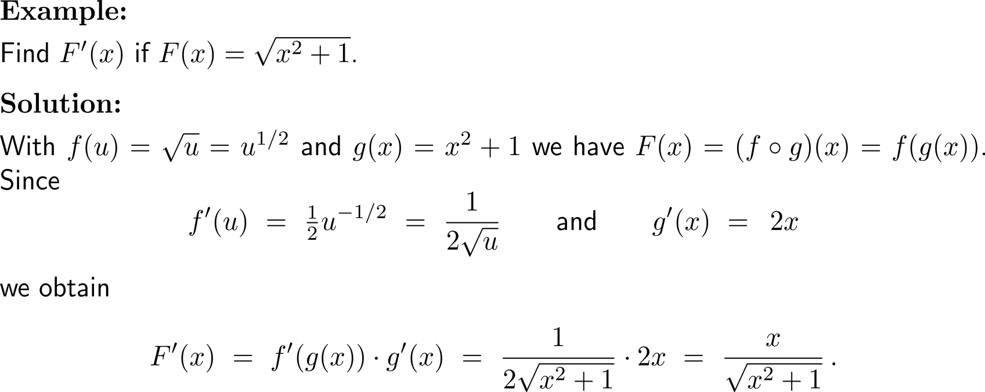
Example: Application of the Chain Rule

Slide 7
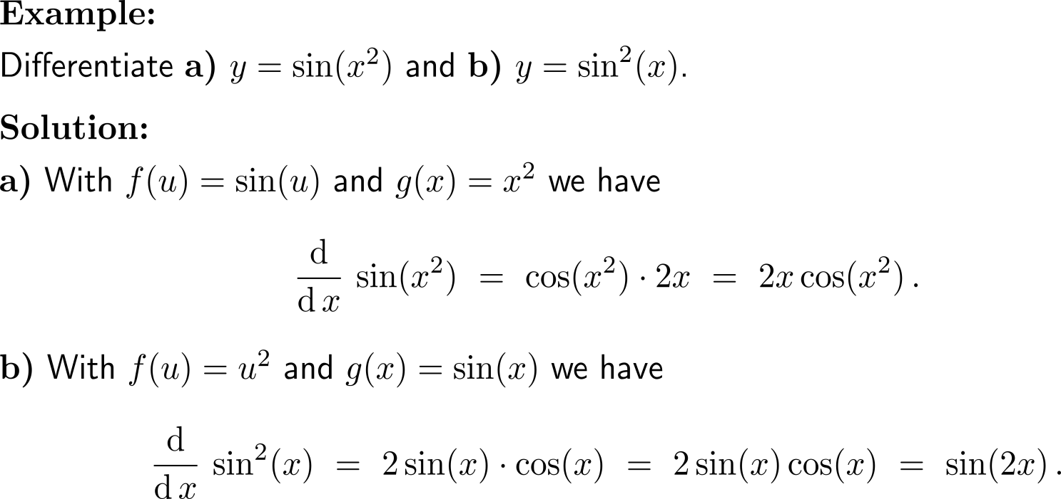
Example: Application of the Chain Rule

Slide 8
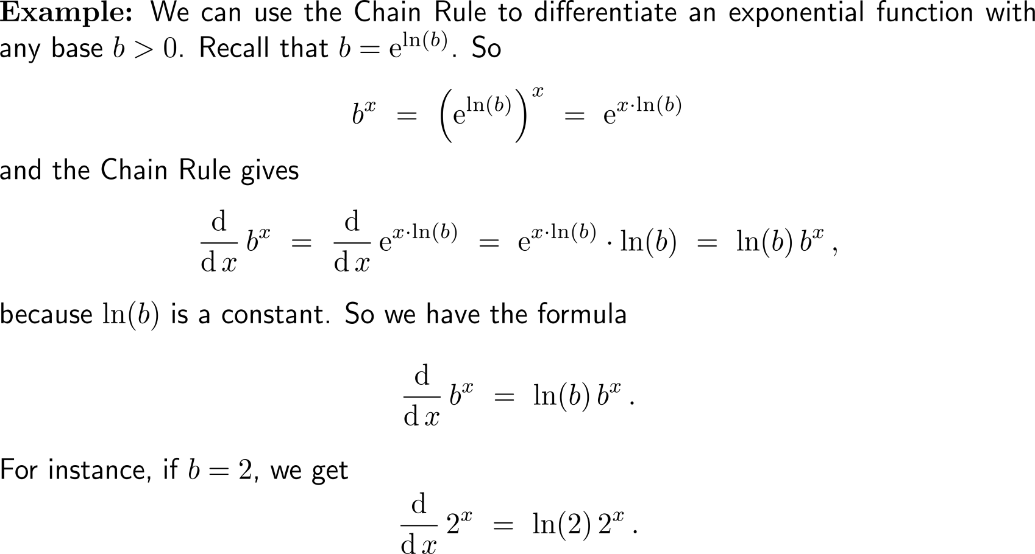
Example: Application of the Chain Rule for differentiating exponential functions

Slide 9
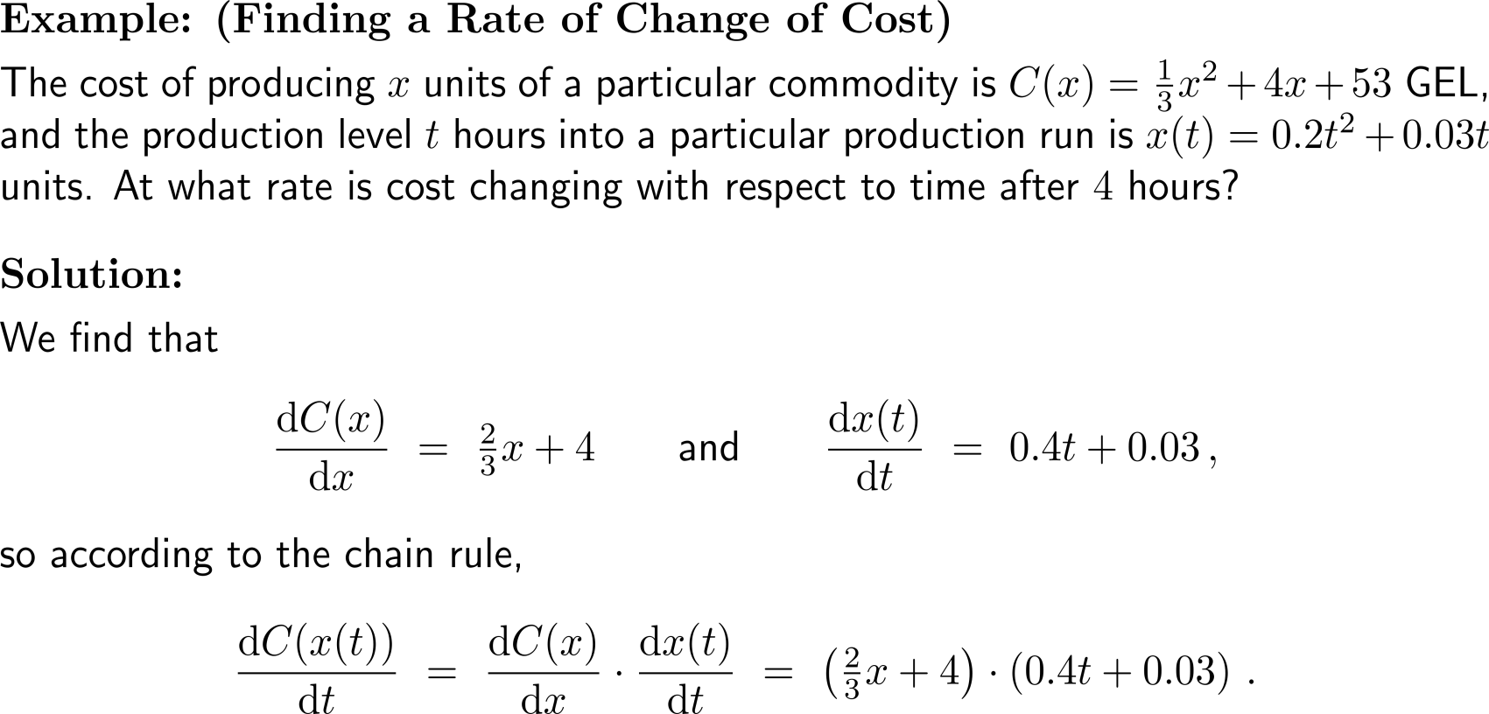
Example: Finding a rate of change of cost

Slide 10
Example: Finding a rate of change of cost

Slide 11
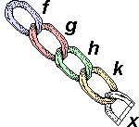
The advantage of the chain rule is its easy application to several layers of outer and inner functions

Slide 12
Example: Repeated application of the Chain Rule

Slide 13
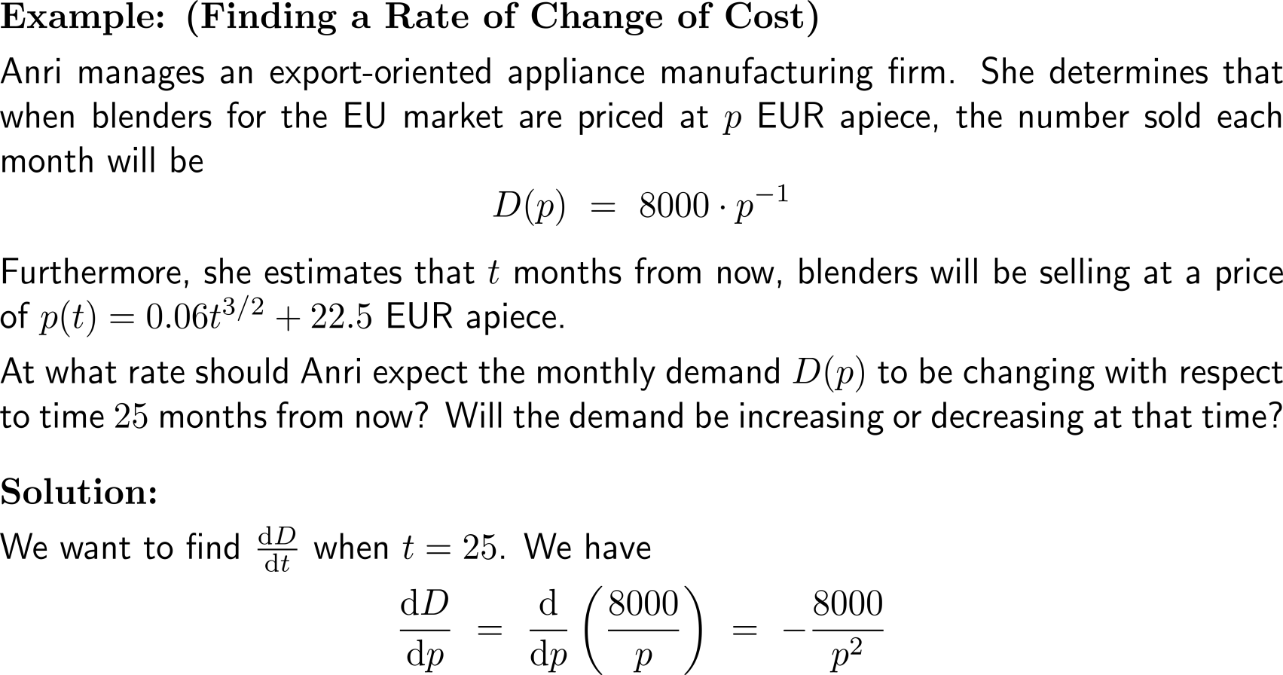
Example: Finding a rate of change of demand

Slide 14
Example: Finding a rate of change of demand

Slide 15
Topics
The Chain Rule
Implicit Differentiation
Linear Approximation
L’Hospital’s Rules

Slide 16
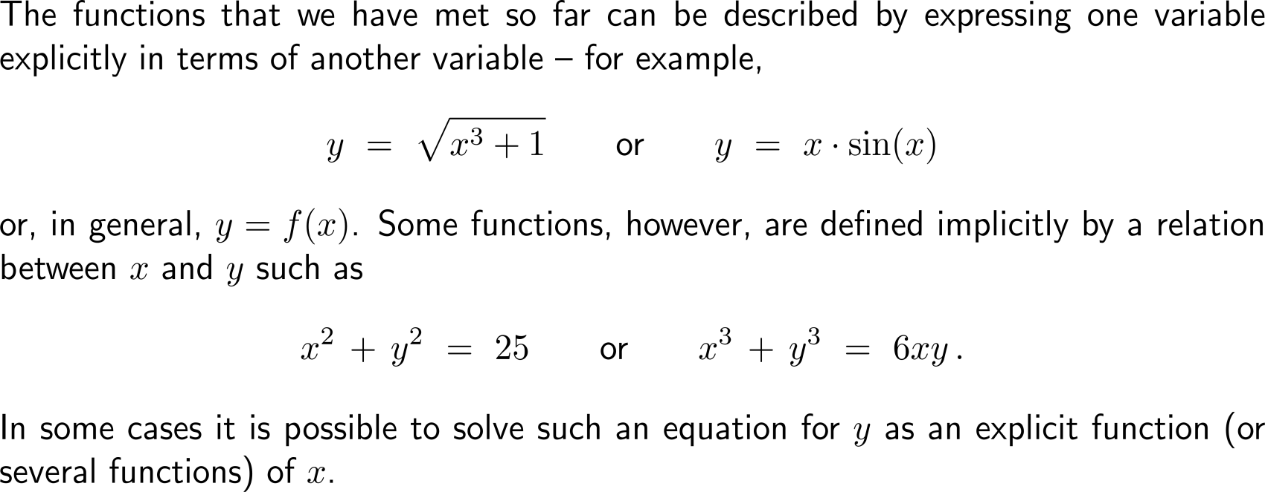
Often two variables are connected by means of a relation such that one of them can be considered as an implicit function of the other

Slide 17
In such cases the implicit function can be resolved as a set of well-defined functions …

Slide 18
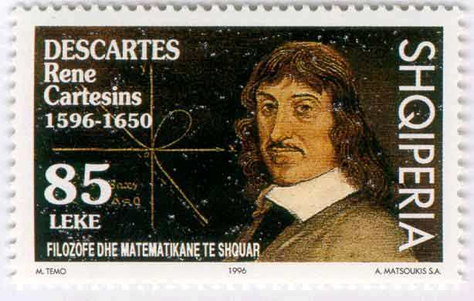
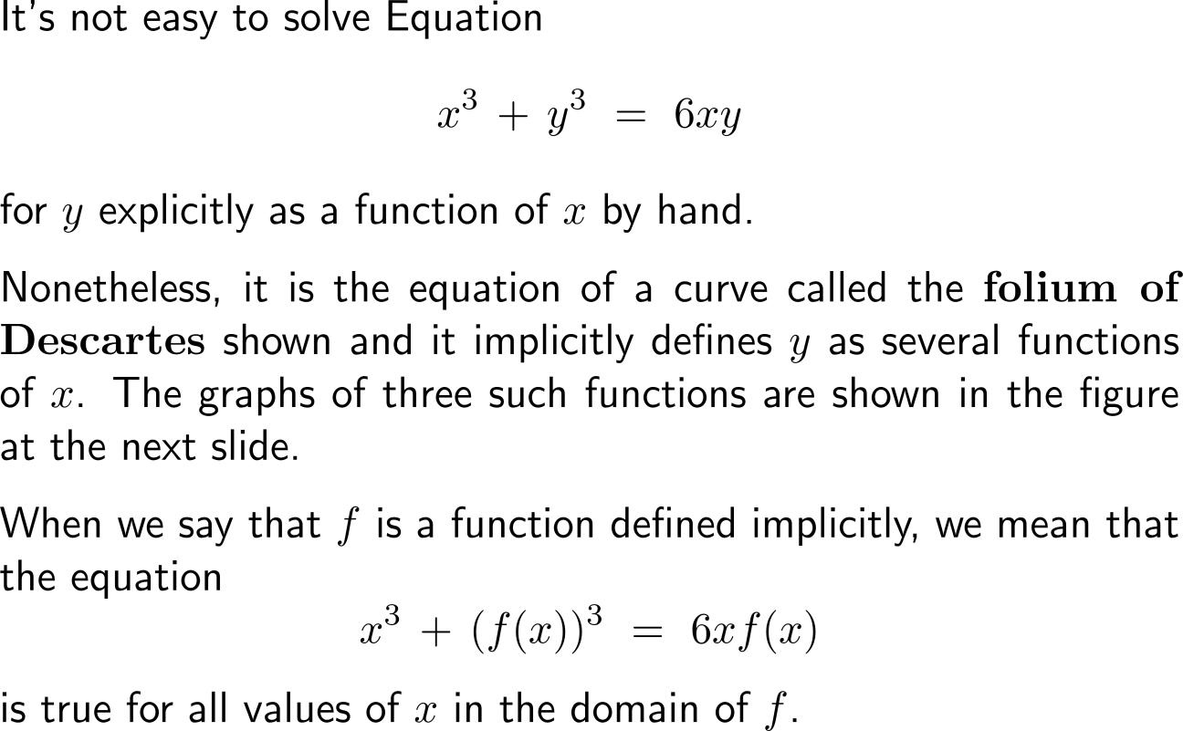
… though, this can sometimes be quite cumbersome, like in the case of the folium of Descartes
Albanian stamp

Slide 19
On the other hand implicit differentiation works in a straightforward way to obtain the derivative of an implicit function

Slide 20
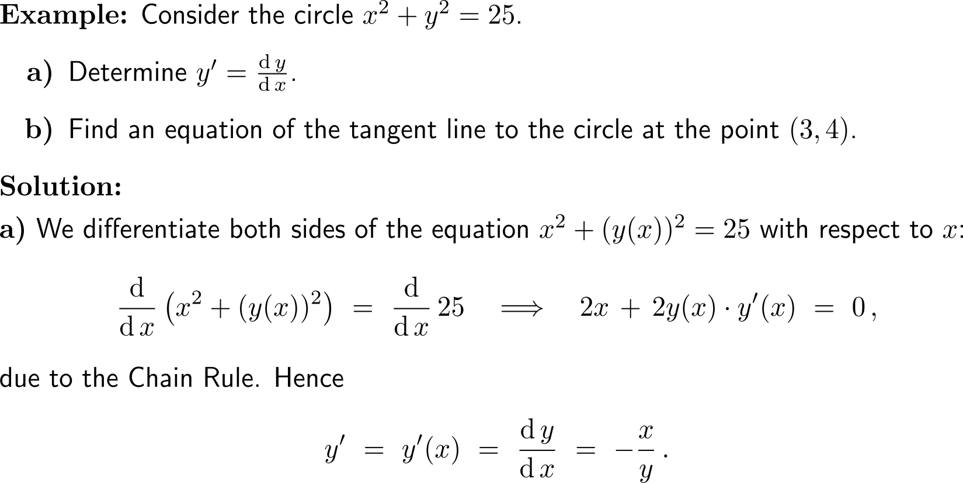
Example: Application of implicit differentiation

Slide 21
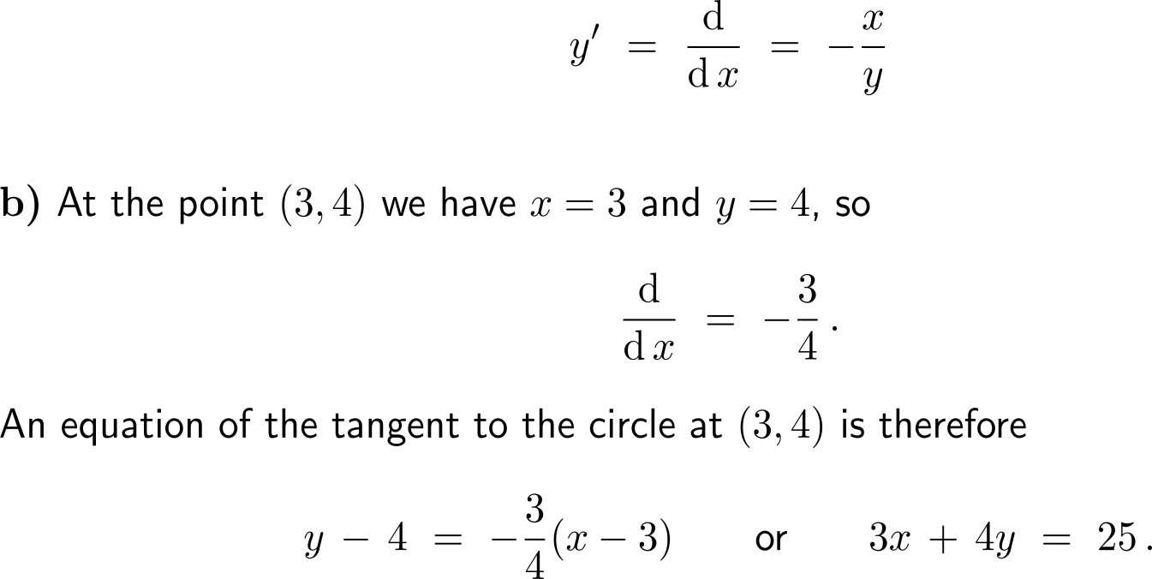
Example: Application of implicit differentiation

Slide 22
Example: Application of implicit differentiation

Slide 23
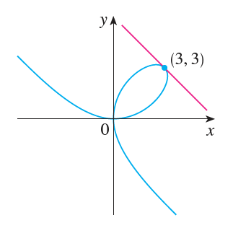
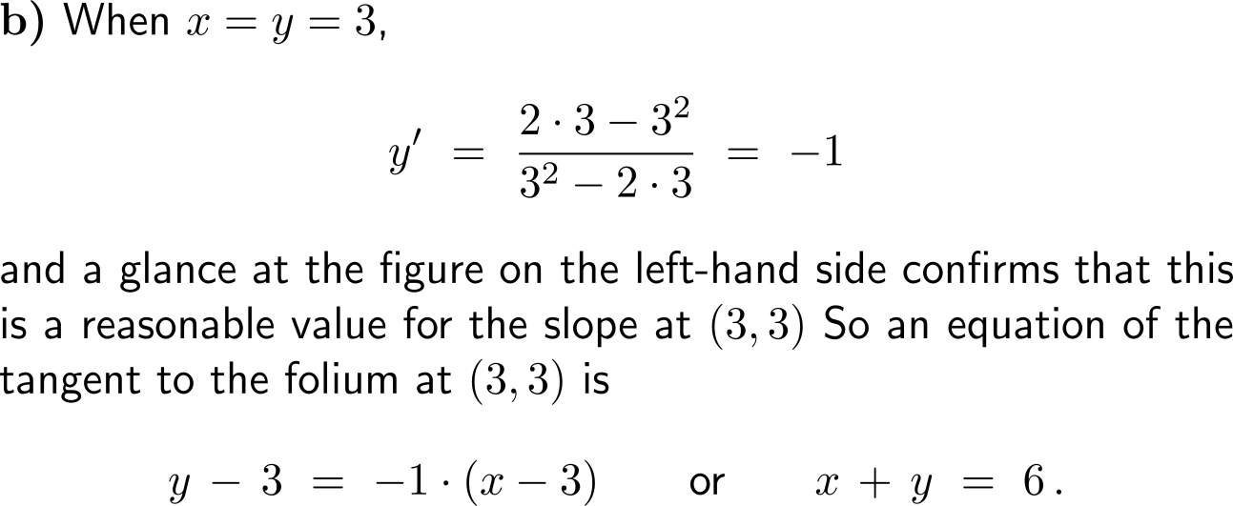
Example: Application of implicit differentiation

Slide 24
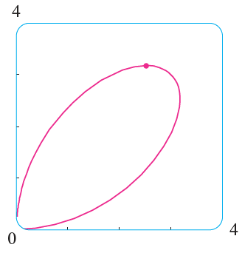
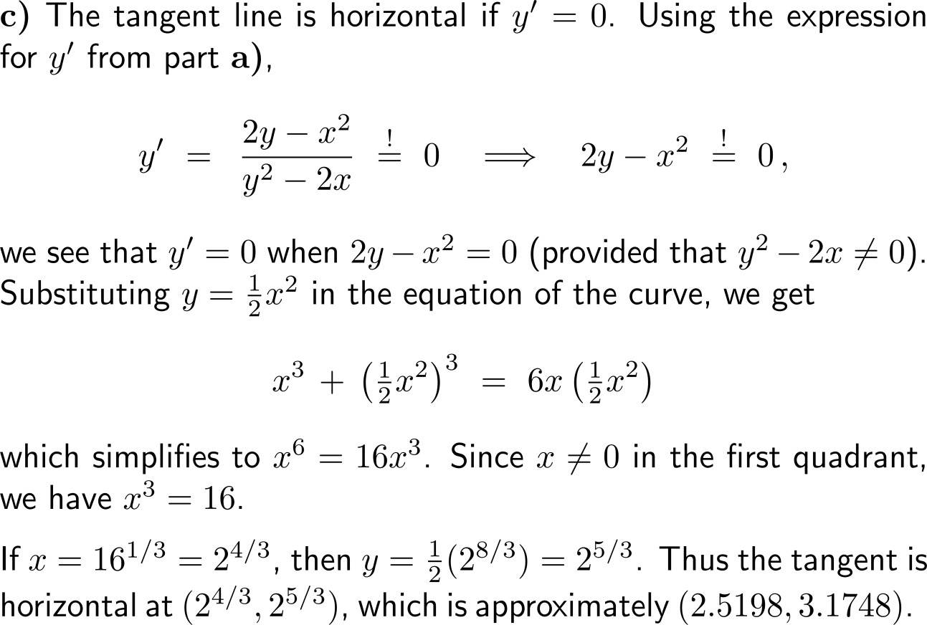
Example: Application of implicit differentiation
(2.5198, 3.1748)

Slide 25
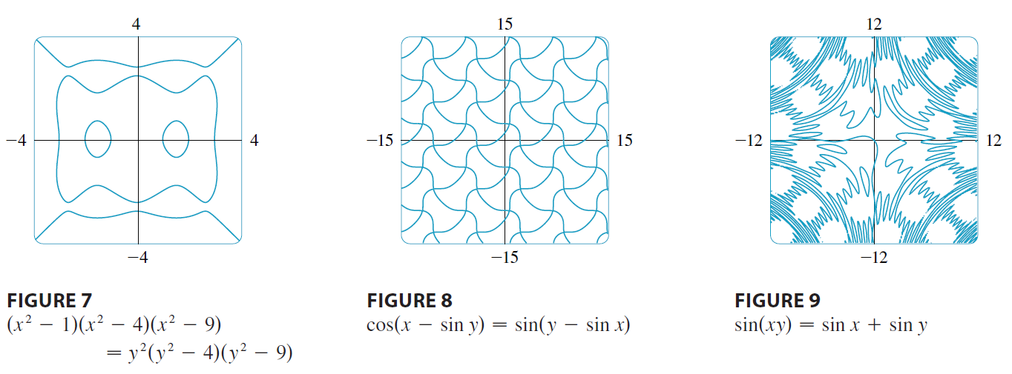
Some further examples of curves due to implicit functions (root manifolds)

Slide 26
Topics
The Chain Rule
Implicit Differentiation
Linear Approximation
L’Hospital’s Rules

Slide 27
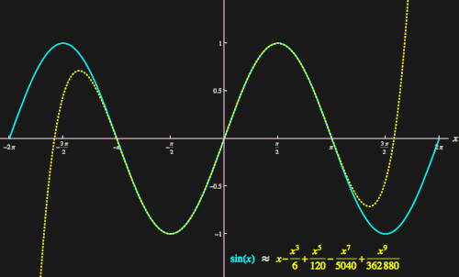
Approximation plays a key role in mathematics and its applications
We have already seen that a tangent line can be used to locally understand the behavior of a function (linear approximation) near a point a.
Taking further information into account, like second, third, … order derivatives the approximation becomes more accurate for a wider range of numbers about the point of expansion a.
This procedure even allows us later to write certain functions as infinite power-series.
The major question in this context are that of the
quality of the approximation and
range on which we trust the approximation.
Next, we discuss some aspects of these two questions for linear approximations.
Example: successive polynomial approximation of the sine function at 0
animation

Slide 28
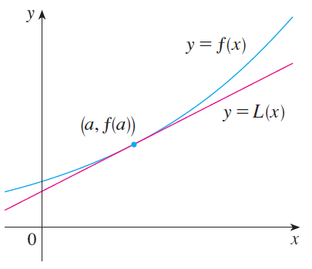
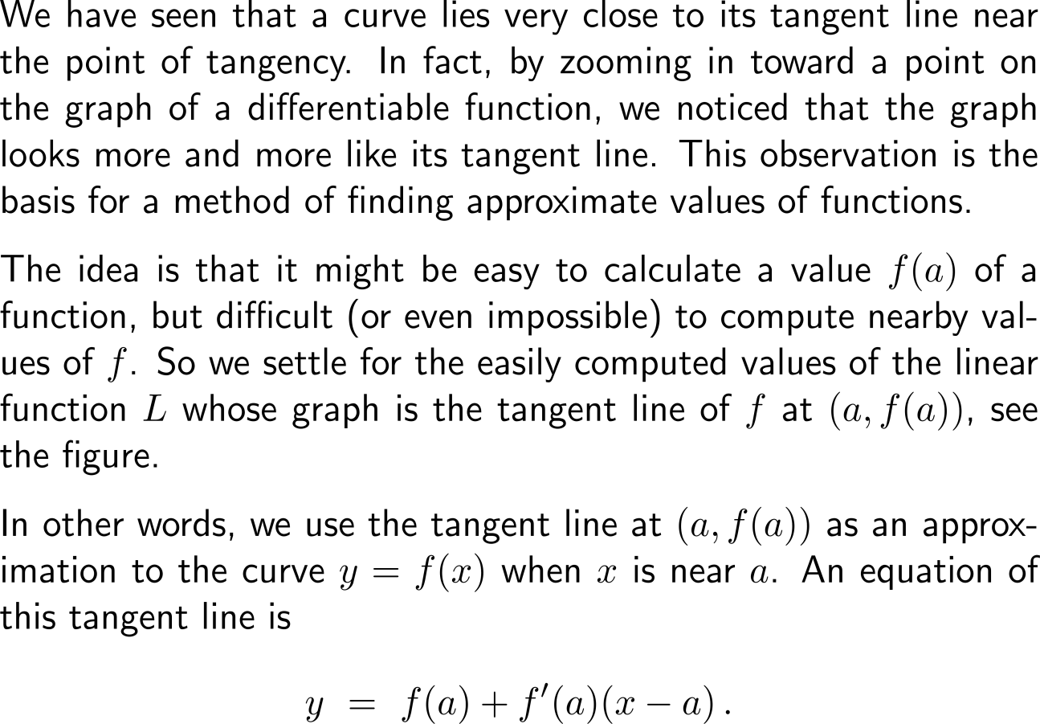
By zooming in toward a point on the graph of a differentiable function, we already noticed that the graph looks more and more like its tangent line …

Slide 29
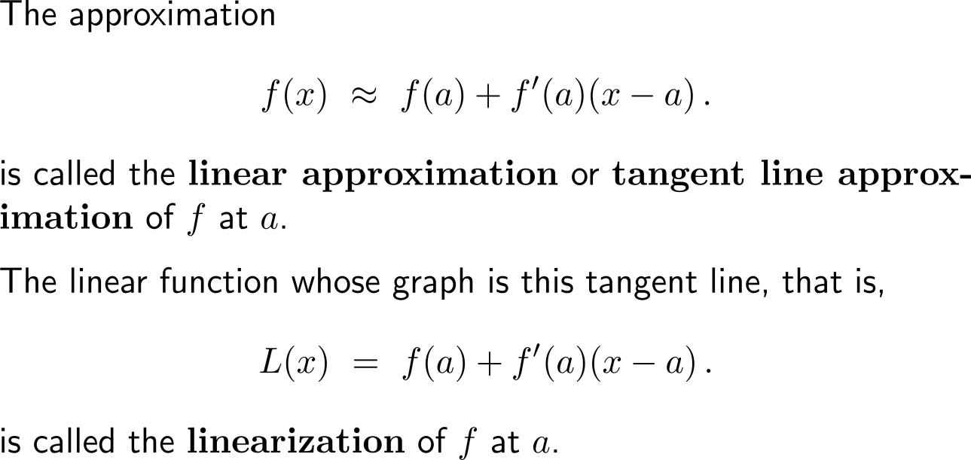
… this gives rise to the (local) approximation of a function by its linearization

Slide 30
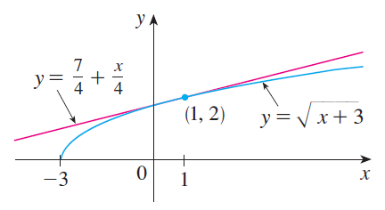
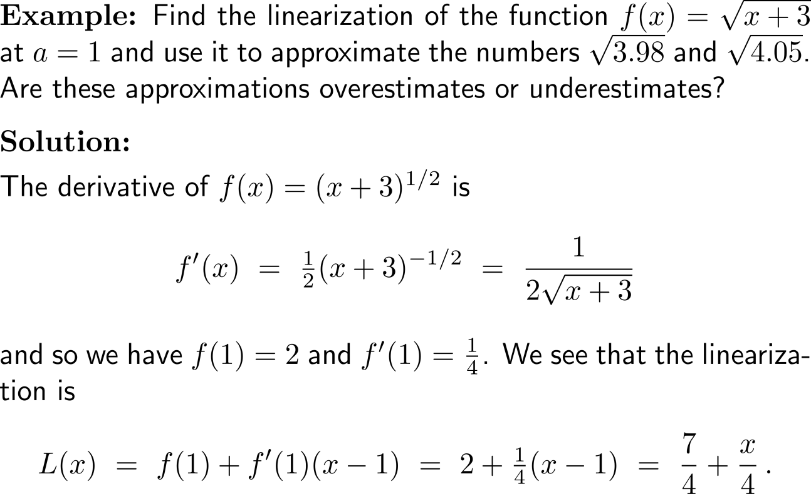
Example: Linear approximation

Slide 31
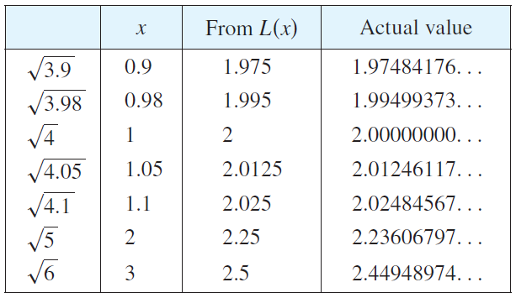
Example: Linear approximation

Slide 32
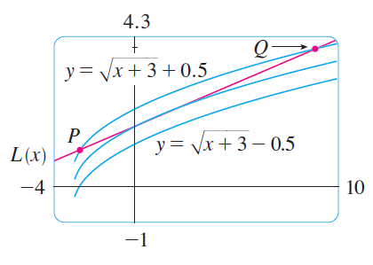
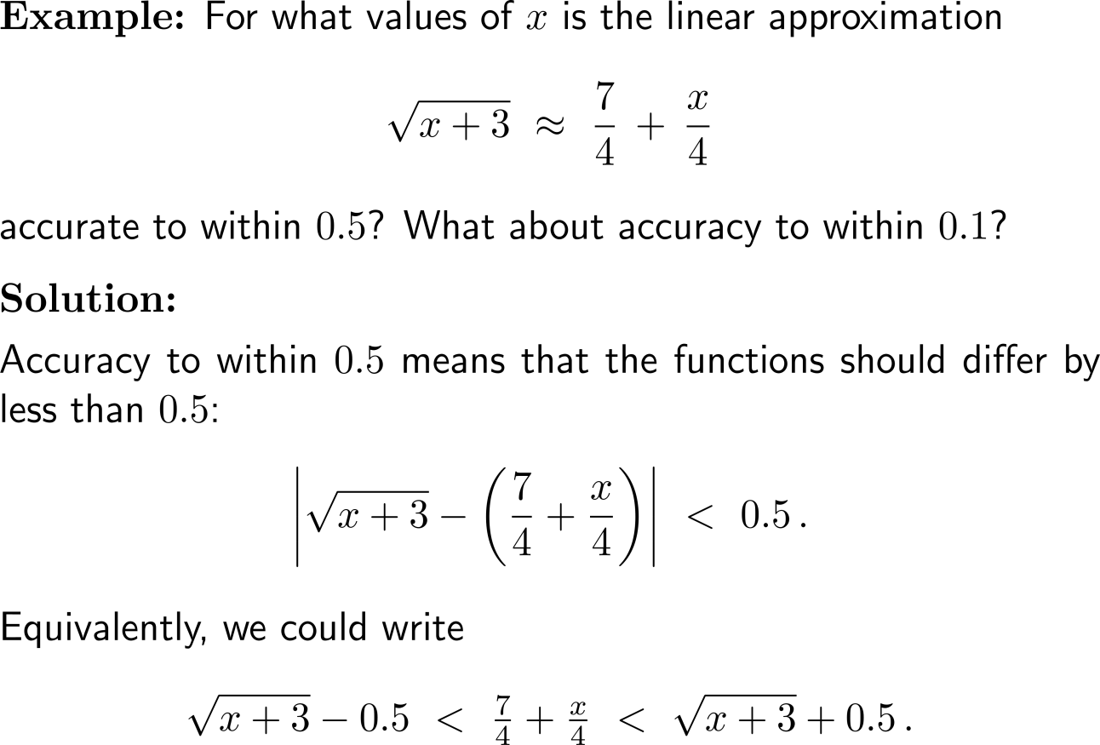
Example: Linear approximation

Slide 33
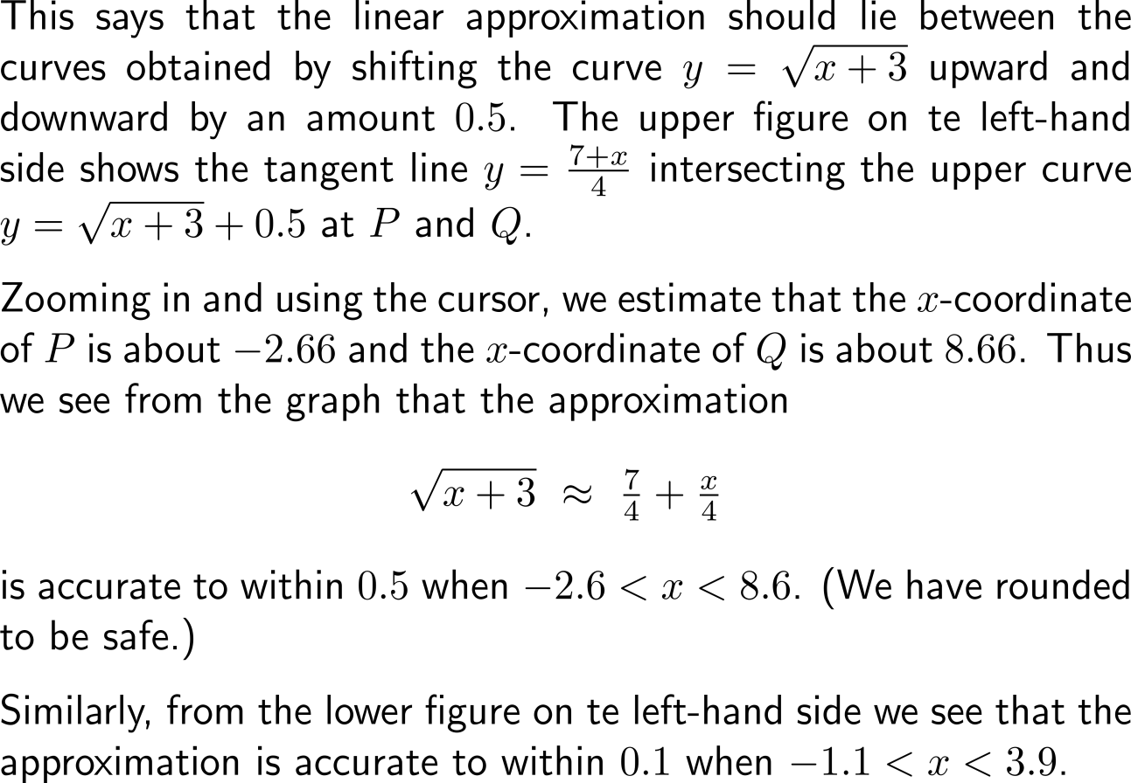
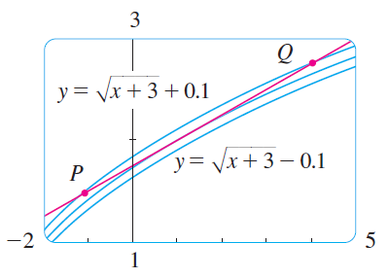
Example: Linear approximation

Slide 34
Topics
The Chain Rule
Implicit Differentiation
Linear Approximation
L’Hospital’s Rules

Slide 35
Motivation: limits and indeterminate forms (1/ 2)

Slide 36
Motivation: limits and indeterminate forms (2/ 2)

Slide 37
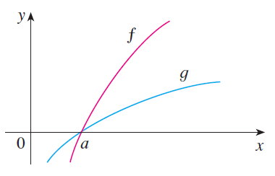
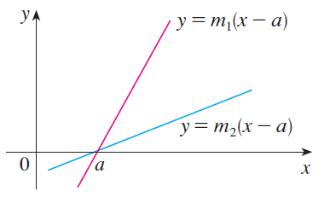
In this section we introduce a systematic method, known as l’Hospital’s Rule, for the evaluation of indeterminate forms

Slide 38
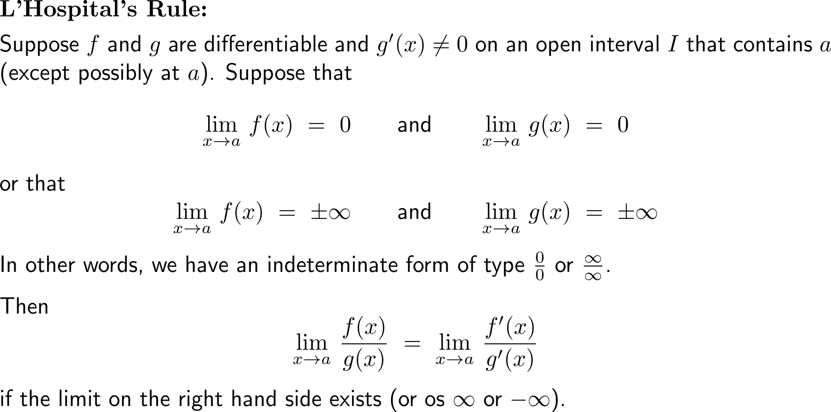
L’Hospital’s rule allows us to evaluate the limits of indeterminate forms by playing the original limit back to a limit formed by derivatives

Slide 39
Some remarks on l’Hospital’s rule (1/ 2)

Slide 40
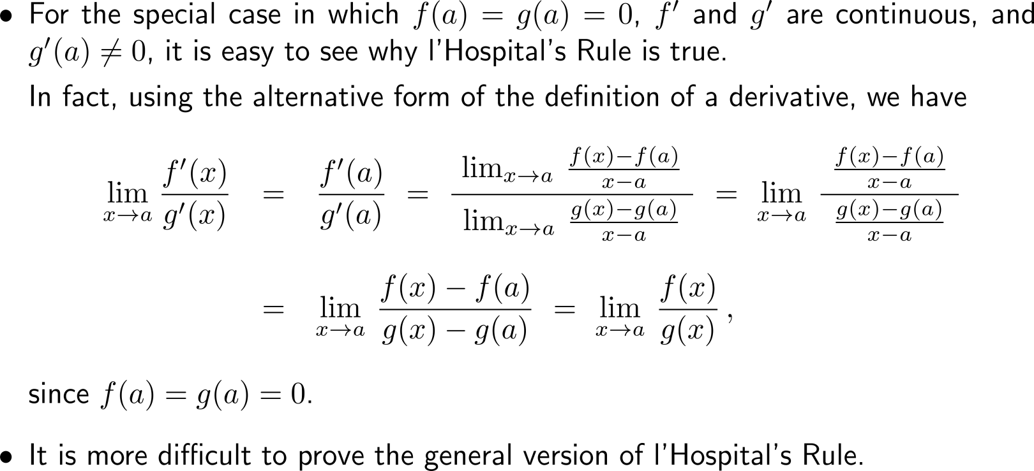
Some remarks on l’Hospital’s rule (2/ 2)

Slide 41
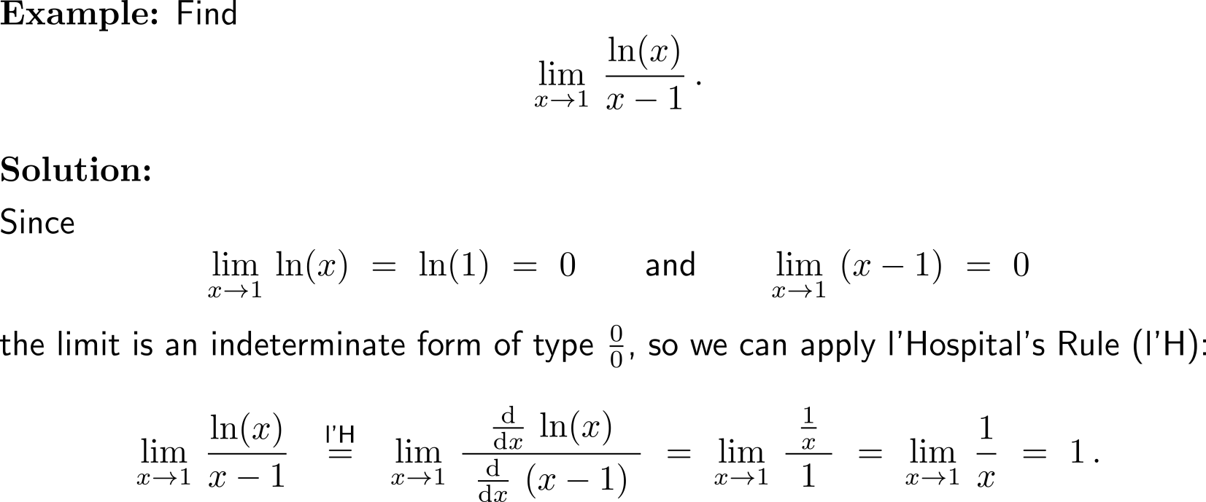
Example: Application of l’Hospital’s Rule

Slide 42
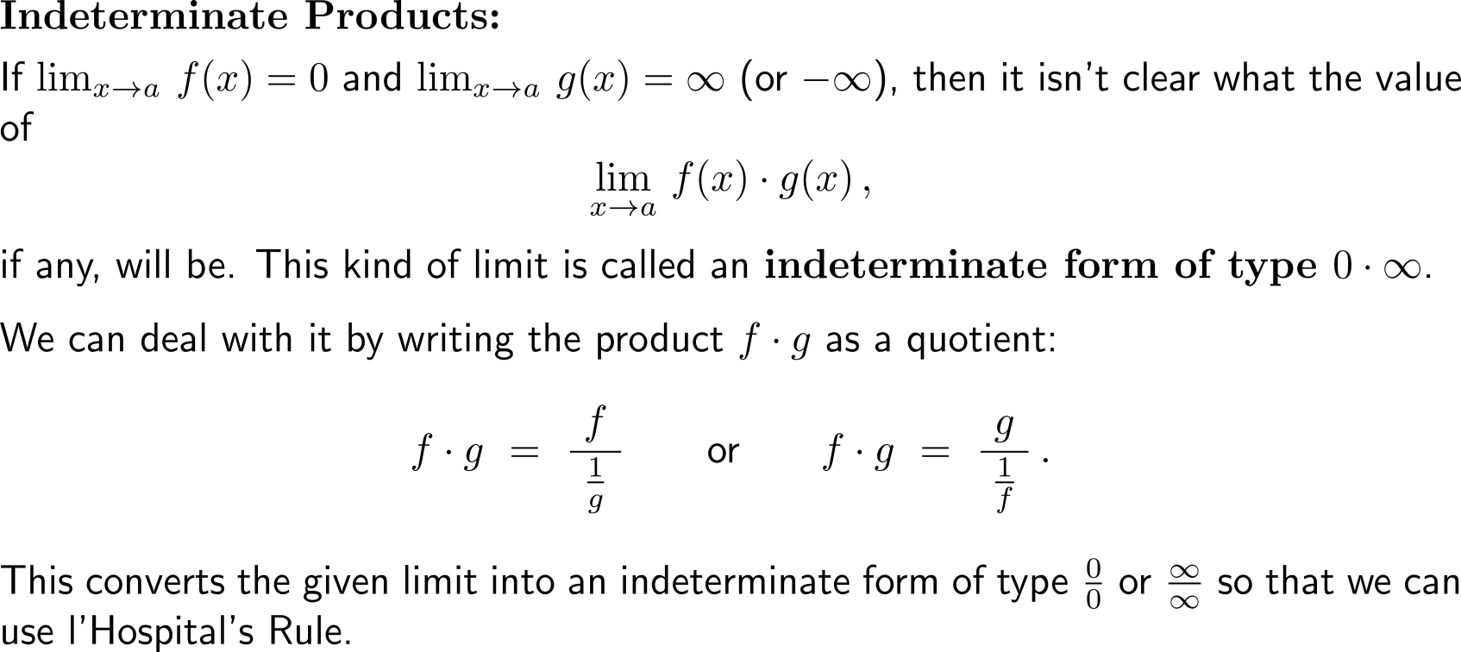
Besides the just discussed indeterminate forms ⁰/₀ and ∞/∞ there are intermediate products 0 ⋅ ∞

Slide 43
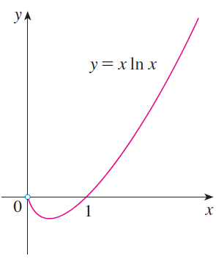
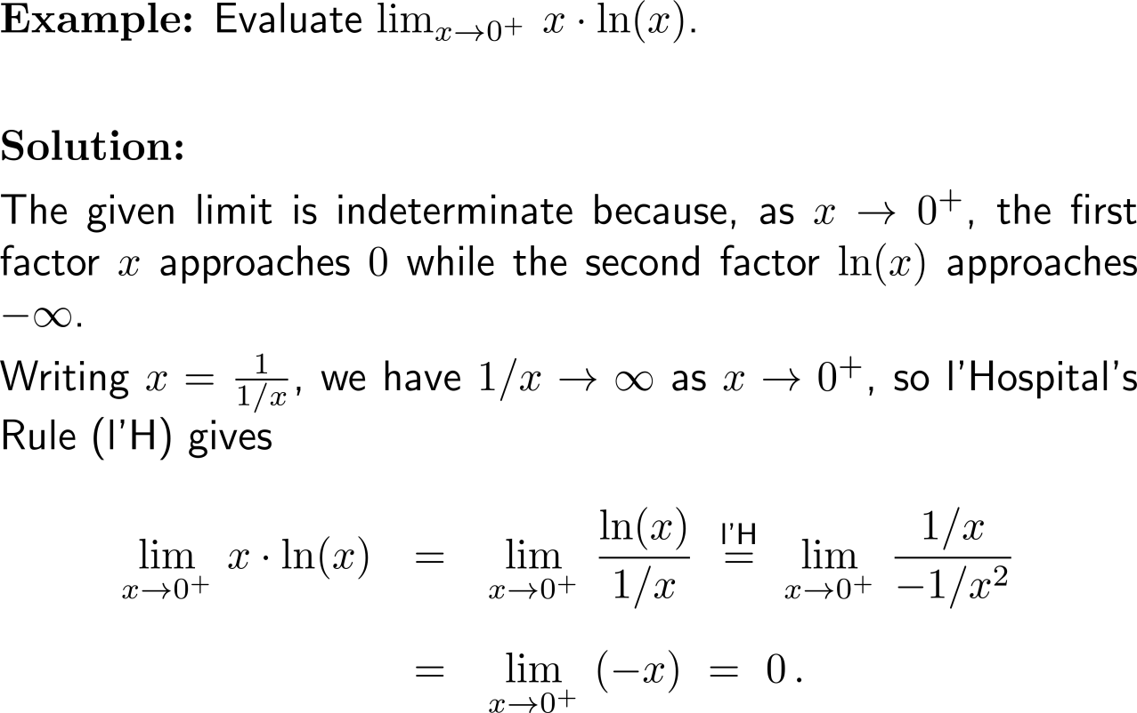
Example: Application of l’Hospital’s Rule on indeterminate products

Slide 44
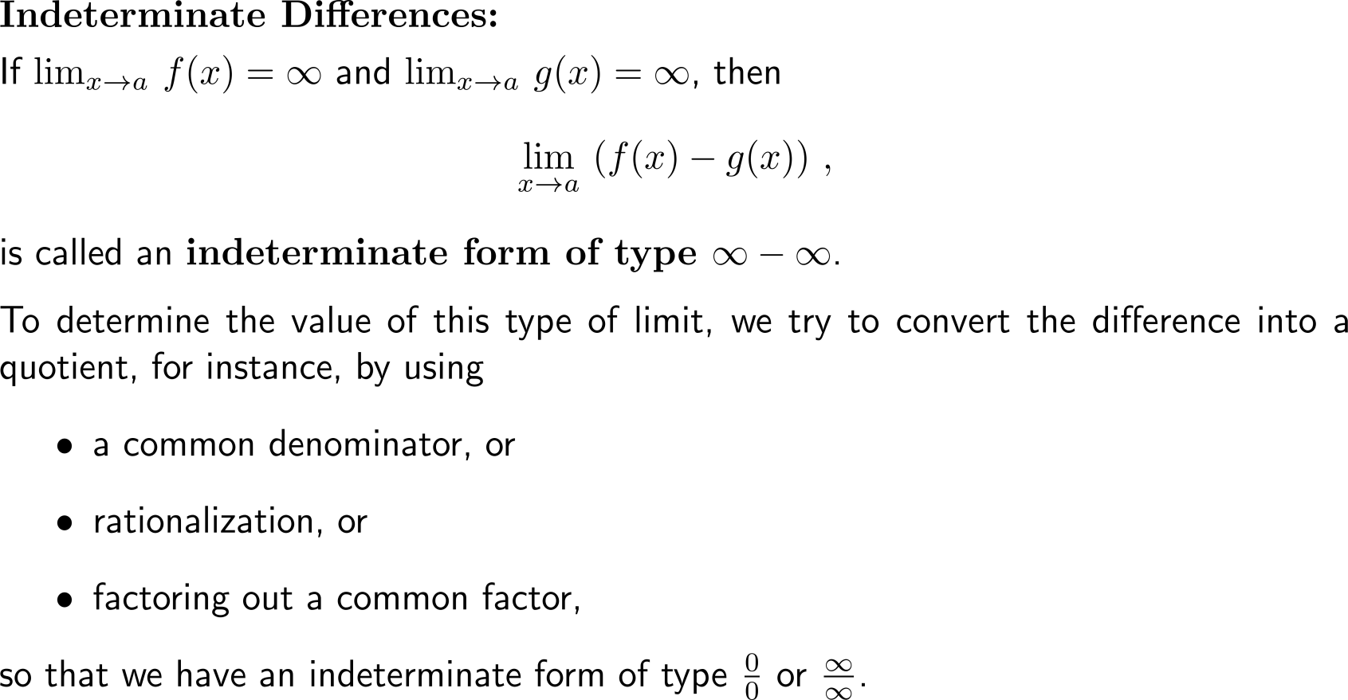
A third type of indeterminate forms are indeterminate differences ∞ - ∞

Slide 45
Example: Application of l’Hospital’s Rule on indeterminate differences

Slide 46
Example: Application of l’Hospital’s Rule on indeterminate differences

Slide 47
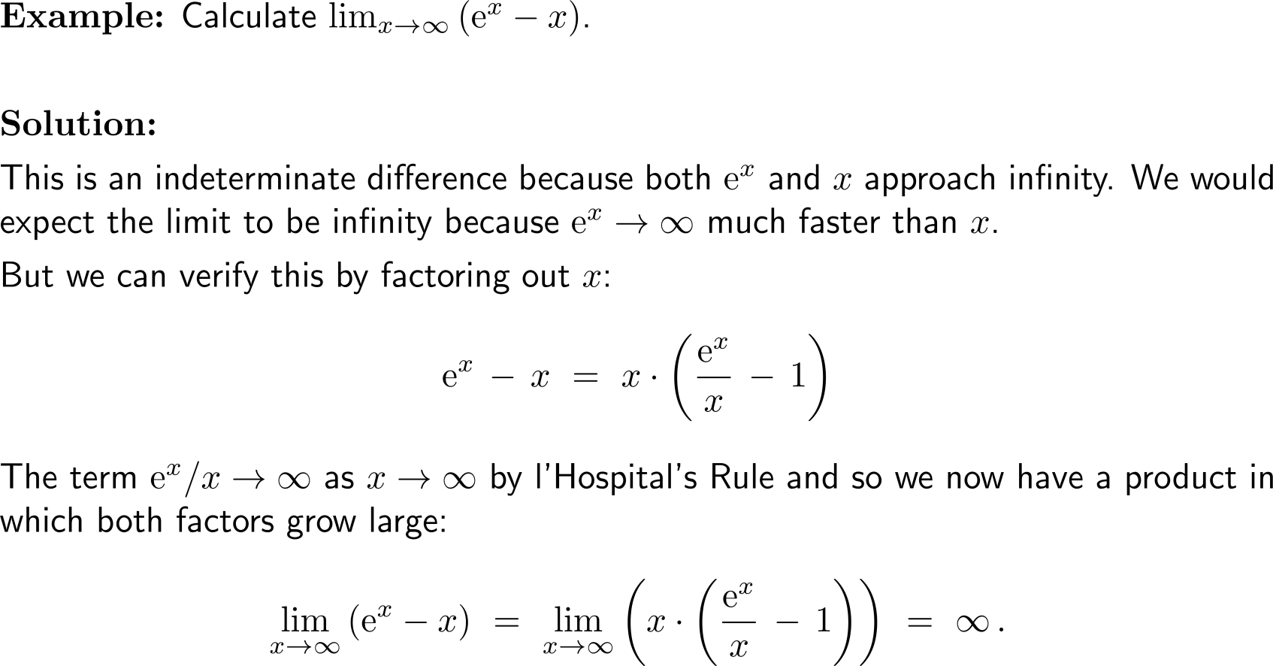
Example: Application of l’Hospital’s Rule on indeterminate differences

Slide 48
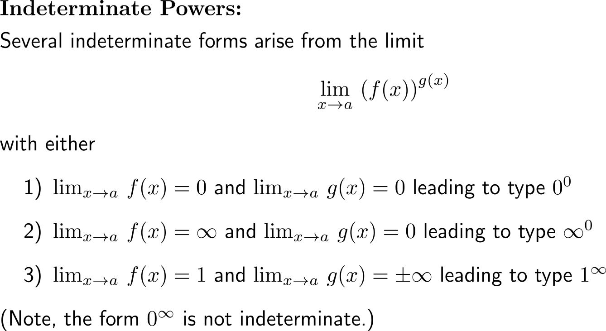
The last type of intermediate forms are indeterminate powers that can occur in three distinct ways 0⁰, ∞⁰ or 1∞ (1/ 2)

Slide 49
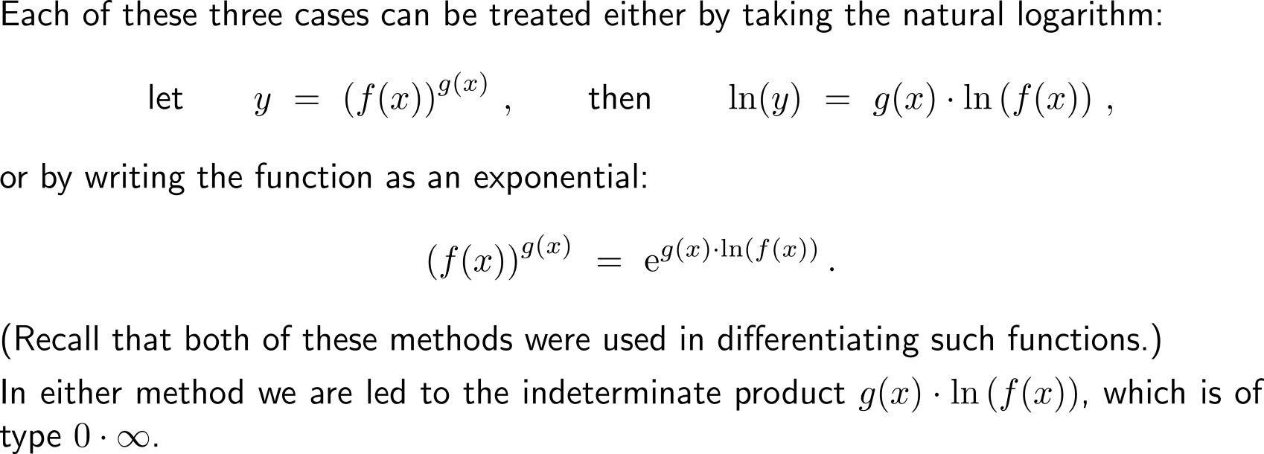
The last type of intermediate forms are indeterminate powers that can occur in three distinct ways 0⁰, ∞⁰ or 1∞ (2/ 2)

Slide 50
Example: Application of l’Hospital’s Rule on indeterminate powers

Slide 51
Further Worked-Out Exercises:
Calculus I for Management
Topics
The chain rule
Implicit differentiation
L’Hospital’s rules
Linear approximations using increments

Slide 52
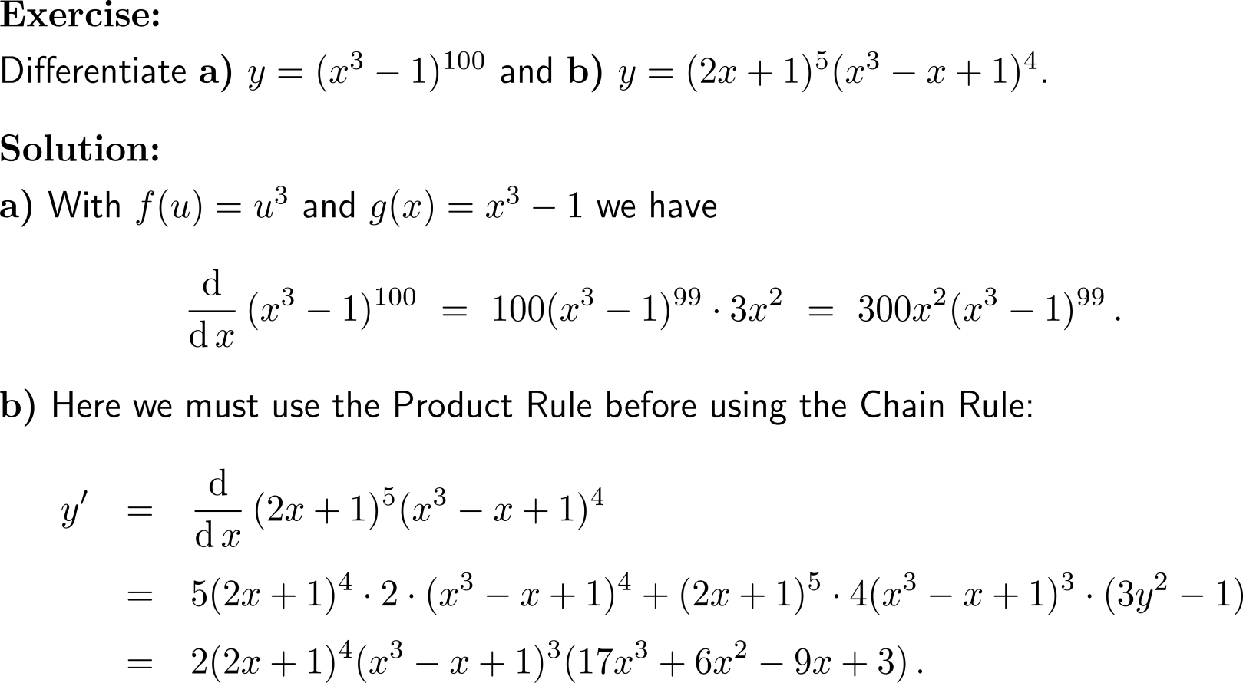
Exercise: Application of the Chain Rule

Slide 53
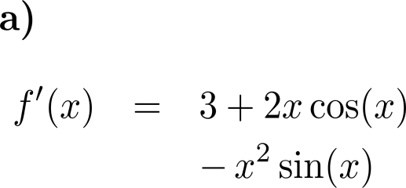
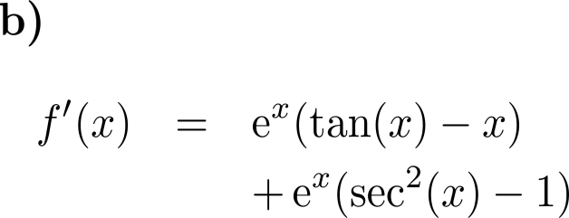
Exercise
10 minutes
self/ group work
please, upload your solutions to the chat

Slide 54
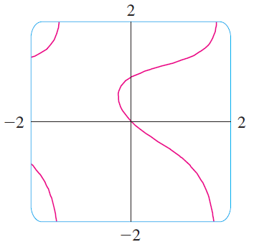
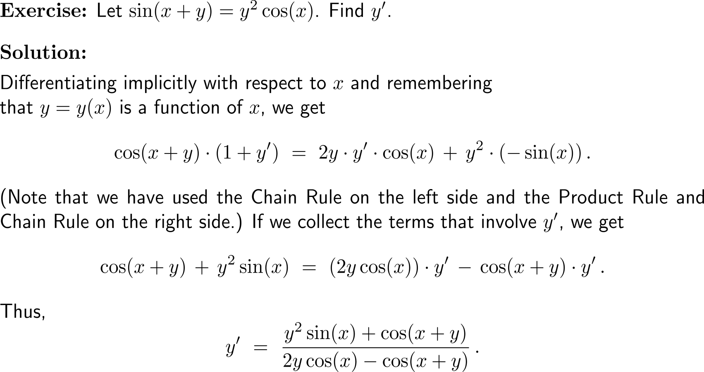
Exercise: Application of implicit differentiation

Slide 55
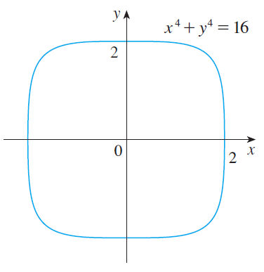
Exercise: Application of implicit differentiation

Slide 56
Exercise: Application of implicit differentiation

Slide 57
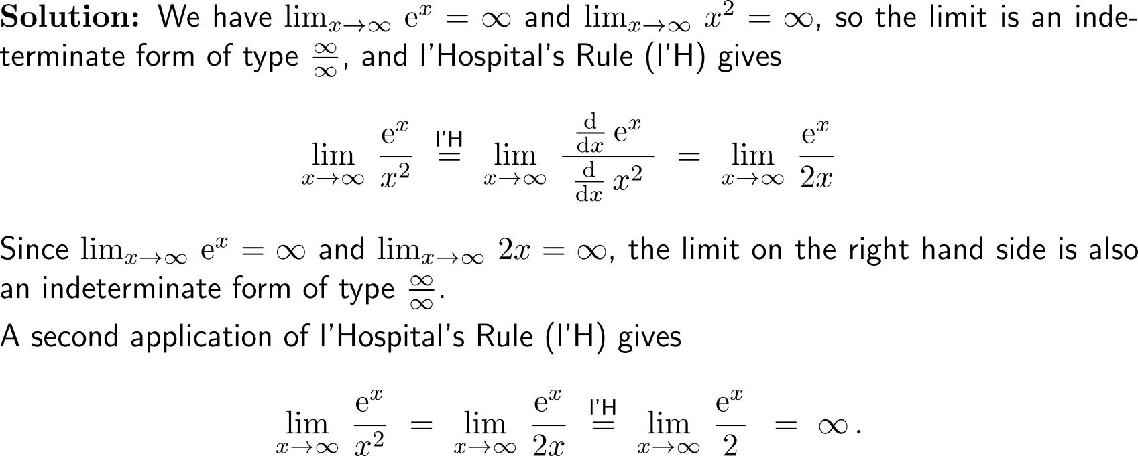
Exercise: Application of l’Hospital’s Rule

Slide 58
Exercise: Application of l’Hospital’s Rule on indeterminate powers

Slide 59
Exercise: Differentials and the quality of linear approximation

Slide 60
Exercise: Differentials and the quality of linear approximation

Slide 61
Calculus I for Management

