Slide 1
Calculus I for MGMT – Applications of Differentiation The Chain Rule
Mathematics for Management
Supplementary Electronic Materials
Applications of
Differentiation
The Chain Rule
Implicit Differentiation
Linear Approximation
L’Hospital’s Rules & Indeterminate Forms

Slide 2
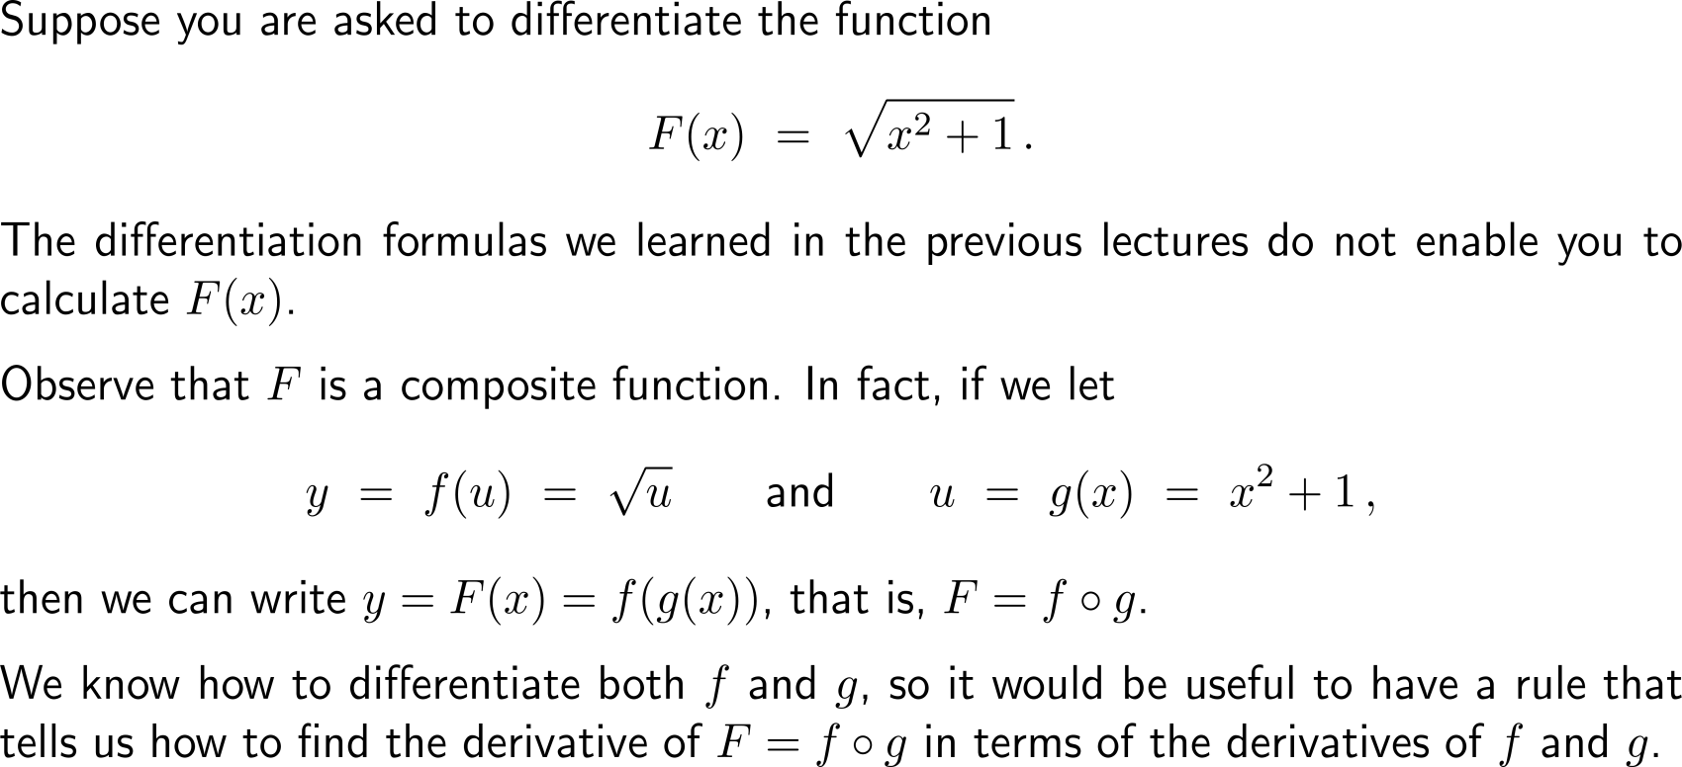
In order to differentiate composite functions …

Slide 3
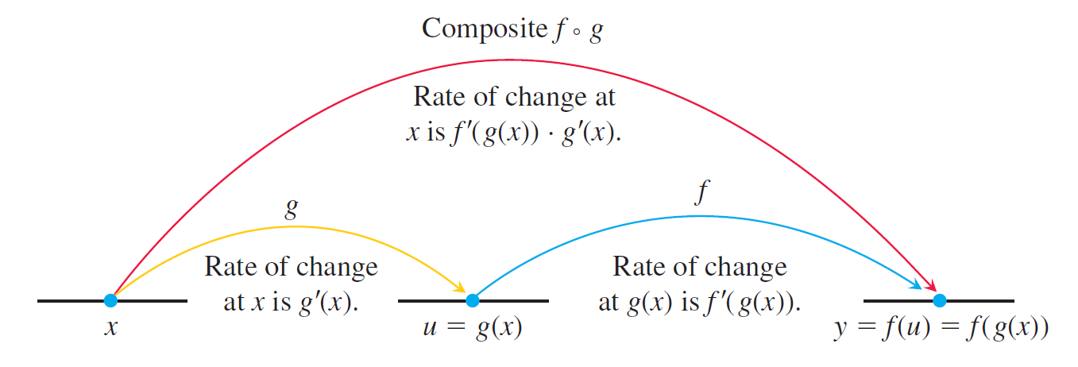
… we need to consider a two step procedure that takes care of the derivatives of the outer and the inner function

Slide 4
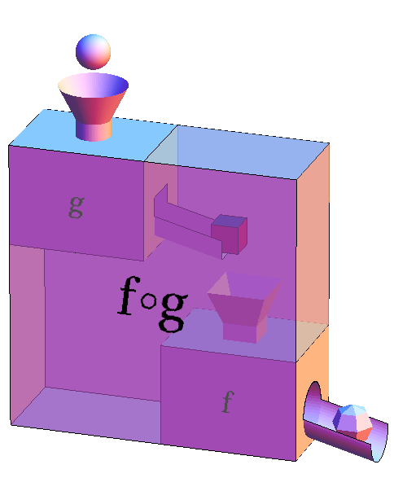
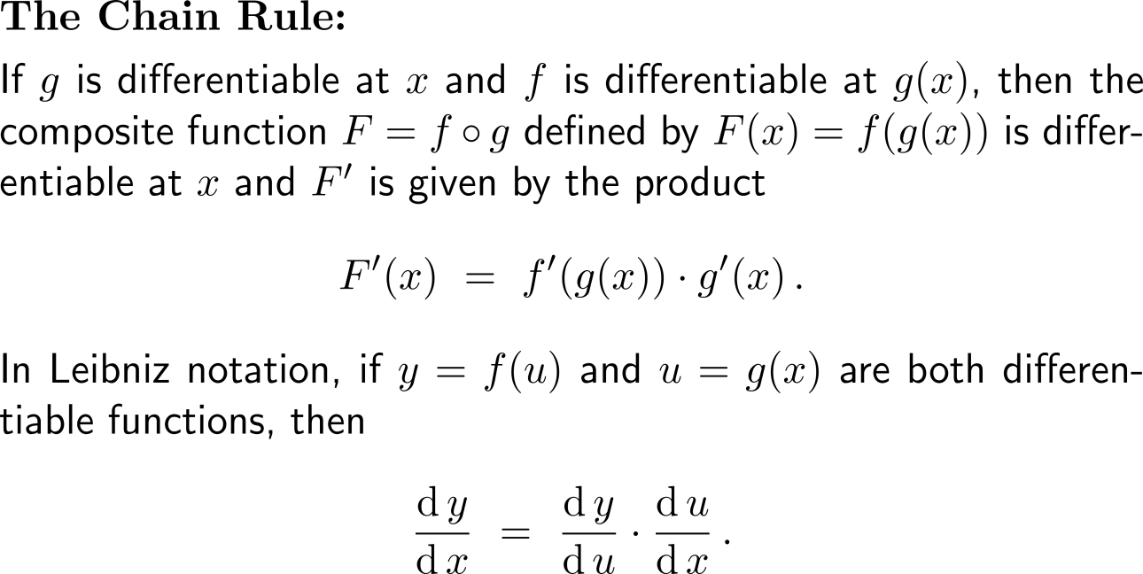
The Chain Rule: the derivative of a composite function is the product of the derivatives of the outer and the inner function

Slide 5
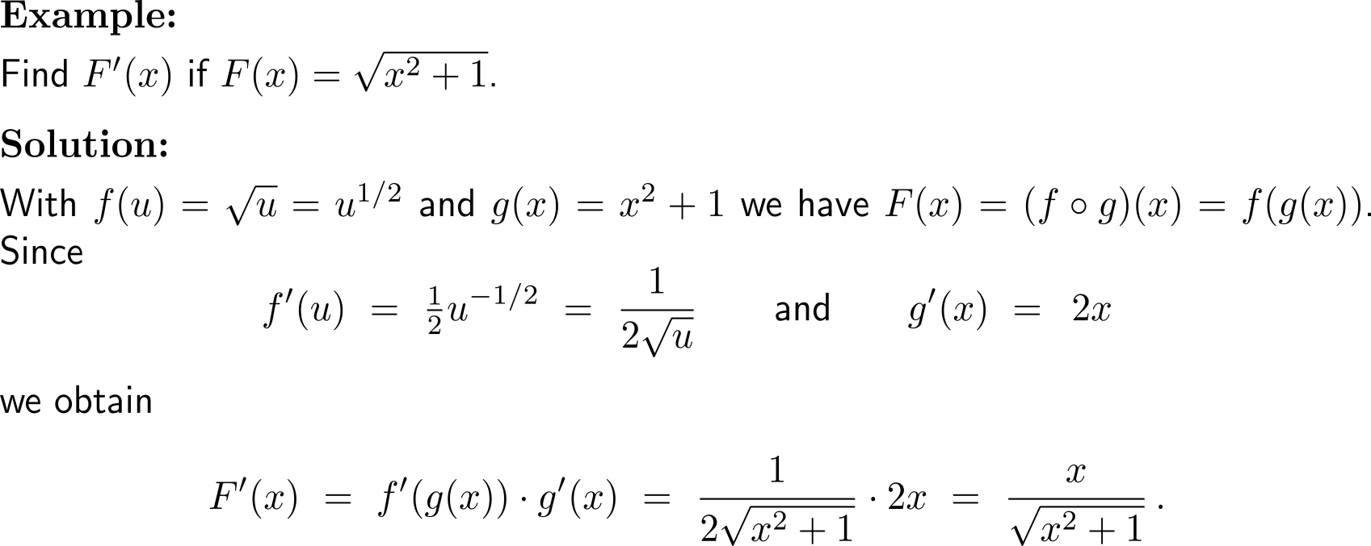
Example: Application of the Chain Rule

Slide 6
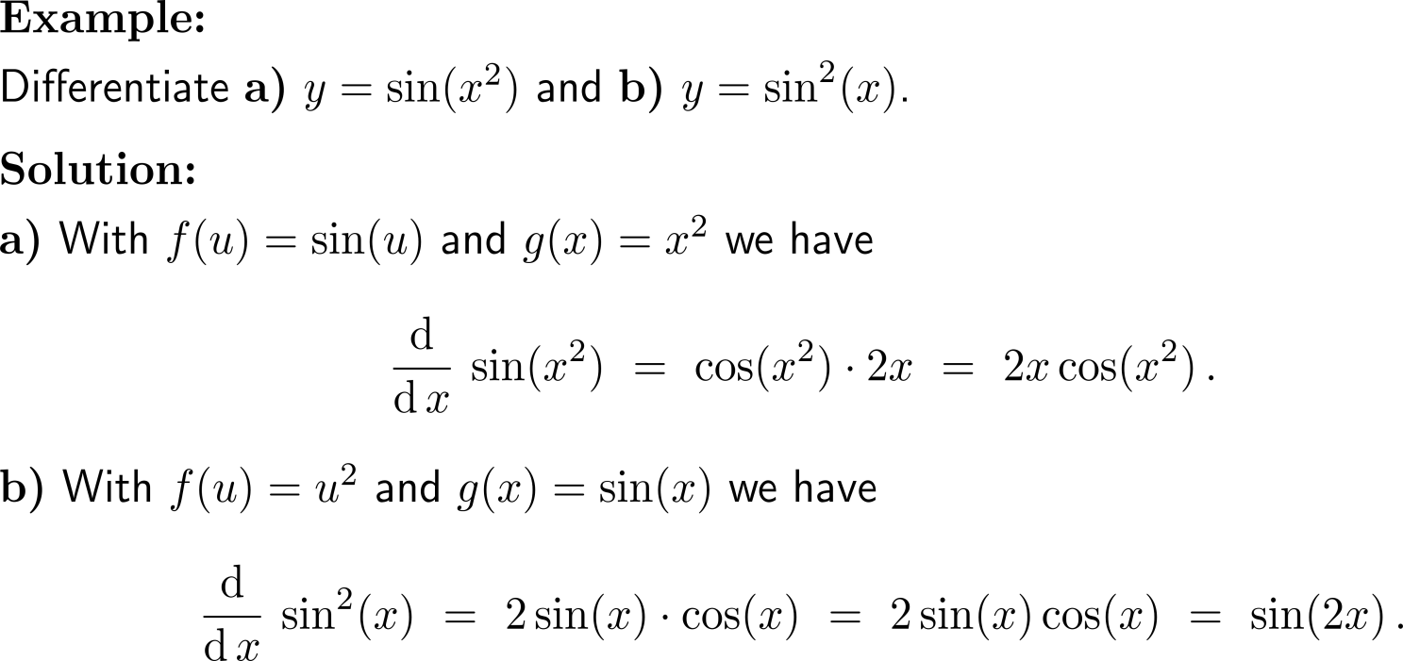
Example: Application of the Chain Rule

Slide 7
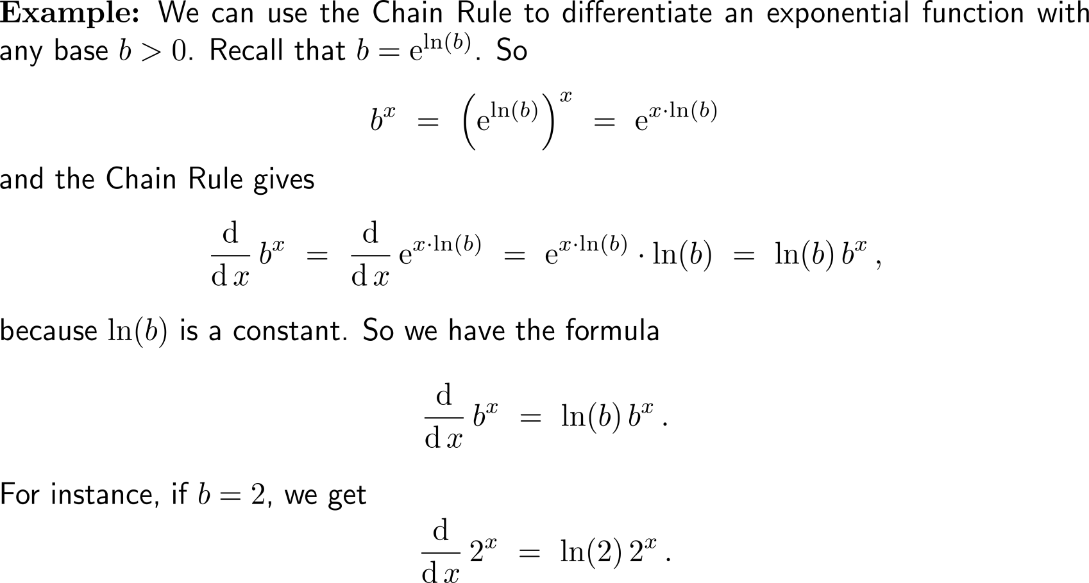
Example: Application of the Chain Rule for differentiating exponential functions

Slide 8
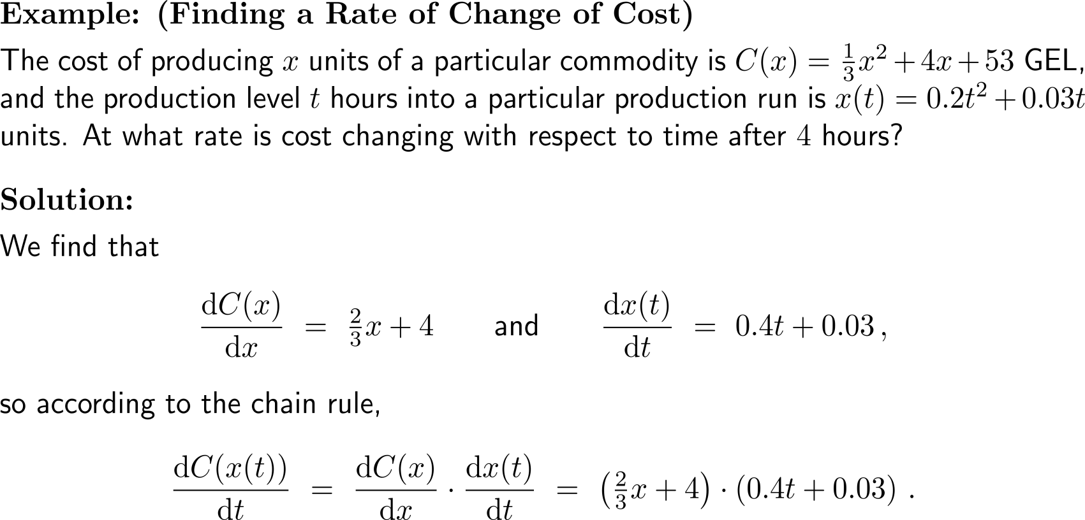
Example: Finding a rate of change of cost

Slide 9
Example: Finding a rate of change of cost

Slide 10
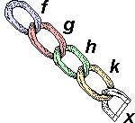
The advantage of the chain rule is its easy application to several layers of outer and inner functions

Slide 11
Example: Repeated application of the Chain Rule

Slide 12
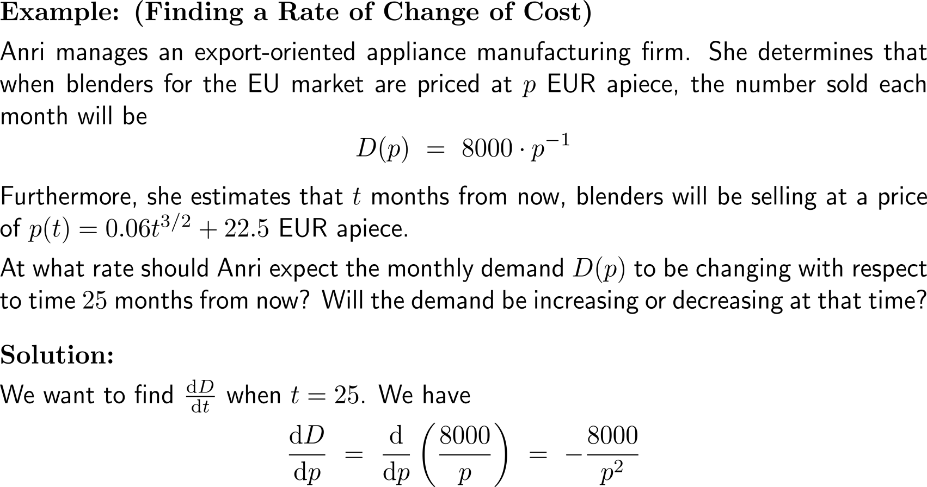
Example: Finding a rate of change of demand

Slide 13
Example: Finding a rate of change of demand

Slide 14
Calculus I for Management

