Slide 1
Calculus I for MGMT – Applications of Differentiation Implicit Differentiation
Mathematics for Management
Supplementary Electronic Materials
Applications of
Differentiation
The Chain Rule
Implicit Differentiation
Linear Approximation
L’Hospital’s Rules & Indeterminate Forms

Slide 2
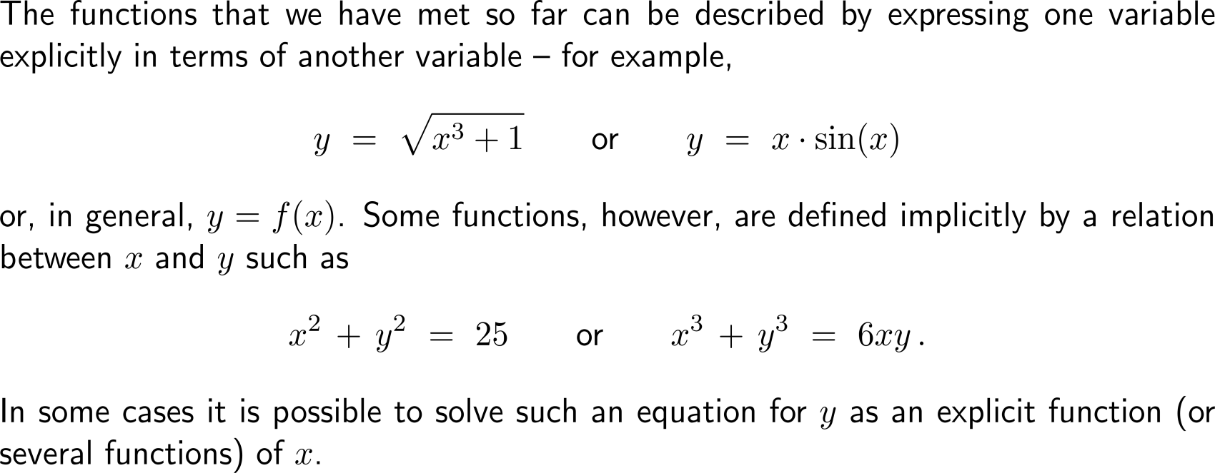
Often two variables are connected by means of a relation such that one of them can be considered as an implicit function of the other

Slide 3
In such cases the implicit function can be resolved as a set of well-defined functions …

Slide 4
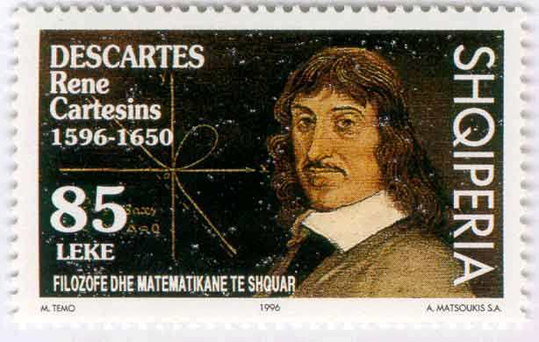
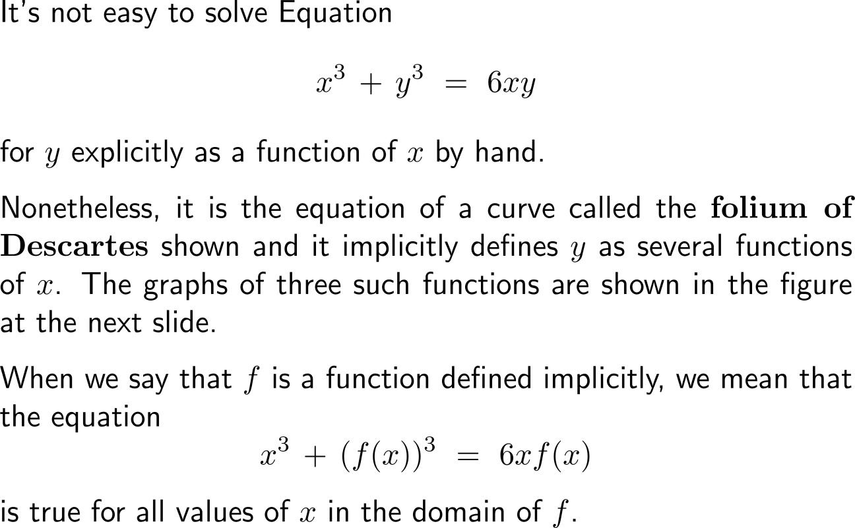
… though, this can sometimes be quite cumbersome, like in the case of the folium of Descartes
Albanian stamp

Slide 5
On the other hand implicit differentiation works in a straightforward way to obtain the derivative of an implicit function

Slide 6
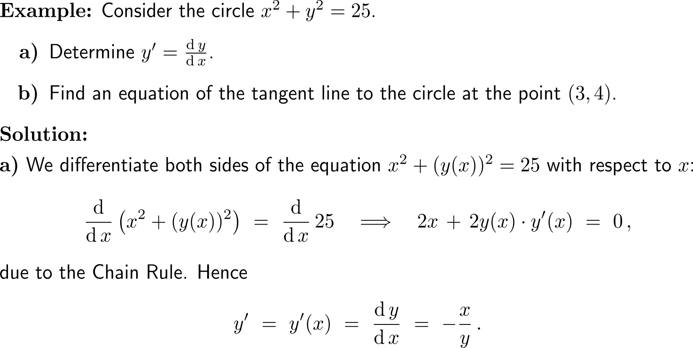
Example: Application of implicit differentiation

Slide 7
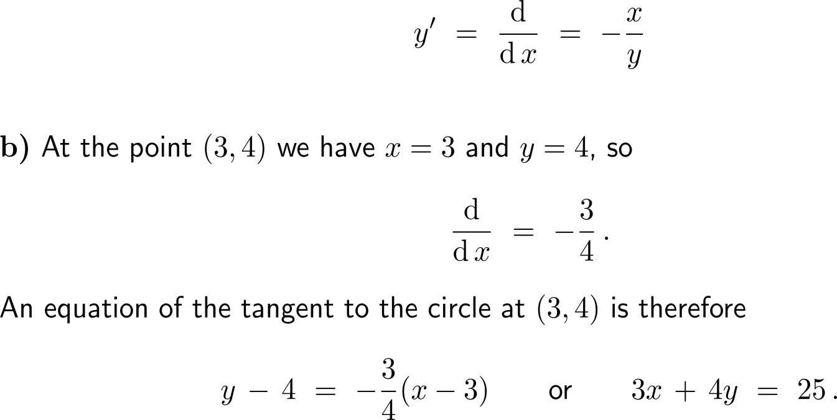
Example: Application of implicit differentiation

Slide 8
Example: Application of implicit differentiation

Slide 9
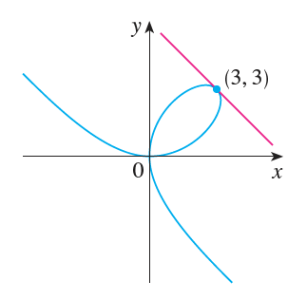
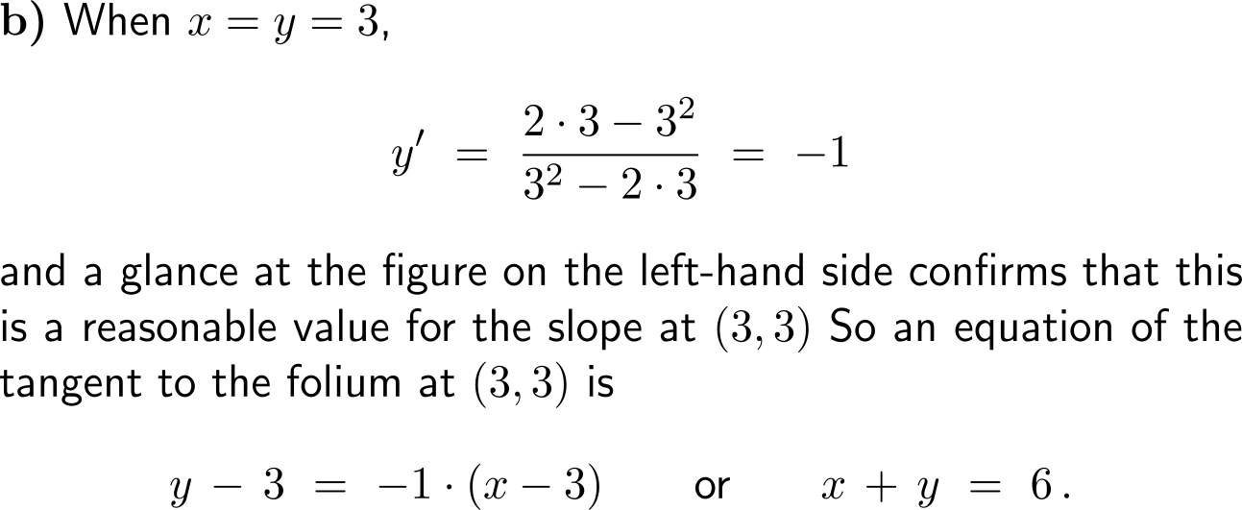
Example: Application of implicit differentiation

Slide 10
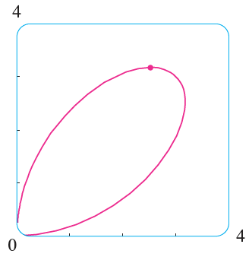
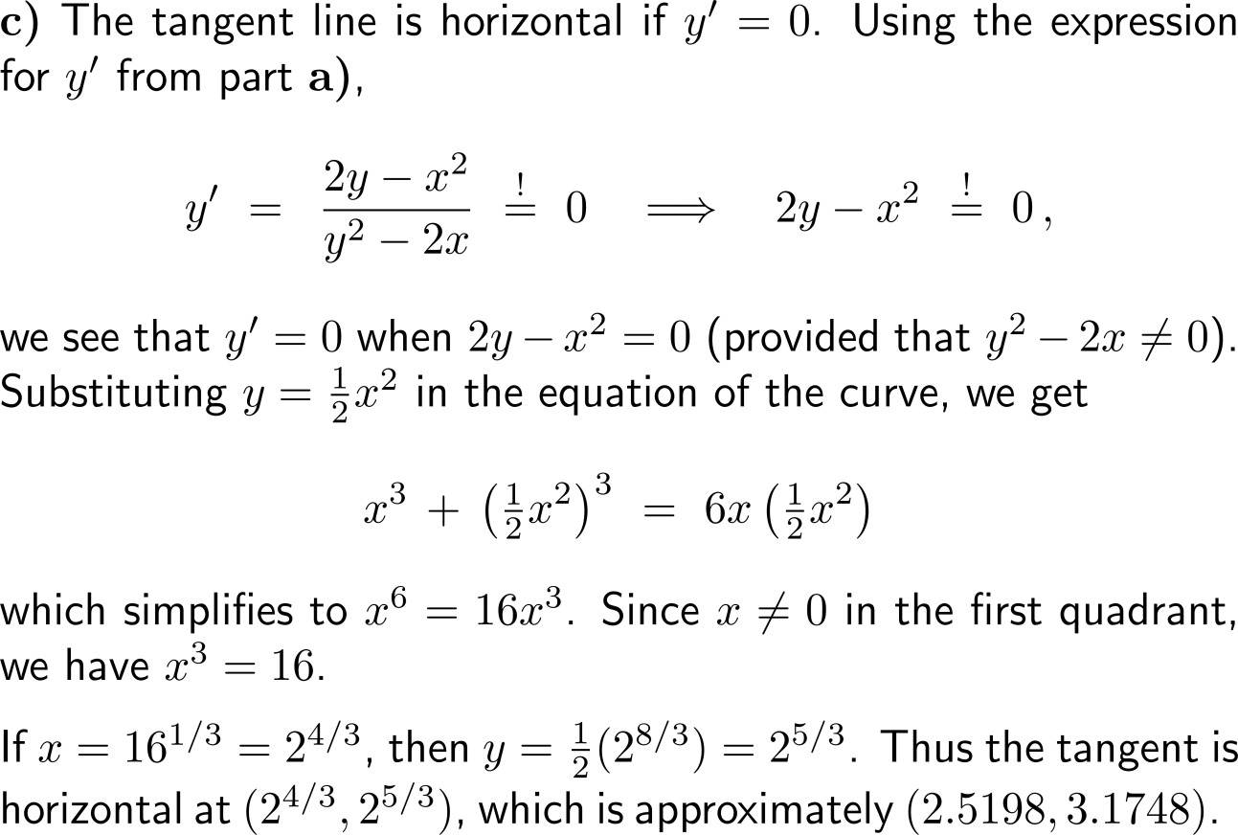
Example: Application of implicit differentiation
(2.5198, 3.1748)

Slide 11
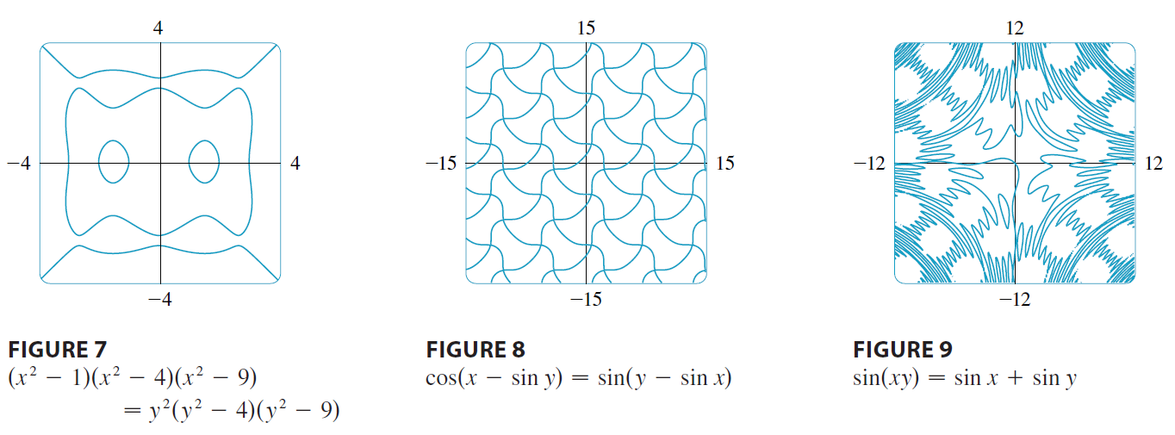
Some further examples of curves due to implicit functions (root manifolds)

Slide 12
Calculus I for Management

