Slide 1
Calculus I for MGMT – Applications of Differentiation L’Hospital’s Rules & Indeterminate Forms
Mathematics for Management
Supplementary Electronic Materials
Applications of
Differentiation
The Chain Rule
Implicit Differentiation
Linear Approximation
L’Hospital’s Rules & Indeterminate Forms

Slide 2
Motivation: limits and indeterminate forms (1/ 2)

Slide 3
Motivation: limits and indeterminate forms (2/ 2)

Slide 4
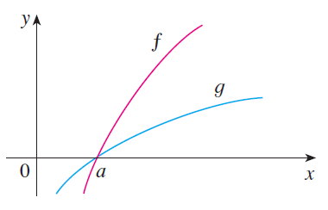
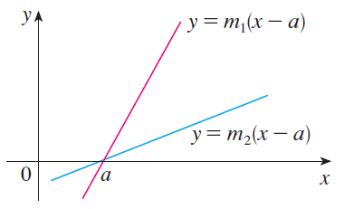
In this section we introduce a systematic method, known as l’Hospital’s Rule, for the evaluation of indeterminate forms

Slide 5
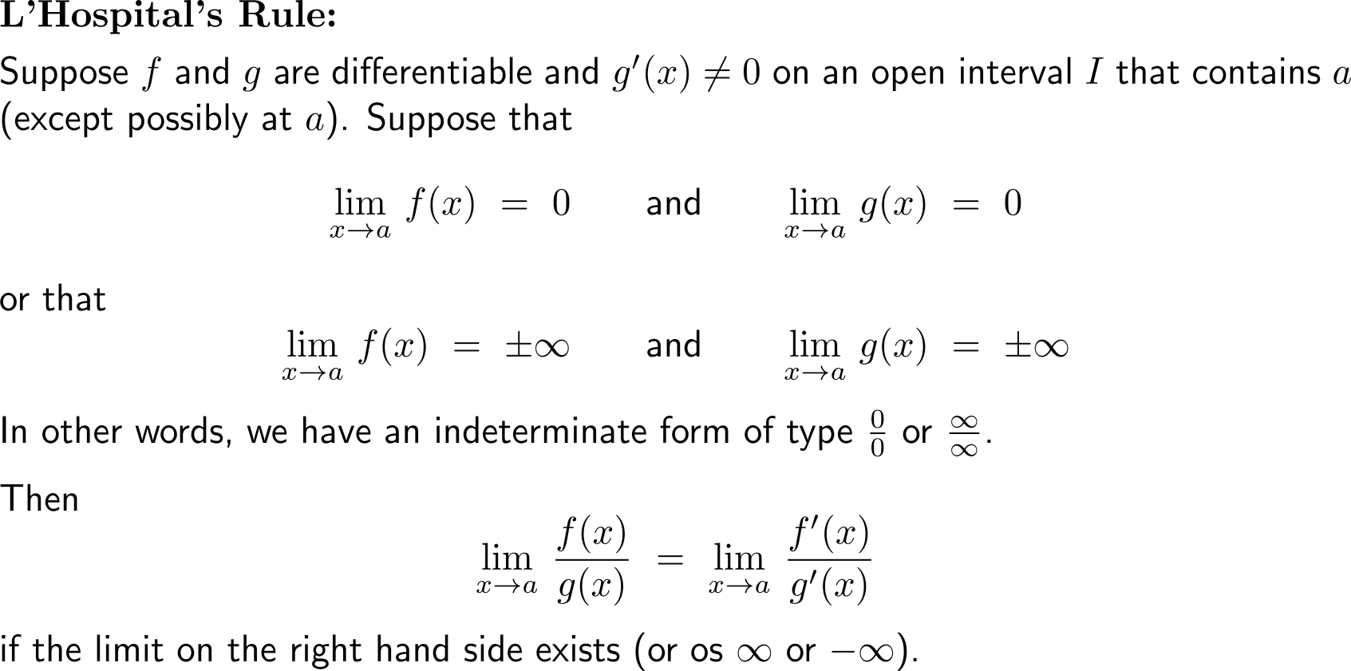
L’Hospital’s rule allows us to evaluate the limits of indeterminate forms by playing the original limit back to a limit formed by derivatives

Slide 6
Some remarks on l’Hospital’s rule (1/ 2)

Slide 7
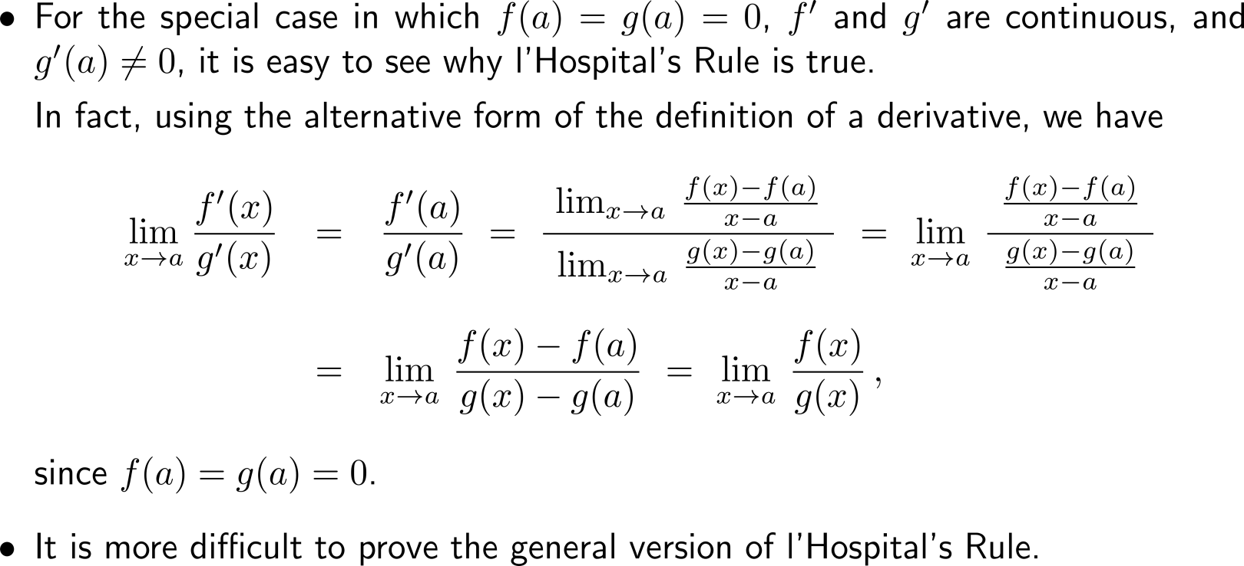
Some remarks on l’Hospital’s rule (2/ 2)

Slide 8
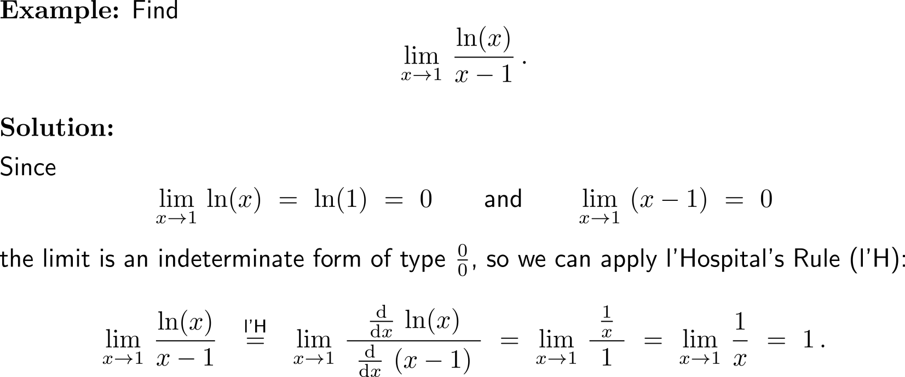
Example: Application of l’Hospital’s Rule

Slide 9
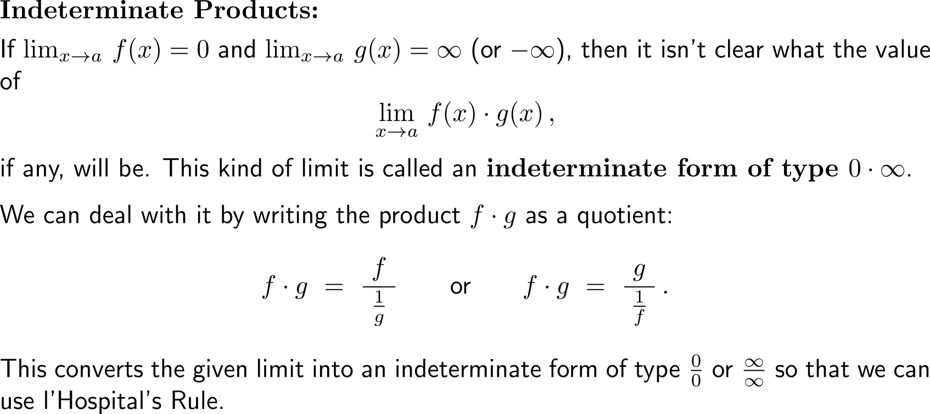
Besides the just discussed indeterminate forms ⁰/₀ and ∞/∞ there are intermediate products 0 ⋅ ∞

Slide 10
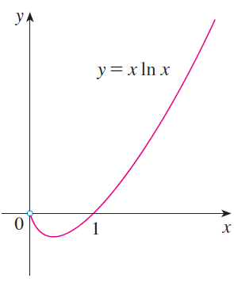
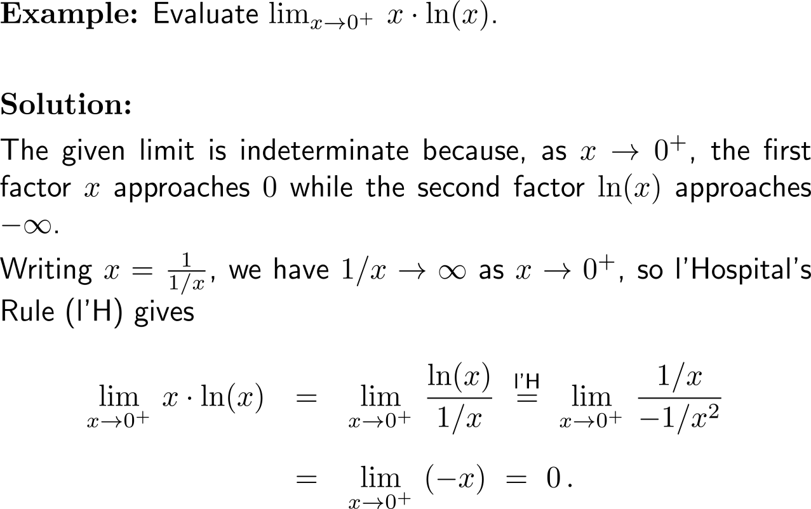
Example: Application of l’Hospital’s Rule on indeterminate products

Slide 11
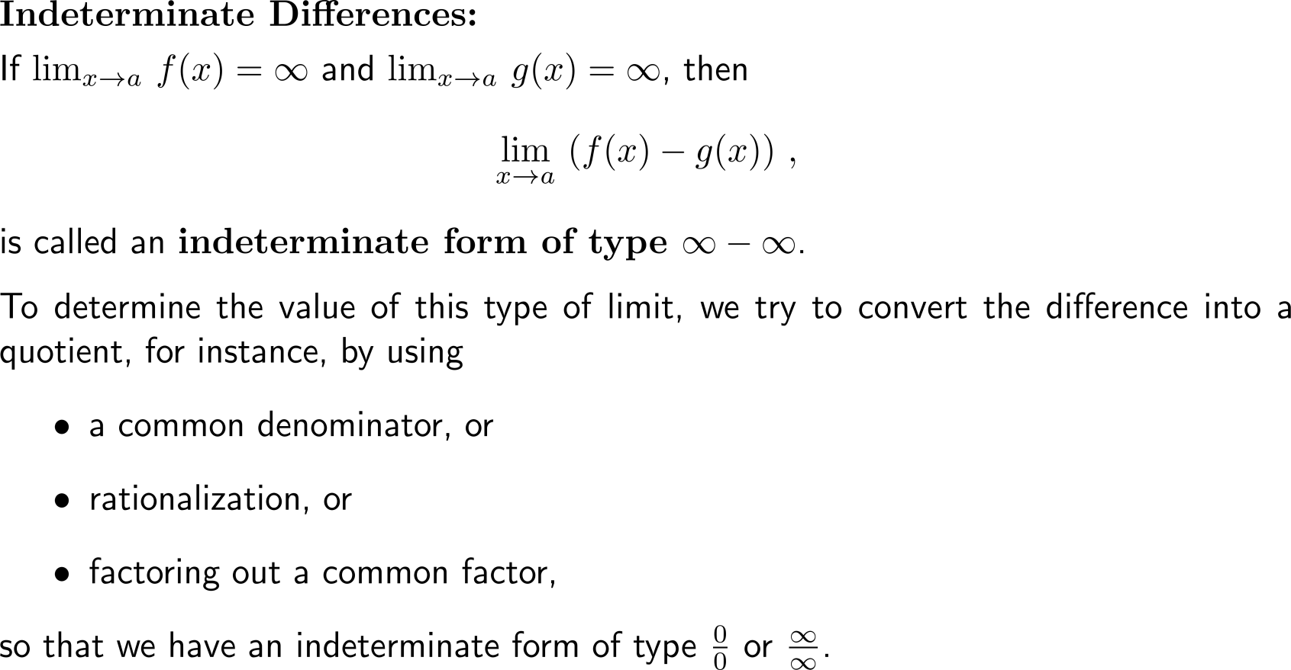
A third type of indeterminate forms are indeterminate differences ∞ - ∞

Slide 12
Example: Application of l’Hospital’s Rule on indeterminate differences

Slide 13
Example: Application of l’Hospital’s Rule on indeterminate differences

Slide 14
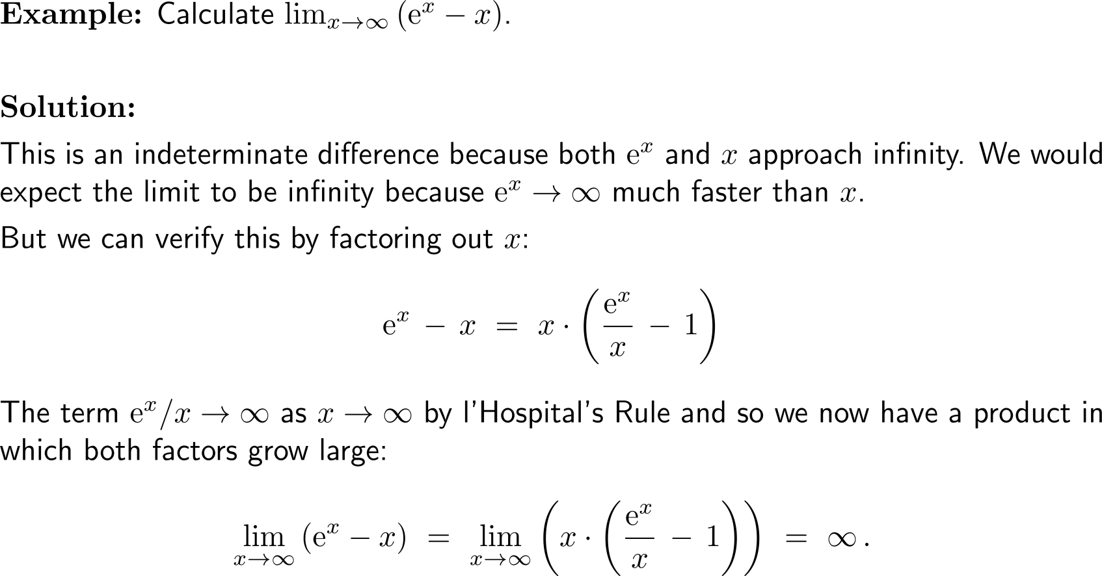
Example: Application of l’Hospital’s Rule on indeterminate differences

Slide 15
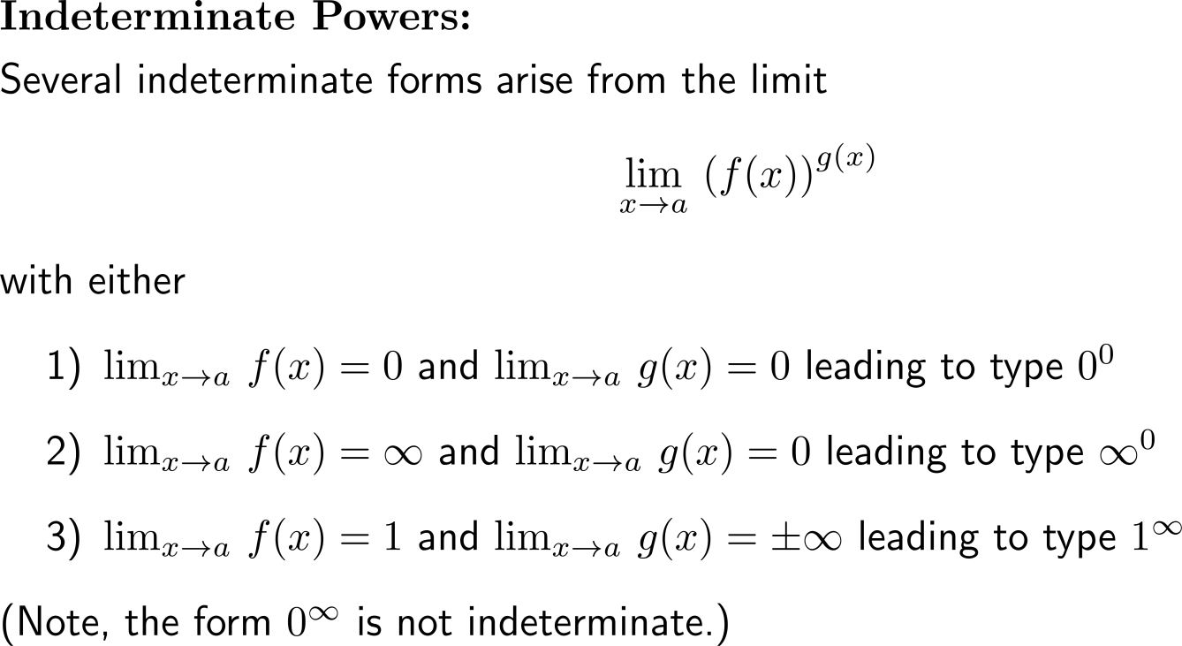
The last type of intermediate forms are indeterminate powers that can occur in three distinct ways 0⁰, ∞⁰ or 1∞ (1/ 2)

Slide 16
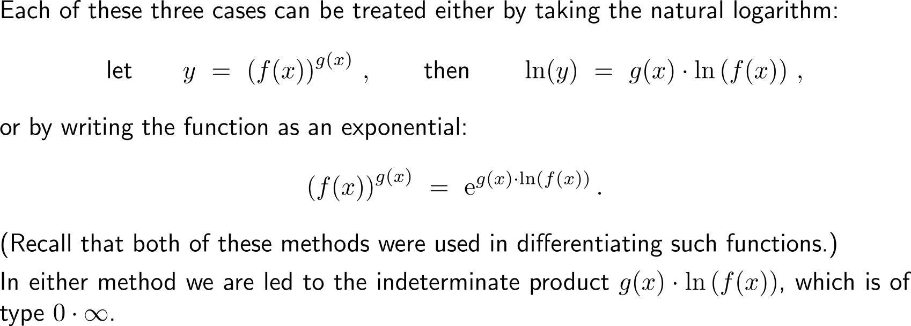
The last type of intermediate forms are indeterminate powers that can occur in three distinct ways 0⁰, ∞⁰ or 1∞ (2/ 2)

Slide 17
Example: Application of l’Hospital’s Rule on indeterminate powers

Slide 18
Calculus I for Management

