Slide 1
Calculus I for MGMT – Exp. & Log. Functions II and Marginal Analysis Differentiation of Exp. & Log. Functions
Mathematics for Management
Supplementary Electronic Materials
Exp. & Log. Functions II and
Marginal Analysis
Differentiation of
Exp. & Log. Functions
Exponential Models
Marginal Analysis & Approx. using Increments
Related Rates

Slide 2
Recap: the natural exponential function with base e is the only non-constant function whose derivative is equal to the function itself

Slide 3
Next, let us use implicit differentiation to find the derivatives of logarithmic functions …

Slide 4
… and, in particular, the natural logarithmic function

Slide 5
Example: Application of the differentiation rule for the natural logarithm

Slide 6
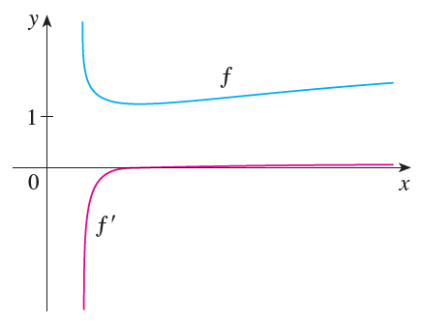
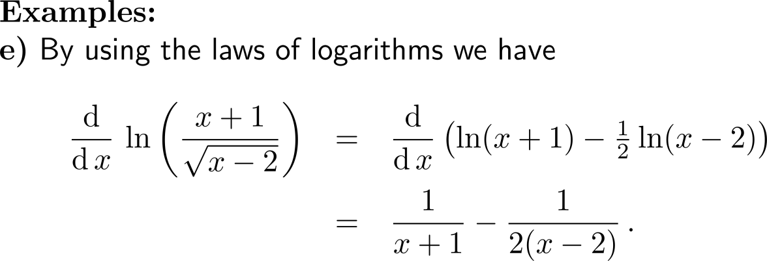
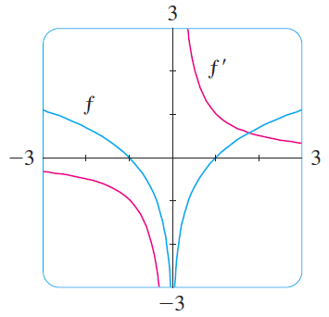
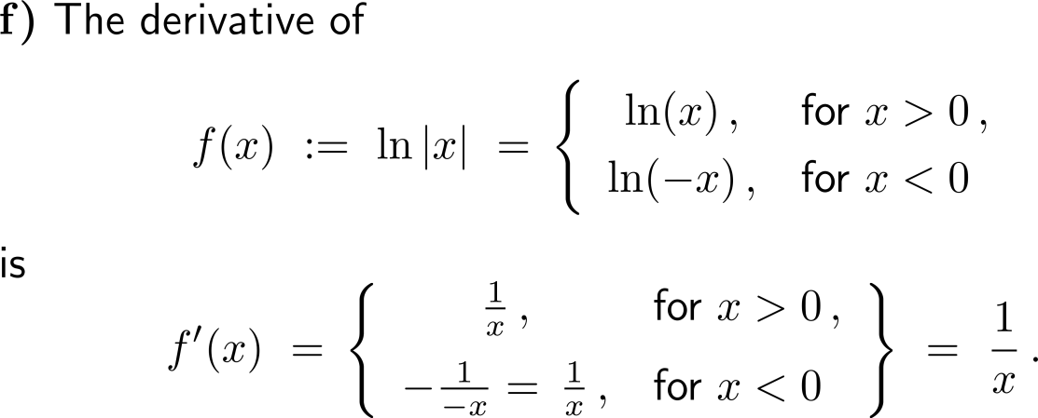
Example: Application of the differentiation rule for the natural logarithm

Slide 7
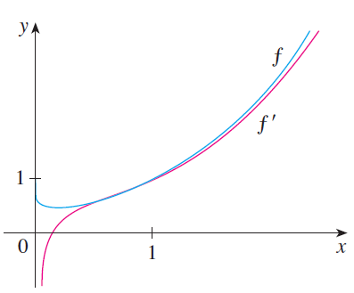
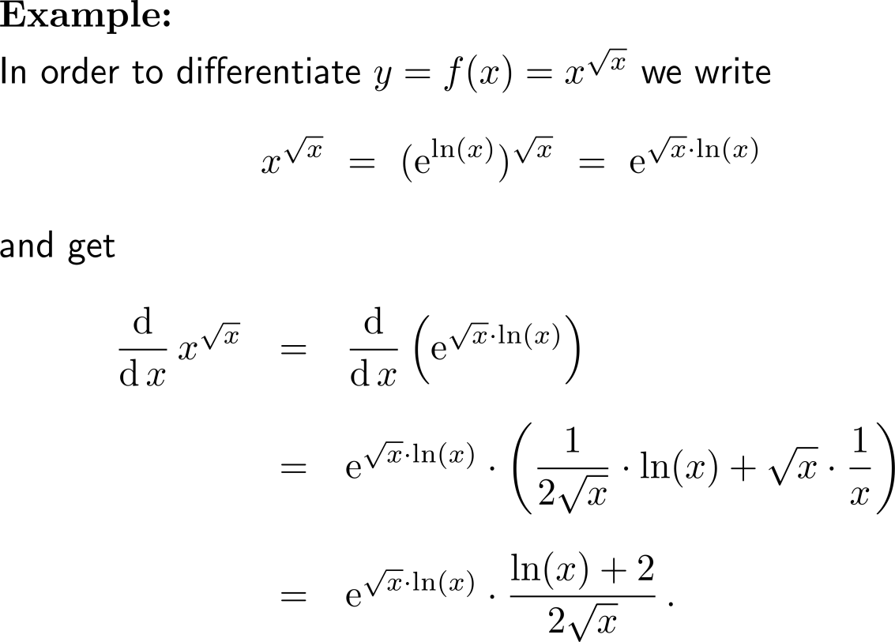
Example: Derivative of natural exponential and logarithmic functions

Slide 8
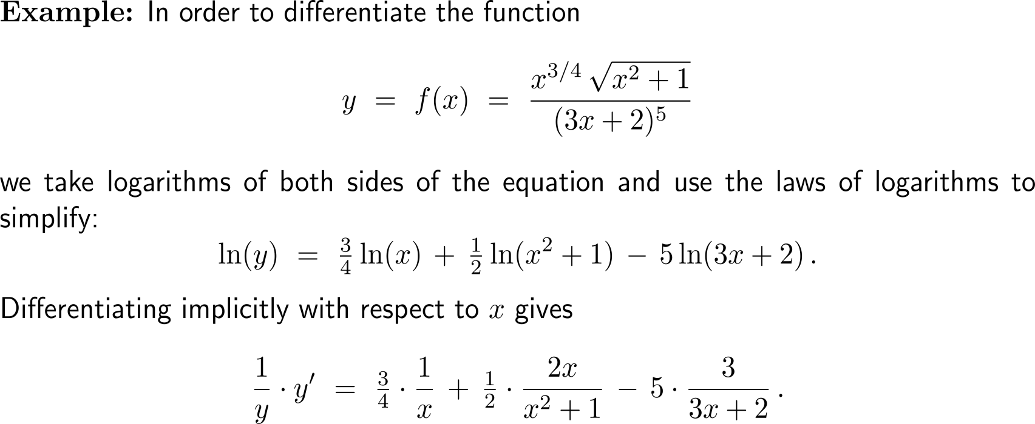
The calculation of derivatives of complicated functions involving products, quotients, or powers can often be simplified by taking logarithms (1/ 3)

Slide 9
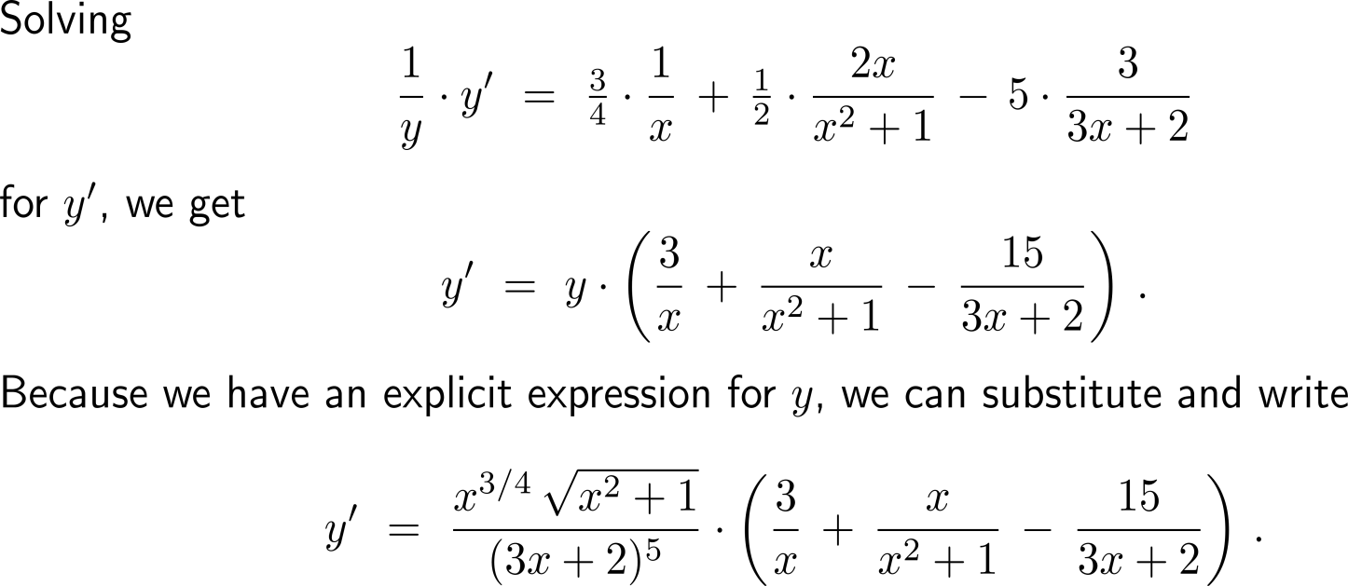
The calculation of derivatives of complicated functions involving products, quotients, or powers can often be simplified by taking logarithms (2/ 3)

Slide 10
The calculation of derivatives of complicated functions involving products, quotients, or powers can often be simplified by taking logarithms (3/ 3)

Slide 11
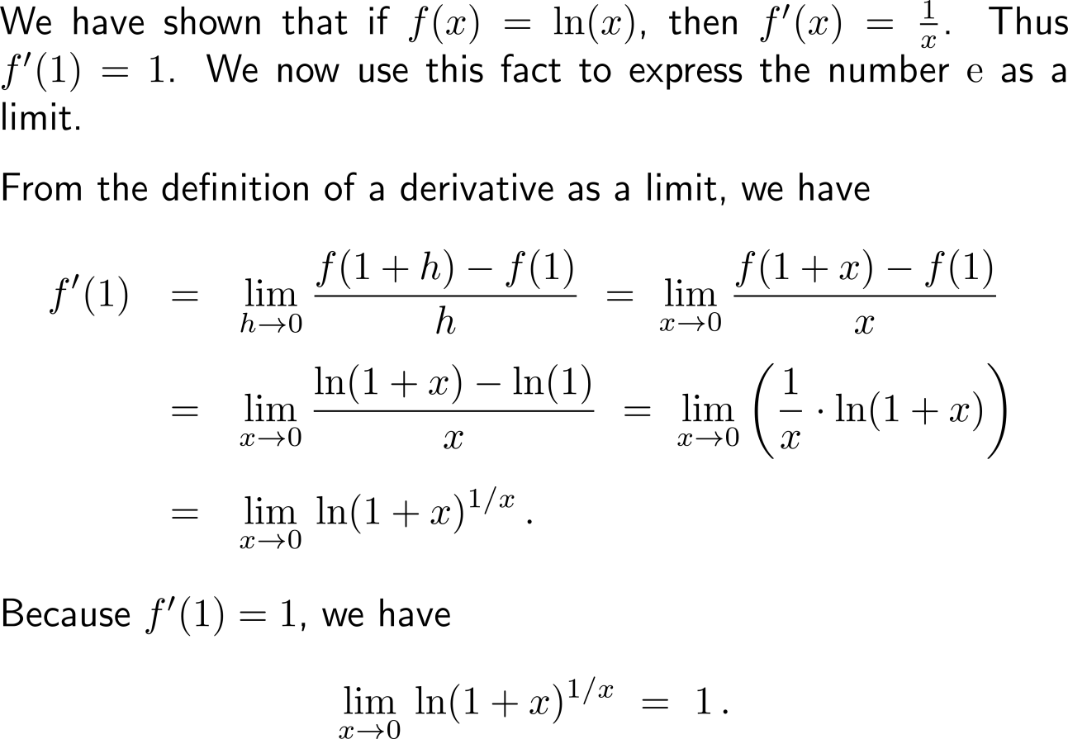
The Euler-number e as a limit (1/ 2)

Slide 12
The Euler-number e as a limit (2/ 2)

Slide 13
Calculus I for Management

