Slide 1
Calculus I for MGMT – Curves & Derivatives Concavity and Points of Inflection
Mathematics for Management
Supplementary Electronic Materials
Connecting the Properties of Curves with Derivatives
Increasing/ Decreasing Functions & Relative Extrema
Concavity and Points of Inflection
Horizontal, Vertical & Slant Asymptotes

Slide 2
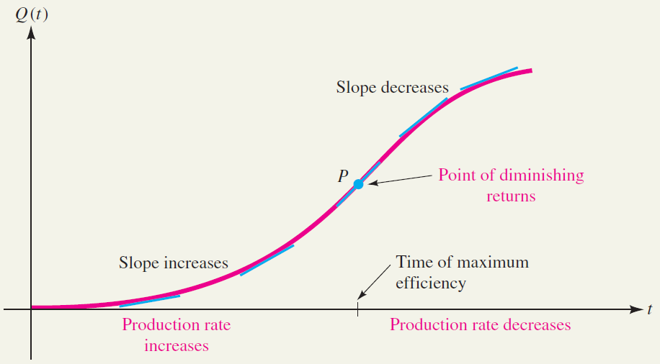
When analyzing production/ work performance one is interested in the point of demising returns (where the 2nd derivative changes sign)
The number of units that a factory worker can produce in t hours after arriving at work is often given by a function Q(t) like the one whose graph is shown in the figure.
Notice that at first the graph is not very steep. The steepness increases, however, until the graph reaches a point of maximum steepness, after which the steepness begins to decrease.
This reflects the fact that at first the worker’s efficiency is low. The efficiency increases, however, as the worker settles into a routine and continues to increase until the worker is performing at maximum efficiency. Then fatigue sets in and the efficiency begins to decline.
The point P on the output curve where maximum efficiency occurs is known in economics as the point of diminishing returns.

Slide 3
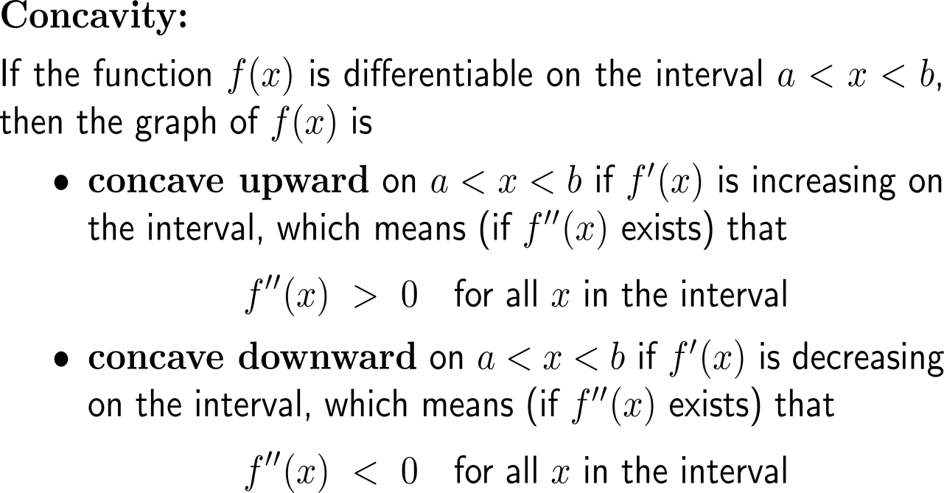
The increase and decrease of the slope of a tangent line is described by the concavity of the graph

Slide 4
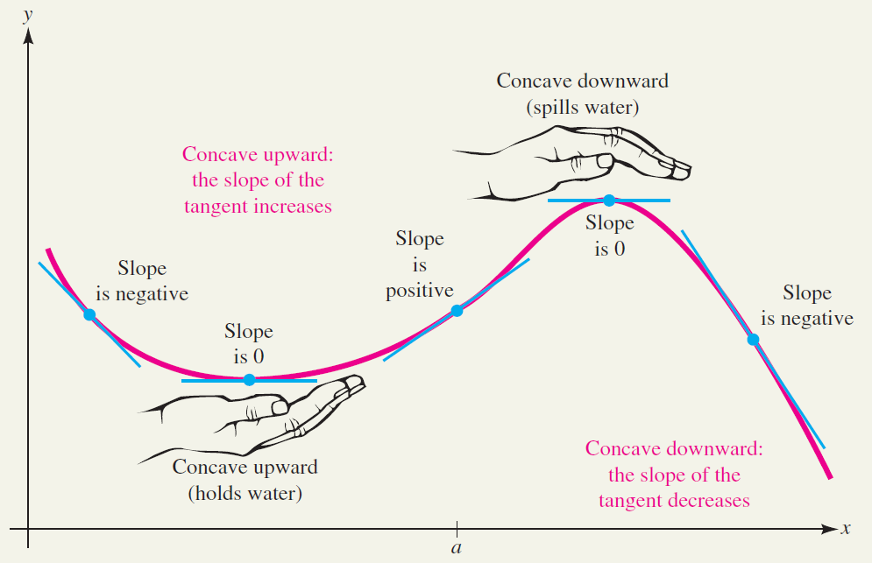
Informally, a concave upward portion of graph “holds water” (cup), while a concave downward portion “spills water” (cap)

Slide 5
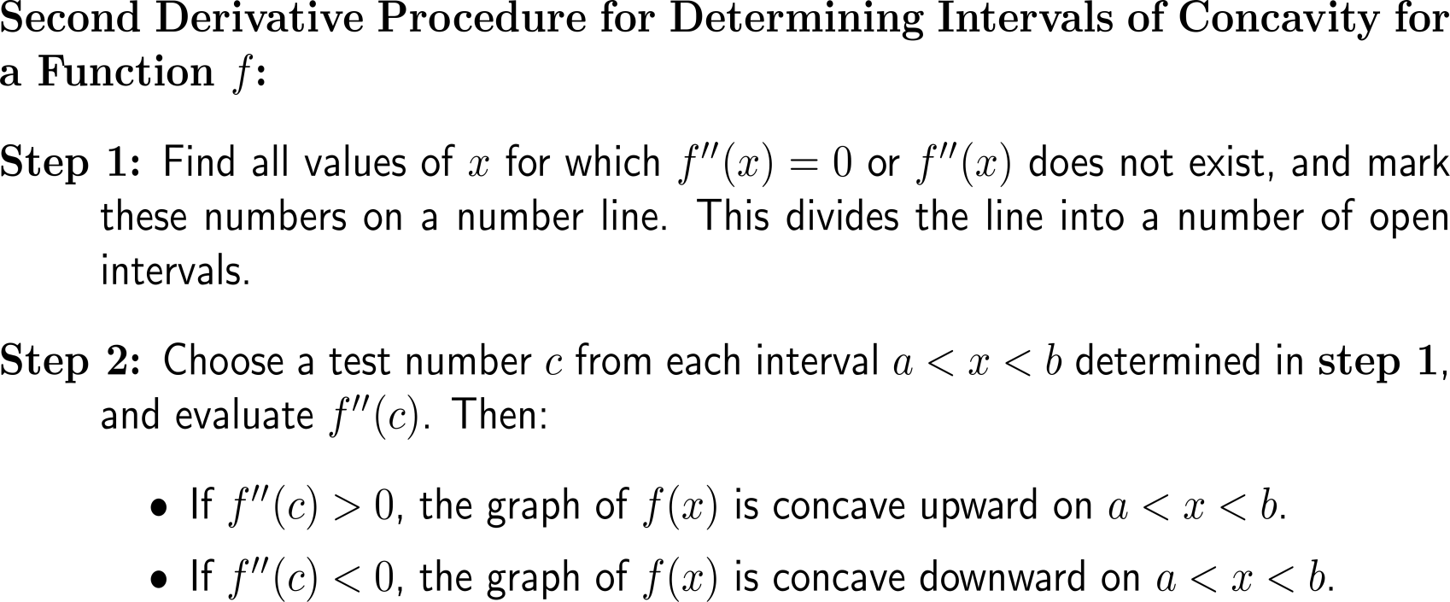
With the signs of the 2nd on specific intervals the concavity (upward vs. downward) of a function is determined

Slide 6
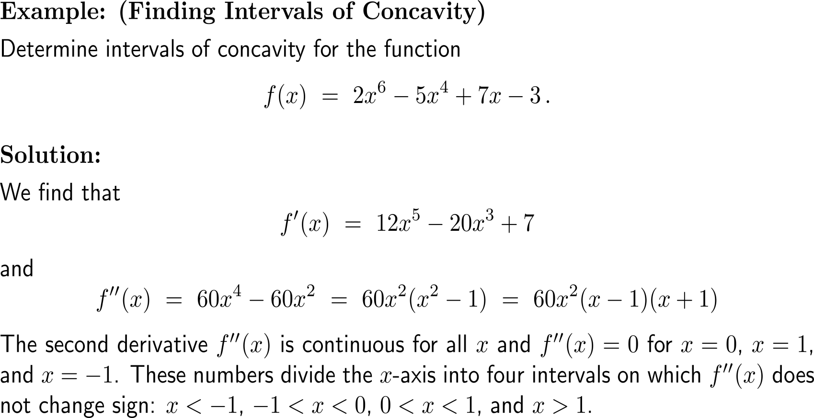
Example: Finding intervals of concavity

Slide 7
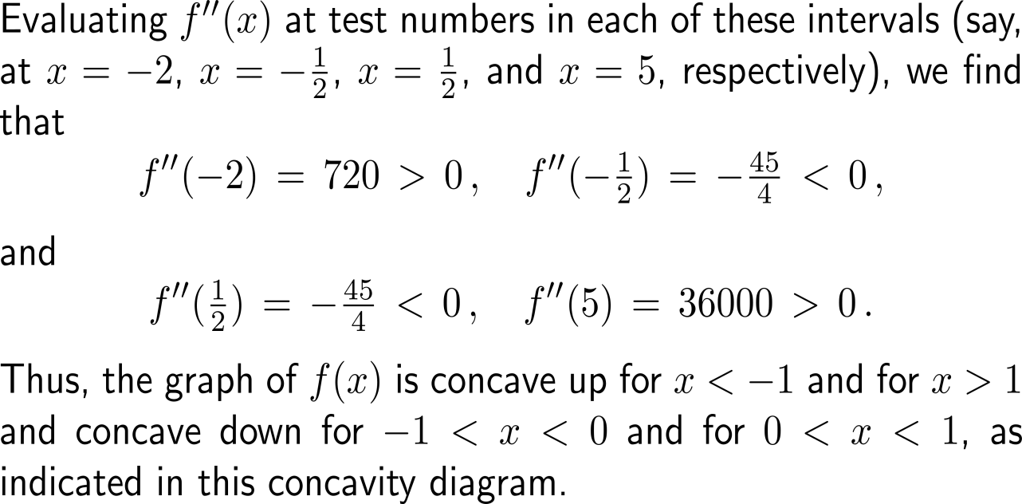
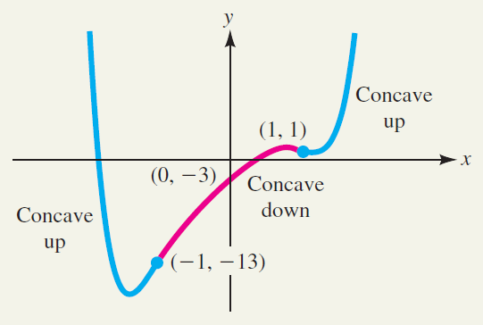
Example: Finding intervals of concavity

Slide 8
A function f(x) may be increasing or decreasing on an interval regardless of whether its graph is concave upward or concave downward on that interval
Do not confuse the concavity of a graph with its “direction” (strictly monotonously increas-ing or decreasing).
A function f(x) may be increas-ing or decreasing on an interval regardless of whether its graph is concave upward or concave downward on that interval.

Slide 9
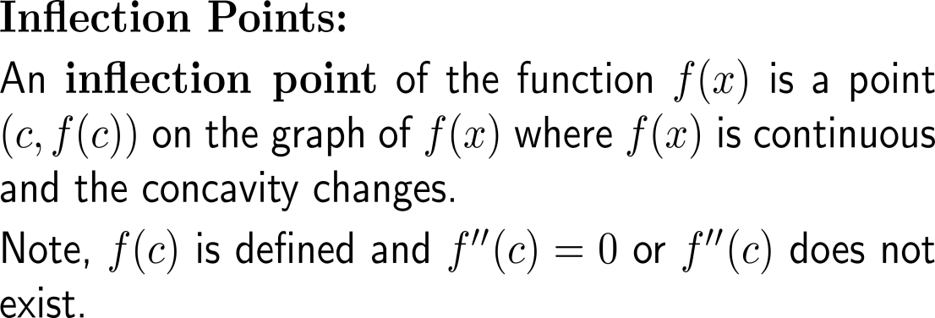
Inflection points separate regions of downward and upward concavity for continuous functions
point of inflection

Slide 10
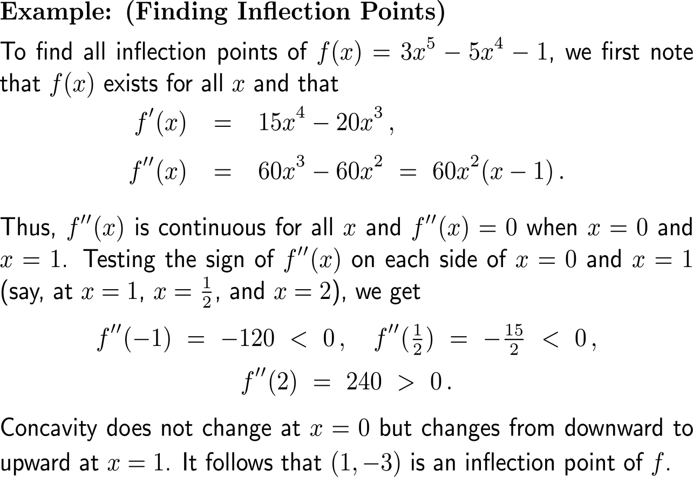
Example: Finding inflection points

Slide 11
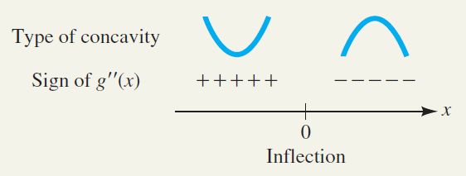
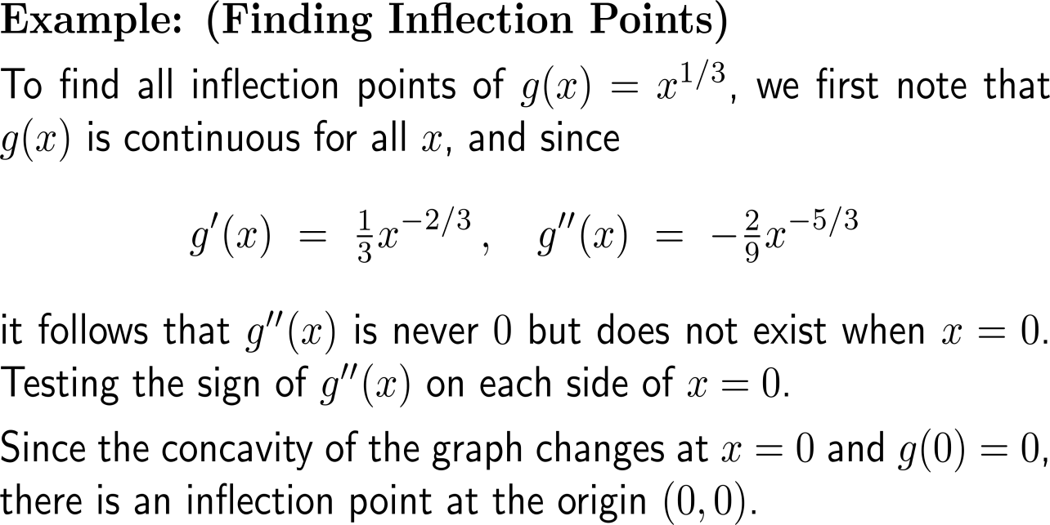
Example: Finding inflection points

Slide 12
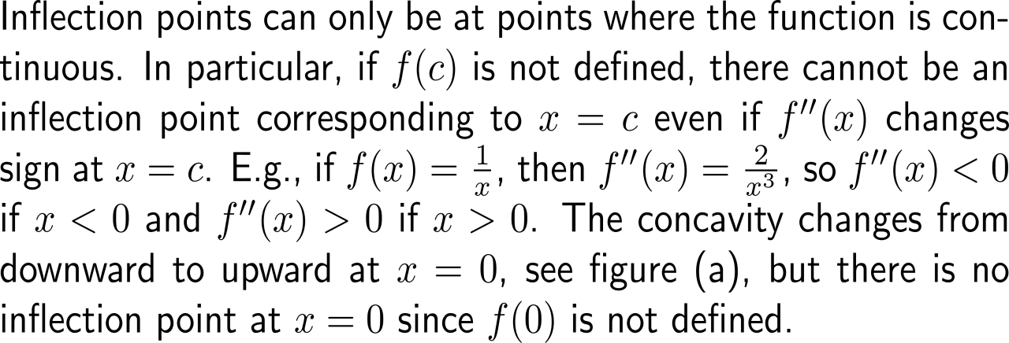
Examples: Situations where the procedure for inflection points does not work

Slide 13
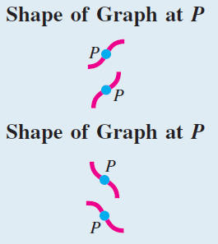
Geometrically, inflection points occur at ‘twists’ of the graph

Slide 14
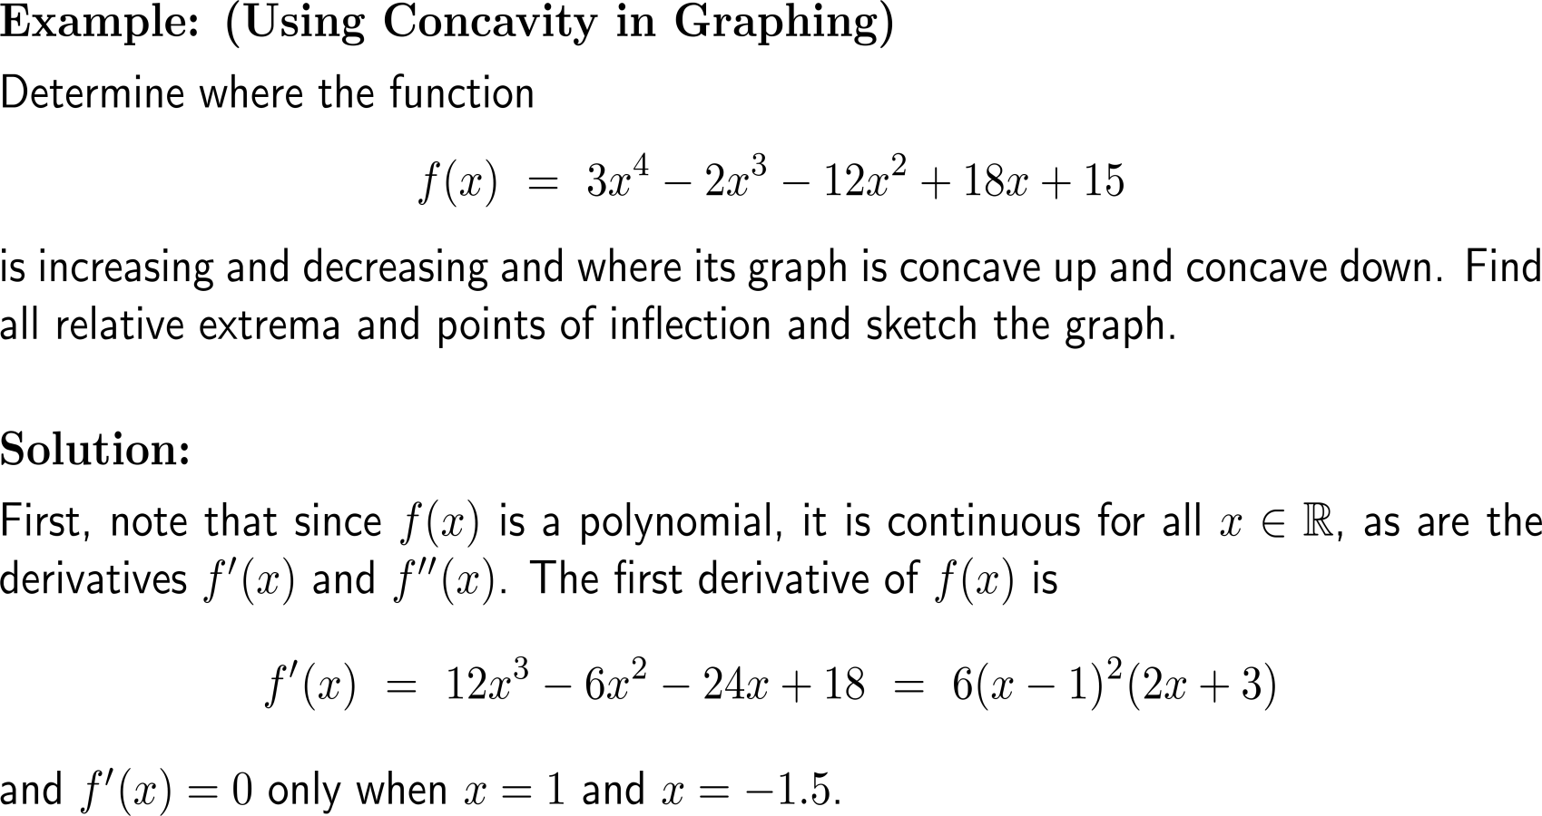
Example: Using concavity for graphing

Slide 15
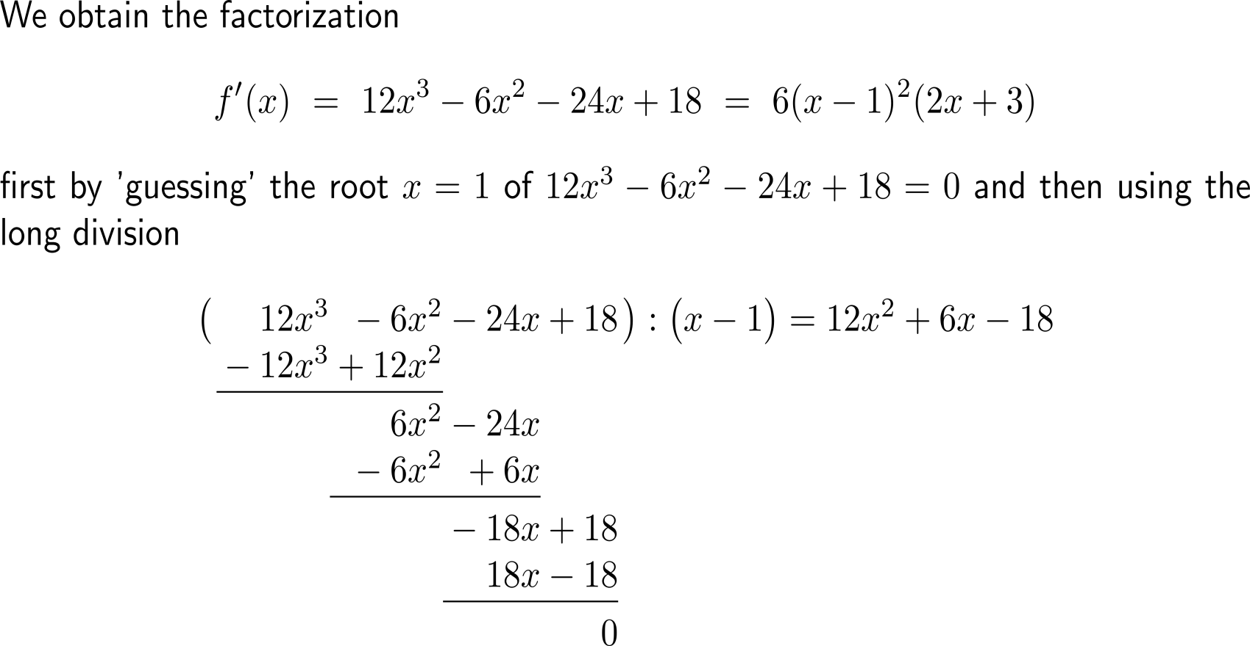
Example: Using concavity for graphing

Slide 16
Example: Using concavity for graphing

Slide 17
Example: Using concavity for graphing

Slide 18
Example: Using concavity for graphing

Slide 19
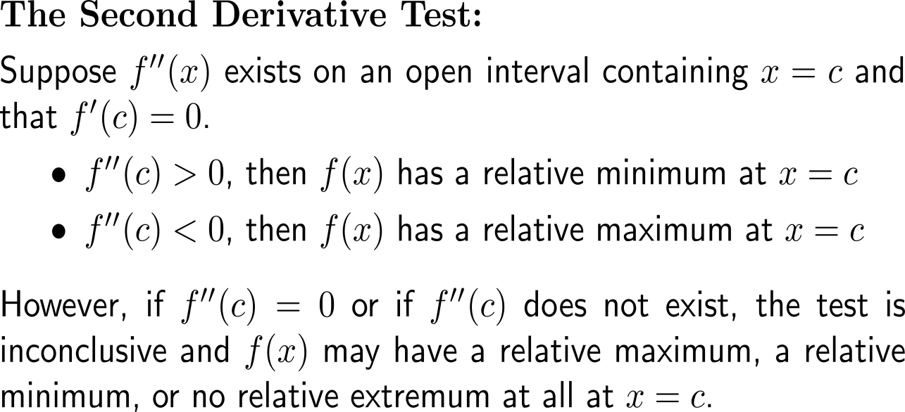
The sign of the 2nd derivative at a critical number determines the type of the relative extremum at the critical number

Slide 20
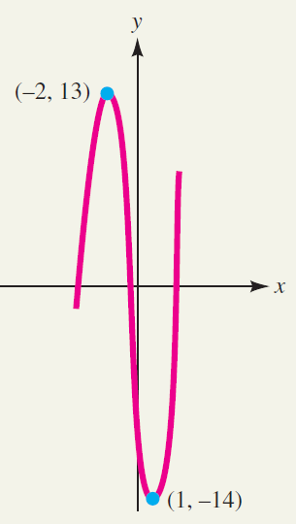
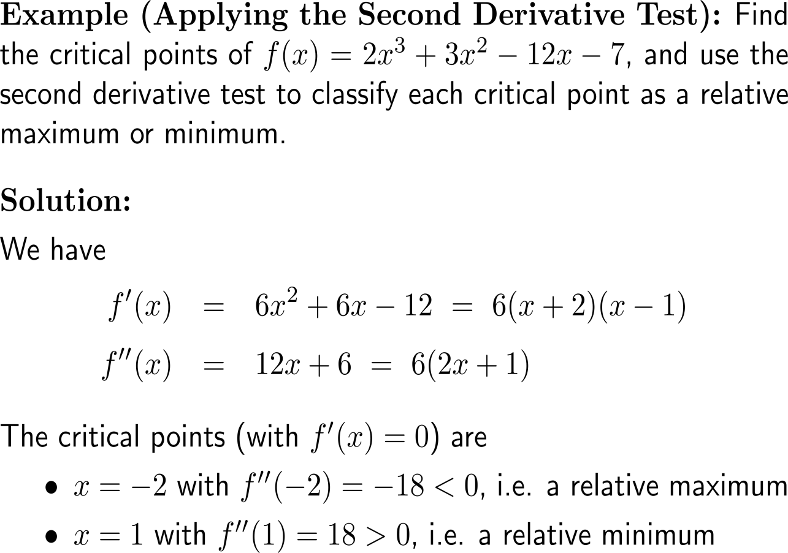
Example: Applying the second derivative test

Slide 21
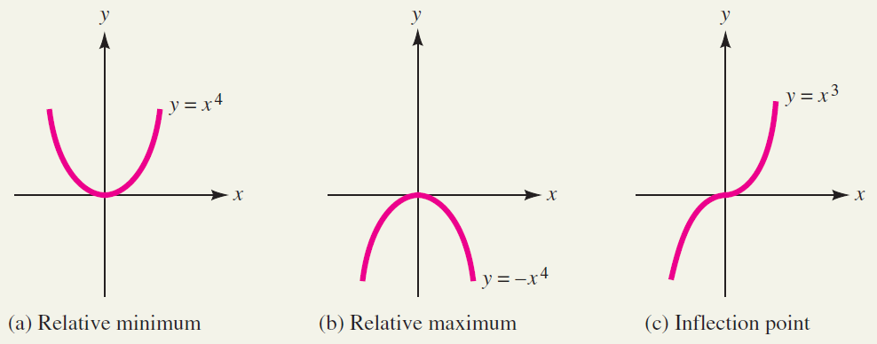
If the 2nd derivative at a critical point is vanishing then the second derivatives test is inconclusive

Slide 22
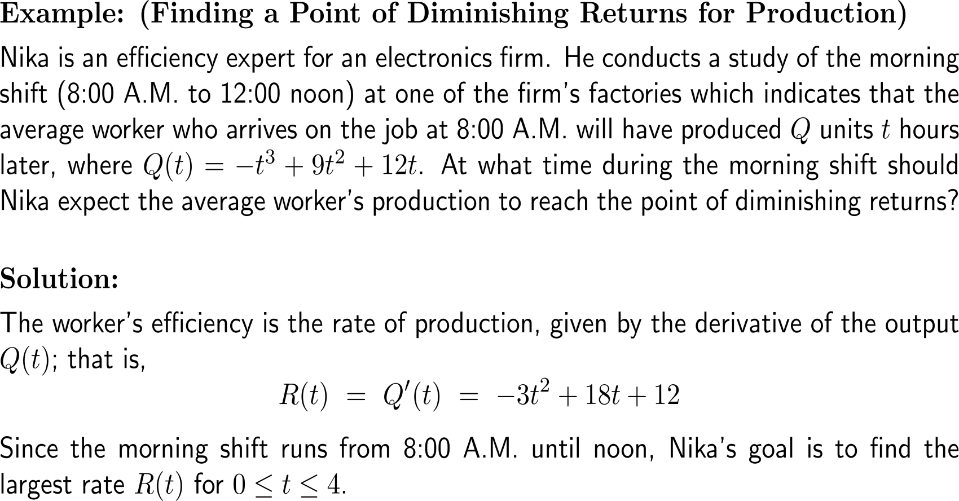
Example: Finding a point of diminishing returns for production

Slide 23
Example: Finding a point of diminishing returns for production

Slide 24
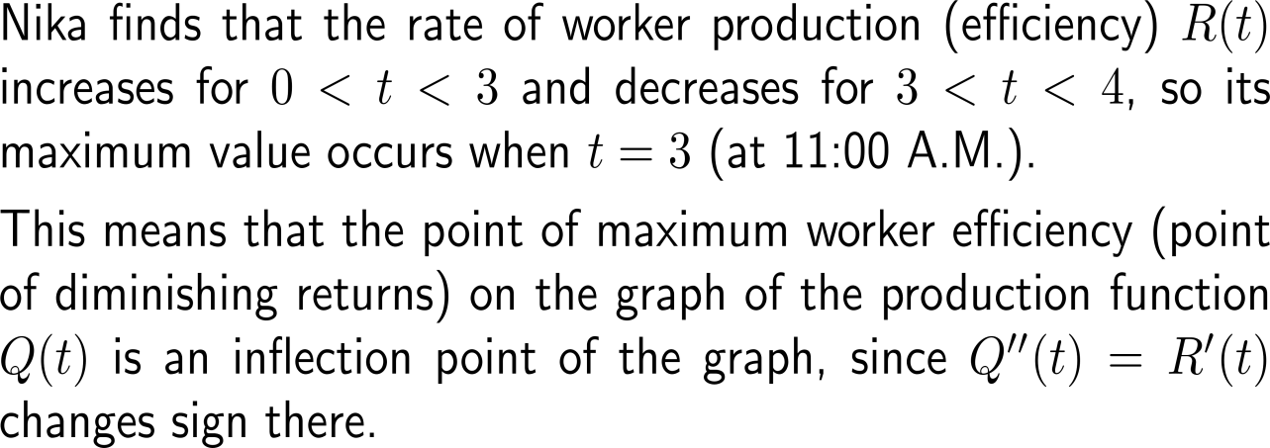
Example: Finding a point of diminishing returns for production

Slide 25
Calculus I for Management

