Slide 1
Calculus I for Management
Connecting the Properties of Curves with Derivatives
week 9
Lecture
Increasing/ decreasing functions & relative extrema
Concavity & points of inflection
Horizontal, vertical and slant asymptotes

Slide 2
Topics
Increasing/ Decreasing Functions & Relative Extrema
Concavity and Points of Inflection
Horizontal, Vertical & Slant Asymptotes

Slide 3
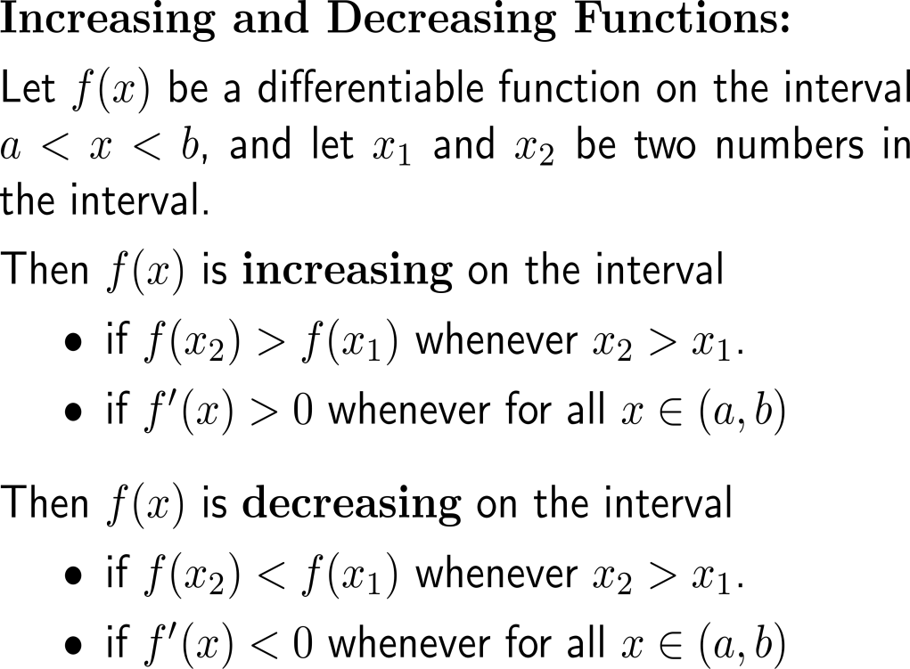
Recap: Increasing and decreasing functions

Slide 4
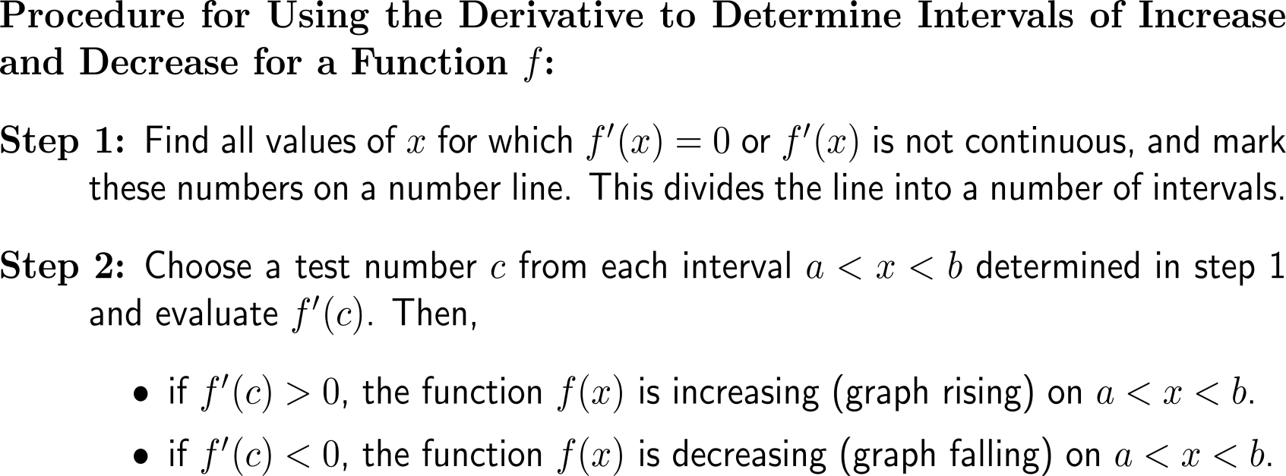
This leads to a hands-on procedure to use the derivative to determine intervals of increase and decease for a function

Slide 5
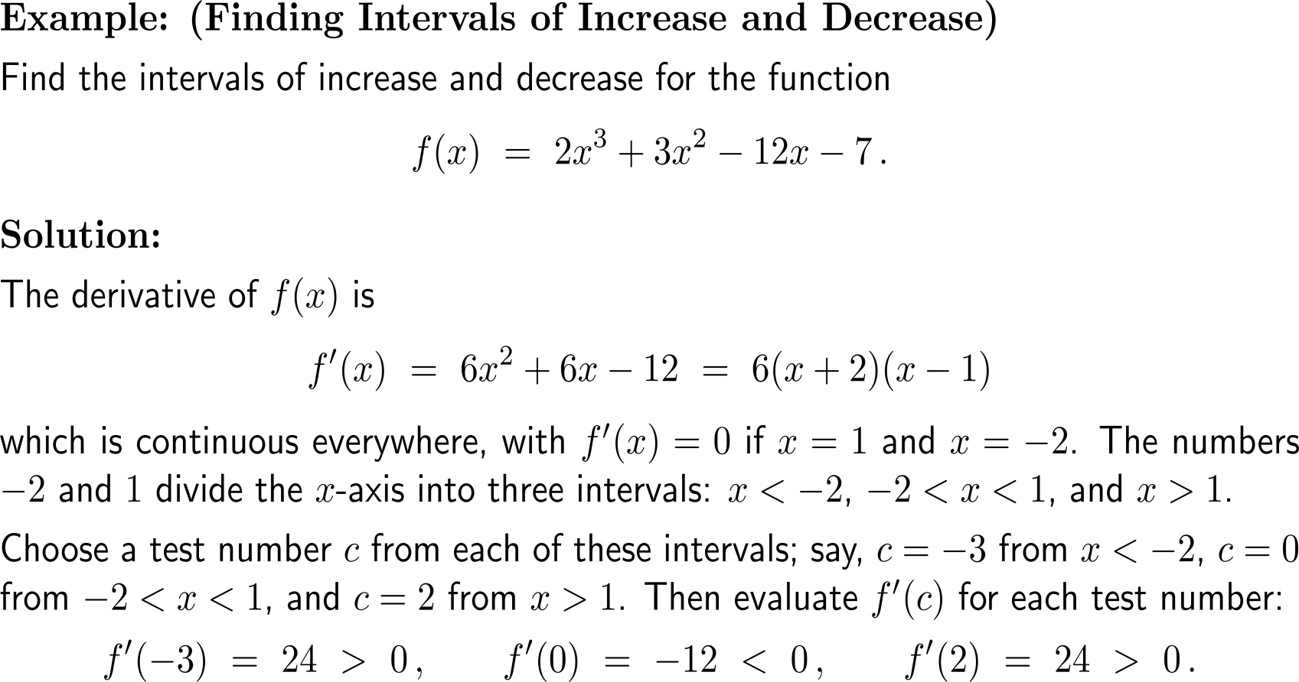
Example: Finding intervals of increase and decrease

Slide 6
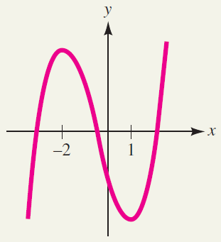
Example: Finding intervals of increase and decrease

Slide 7
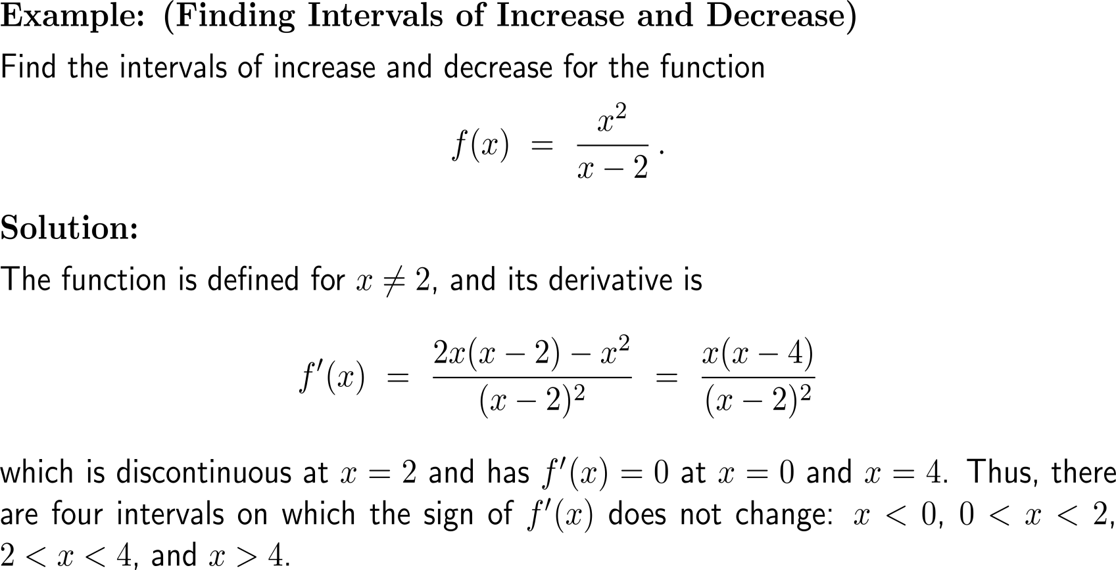
Example: Finding intervals of increase and decrease

Slide 8
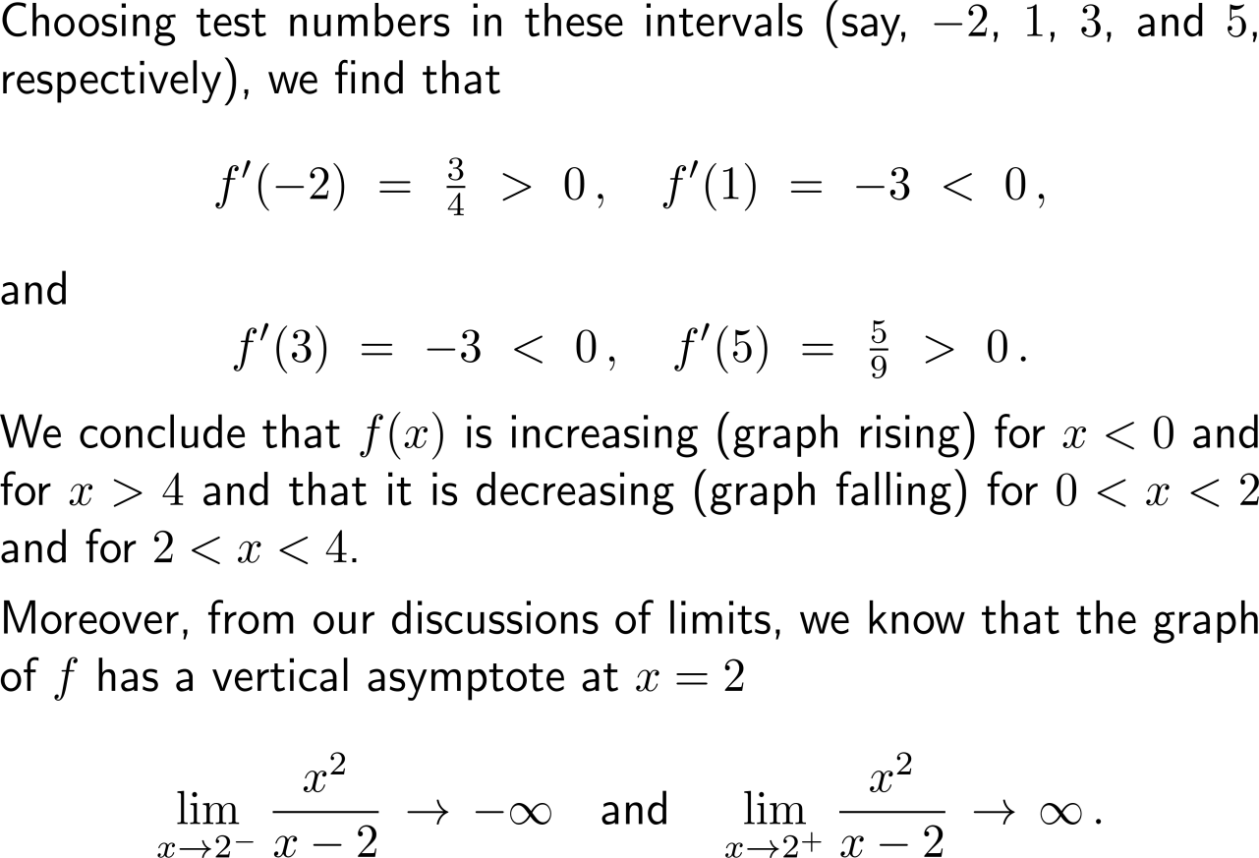
Example: Finding intervals of increase and decrease

Slide 9
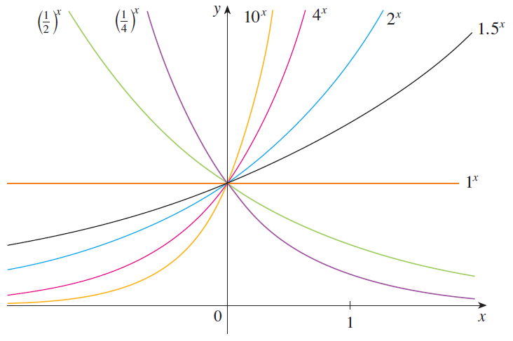
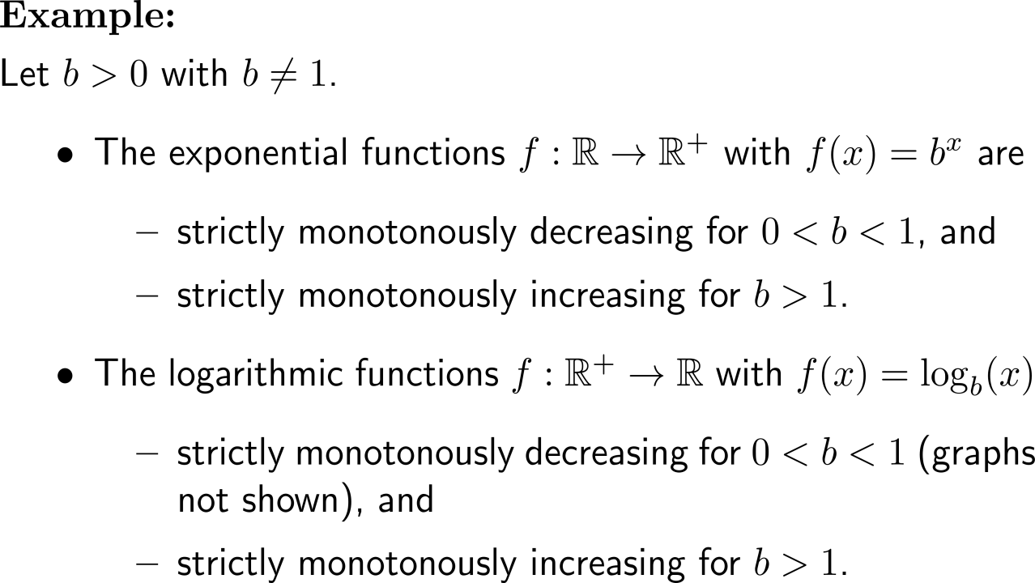
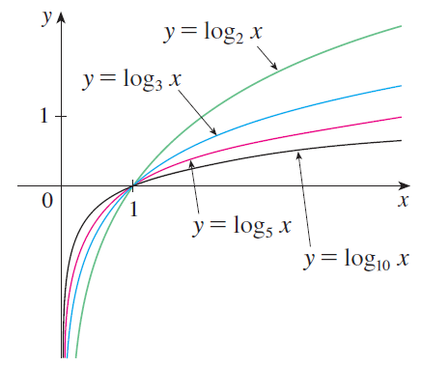
Example: Exponential functions and logarithms

Slide 10
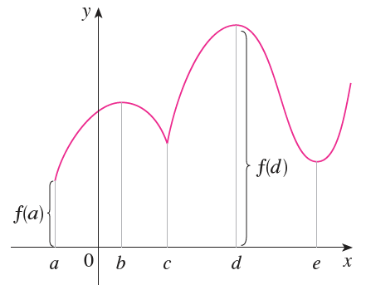
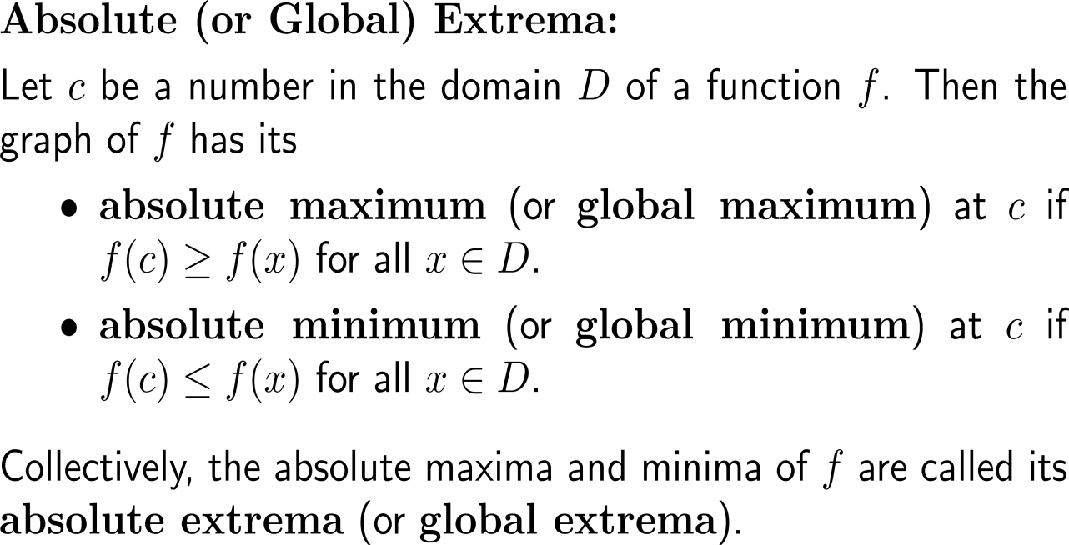
We distinguish between to types of extrema: (i) absolute or global extrema …
absolute extremum

Slide 11
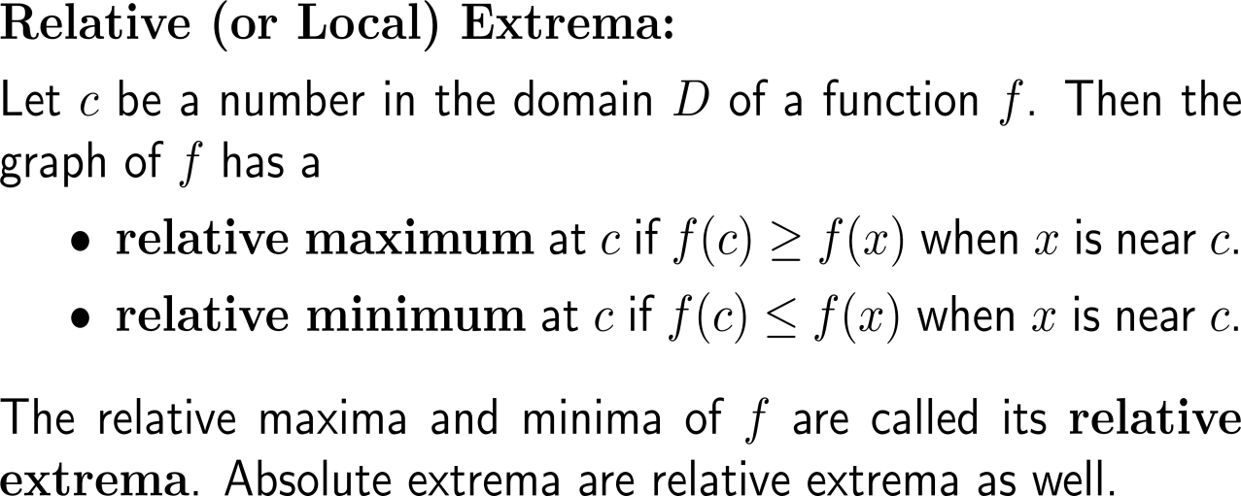
… and (ii) relative or local extrema
relative extremum
absolute extremum

Slide 12
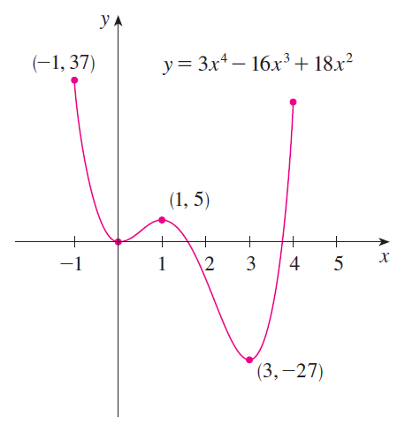
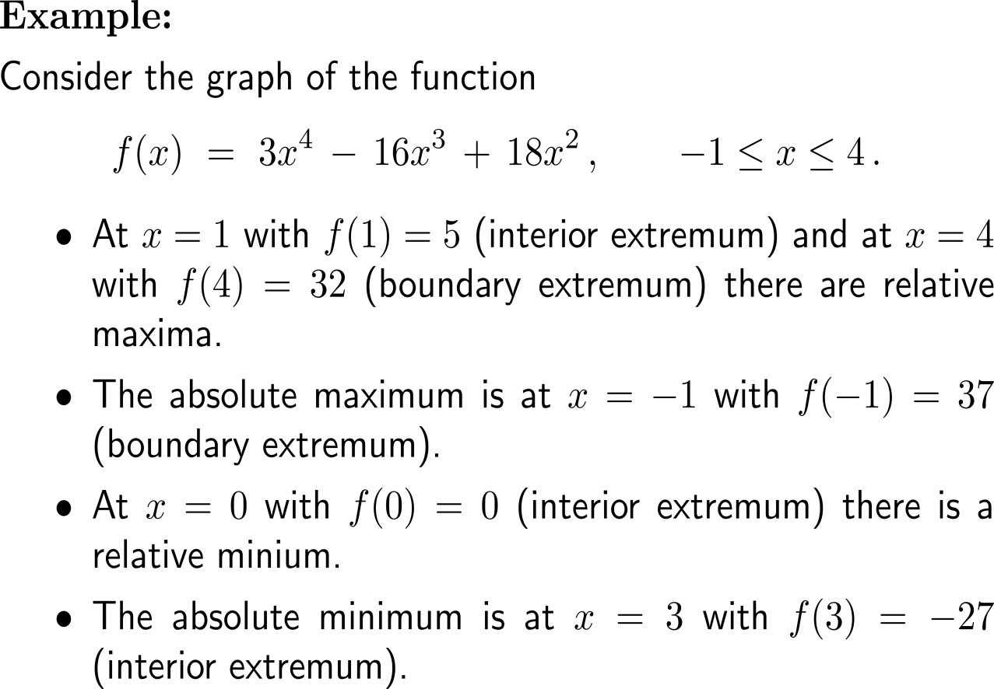
Example: Relative and absolute extrema

Slide 13
Relative extrema can only occur at critical points (1/ 2)
the differentiable
situation
c is a critical number if
f’(c) = 0 or
f’(c) does not exist

Slide 14
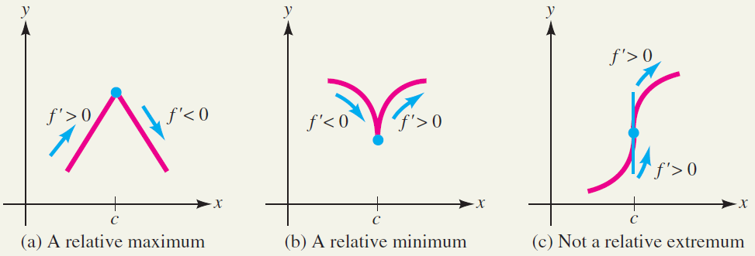
Relative extrema can only occur at critical points (2/ 2)
the non-differentiable
situation
c is a critical number if
f’(c) = 0 or
f’(c) does not exist

Slide 15
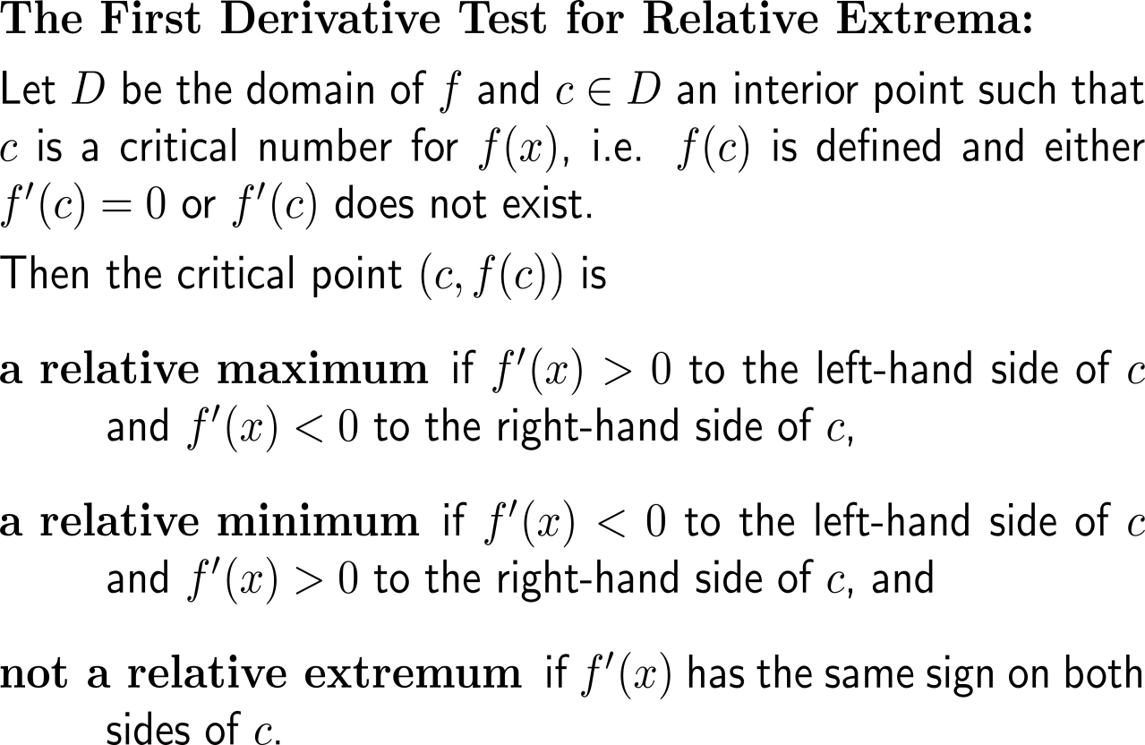
The type of sign change of the 1st derivative at a critical number determines the type of the relative extremum at the critical number
relative maximum
relative minimum
not a relative extremum

Slide 16
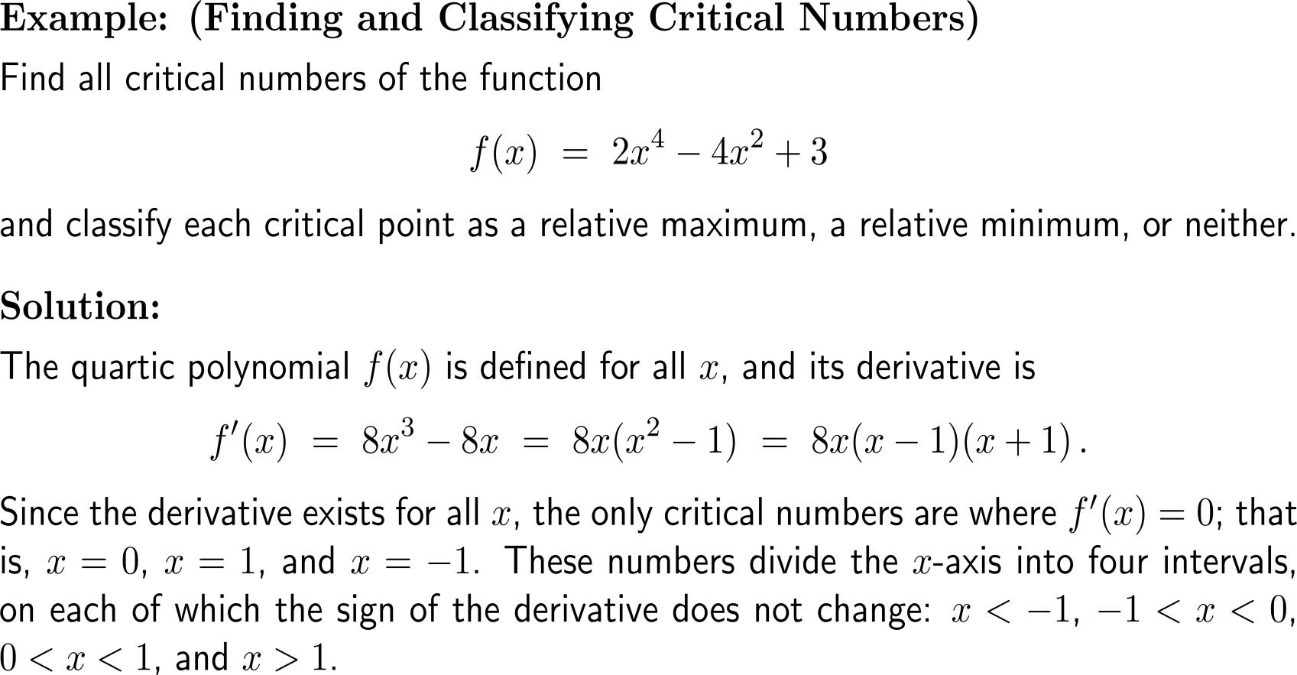
Example: Finding and classifying critical numbers

Slide 17
Example: Finding and classifying critical numbers

Slide 18
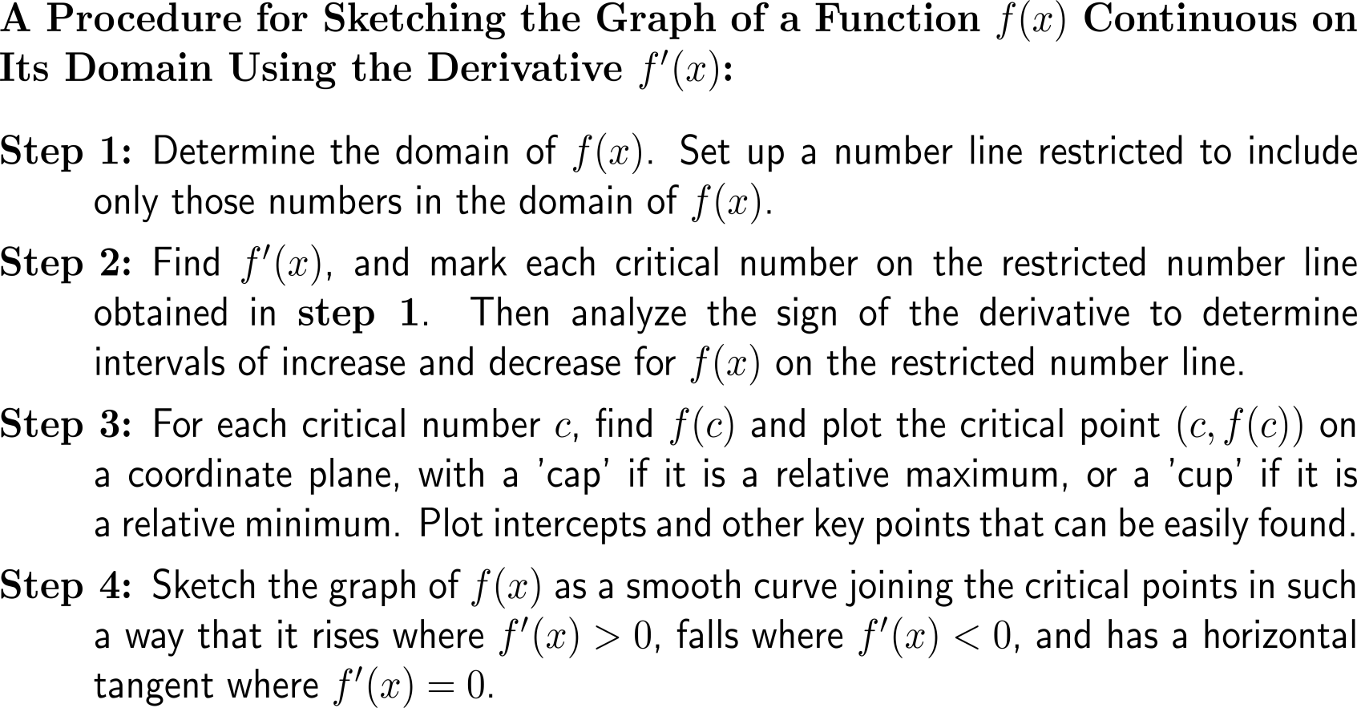
The 1st derivatives gives good information for sketching the graph of a function
‘cap’
‘cup’

Slide 19
Example: Graphing using a derivative

Slide 20
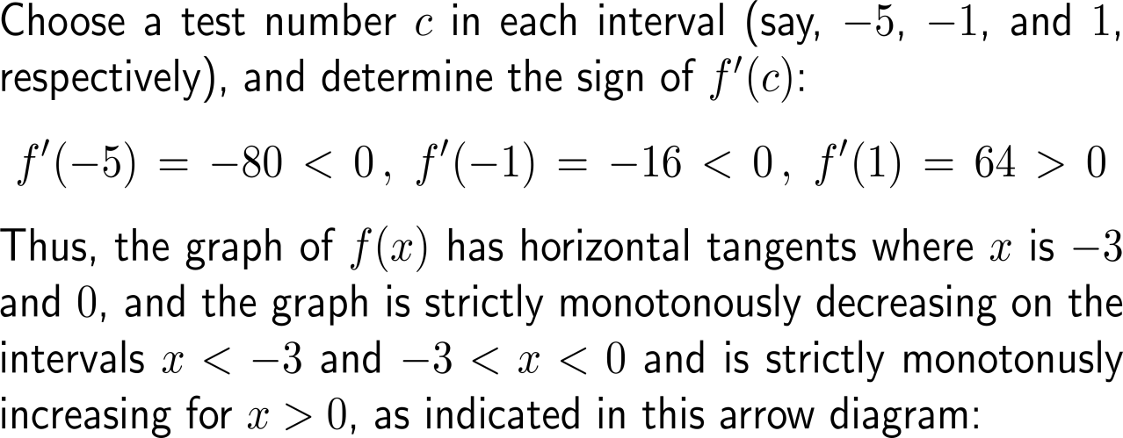
Example: Graphing using a derivative

Slide 21
Example: Finding maximum revenue

Slide 22
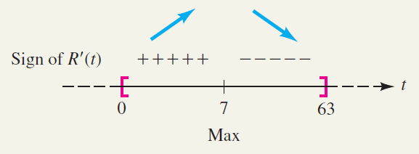
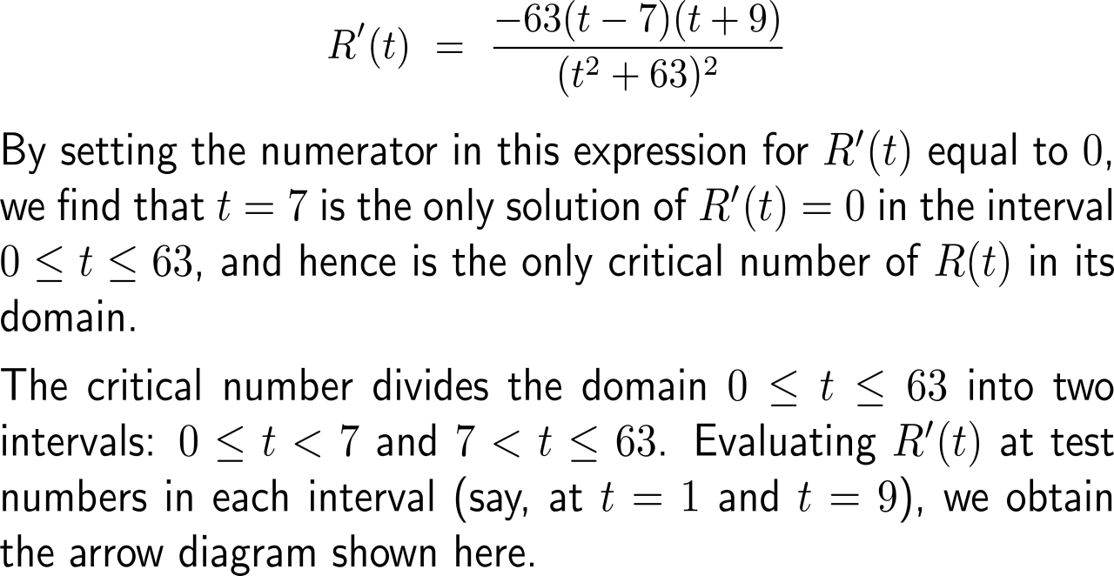
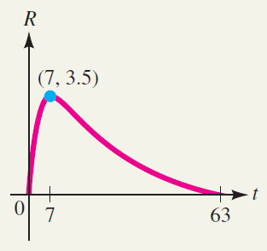
Example: Finding maximum revenue

Slide 23
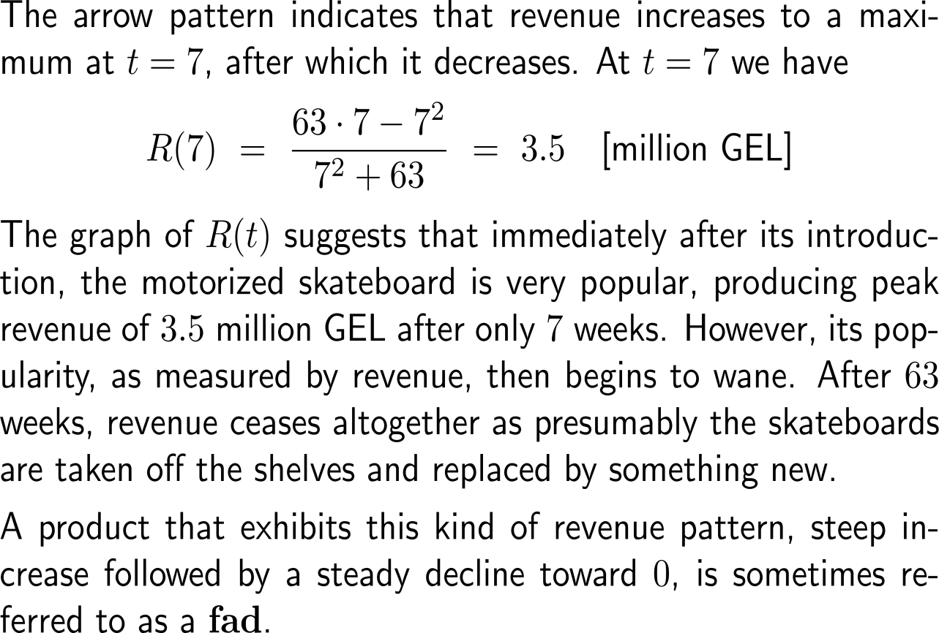
Example: Finding maximum revenue

Slide 24
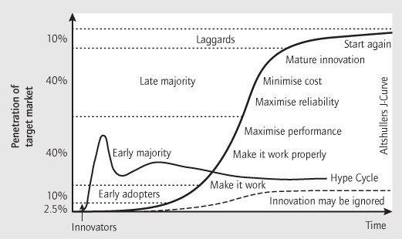
Outlook: In the next semester, we will discuss a differential-equation model for the spreading of a new product
Everett M. Rogers
(1931 – 2004)
Diffusion is the process by which an innovation is communicated over time among the participants in a social system
Four main elements influence the spread of a new idea: the innovation itself, communication channels, time, and a social system. This process relies heavily on human capital.
The innovation must be widely adopted in order to self-sustain. Within the rate of adoption, there is a point at which an innovation reaches critical mass.

Slide 25
Topics
Increasing/ Decreasing Functions & Relative Extrema
Concavity and Points of Inflection
Horizontal, Vertical & Slant Asymptotes

Slide 26
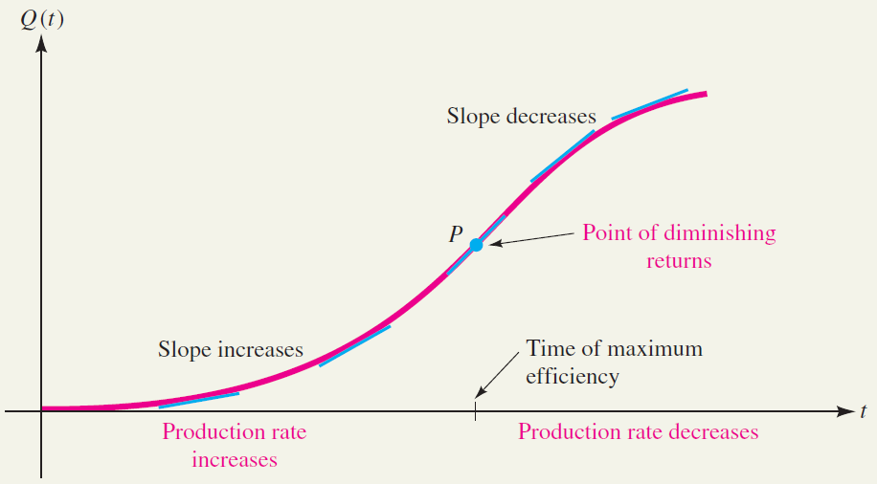
When analyzing production/ work performance one is interested in the point of demising returns (where the 2nd derivative changes sign)
The number of units that a factory worker can produce in t hours after arriving at work is often given by a function Q(t) like the one whose graph is shown in the figure.
Notice that at first the graph is not very steep. The steepness increases, however, until the graph reaches a point of maximum steepness, after which the steepness begins to decrease.
This reflects the fact that at first the worker’s efficiency is low. The efficiency increases, however, as the worker settles into a routine and continues to increase until the worker is performing at maximum efficiency. Then fatigue sets in and the efficiency begins to decline.
The point P on the output curve where maximum efficiency occurs is known in economics as the point of diminishing returns.

Slide 27
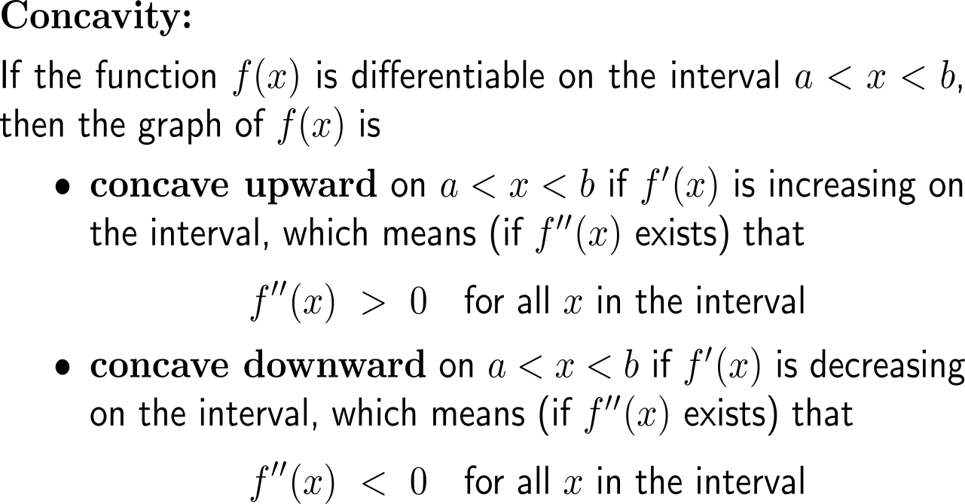
The increase and decrease of the slope of a tangent line is described by the concavity of the graph

Slide 28
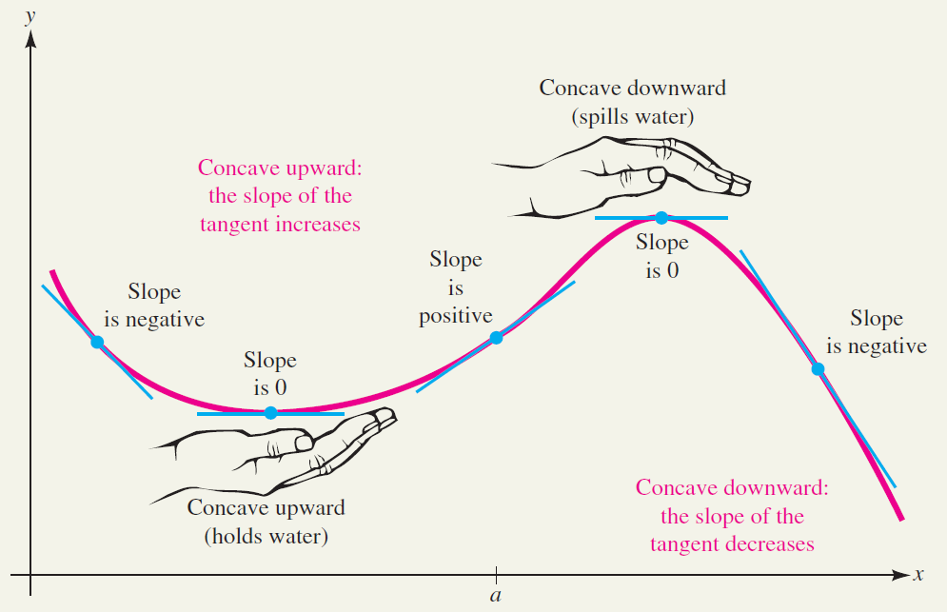
Informally, a concave upward portion of graph “holds water” (cup), while a concave downward portion “spills water” (cap)

Slide 29
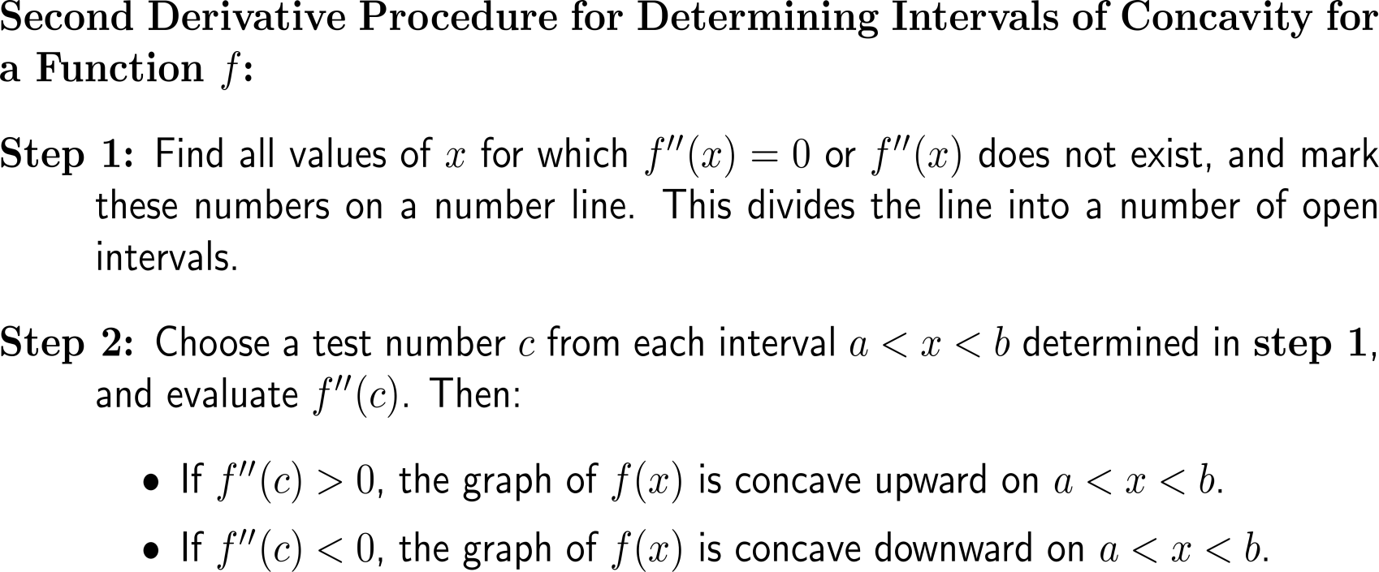
With the signs of the 2nd on specific intervals the concavity (upward vs. downward) of a function is determined

Slide 30
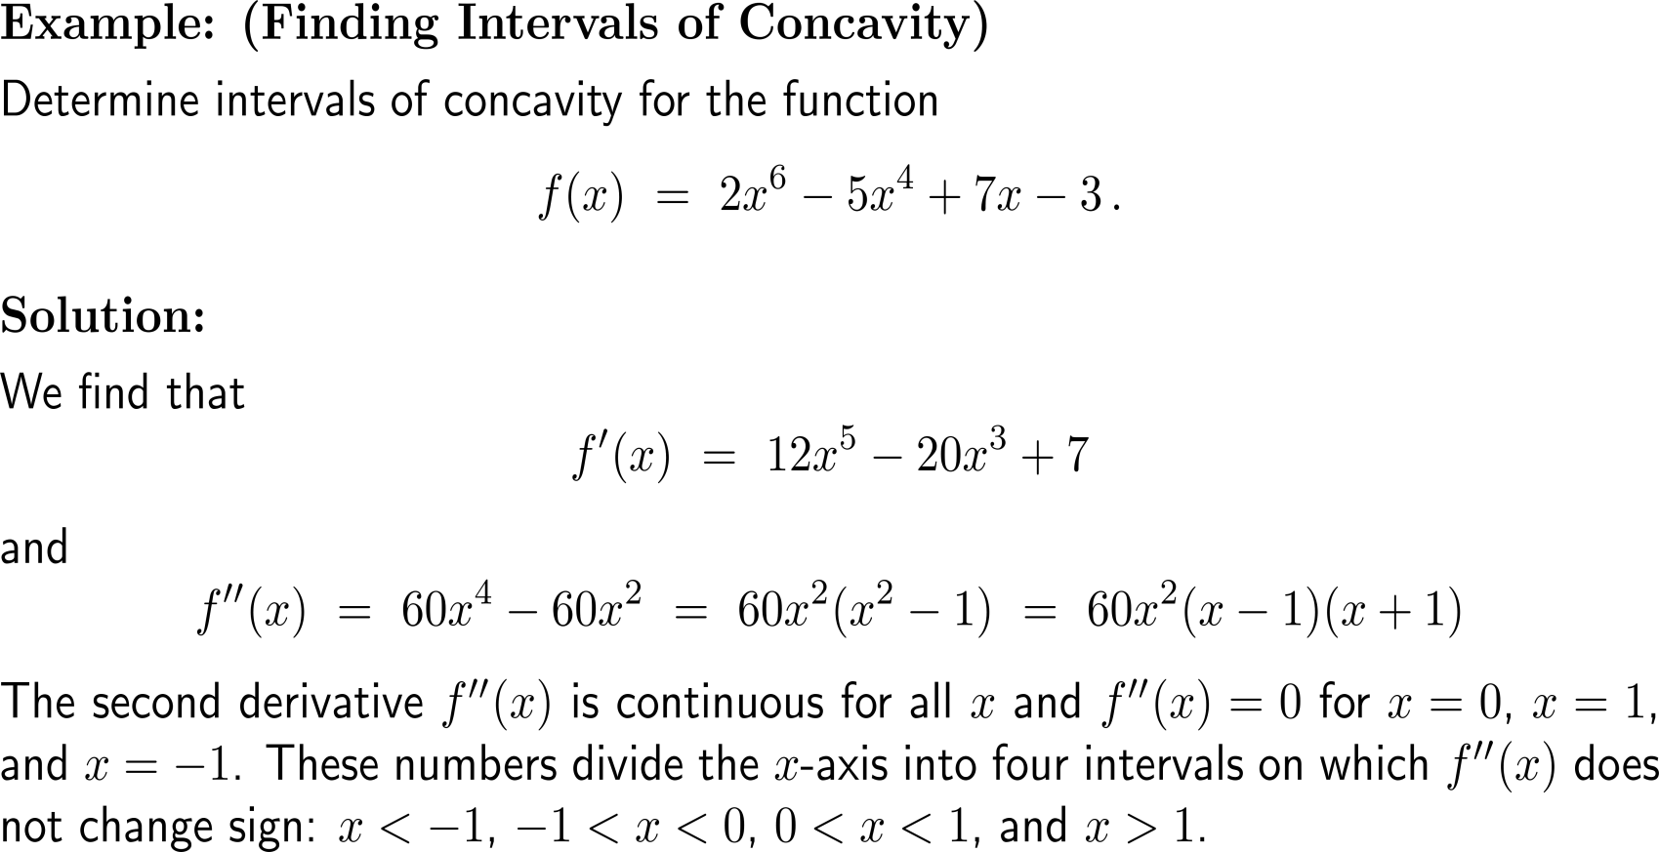
Example: Finding intervals of concavity

Slide 31
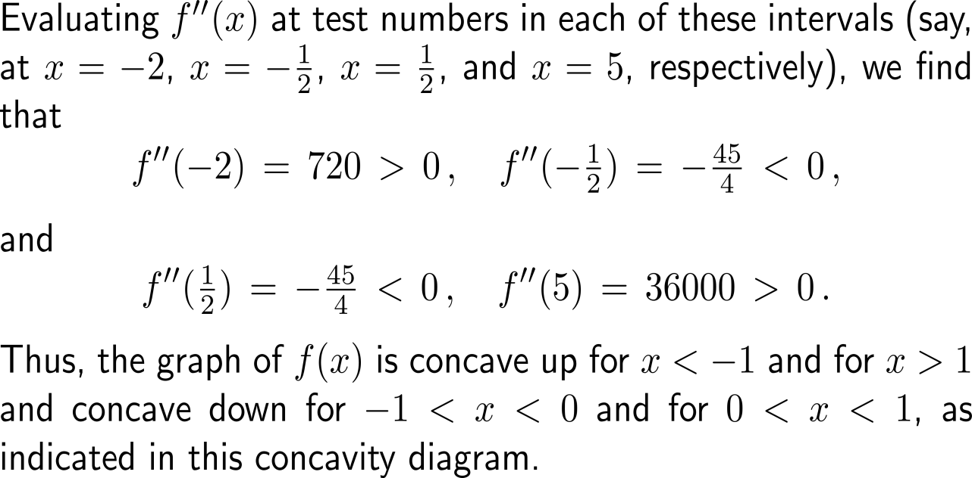
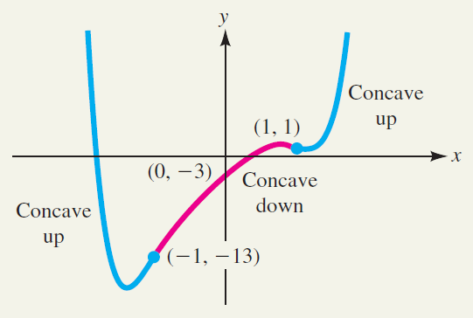
Example: Finding intervals of concavity

Slide 32
A function f(x) may be increasing or decreasing on an interval regardless of whether its graph is concave upward or concave downward on that interval
Do not confuse the concavity of a graph with its “direction” (strictly monotonously increas-ing or decreasing).
A function f(x) may be increas-ing or decreasing on an interval regardless of whether its graph is concave upward or concave downward on that interval.

Slide 33
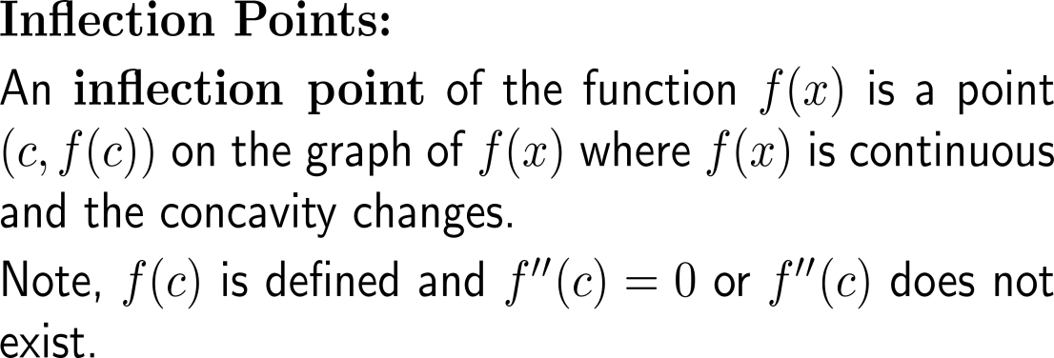
Inflection points separate regions of downward and upward concavity for continuous functions
point of inflection

Slide 34
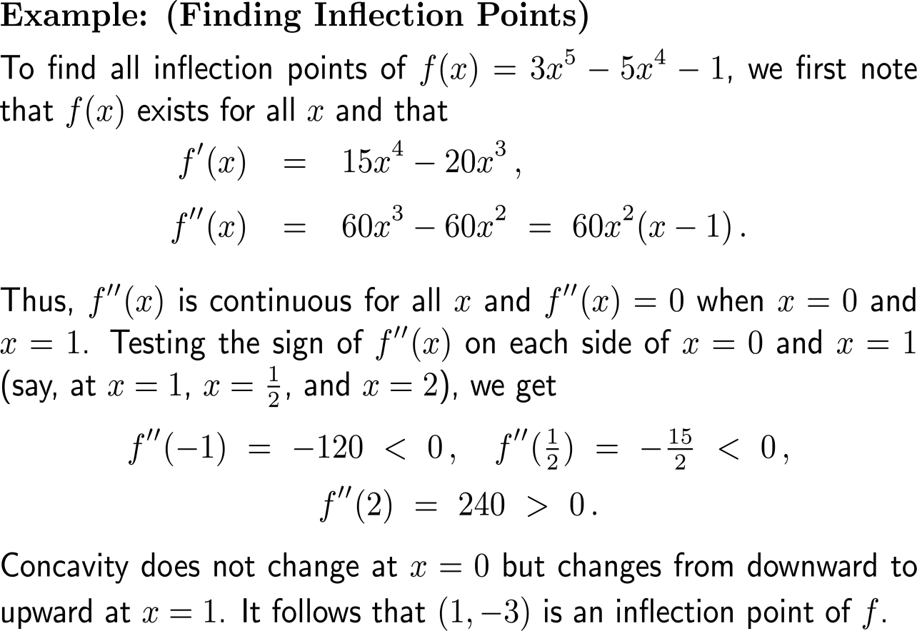
Example: Finding inflection points

Slide 35
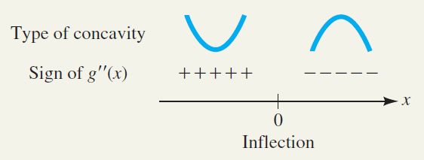
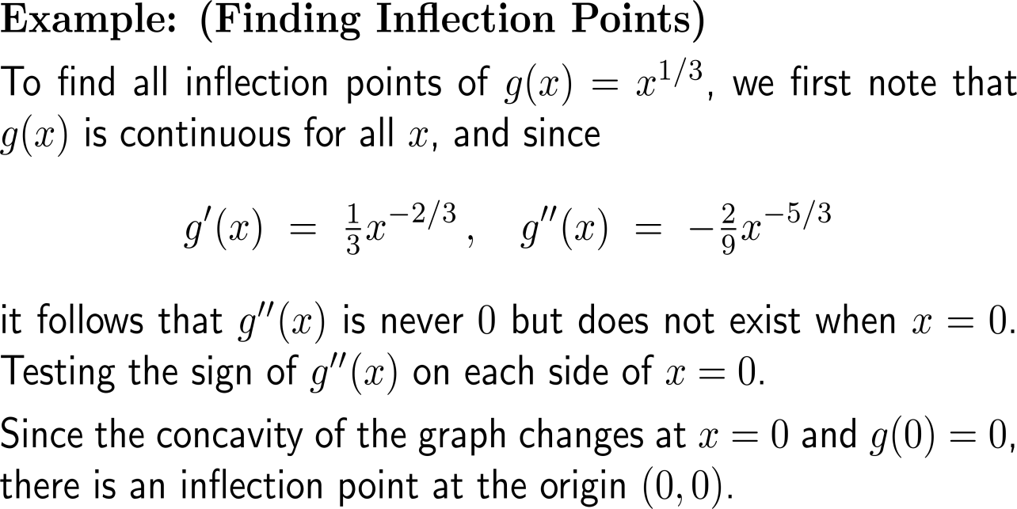
Example: Finding inflection points

Slide 36
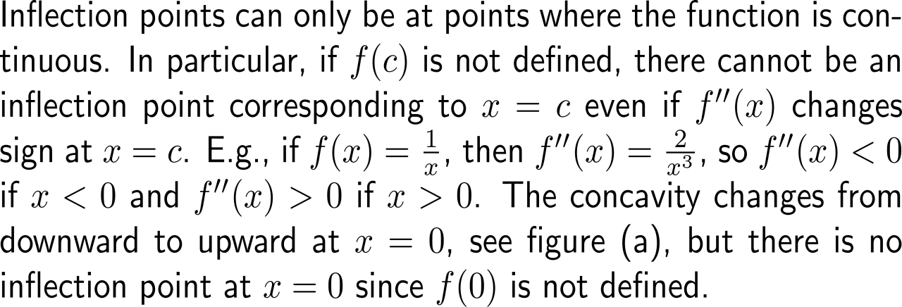
Examples: Situations where the procedure for inflection points does not work

Slide 37
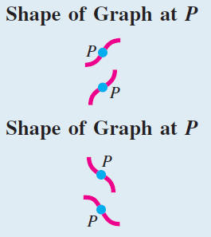
Geometrically, inflection points occur at ‘twists’ of the graph

Slide 38
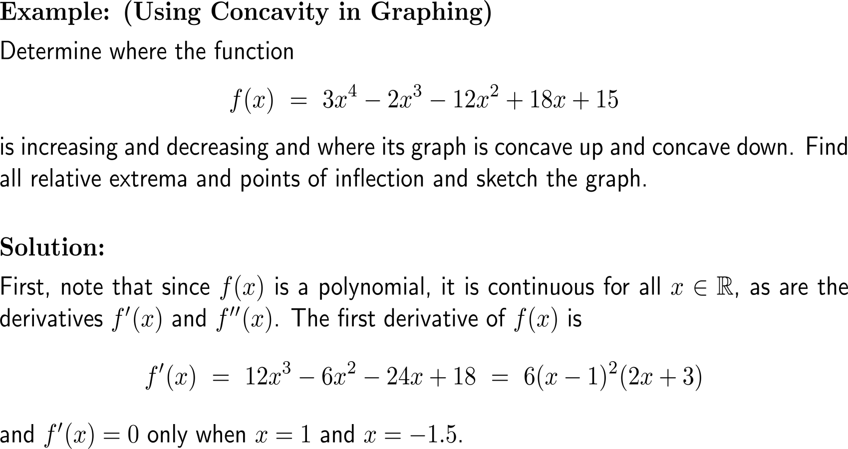
Example: Using concavity for graphing

Slide 39
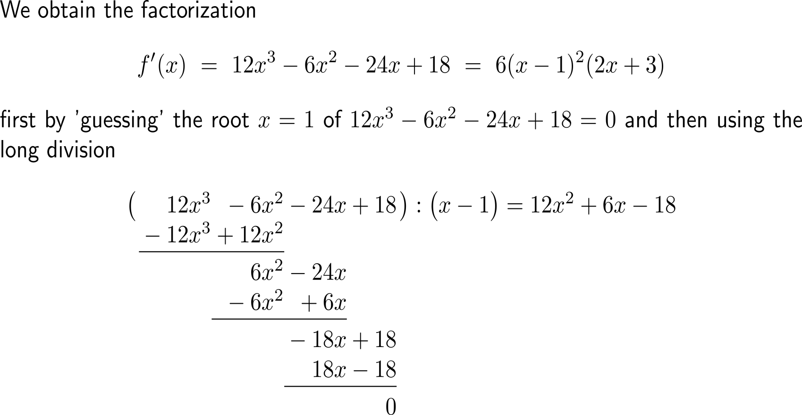
Example: Using concavity for graphing

Slide 40
Example: Using concavity for graphing

Slide 41
Example: Using concavity for graphing

Slide 42
Example: Using concavity for graphing

Slide 43
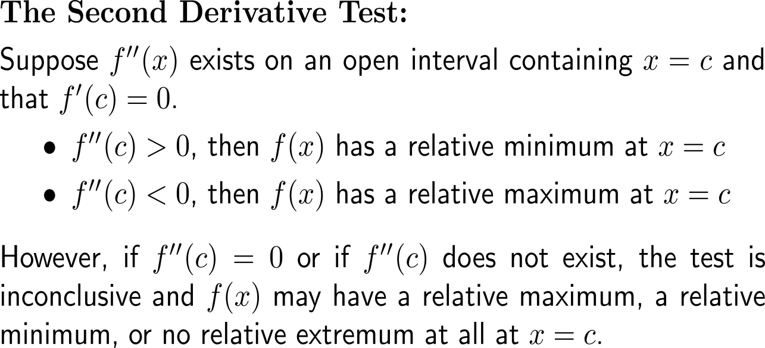
The sign of the 2nd derivative at a critical number determines the type of the relative extremum at the critical number

Slide 44
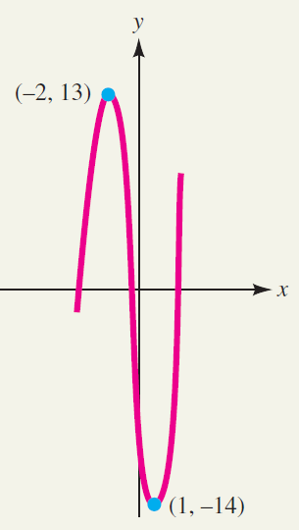
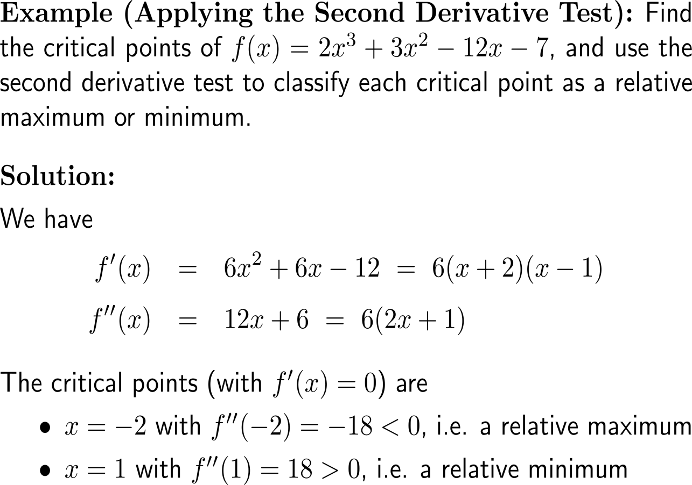
Example: Applying the second derivative test

Slide 45
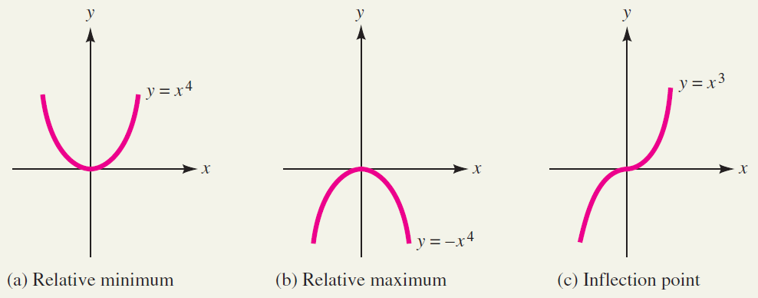
If the 2nd derivative at a critical point is vanishing then the second derivatives test is inconclusive

Slide 46
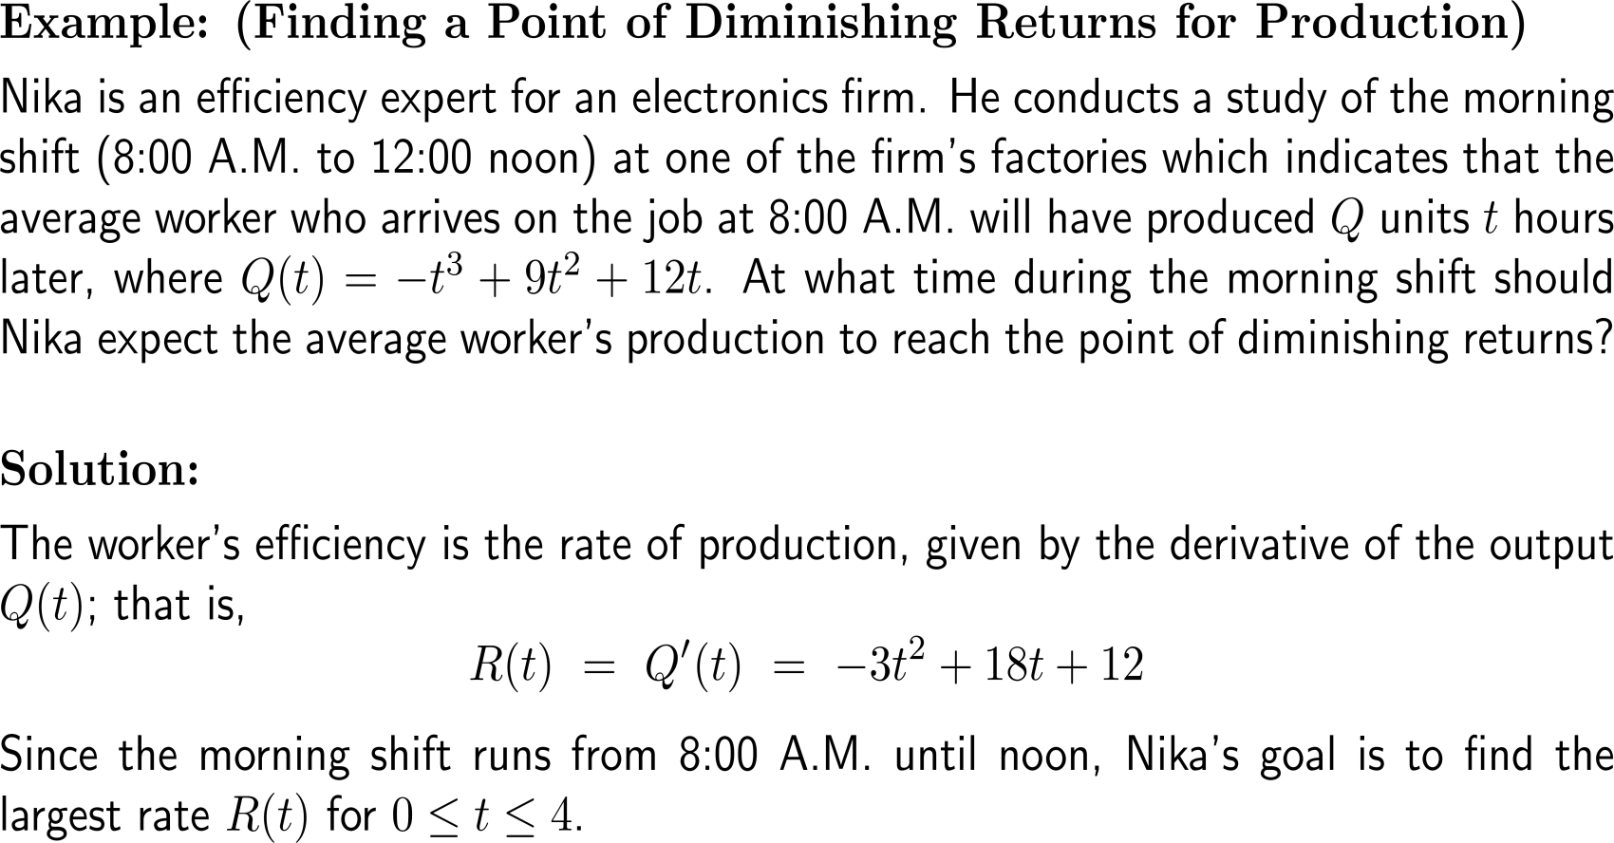
Example: Finding a point of diminishing returns for production

Slide 47
Example: Finding a point of diminishing returns for production

Slide 48
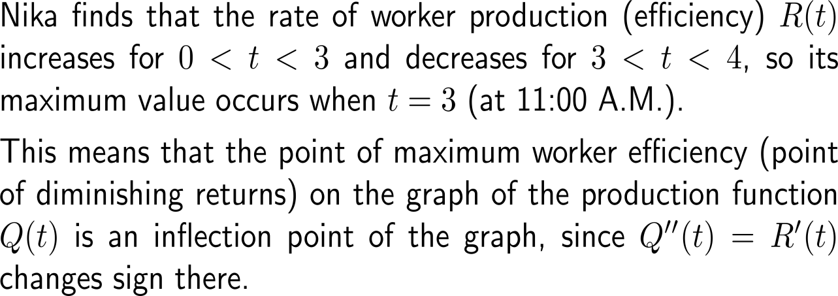
Example: Finding a point of diminishing returns for production

Slide 49
Topics
Increasing/ Decreasing Functions & Relative Extrema
Concavity and Points of Inflection
Horizontal, Vertical & Slant Asymptotes

Slide 50
We already discussed vertical and horizontal asymptotes
vertical asymptote
horizontal
asymptote

Slide 51
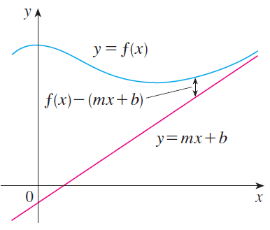
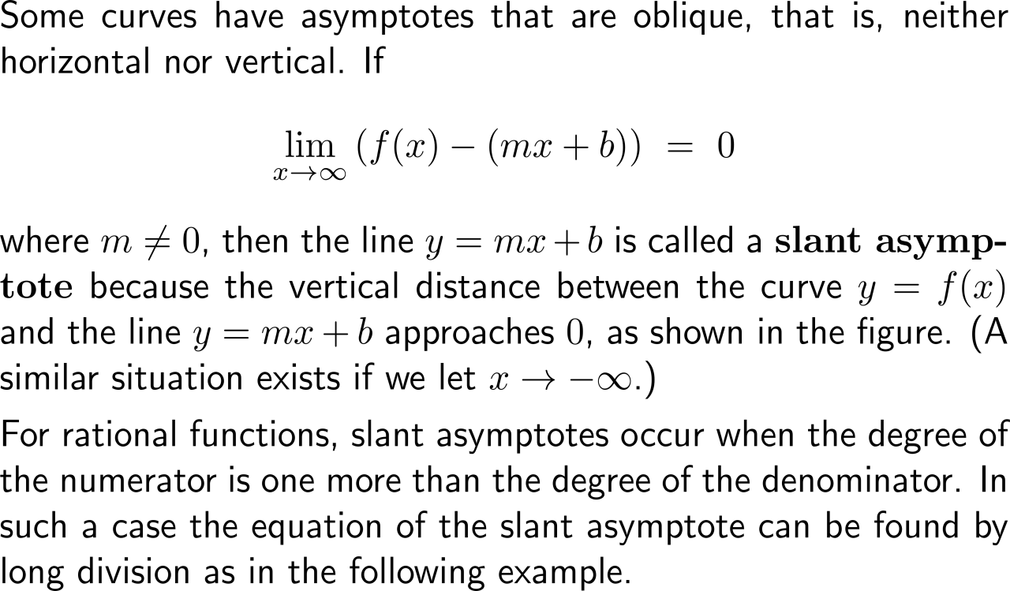
Besides horizontal and vertical asymptotes, slant asymptotes may occur in graphs and help to accurately sketch the behavior of a curve

Slide 52
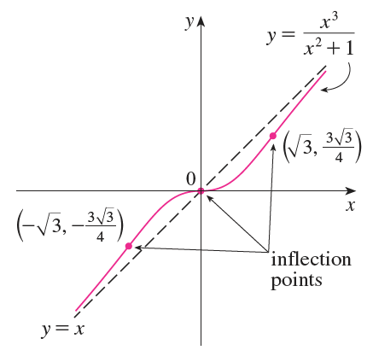
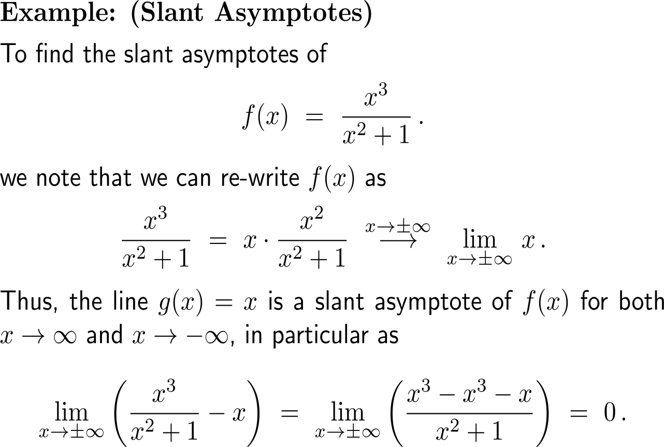
Example: Finding slant asymptotes

Slide 53
Further Worked-Out Exercises:
Calculus I for Management
Topics
Increasing/ decreasing functions & relative extrema
Concavity and points of inflection

Slide 54
Exercise: Graphing using a derivative

Slide 55
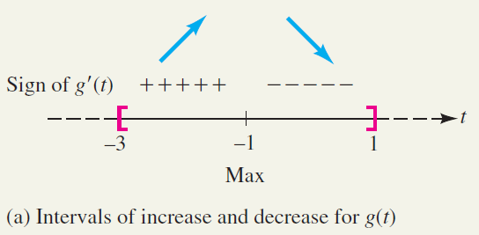
Exercise: Graphing using a derivative

Slide 56
Exercise: Using the graph of f to graph the derivative f

Slide 57
Exercise: Using the graph of f to graph the derivative f

Slide 58
Exercise: Using the graph of a derivative f’(x) to graph f(x)

Slide 59
Exercise: Using the graph of a derivative f’(x) to graph f(x)

Slide 60
Exercise: Using the graph of a derivative f’(x) to graph f(x)

Slide 61
Calculus I for Management

