Slide 1
Calculus I for Management
Curve Sketching & Optimization
week 10
Lecture
Summary of curve sketching
Optimization, marginal analysis & elasticity

Slide 2
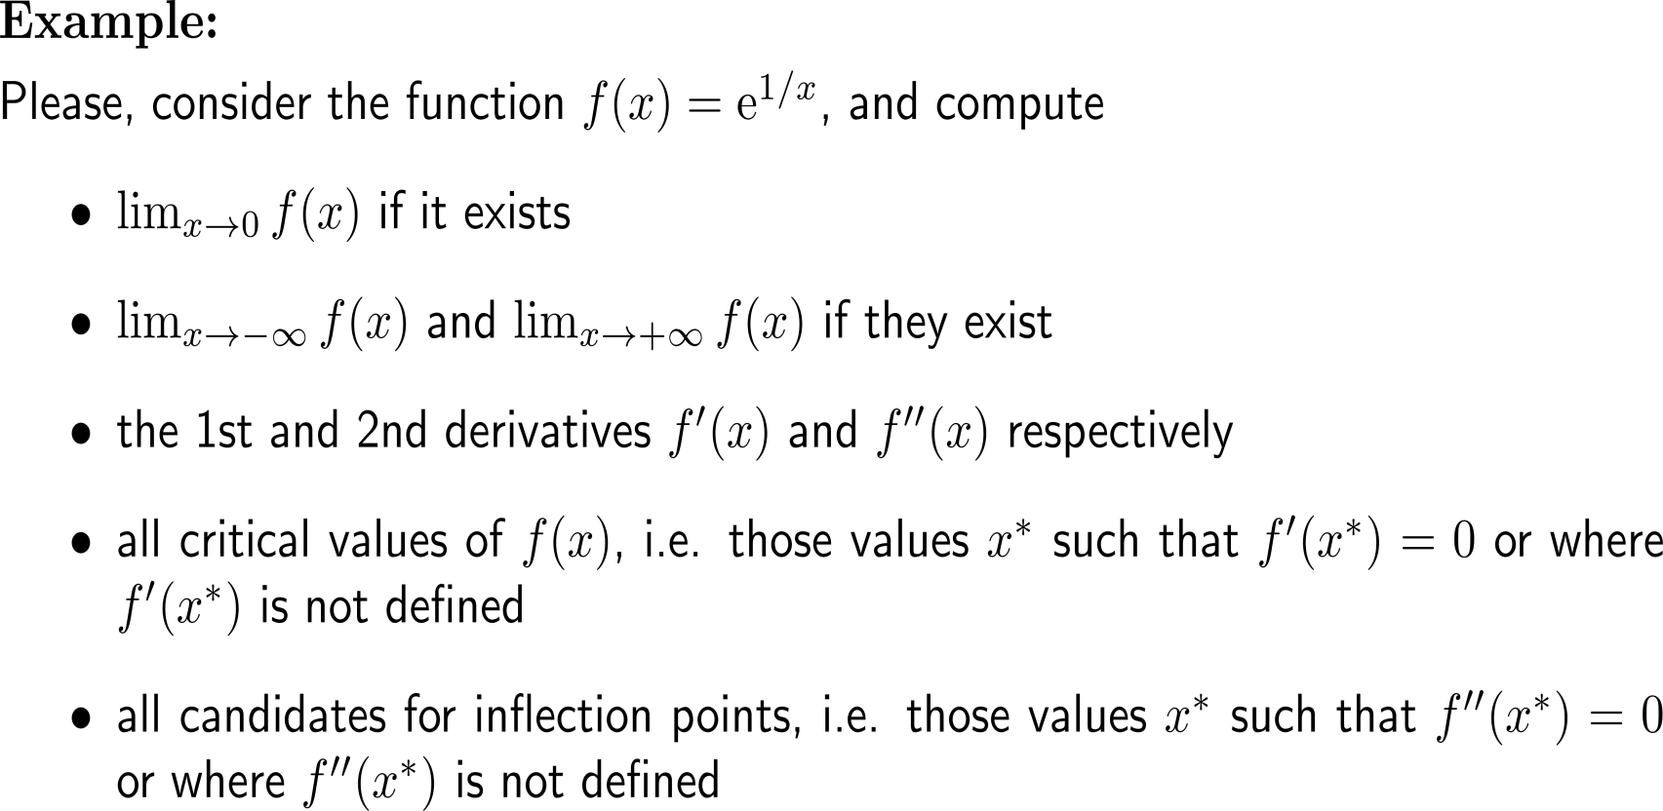
Before we start, let’s go for a short self-study/ group-work exercise
15 minutes
self/ group work
please, upload your solutions to the chat
we will discuss the results afterwards

Slide 3
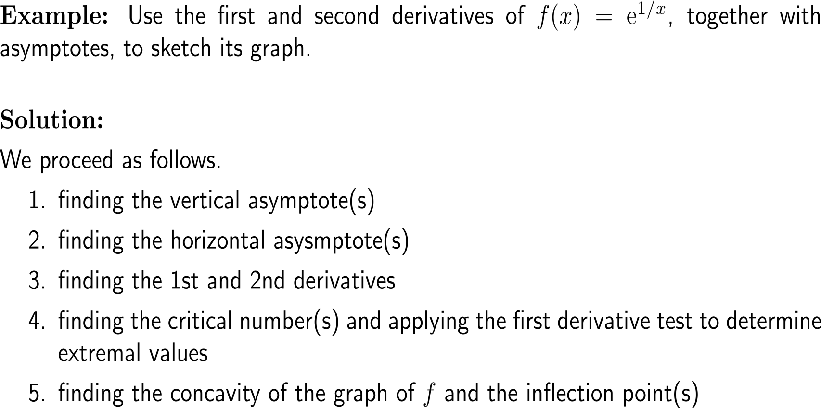
Example: Sketching a graph with certain properties

Slide 4
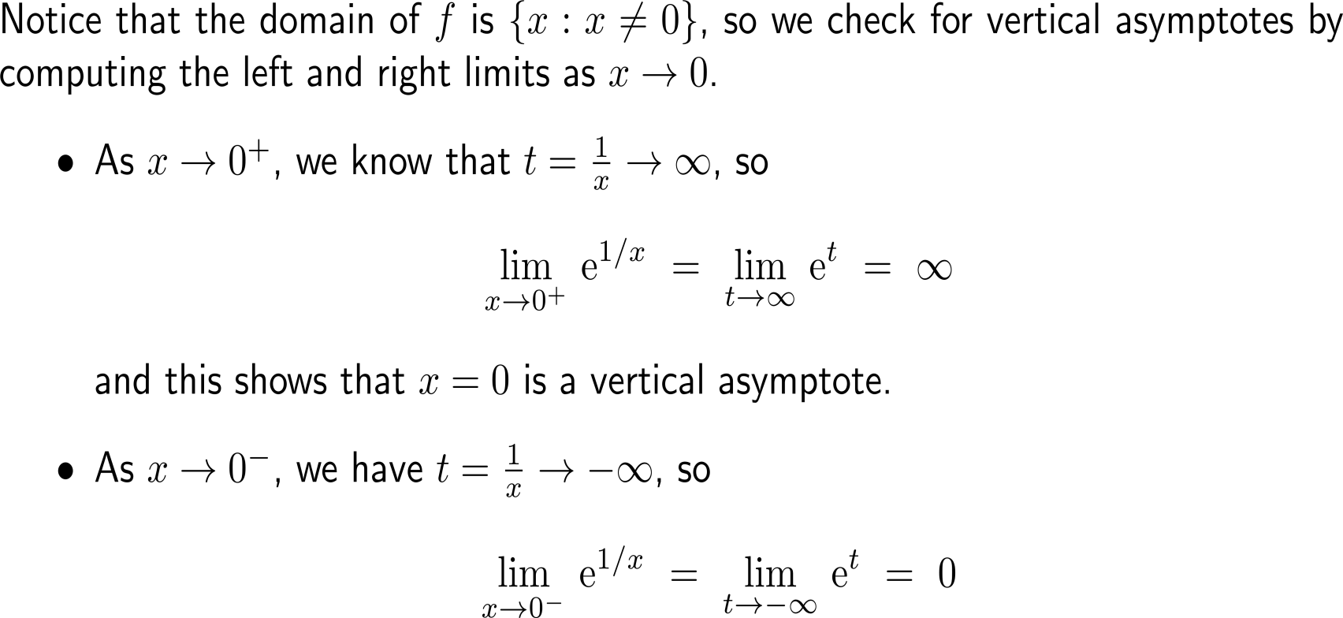
Example: Sketching a graph with certain properties

Slide 5
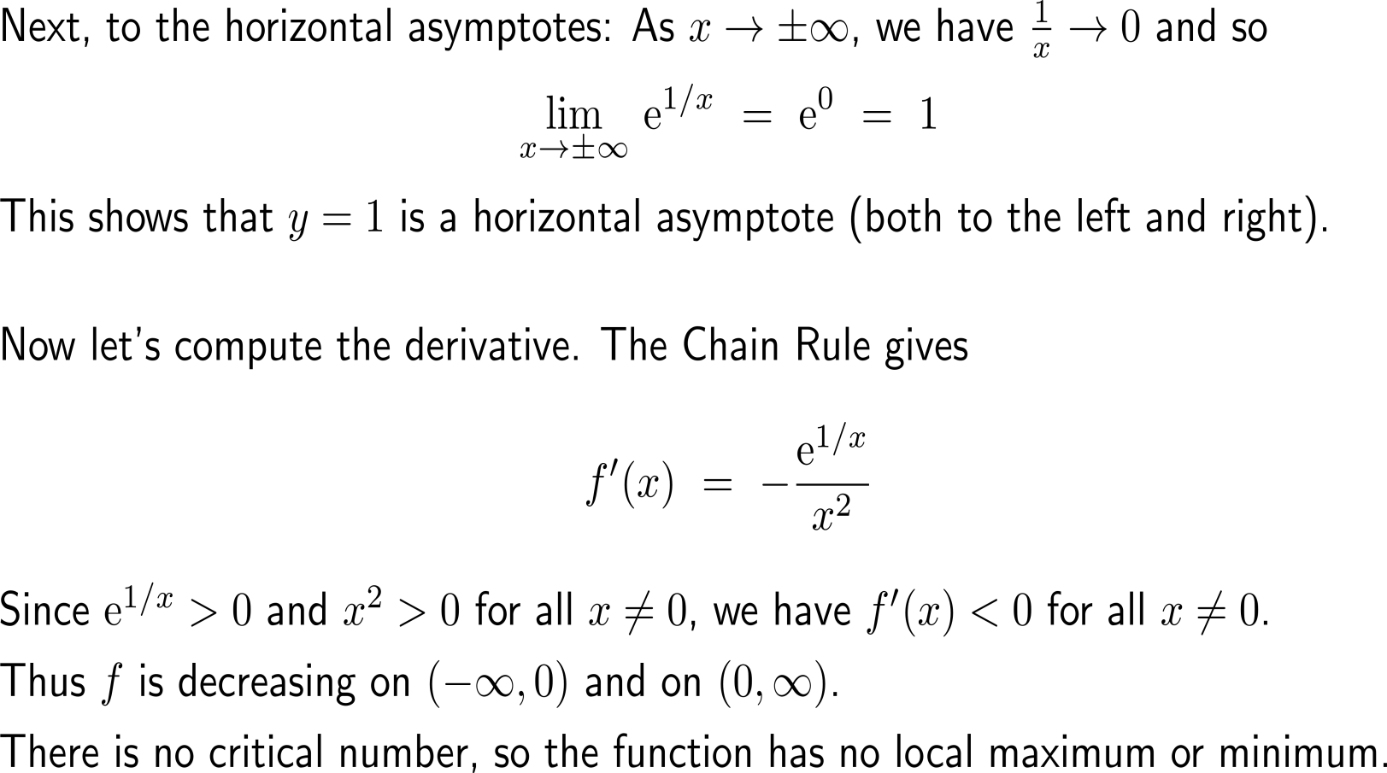
Example: Sketching a graph with certain properties

Slide 6
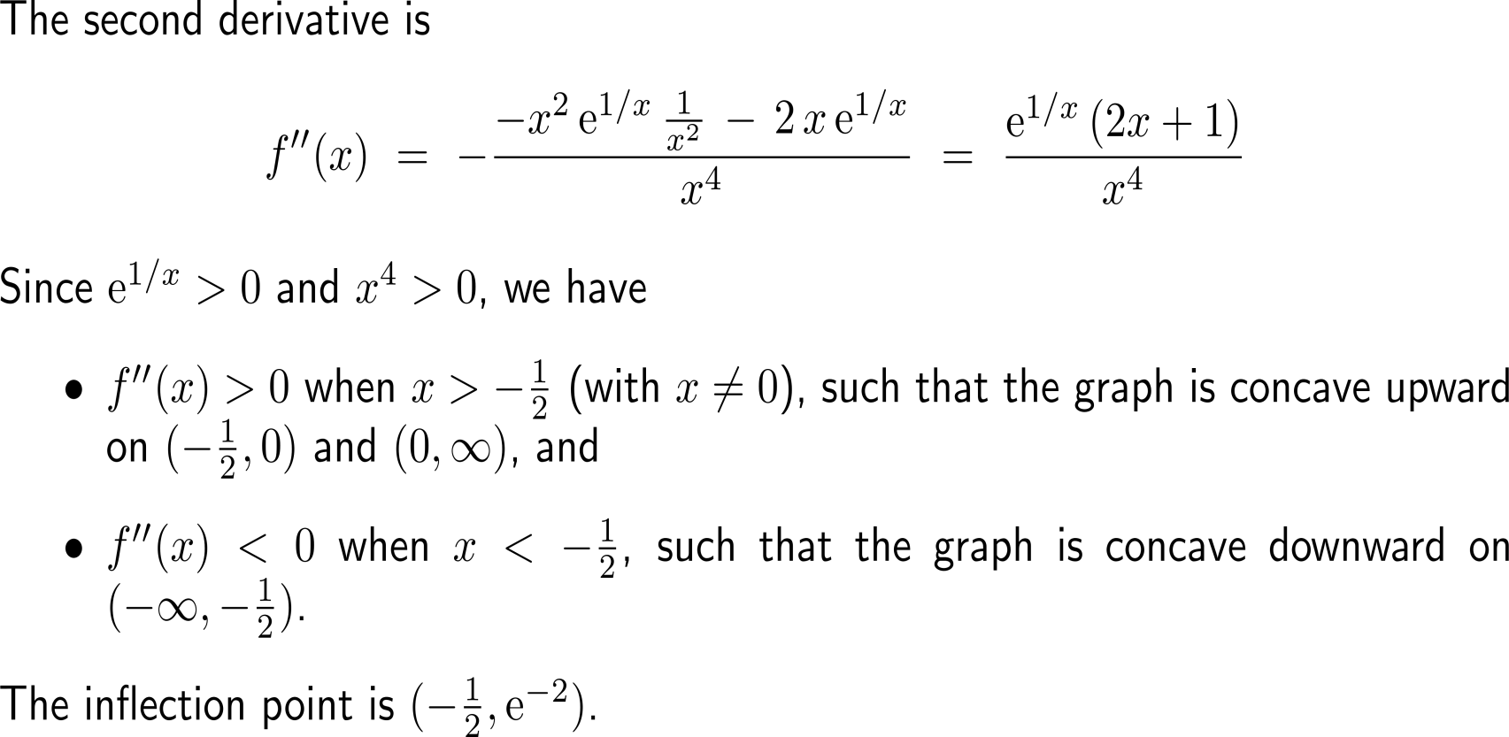
Example: Sketching a graph with certain properties

Slide 7
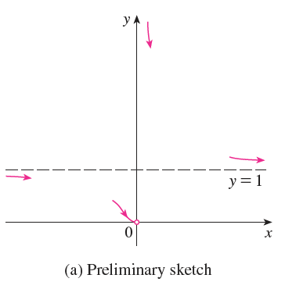
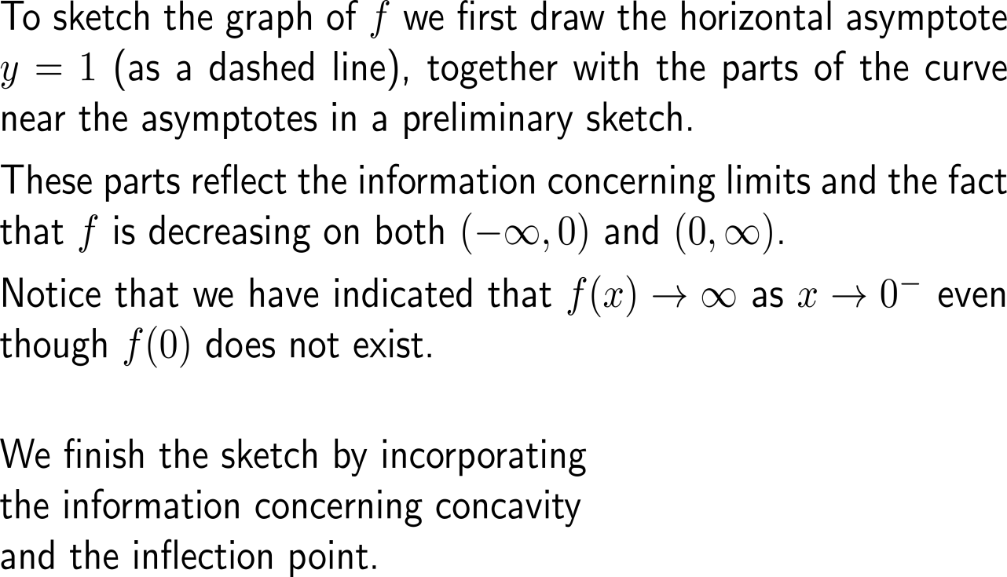
Example: Sketching a graph with certain properties

Slide 8
Topics
Summary of Curve Sketching
Optimization, Marginal Analysis & Elasticity

Slide 9
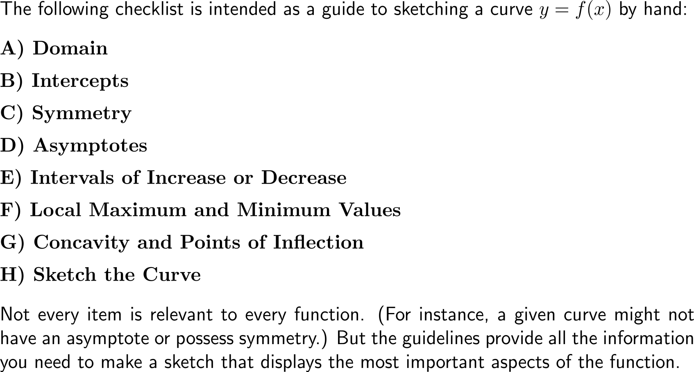
Sketching a curve can be systematically done by following a list of straightforward guidelines
A
B
C
H
D
G
F
E

Slide 10
Curve sketching guidelines (1a/ 4)
A
B
C
H
D
G
F
E

Slide 11
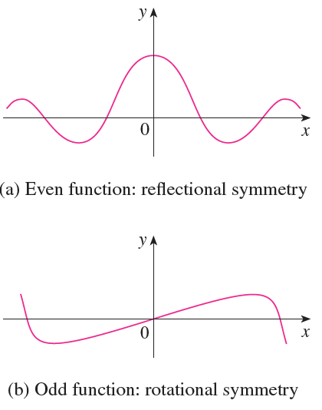
Curve sketching guidelines (1b/ 4)

Slide 12
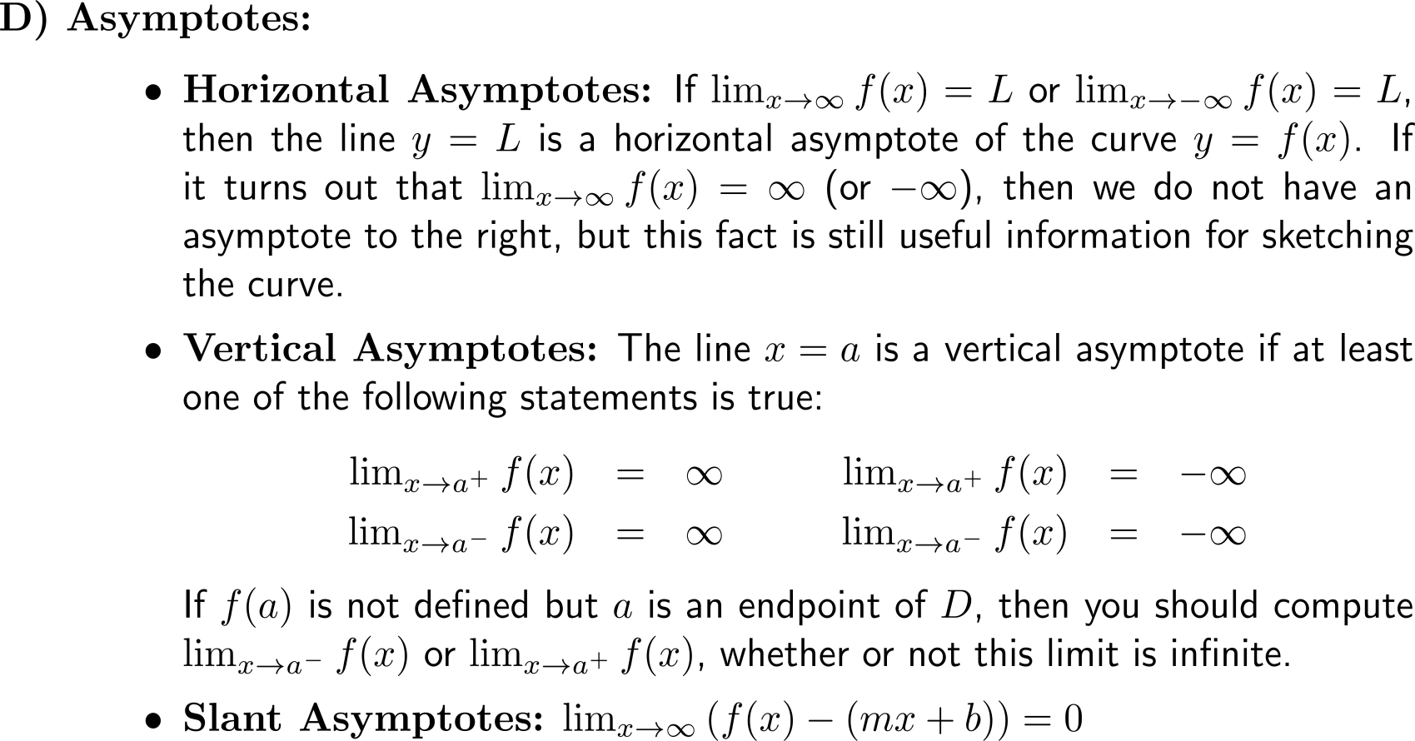
Curve sketching guidelines (2/ 4)
A
B
C
H
D
G
F
E

Slide 13
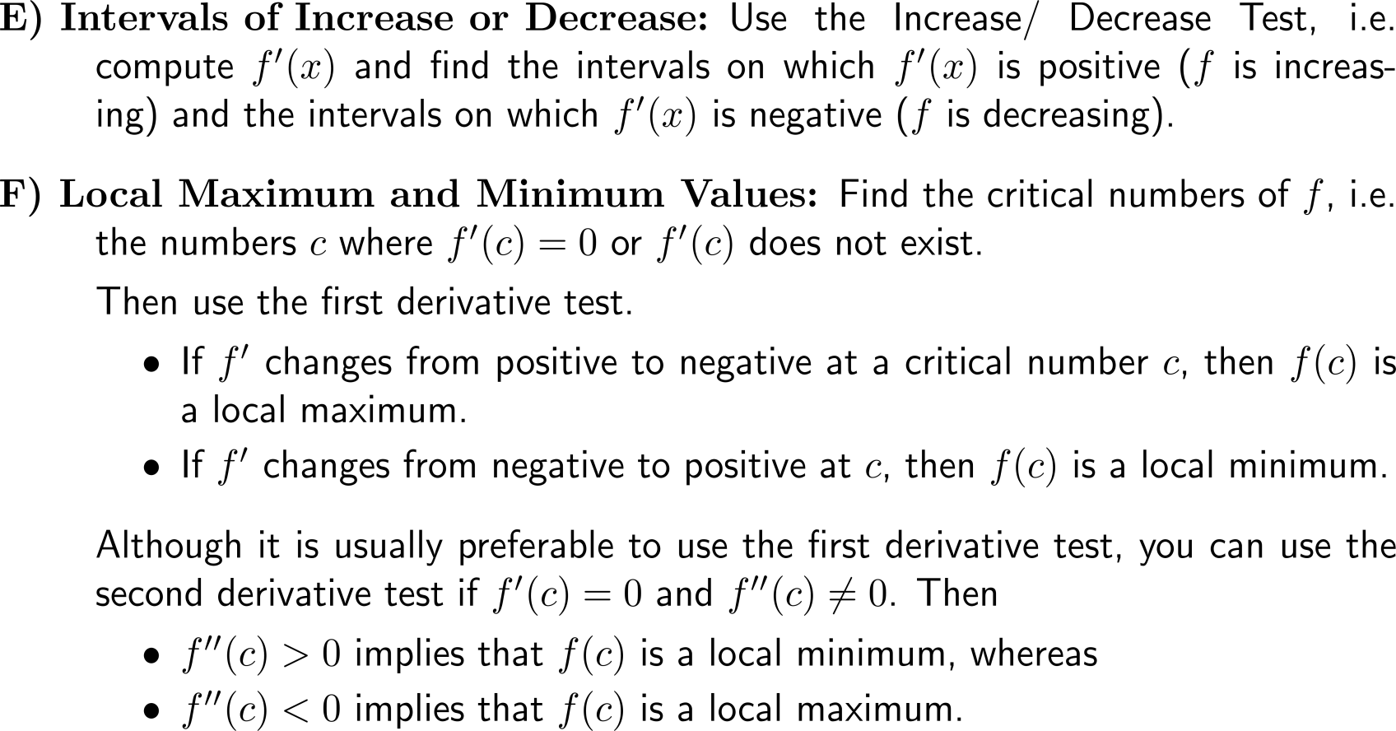
Curve sketching guidelines (3/ 4)
A
B
C
H
D
G
F
E

Slide 14
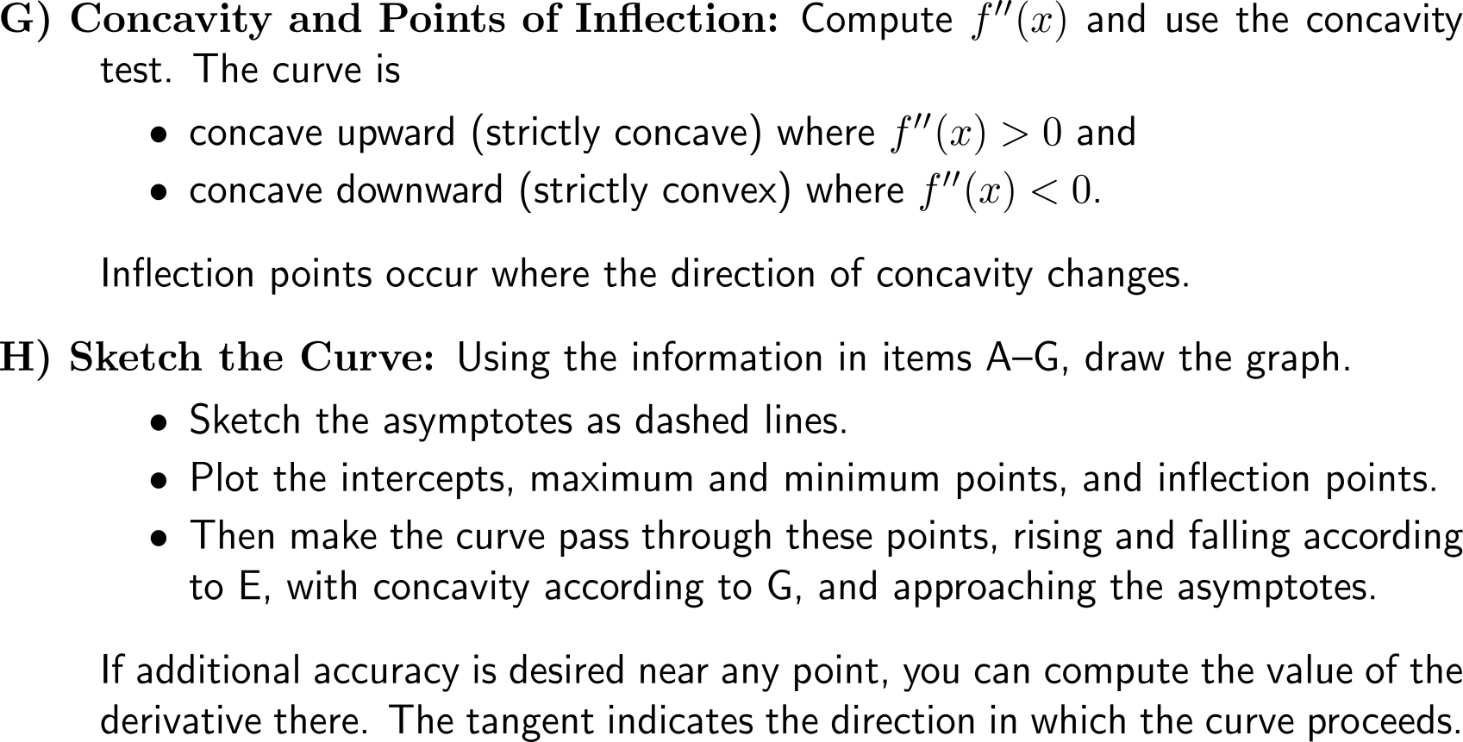
Curve sketching guidelines (4/ 4)
A
B
C
H
D
G
F
E

Slide 15
Example: Applying the guidelines of curve sketching
A
B
C

Slide 16
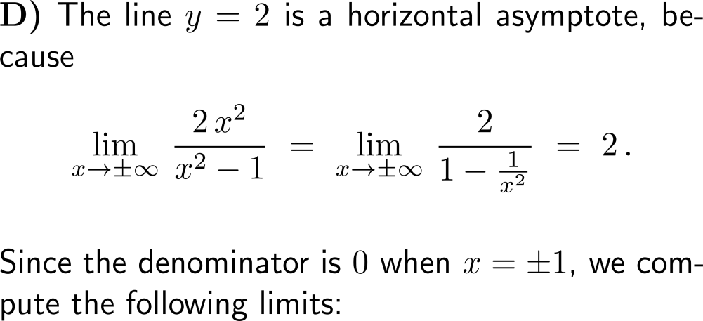
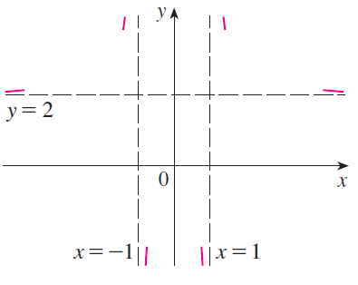
Example: Applying the guidelines of curve sketching
D

Slide 17
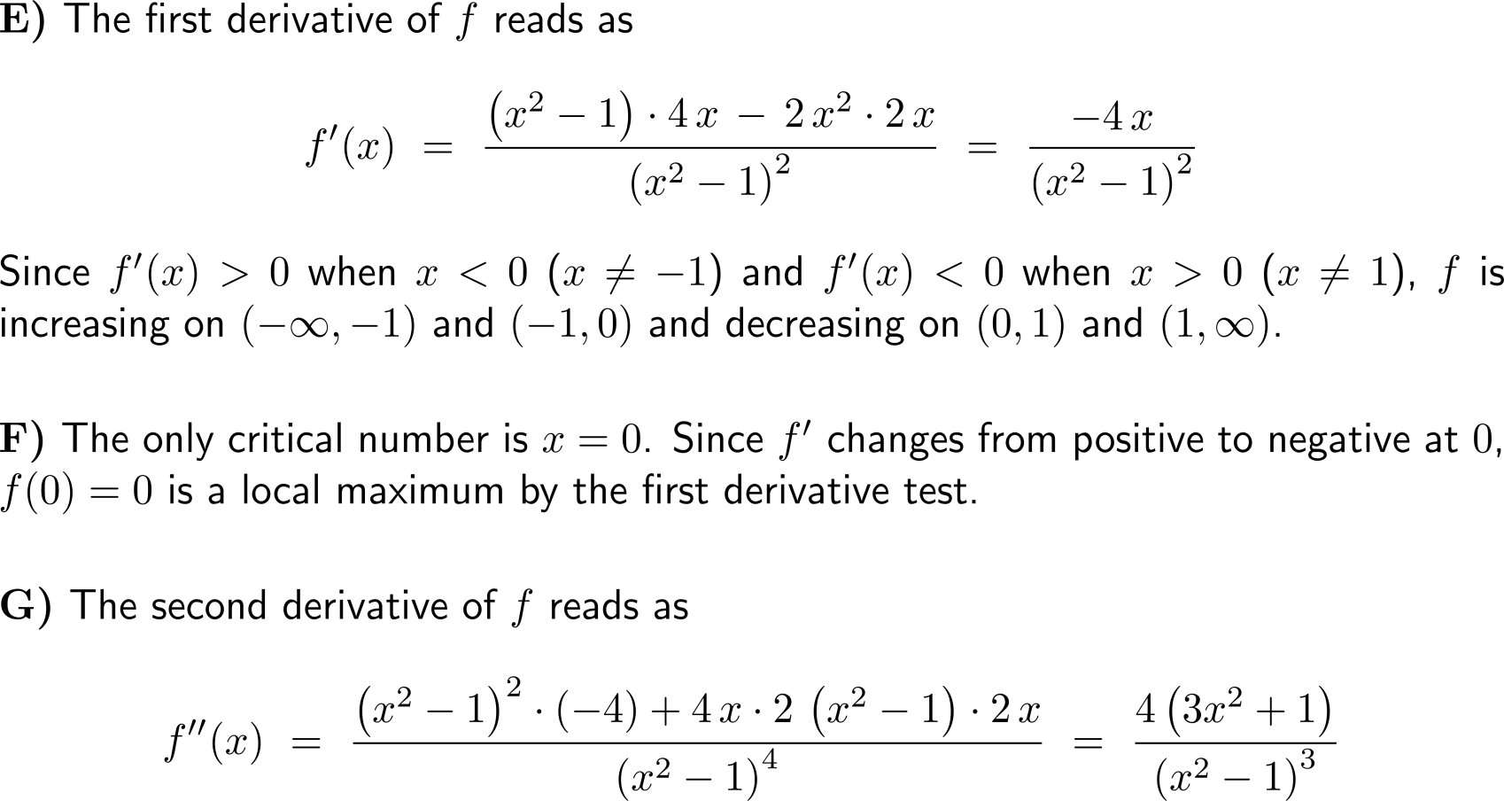
Example: Applying the guidelines of curve sketching
E
F
G

Slide 18
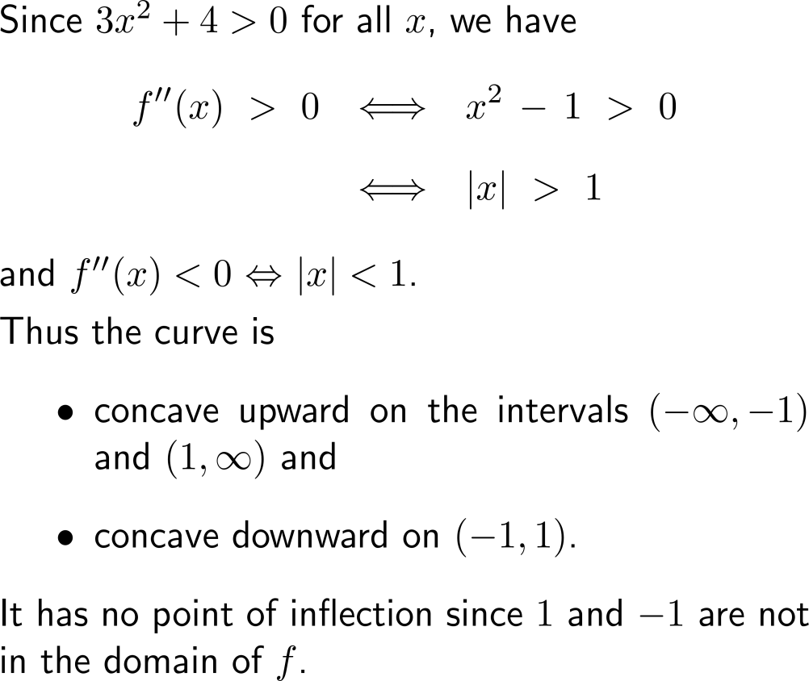
Example: Applying the guidelines of curve sketching
concave upward
concave upward
local maximum
concave downward

Slide 19
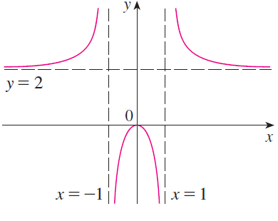
Example: Applying the guidelines of curve sketching
H

Slide 20
Example: Applying the guidelines of curve sketching
A
B
C
D

Slide 21
Example: Applying the guidelines of curve sketching
E

Slide 22
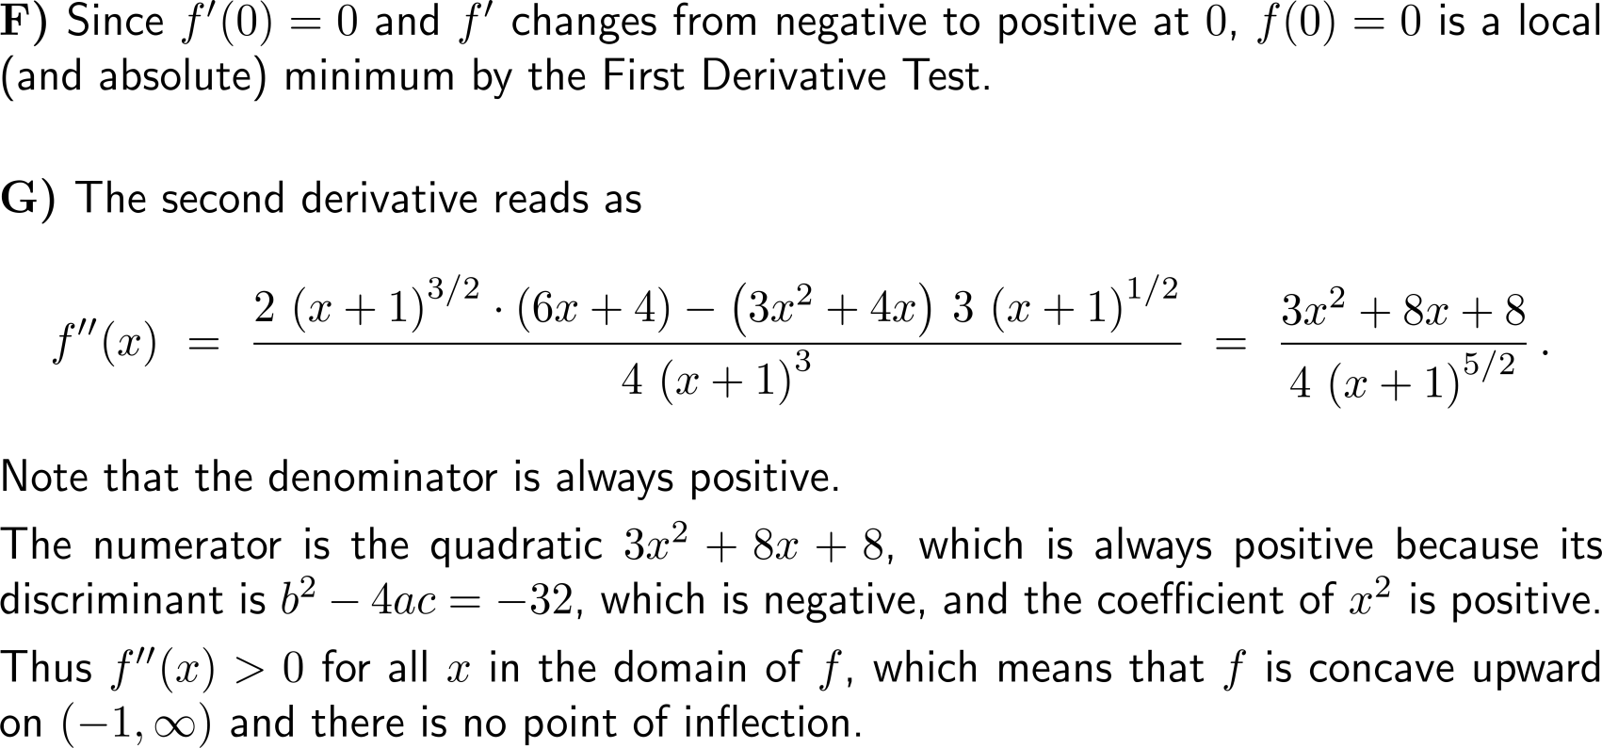
Example: Applying the guidelines of curve sketching
F
G

Slide 23
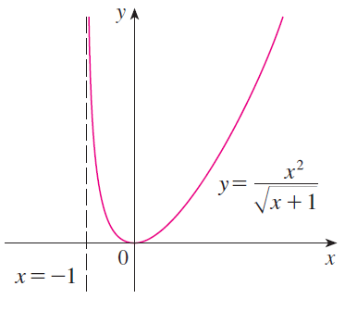
Example: Applying the guidelines of curve sketching
H

Slide 24
Topics
Summary of Curve Sketching
Optimization, Marginal Analysis & Elasticity

Slide 25
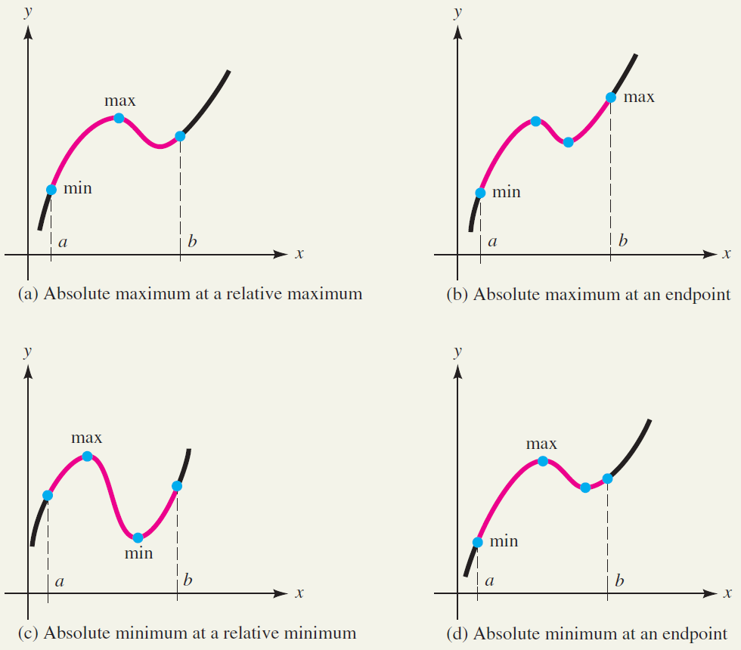
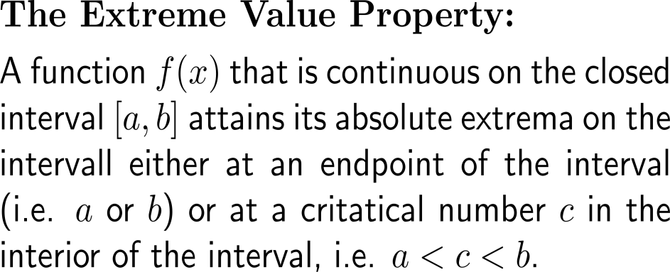
A continuous function on a closed interval attains its absolute extrema either at an endpoint or in the interior of the interval

Slide 26
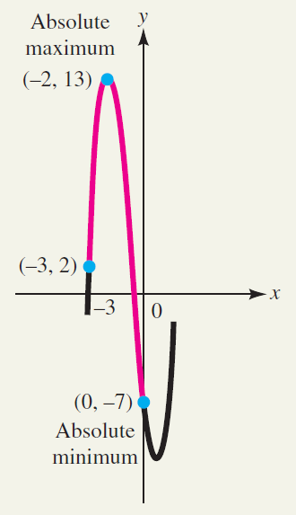
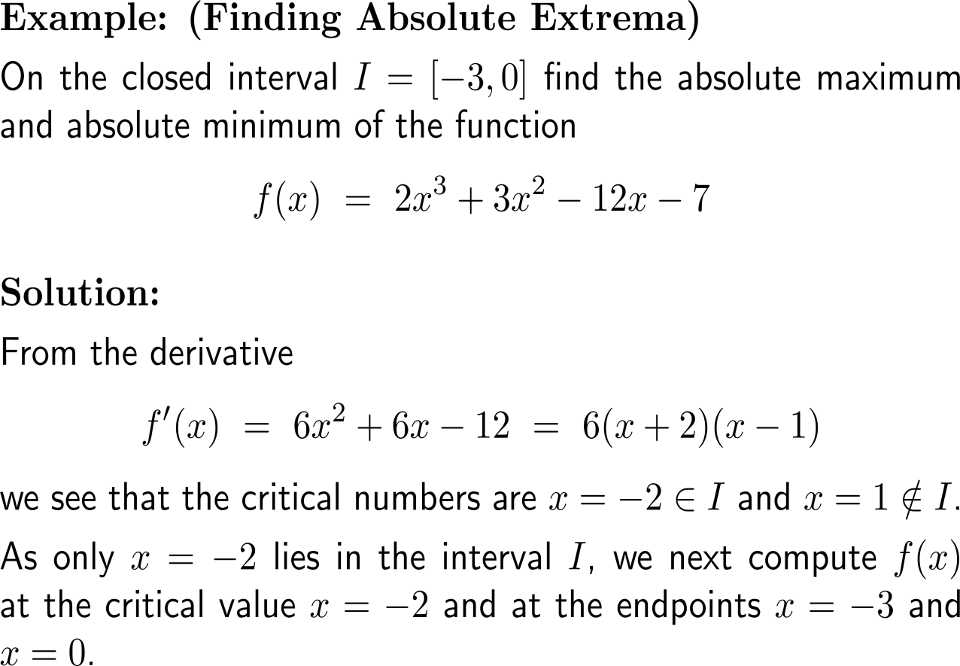
Example: Finding absolute extrema

Slide 27
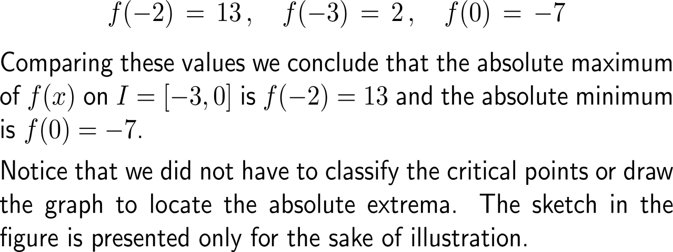
Example: Finding absolute extrema

Slide 28
For continuous functions on non-closed intervals our procedure does not work anymore, though it still can yield very valuable insights
Extrema for functions defined on unbounded intervals

Slide 29
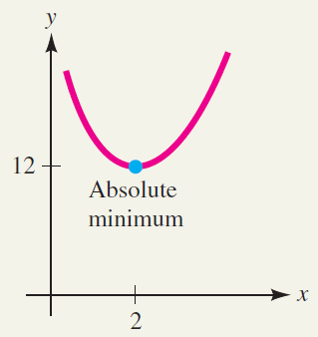
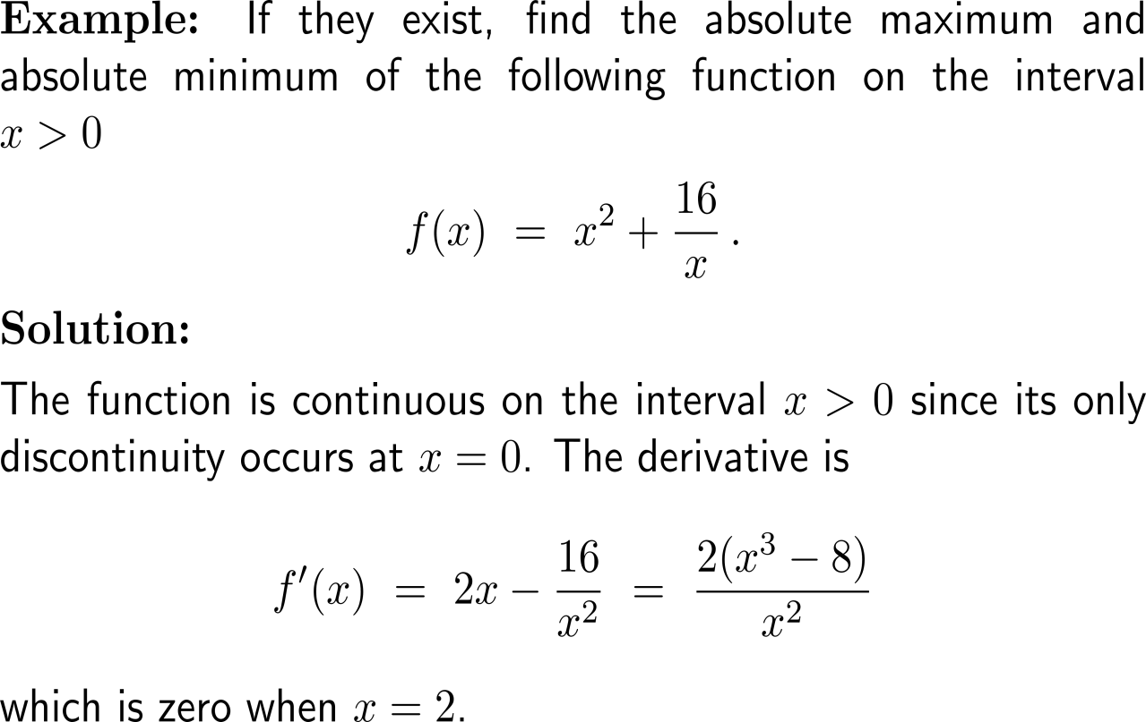
Example: Finding absolute extrema on an open interval

Slide 30
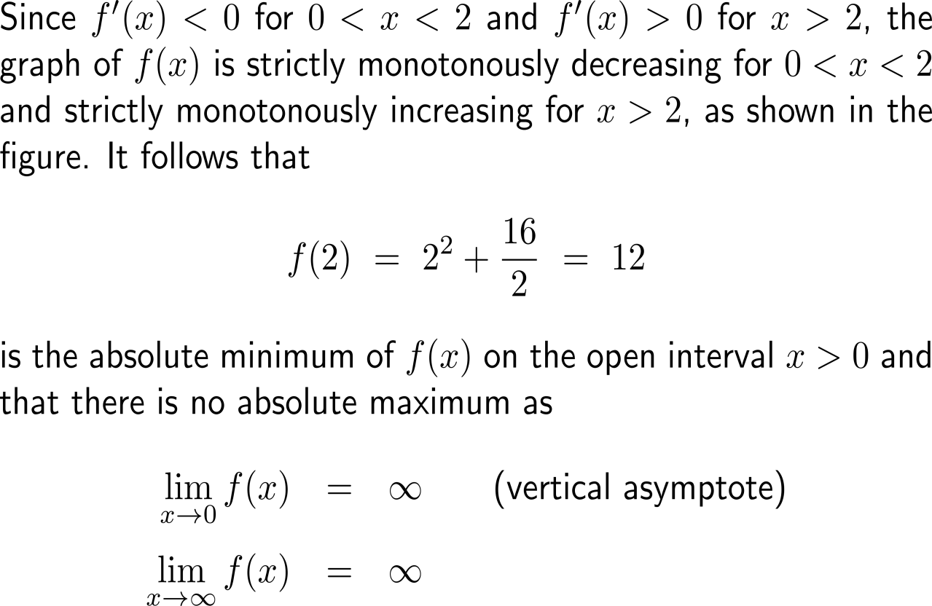
Example: Finding absolute extrema on an open interval

Slide 31
If there is only one critical number then the 2nd derivative at this point is sufficient to determine the type of extremum

Slide 32
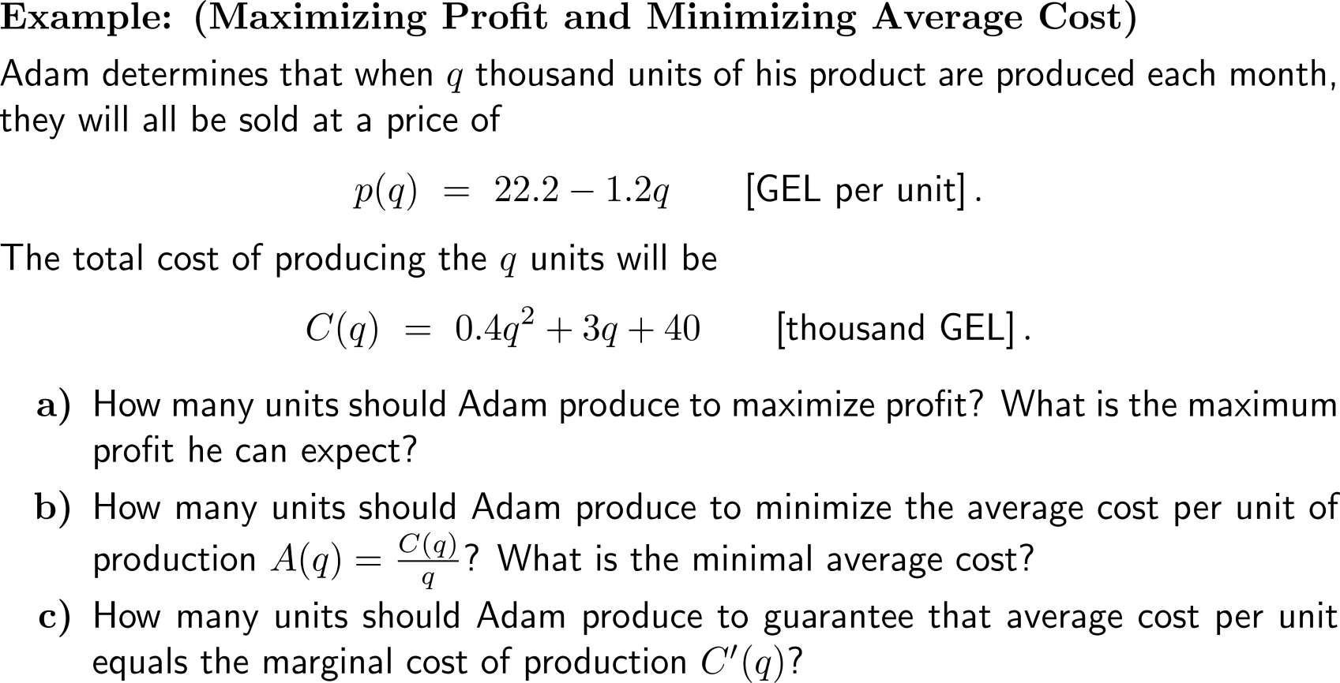
Example: Maximizing profit and minimizing average cost

Slide 33
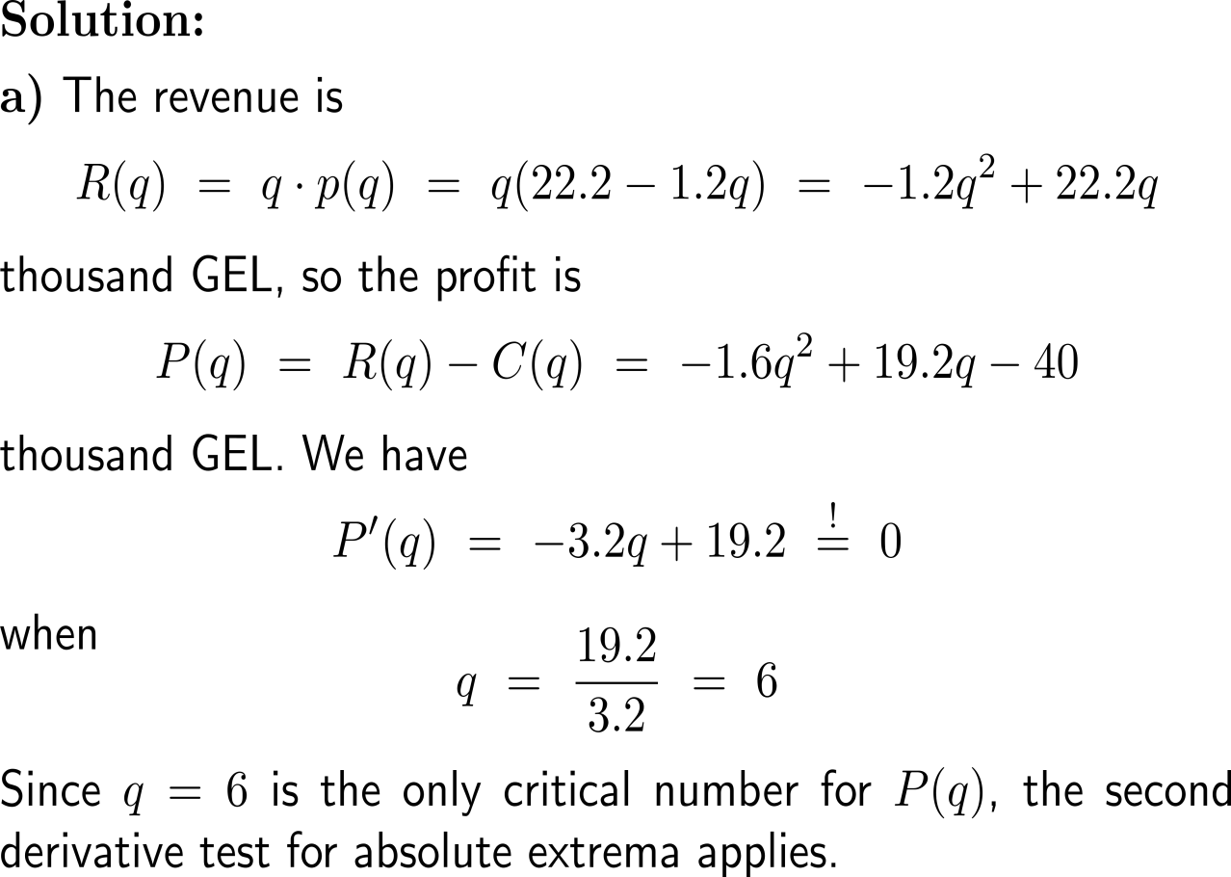
Example: Maximizing profit and minimizing average cost

Slide 34
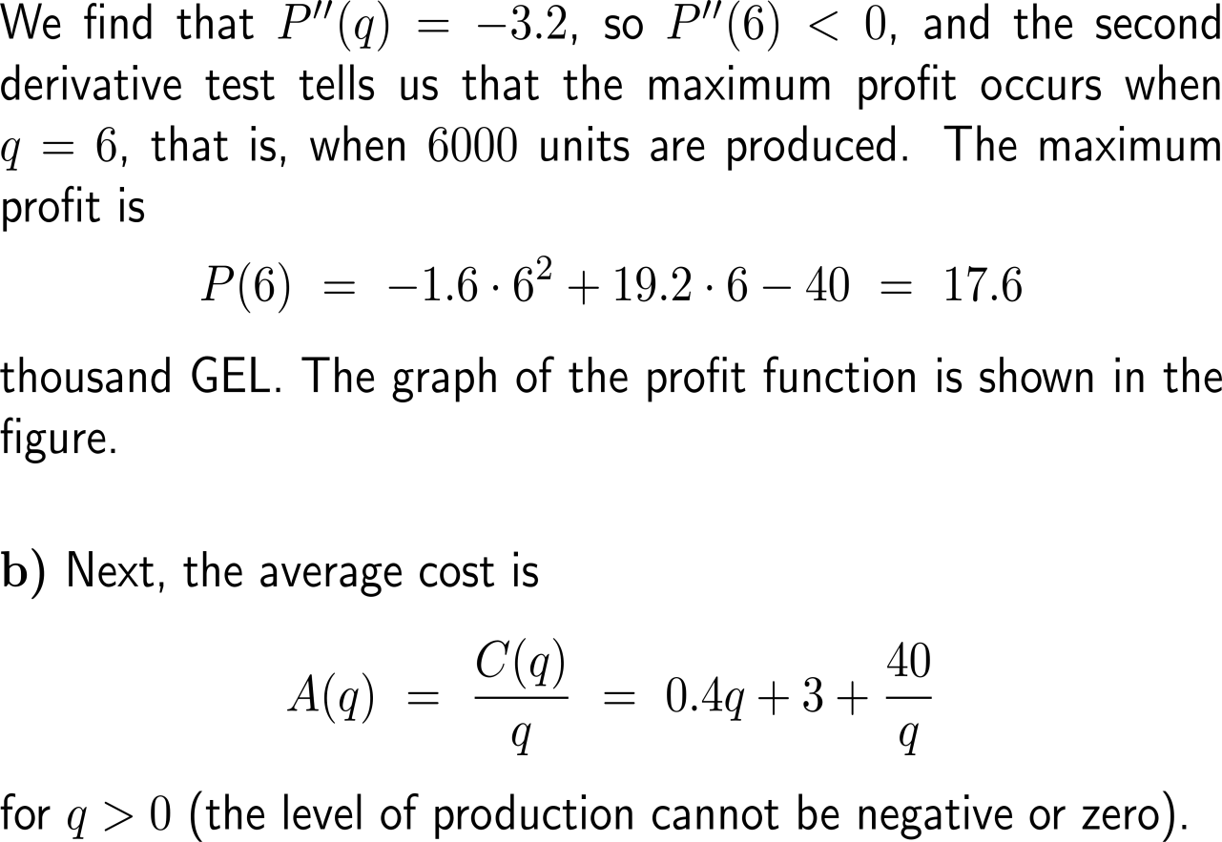
Example: Maximizing profit and minimizing average cost

Slide 35
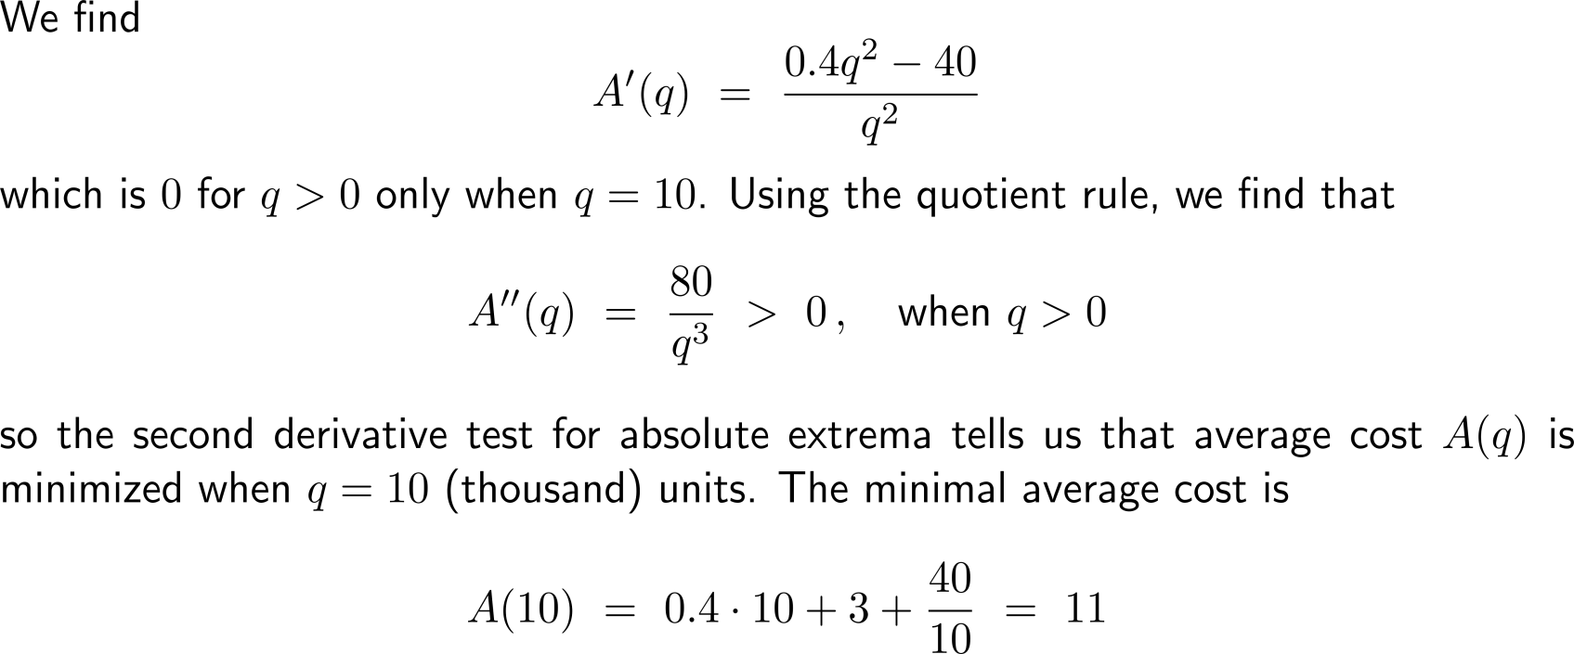
Example: Maximizing profit and minimizing average cost

Slide 36
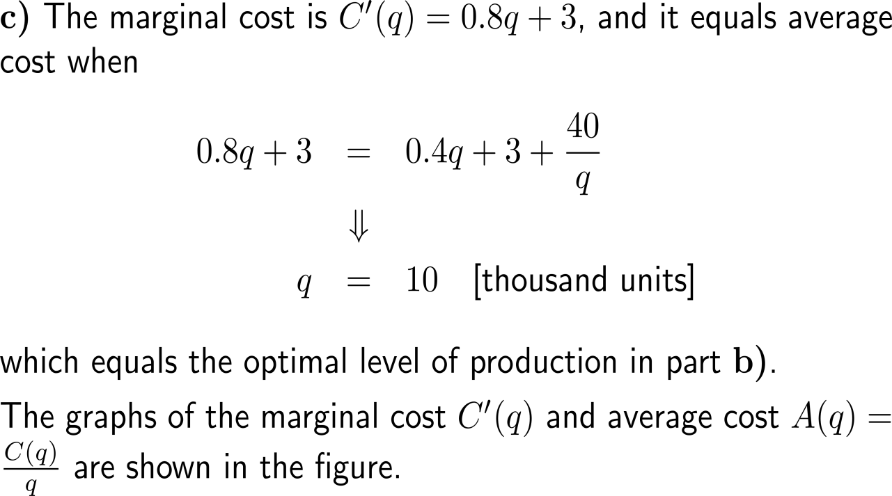
Example: Maximizing profit and minimizing average cost

Slide 37
The marginal analysis criterion for maximum profit gives a method for solving the optimization problem of determining maximum profit (1/ 2)

Slide 38
The marginal analysis criterion for maximum profit gives a method for solving the optimization problem of determining maximum profit (2/ 2)

Slide 39
The marginal analysis criterion for minimal average cost gives a method for solving the optimization problem of determining minimal average cost (1/ 2)

Slide 40
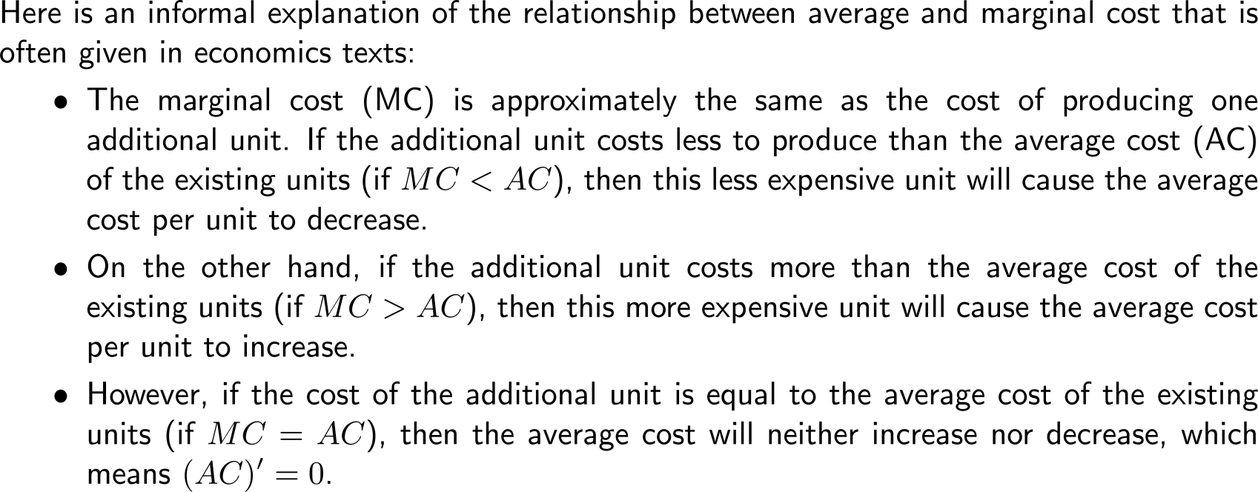
The marginal analysis criterion for minimal average cost gives a method for solving the optimization problem of determining minimal average cost (2/ 2)

Slide 41
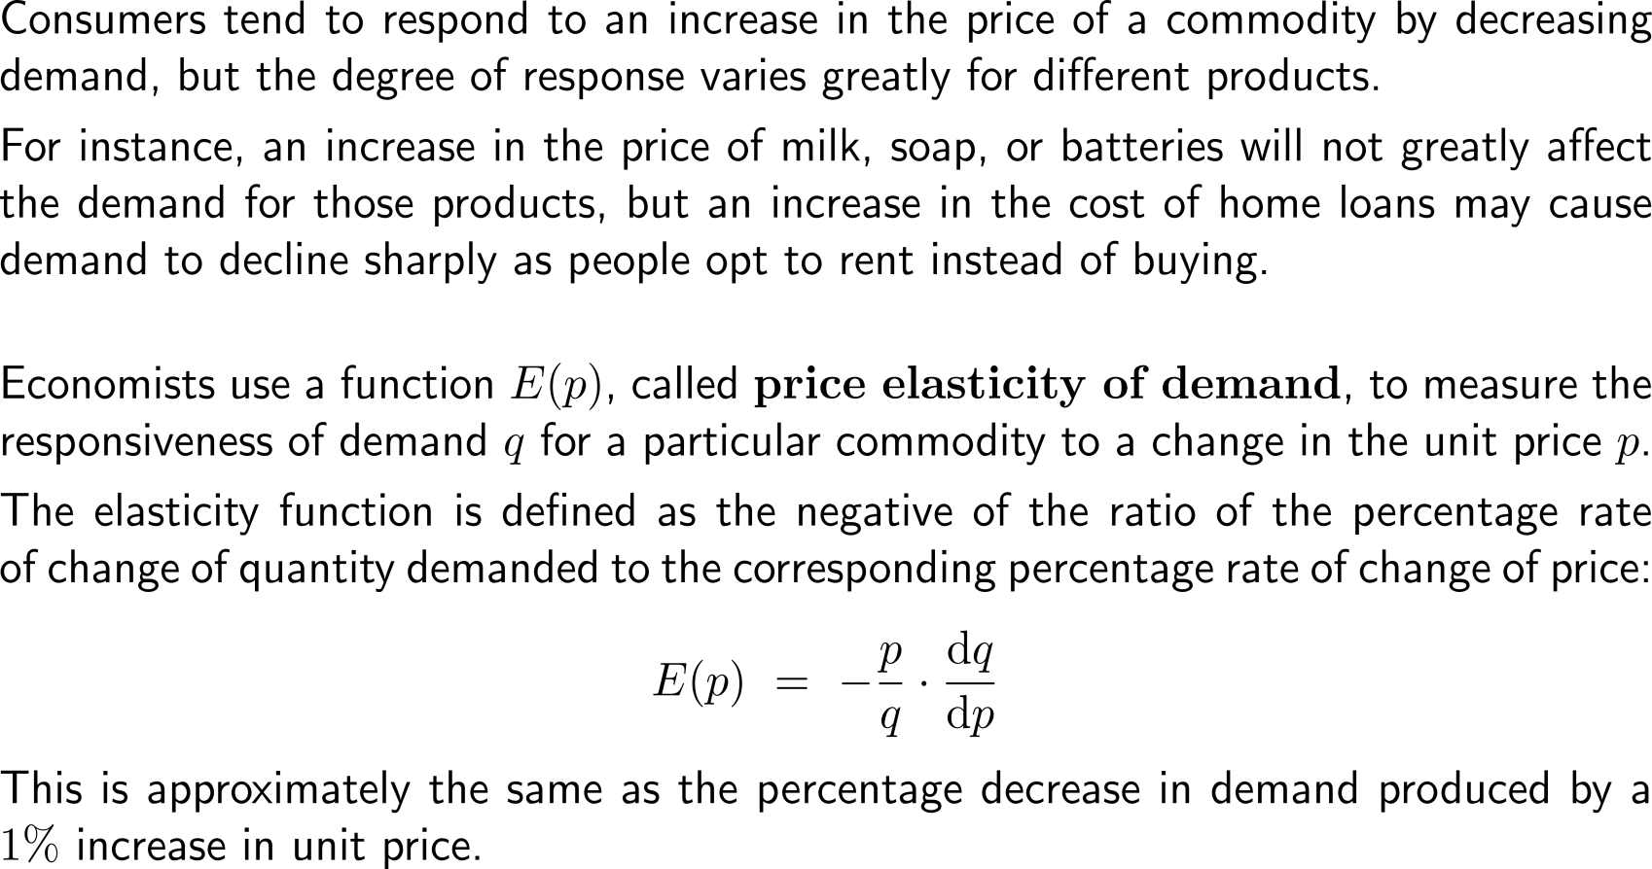
Price elasticity of demand describes the percentage decrease in demand produced by a 1% increase in unit price (1/ 2)
demand
price
demand
price

Slide 42
Price elasticity of demand describes the percentage decrease in demand produced by a 1% increase in unit price (2/ 2)

Slide 43
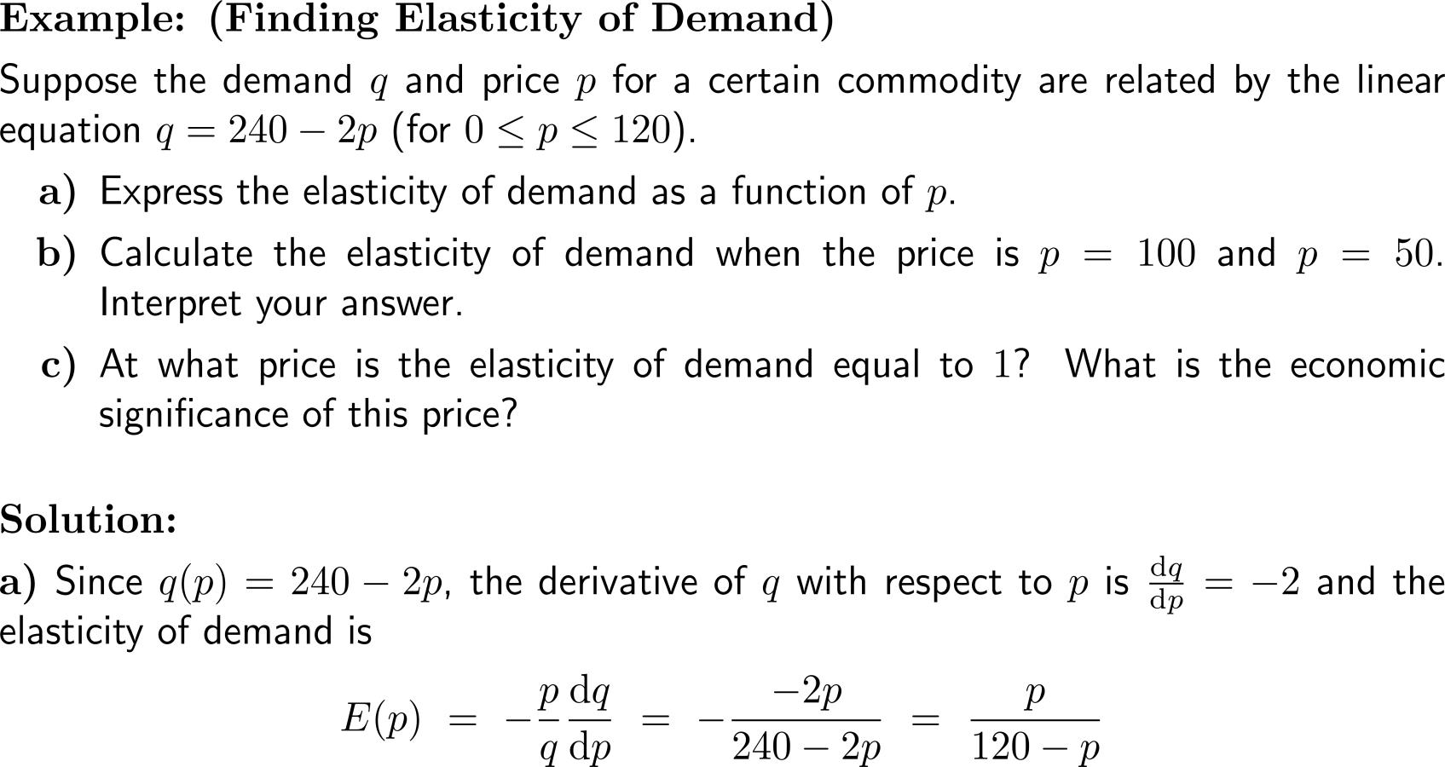
Example: Finding elasticity of demand

Slide 44
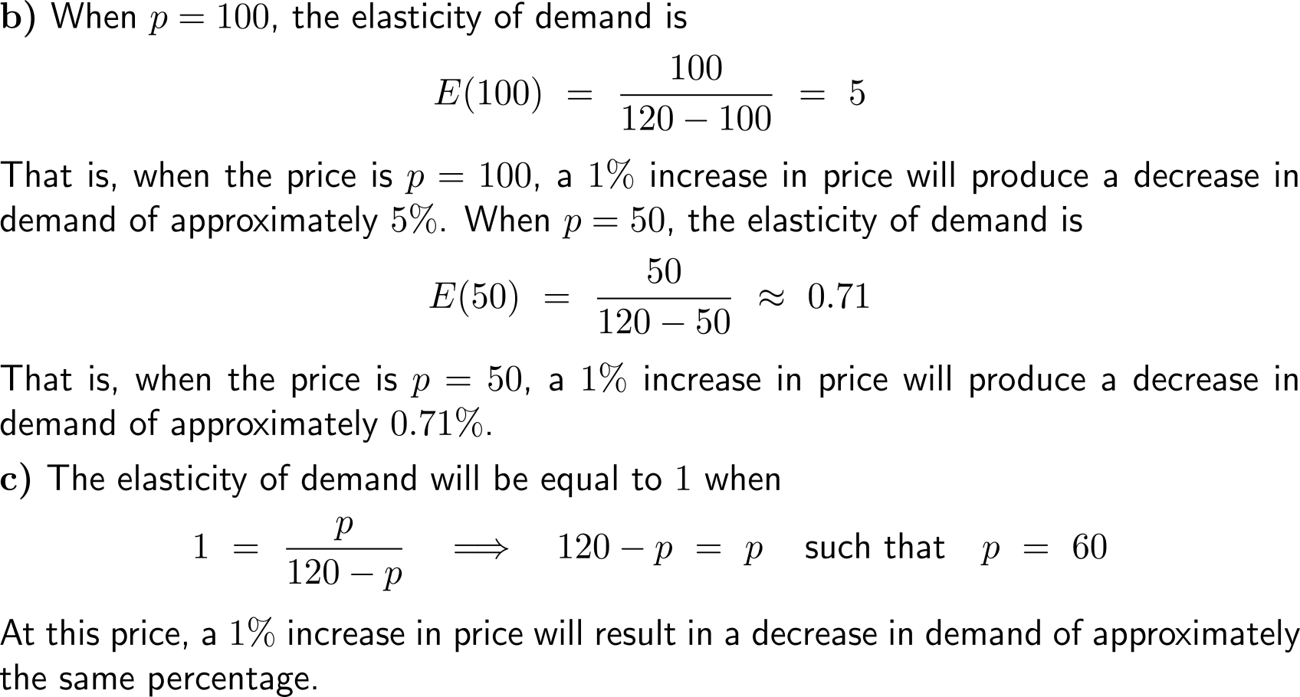
Example: Finding elasticity of demand

Slide 45
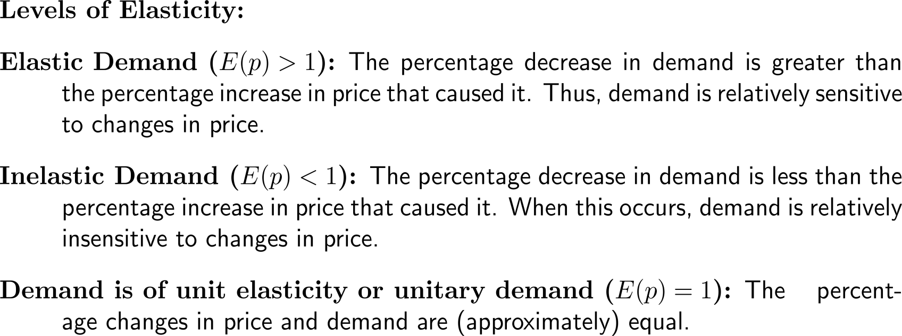
We distinguish between (i) elastic demand, (ii) inelastic demand, and (iii) unitary demand

Slide 46
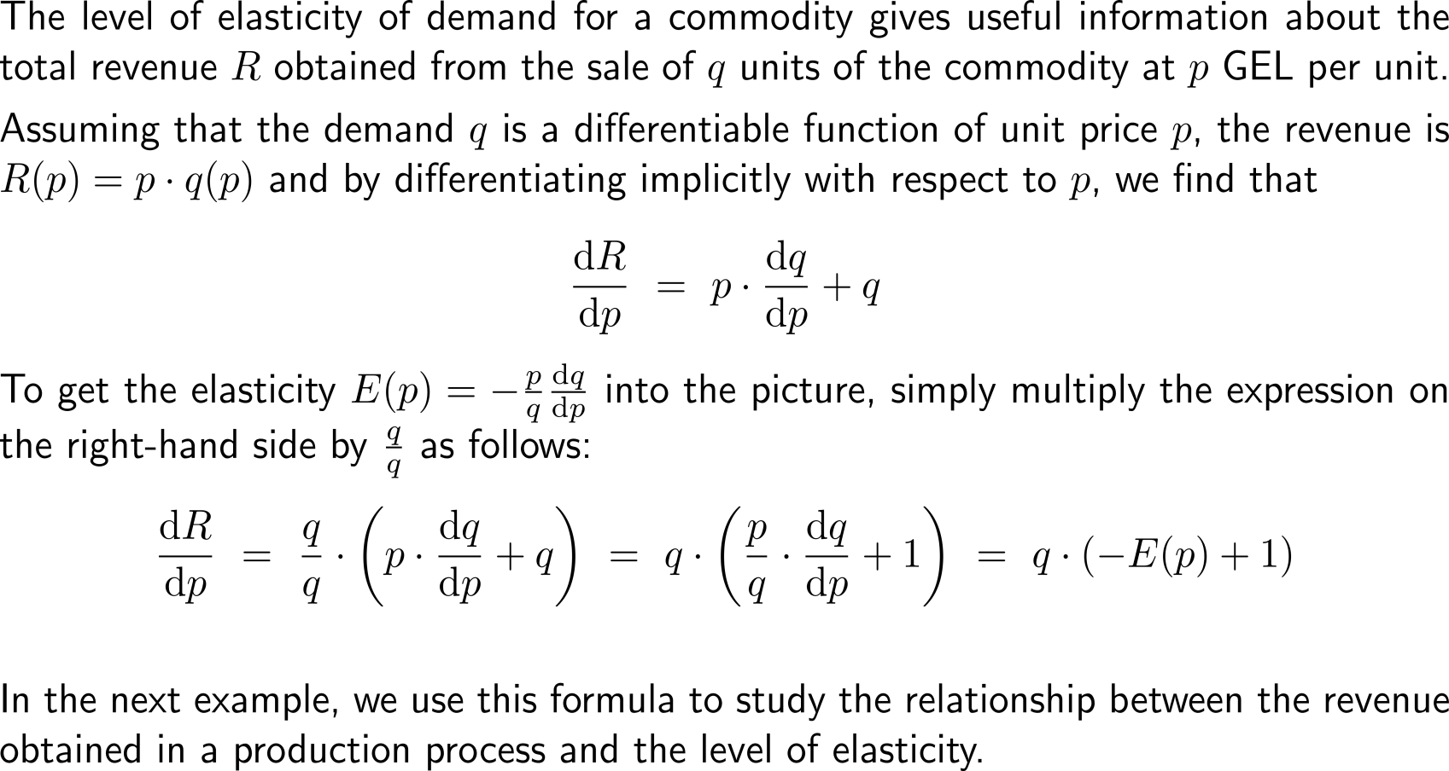
Not surprisingly, the rate of change of revenue can be linked easily to the price elasticity of demand

Slide 47
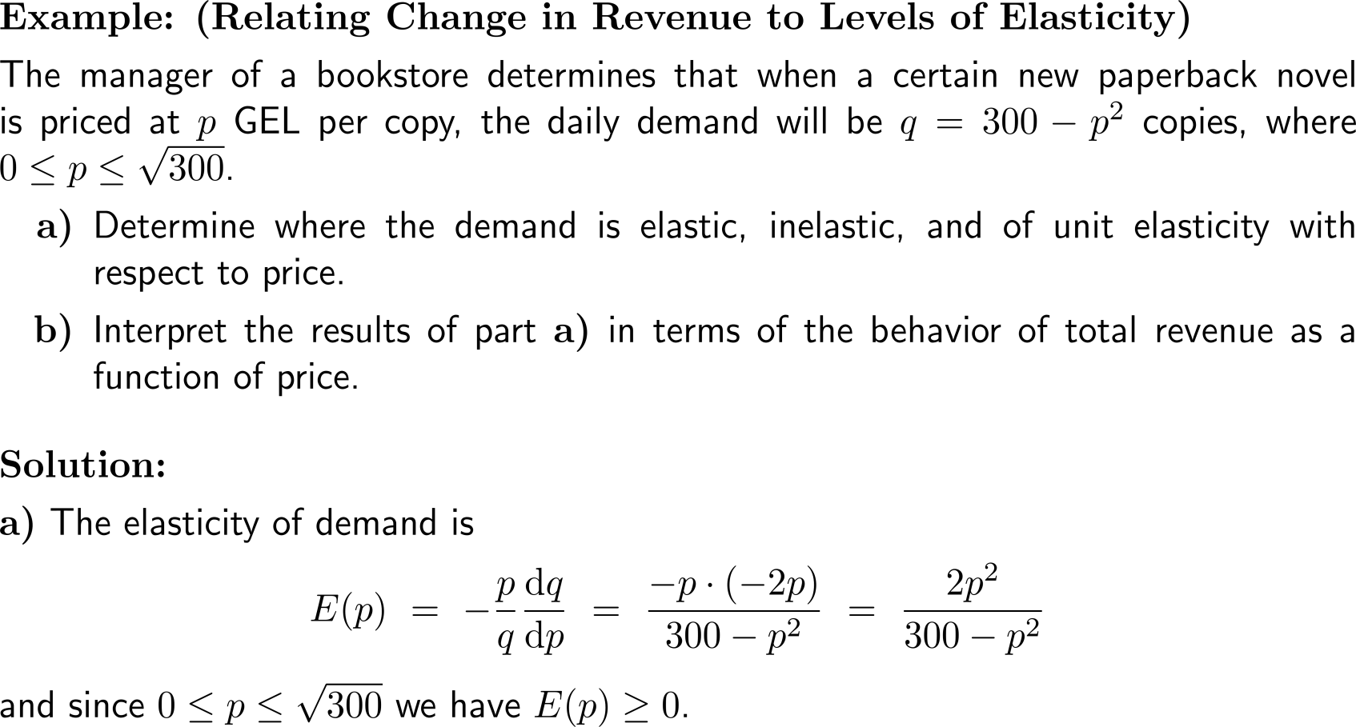
Example: Relating change in revenue to levels of elasticity

Slide 48
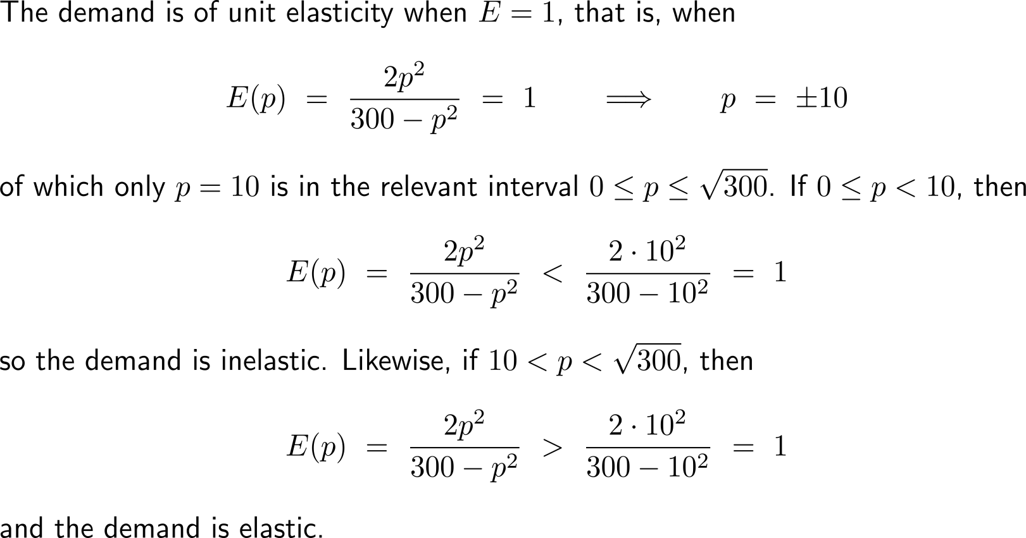
Example: Relating change in revenue to levels of elasticity

Slide 49
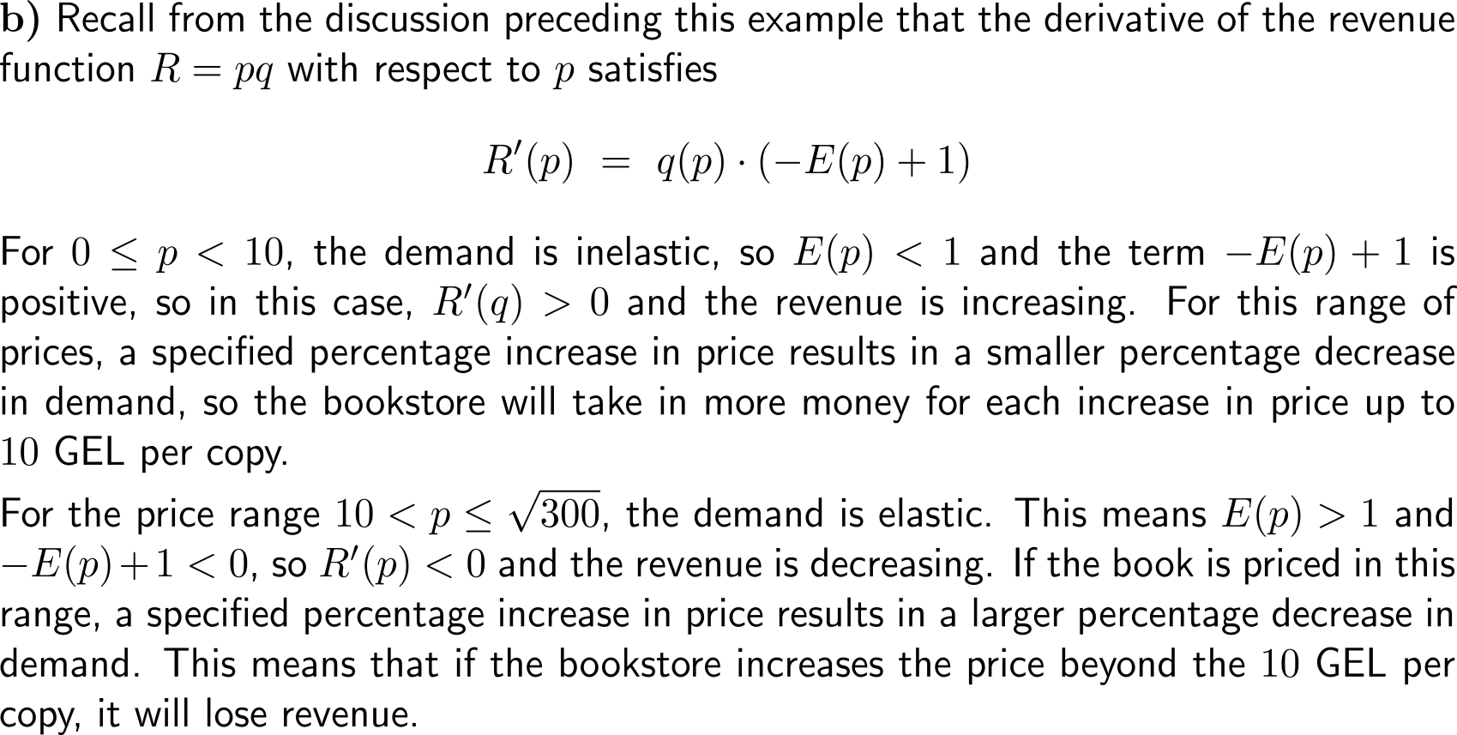
Example: Relating change in revenue to levels of elasticity

Slide 50
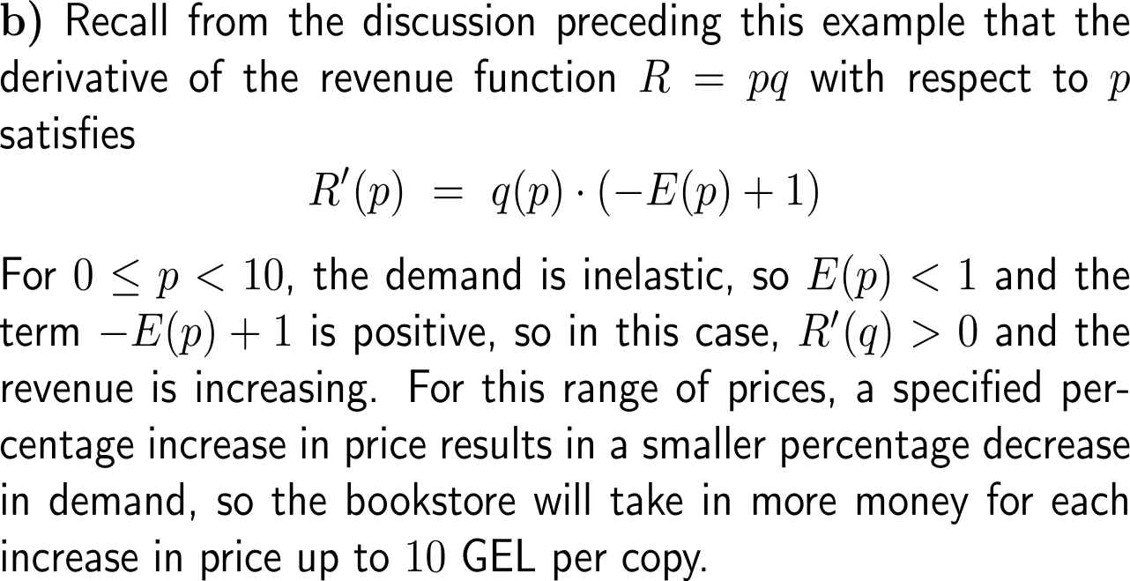
Example: Relating change in revenue to levels of elasticity

Slide 51
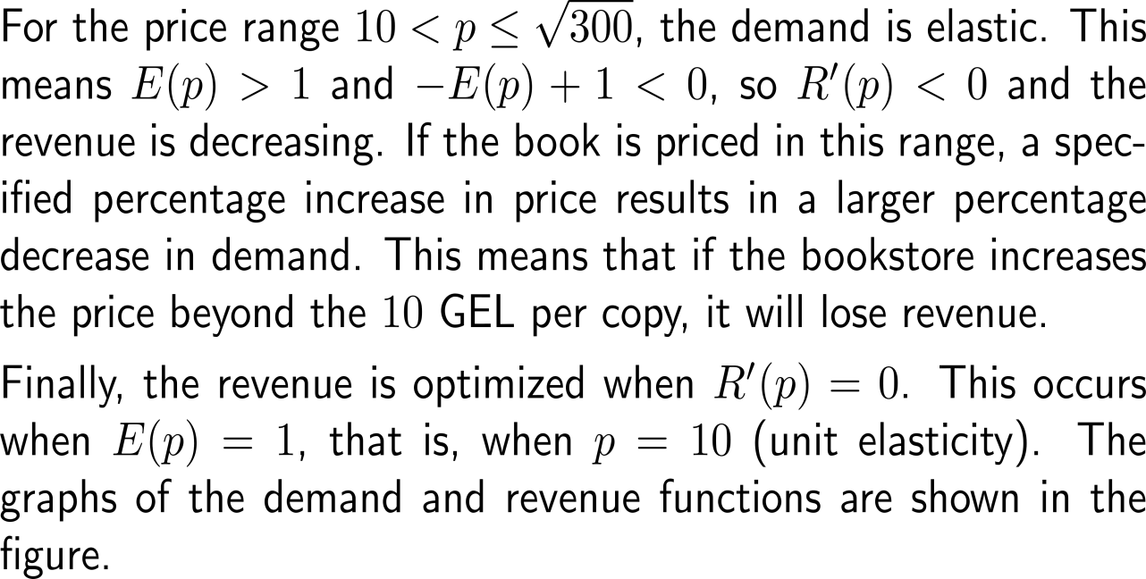
Example: Relating change in revenue to levels of elasticity

Slide 52
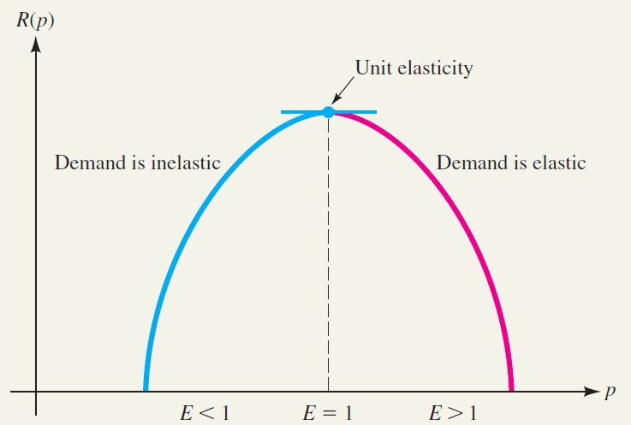
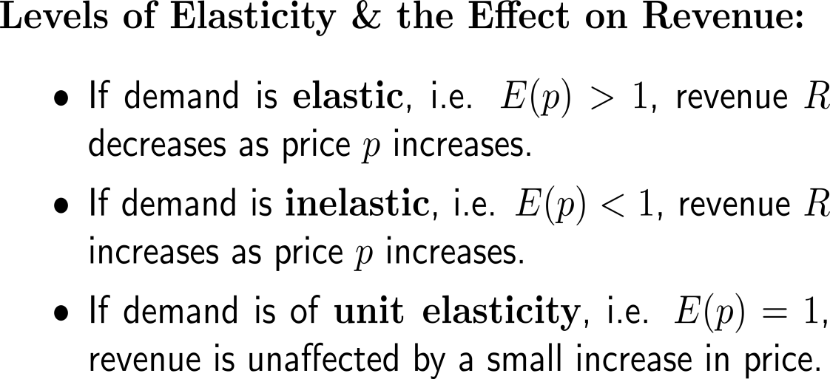
Altogether, we distinguish between three levels of elasticity and their general effect on revenue

Slide 53
Further Worked-Out Exercises:
Calculus I for Management
Topics
Curve sketching
Solving optimization problems

Slide 54
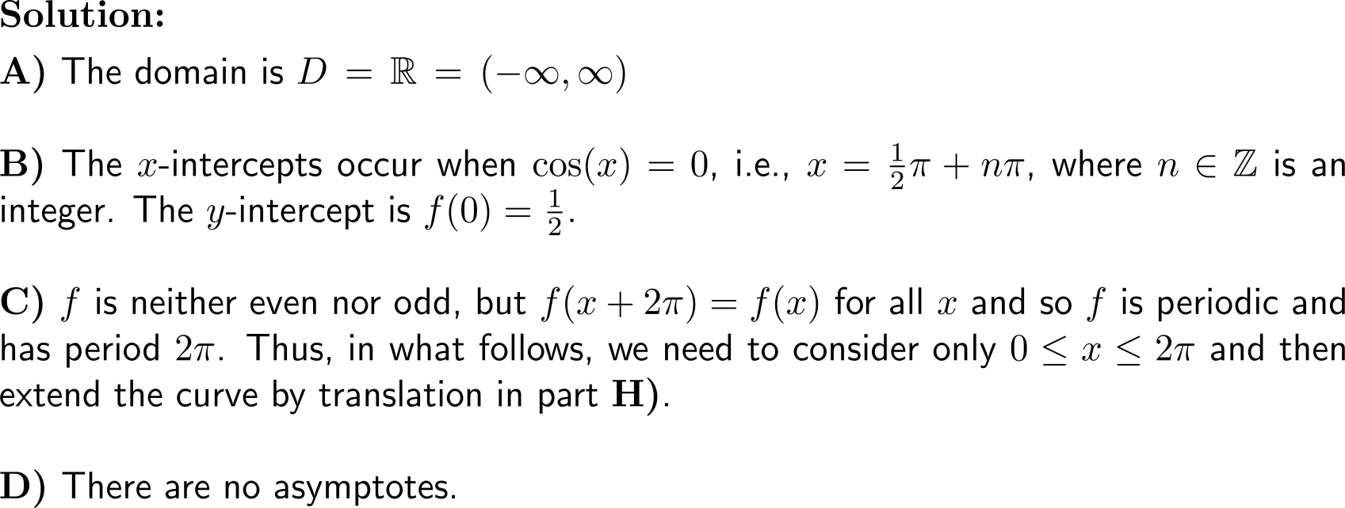
Exercise: Applying the guidelines of curve sketching
A
B
C
D

Slide 55
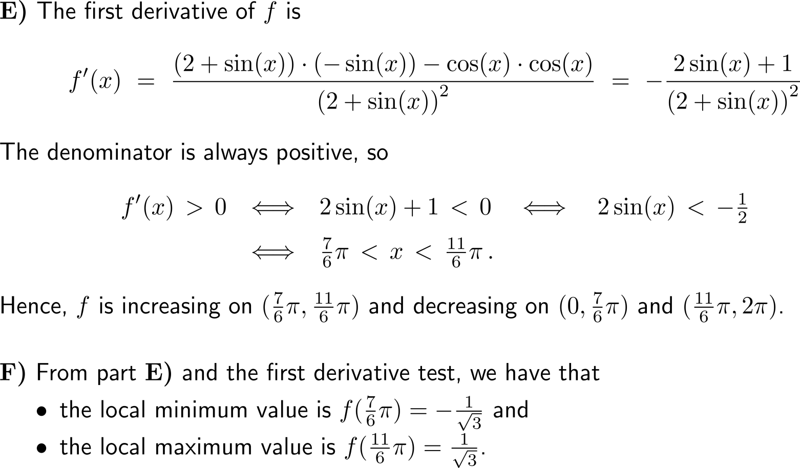
Example: Applying the guidelines of curve sketching
E
F

Slide 56
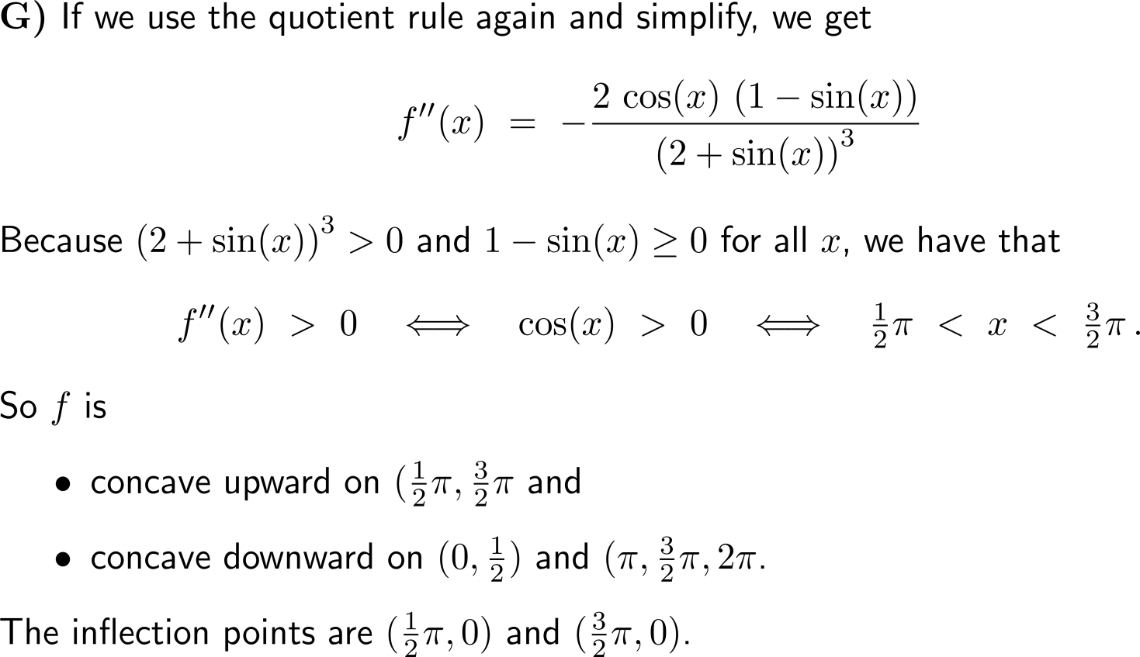
Example: Applying the guidelines of curve sketching
G

Slide 57
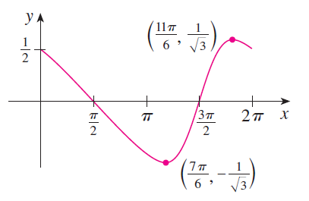
Example: Applying the guidelines of curve sketching
H

Slide 58
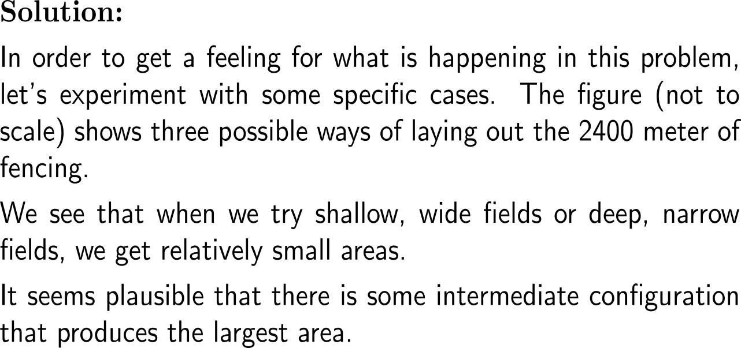
Exercise: Solving optimization problems

Slide 59
Exercise: Solving optimization problems

Slide 60
Exercise: Solving optimization problems

Slide 61
This exercise is a simplified case of Dido’s isoperimetric problem
An illustration of the ancient city of Carthage by Sir William Thompson (Lord Kelvin), 1894

Slide 62
Exercise: Solving optimization problems

Slide 63
Exercise: Solving optimization problems

Slide 64
Exercise: Solving optimization problems

Slide 65
Exercise: Solving optimization problems

Slide 66
Implicit differentiation serves as an alternative way to solve optimization problems

Slide 67
Exercise: Estimating additional revenue using marginal revenue

Slide 68
Exercise: Estimating additional revenue using marginal revenue

Slide 69
Exercise: Studying elasticity of demand

Slide 70
Exercise: Studying elasticity of demand

Slide 71
Exercise: Studying elasticity of demand

Slide 72
Exercise: Studying elasticity of demand

Slide 73
Calculus I for Management

