Slide 1
Calculus I for MGMT – Curves & Optimization Curve Sketching & Optimization
Mathematics for Management
Supplementary Electronic Materials
Curve Sketching & Optimization
Summary of Curve Sketching
Optimization, Marginal Analysis & Elasticity

Slide 2
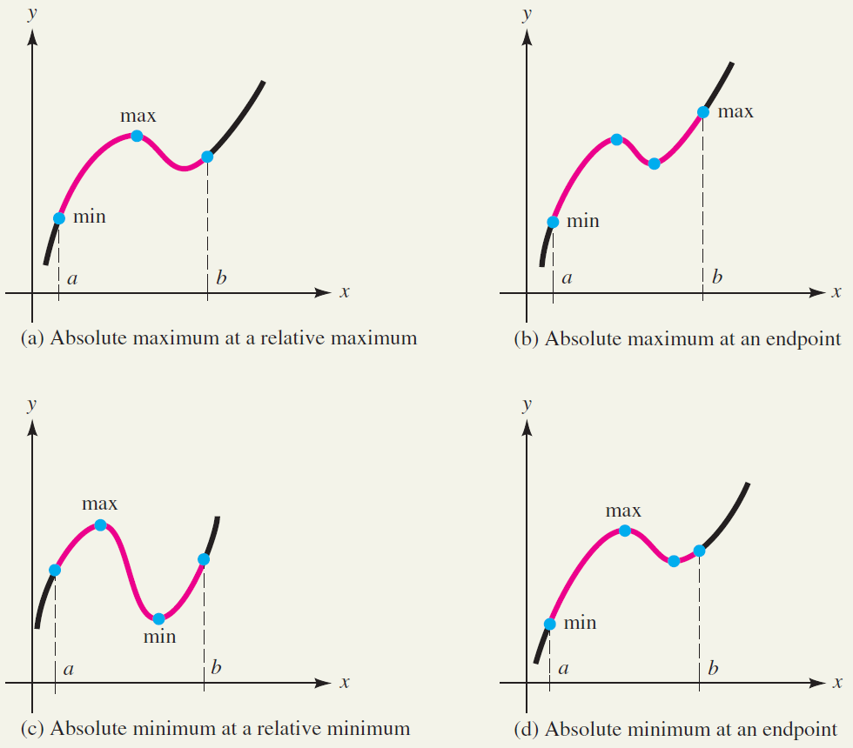
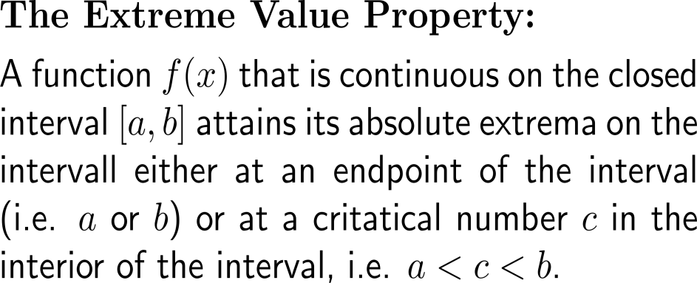
A continuous function on a closed interval attains its absolute extrema either at an endpoint or in the interior of the interval

Slide 3
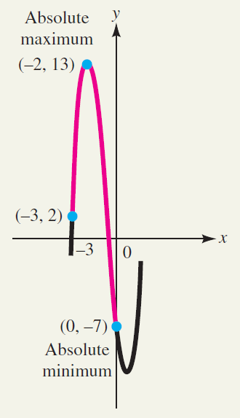
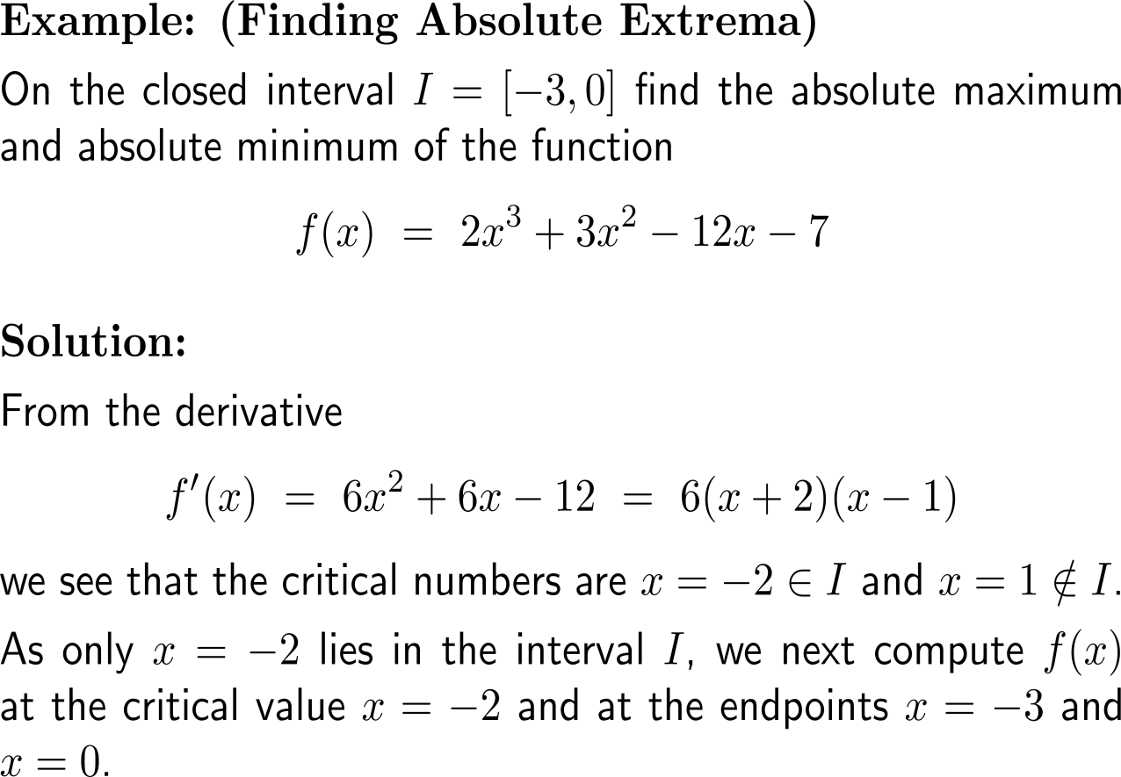
Example: Finding absolute extrema

Slide 4
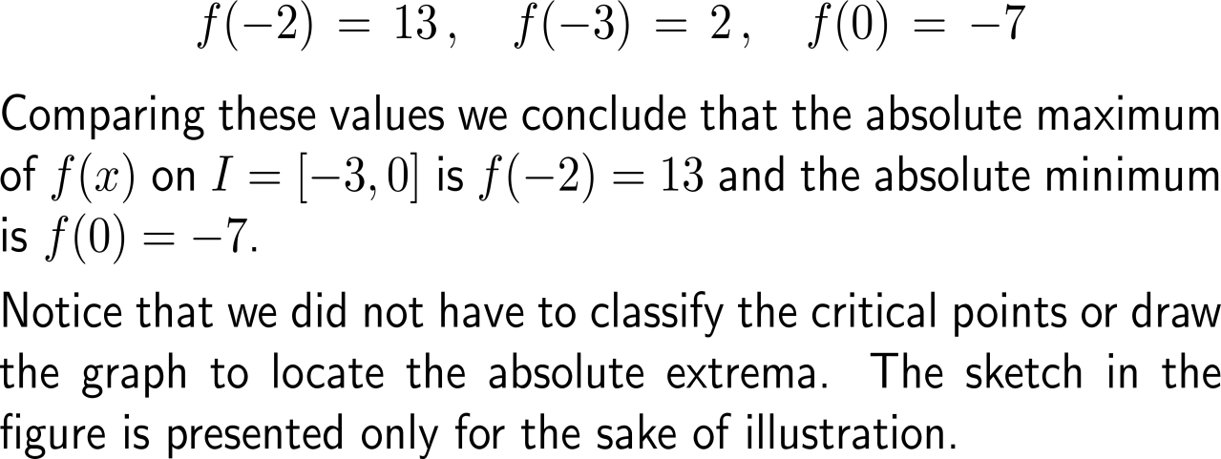
Example: Finding absolute extrema

Slide 5
For continuous functions on non-closed intervals our procedure does not work anymore, though it still can yield very valuable insights
Extrema for functions defined on unbounded intervals

Slide 6
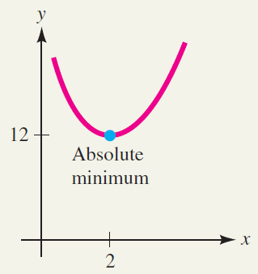
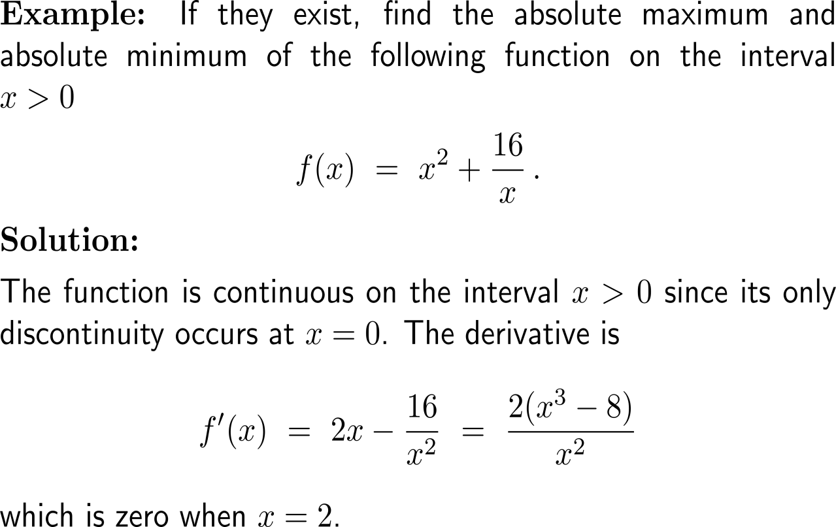
Example: Finding absolute extrema on an open interval

Slide 7
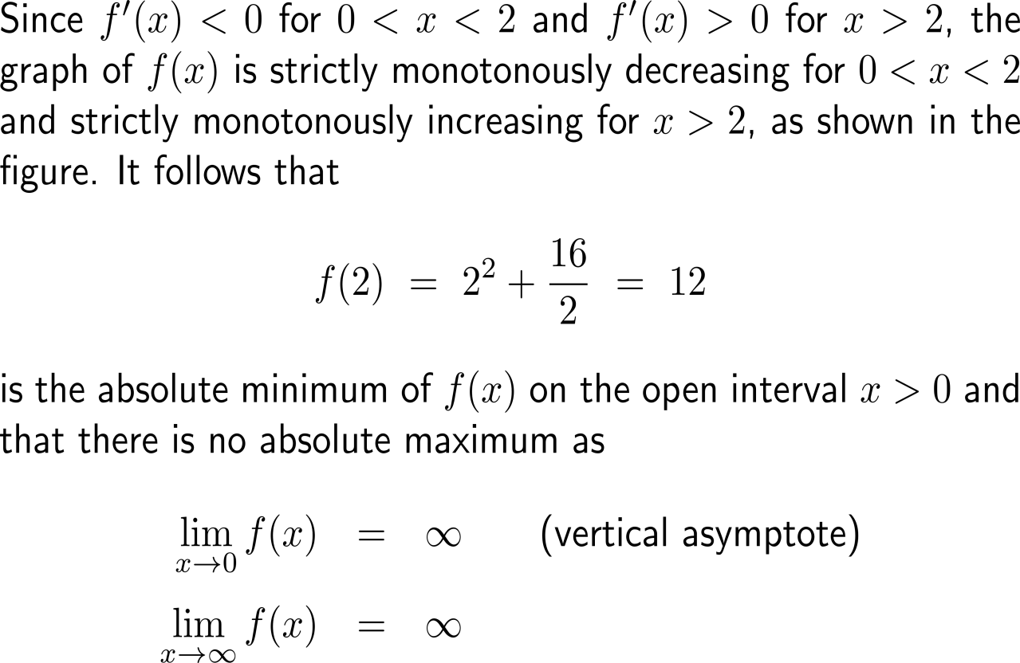
Example: Finding absolute extrema on an open interval

Slide 8
If there is only one critical number then the 2nd derivative at this point is sufficient to determine the type of extremum

Slide 9
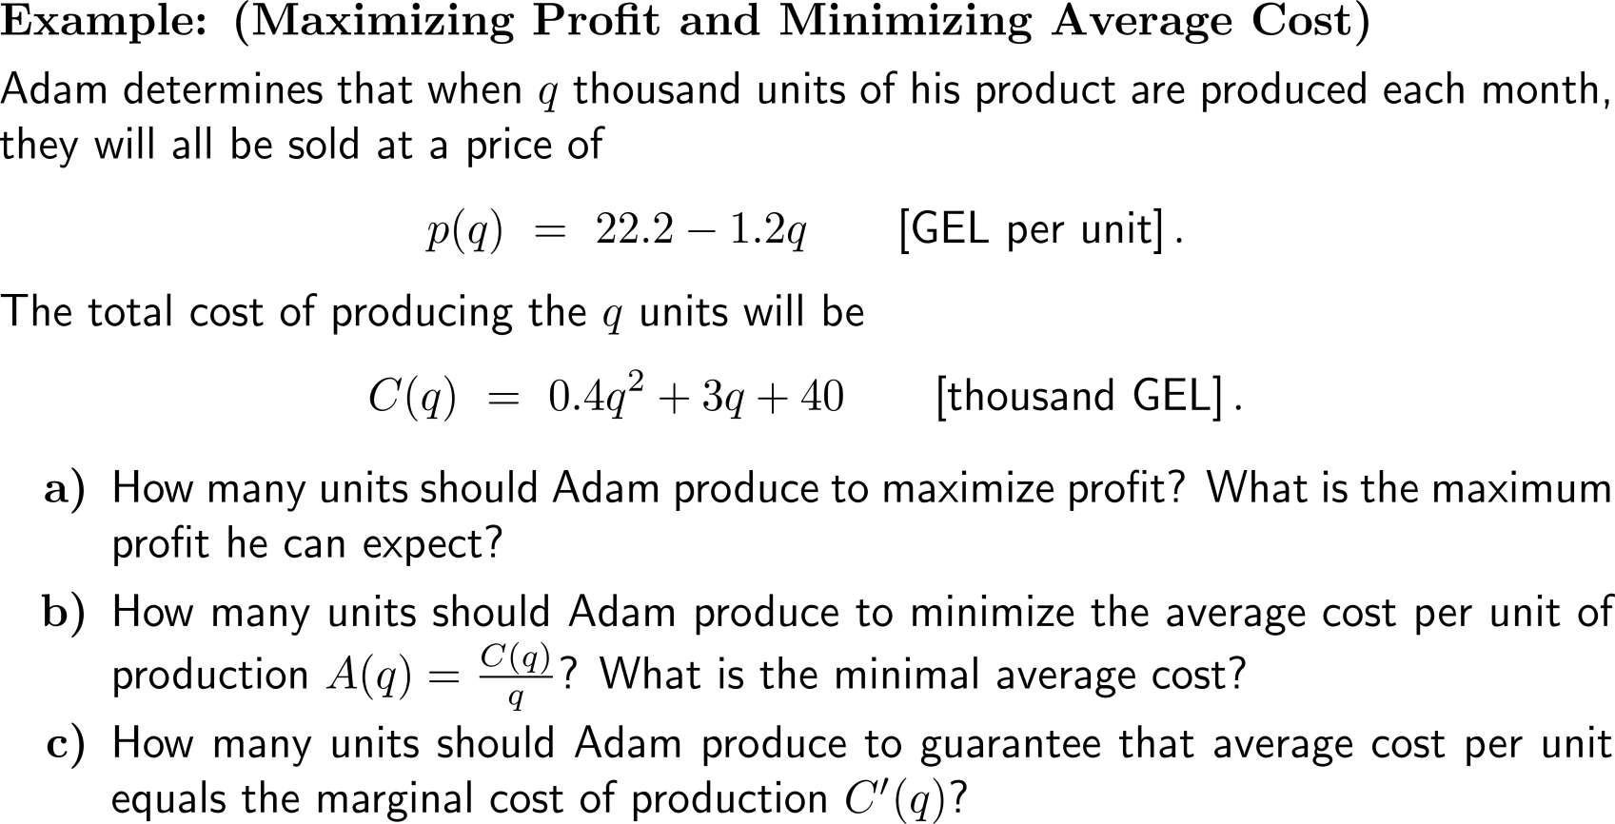
Example: Maximizing profit and minimizing average cost

Slide 10
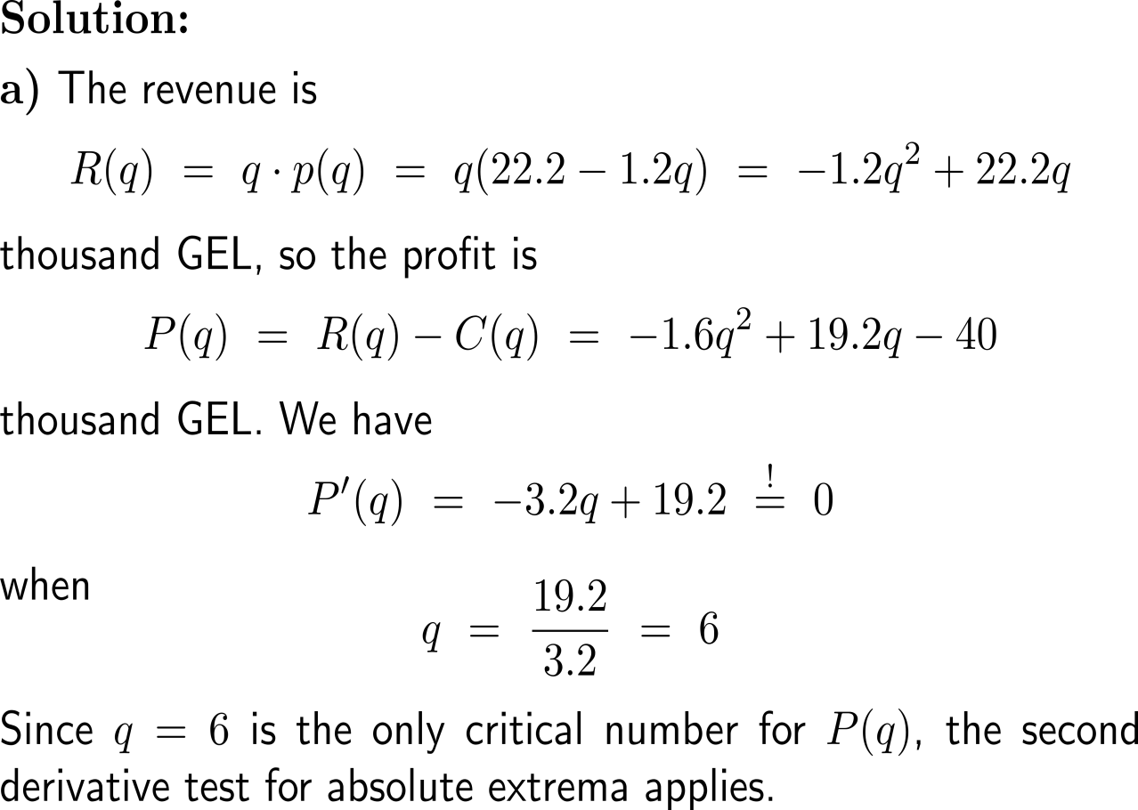
Example: Maximizing profit and minimizing average cost

Slide 11
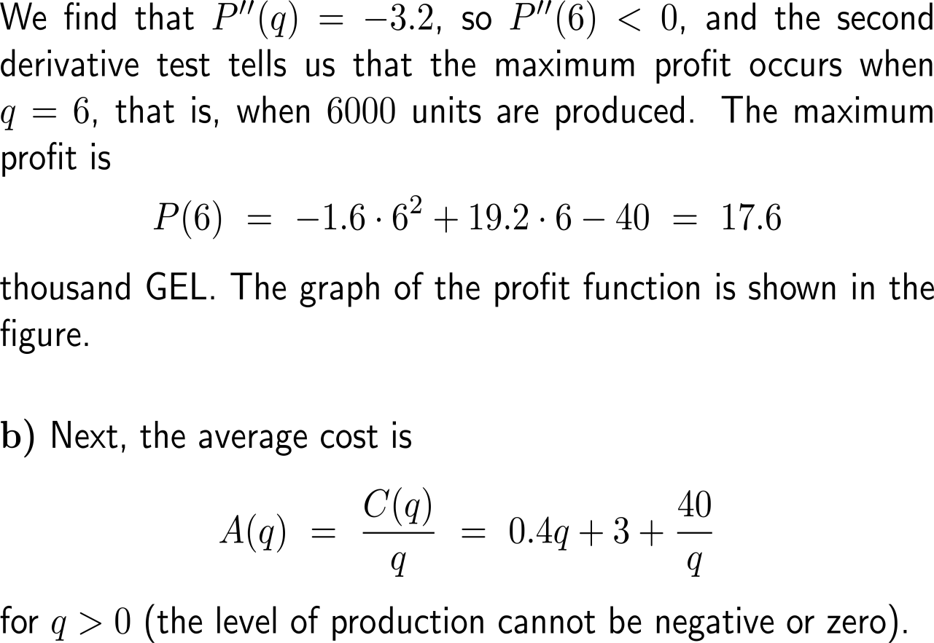
Example: Maximizing profit and minimizing average cost

Slide 12
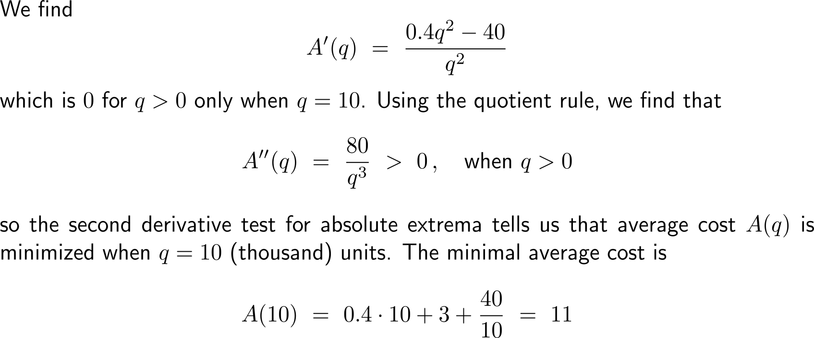
Example: Maximizing profit and minimizing average cost

Slide 13
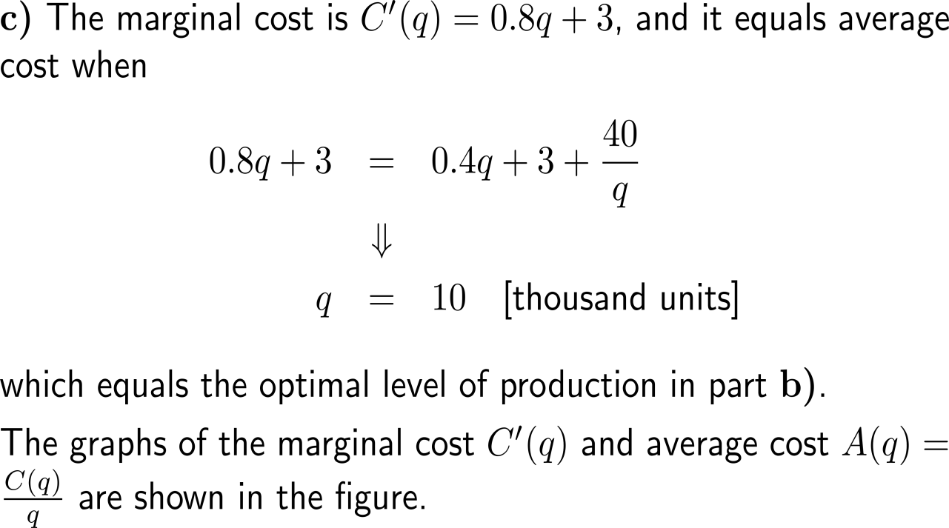
Example: Maximizing profit and minimizing average cost

Slide 14
The marginal analysis criterion for maximum profit gives a method for solving the optimization problem of determining maximum profit (1/ 2)

Slide 15
The marginal analysis criterion for maximum profit gives a method for solving the optimization problem of determining maximum profit (2/ 2)

Slide 16
The marginal analysis criterion for minimal average cost gives a method for solving the optimization problem of determining minimal average cost (1/ 2)

Slide 17
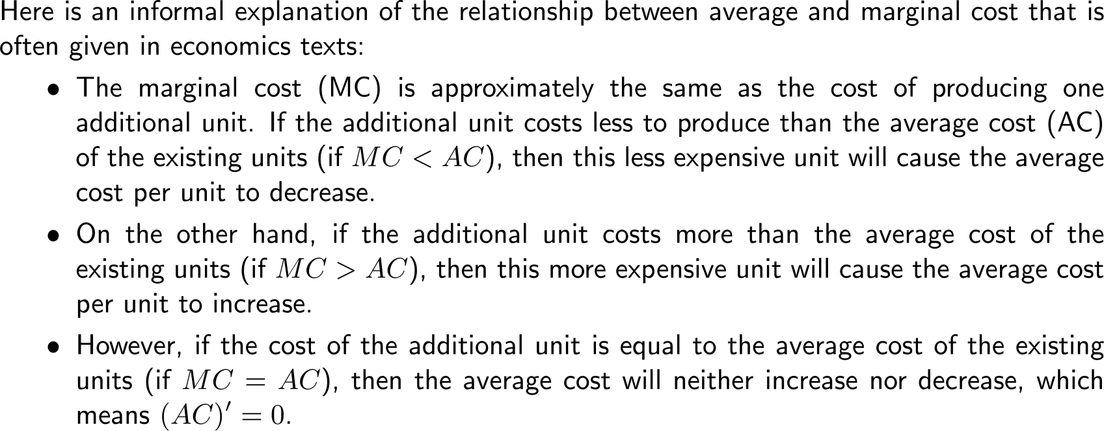
The marginal analysis criterion for minimal average cost gives a method for solving the optimization problem of determining minimal average cost (2/ 2)

Slide 18
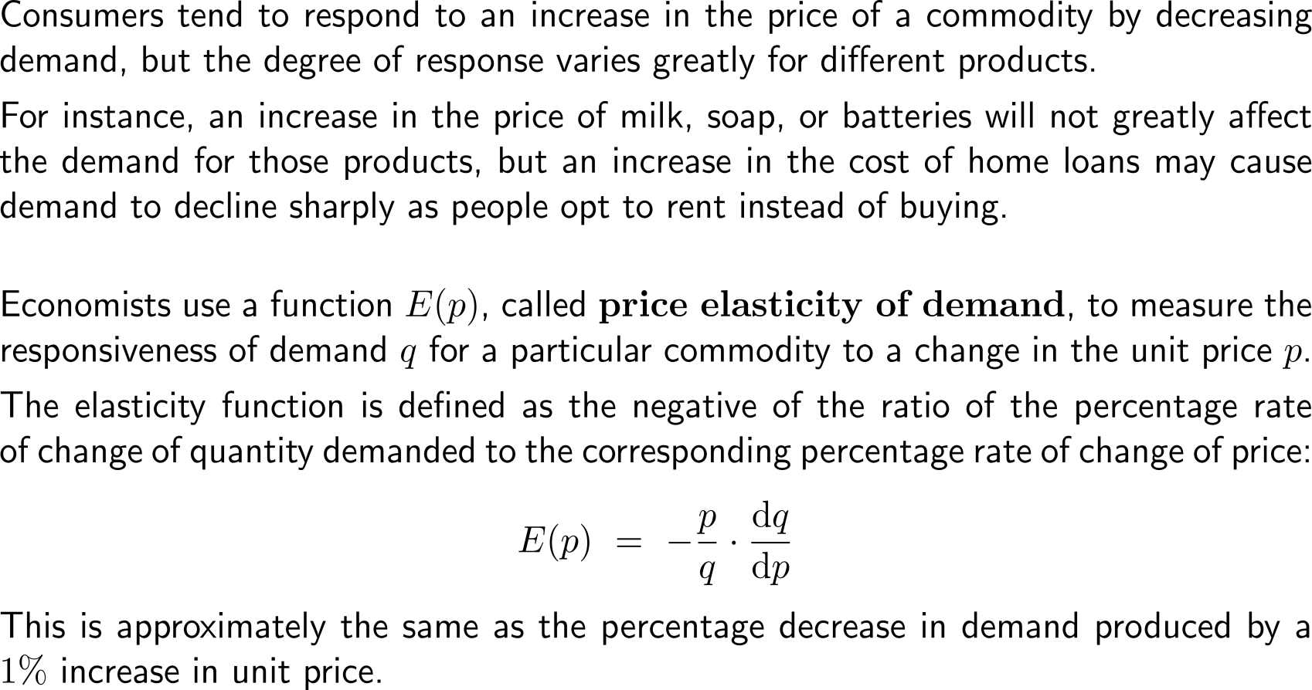
Price elasticity of demand describes the percentage decrease in demand produced by a 1% increase in unit price (1/ 2)
demand
price
demand
price

Slide 19
Price elasticity of demand describes the percentage decrease in demand produced by a 1% increase in unit price (2/ 2)

Slide 20
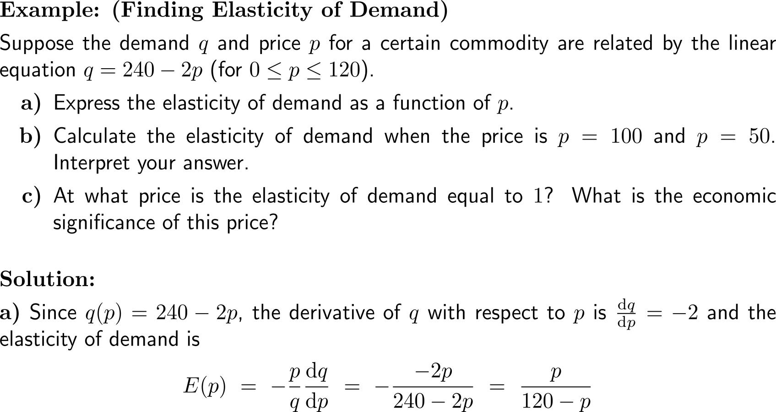
Example: Finding elasticity of demand

Slide 21
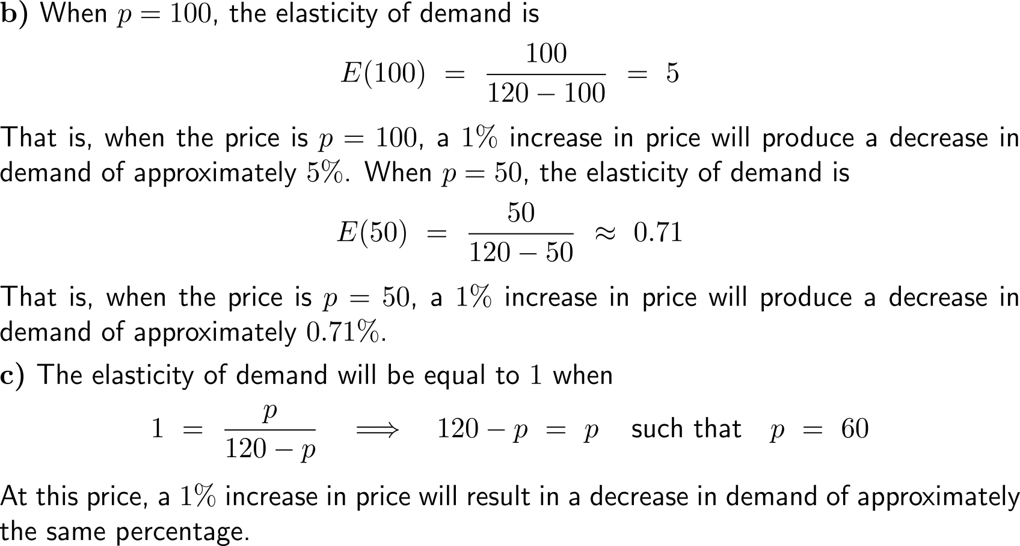
Example: Finding elasticity of demand

Slide 22
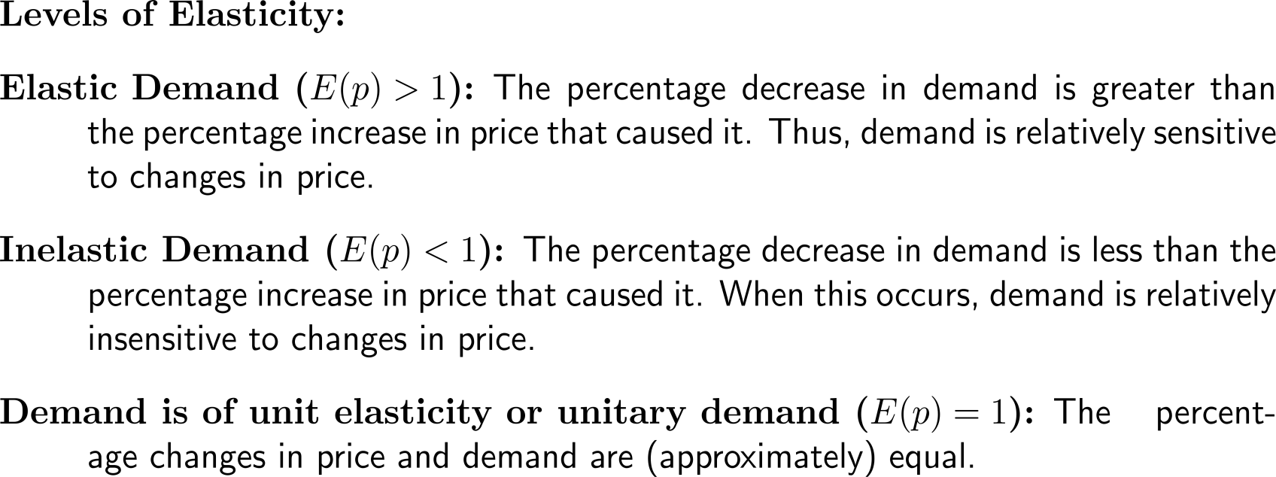
We distinguish between (i) elastic demand, (ii) inelastic demand, and (iii) unitary demand

Slide 23
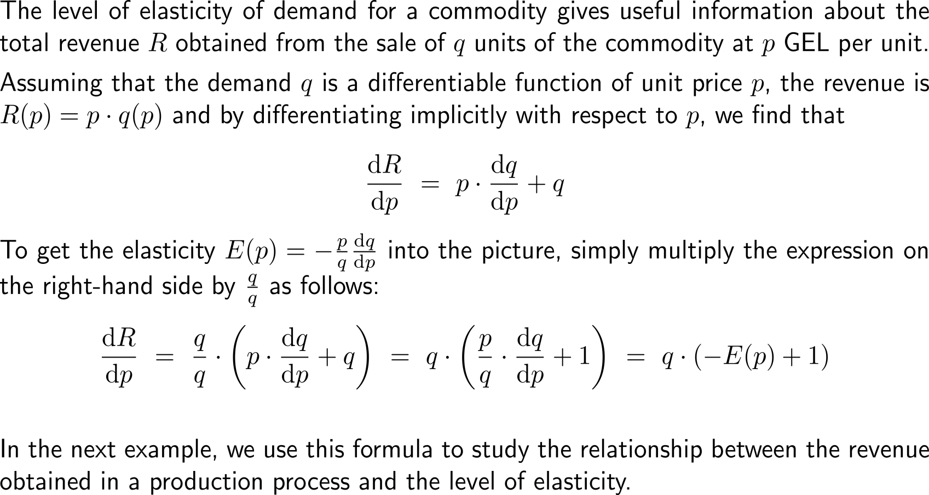
Not surprisingly, the rate of change of revenue can be linked easily to the price elasticity of demand

Slide 24
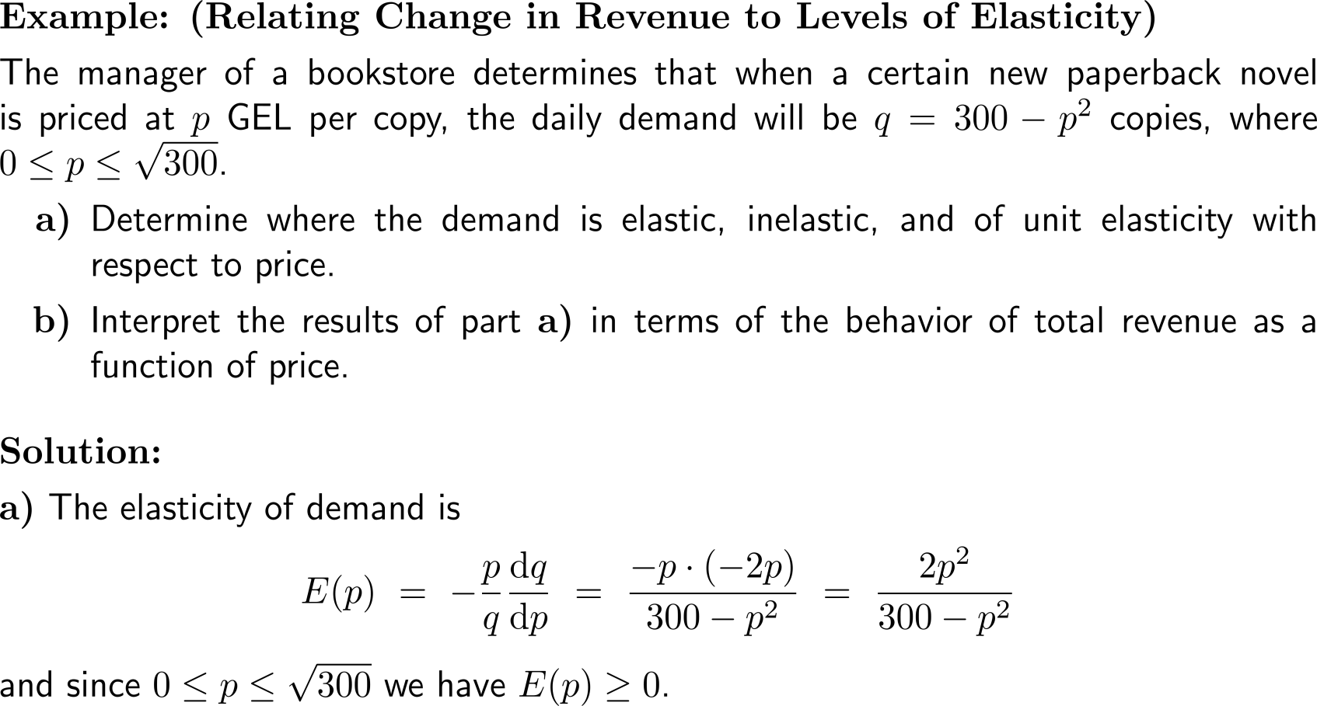
Example: Relating change in revenue to levels of elasticity

Slide 25
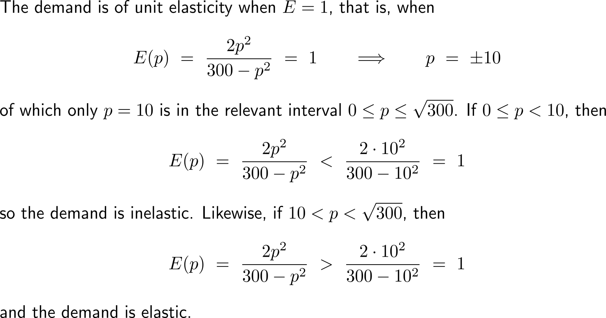
Example: Relating change in revenue to levels of elasticity

Slide 26
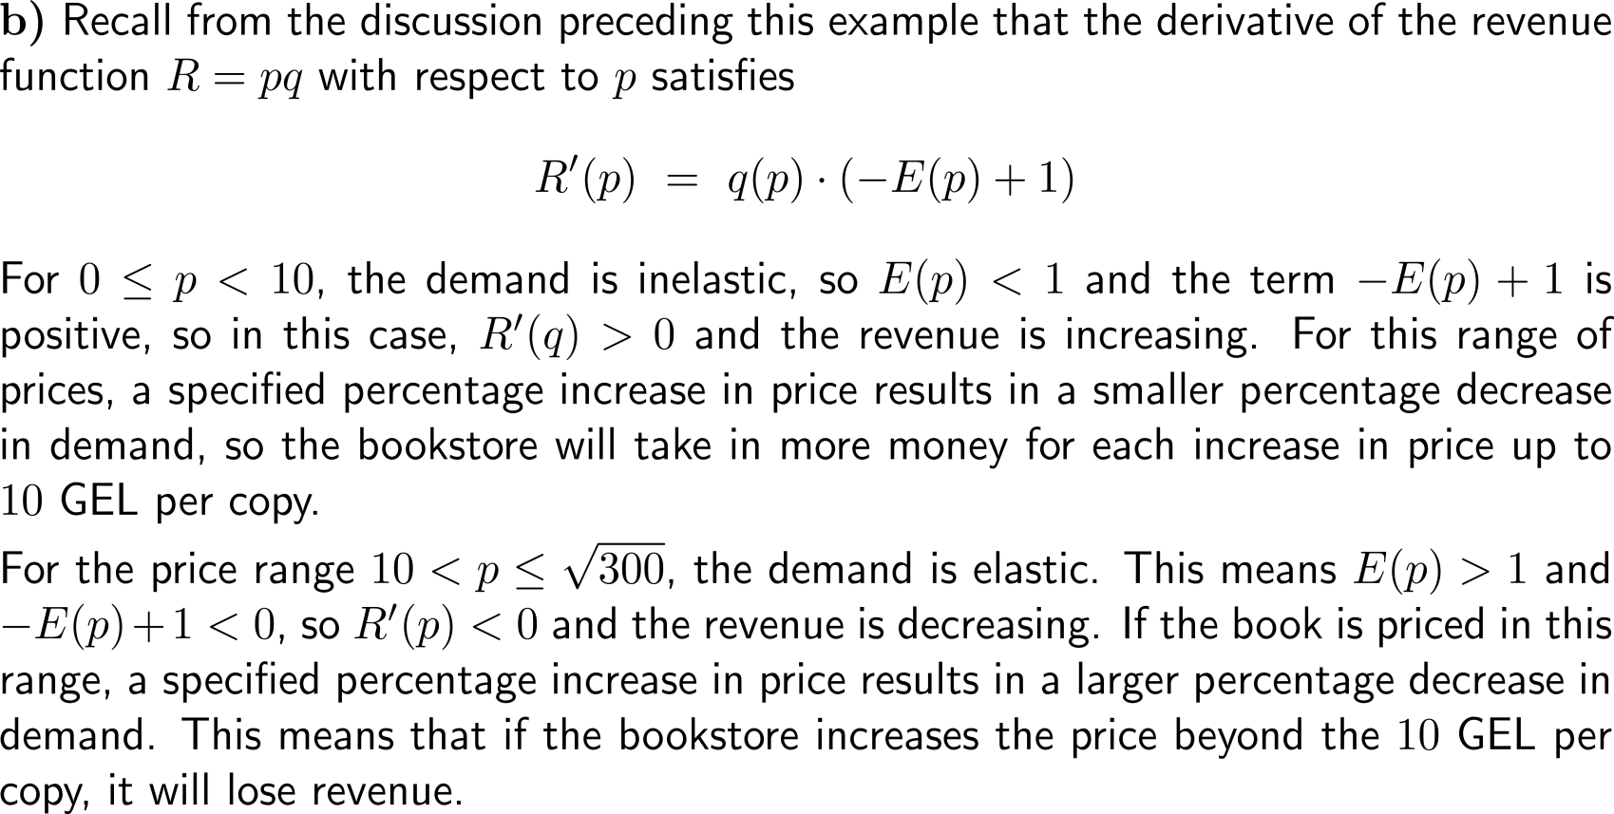
Example: Relating change in revenue to levels of elasticity

Slide 27
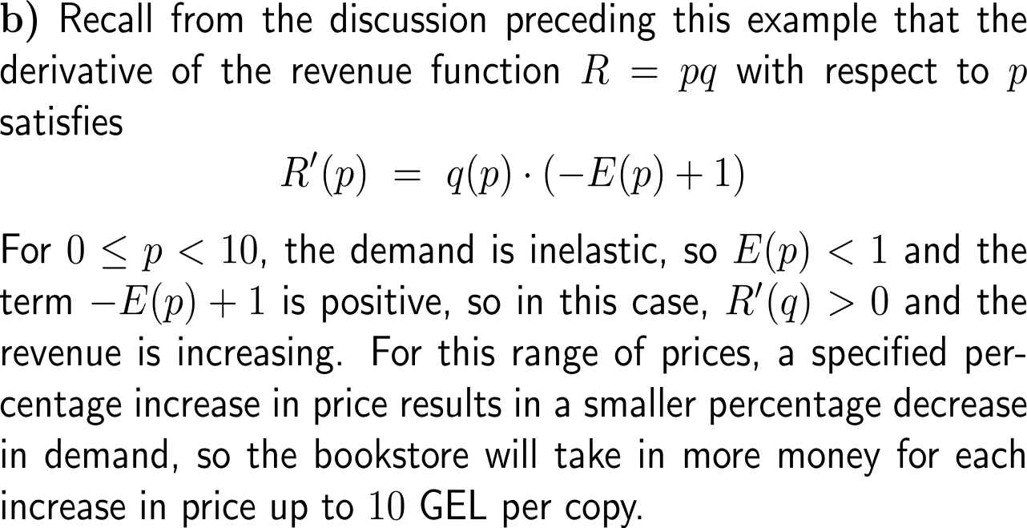
Example: Relating change in revenue to levels of elasticity

Slide 28
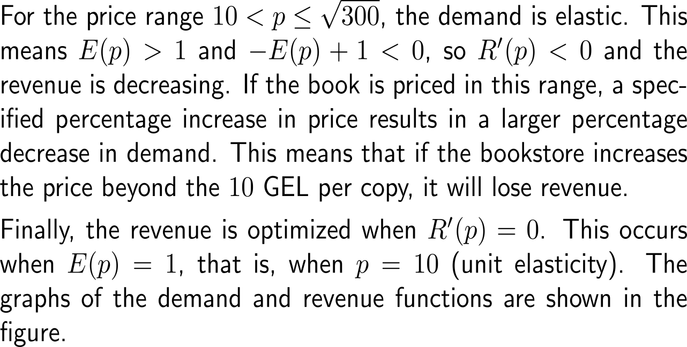
Example: Relating change in revenue to levels of elasticity

Slide 29
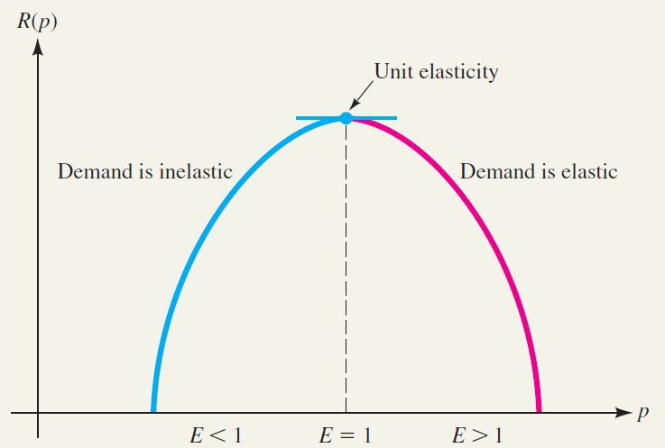
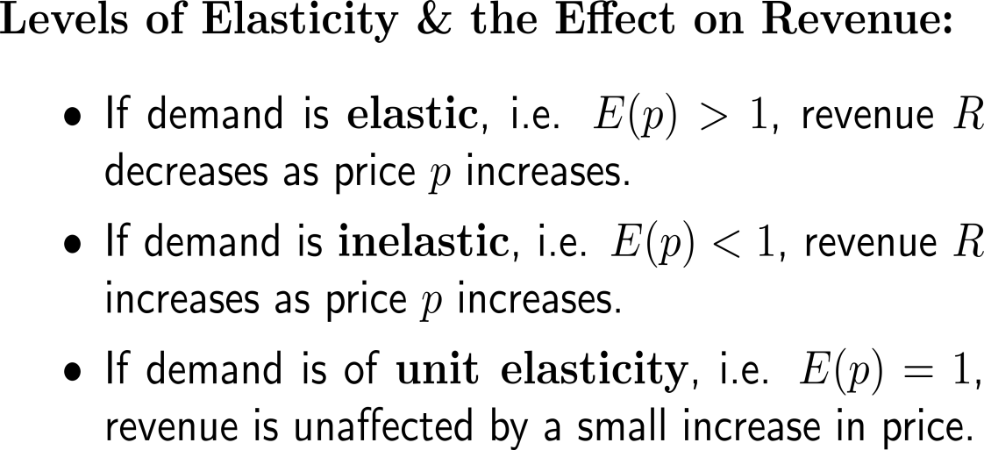
Altogether, we distinguish between three levels of elasticity and their general effect on revenue

Slide 30
Calculus I for Management

