Slide 1
Calculus I for MGMT – Integration Antiderivatives & Indefinite Integrals
Mathematics for Management
Supplementary Electronic Materials
Antiderivatives & Indefinite Integrals
Indefinite Integration
Integration yielding Inverse Trigonometric Functions
First Rules of Integration

Slide 2
The antiderivative or indefinite integral of a function f(x) is a function F(x) such that F’(x) = f(x)

Slide 3
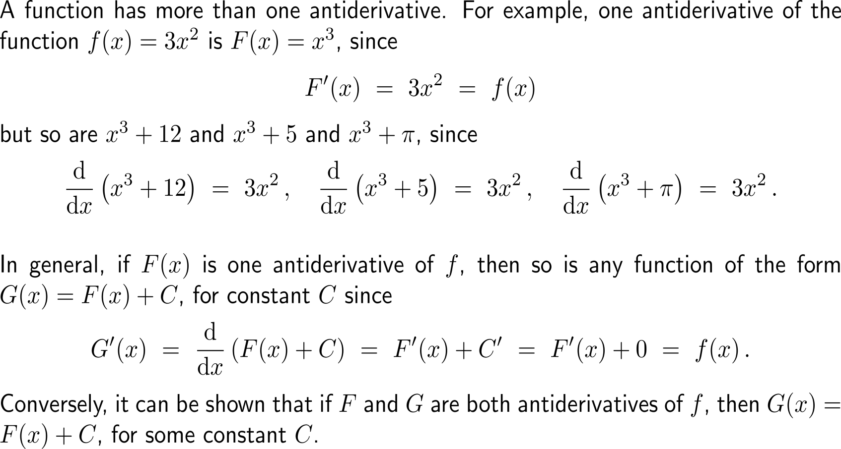
A function has a whole family of antiderivatives that differ by an additive constant from each other (1/ 3)

Slide 4
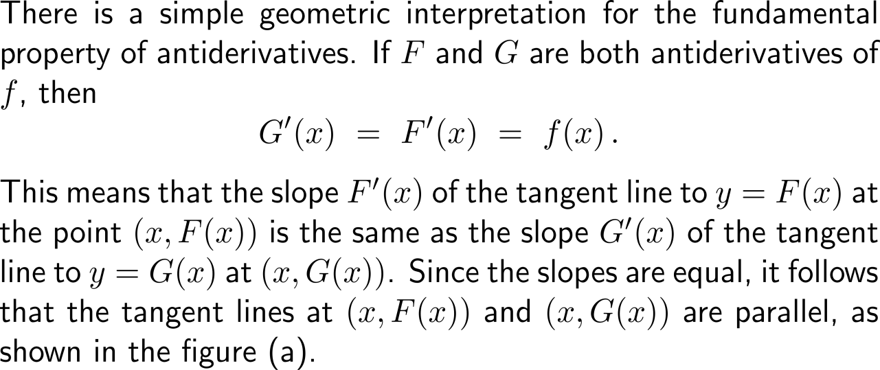
A function has a whole family of antiderivatives that differ by an additive constant from each other (2/ 3)

Slide 5
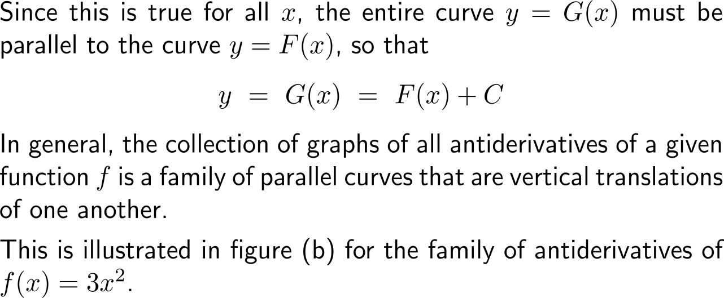
A function has a whole family of antiderivatives that differ by an additive constant from each other (3/ 3)

Slide 6
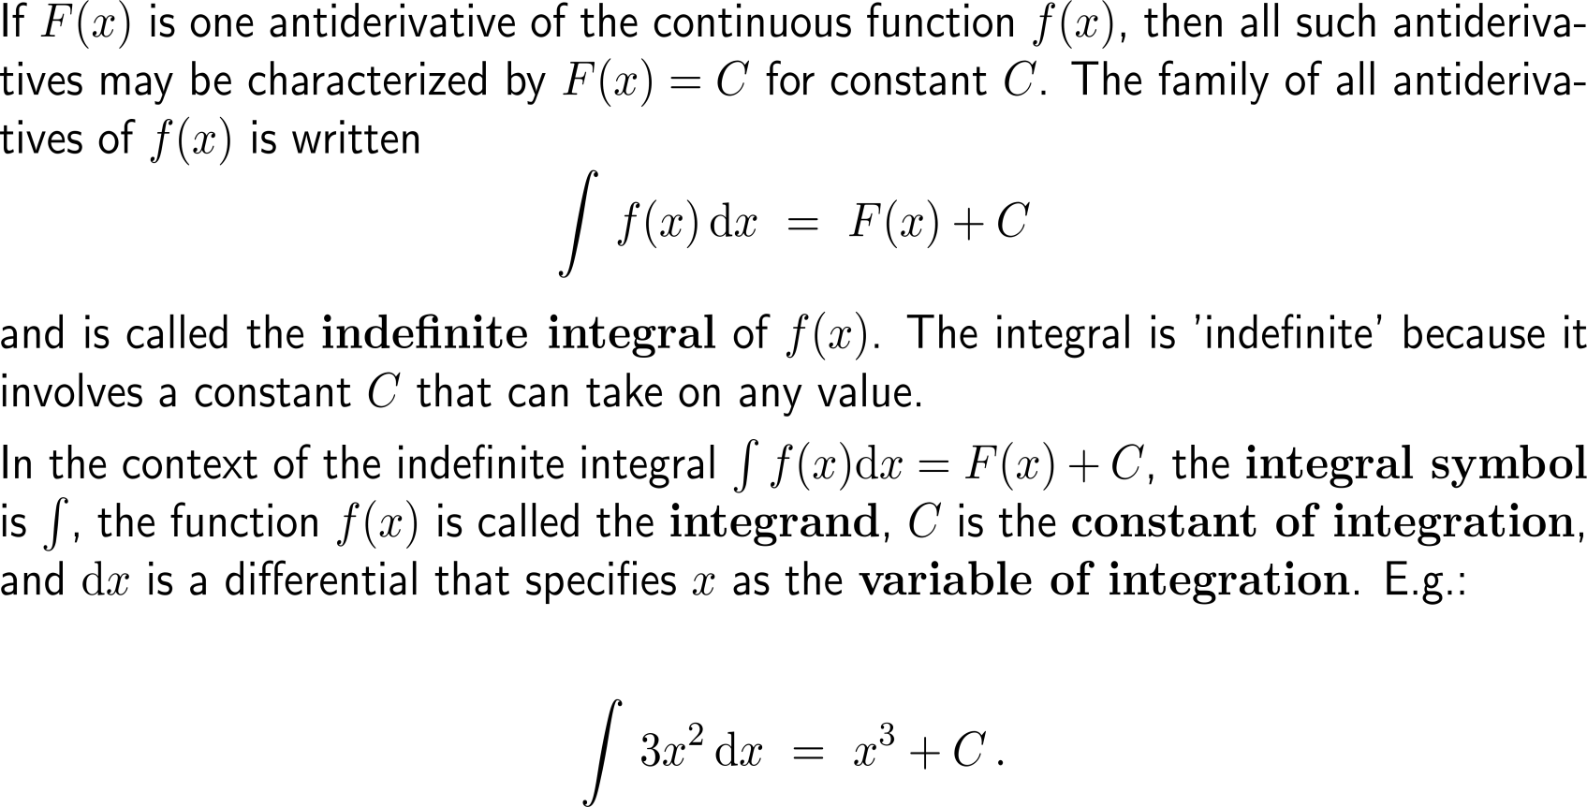
An indefinite integral consist of the integral symbol, an integrand, and the differential symbol dx indicating the variable x of integration
integrand
constant of integration
integral symbol
variable of integration

Slide 7
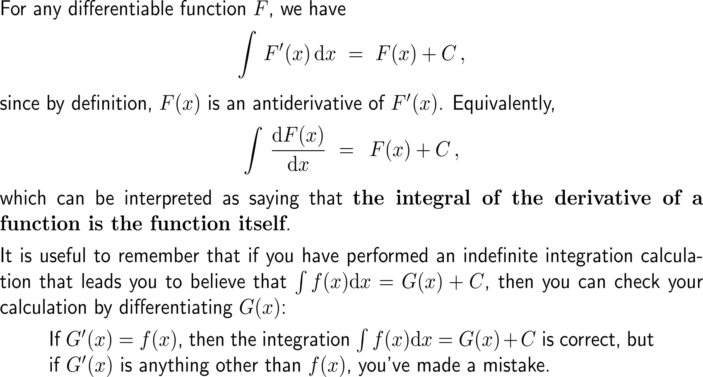
The integral of the derivative of a function is the function itself

Slide 8
Example: Determination of antiderivatives

Slide 9
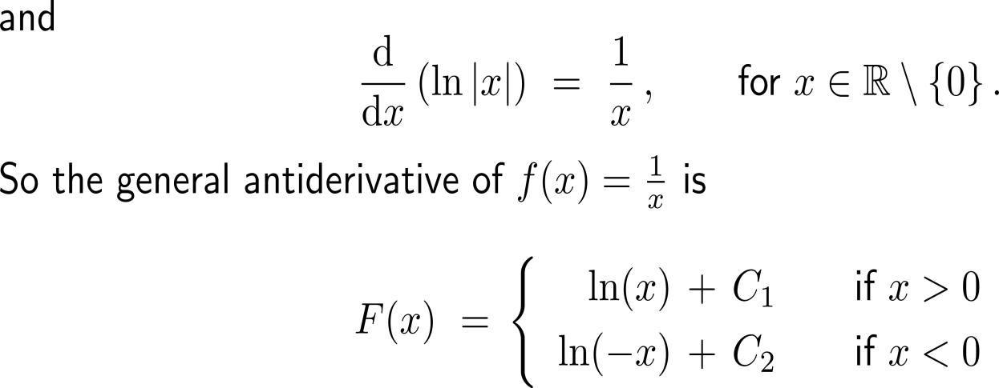
Example: Determination of antiderivatives

Slide 10
Example: Determination of antiderivatives

Slide 11
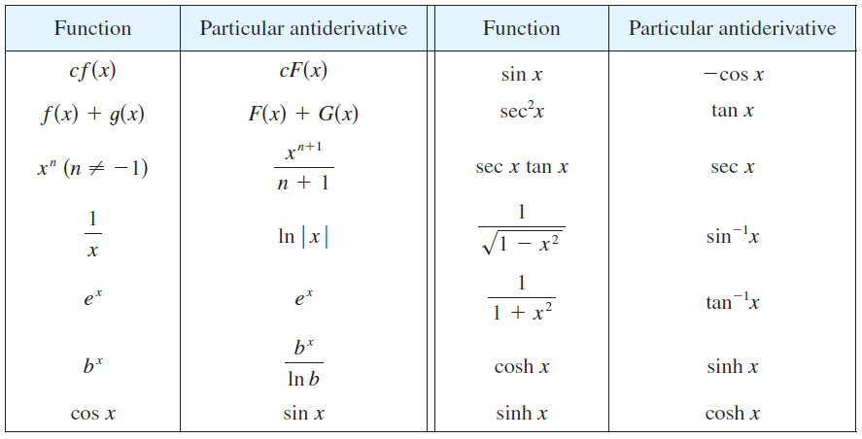
Every differentiation formula, when read from right to left, gives rise to an antidifferentiation formula
see
next section

Slide 12
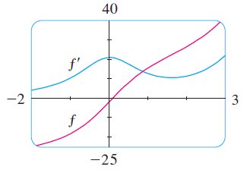
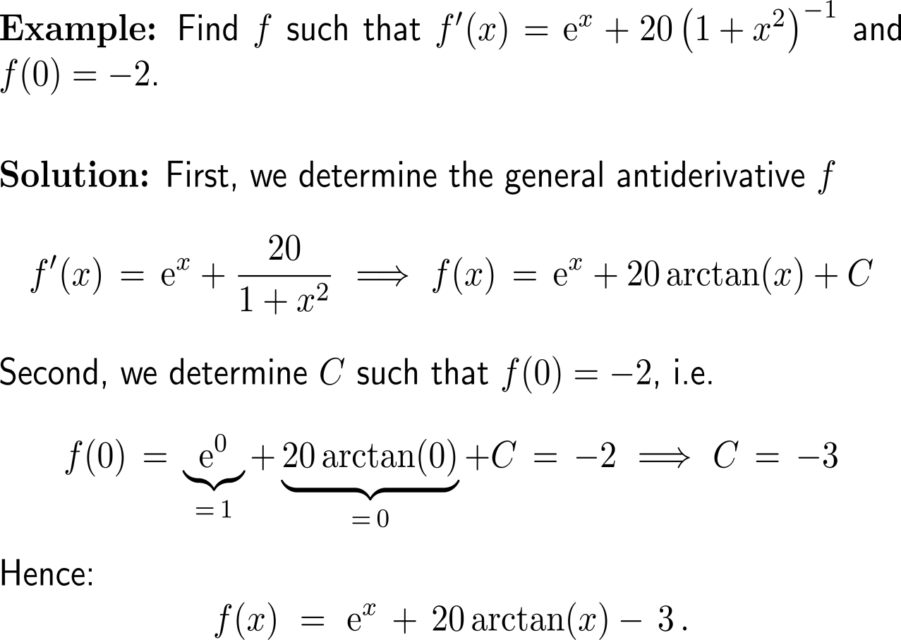
Example: Determination of antiderivatives
Shown are the graphs of the function f’ and its antiderivative f.
Notice that f’(x) > 0, so f is always increasing. Also notice that when f has a maximum or minimum, f appears to have an inflection point.
So the graph serves as a check on our calculation.

Slide 13
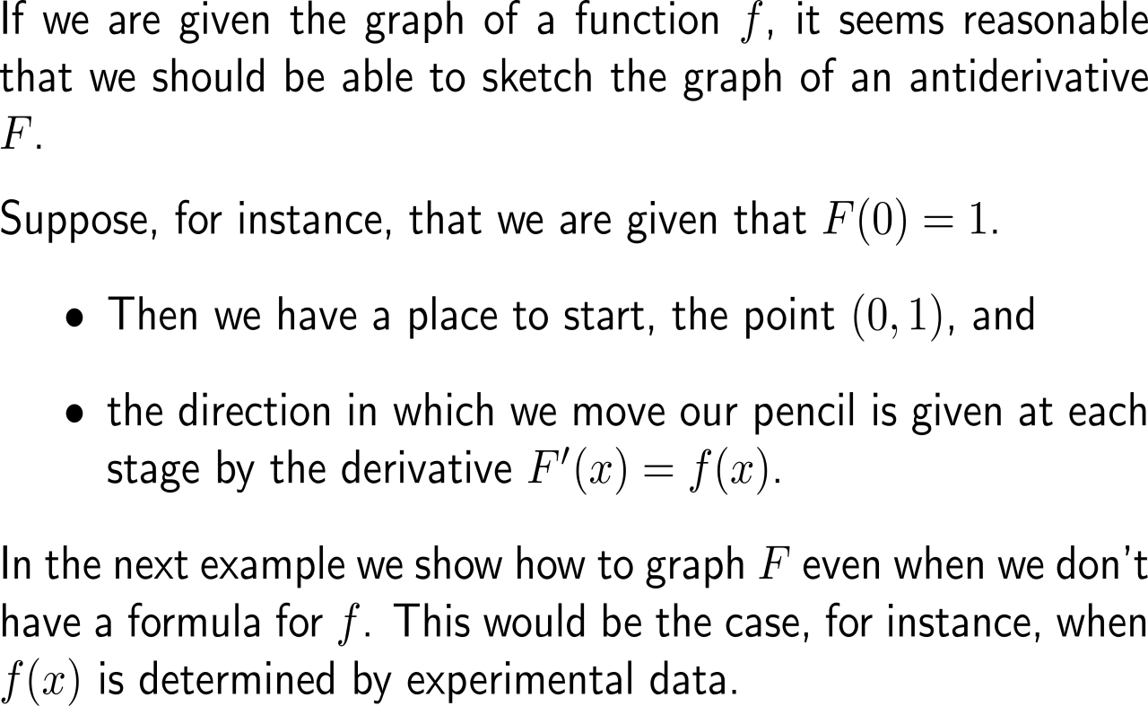
To round the discussion of antiderivatives, let us discuss the shape of the graph of an antiderivative, given the graph of the function
Shown are the graphs of the function f’ and its antiderivative f.
Notice that f’(x) > 0, so f is always increasing. Also notice that when f has a maximum or minimum, f appears to have an inflection point.
So the graph serves as a check on our calculation.

Slide 14
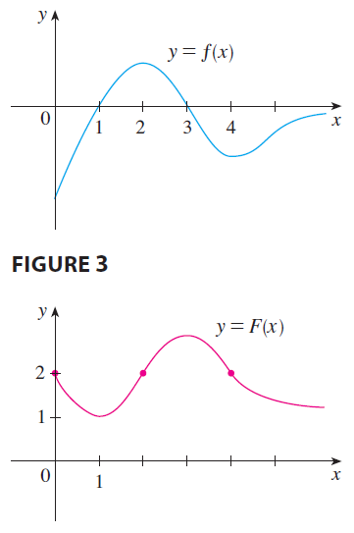
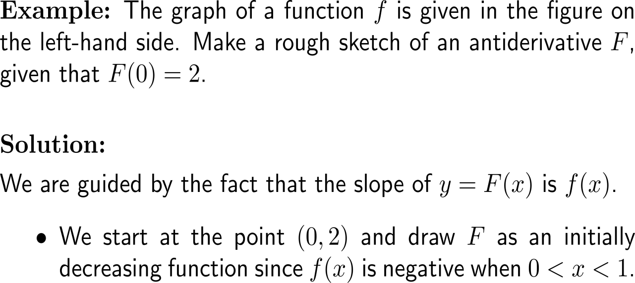
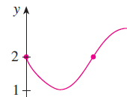
Example: Determination of antiderivatives

Slide 15
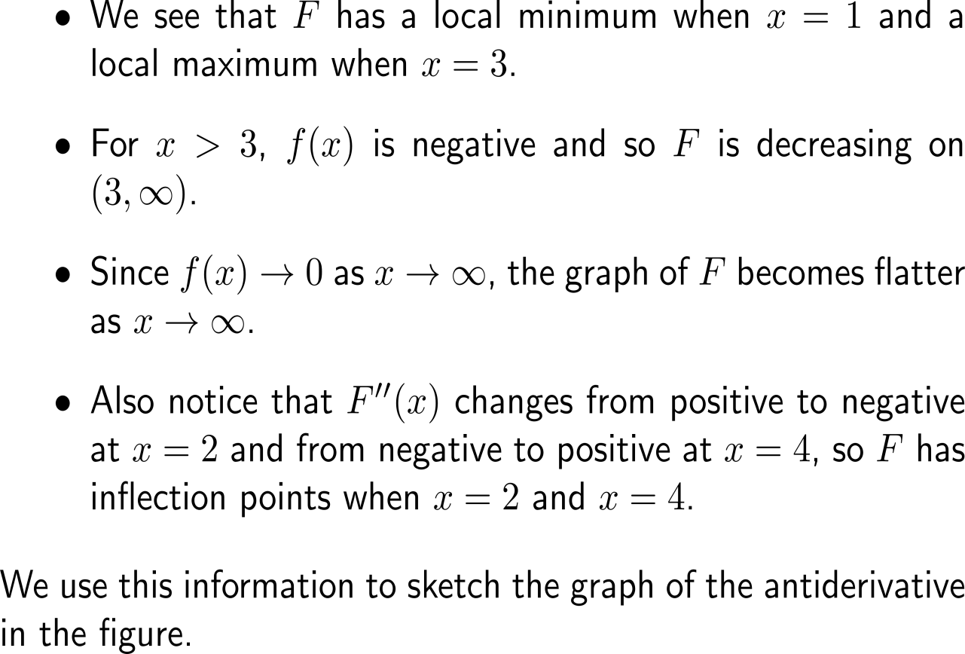
Example: Determination of antiderivatives

Slide 16
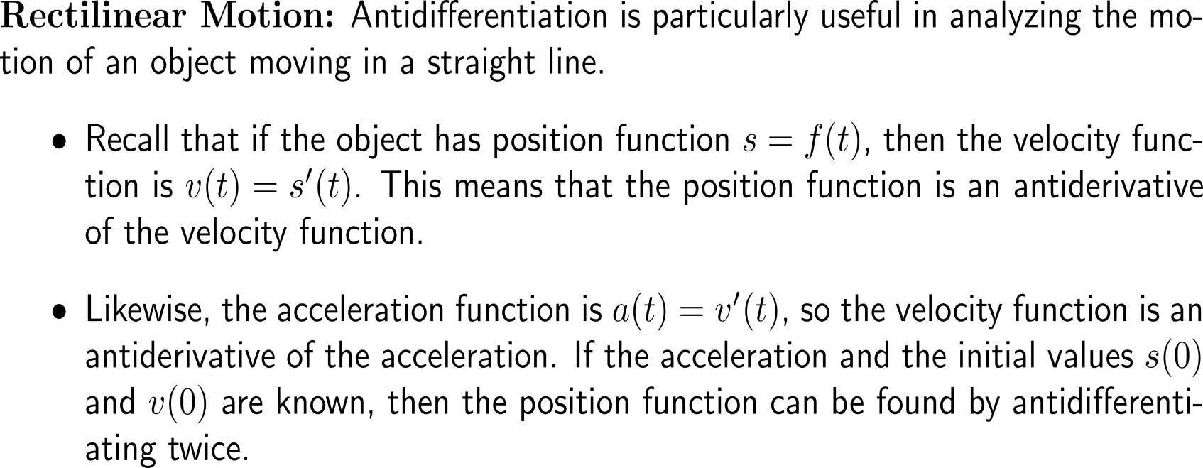
Antidifferentiation is particularly useful in analyzing the motion of an object moving in a straight line

Slide 17
Example: Antiderivatives and rectilinear motion

Slide 18
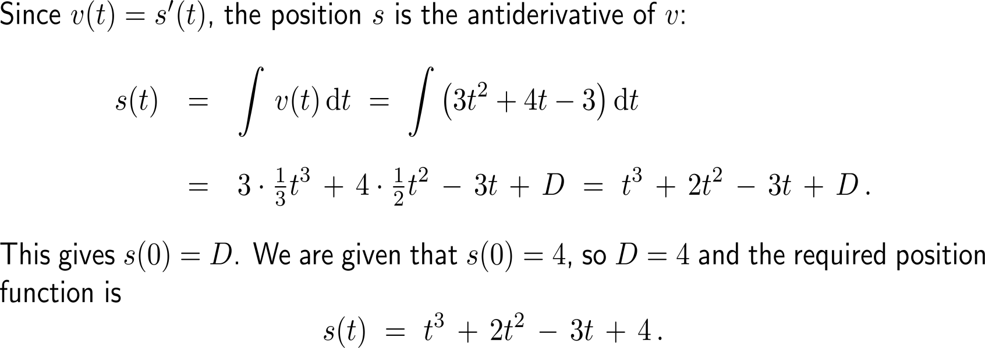
Example: Antiderivatives and rectilinear motion

Slide 19
Calculus I for Management

