Slide 1
Calculus I for MGMT – Integration Antiderivatives & Indefinite Integrals
Mathematics for Management
Supplementary Electronic Materials
Antiderivatives & Indefinite Integrals
Indefinite Integration
Integration yielding Inverse Trigonometric Functions
First Rules of Integration

Slide 2
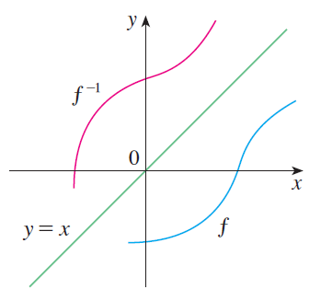
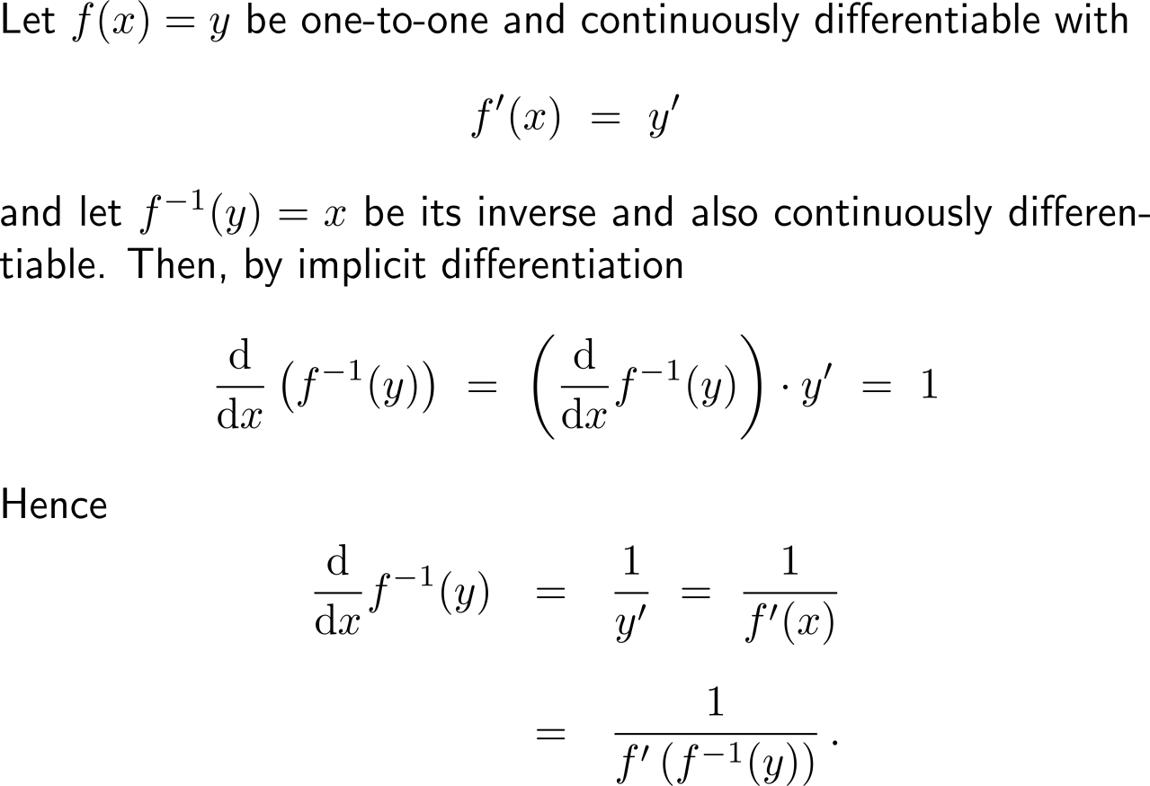
Recap: Implicit differentiation of inverse functions

Slide 3
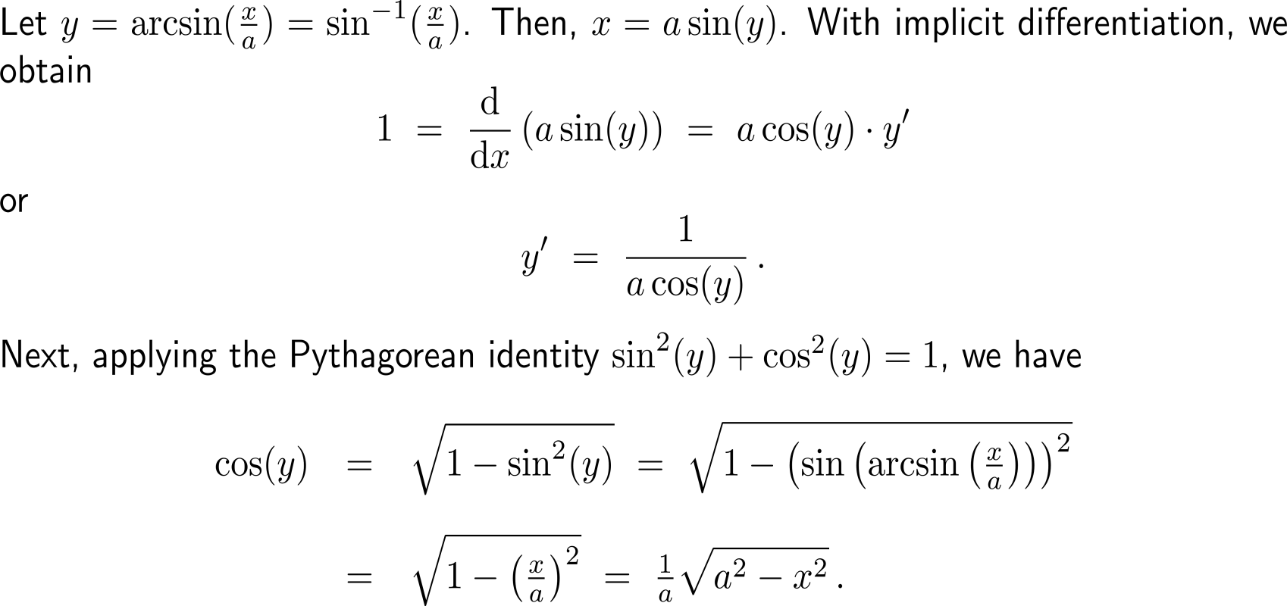
By determining the derivative of the inverse sine function …

Slide 4
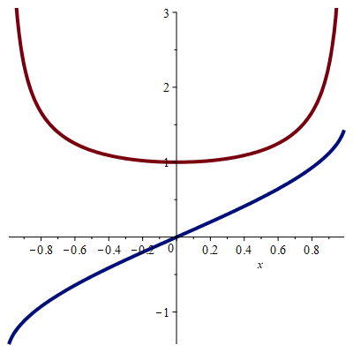
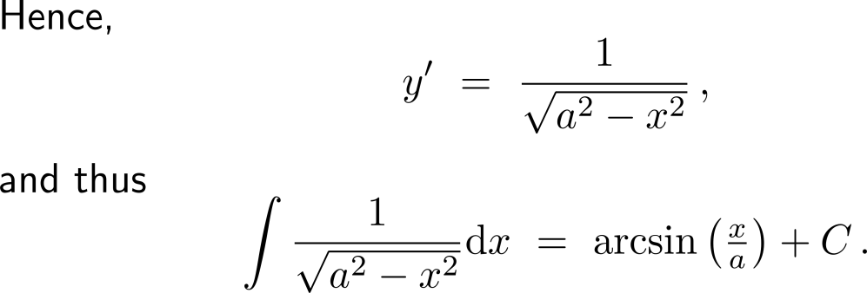
… we can apply this for integration

Slide 5
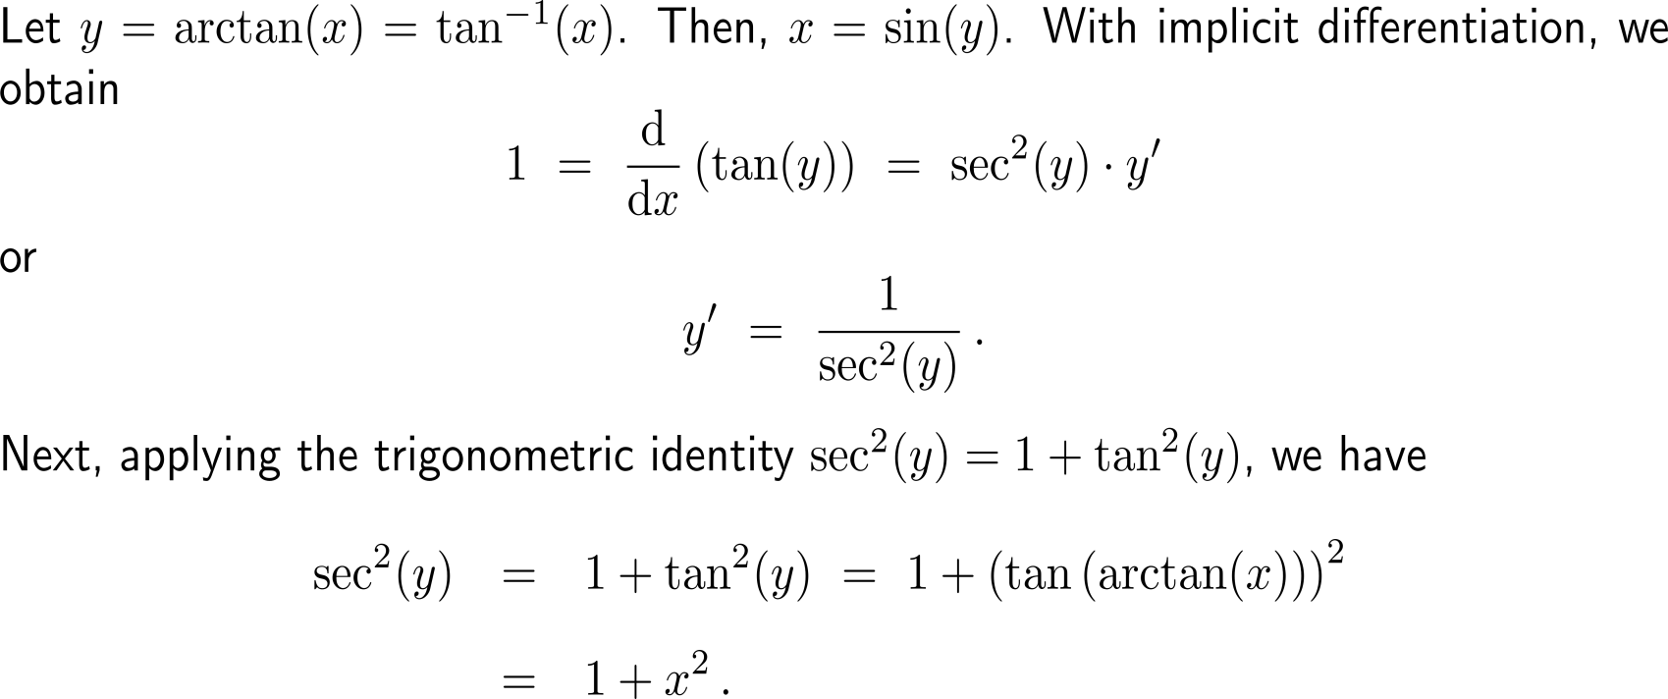
By determining the derivative of the inverse tangent function …

Slide 6
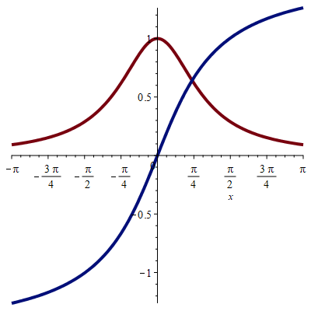
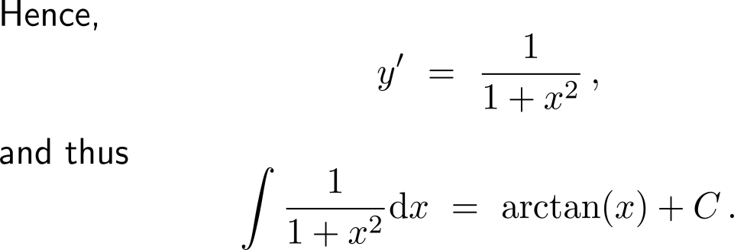
… we can apply this for integration

Slide 7
Calculus I for Management

