Slide 1
Calculus I for MGMT – Integration Antiderivatives & Indefinite Integrals
Mathematics for Management
Supplementary Electronic Materials
Antiderivatives & Indefinite Integrals
Indefinite Integration
Integration yielding Inverse Trigonometric Functions
First Rules of Integration

Slide 2
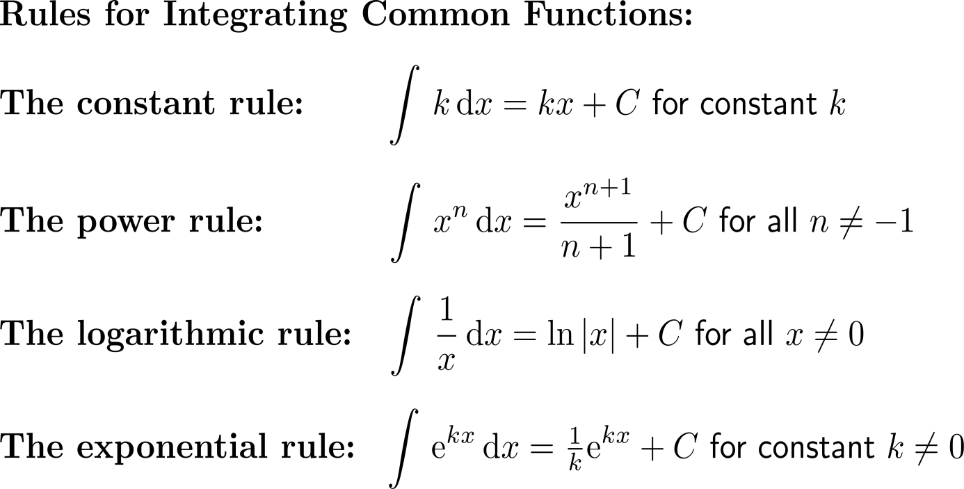
The relationship between differentiation and antidifferentiation enables us to establish integration rules by 'reversing' analogous differentiation rules

Slide 3
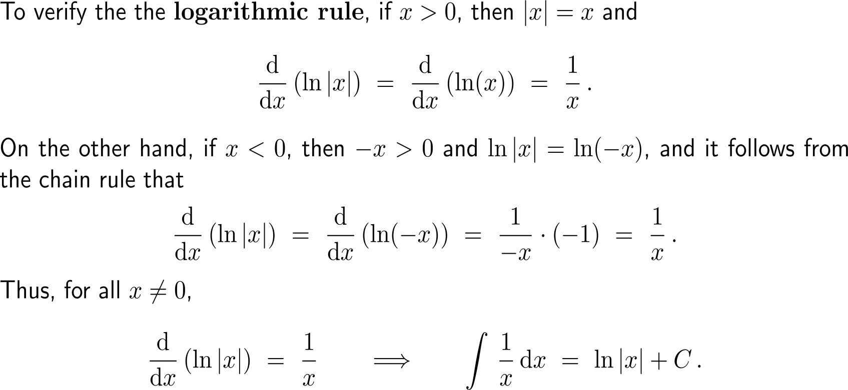
The verification of the logarithmic rule …

Slide 4
… and the power rule is straight forward

Slide 5
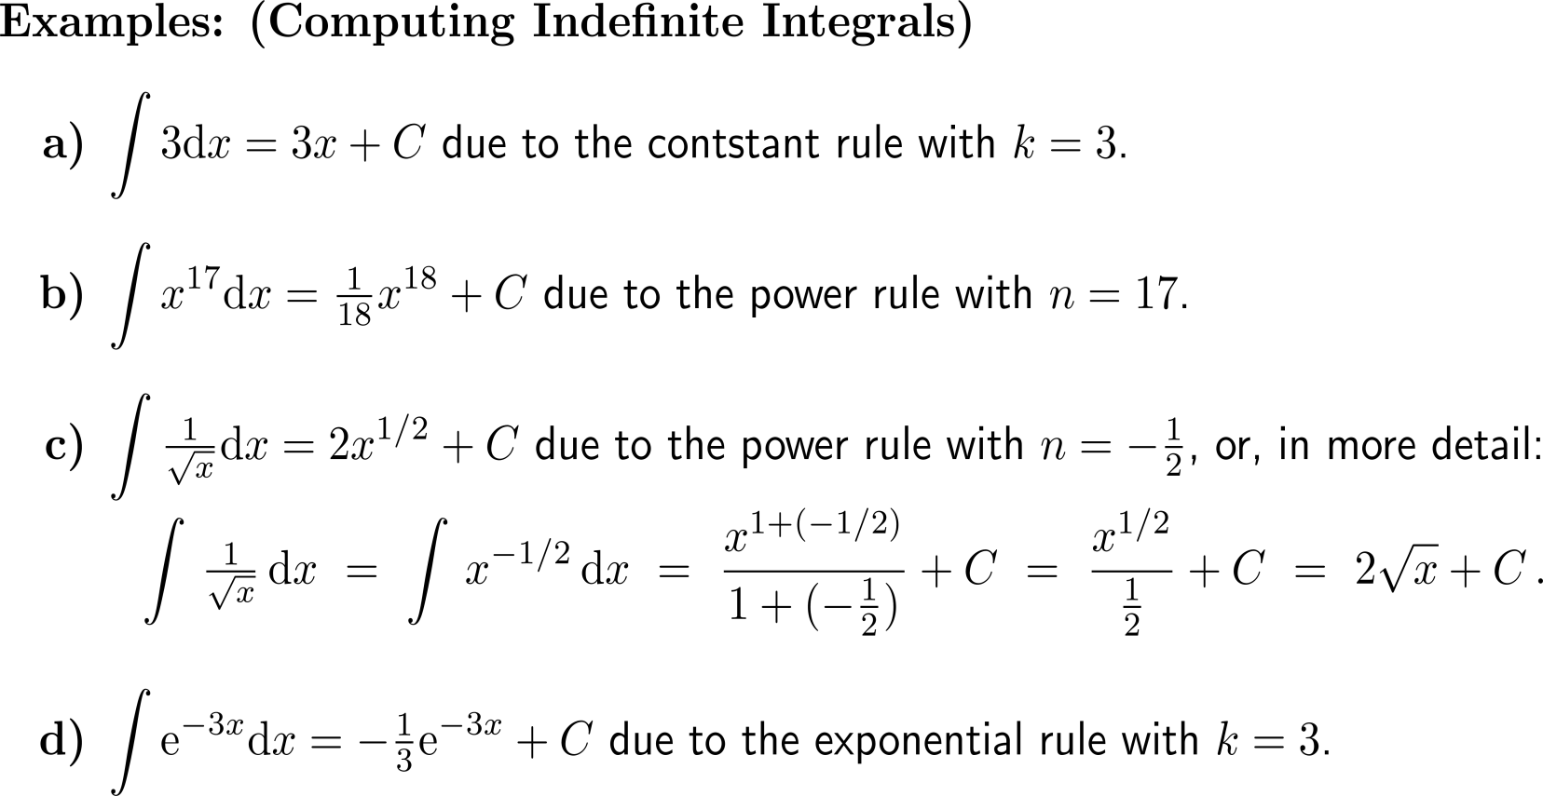
Examples: Computing indefinite integrals

Slide 6
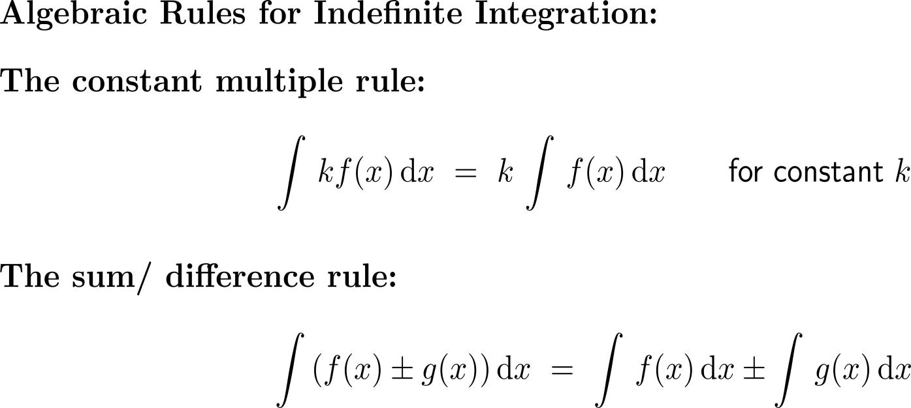
Algebraic rules for indefinite integrals allow the integration of a variety of combinations of functions

Slide 7
The algebraic rules for indefinite integrals are also easily verified

Slide 8
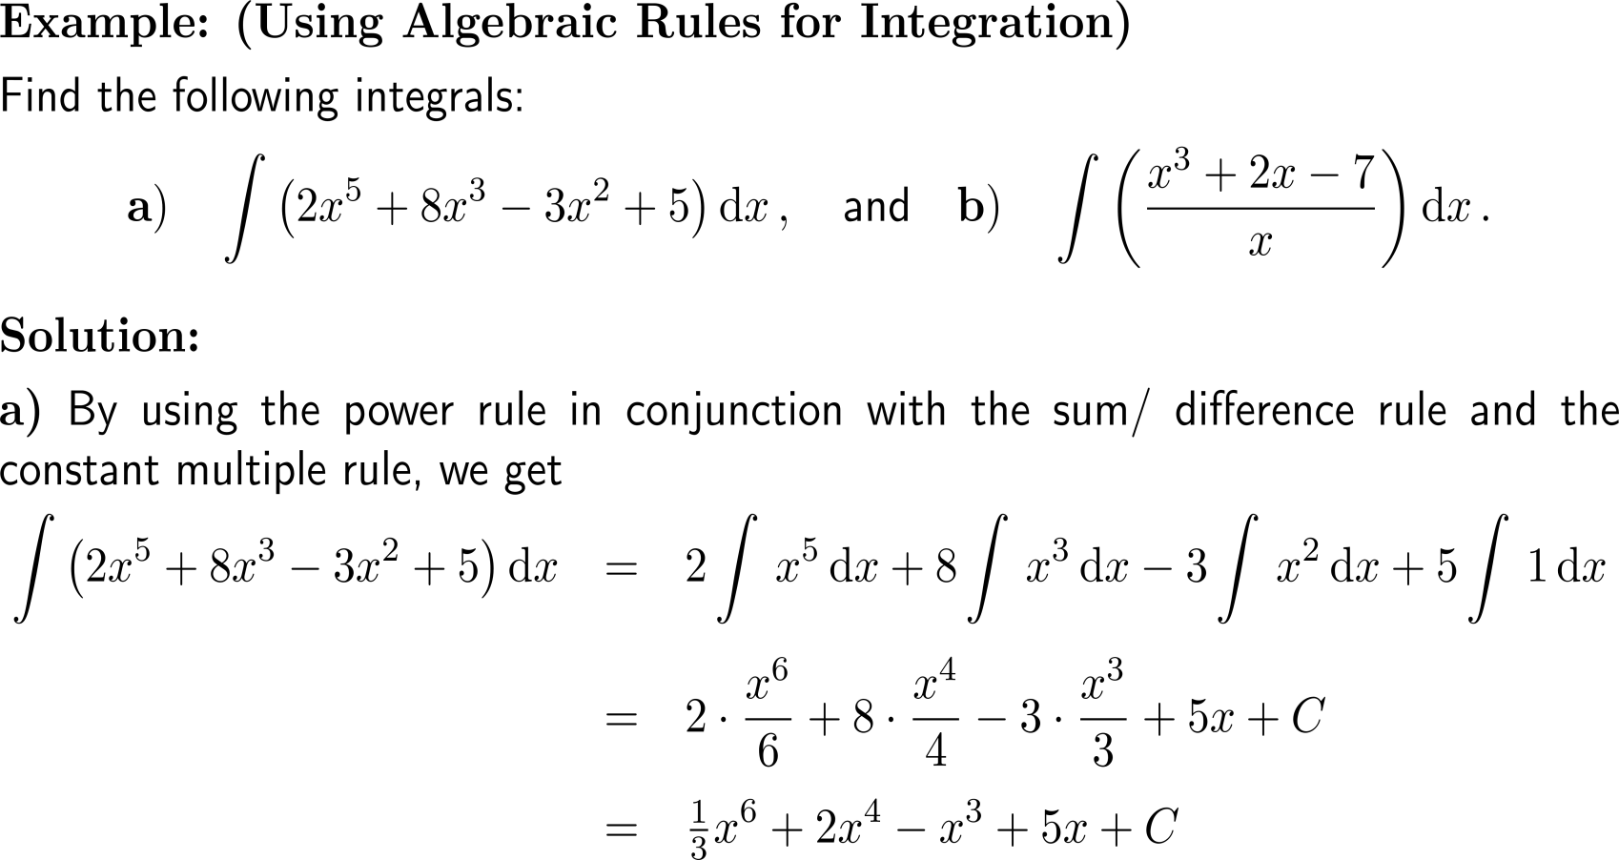
Example: Using algebraic rules for integration

Slide 9
Example: Using algebraic rules for integration

Slide 10
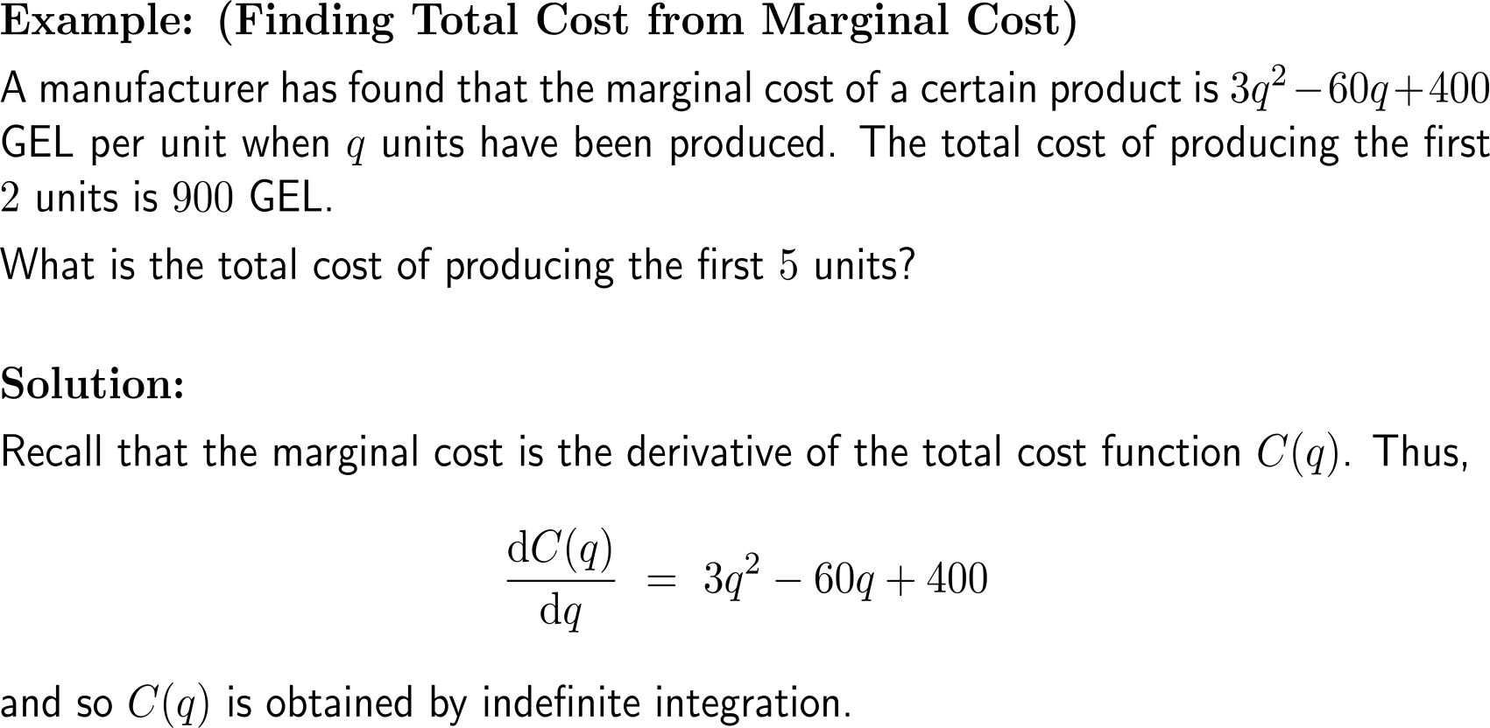
Example: Finding total cost from marginal cost

Slide 11
Example: Finding total cost from marginal cost

Slide 12
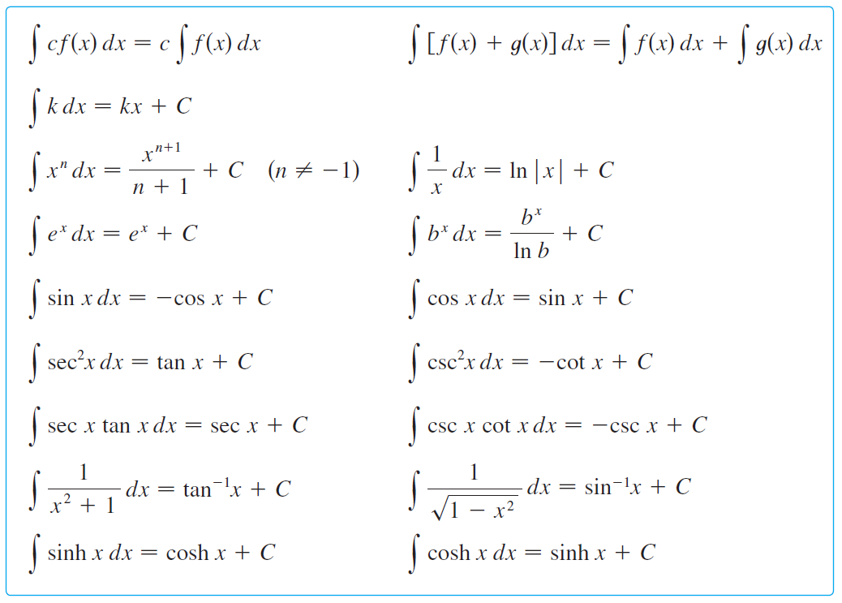
Table of indefinite integrals/ antidifferentiation formulas (any formula can be verified by differentiating the function on the right)

Slide 13
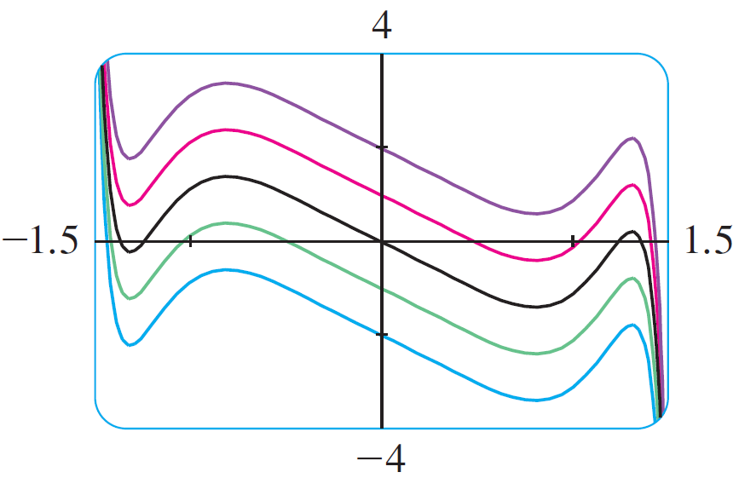
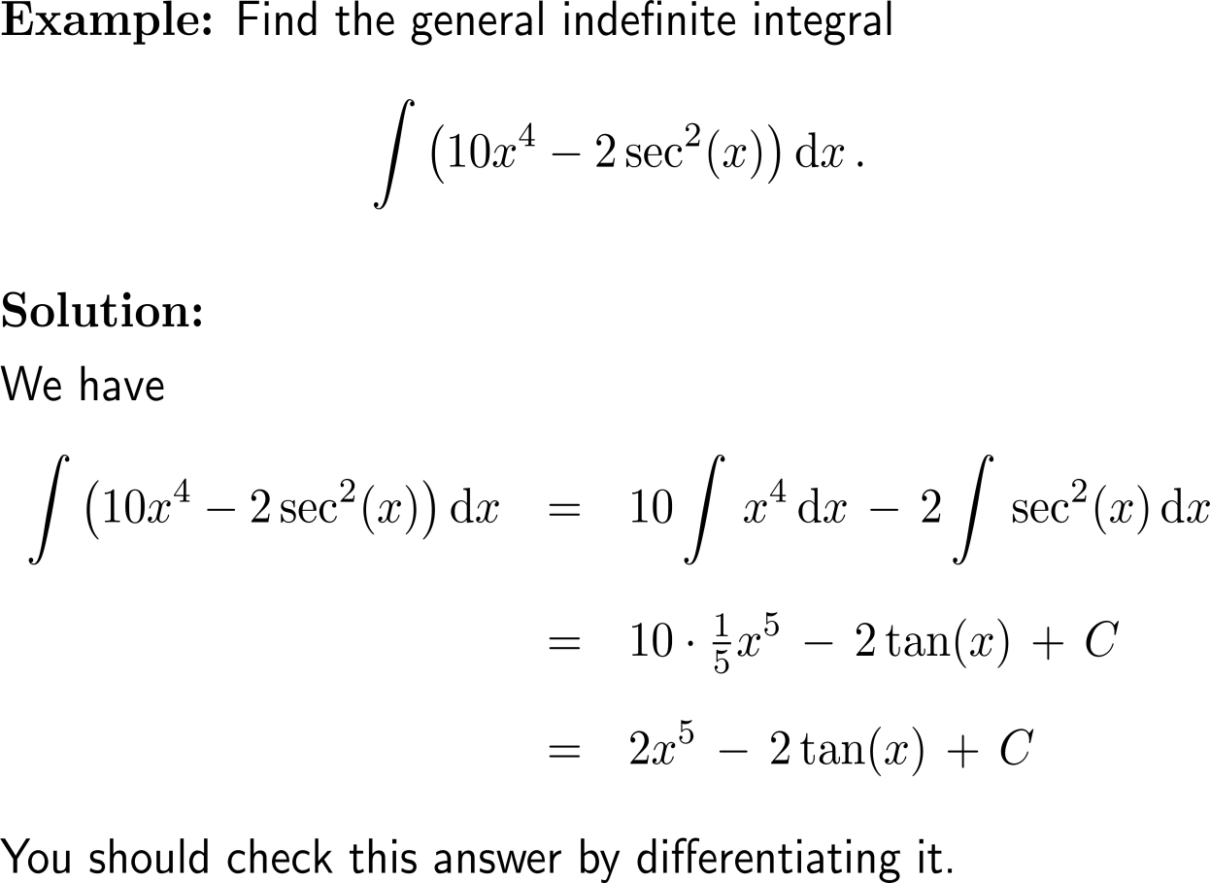
Example: Indefinite integrals
The indefinite integral in the example
is graphed for several values of C.
Here the value of C is the y-intercept.

Slide 14
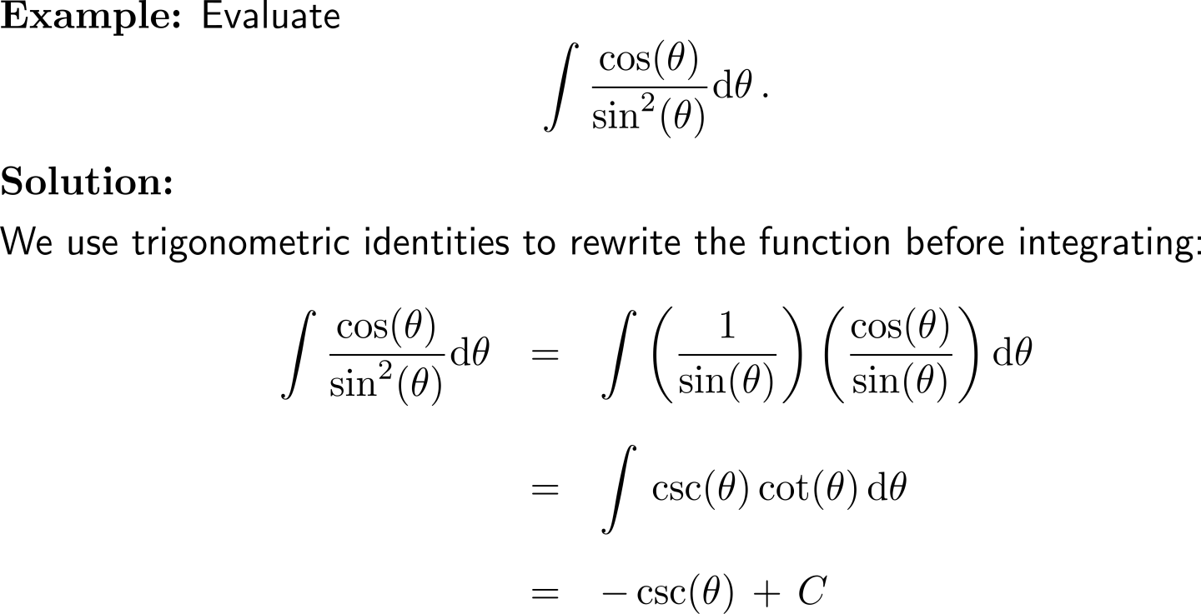
Example: Indefinite integrals

Slide 15
Calculus I for Management

