Slide 1
Calculus I for Management
The Fundamental Theorem of Calculus
week 12
Lecture
The Substitution Rule
Definite integrals
The Fundamental Theorem of Calculus

Slide 2
Topics
The Substitution Rule
Definite Integrals
The Fundamental Theorem of Calculus

Slide 3
A change of variables leads to integrals that are more easy to evaluate: motivation of the Substitution Rule (1/ 3)

Slide 4
A change of variables leads to integrals that are more easy to evaluate: motivation of the Substitution Rule (2/ 3)

Slide 5
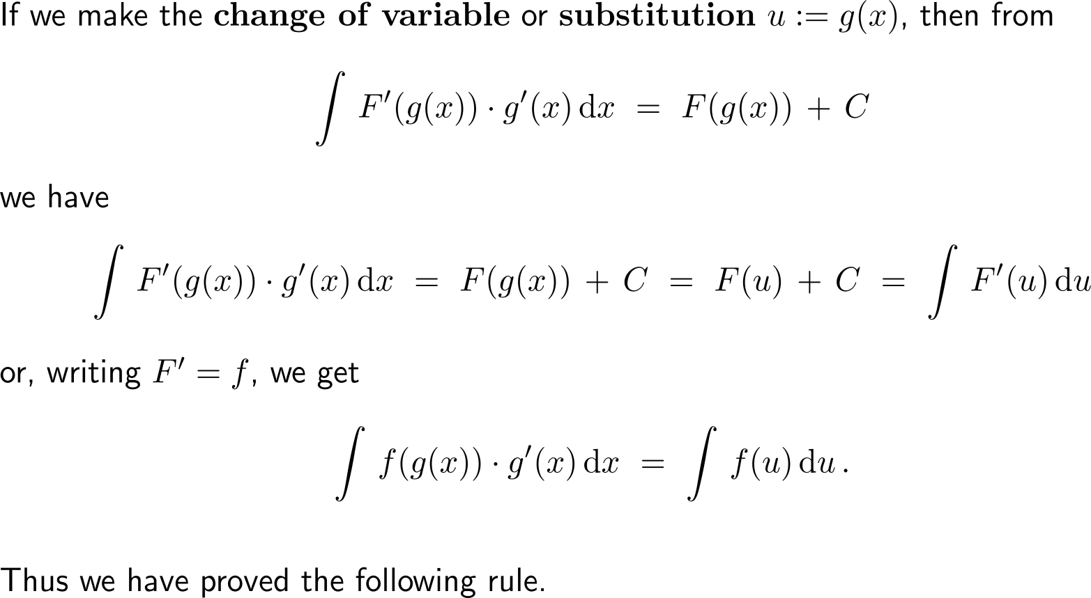
A change of variables leads to integrals that are more easy to evaluate: motivation of the Substitution Rule (3/ 3)

Slide 6
The Substitution Rule of integration is the reverse of the Chain Rule of differentiation

Slide 7
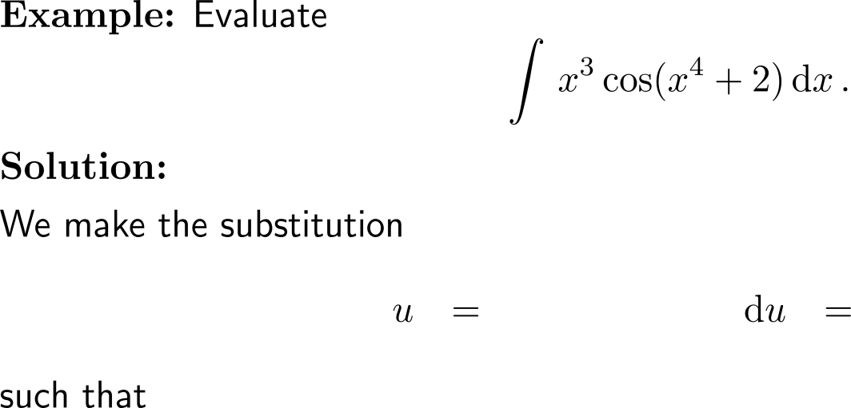
Example: Substitution Rule

Slide 8
The Substitution Rule works only if we find a suitable substitution such that substitution becomes a bit of an art (experience and practice is needed)

Slide 9
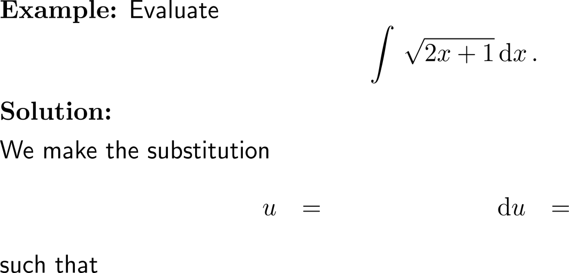
Example: Substitution Rule

Slide 10
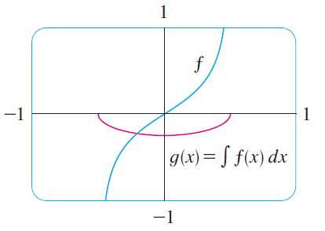
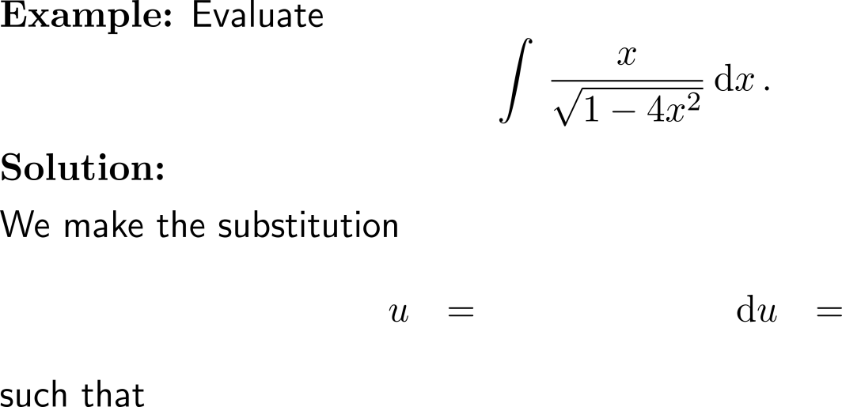
Example: Substitution Rule

Slide 11
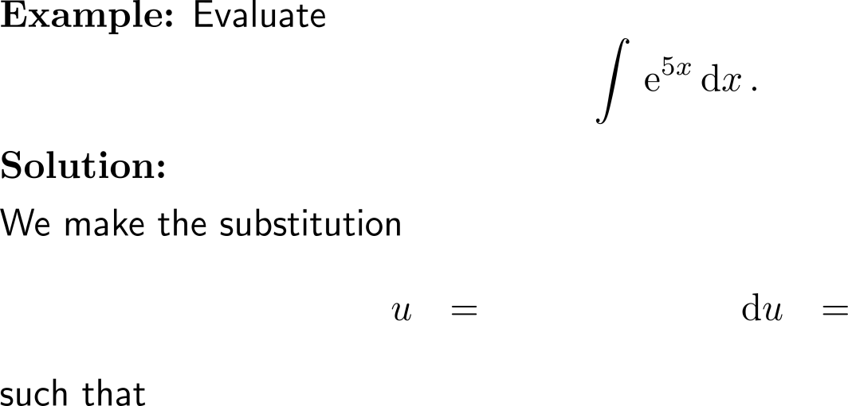
Example: Substitution Rule

Slide 12
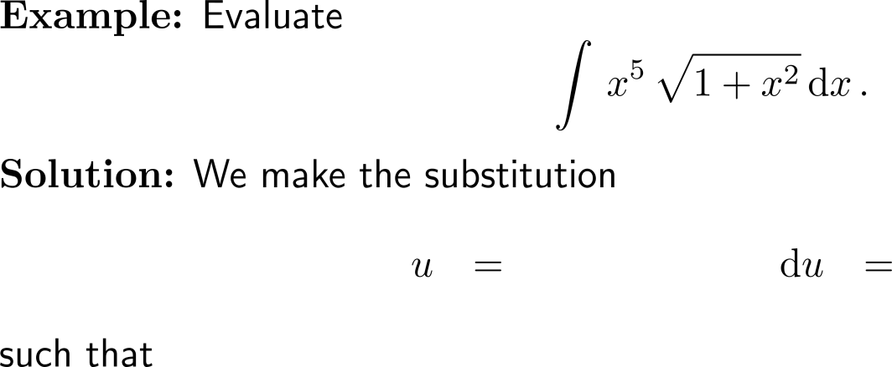
Example: Substitution Rule

Slide 13
Example: Substitution Rule

Slide 14
The previous example allows us to determine the antiderivative of the tangent function

Slide 15
Topics
The Substitution Rule
Definite Integrals
The Fundamental Theorem of Calculus

Slide 16
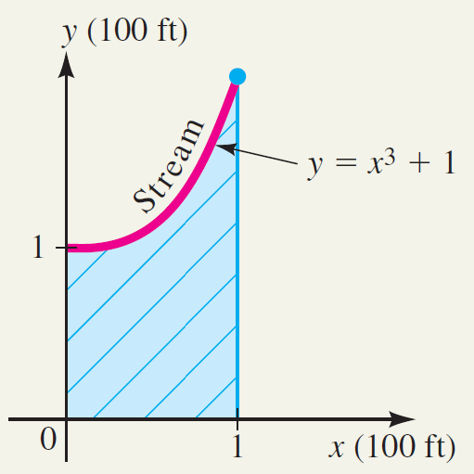
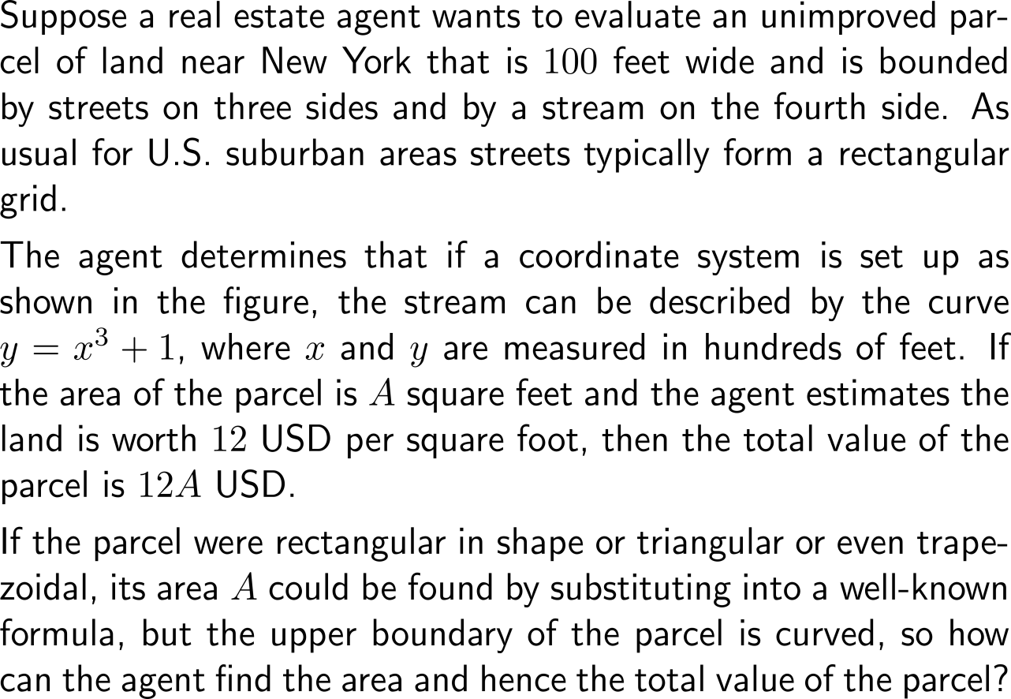
Motivation: Calculating the area under a graph

Slide 17
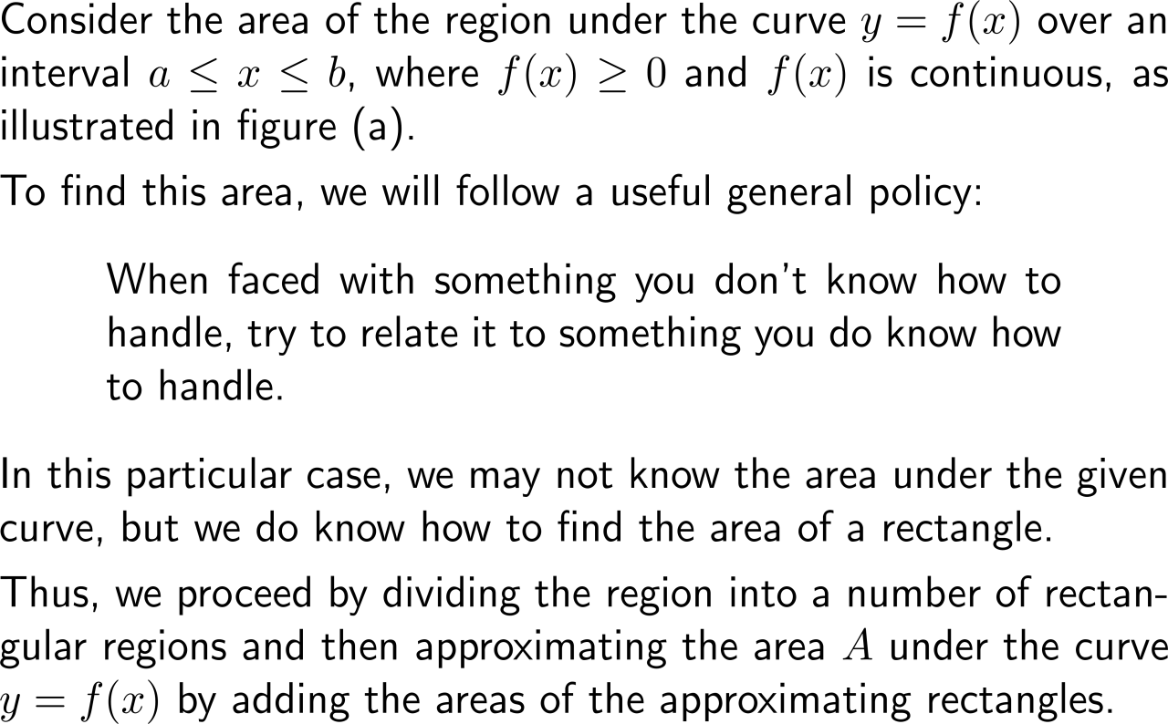
To calculate the area under a graph, we approximate it by a trail of equally wide rectangles … (1/ 2)

Slide 18
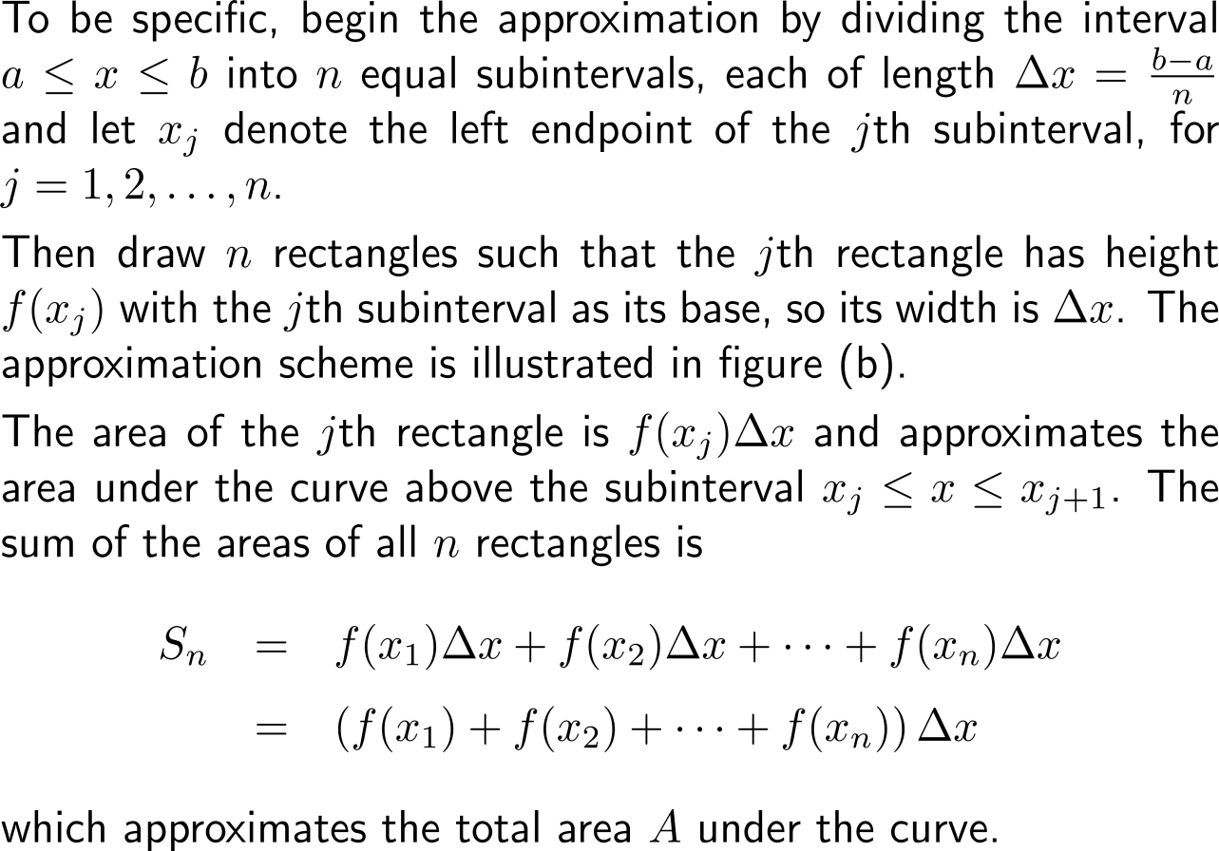
To calculate the area under a graph, we approximate it by a trail of equally wide rectangles … (2/ 2)

Slide 19
… that we then use in a limit argument to finally gain the value of the area

Slide 20
The area under a curve is obtained by virtue of a straightforward limit process

Slide 21
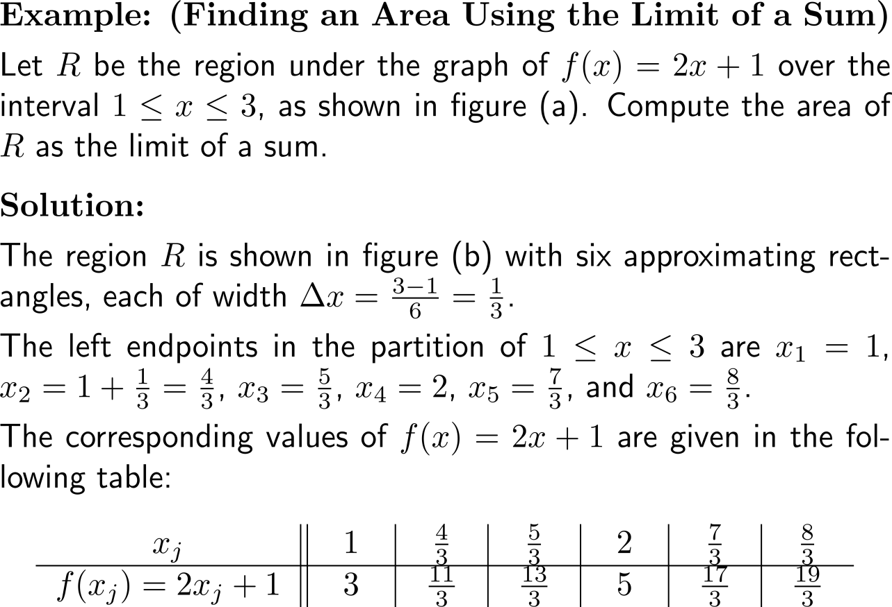
Example: Finding an area using the limit of a sum

Slide 22
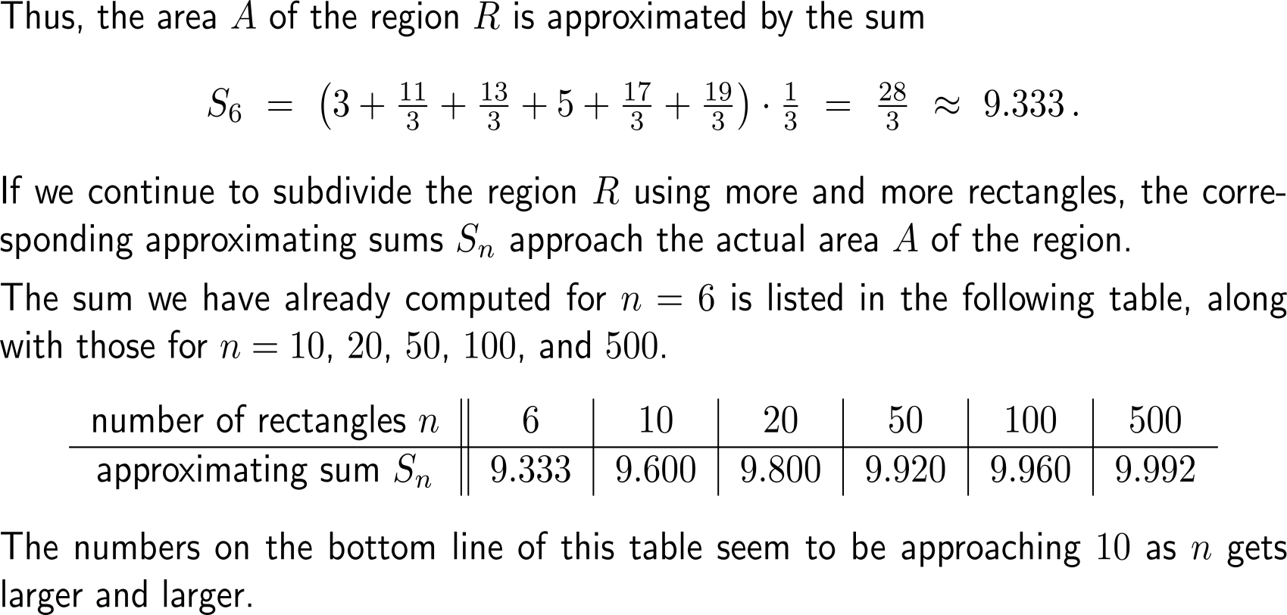
Example: Finding an area using the limit of a sum

Slide 23
Example: Finding an area using the limit of a sum

Slide 24
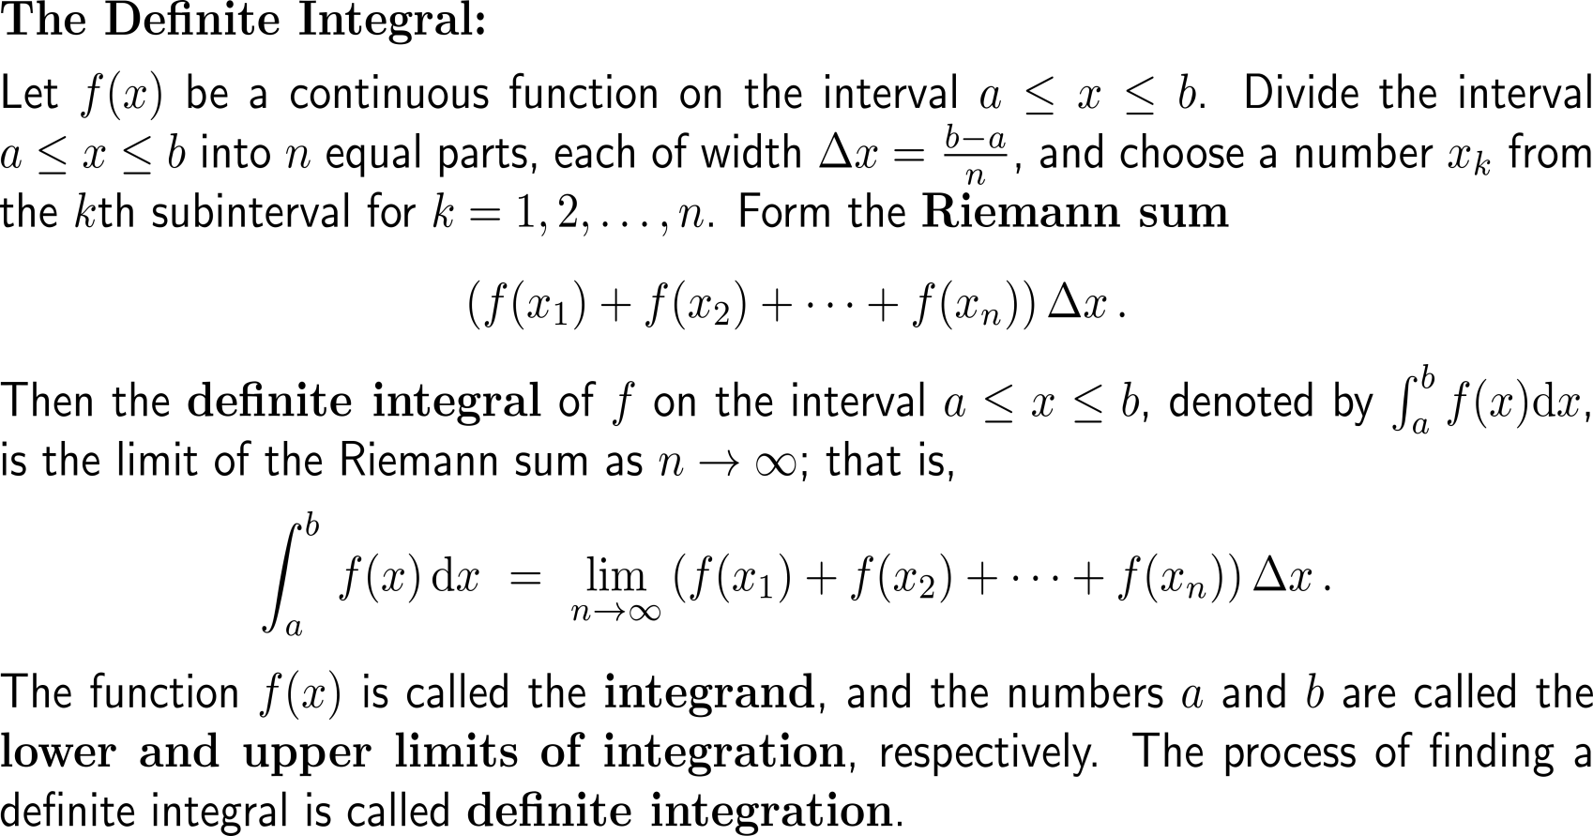
The definite integral equals the area under the graph of a function

Slide 25
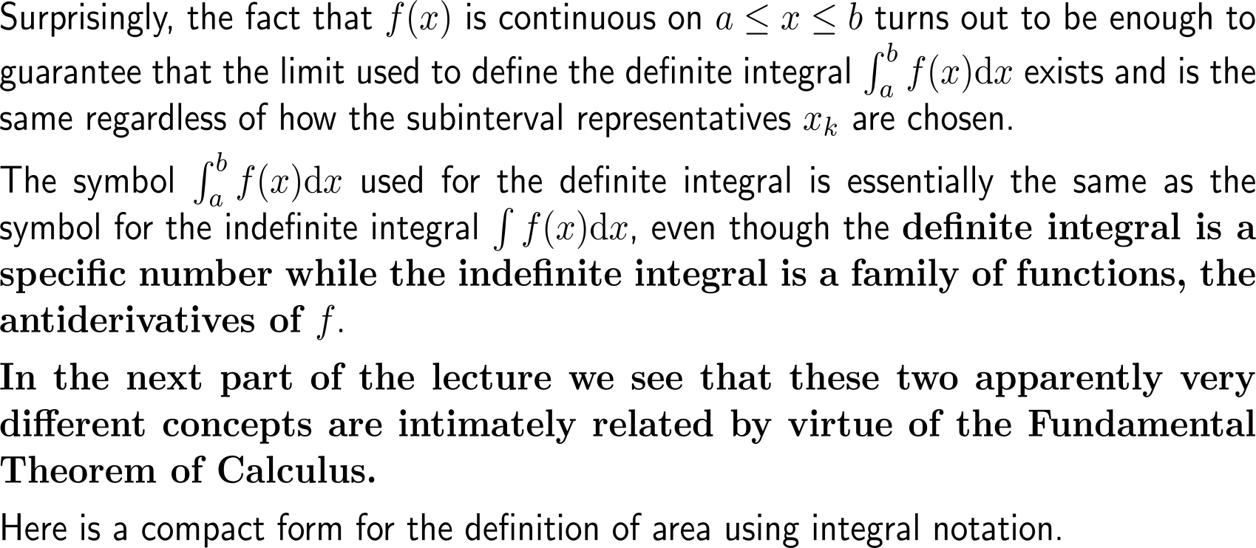
It is a specific number and connected to the indefinite integral (a function) by virtue of the Fundamental Theorem of Calculus

Slide 26
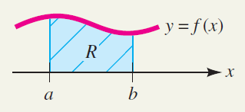
Finding an area is equivalent to determining the value of a definite integral

Slide 27
Topics
The Substitution Rule
Definite Integrals
The Fundamental Theorem of Calculus

Slide 28
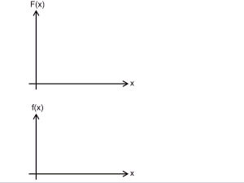
The Fundamental Theorem of Calculus allows us to view differentiation and integration as inverse processes …

Slide 29
The Fundamental Theorem of Calculus allows us to view differentiation and integration as inverse processes …

Slide 30
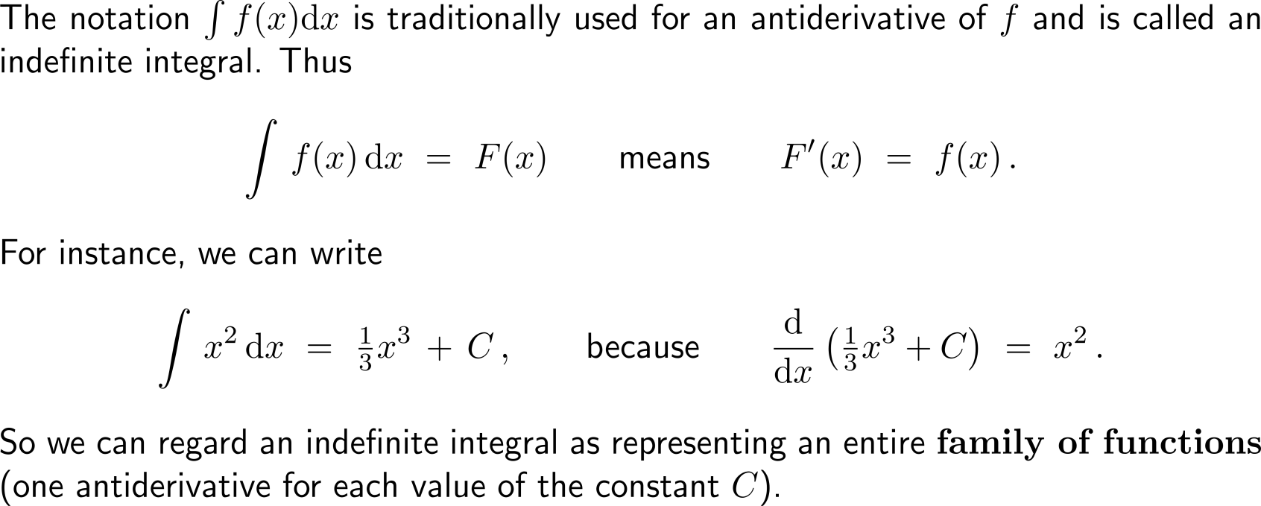
… such that in particular the indefinite integral can be viewed as a synonym for the antiderivative

Slide 31
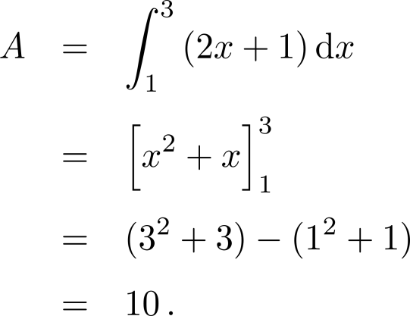
Example: Finding an area using the Fundamental Theorem

Slide 32
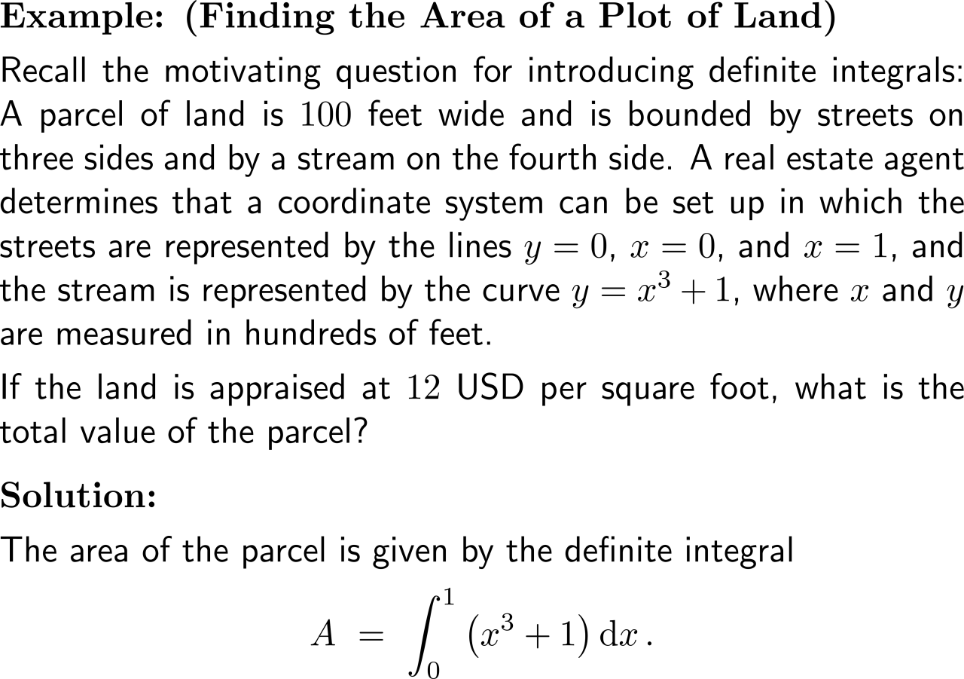
Example: Using integration to find the area of a plot of land

Slide 33
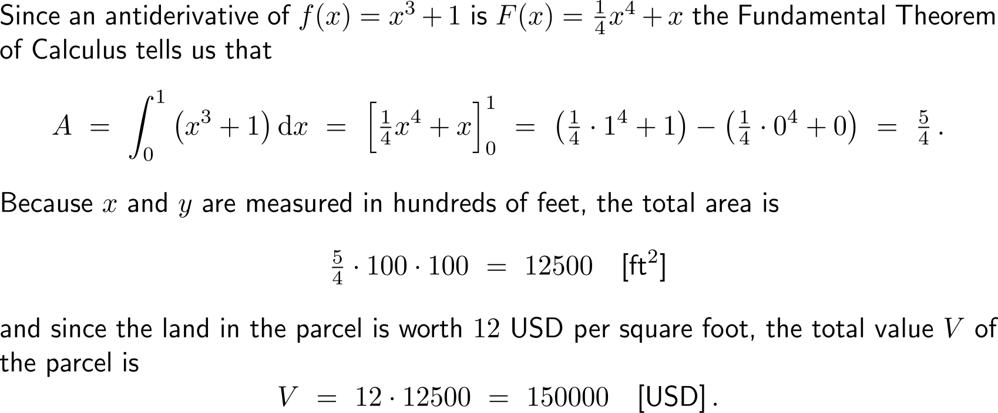
Example: Using integration to find the area of a plot of land

Slide 34
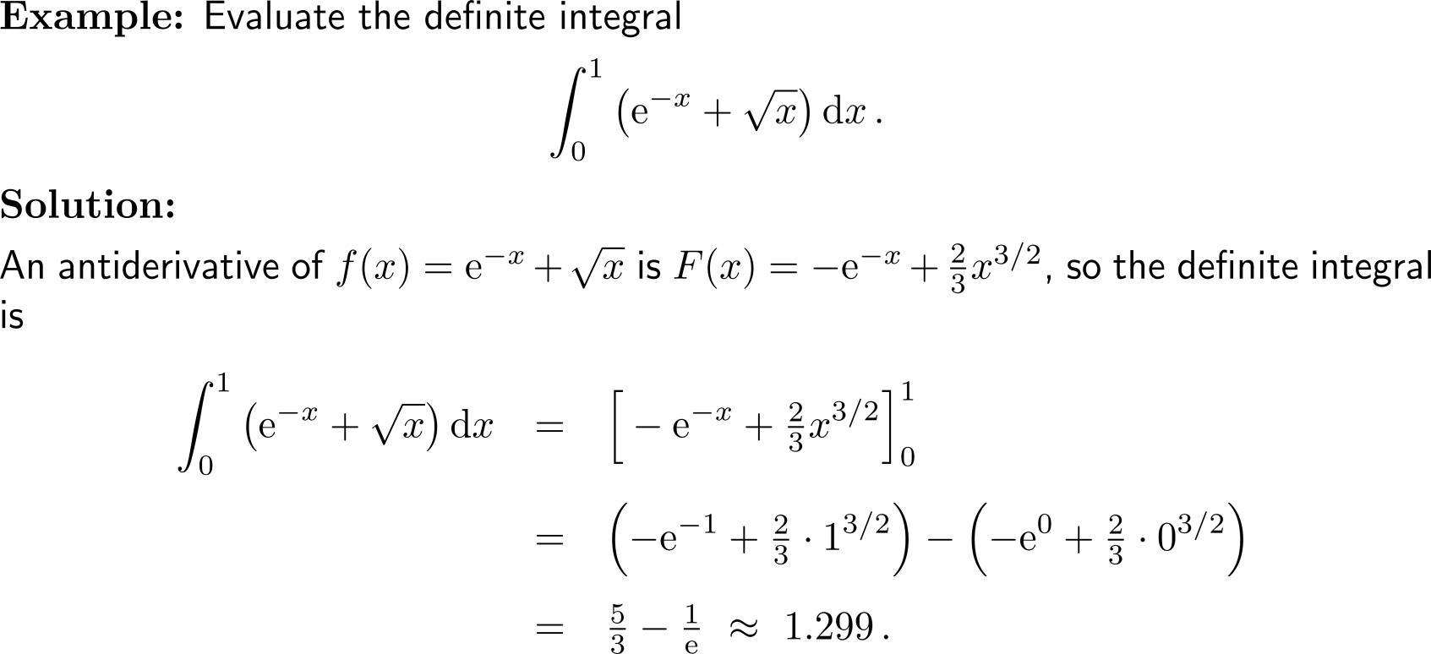
Example: Evaluating a definite integral

Slide 35
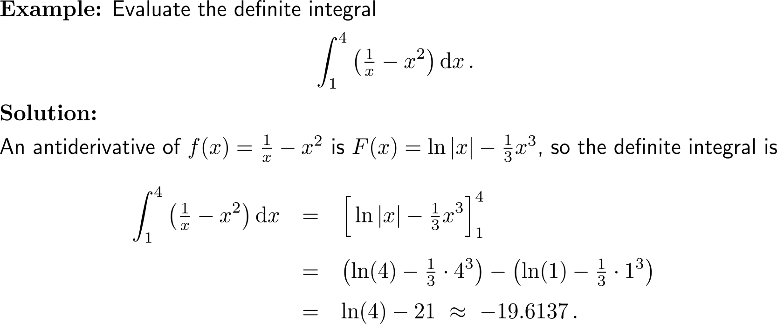
Example: Evaluating a definite integral

Slide 36
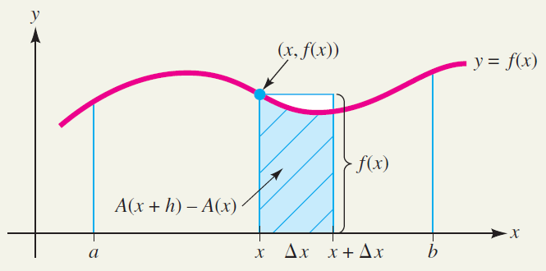
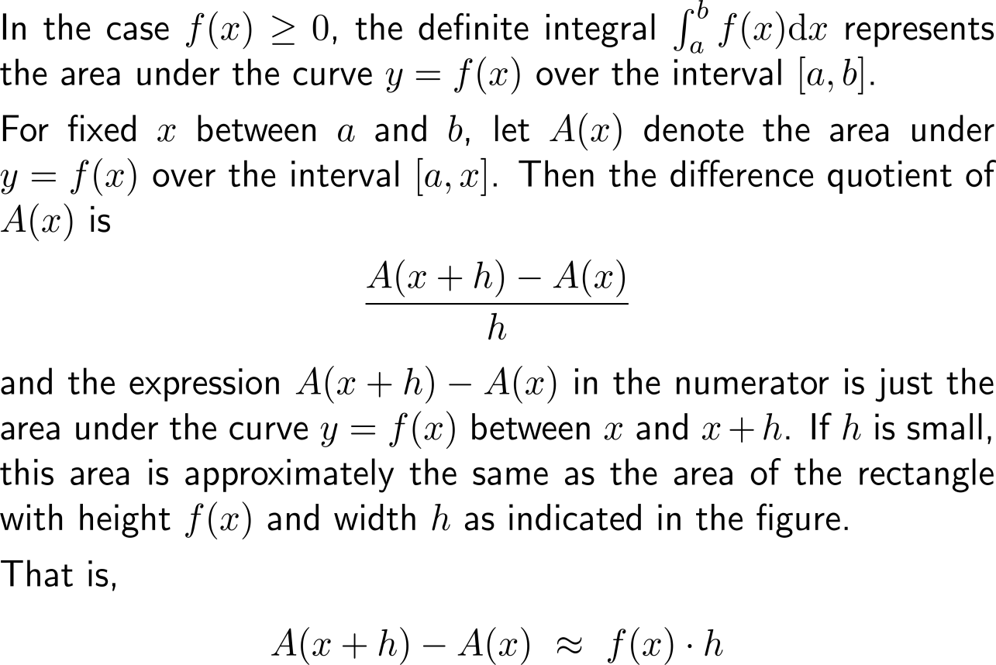
Before we compile some useful computation rules for definite integrals, let us give an area justification of the Fundamental Theorem of Calculus (1/ 3)

Slide 37
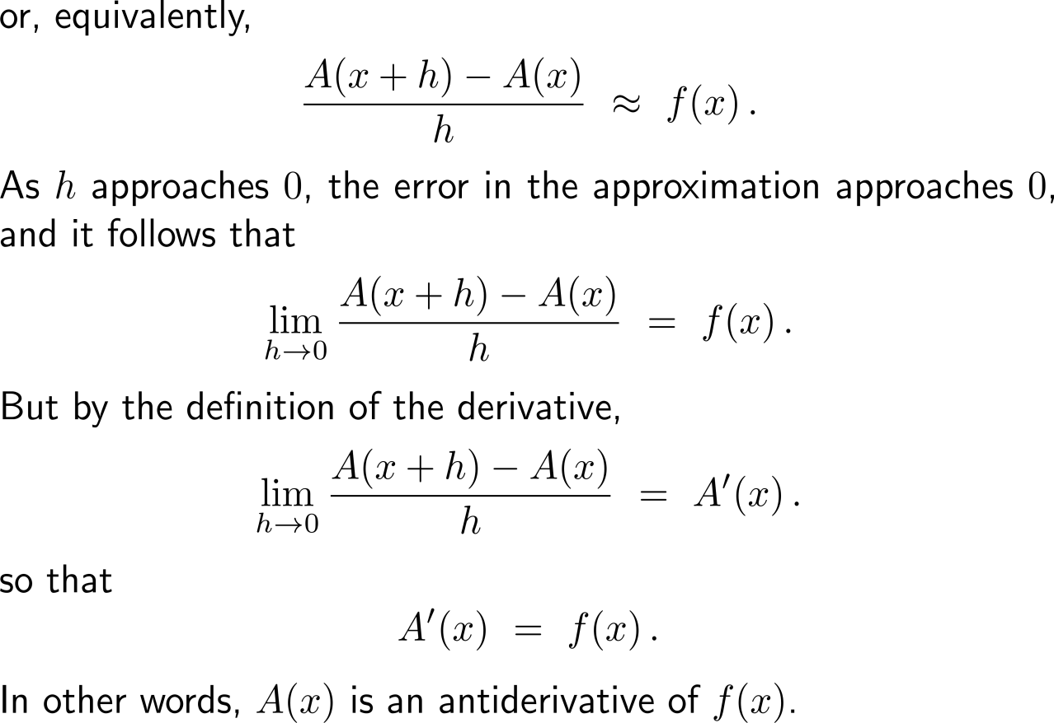
Before we compile some useful computation rules for definite integrals, let us give an area justification of the Fundamental Theorem of Calculus (2/ 3)

Slide 38
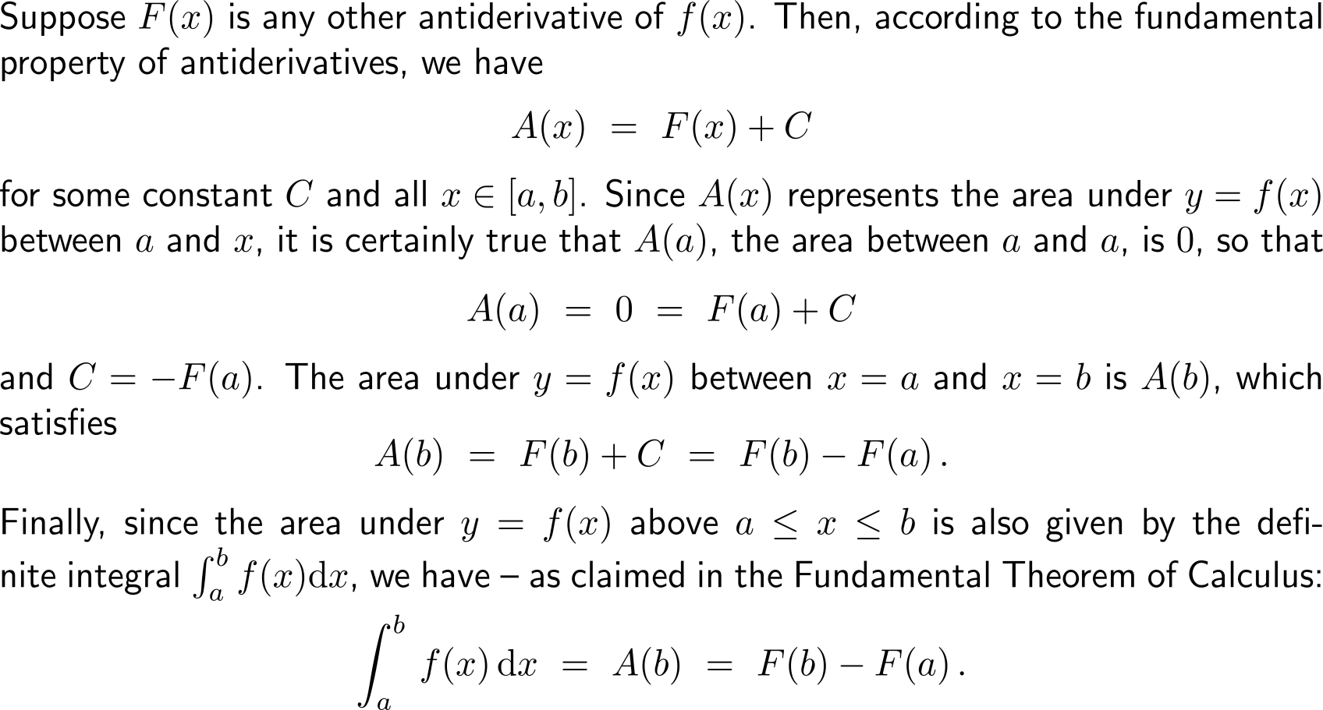
Before we compile some useful computation rules for definite integrals, let us give an area justification of the Fundamental Theorem of Calculus (3/ 3)

Slide 39
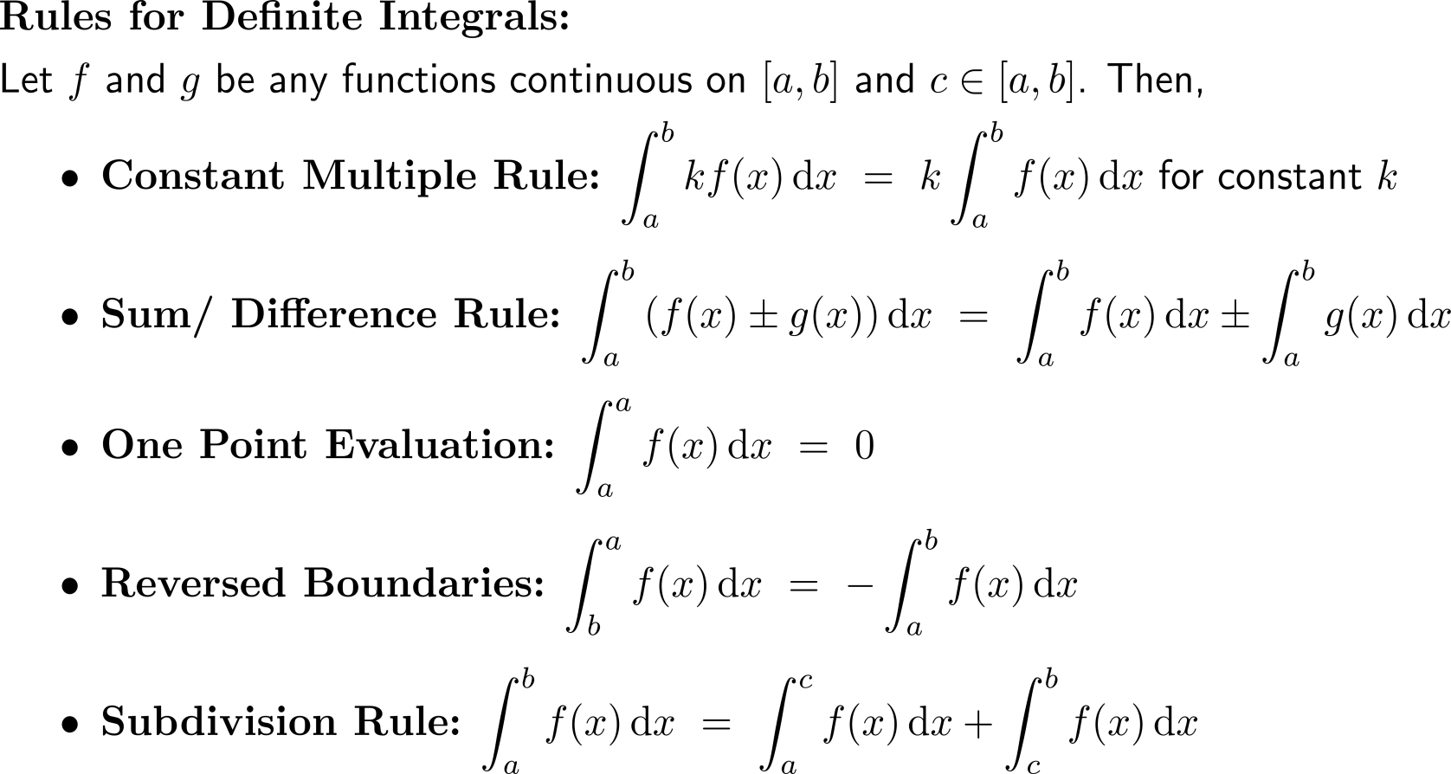
The computation rules for definite integrals carry over from those for indefinite integrals

Slide 40
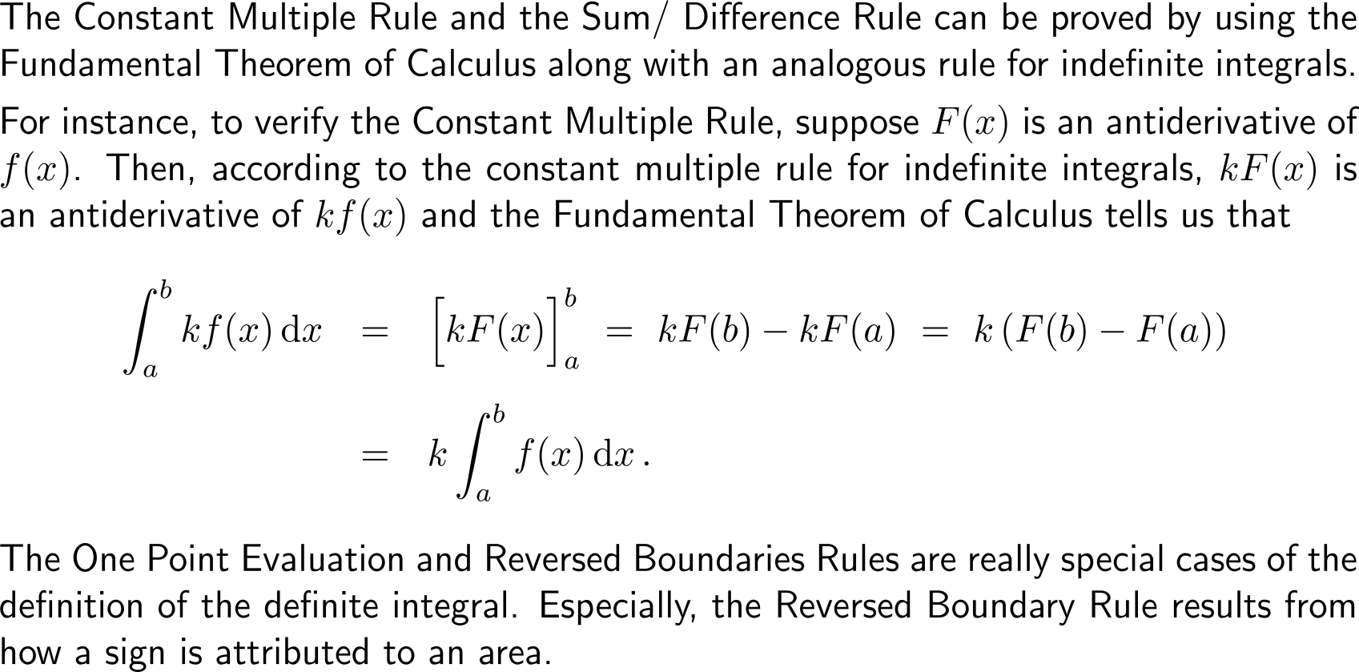
The computation rules follow from the Fundamental Theorem of Calculus and Geometry (1/ 2)

Slide 41
The computation rules follow from the Fundamental Theorem of Calculus and Geometry (2/ 2)

Slide 42
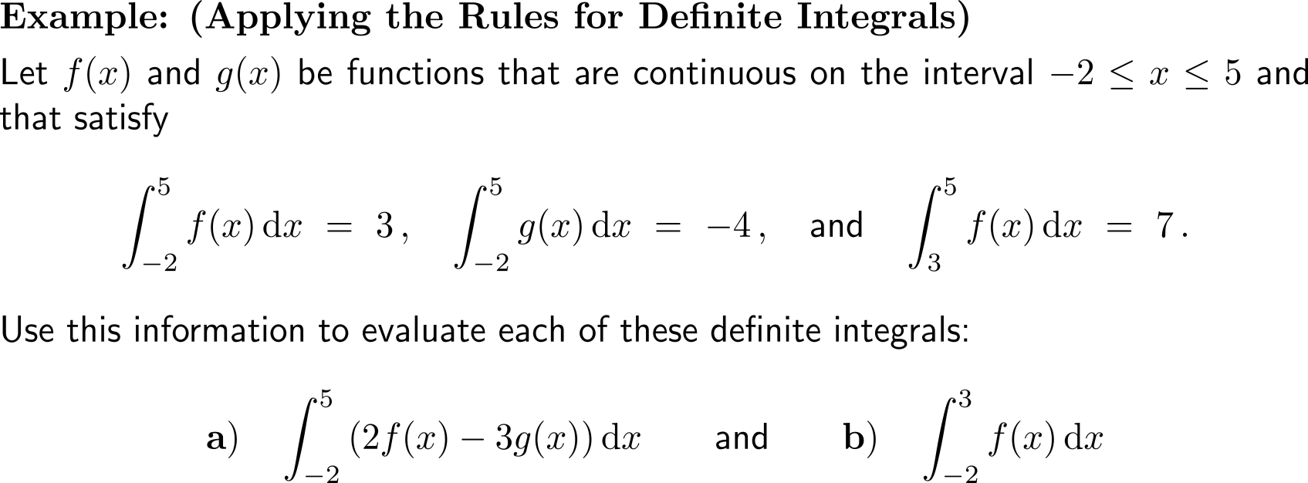
Example: Applying the rules for definite integrals

Slide 43
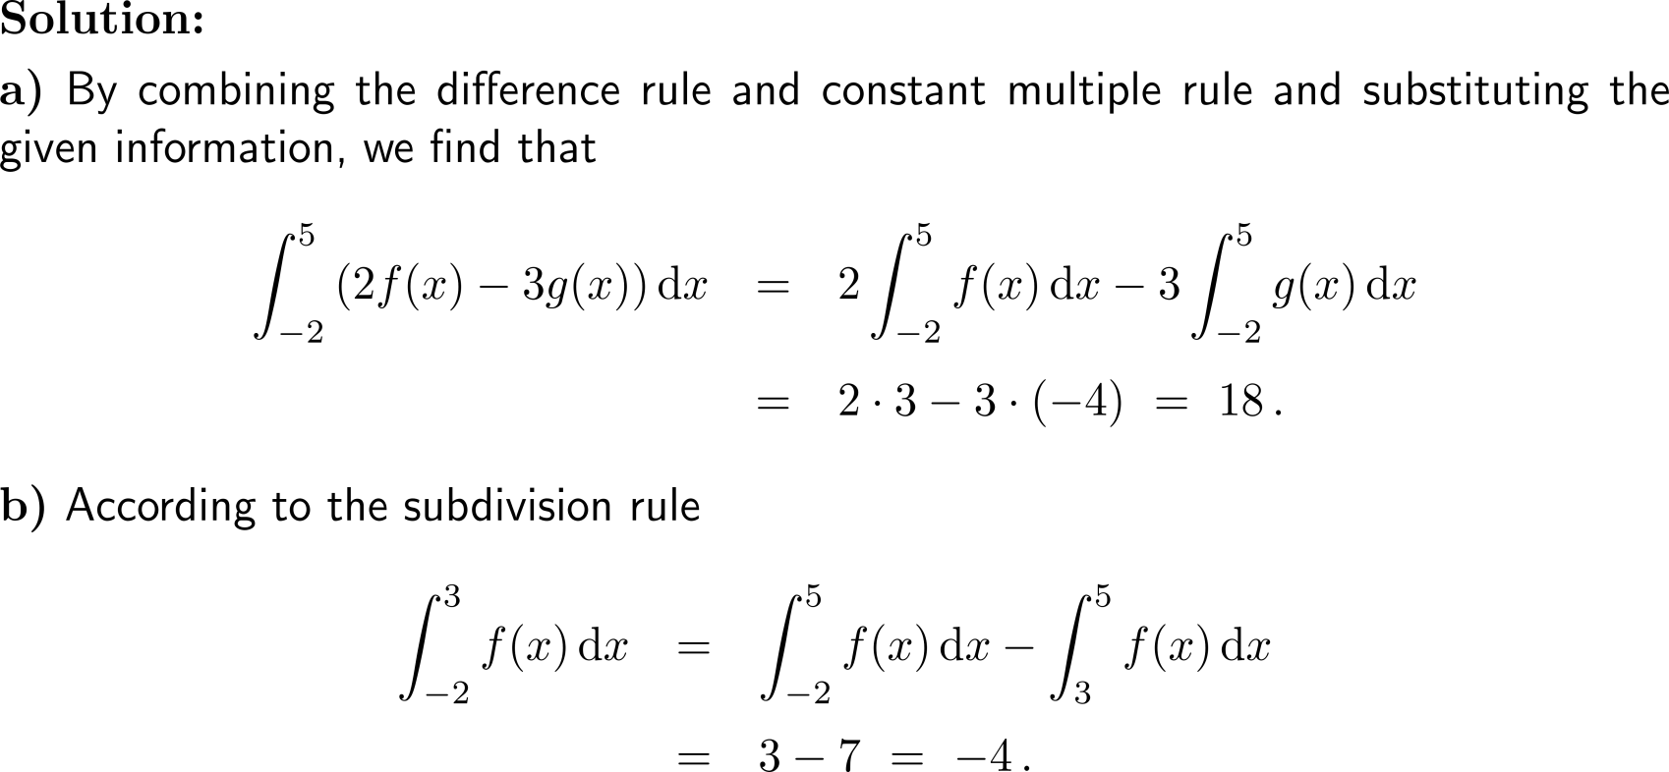
Example: Applying the rules for definite integrals

Slide 44
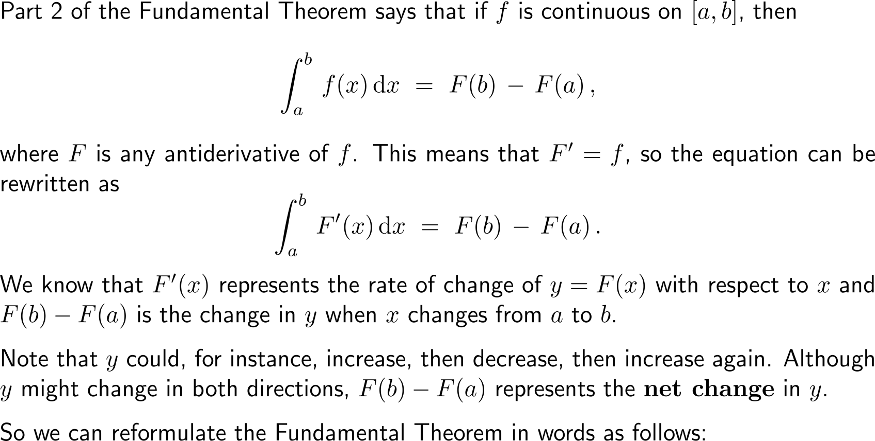
The 2nd part of the Fundamental Theorem of Calculus allows an interpretation in terms of net changes

Slide 45
The Net Change Theorem …

Slide 46
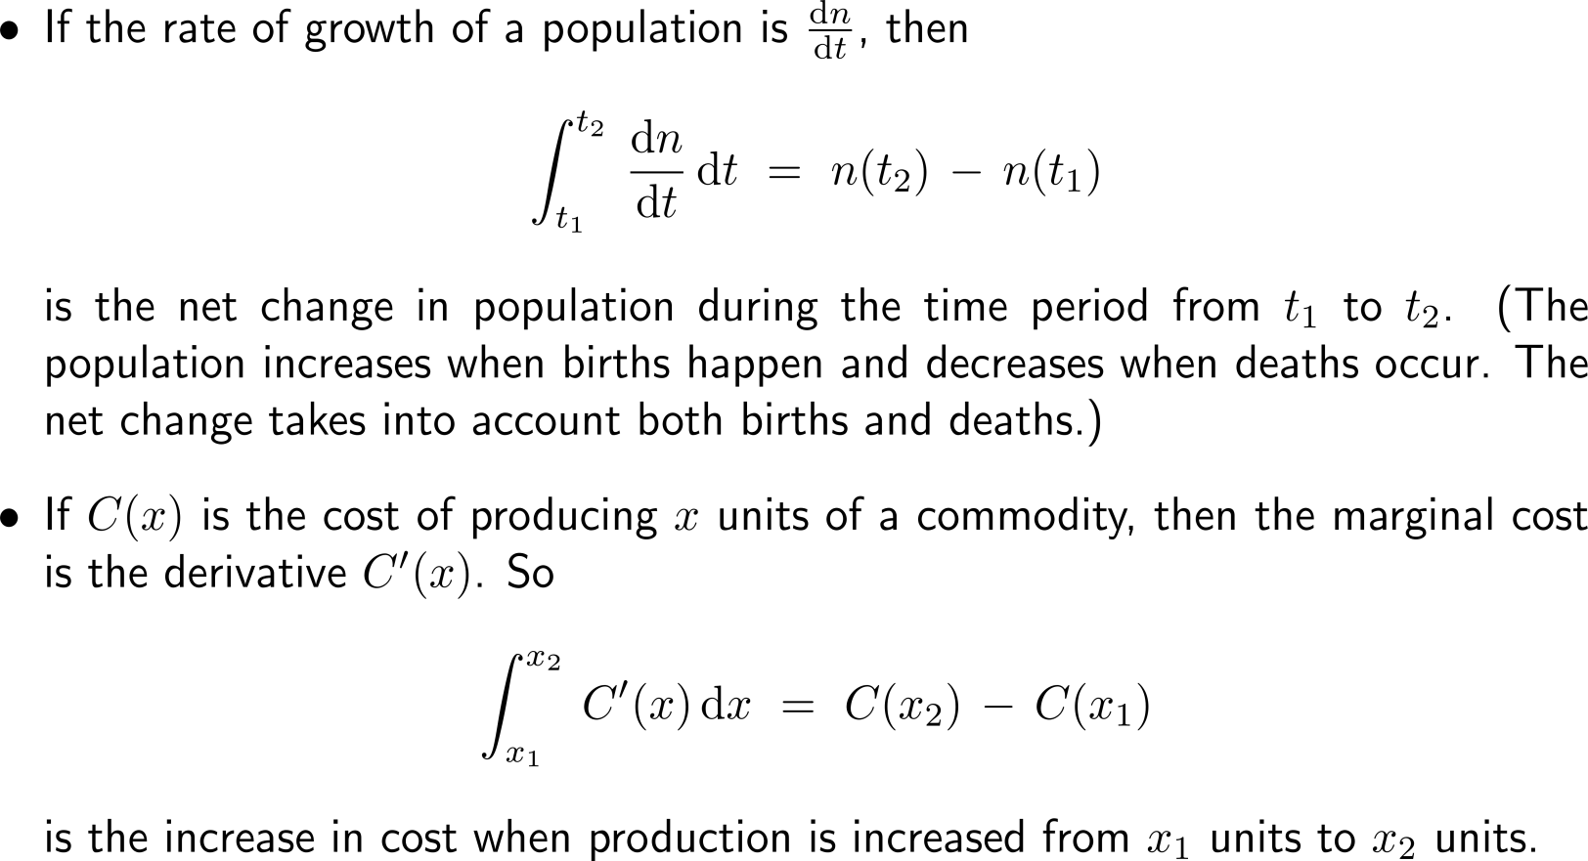
… and some of its applications

Slide 47
Further Worked-Out Exercises:
Calculus I for Management
Topics
The Substitution Rule
Areas & estimating with finite sums
Applications of the Fundamental Theorem of Calculus

Slide 48
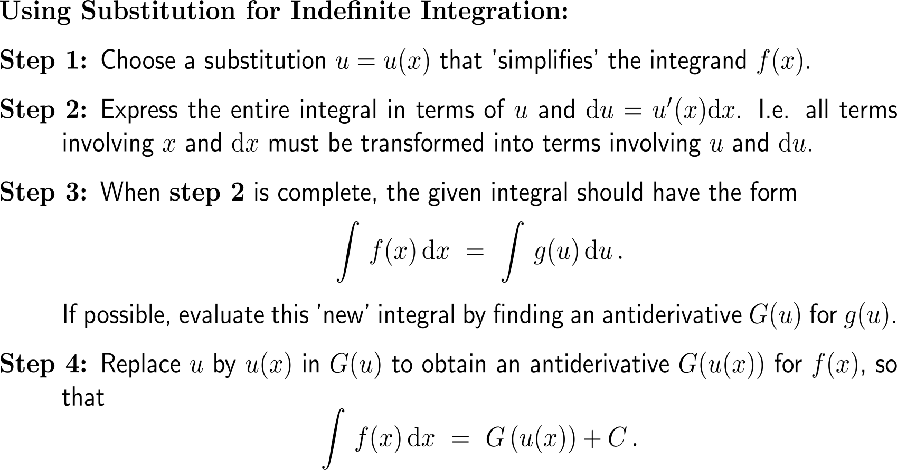
Recap: Step-by-step procedure for integrating by substitution

Slide 49
Exercise
a)

Slide 50
Exercise
b)
c)

Slide 51
Exercise
d)

Slide 52
Exercise

Slide 53
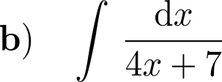
Exercise

Slide 54
Exercise

Slide 55
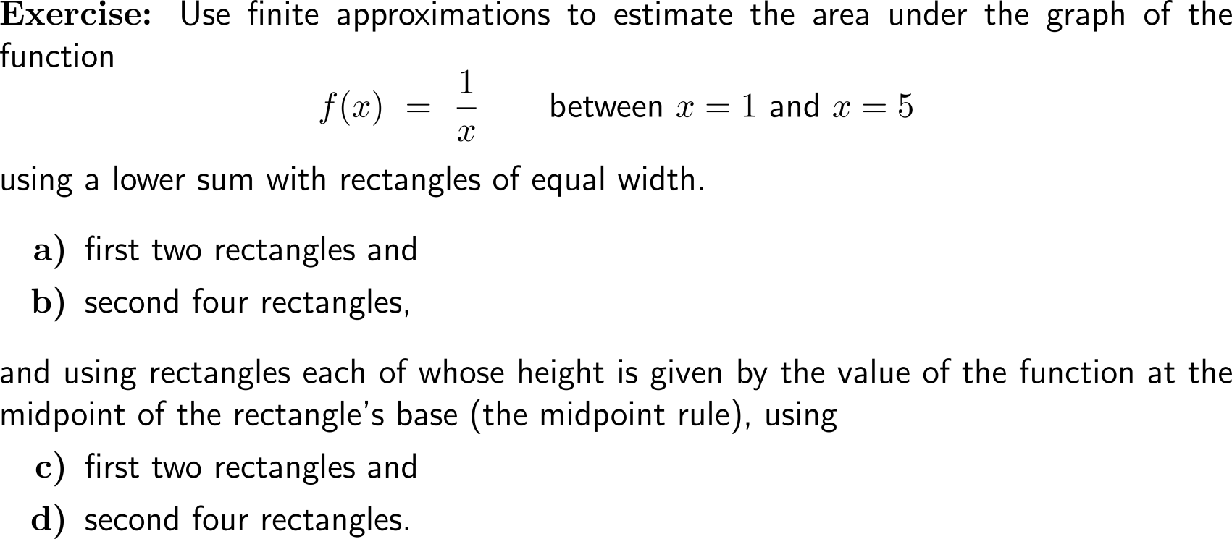
Exercise: Area & estimating with finite sums
Lower Sum Rule
Midpoint
Rule
Please, upload your solutions to the chat.

Slide 56
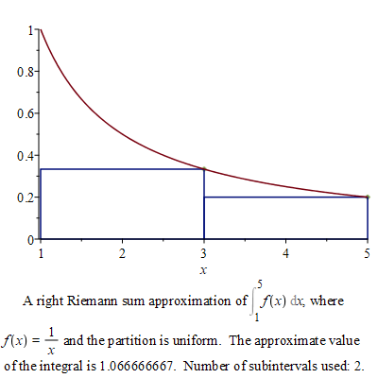
Exercise: Area & estimating with finite sums
Discussion
Lower Sum Rule

Slide 57
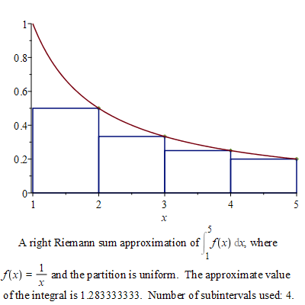
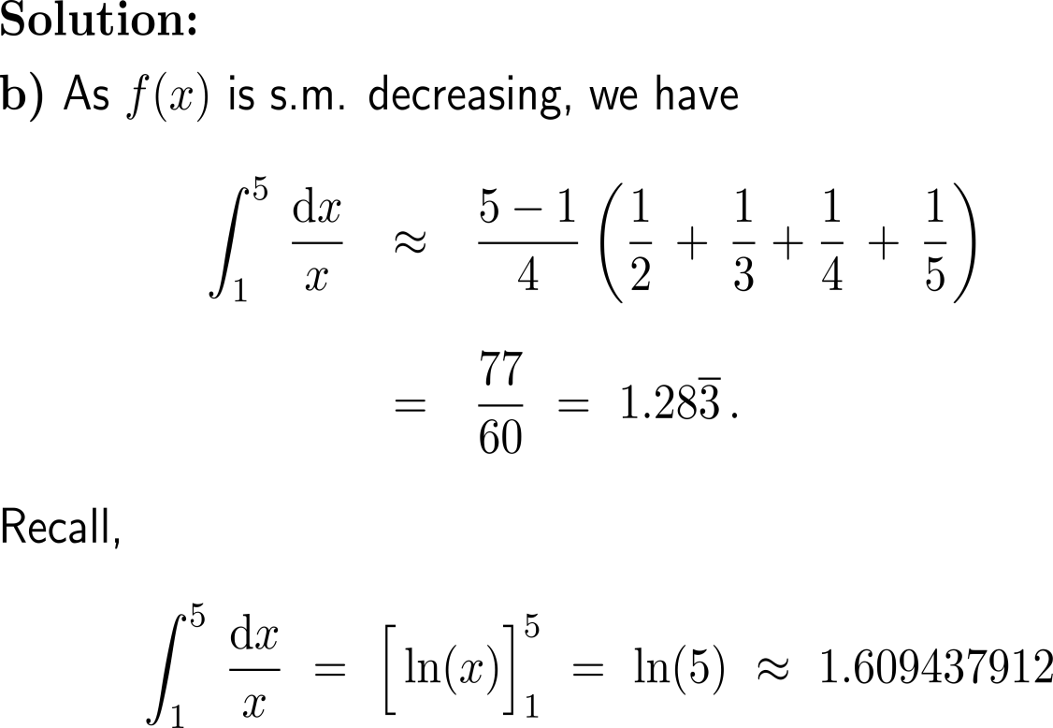
Exercise: Area & estimating with finite sums
Discussion
Lower Sum Rule
with(Student[Calculus1])
RiemannSum(1/x, x = 1 .. 5, method = right, partition = 4, output = plot)

Slide 58
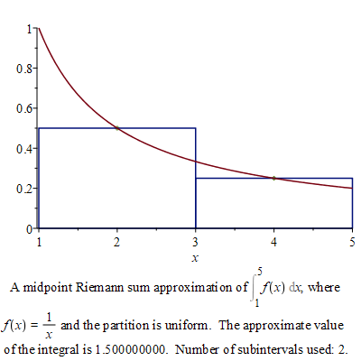
Exercise: Area & estimating with finite sums
Discussion
Midpoint
Rule

Slide 59
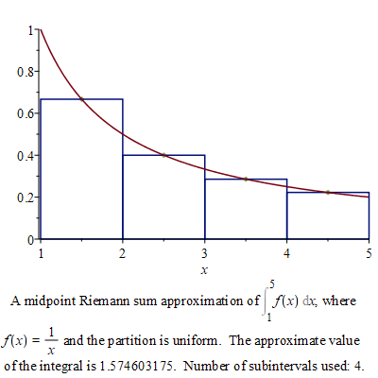
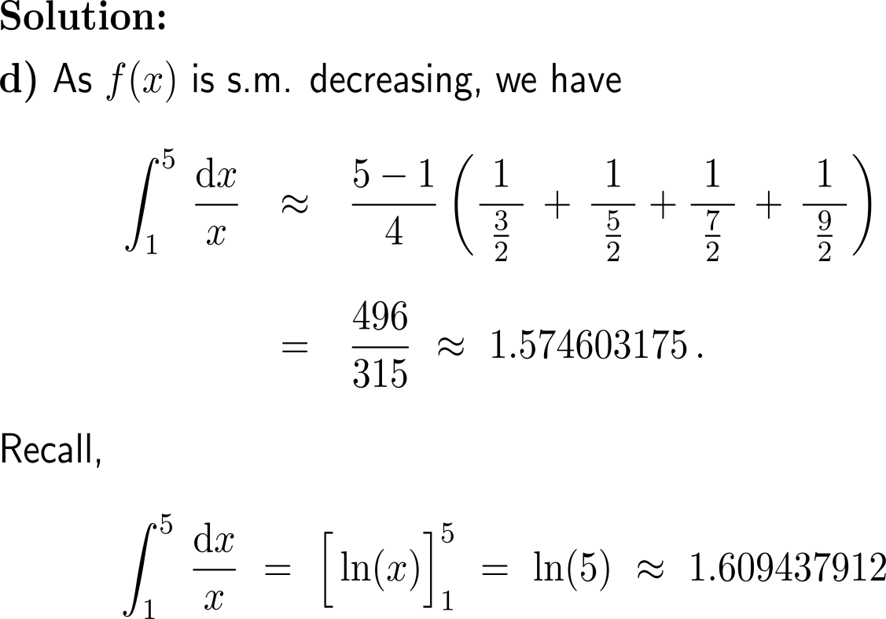
Exercise: Area & estimating with finite sums
Discussion
Midpoint
Rule
with(Student[Calculus1])
RiemannSum(1/x, x = 1 .. 5, method = midpoint, partition = 4, output = plot)

Slide 60
Calculus I for Management

