Slide 1
Calculus I for MGMT – Integration The Fundamental Theorem of Calculus
Mathematics for Management
Supplementary Electronic Materials
The Fundamental Theorem of Calculus
The Substitution Rule
Definite Integrals
The Fundamental Theorem of Calculus

Slide 2
A change of variables leads to integrals that are more easy to evaluate: motivation of the Substitution Rule (1/ 3)

Slide 3
A change of variables leads to integrals that are more easy to evaluate: motivation of the Substitution Rule (2/ 3)

Slide 4
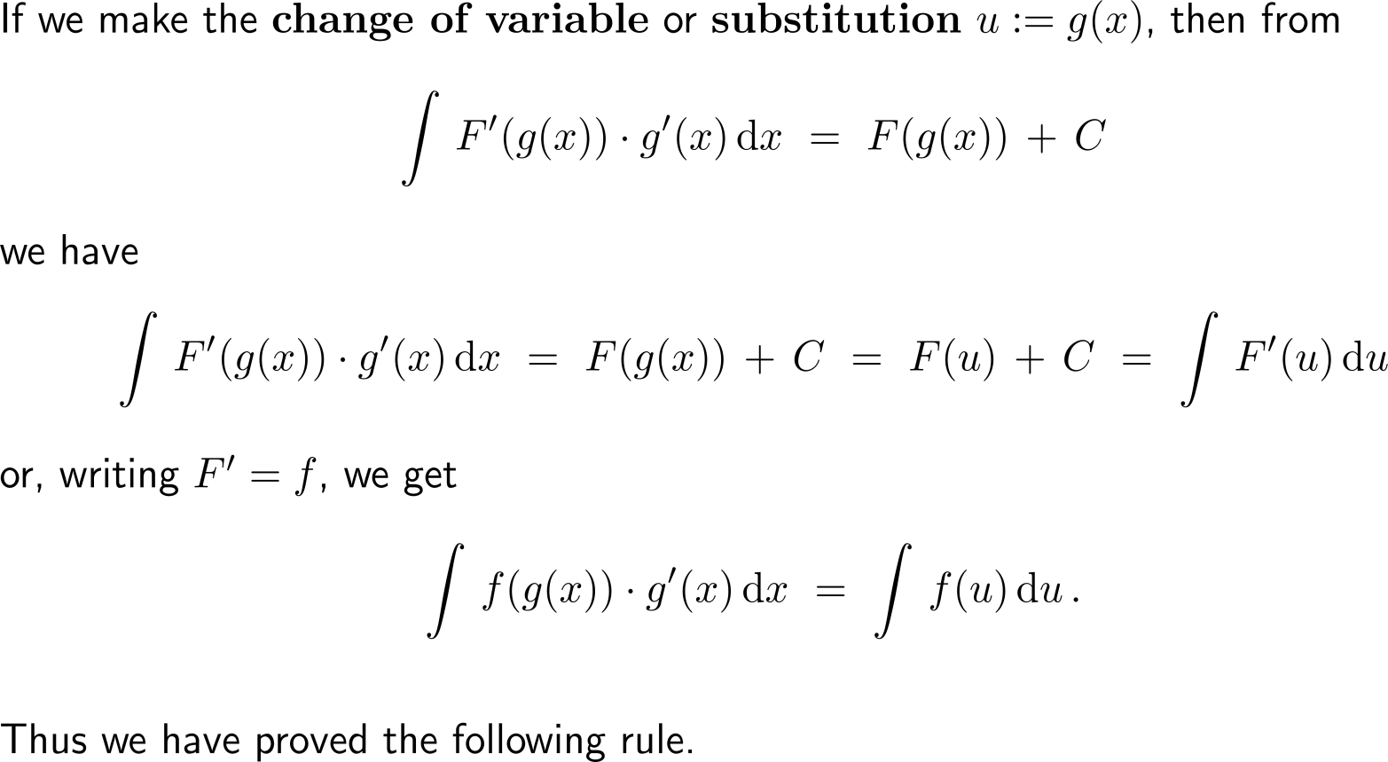
A change of variables leads to integrals that are more easy to evaluate: motivation of the Substitution Rule (3/ 3)

Slide 5
The Substitution Rule of integration is the reverse of the Chain Rule of differentiation

Slide 6
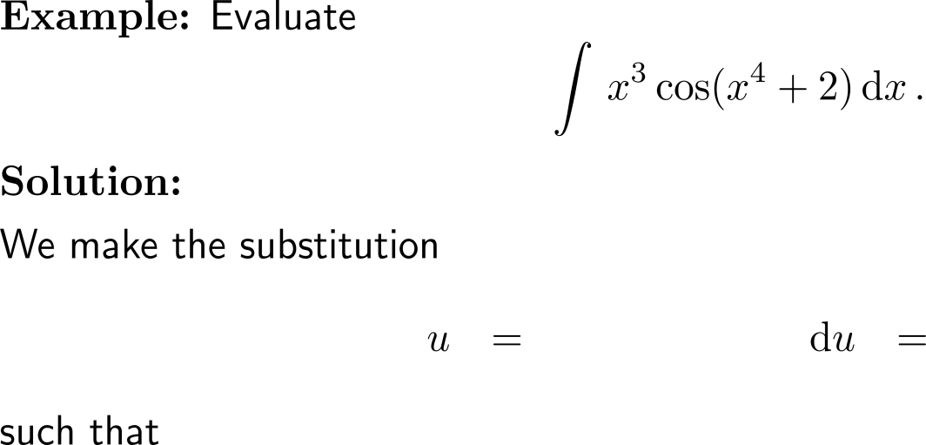
Example: Substitution Rule

Slide 7
The Substitution Rule works only if we find a suitable substitution such that substitution becomes a bit of an art (experience and practice is needed)

Slide 8
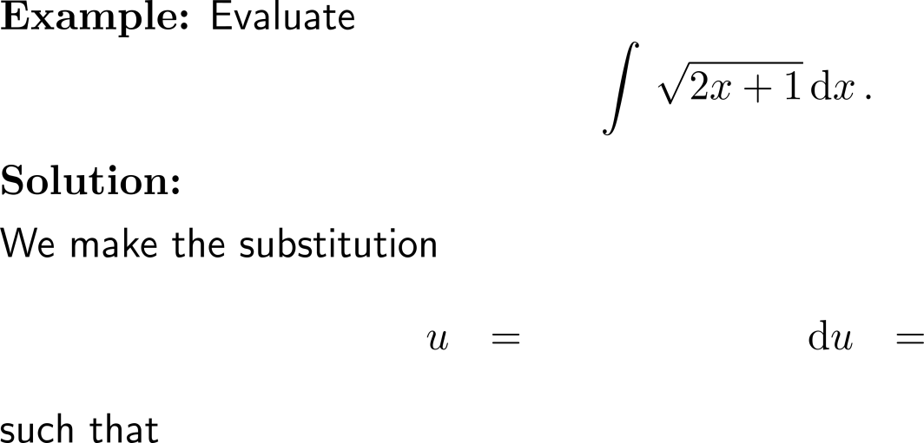
Example: Substitution Rule

Slide 9
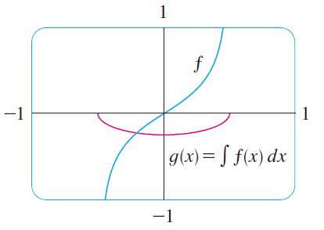
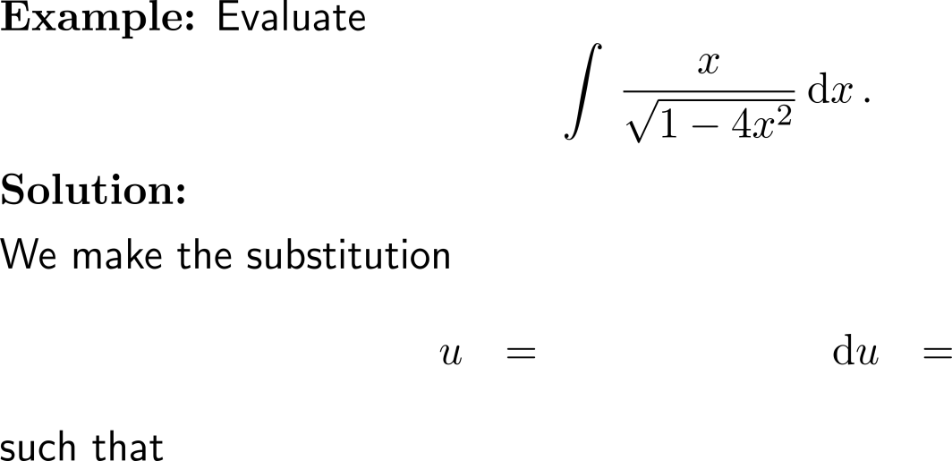
Example: Substitution Rule

Slide 10
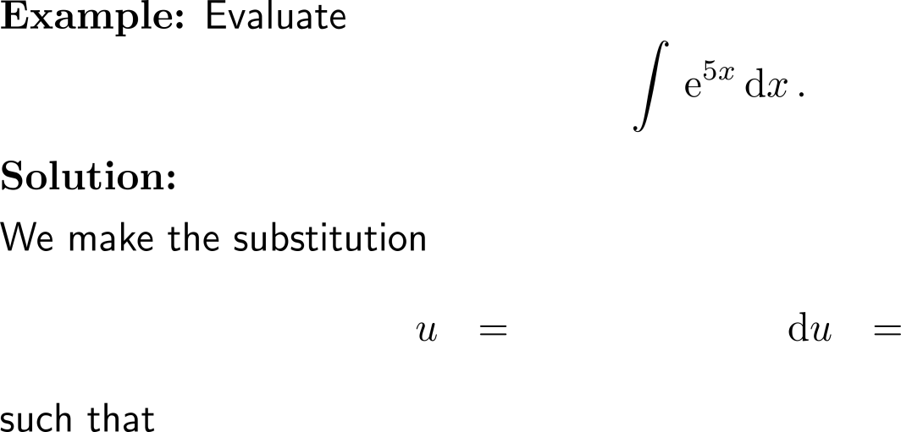
Example: Substitution Rule

Slide 11
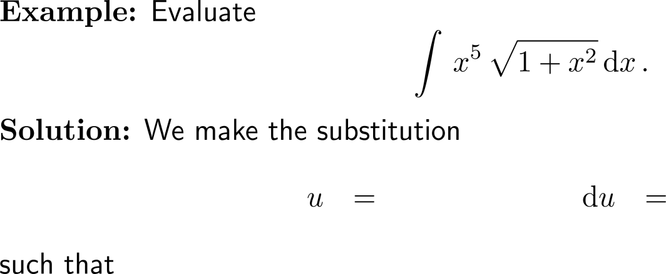
Example: Substitution Rule

Slide 12
Example: Substitution Rule

Slide 13
The previous example allows us to determine the antiderivative of the tangent function

Slide 14
Calculus I for Management

