Slide 1
Calculus I for MGMT – Integration The Fundamental Theorem of Calculus
Mathematics for Management
Supplementary Electronic Materials
The Fundamental Theorem of Calculus
The Substitution Rule
Definite Integrals
The Fundamental Theorem of Calculus

Slide 2
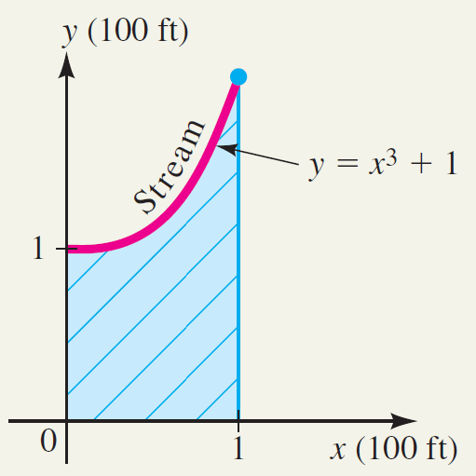
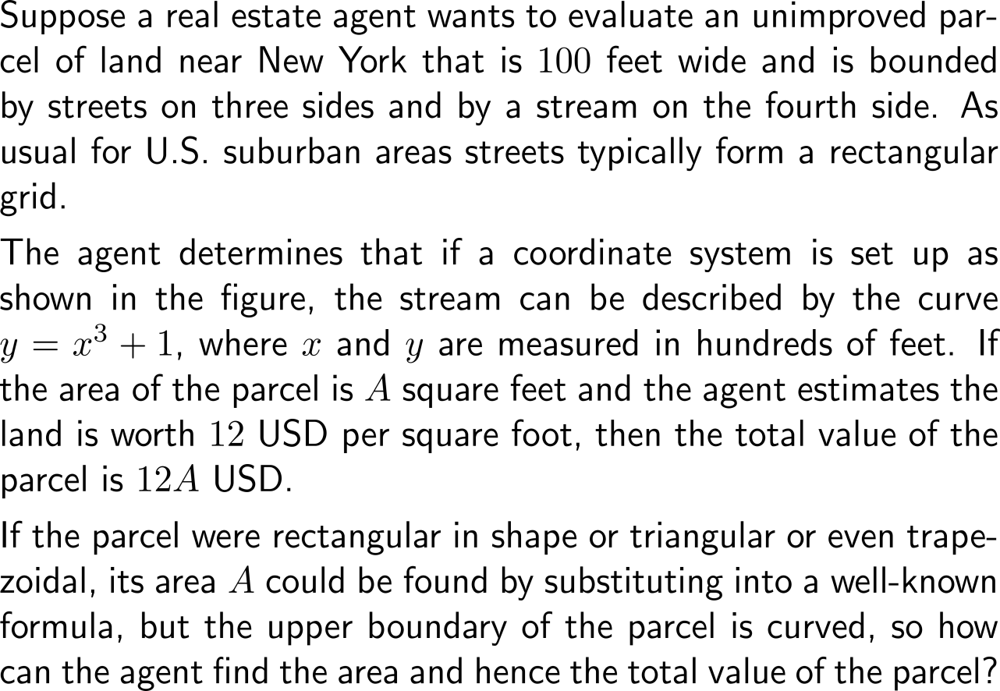
Motivation: Calculating the area under a graph

Slide 3
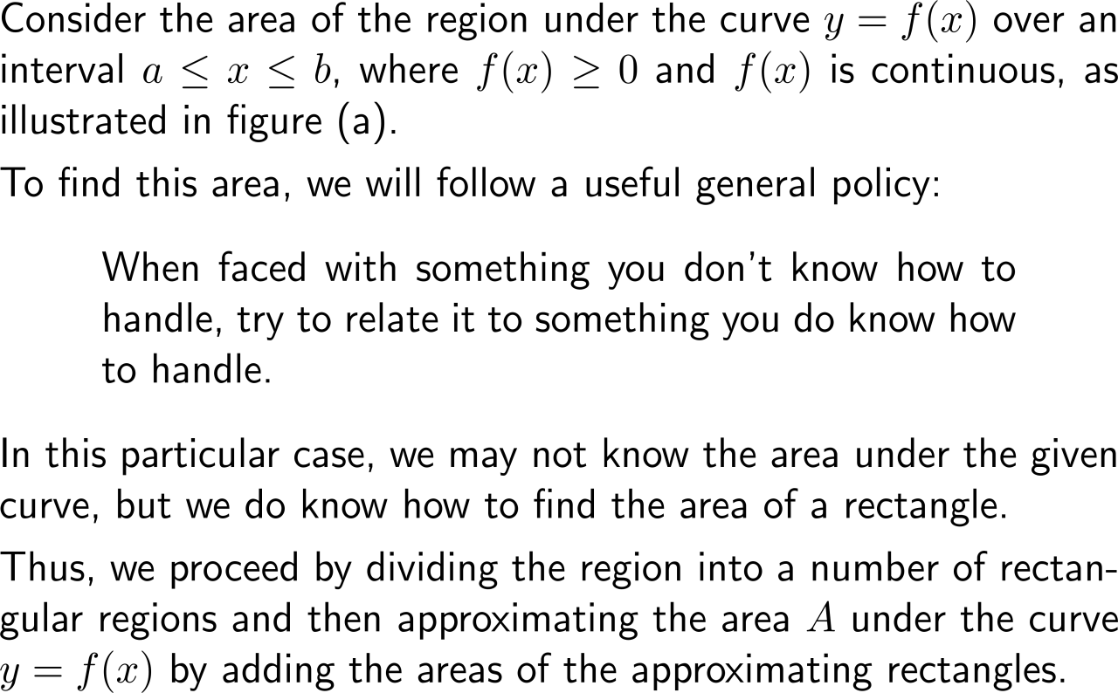
To calculate the area under a graph, we approximate it by a trail of equally wide rectangles … (1/ 2)

Slide 4
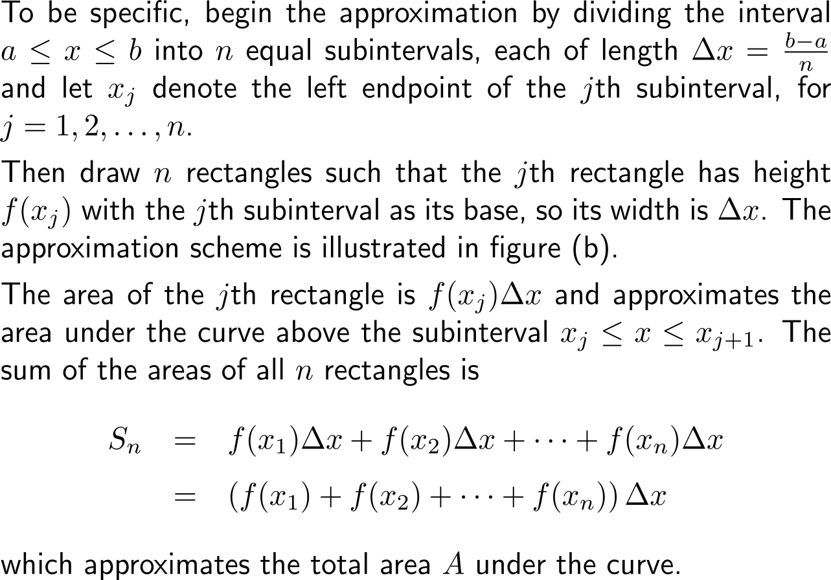
To calculate the area under a graph, we approximate it by a trail of equally wide rectangles … (2/ 2)

Slide 5
… that we then use in a limit argument to finally gain the value of the area

Slide 6
The area under a curve is obtained by virtue of a straightforward limit process

Slide 7
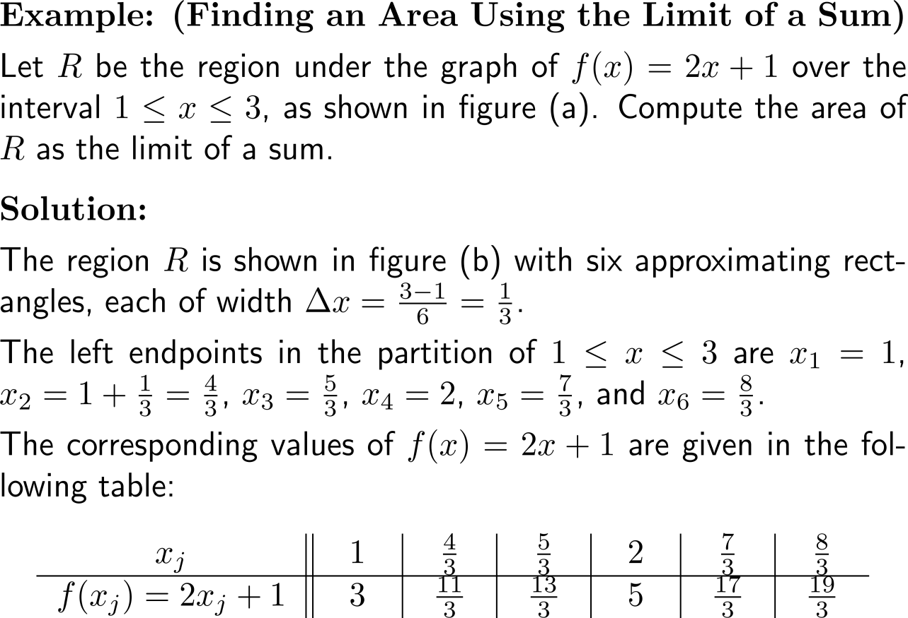
Example: Finding an area using the limit of a sum

Slide 8
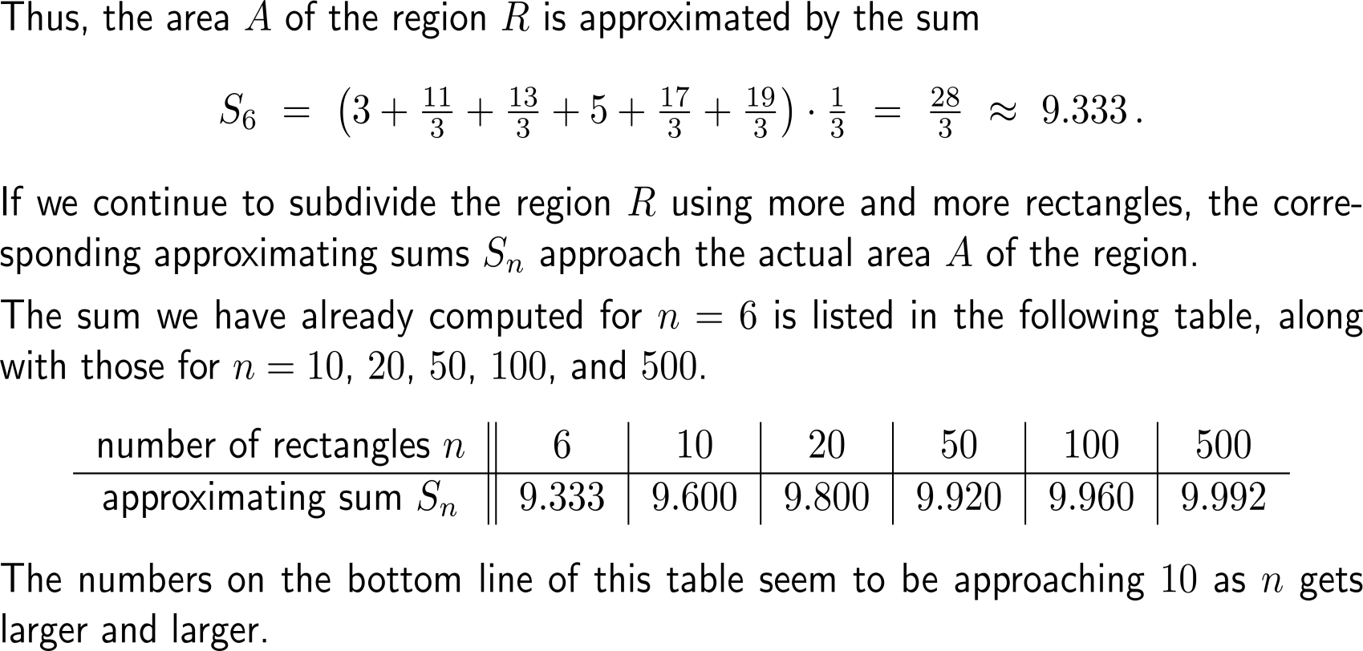
Example: Finding an area using the limit of a sum

Slide 9
Example: Finding an area using the limit of a sum

Slide 10
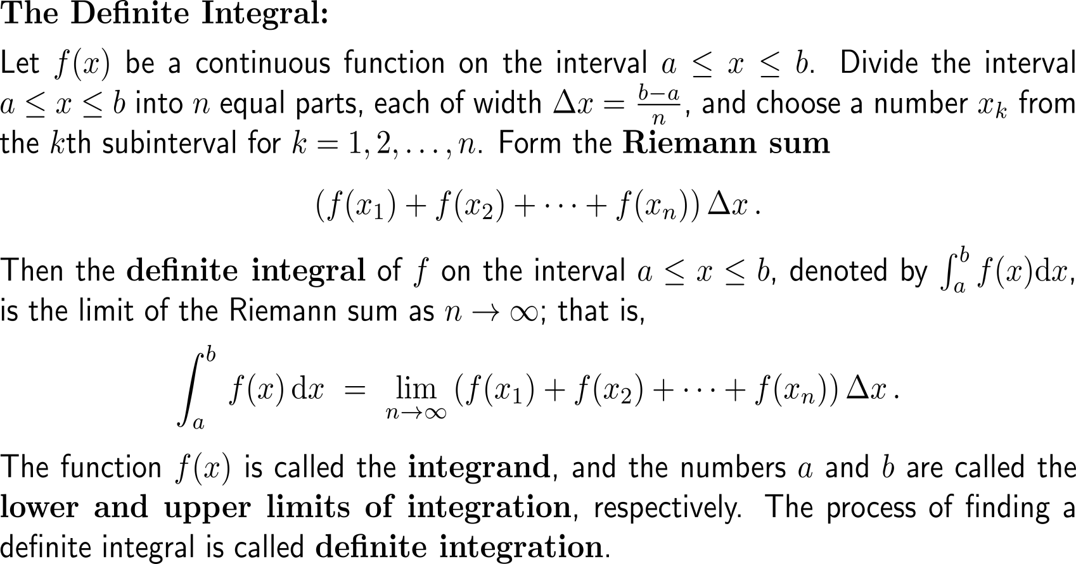
The definite integral equals the area under the graph of a function

Slide 11
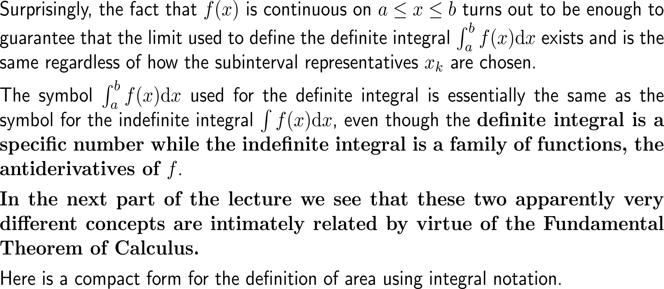
It is a specific number and connected to the indefinite integral (a function) by virtue of the Fundamental Theorem of Calculus

Slide 12
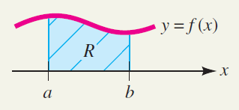
Finding an area is equivalent to determining the value of a definite integral

Slide 13
Calculus I for Management

