Slide 1
Calculus I for MGMT – Integration The Fundamental Theorem of Calculus
Mathematics for Management
Supplementary Electronic Materials
The Fundamental Theorem of Calculus
The Substitution Rule
Definite Integrals
The Fundamental Theorem of Calculus

Slide 2
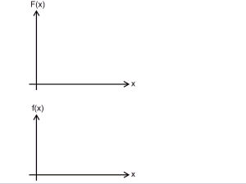
The Fundamental Theorem of Calculus allows us to view differentiation and integration as inverse processes …

Slide 3
The Fundamental Theorem of Calculus allows us to view differentiation and integration as inverse processes …

Slide 4
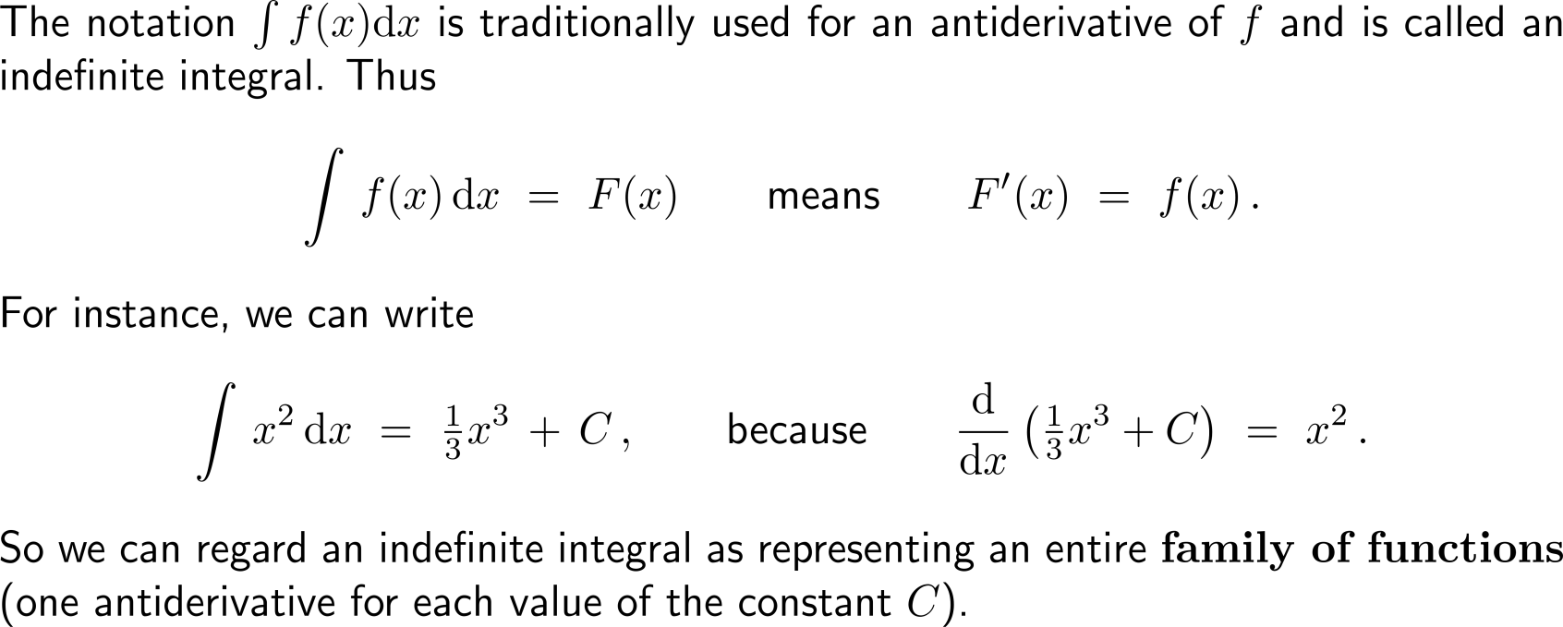
… such that in particular the indefinite integral can be viewed as a synonym for the antiderivative

Slide 5
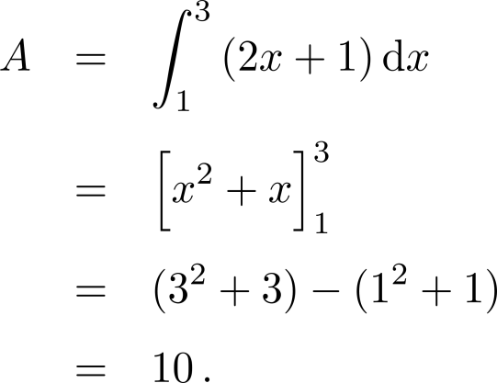
Example: Finding an area using the Fundamental Theorem

Slide 6
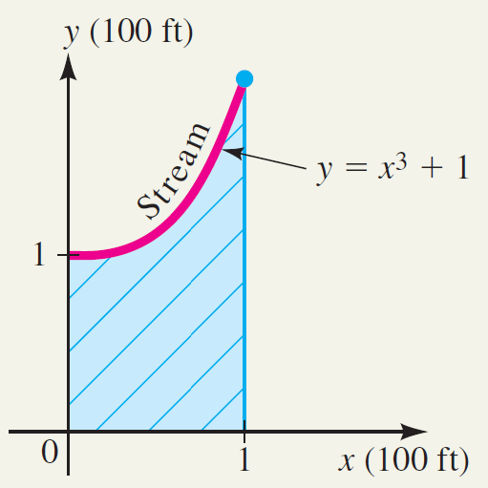
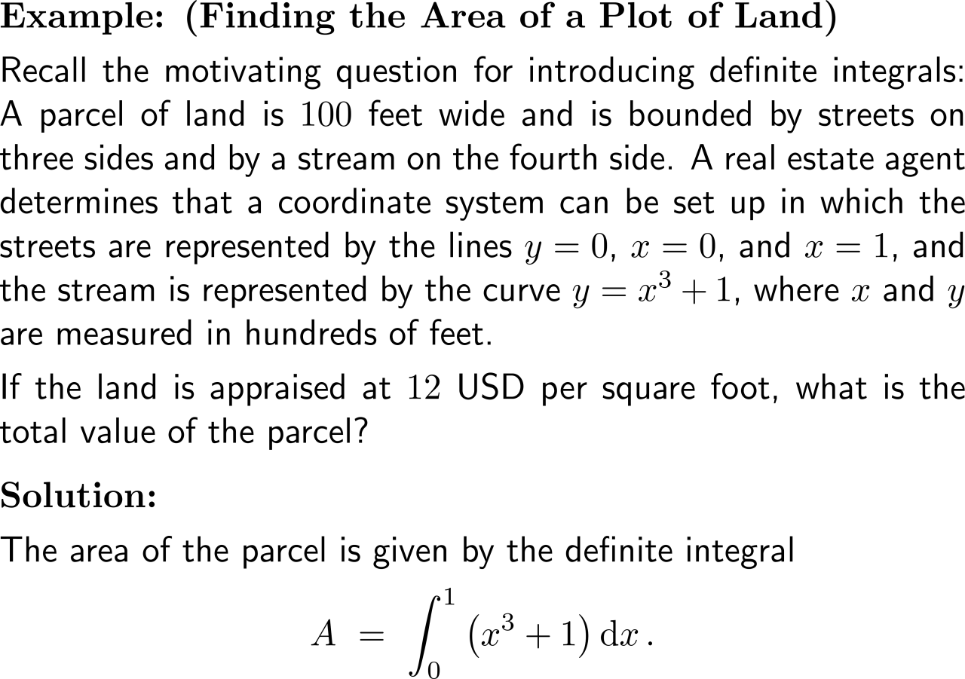
Example: Using integration to find the area of a plot of land

Slide 7
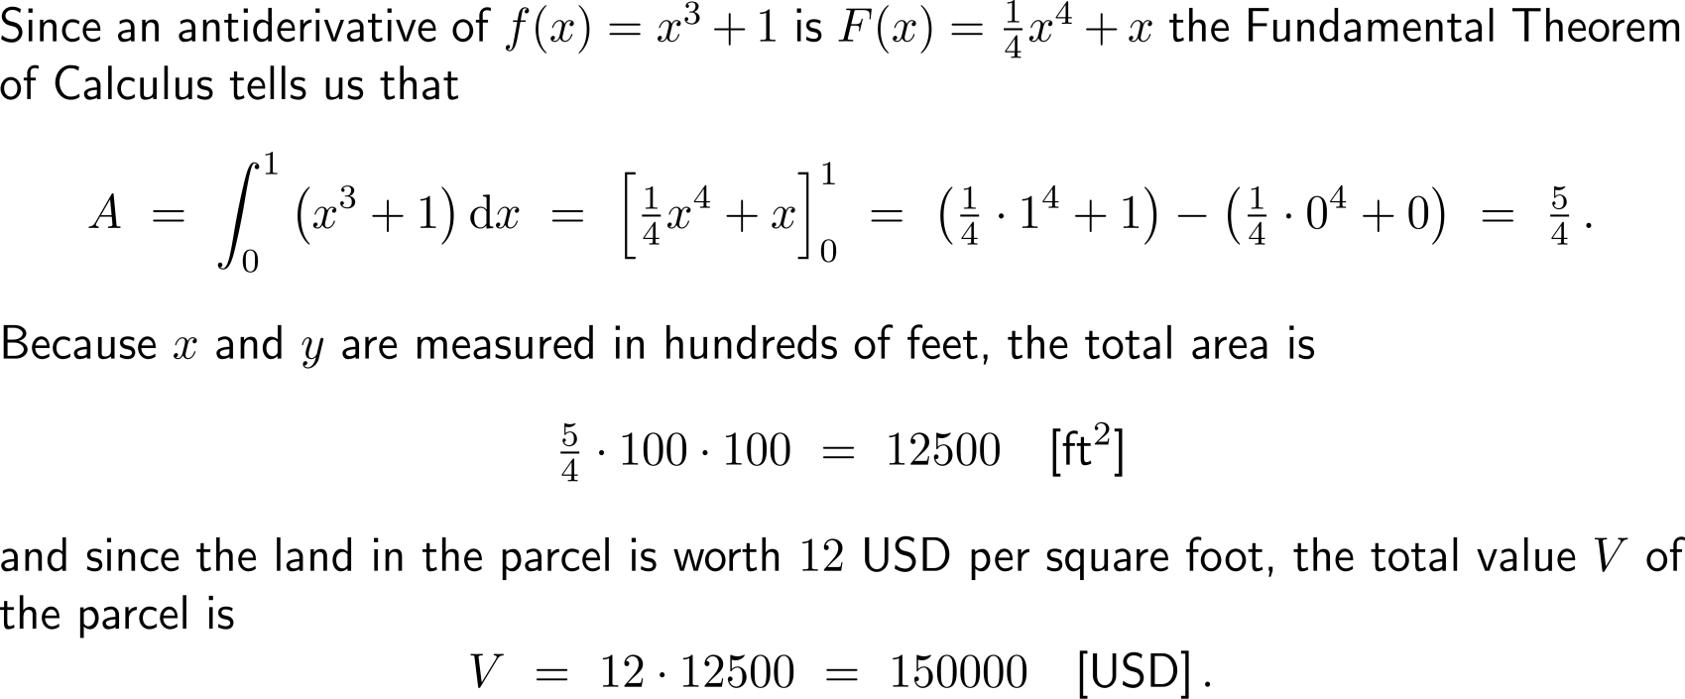
Example: Using integration to find the area of a plot of land

Slide 8
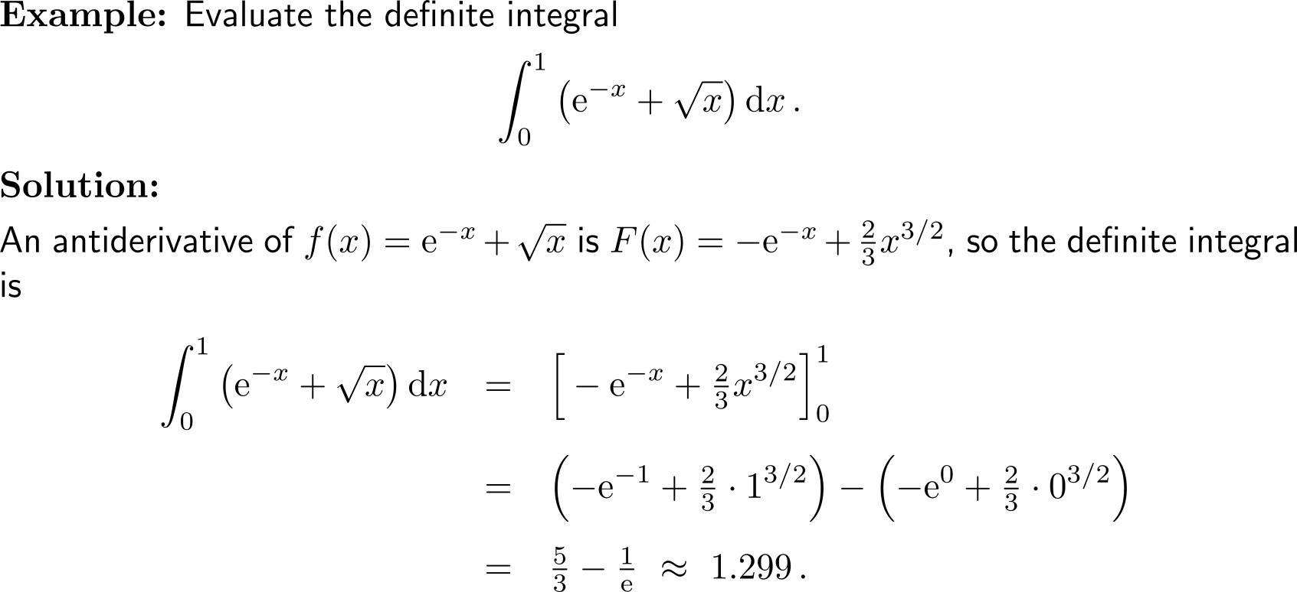
Example: Evaluating a definite integral

Slide 9
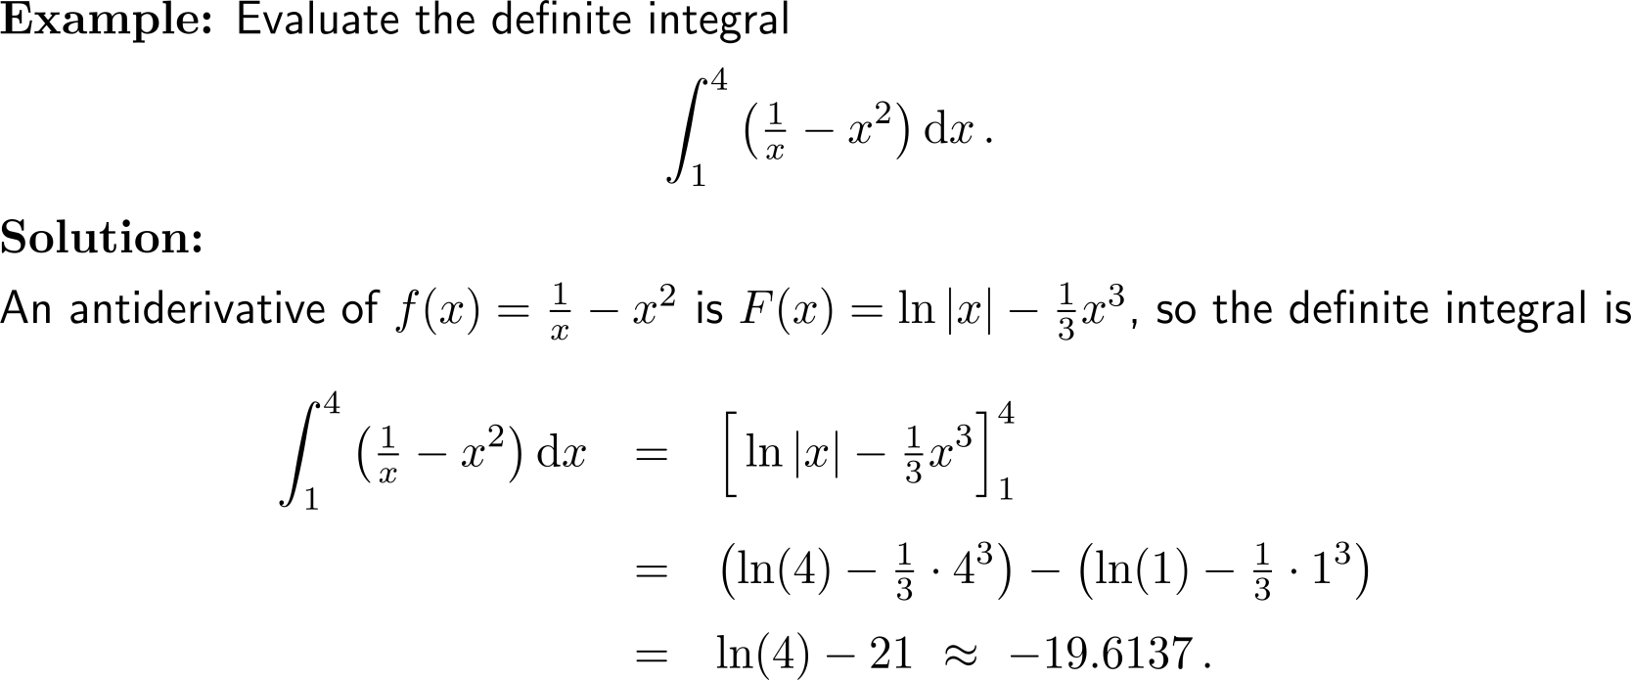
Example: Evaluating a definite integral

Slide 10
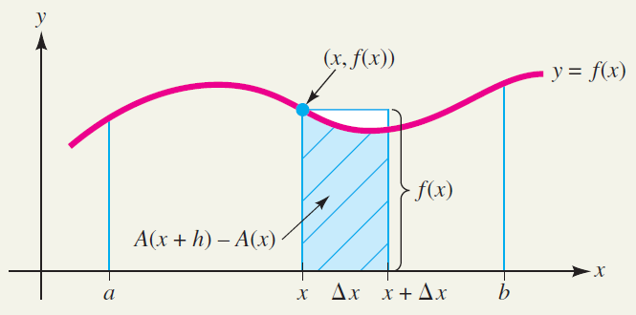
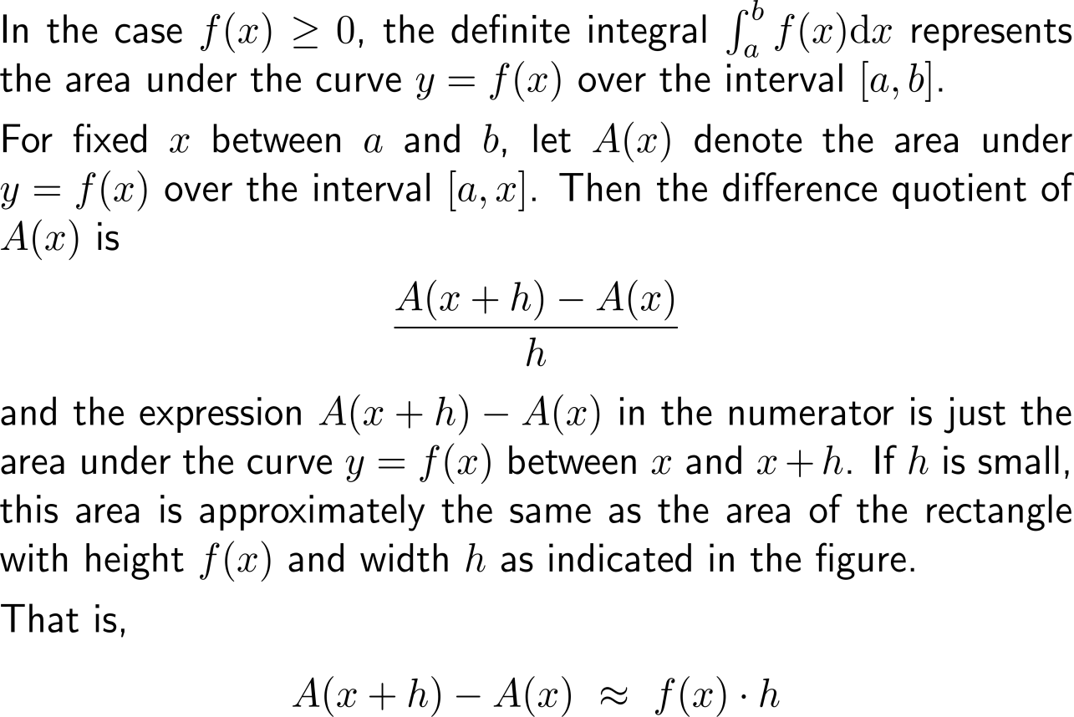
Before we compile some useful computation rules for definite integrals, let us give an area justification of the Fundamental Theorem of Calculus (1/ 3)

Slide 11
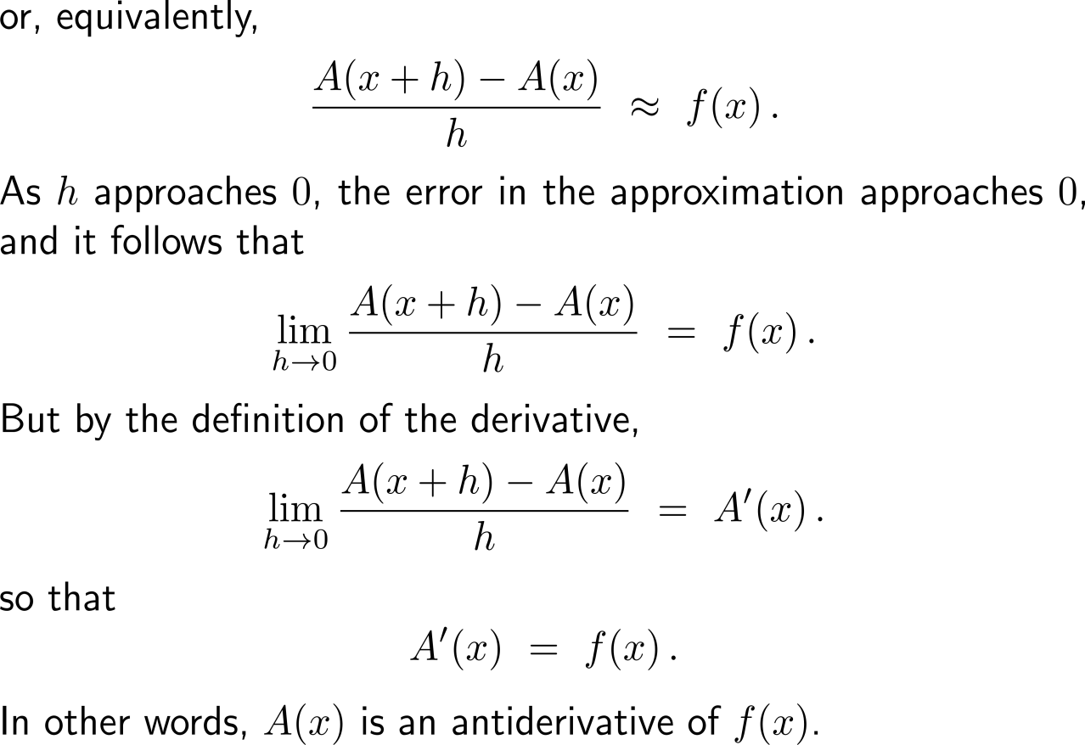
Before we compile some useful computation rules for definite integrals, let us give an area justification of the Fundamental Theorem of Calculus (2/ 3)

Slide 12
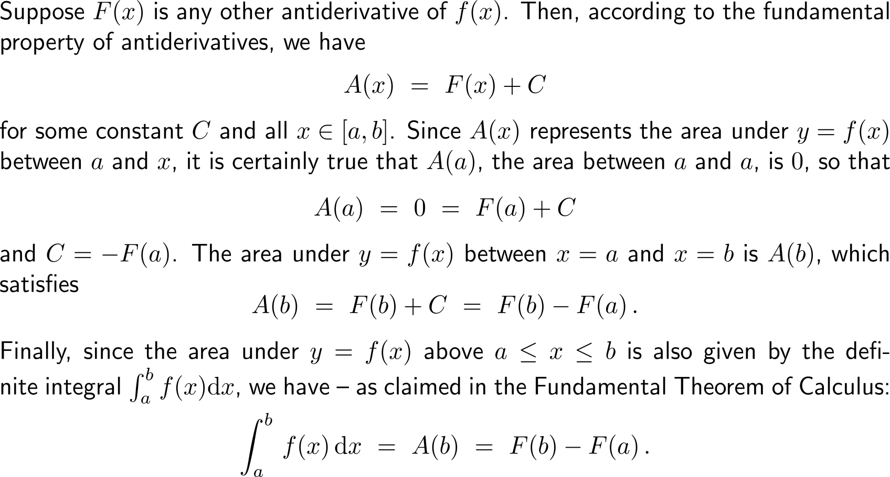
Before we compile some useful computation rules for definite integrals, let us give an area justification of the Fundamental Theorem of Calculus (3/ 3)

Slide 13
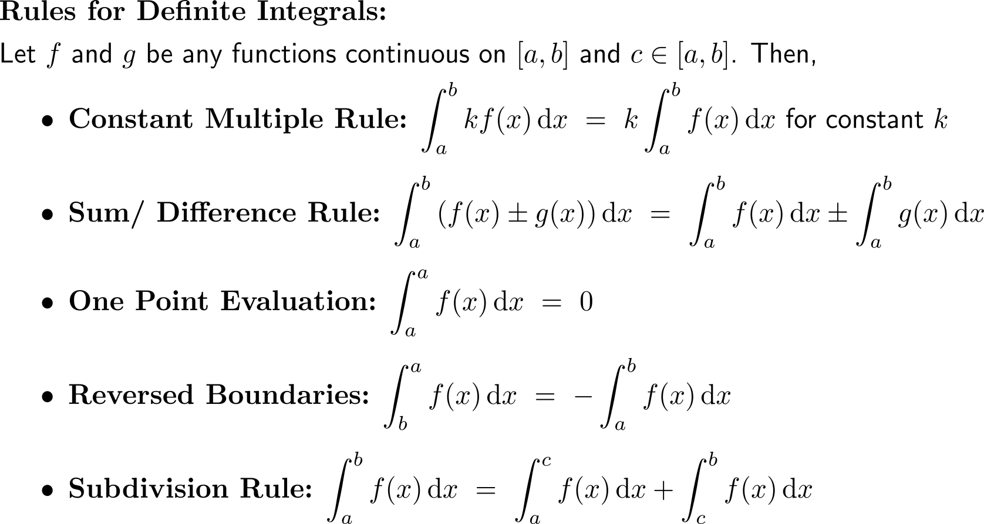
The computation rules for definite integrals carry over from those for indefinite integrals

Slide 14
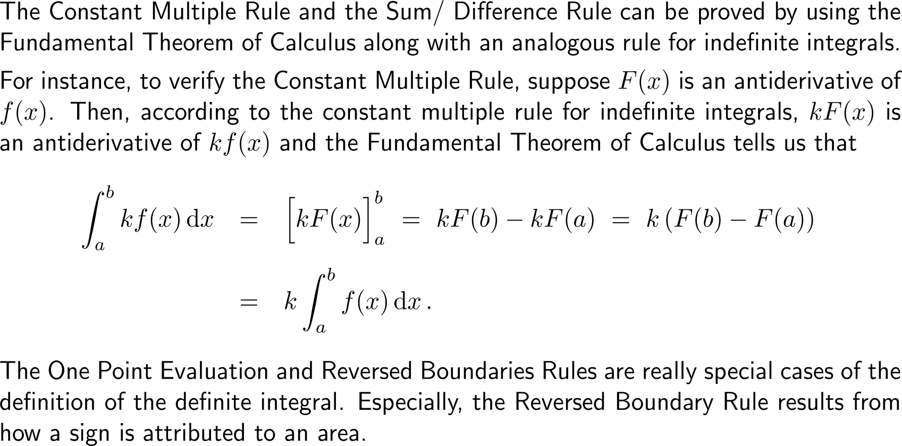
The computation rules follow from the Fundamental Theorem of Calculus and Geometry (1/ 2)

Slide 15
The computation rules follow from the Fundamental Theorem of Calculus and Geometry (2/ 2)

Slide 16
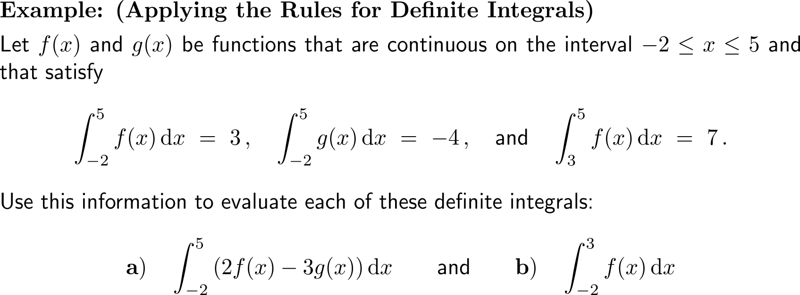
Example: Applying the rules for definite integrals

Slide 17
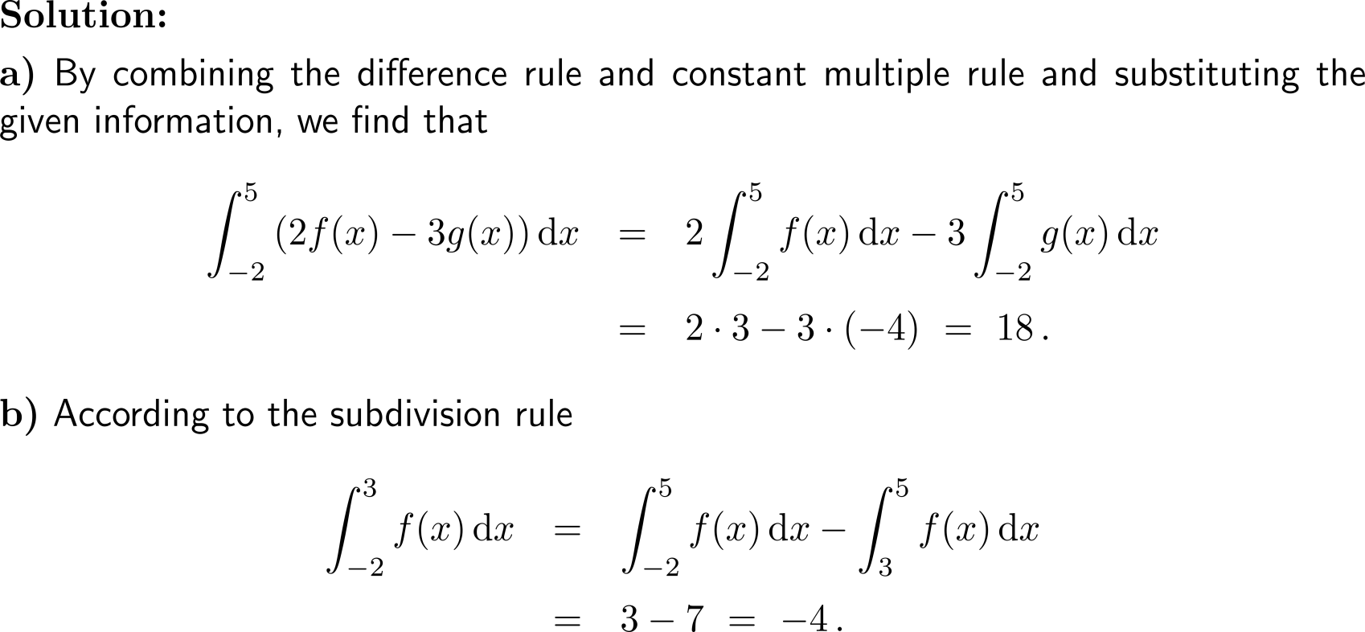
Example: Applying the rules for definite integrals

Slide 18
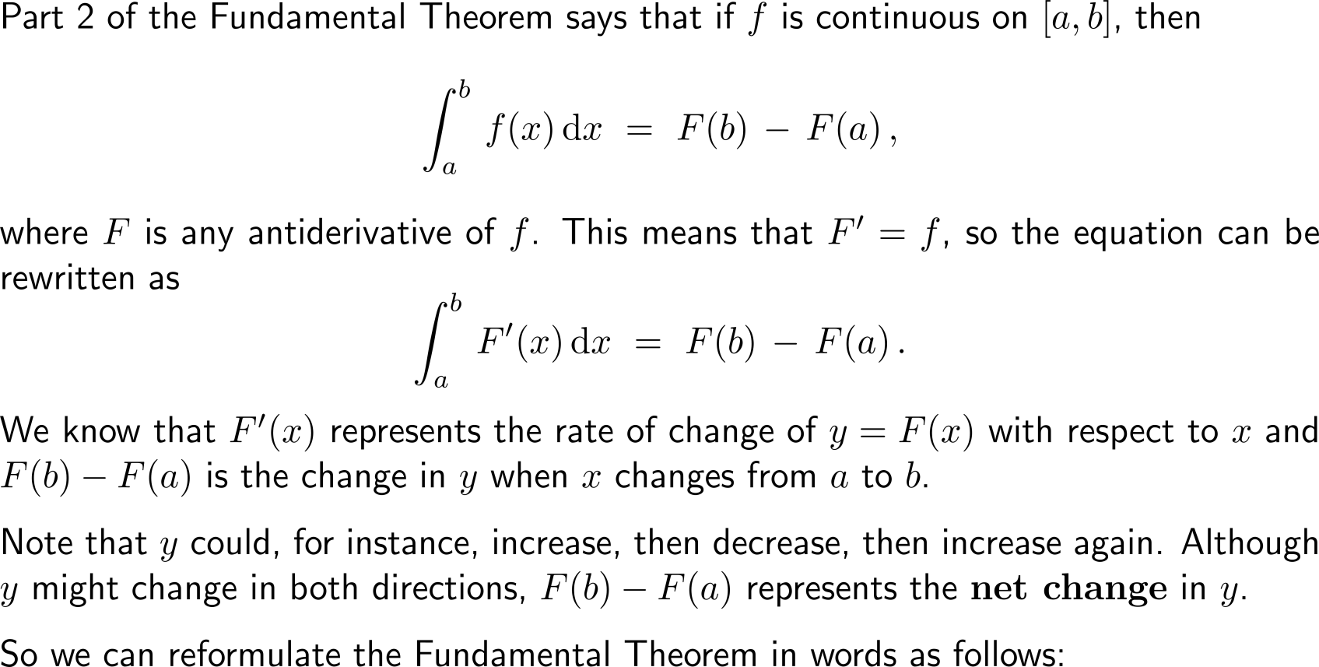
The 2nd part of the Fundamental Theorem of Calculus allows an interpretation in terms of net changes

Slide 19
The Net Change Theorem …

Slide 20
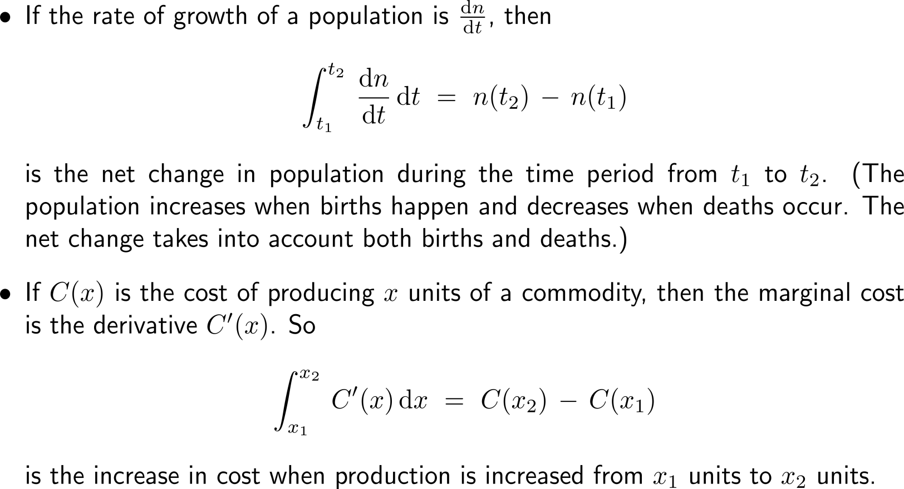
… and some of its applications

Slide 21
Calculus I for Management

