Slide 1
Calculus I for MGMT – Integration First Applications of Integration
Mathematics for Management
Supplementary Electronic Materials
First Applications of Integration
The Substitution Rule for Definite Integrals
The Area Between Curves

Slide 2
When using a substitution in a definite integral, we must put everything in terms of the new variable including the limits of integration

Slide 3
Proof of the Substitution Rule

Slide 4
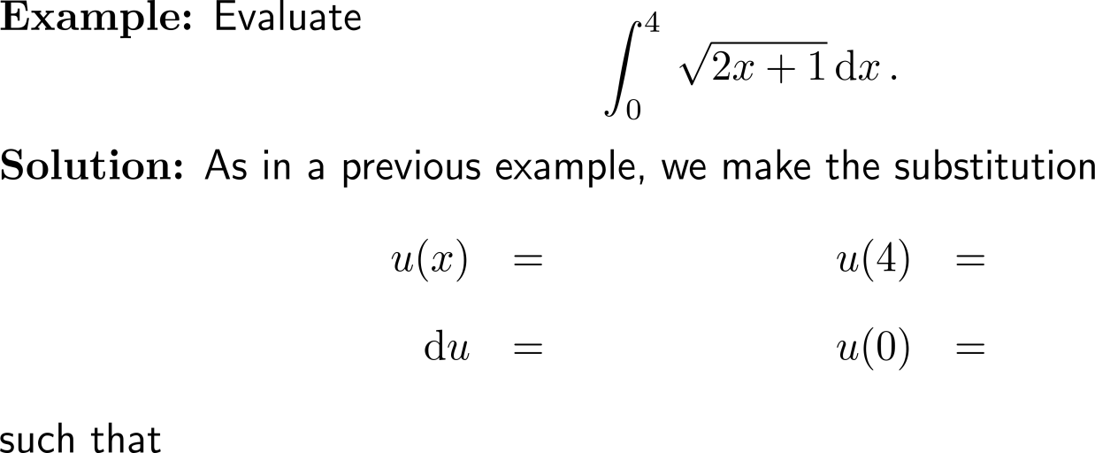
Example: Substitution Rule and definite integrals

Slide 5
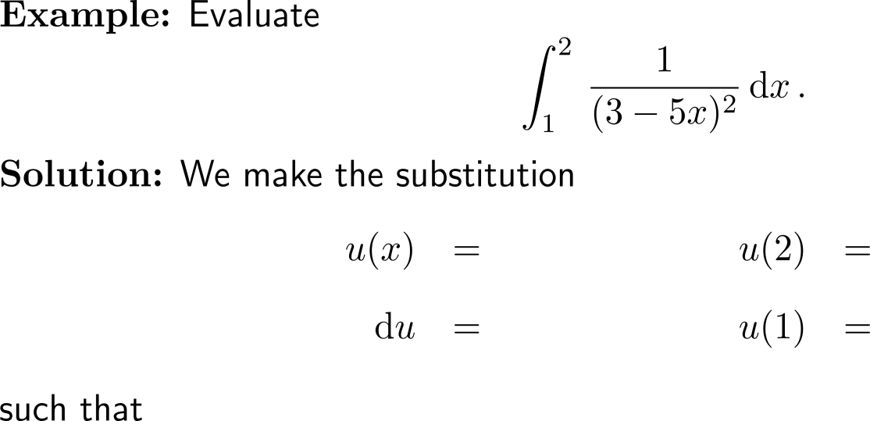
Example: Substitution Rule and definite integrals

Slide 6
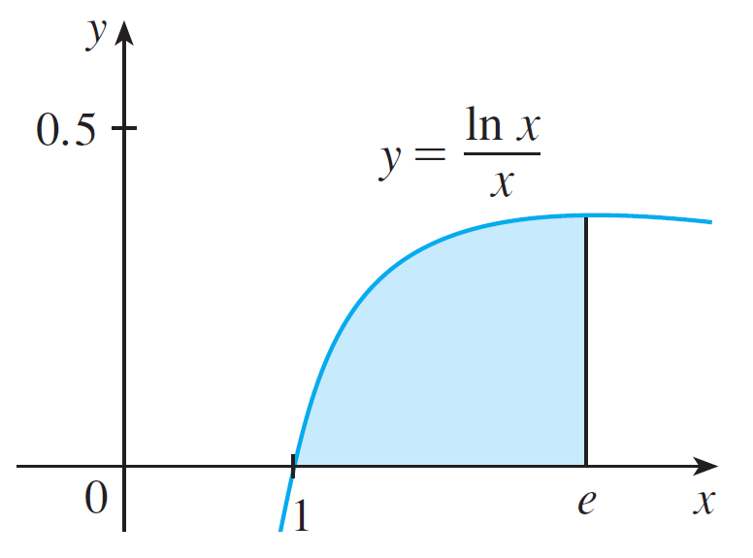
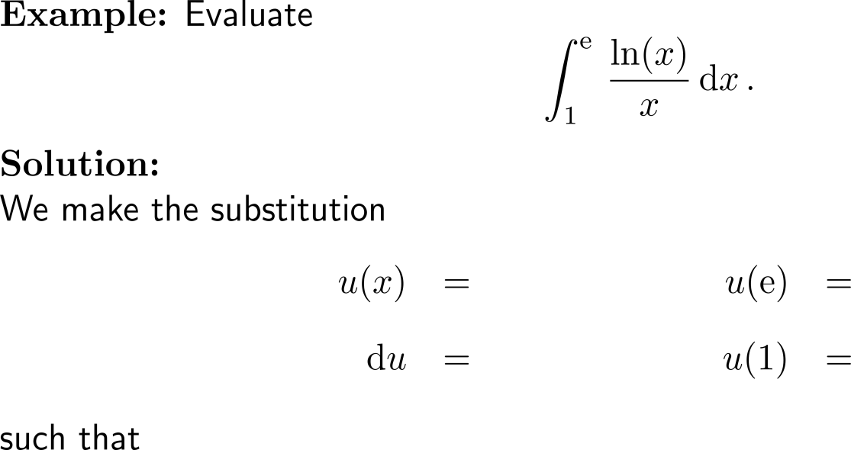
Example: Substitution Rule and definite integrals

Slide 7
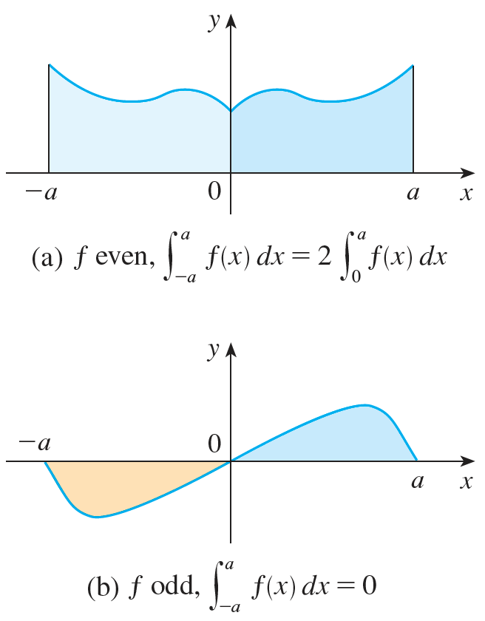
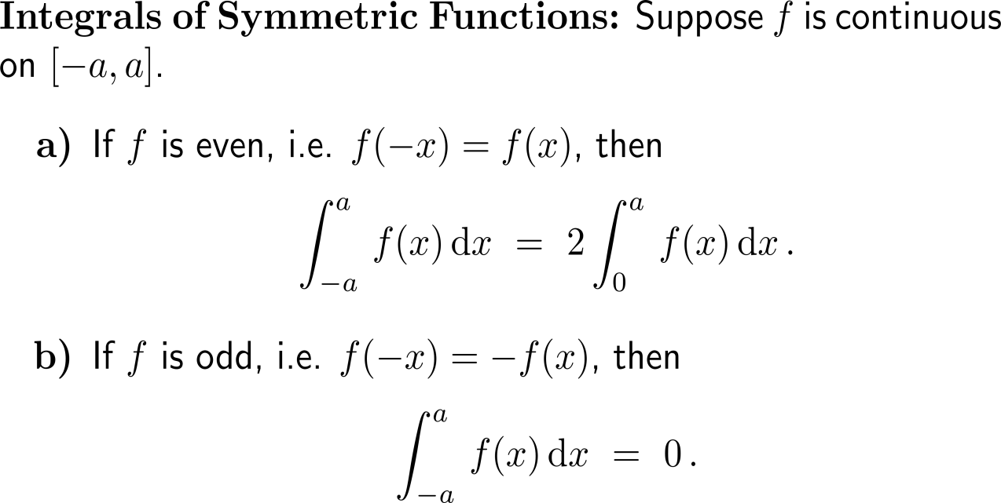
Symmetry considerations can simplify the evaluation of definite integrals considerably

Slide 8
Proof of the theorem for integrals of symmetric functions (1/ 2)

Slide 9
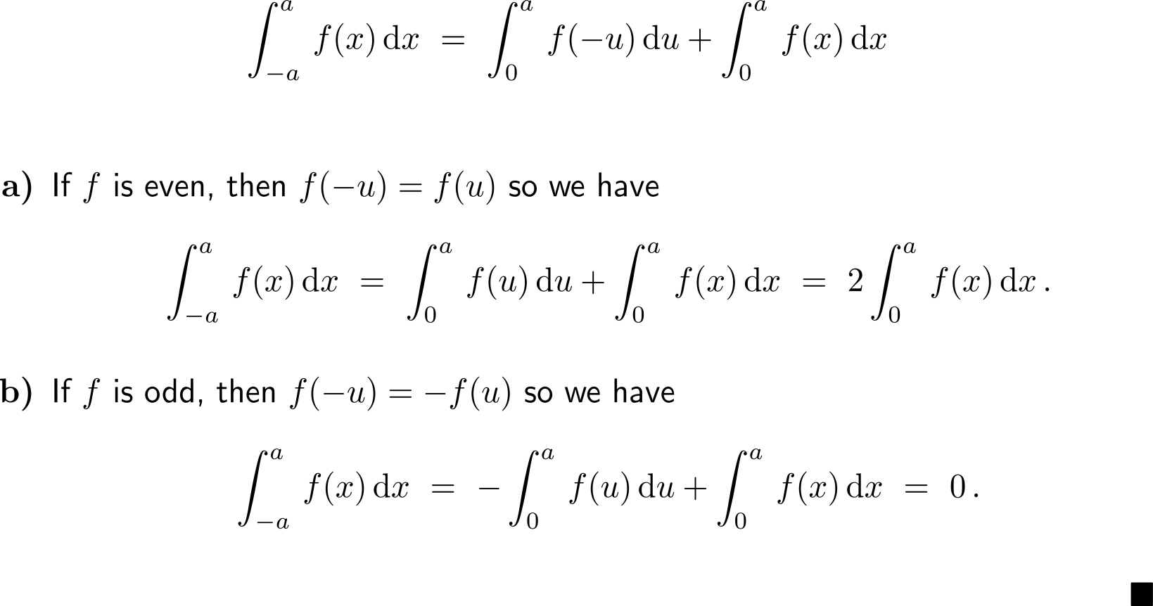
Proof of the theorem for integrals of symmetric functions (2/ 2)

Slide 10
Example: Definite Integrals of symmetric integrand functions

Slide 11
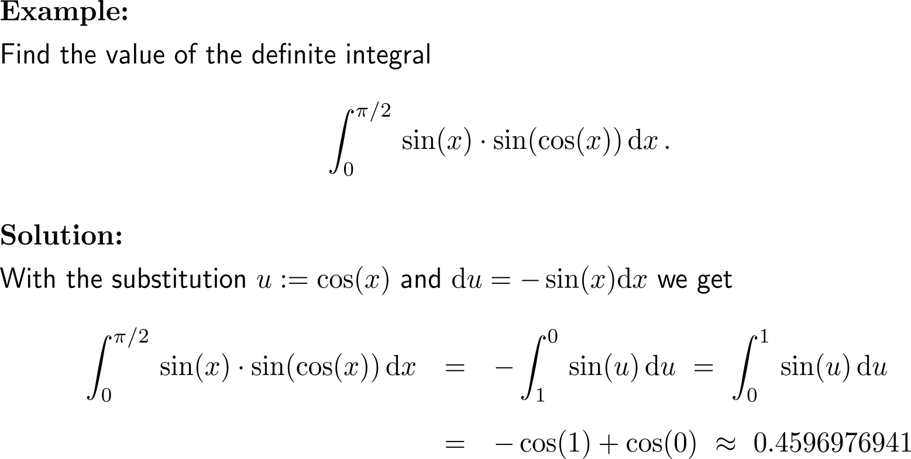
Example

Slide 12
Calculus I for Management

