Slide 1
Calculus I for MGMT – Integration First Applications of Integration
Mathematics for Management
Supplementary Electronic Materials
First Applications of Integration
The Substitution Rule for Definite Integrals
The Area Between Curves

Slide 2
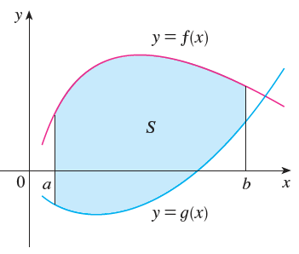
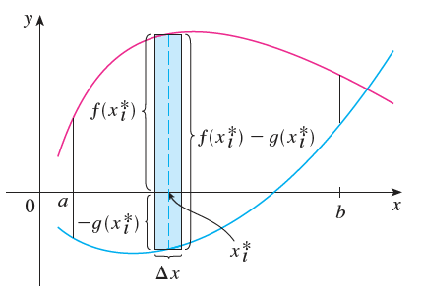
In order to compute an area between two curves, we play this problem back to the computation of areas between a curve and the x-axis …

Slide 3
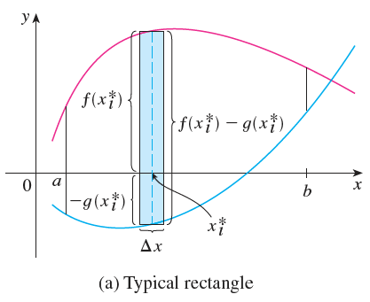
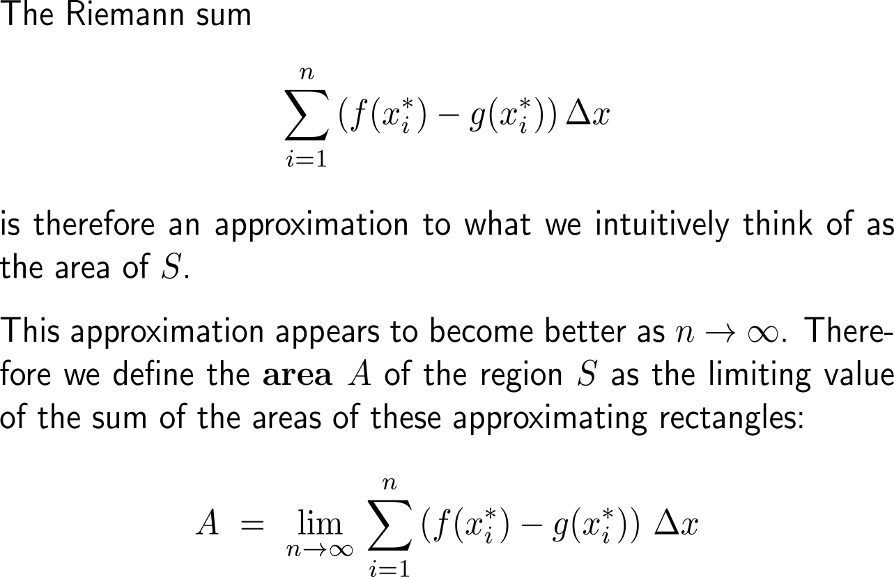
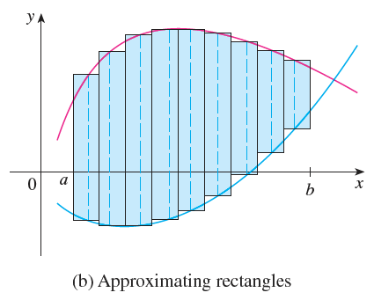
… and the known approximation of an area by Riemann sums …

Slide 4
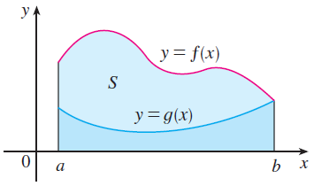
… and their limits
Notice that in the special case where g(x) = 0, S is the region between the graph of f and the x-axis such that our general definition of an area reduces to our previous definition.

Slide 5
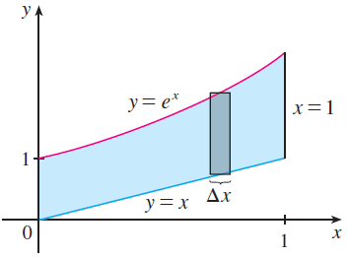
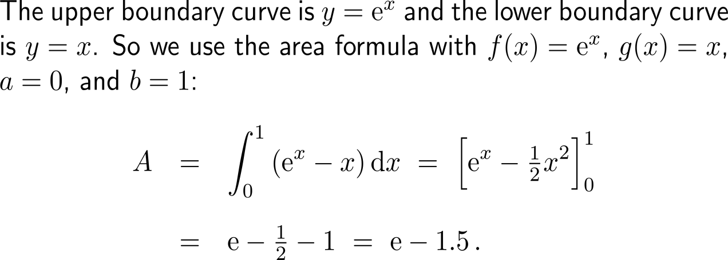
Example: Area bounded by curves

Slide 6
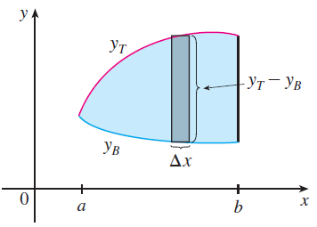
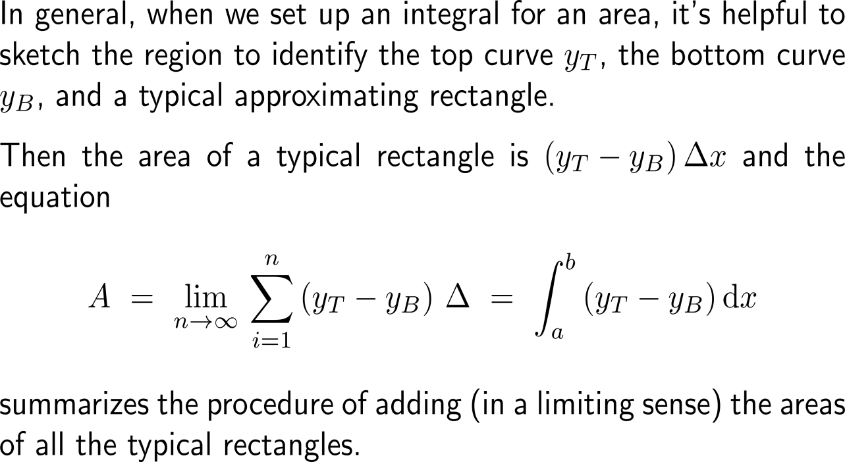
In order to evaluate the area integral correctly, we need to identify the top curve y_{T} and the bottom curve y_{B}

Slide 7
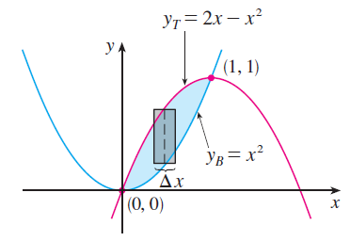
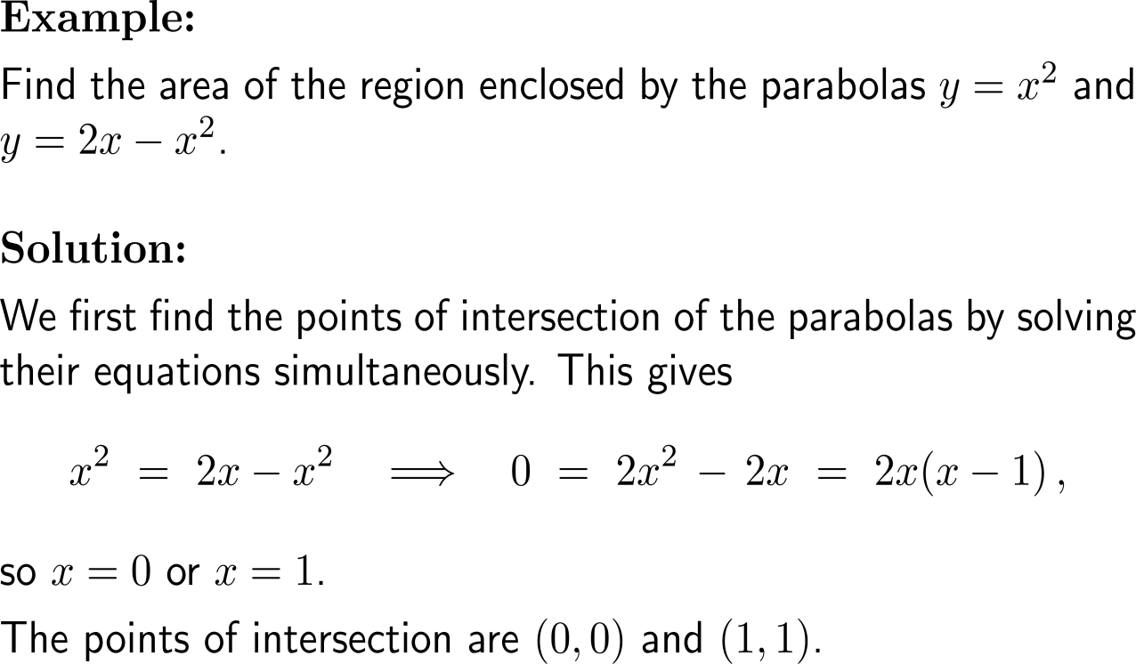
Example: Area bounded by curves

Slide 8
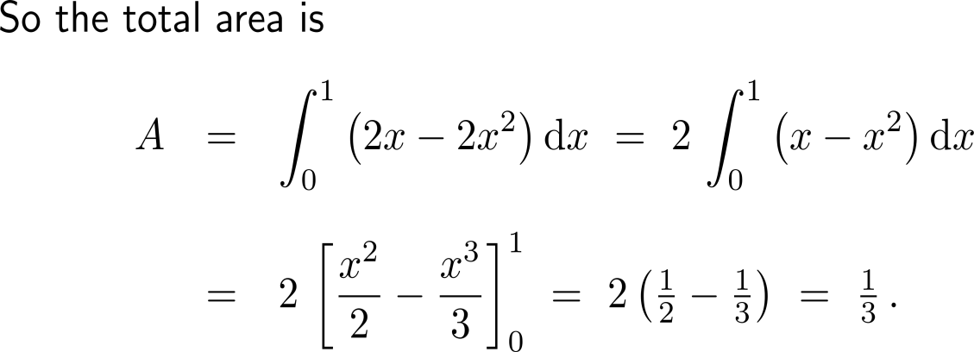
Example: Area bounded by curves

Slide 9
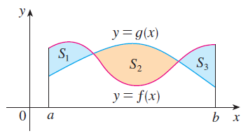
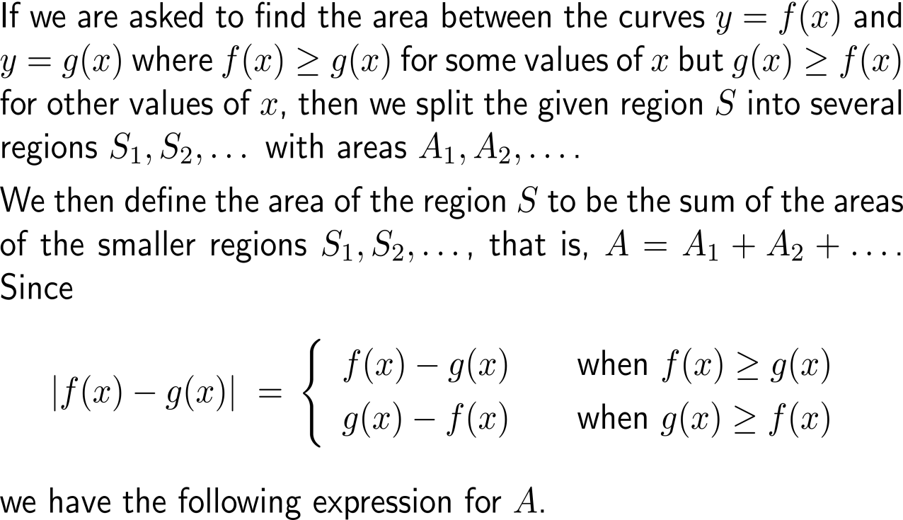
We can extend our formula for the are between two curves to situations where the top and bottom curves change on consecutive intervals …

Slide 10
… this gives the general formula for the area bounded by two graphs

Slide 11
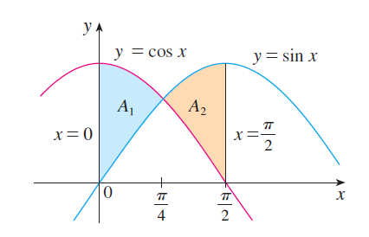
Example: Area bounded by curves

Slide 12
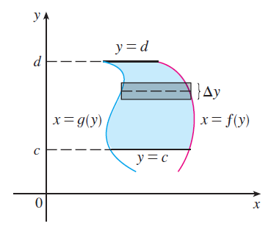
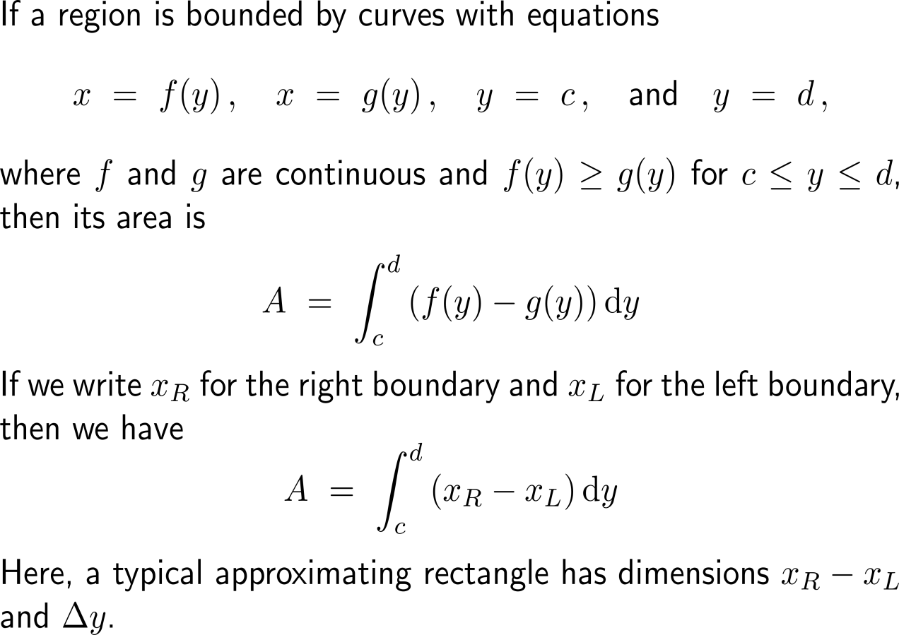
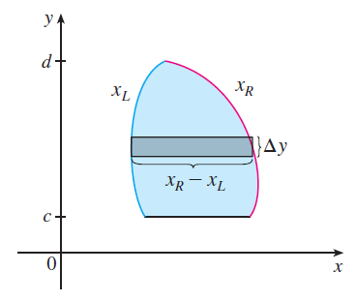
Some regions are best treated by regarding x as a function of y

Slide 13
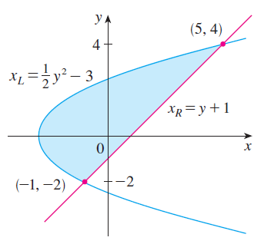
Example: Area bounded by curves

Slide 14
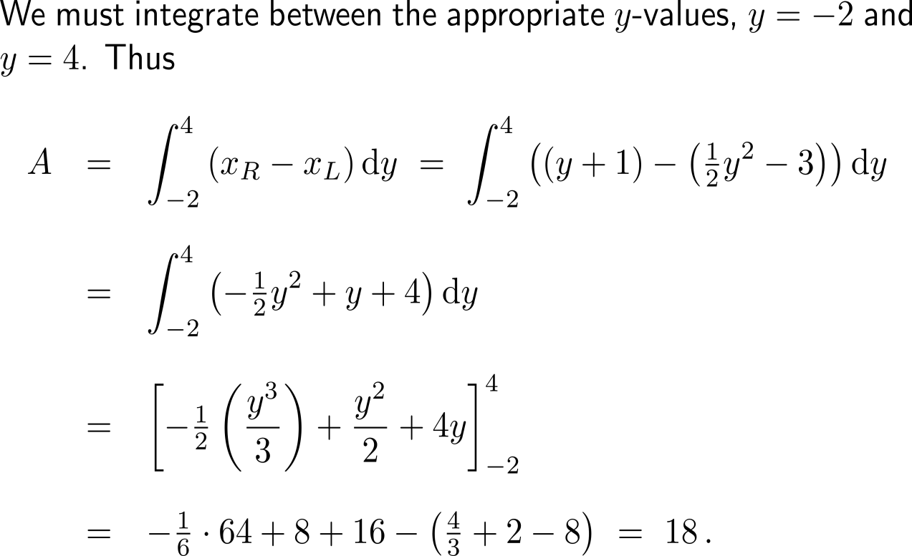
Example: Area bounded by curves

Slide 15
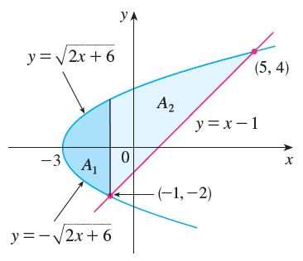
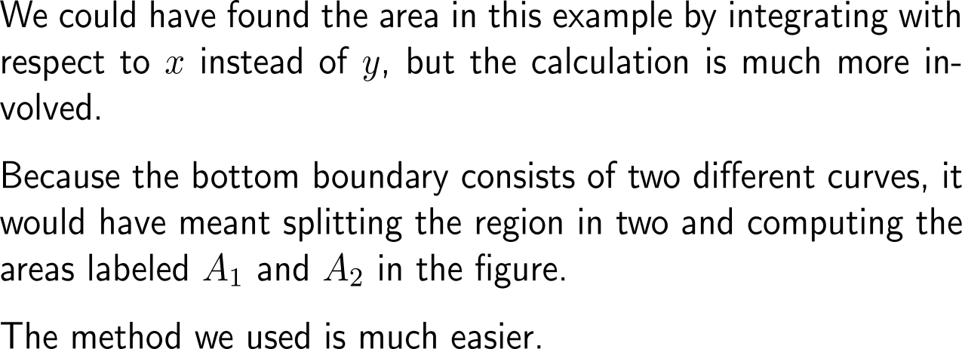
The value for the area is independent of the parameterization we used for the two curves

Slide 16
Calculus I for Management

