Slide 1
Calculus I for Management
1st Applications of the Fundamental Theorem of Calculus
week 13
Lecture
The Substitution Rule for definite integrals
The area between curves

Slide 2
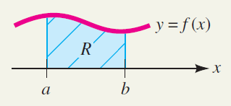
Recap: Last time we introduced the indefinite and definite integral …

Slide 3
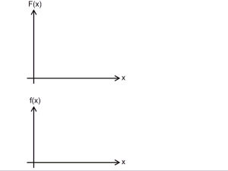
Recap: … as well as the Fundamental Theorem of Calculus

Slide 4
Topics
The Substitution Rule for Definite Integrals
The Area Between Curves

Slide 5
When using a substitution in a definite integral, we must put everything in terms of the new variable including the limits of integration

Slide 6
Proof of the Substitution Rule

Slide 7
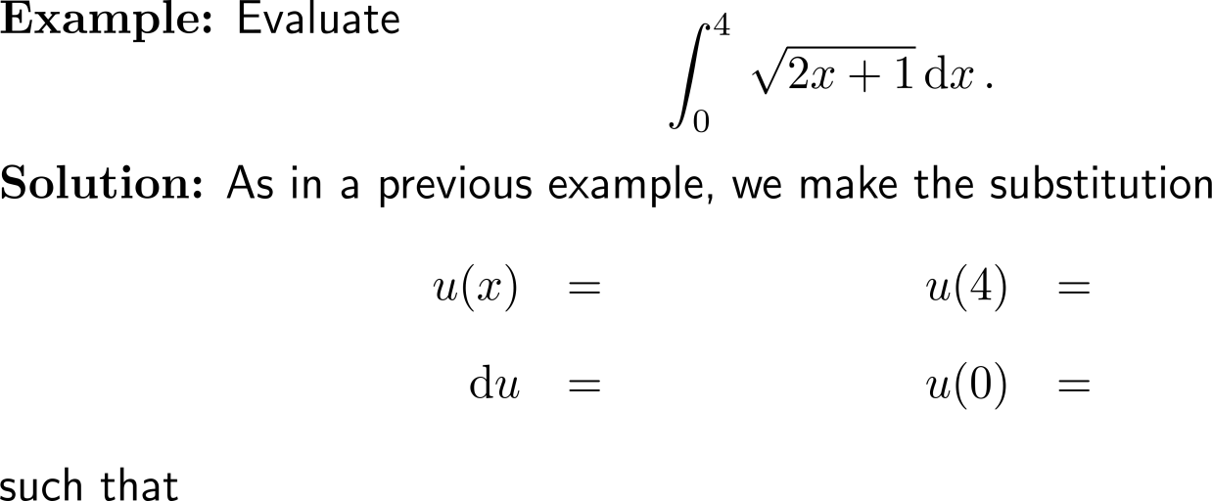
Example: Substitution Rule and definite integrals

Slide 8
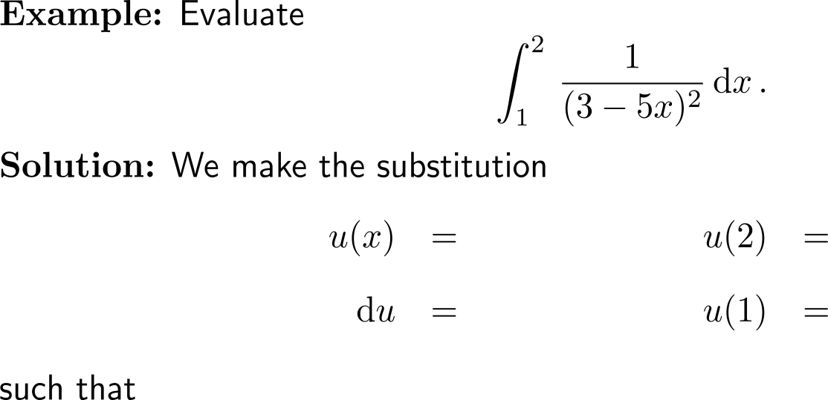
Example: Substitution Rule and definite integrals

Slide 9
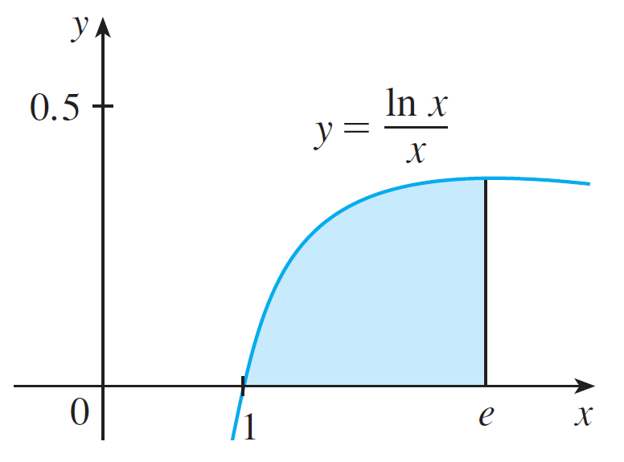
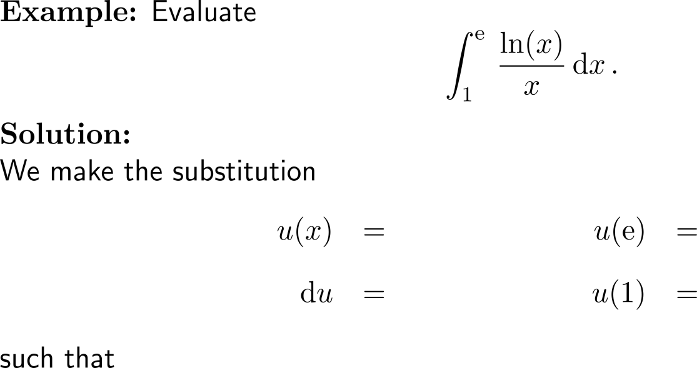
Example: Substitution Rule and definite integrals

Slide 10
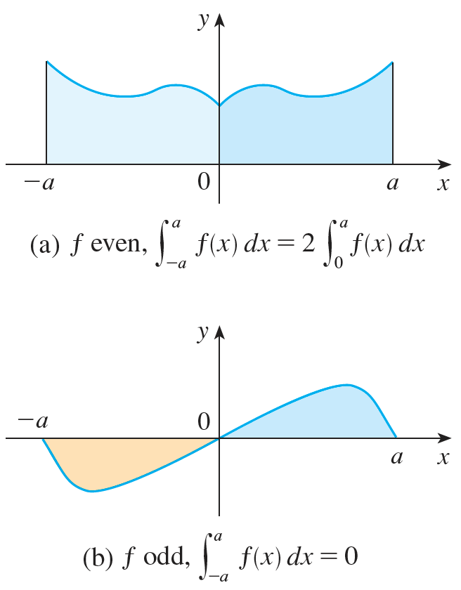
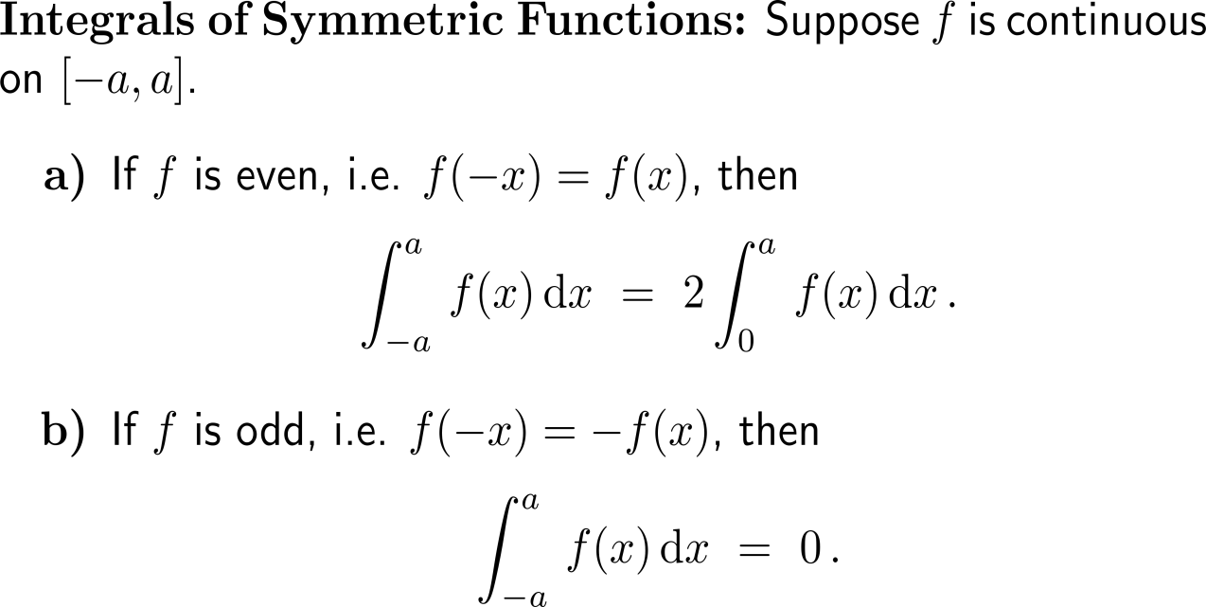
Symmetry considerations can simplify the evaluation of definite integrals considerably

Slide 11
Proof of the theorem for integrals of symmetric functions (1/ 2)

Slide 12
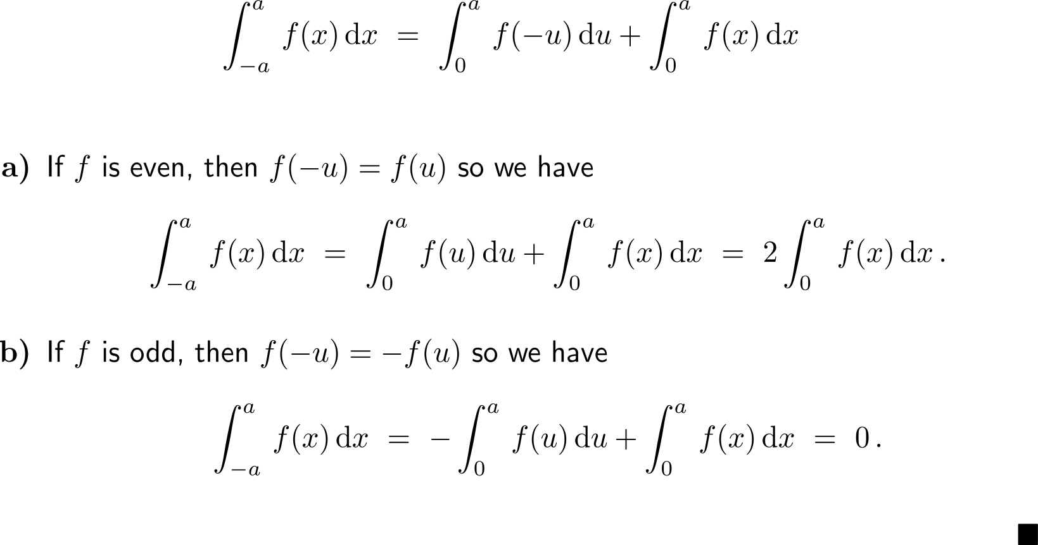
Proof of the theorem for integrals of symmetric functions (2/ 2)

Slide 13
Example: Definite Integrals of symmetric integrand functions

Slide 14
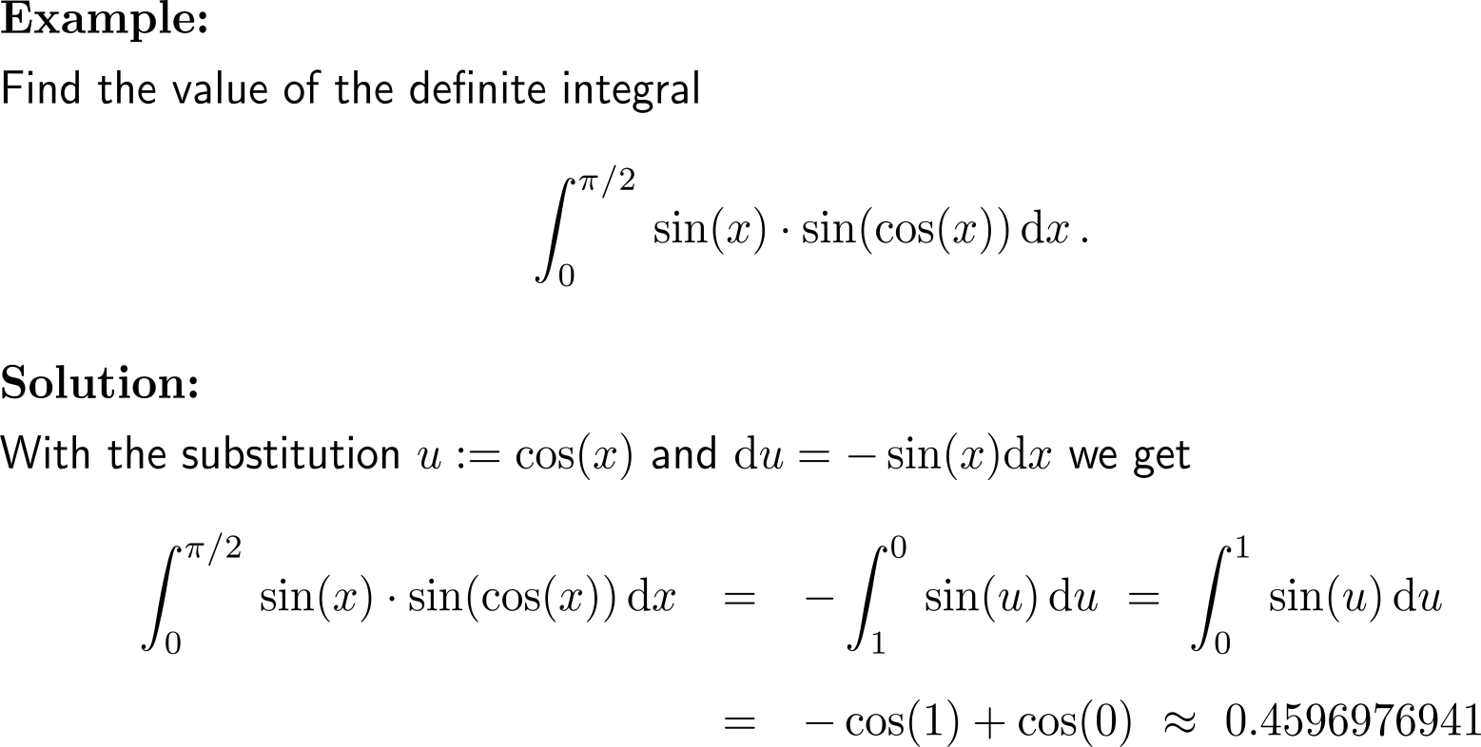
Example

Slide 15
Topics
The Substitution Rule for Definite Integrals
The Area Between Curves

Slide 16
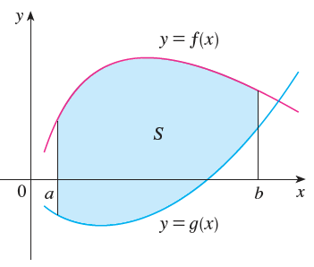
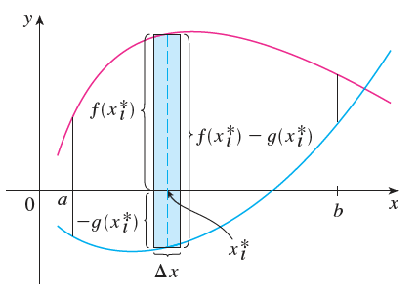
In order to compute an area between two curves, we play this problem back to the computation of areas between a curve and the x-axis …

Slide 17
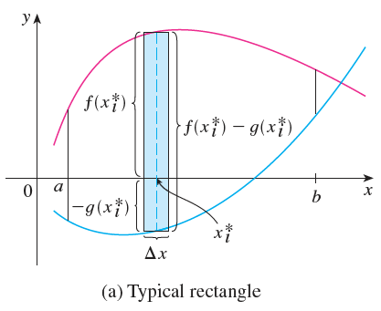
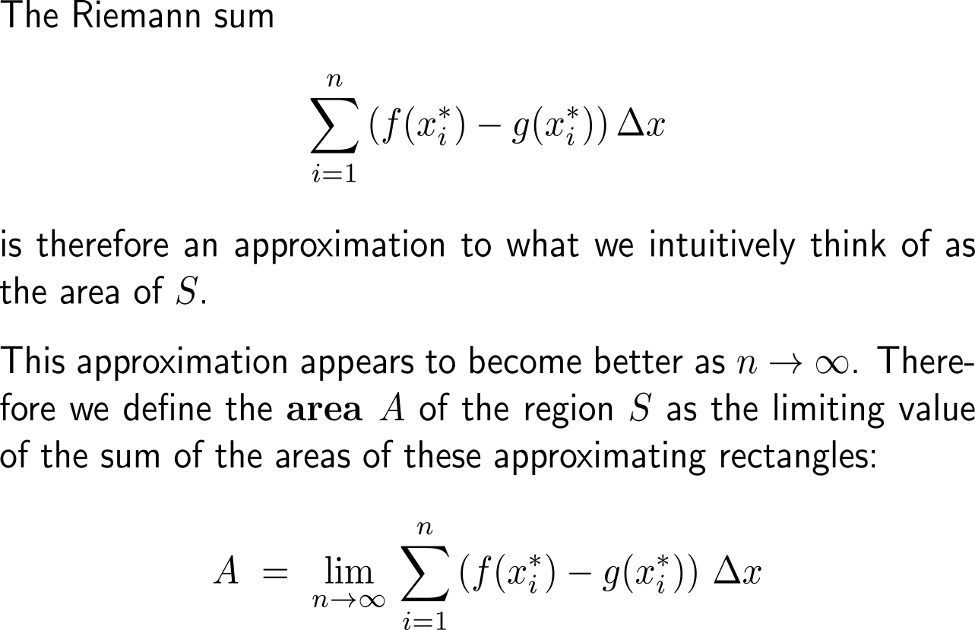
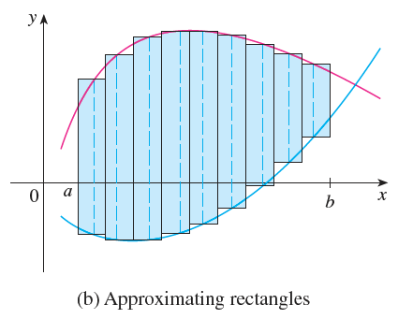
… and the known approximation of an area by Riemann sums …

Slide 18
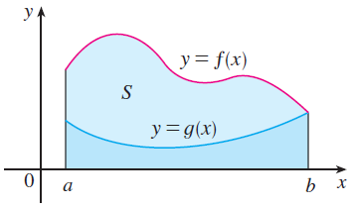
… and their limits
Notice that in the special case where g(x) = 0, S is the region between the graph of f and the x-axis such that our general definition of an area reduces to our previous definition.

Slide 19
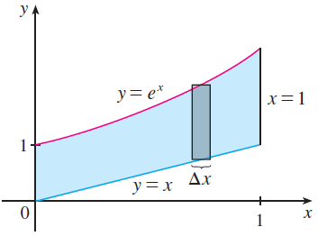
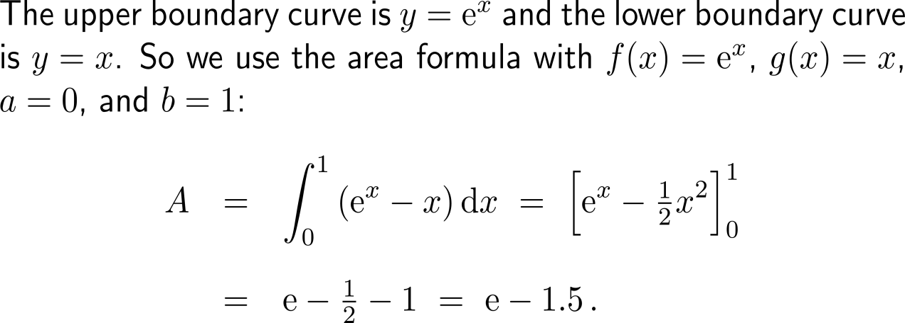
Example: Area bounded by curves

Slide 20
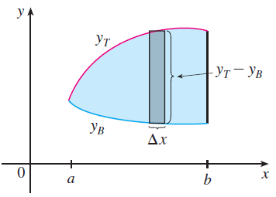
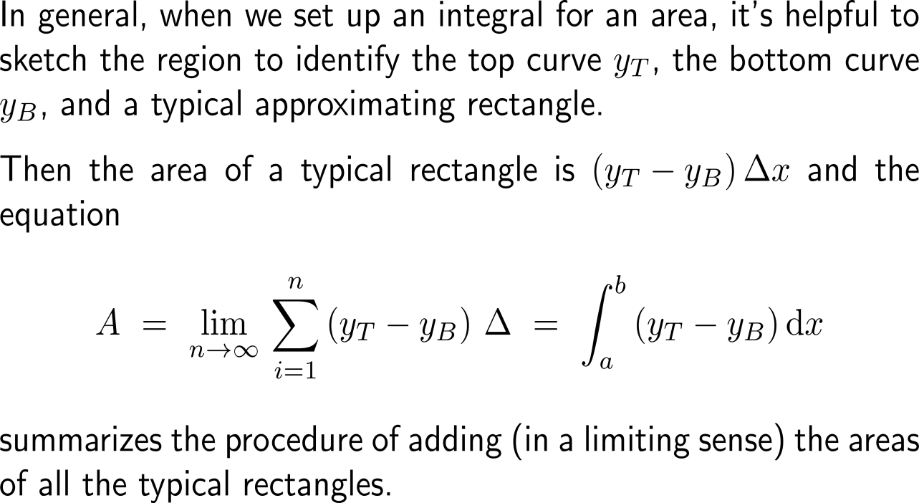
In order to evaluate the area integral correctly, we need to identify the top curve y_{T} and the bottom curve y_{B}

Slide 21
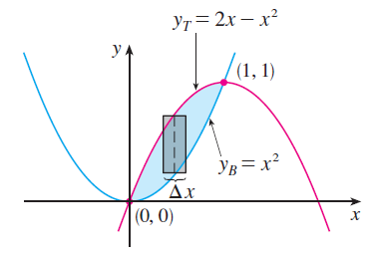
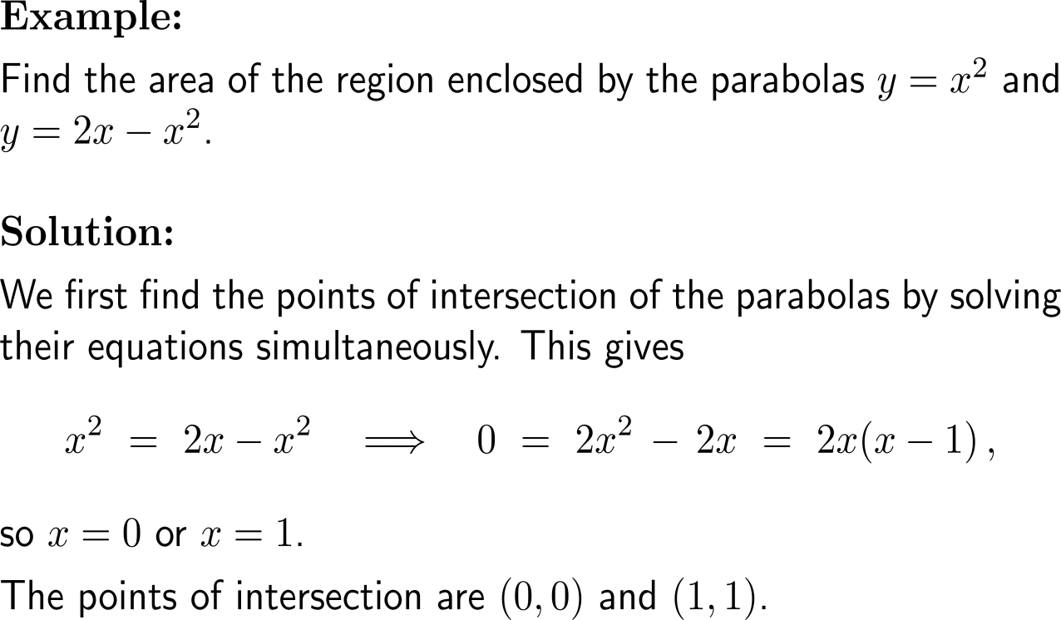
Example: Area bounded by curves

Slide 22
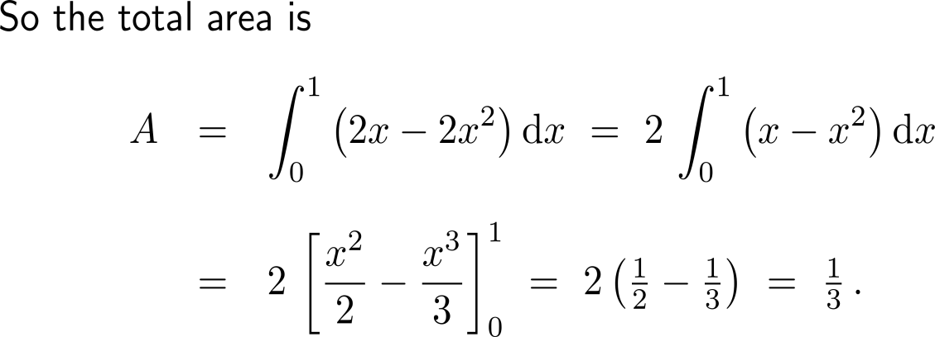
Example: Area bounded by curves

Slide 23
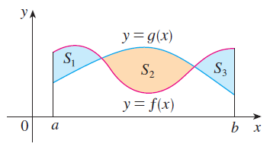
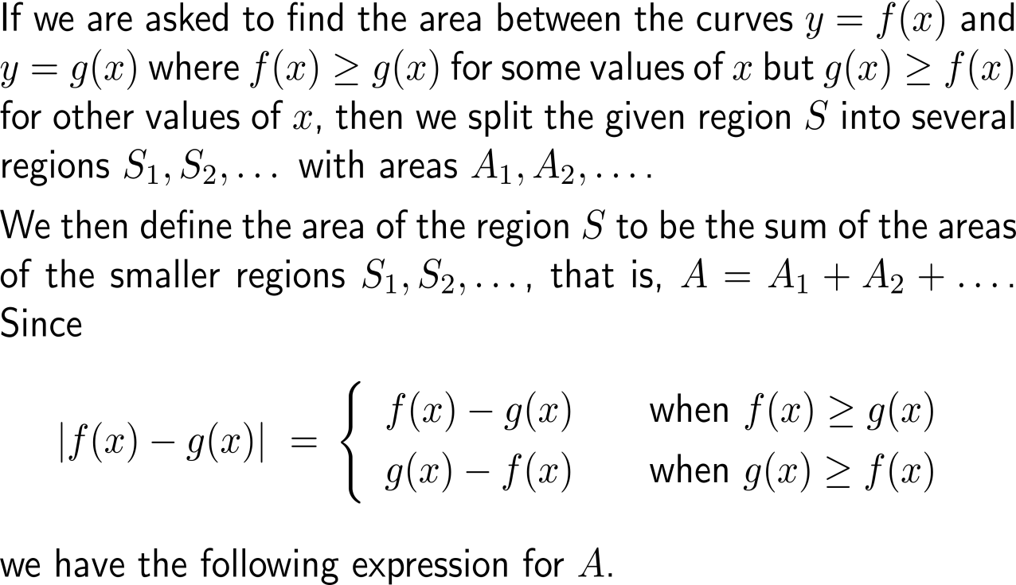
We can extend our formula for the are between two curves to situations where the top and bottom curves change on consecutive intervals …

Slide 24
… this gives the general formula for the area bounded by two graphs

Slide 25
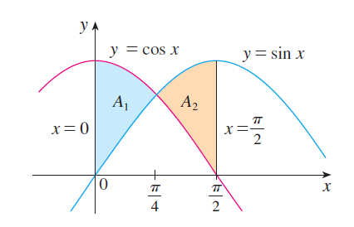
Example: Area bounded by curves

Slide 26
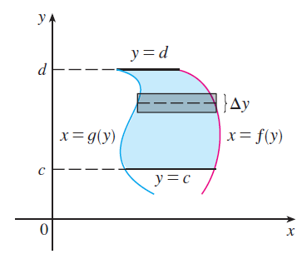
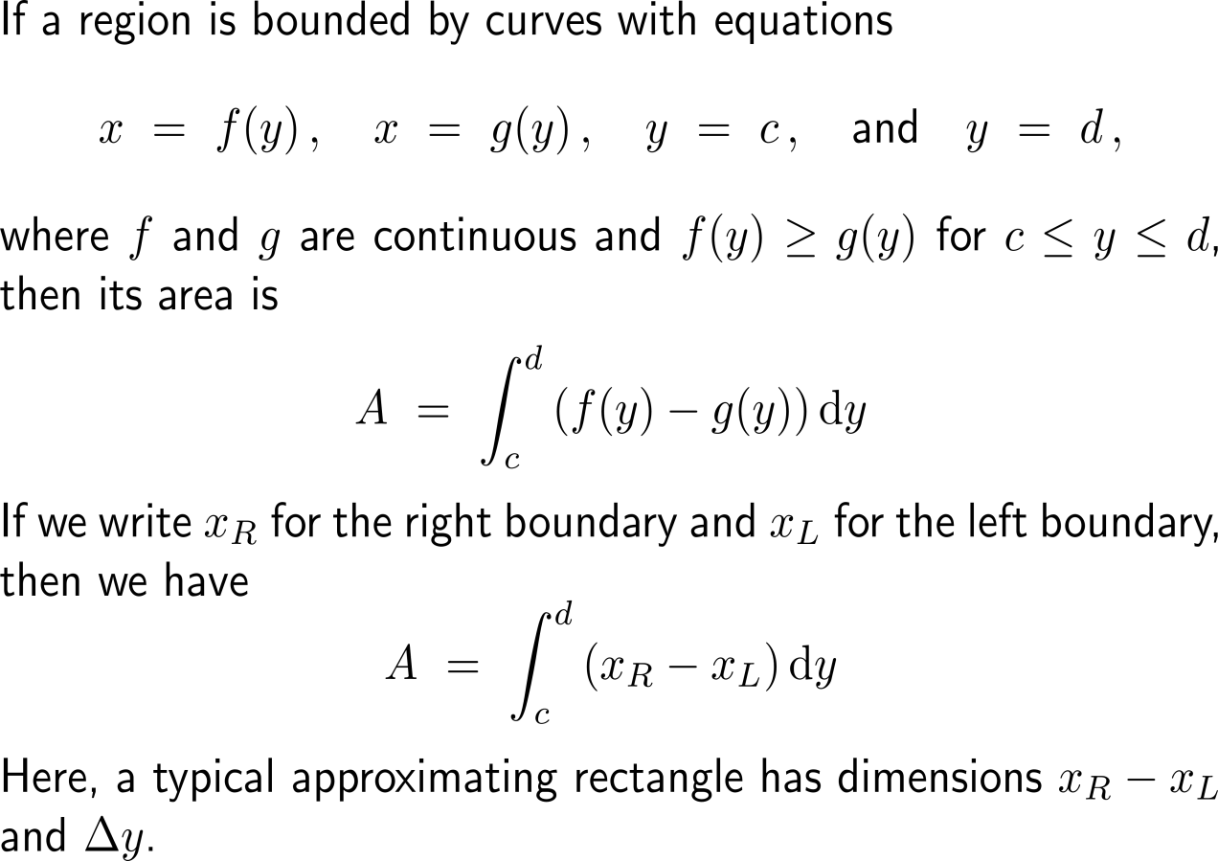
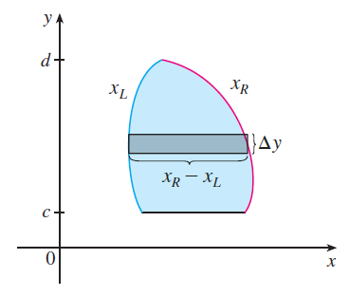
Some regions are best treated by regarding x as a function of y

Slide 27
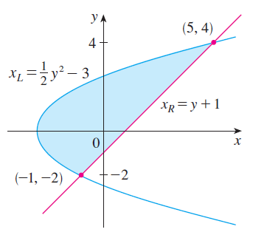
Example: Area bounded by curves

Slide 28
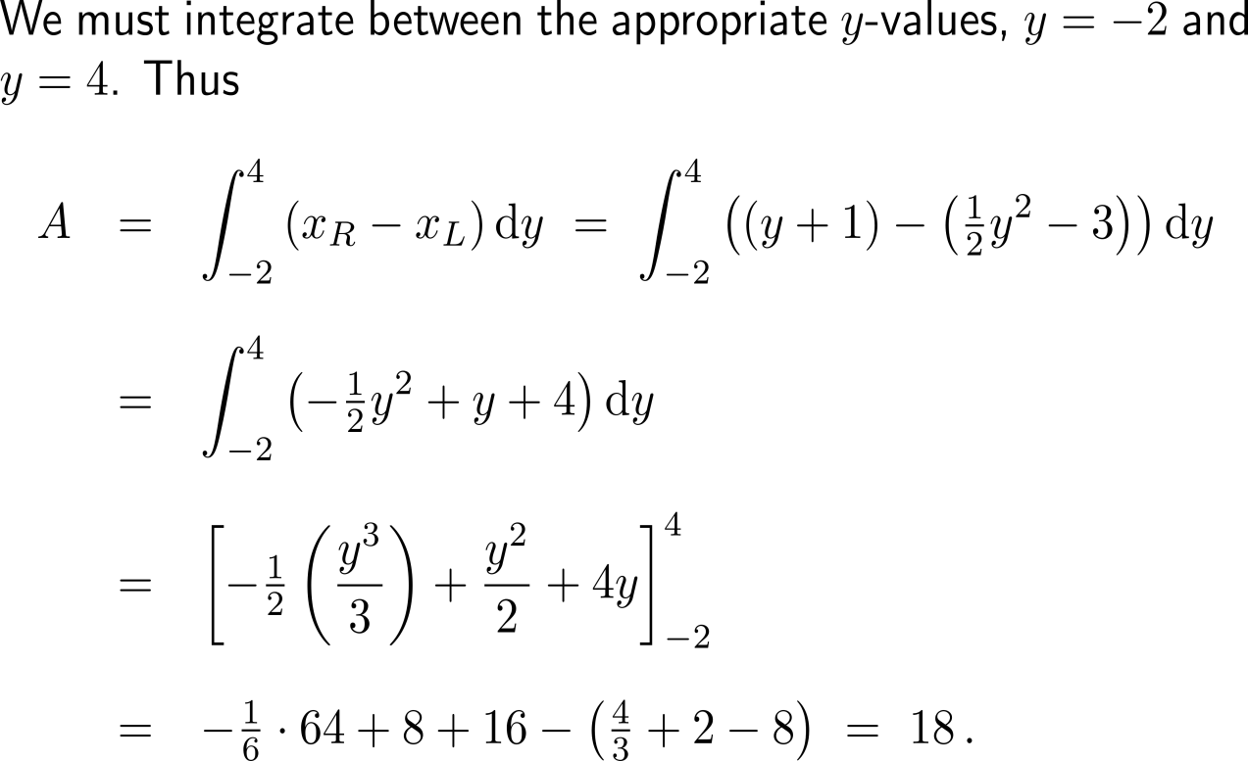
Example: Area bounded by curves

Slide 29
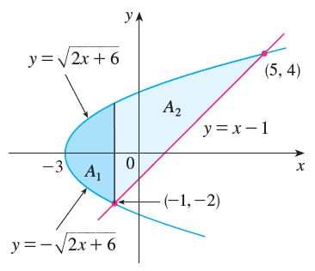
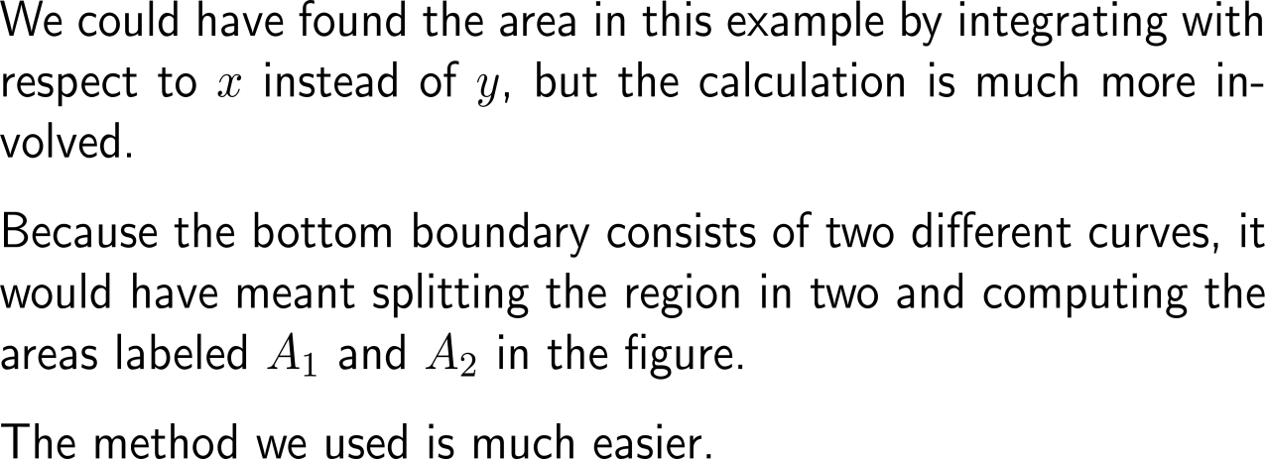
The value for the area is independent of the parameterization we used for the two curves

Slide 30
Further Worked-Out Exercises:
Calculus I for Management
Topics
Applications of the Fundamental Theorem of Calculus
Substitution Rule

Slide 31
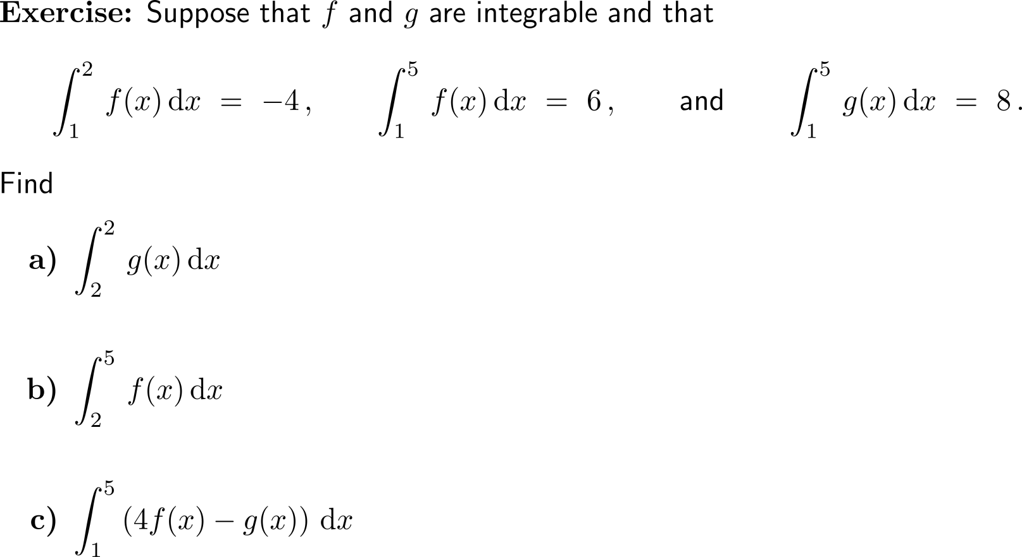
Exercise: Applying the rules for definite integrals
5 minutes
self-/ group-work
please, upload your solutions to the chat

Slide 32
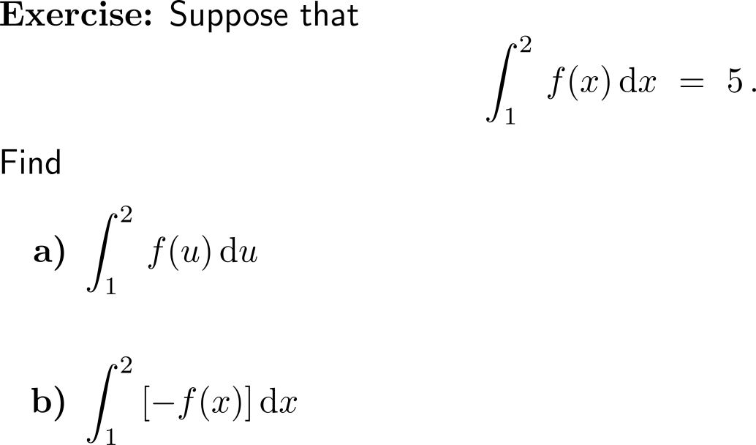
Exercise: Applying the rules for definite integrals
5 minutes
self-/ group-work
please, upload your solutions to the chat

Slide 33
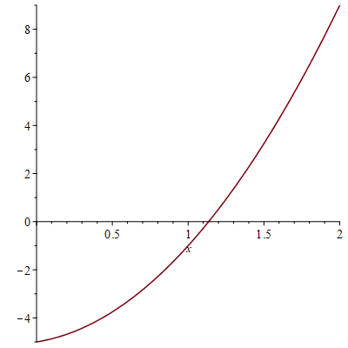
Exercise: Evaluating definite integrals
5 minutes
self-/ group-work
please, upload your solutions to the chat
f(x)

Slide 34
Exercise: Application of the Substitution Rule
5 minutes
self-/ group-work
please, upload your solutions to the chat

Slide 35
Exercise: Application of the Substitution Rule

Slide 36
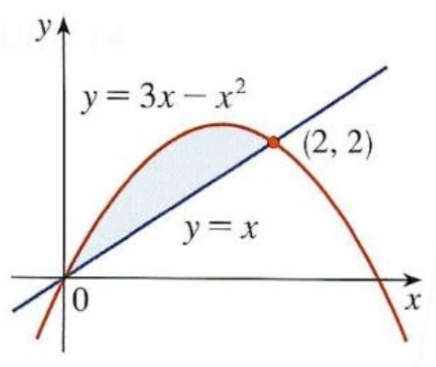
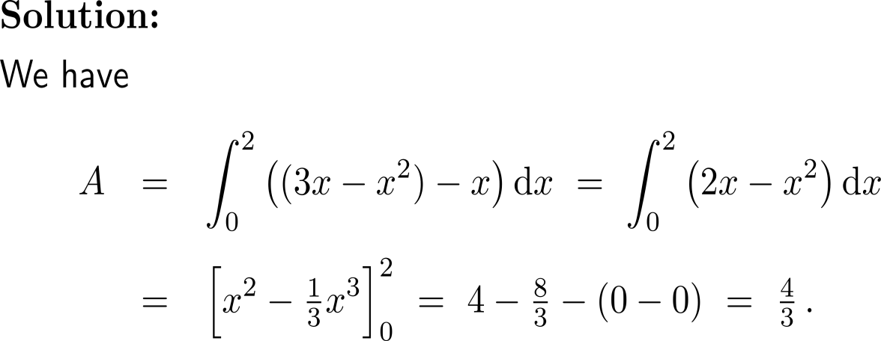
Exercise: Definite integrals and areas bounded by two curves
upper curve: y = 3x – x²
lower curve: y = x

Slide 37
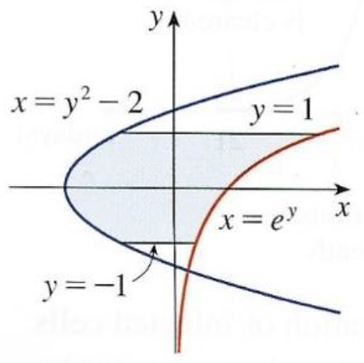
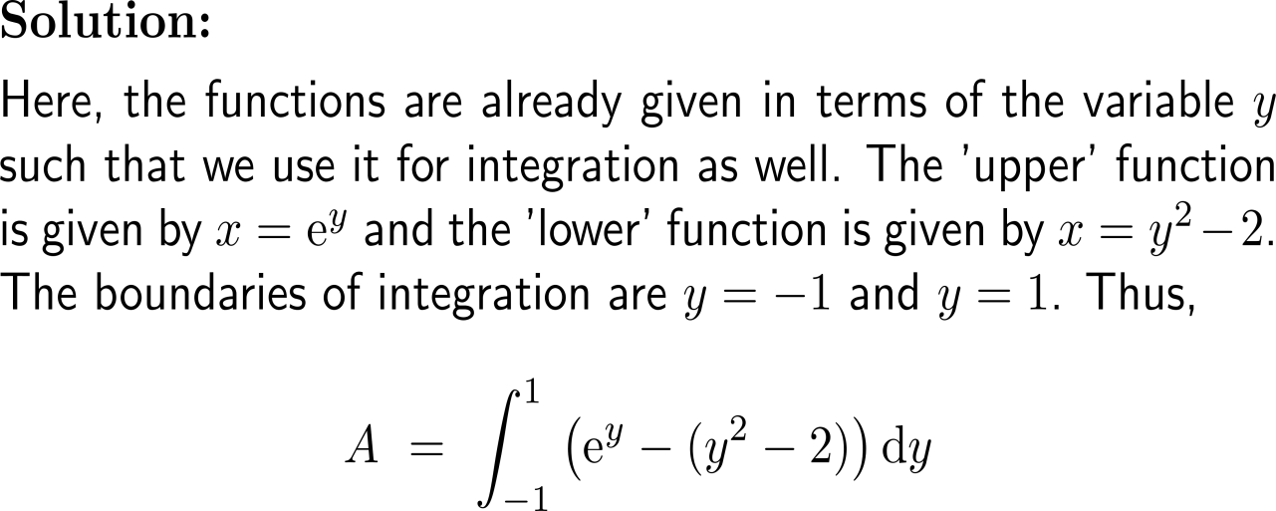
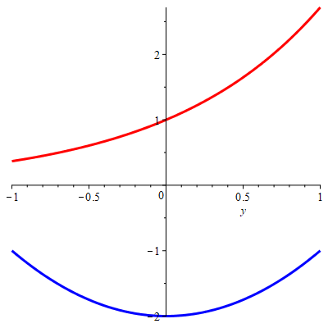
Exercise: Definite integrals and areas (horizontal approximation)

Slide 38
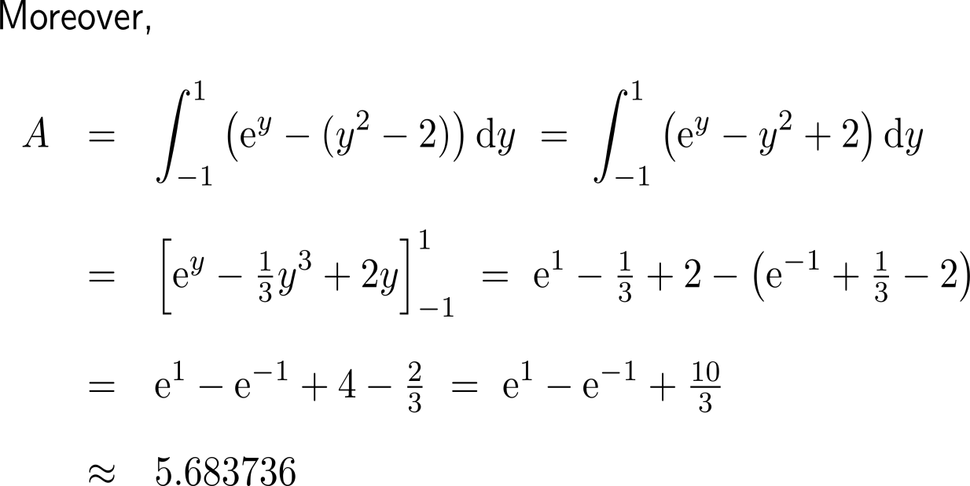
Exercise: Definite integrals and areas (horizontal approximation)
upper curve: x = e^{y}
lower curve: x = y² + 2

Slide 39
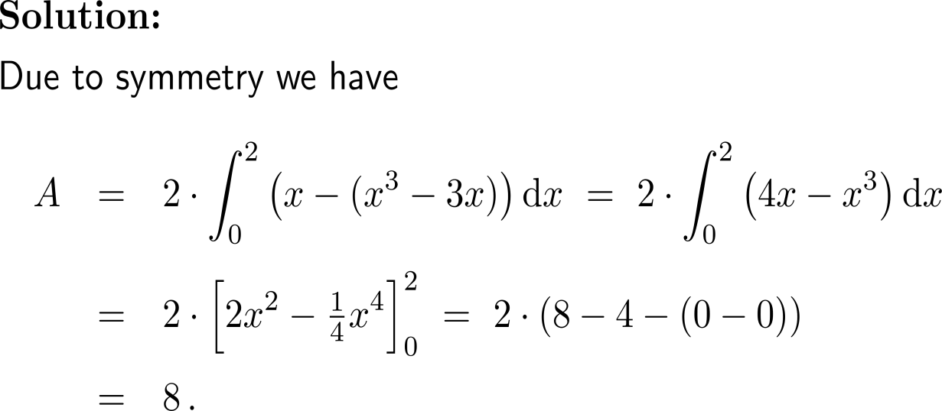
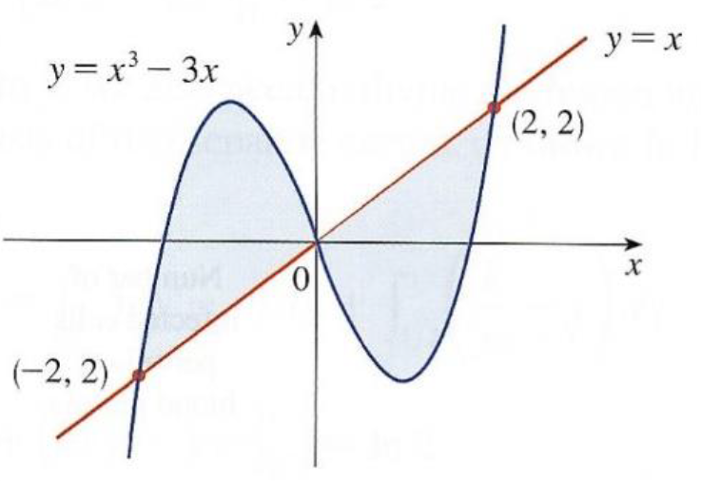
Exercise: Definite integrals and areas (vertical approximation)
10 minutes
self-/ group-work
please, upload your solutions to the chat

Slide 40
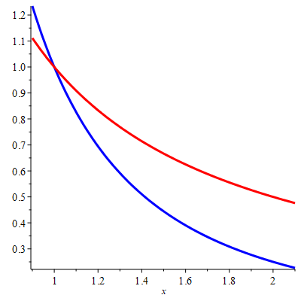
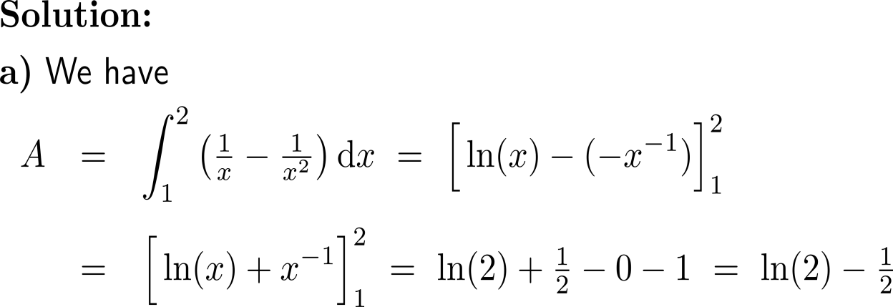
Exercise: Definite integrals and areas
upper curve: y = 1/x
lower curve: y = 1/x²
height: 1/x – 1/x²
width: dx
x = 1

Slide 41
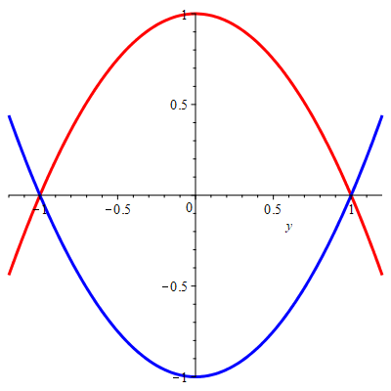
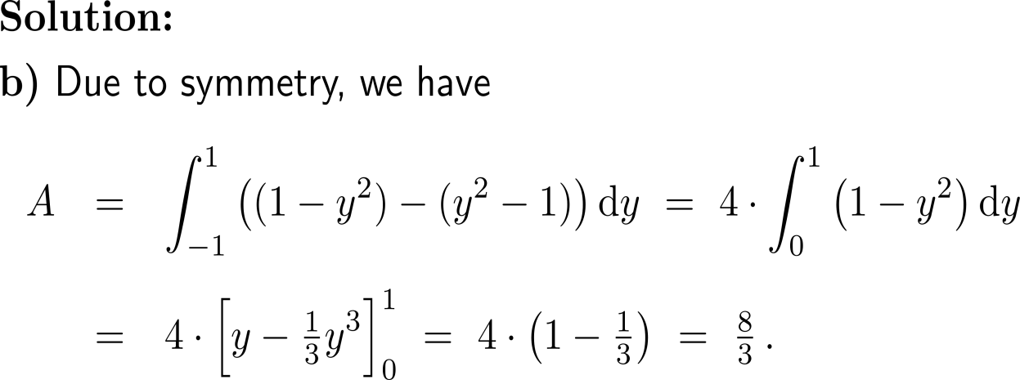
Exercise: Definite integrals and areas
b)
y = -1
y = 1
height: (1 – y²) – (y² – 1)
width: dy
upper curve: x = 1 – y²
lower curve: x = y² – 1

Slide 42
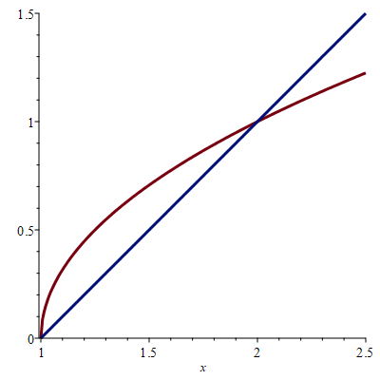
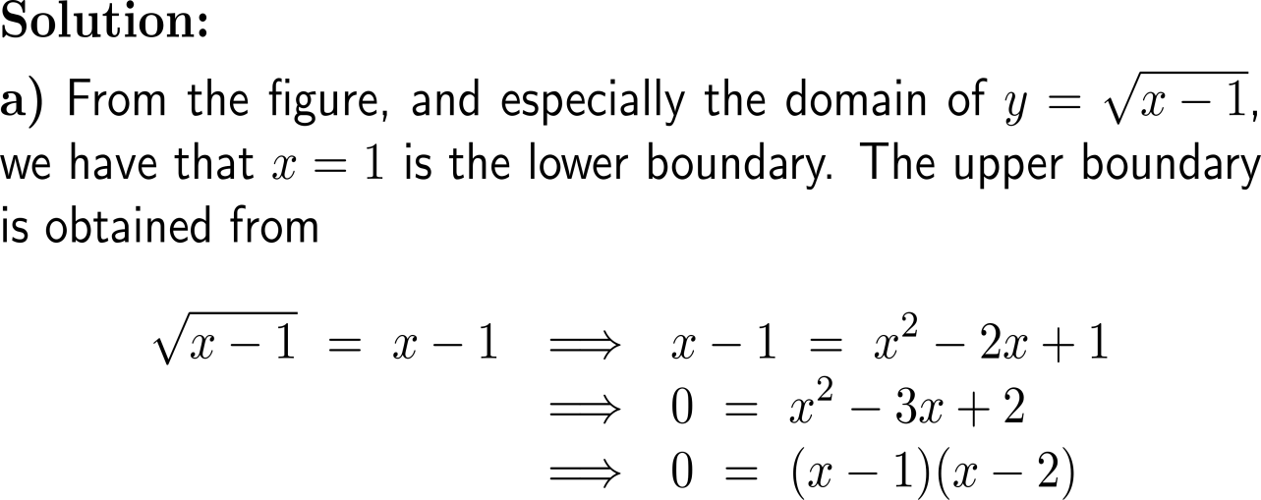
Exercise: Areas enclosed by two curves
A
upper curve: y = (x-1)^{1/2}
lower curve: y = x-1

Slide 43
Exercise: Areas enclosed by two curves
A
upper curve: y = (x-1)^{1/2}
lower curve: y = x-1

Slide 44
Exercise: Areas enclosed by two curves
b)

Slide 45
Exercise: Areas enclosed by two curves
x = 1
x = 2
A

Slide 46
Exercise: Equal partitioning
b

Slide 47
Exercise: Definite integrals with the same value

Slide 48
Exercise: Definite integrals with the same value

Slide 49
Calculus I for Management

