Slide 1
Calculus I for MGMT – Integration Applications of Integration in Economics
Mathematics for Management
Supplementary Electronic Materials
Applications of Integration in Economics
Net Excess Profit & Lorenz Curves
The Average Value of a Function
Future Value & Present Value of an Income Flow
Consumer Willingness to Spend & Consumer’s Surplus

Slide 2
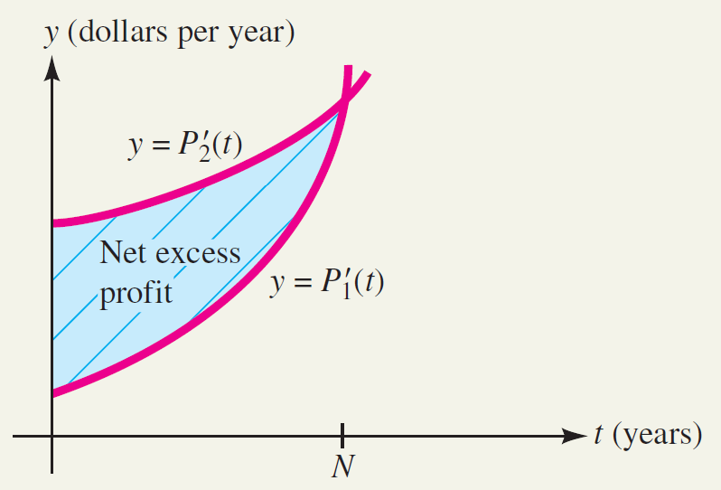
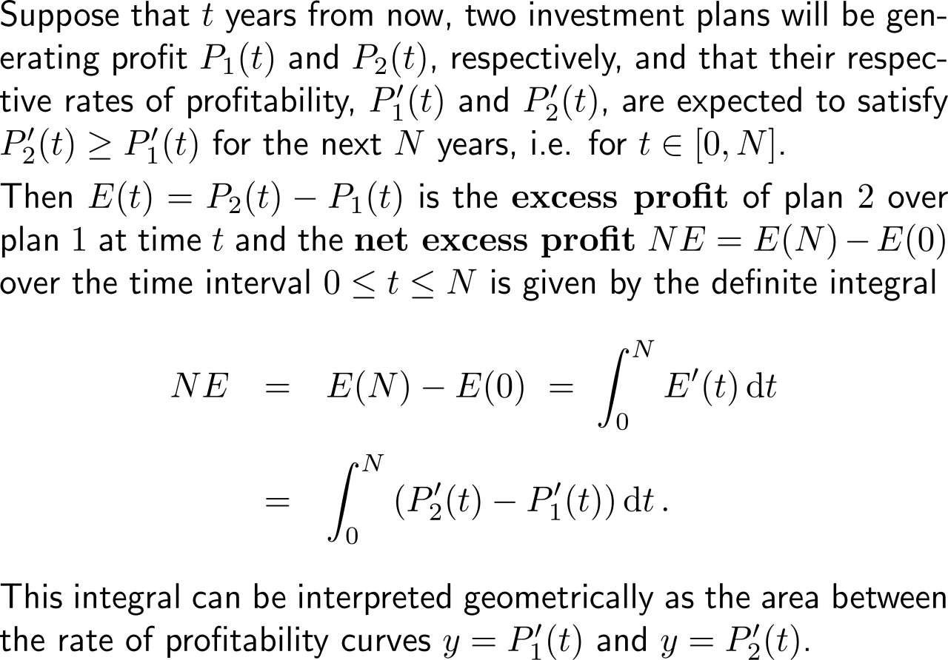
The net excess profit is the accumulated difference between two profit schemes

Slide 3
Example: Finding net excess profit

Slide 4
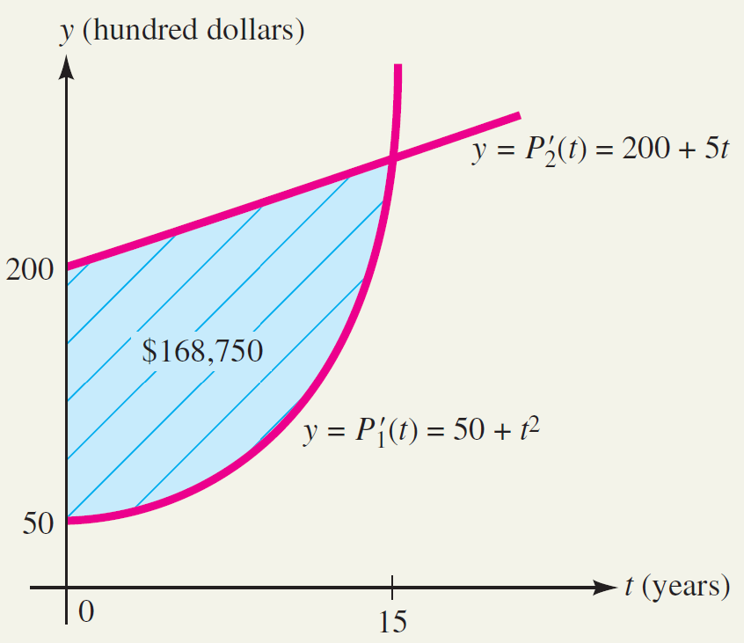
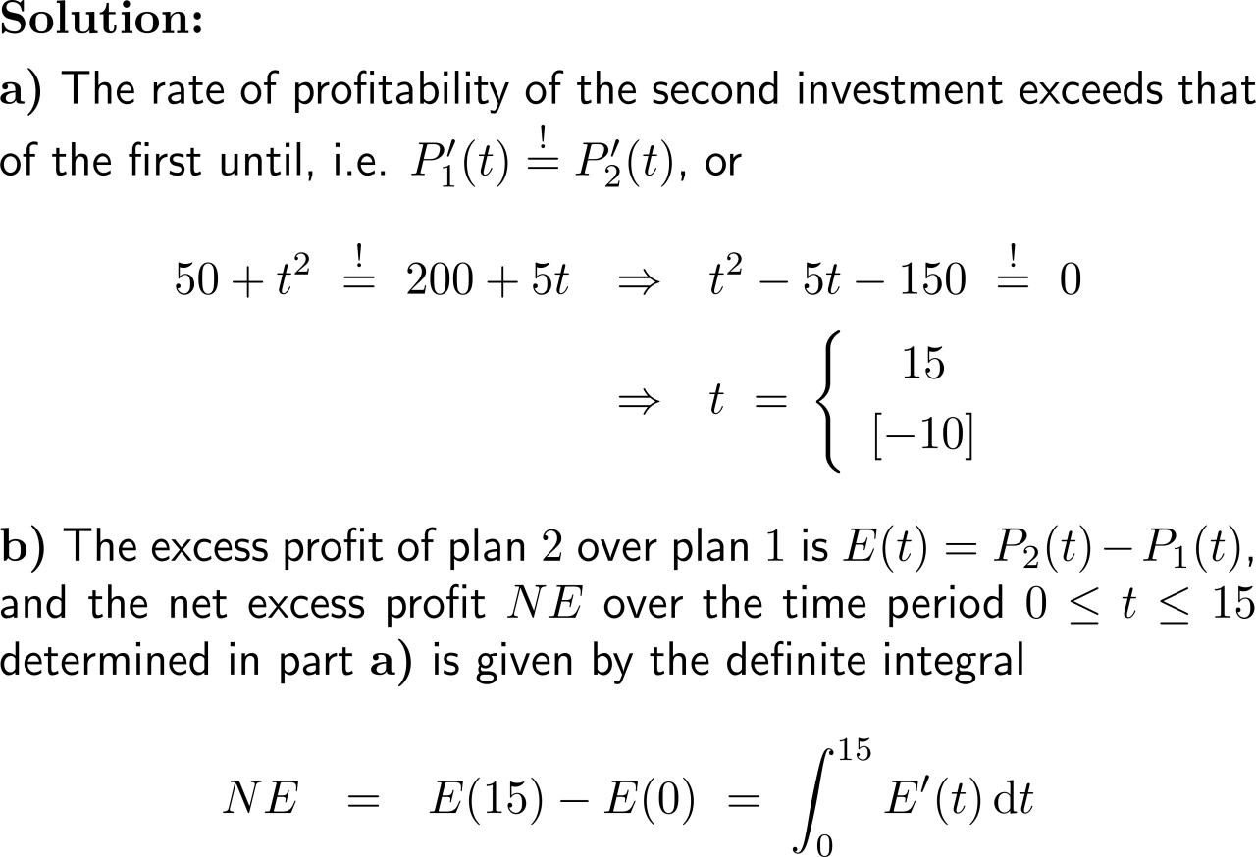
Example: Finding net excess profit

Slide 5
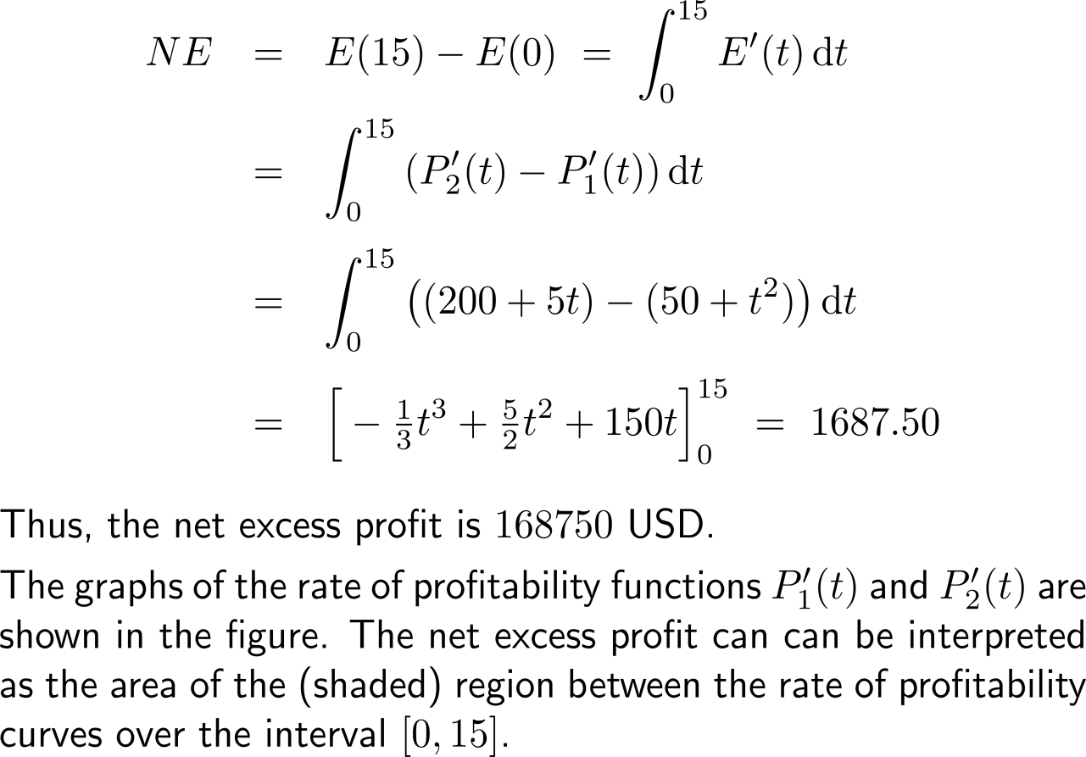
Example: Finding net excess profit

Slide 6
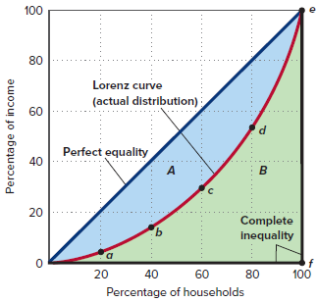
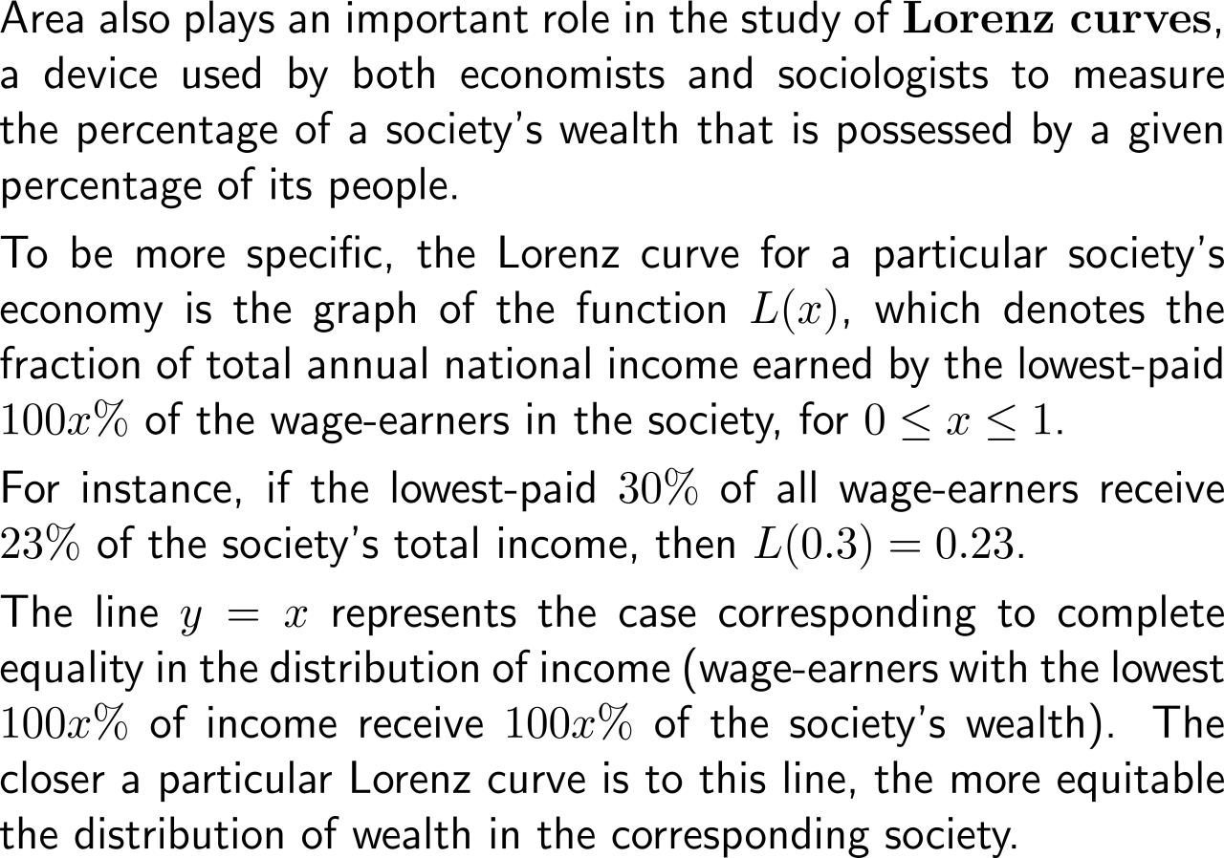
The Lorenz curves illustrates the percentage of a society’s wealth that is possessed by a given percentage of its people

Slide 7
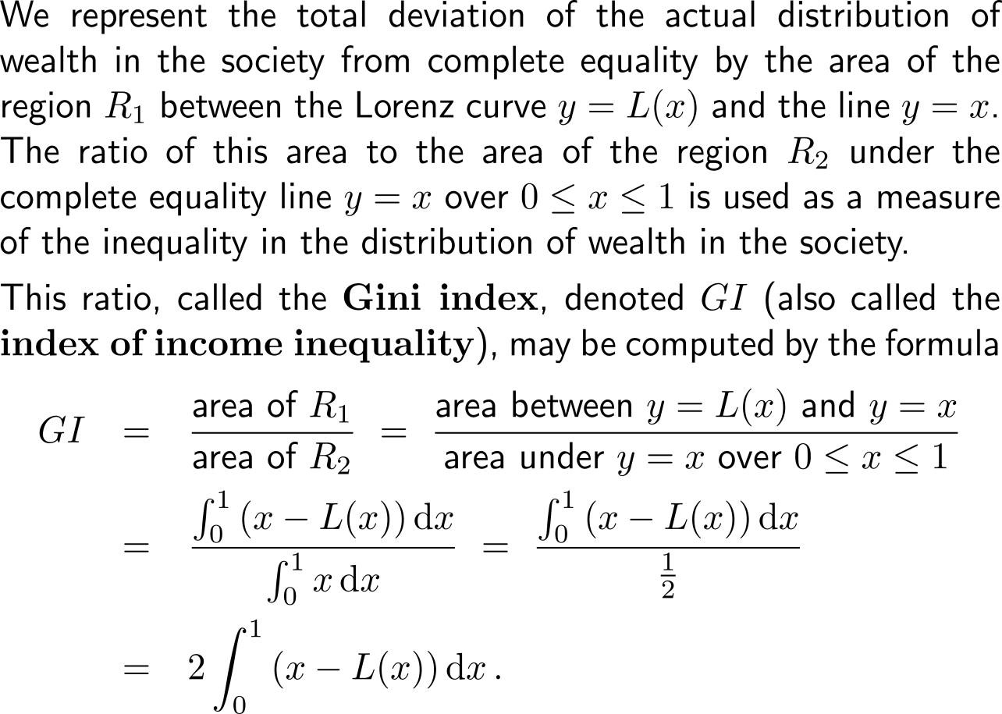
The Gini index is a measure fir the inequality in the distribution of wealth in a society (1/ 2)

Slide 8
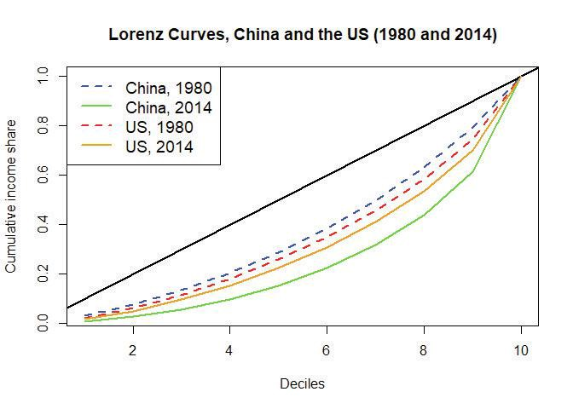
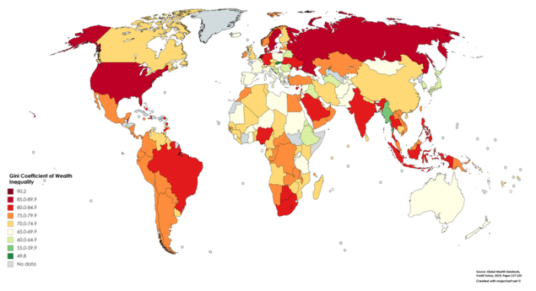
The Gini index is a measure fir the inequality in the distribution of wealth in a society (2/ 2)
Gini Coefficient of Wealth Inequality
(source: Global wealth databook 2019, Credit Suisse)

Slide 9
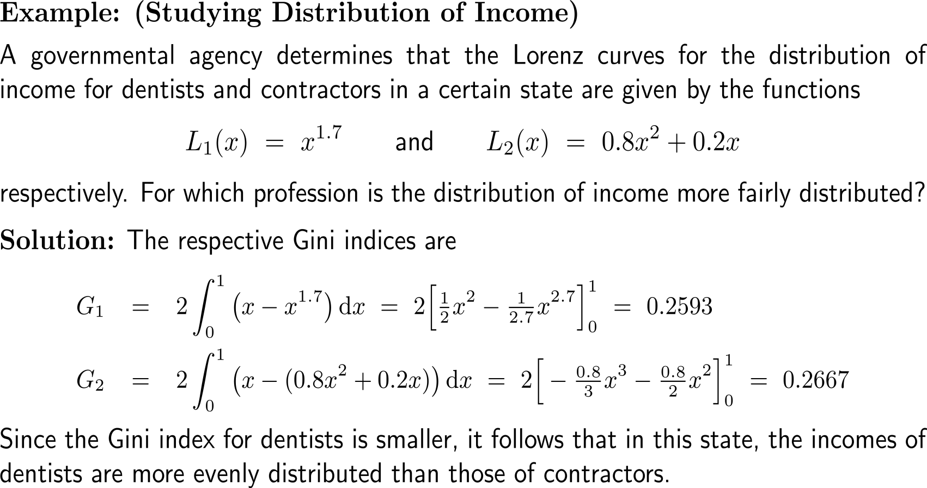
Example: Studying distribution of income

Slide 10
Calculus I for Management

