Slide 1
Calculus I for MGMT – Integration Applications of Integration in Economics
Mathematics for Management
Supplementary Electronic Materials
Applications of Integration in Economics
Net Excess Profit & Lorenz Curves
The Average Value of a Function
Future Value & Present Value of an Income Flow
Consumer Willingness to Spend & Consumer’s Surplus

Slide 2
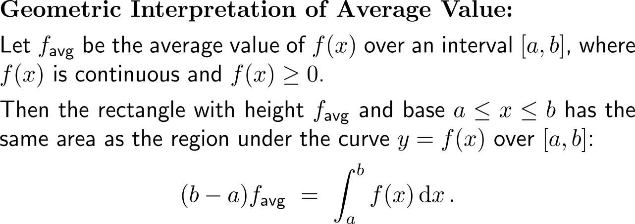
The average value of a function over an interval is its corresponding definite integral divided by the length of the interval

Slide 3
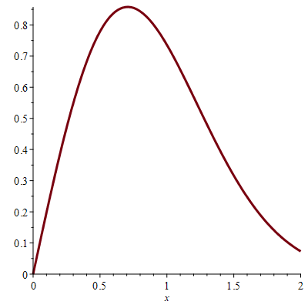
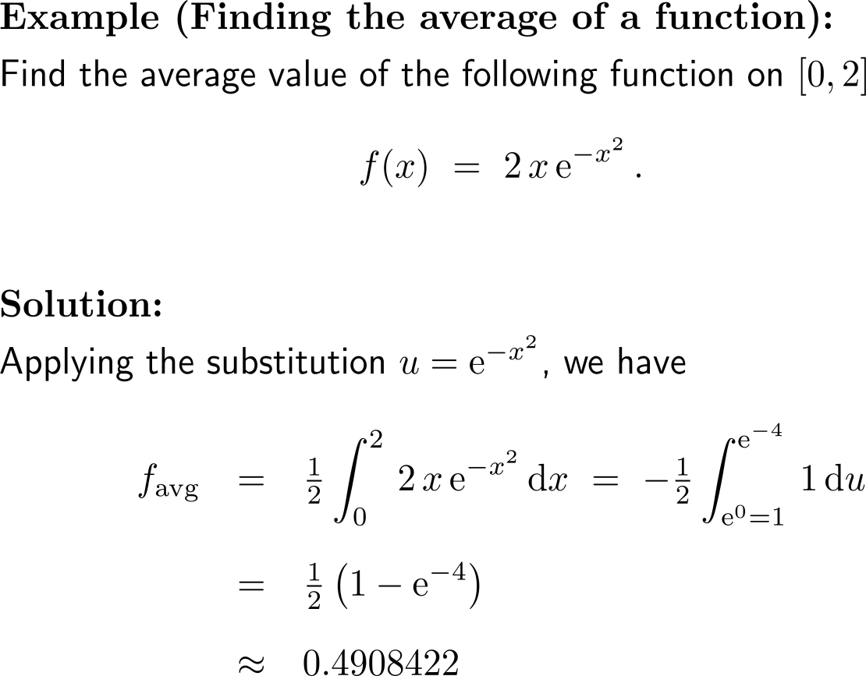
Example: Finding the average of a function
f(x)

Slide 4
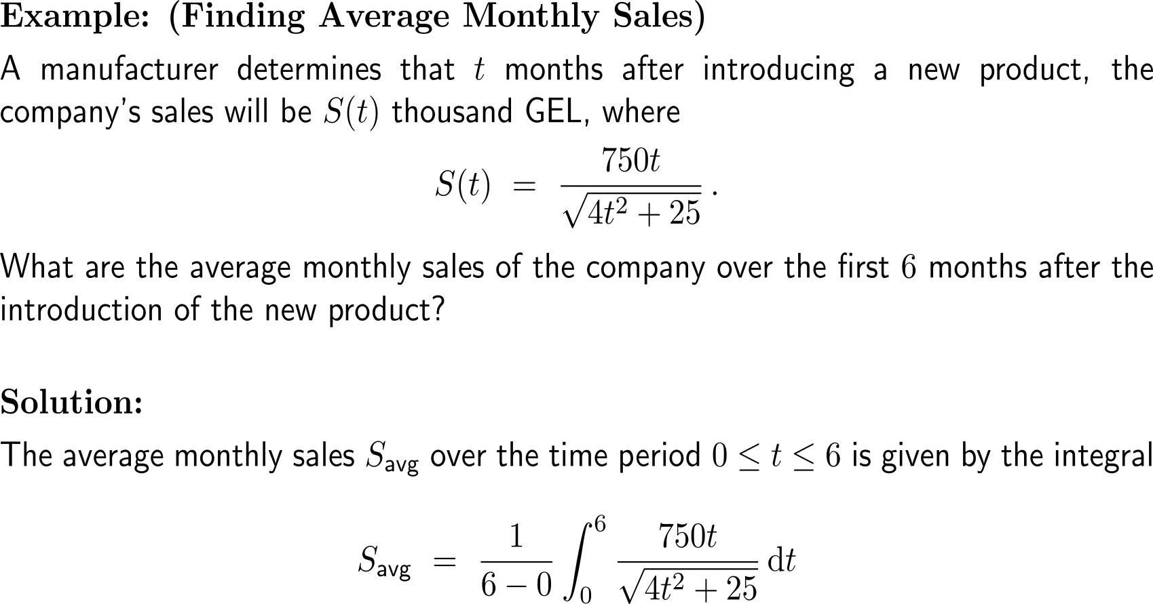
Example: Finding average monthly sales

Slide 5
Example: Finding average monthly sales

Slide 6
The average value equals the average rate of change of any of the functions antiderivatives

Slide 7
Calculus I for Management

