Slide 1
Calculus I for MGMT – Integration Applications of Integration in Economics
Mathematics for Management
Supplementary Electronic Materials
Applications of Integration in Economics
Net Excess Profit & Lorenz Curves
The Average Value of a Function
Future Value & Present Value of an Income Flow
Consumer Willingness to Spend & Consumer’s Surplus

Slide 2
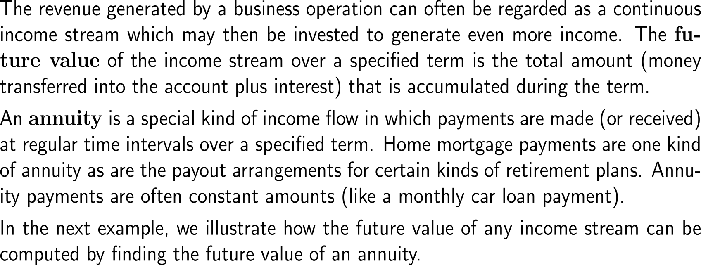
The future value is the total amount (payments plus interest) that is accumulated during a term

Slide 3
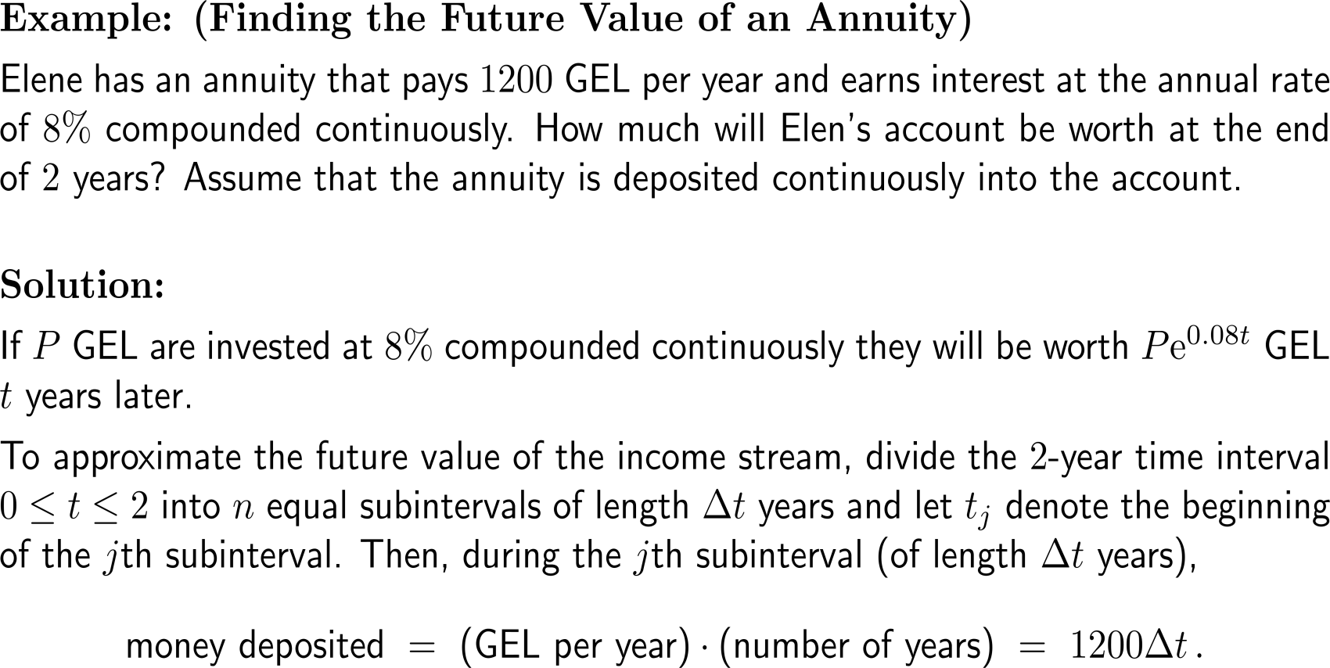
Example: Finding the future value of an annuity

Slide 4
Example: Finding the future value of an annuity

Slide 5
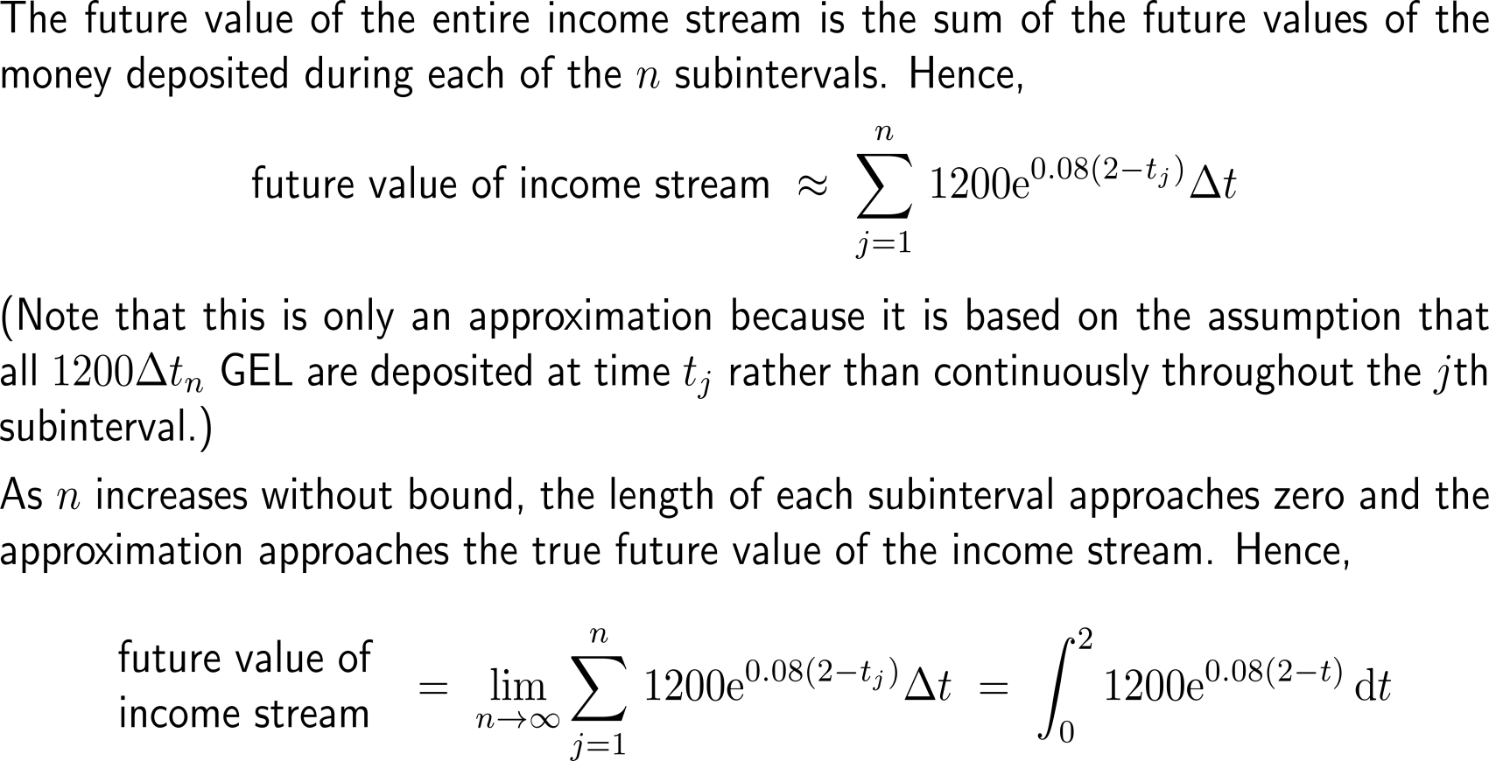
Example: Finding the future value of an annuity

Slide 6
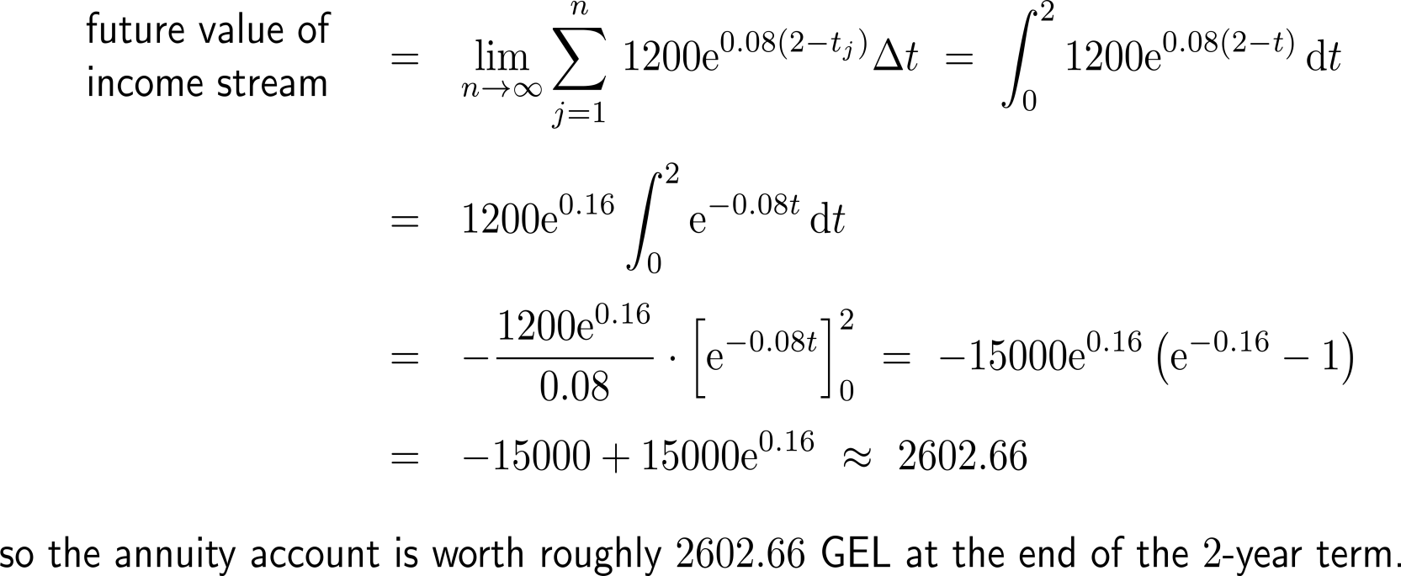
Example: Finding the future value of an annuity

Slide 7
The formula for computing the future value of a continuously compounded income stream

Slide 8
The present value compares continuous compounding of a prime with annuity (1/ 2)

Slide 9
The present value compares continuous compounding of a prime with annuity (2/ 2)

Slide 10
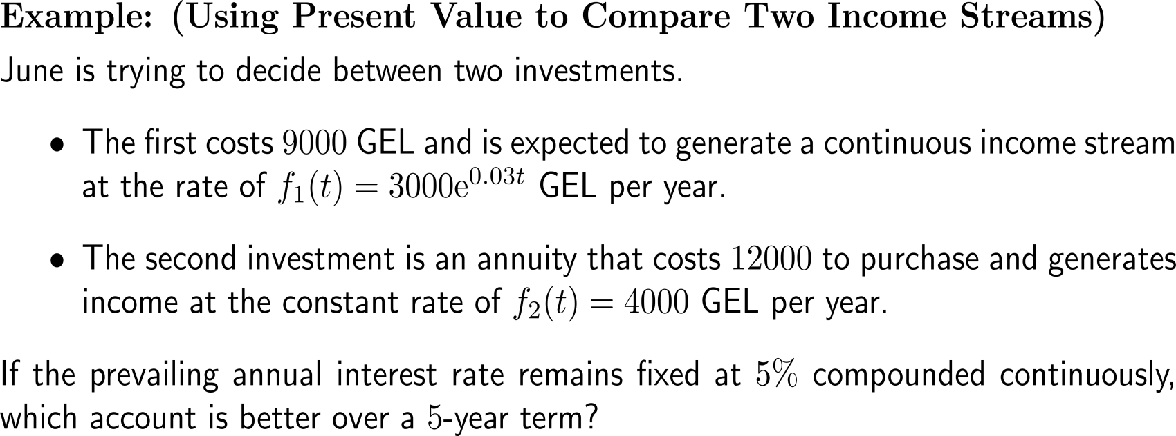
Example: Using present value to compare two income streams

Slide 11
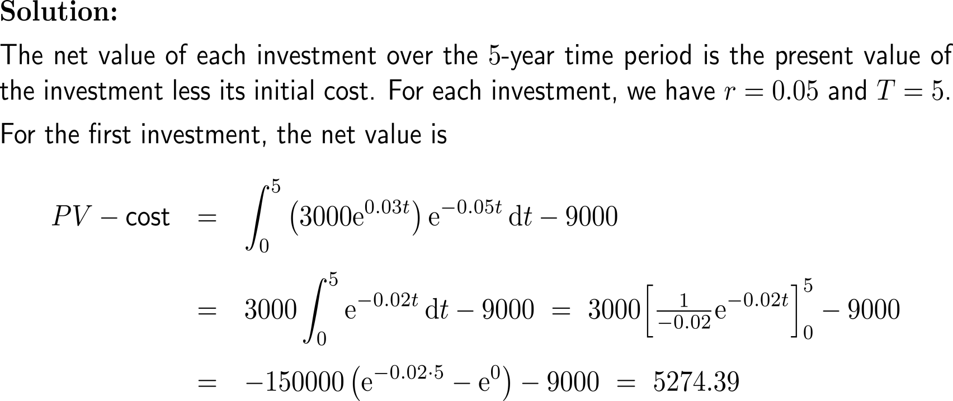
Example: Using present value to compare two income streams

Slide 12
Example: Using present value to compare two income streams

Slide 13
Calculus I for Management

