Slide 1
Calculus I for MGMT – Integration Applications of Integration in Economics
Mathematics for Management
Supplementary Electronic Materials
Applications of Integration in Economics
Net Excess Profit & Lorenz Curves
The Average Value of a Function
Future Value & Present Value of an Income Flow
Consumer Willingness to Spend & Consumer’s Surplus

Slide 2
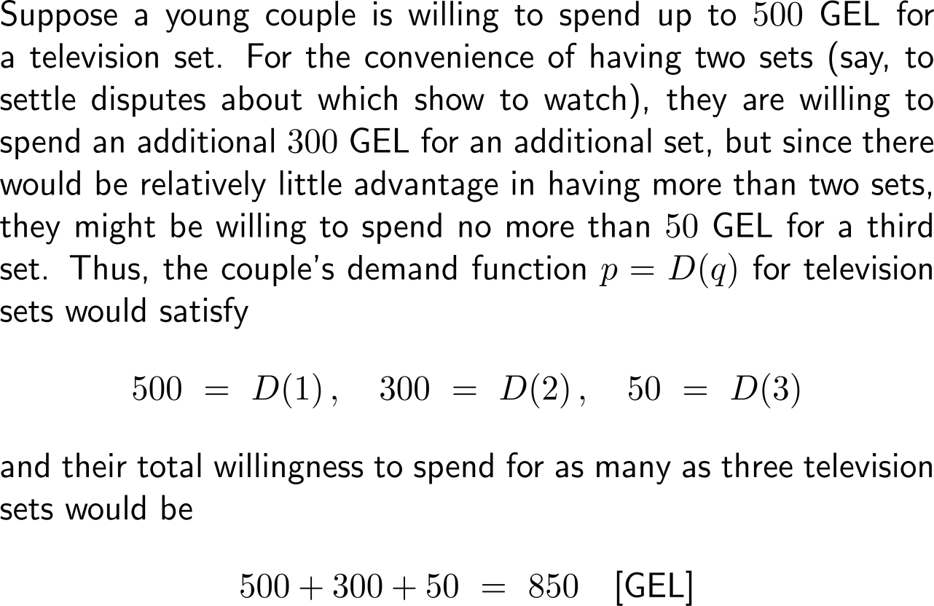
The total consumer willingness to spend describes the accumulated consumption behavior in terms of price and amount of units (1/4)

Slide 3
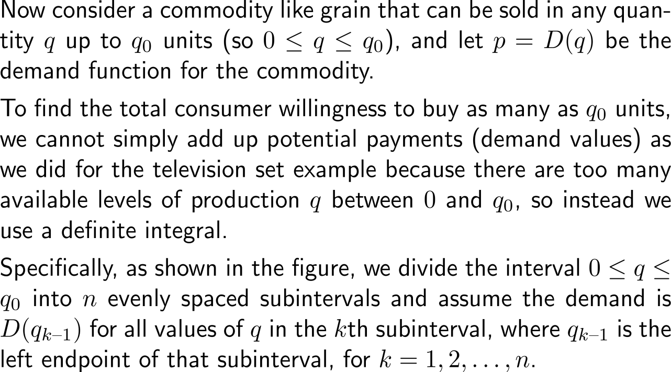
The total consumer willingness to spend describes the accumulated consumption behavior in terms of price and amount of units (2/4)

Slide 4
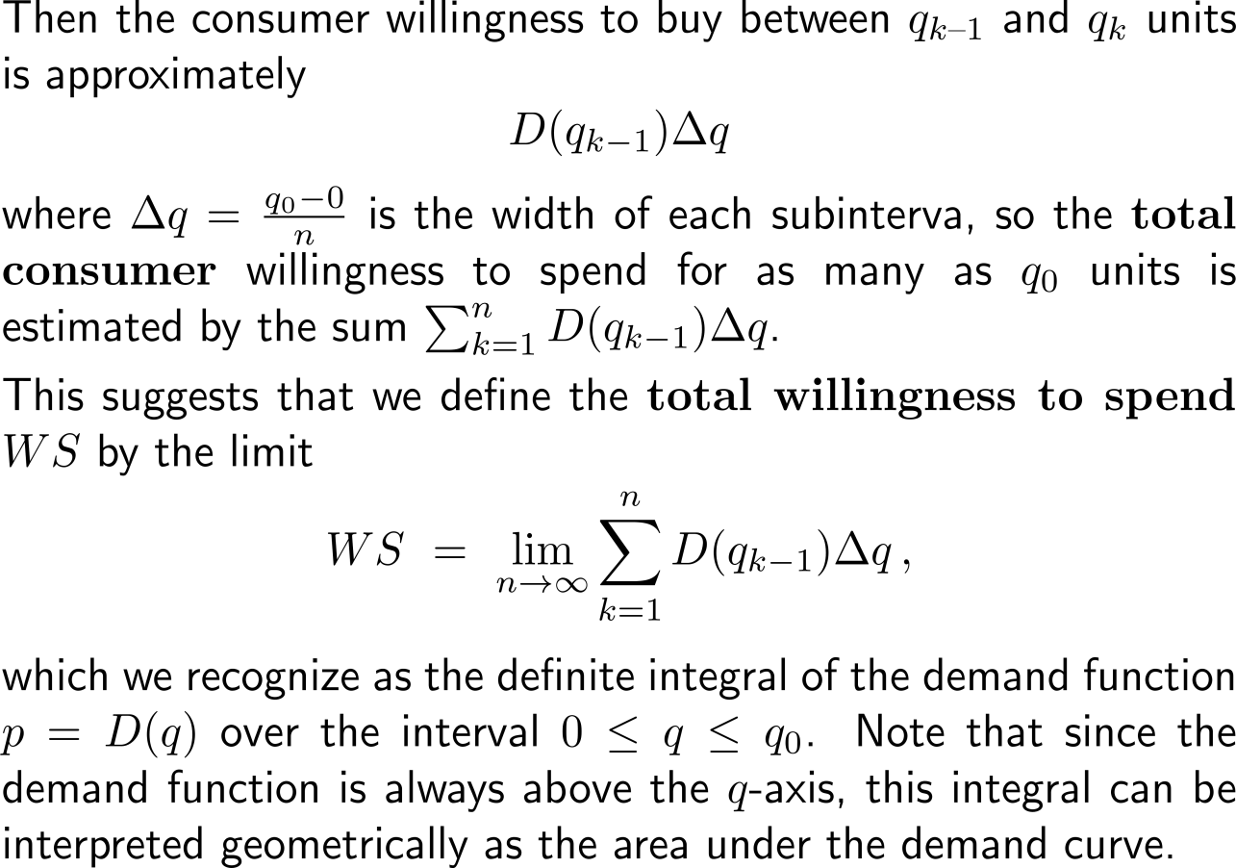
The total consumer willingness to spend describes the accumulated consumption behavior in terms of price and amount of units (3/4)

Slide 5
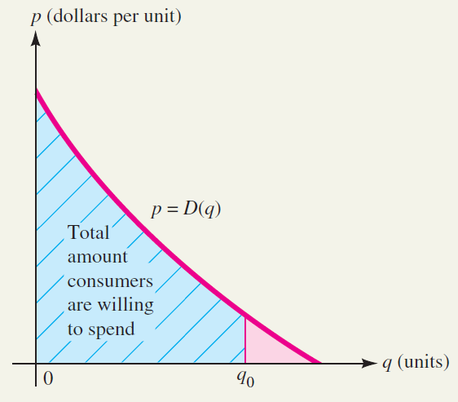
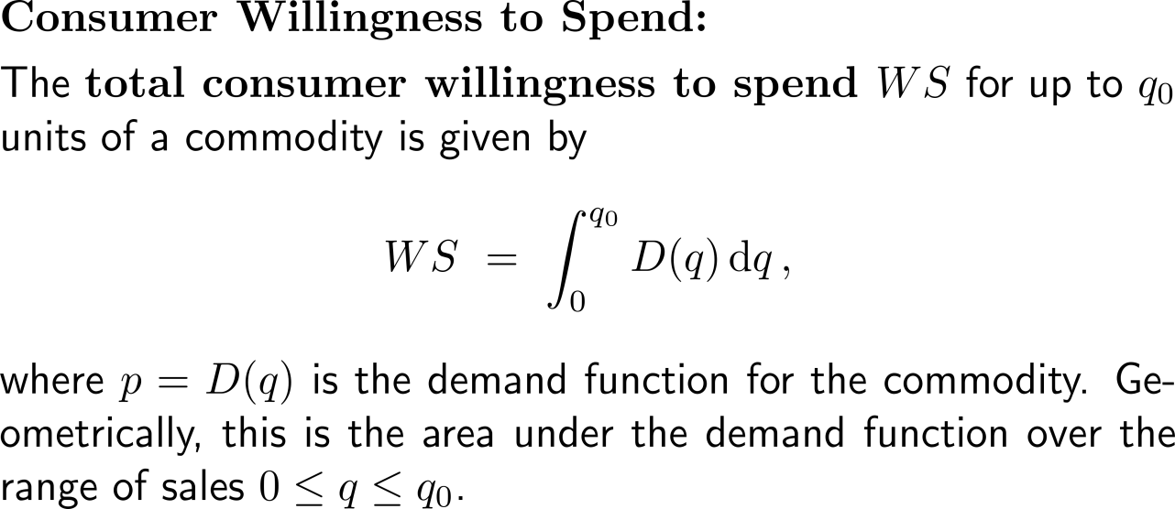
The total consumer willingness to spend describes the accumulated consumption behavior in terms of price and amount of units (4/4)

Slide 6
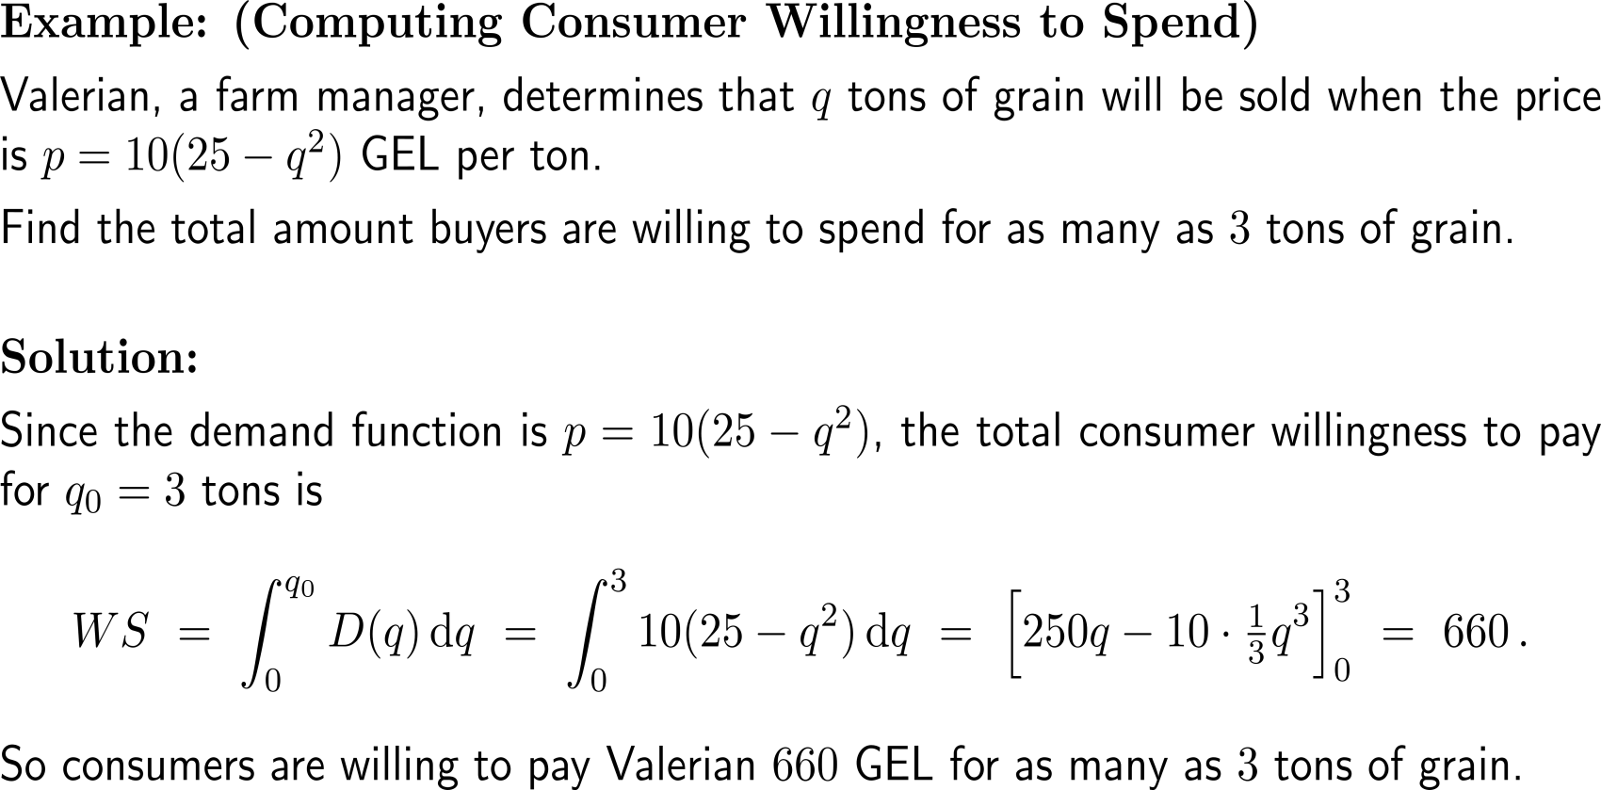
Example: Computing consumer willingness to spend

Slide 7
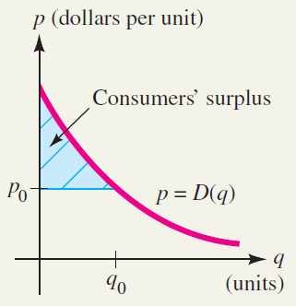
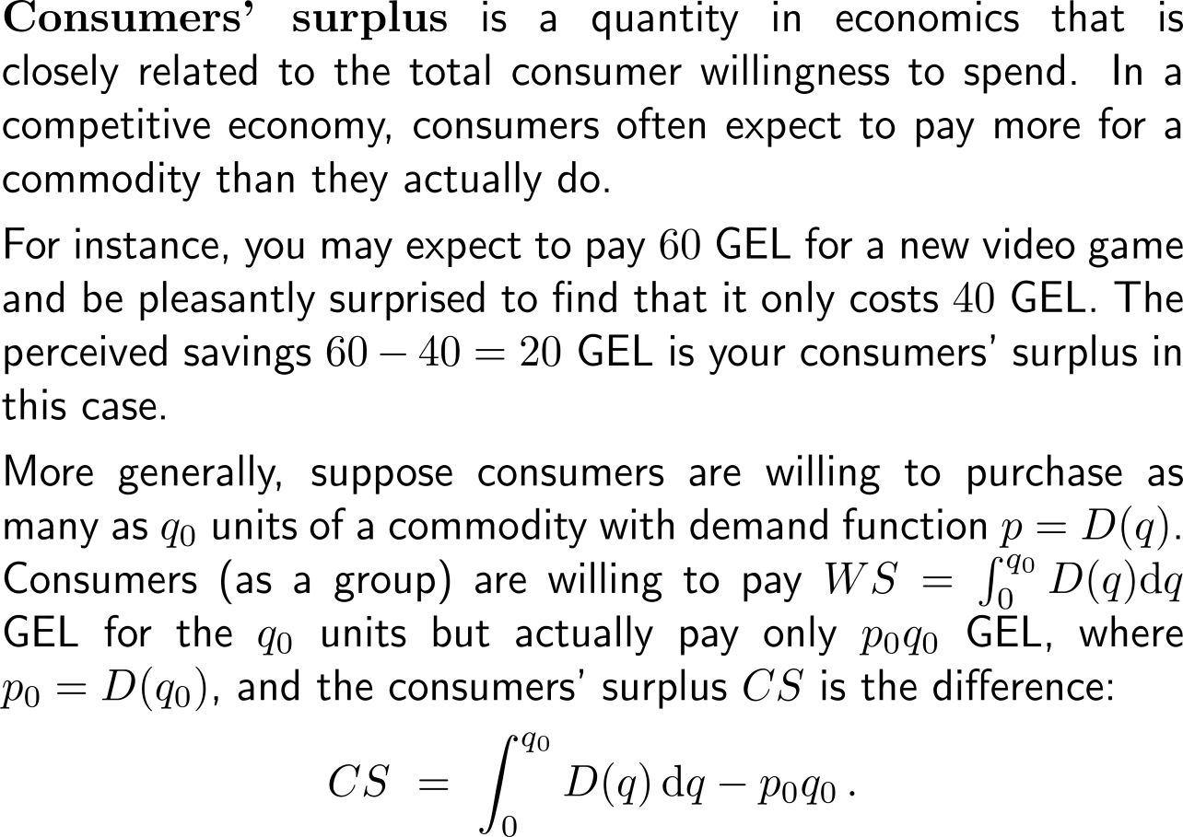
Consumer’s surplus is the total consumer willingness to spend (1/ 2)

Slide 8
Consumer’s surplus is the total consumer willingness to spend (2/ 2)

Slide 9
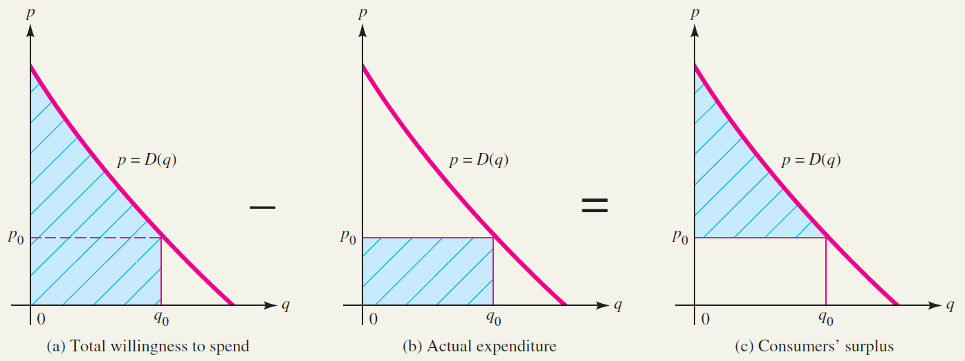
Geometric interpretation of consumers’ surplus

Slide 10
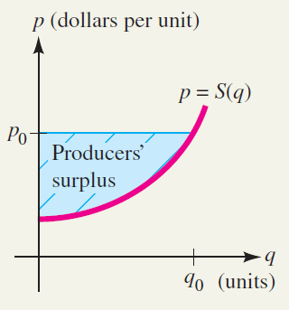
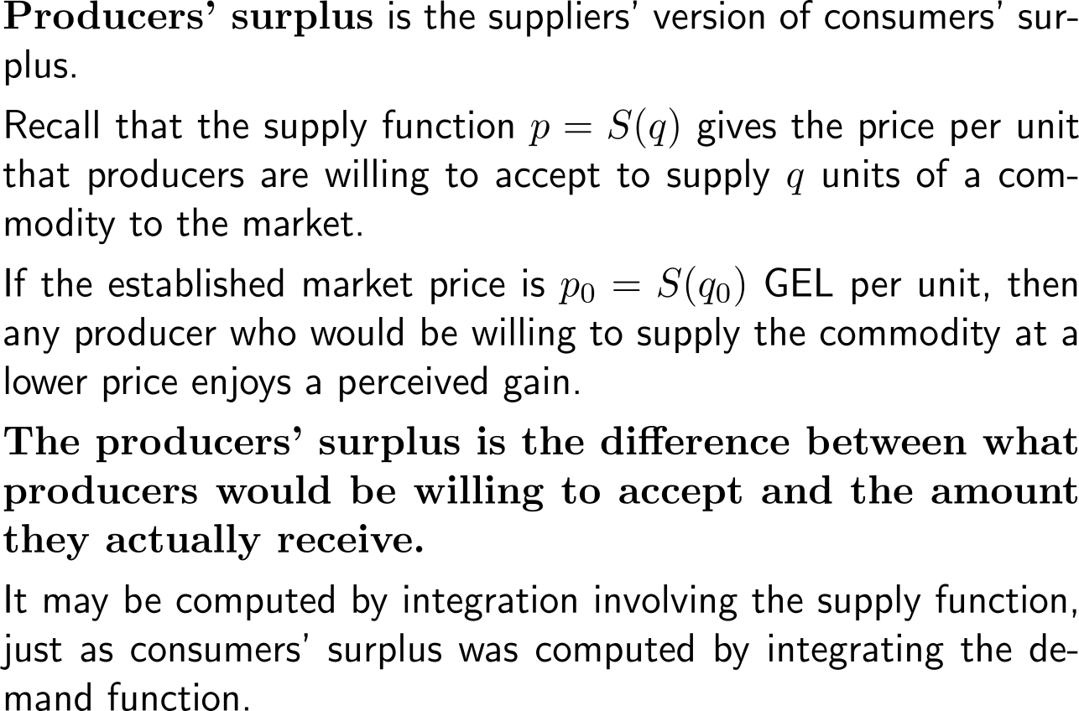
Producers’ surplus is the total supplier’s willingness to produce (1/ 2)

Slide 11
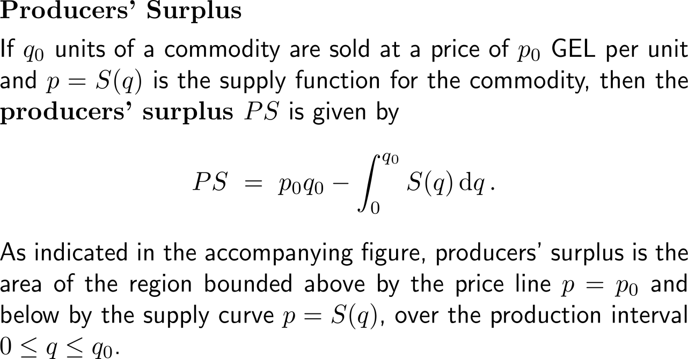
Producers’ surplus is the total supplier’s willingness to produce (2/ 2)

Slide 12
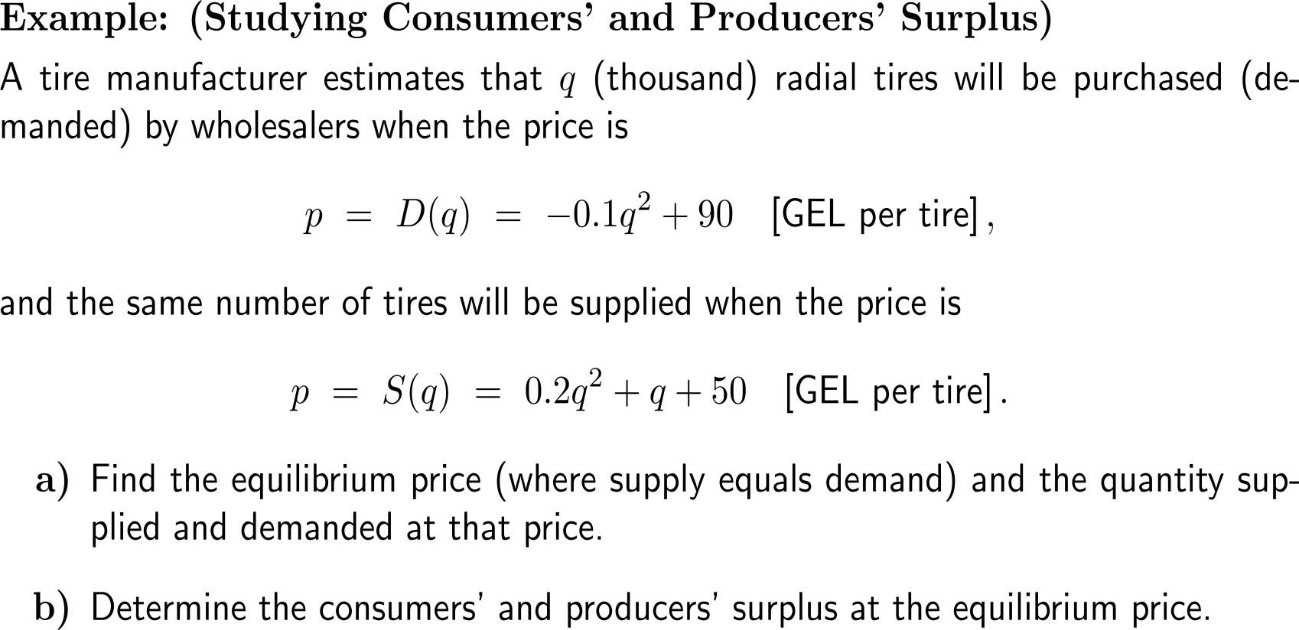
Example: Studying consumers’ and producers’ surplus

Slide 13
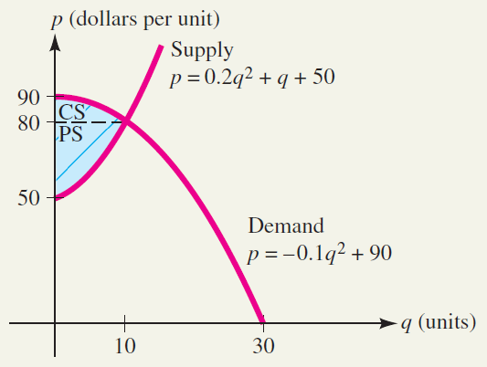
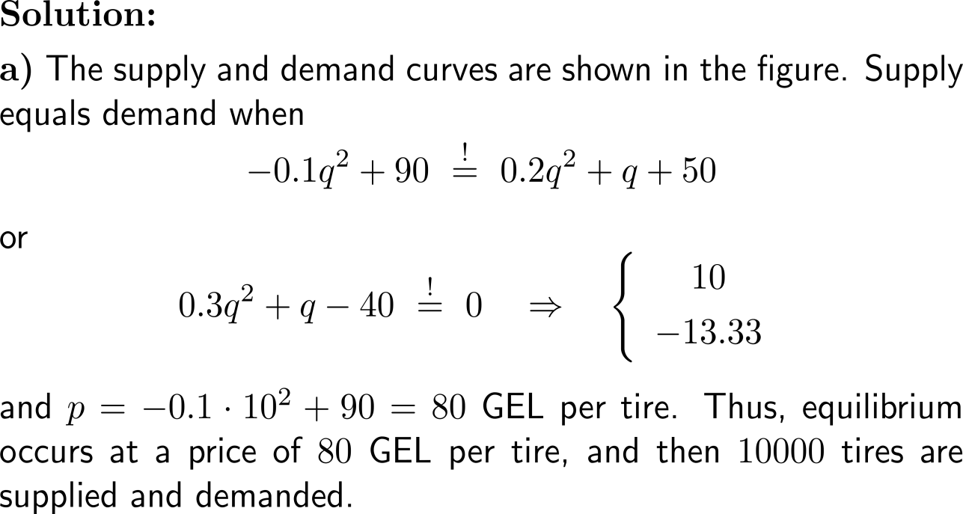
Example: Studying consumers’ and producers’ surplus

Slide 14
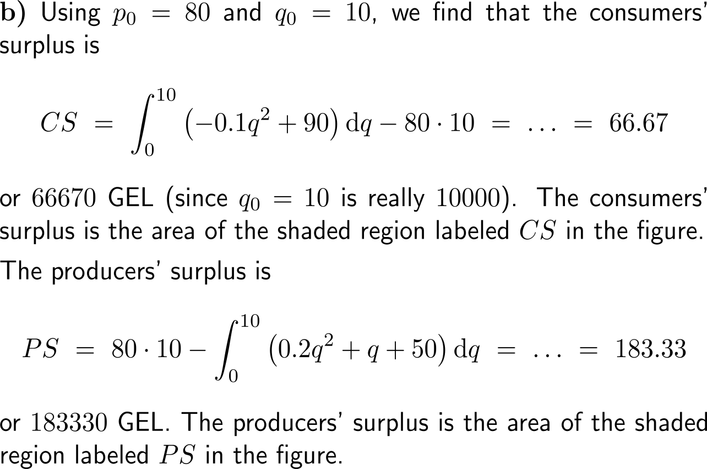
Example: Studying consumers’ and producers’ surplus

Slide 15
Calculus I for Management

