Slide 1
Calculus I for Management
Applications of Integration in Economics
week 14
Lecture
Net excess profit & Lorenz curves
The average value of a function
Future value & present value of an income flow
Consumer willingness to spend & consumer’s surplus

Slide 2
Topics
Net Excess Profit & Lorenz Curves
The Average Value of a Function
Future Value & Present Value of an Income Flow
Consumer Willingness to Spend & Consumer’s Surplus

Slide 3
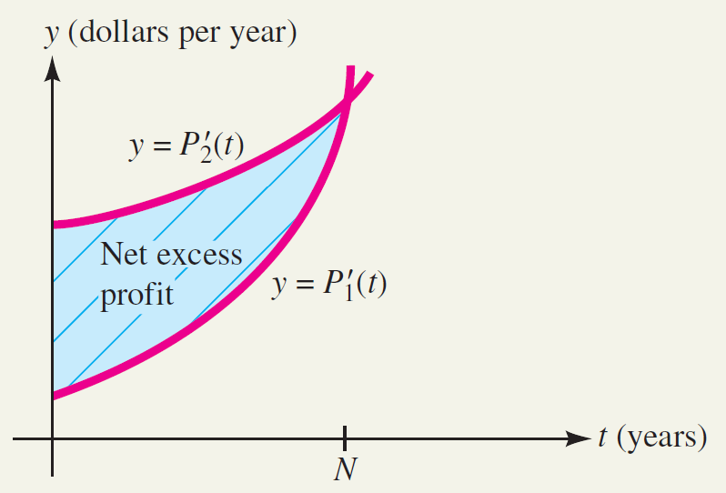
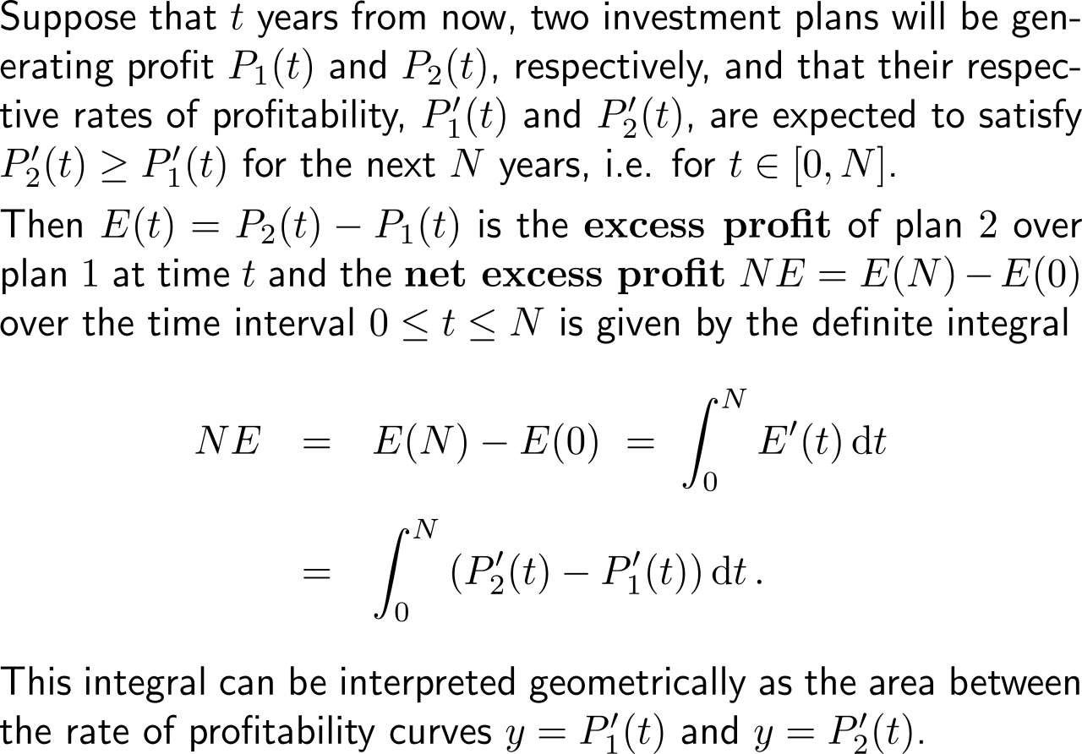
The net excess profit is the accumulated difference between two profit schemes

Slide 4
Example: Finding net excess profit

Slide 5
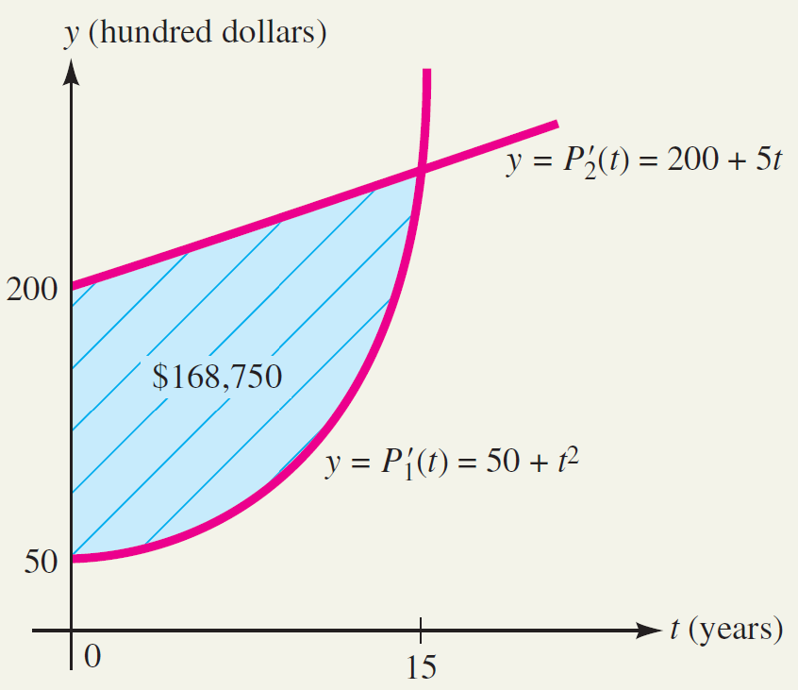
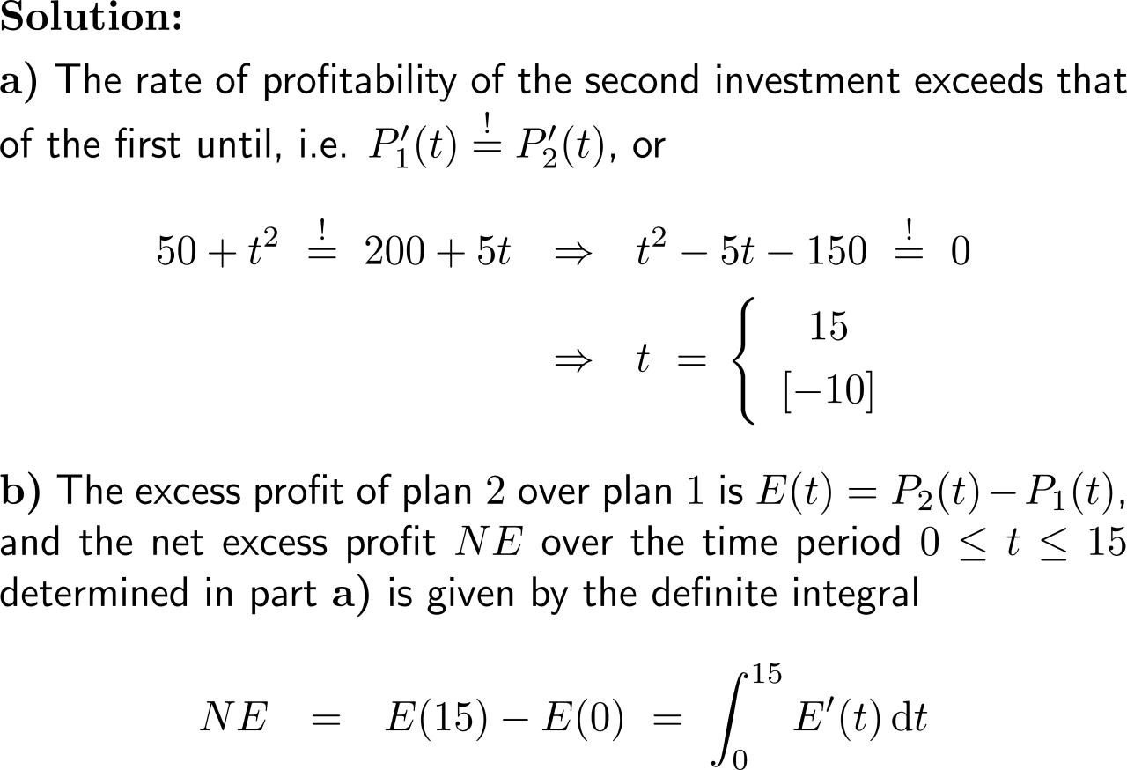
Example: Finding net excess profit

Slide 6
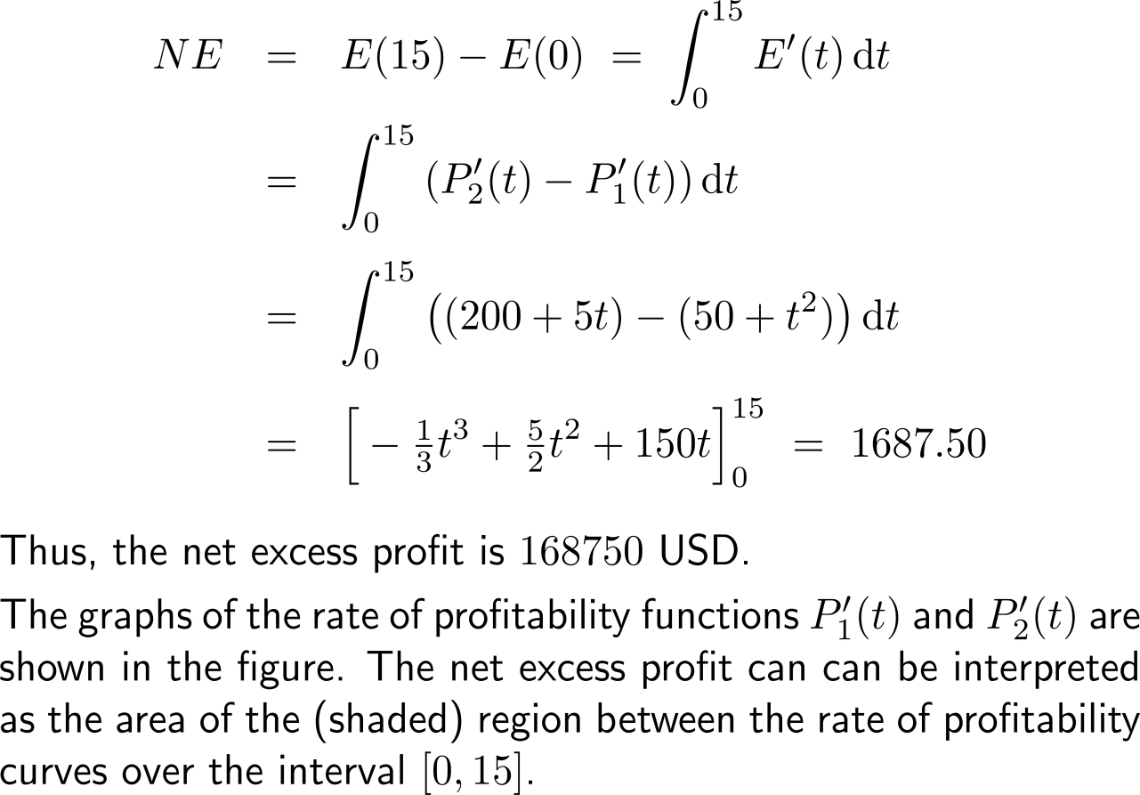
Example: Finding net excess profit

Slide 7
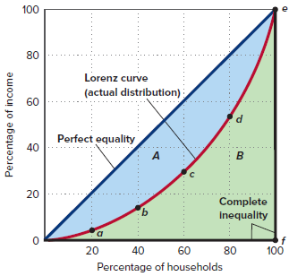
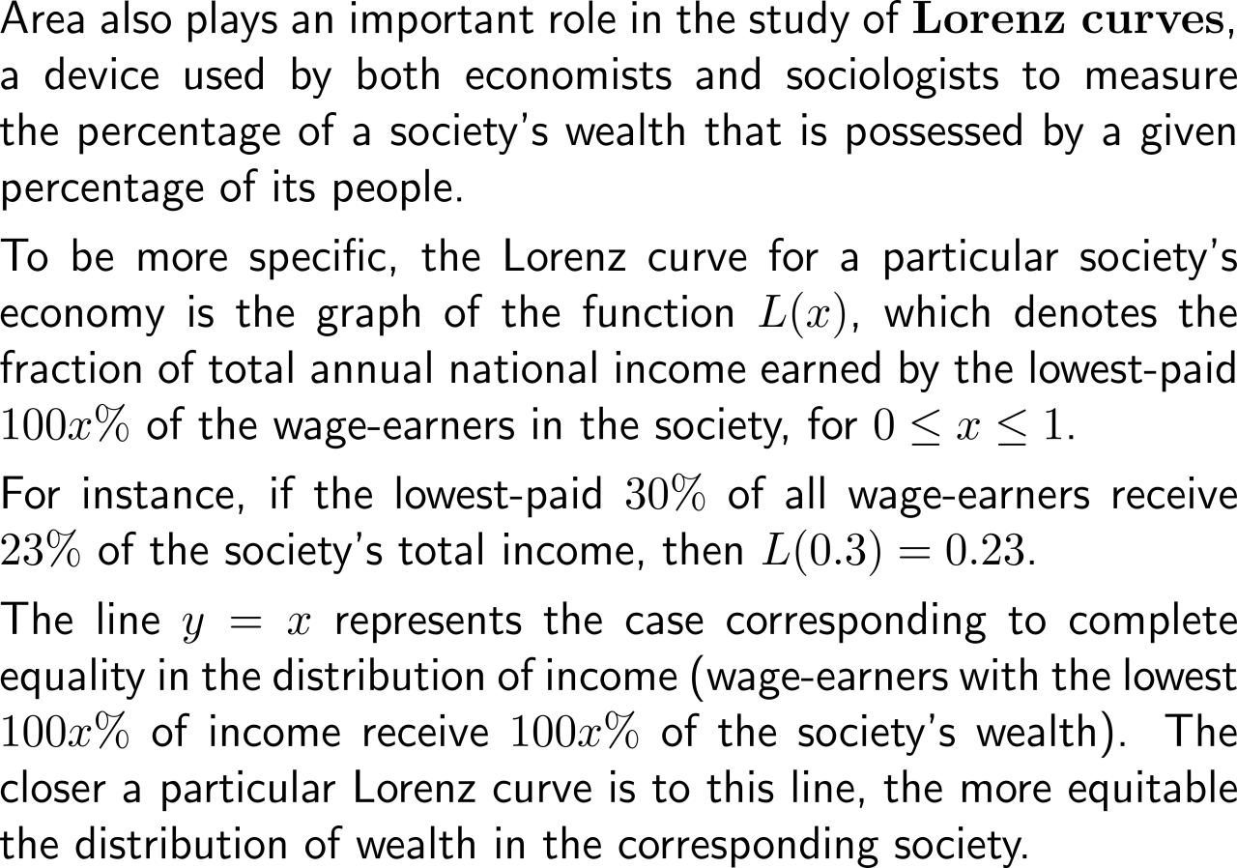
The Lorenz curves illustrates the percentage of a society’s wealth that is possessed by a given percentage of its people

Slide 8
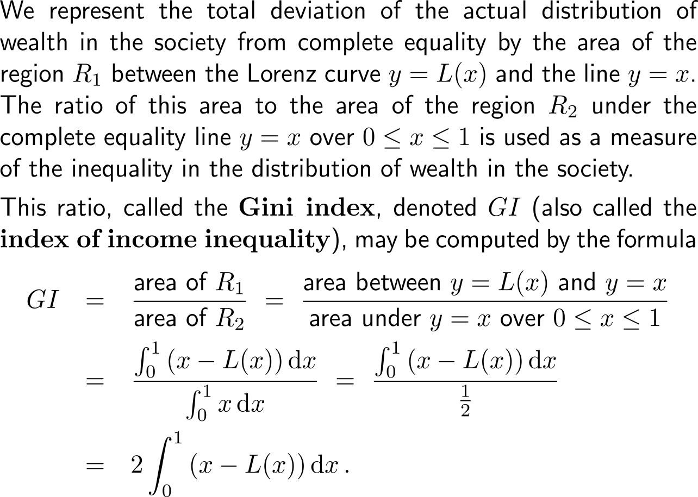
The Gini index is a measure fir the inequality in the distribution of wealth in a society (1/ 2)

Slide 9
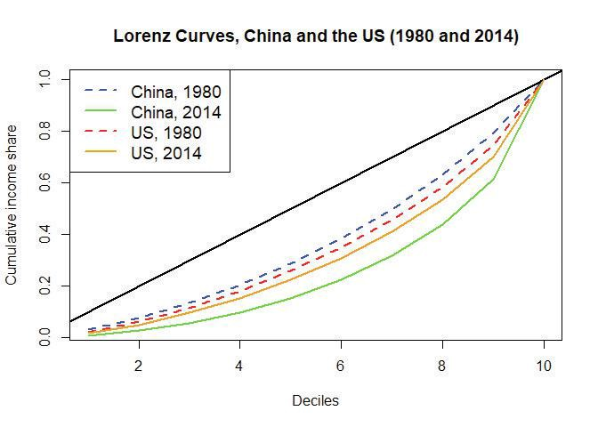
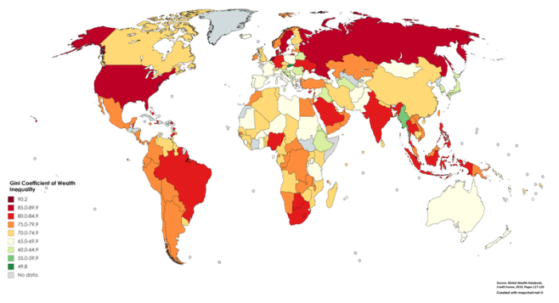
The Gini index is a measure fir the inequality in the distribution of wealth in a society (2/ 2)
Gini Coefficient of Wealth Inequality
(source: Global wealth databook 2019, Credit Suisse)

Slide 10
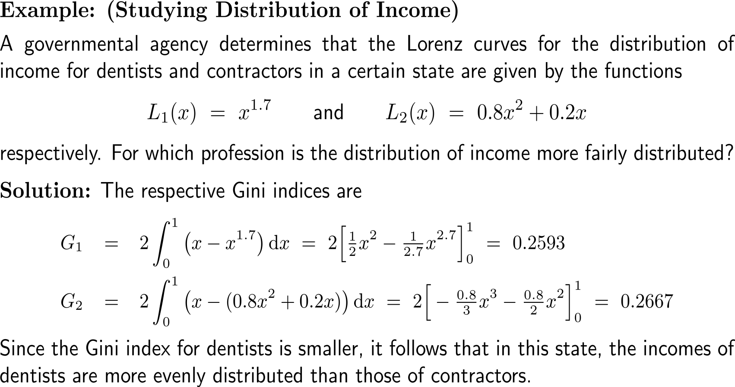
Example: Studying distribution of income

Slide 11
Topics
Net Excess Profit & Lorenz Curves
The Average Value of a Function
Future Value & Present Value of an Income Flow
Consumer Willingness to Spend & Consumer’s Surplus

Slide 12
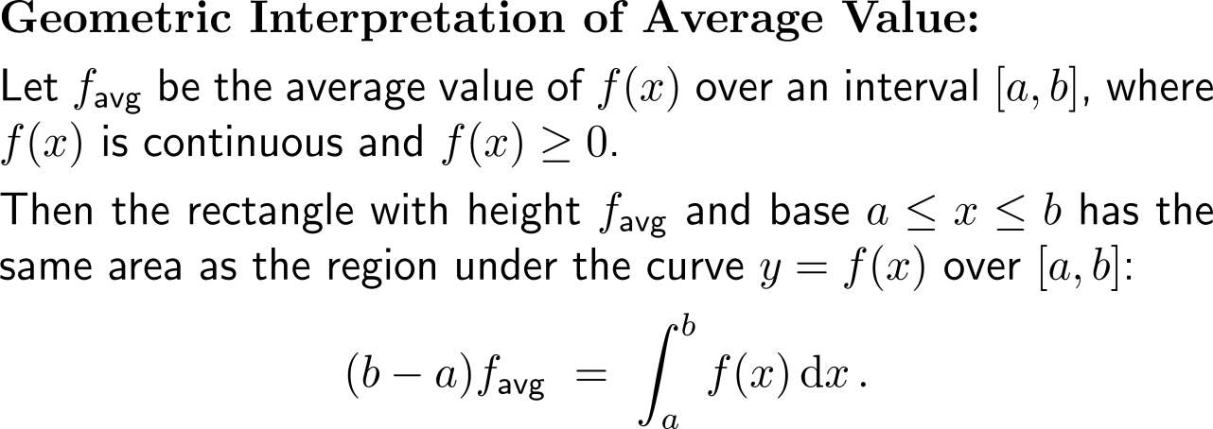
The average value of a function over an interval is its corresponding definite integral divided by the length of the interval

Slide 13
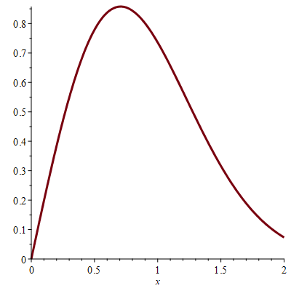
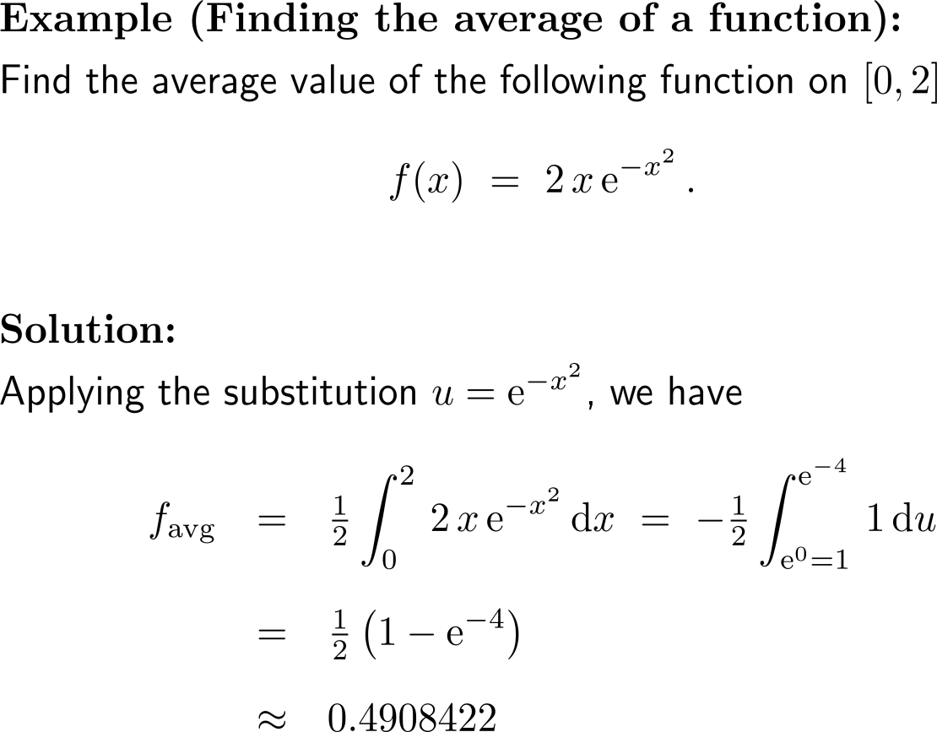
Example: Finding the average of a function
f(x)

Slide 14
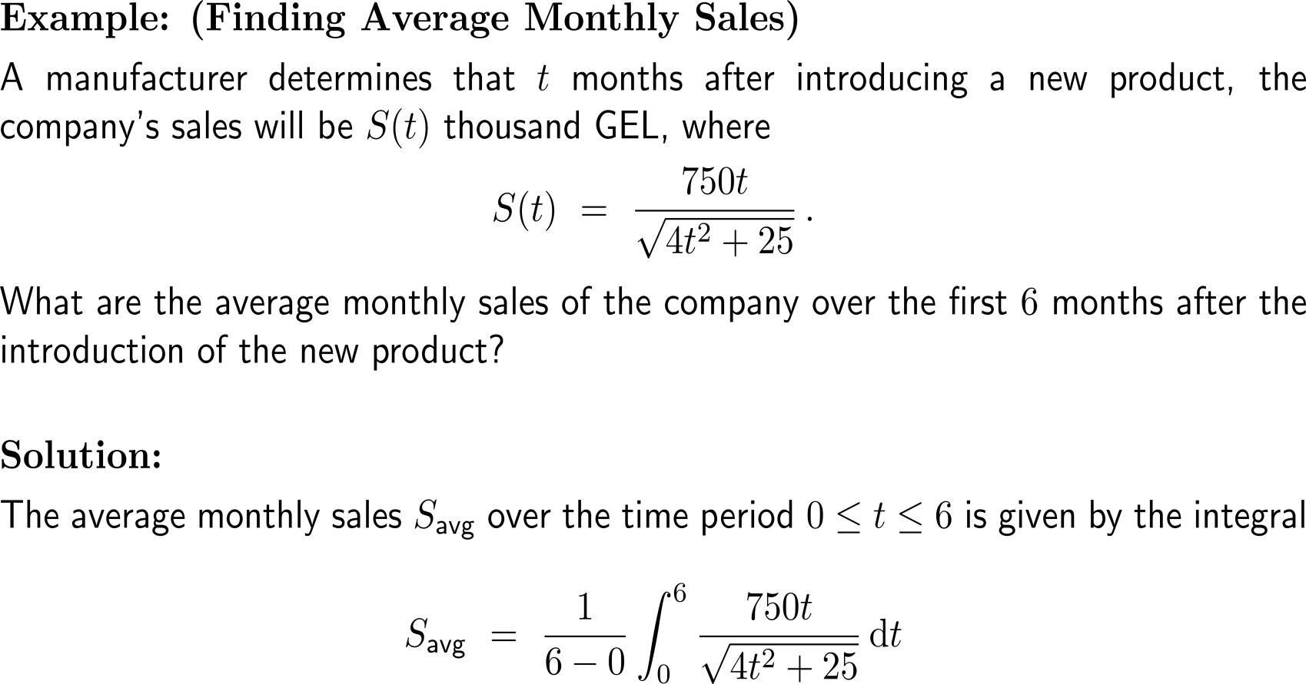
Example: Finding average monthly sales

Slide 15
Example: Finding average monthly sales

Slide 16
The average value equals the average rate of change of any of the functions antiderivatives

Slide 17
Topics
Net Excess Profit & Lorenz Curves
The Average Value of a Function
Future Value & Present Value of an Income Flow
Consumer Willingness to Spend & Consumer’s Surplus

Slide 18
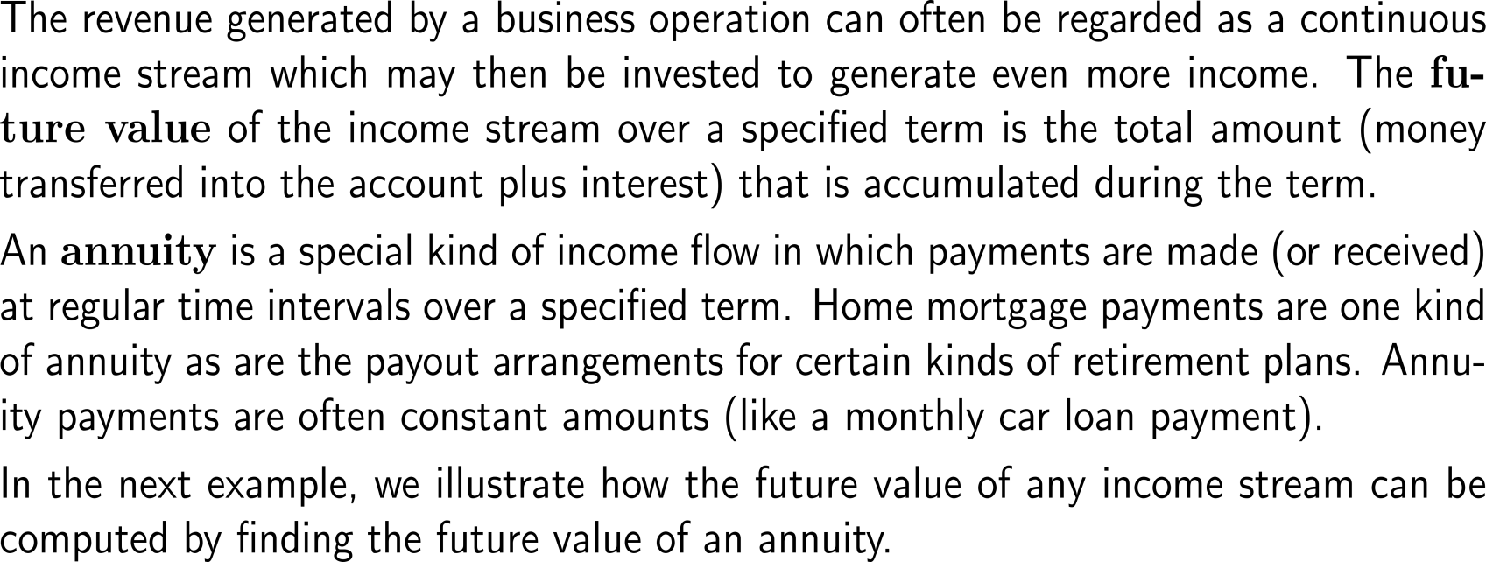
The future value is the total amount (payments plus interest) that is accumulated during a term

Slide 19
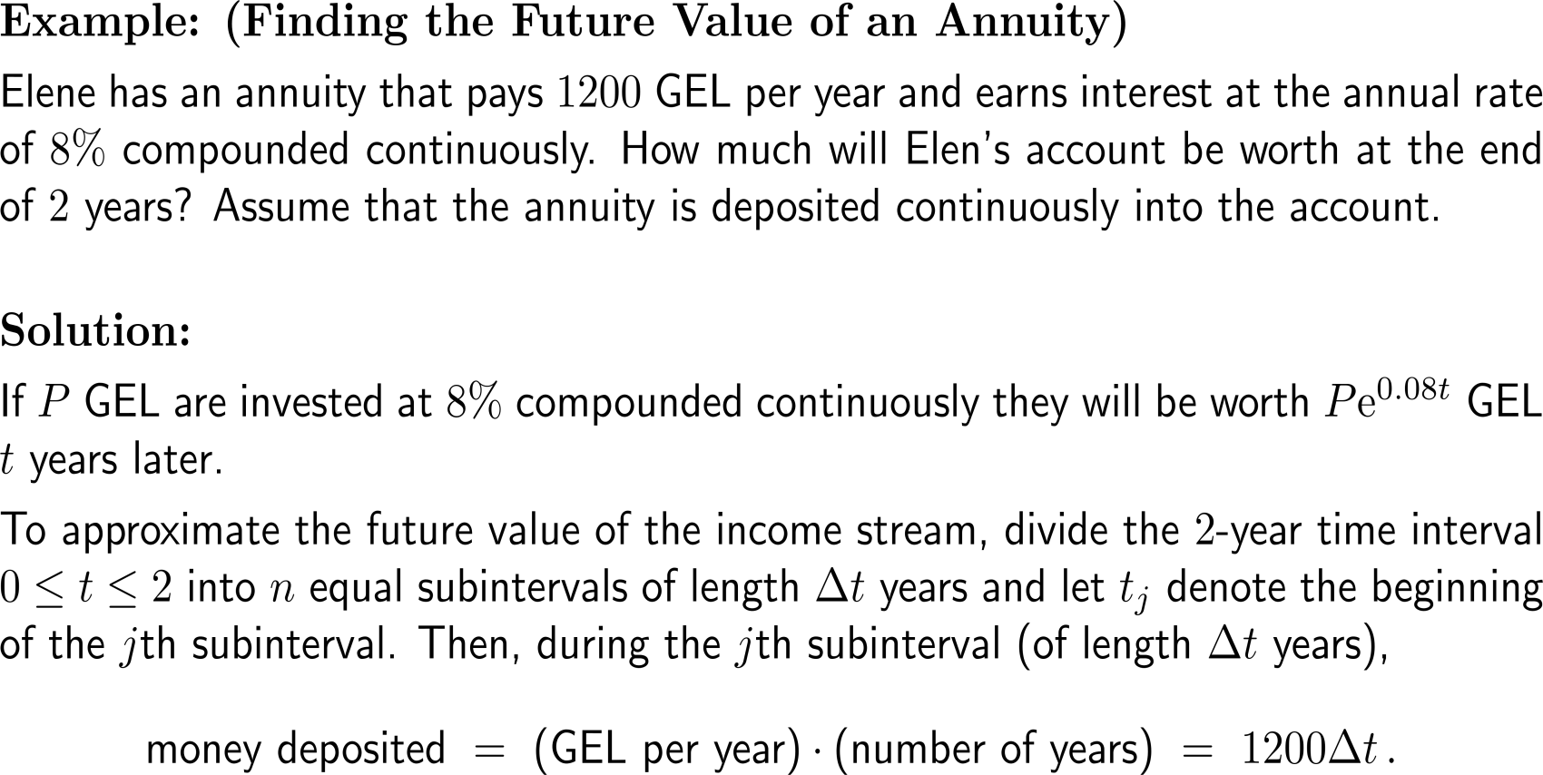
Example: Finding the future value of an annuity

Slide 20
Example: Finding the future value of an annuity

Slide 21
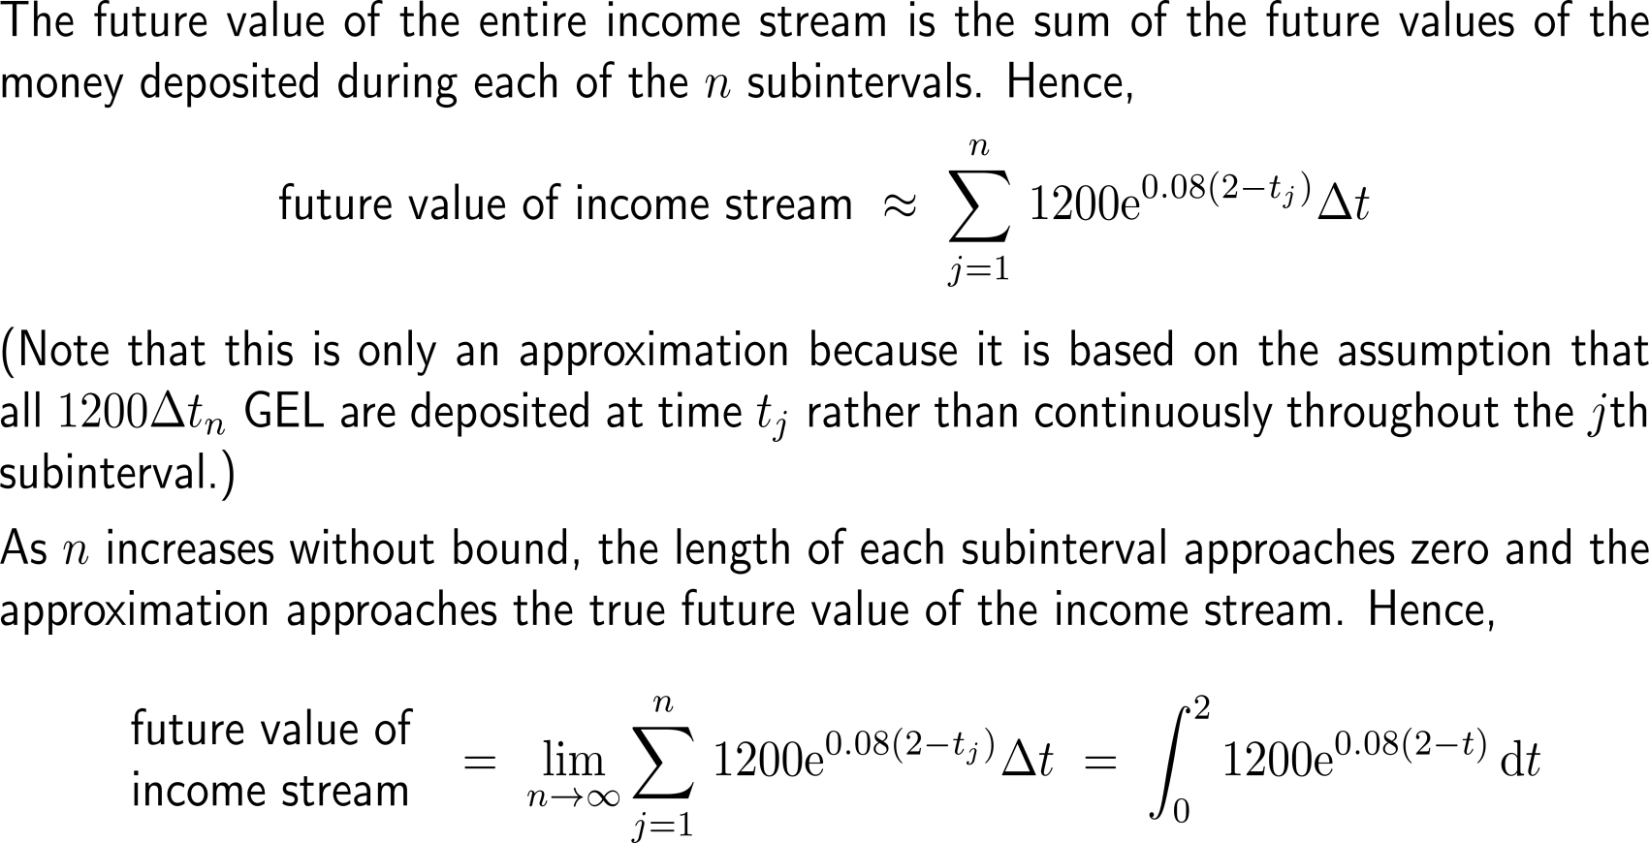
Example: Finding the future value of an annuity

Slide 22
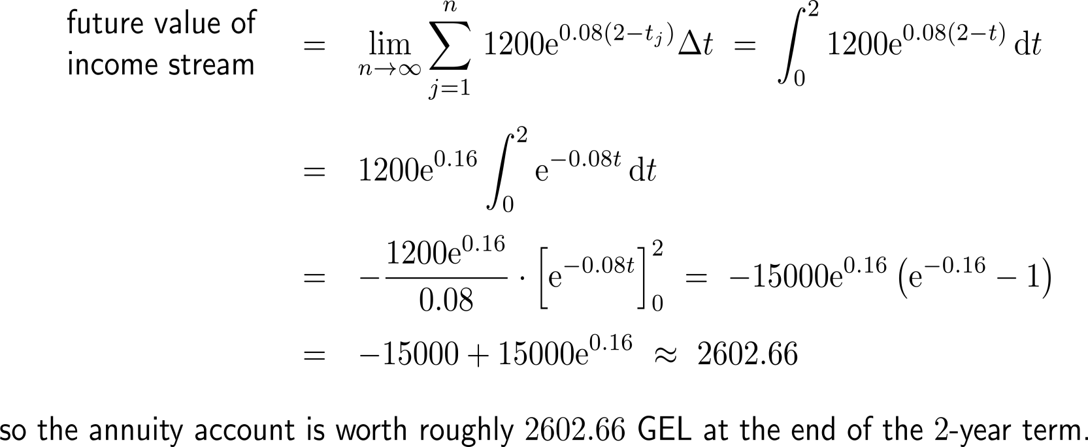
Example: Finding the future value of an annuity

Slide 23
The formula for computing the future value of a continuously compounded income stream

Slide 24
The present value compares continuous compounding of a prime with annuity (1/ 2)

Slide 25
The present value compares continuous compounding of a prime with annuity (2/ 2)

Slide 26
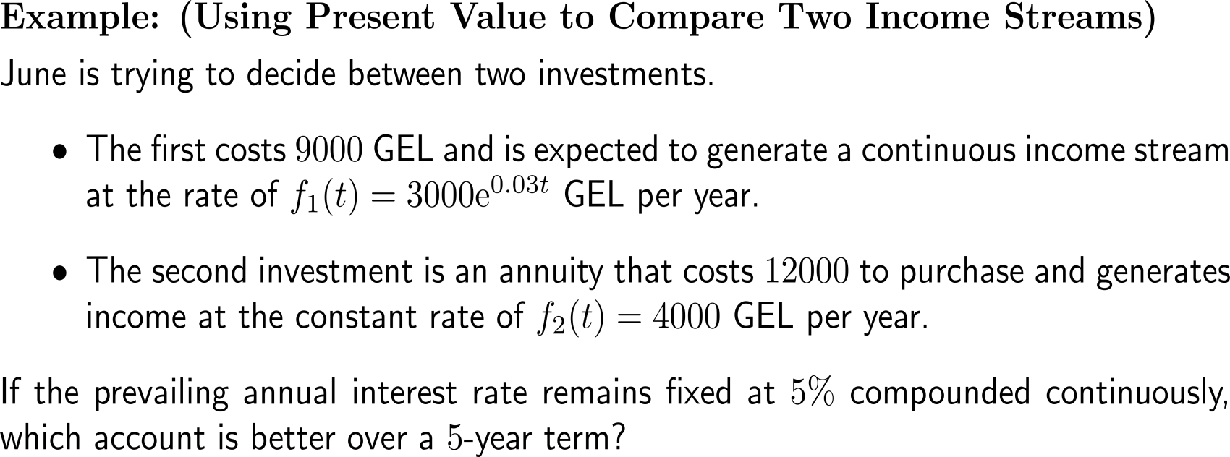
Example: Using present value to compare two income streams

Slide 27
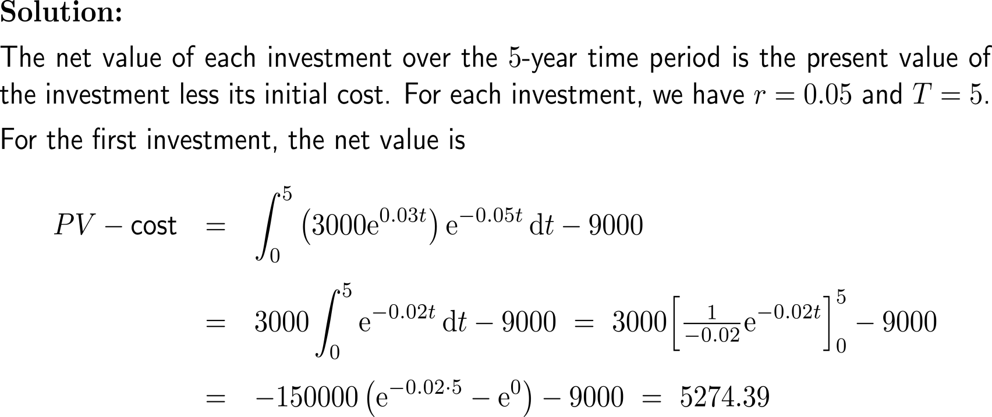
Example: Using present value to compare two income streams

Slide 28
Example: Using present value to compare two income streams

Slide 29
Topics
Net Excess Profit & Lorenz Curves
The Average Value of a Function
Future Value & Present Value of an Income Flow
Consumer Willingness to Spend & Consumer’s Surplus

Slide 30
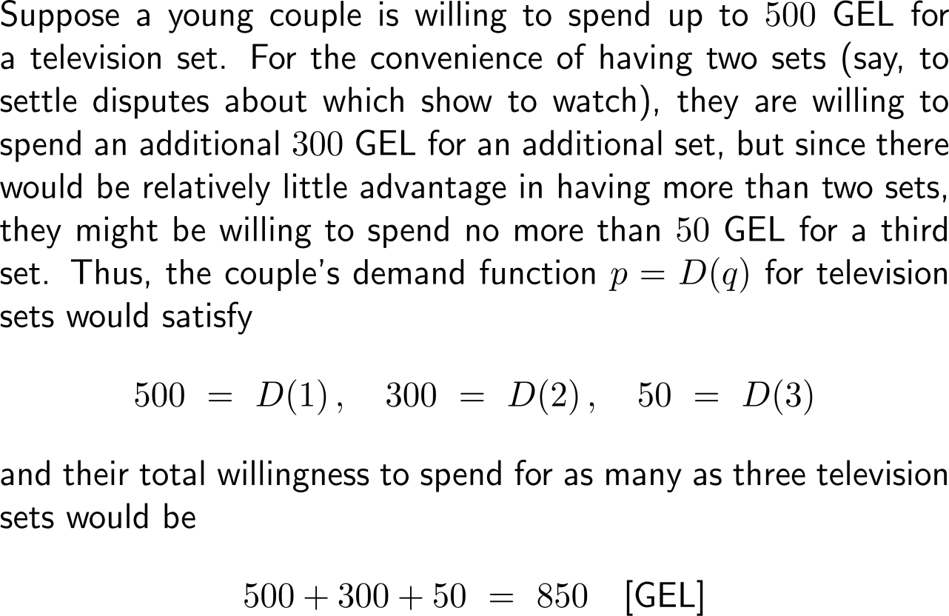
The total consumer willingness to spend describes the accumulated consumption behavior in terms of price and amount of units (1/4)

Slide 31
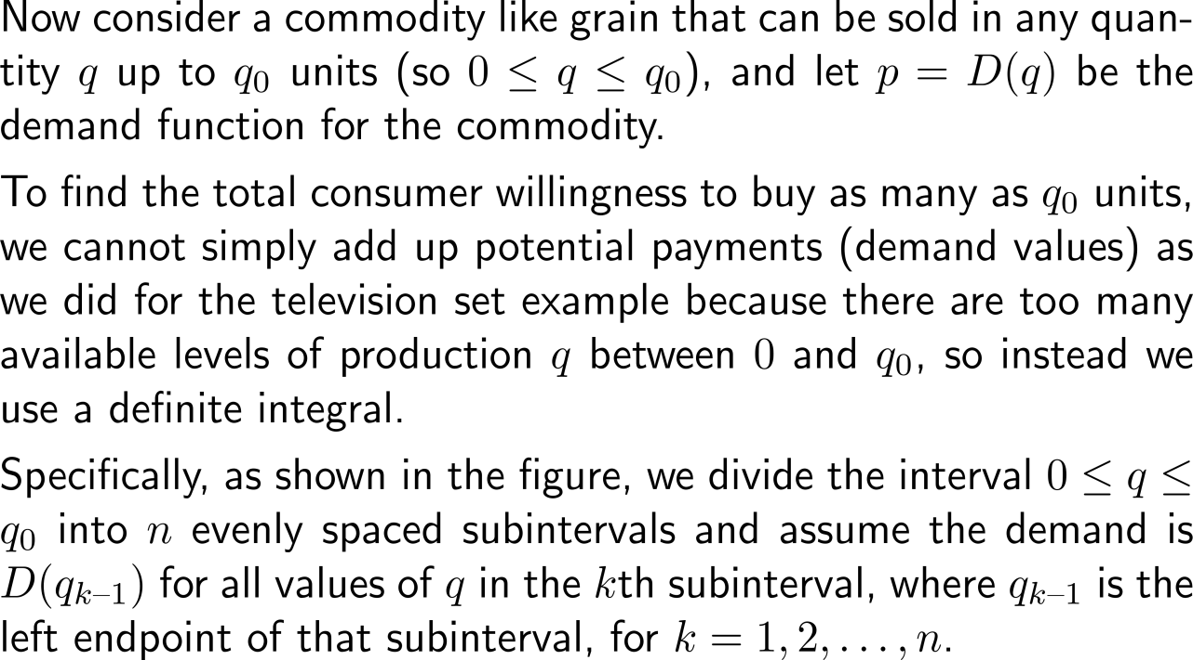
The total consumer willingness to spend describes the accumulated consumption behavior in terms of price and amount of units (2/4)

Slide 32
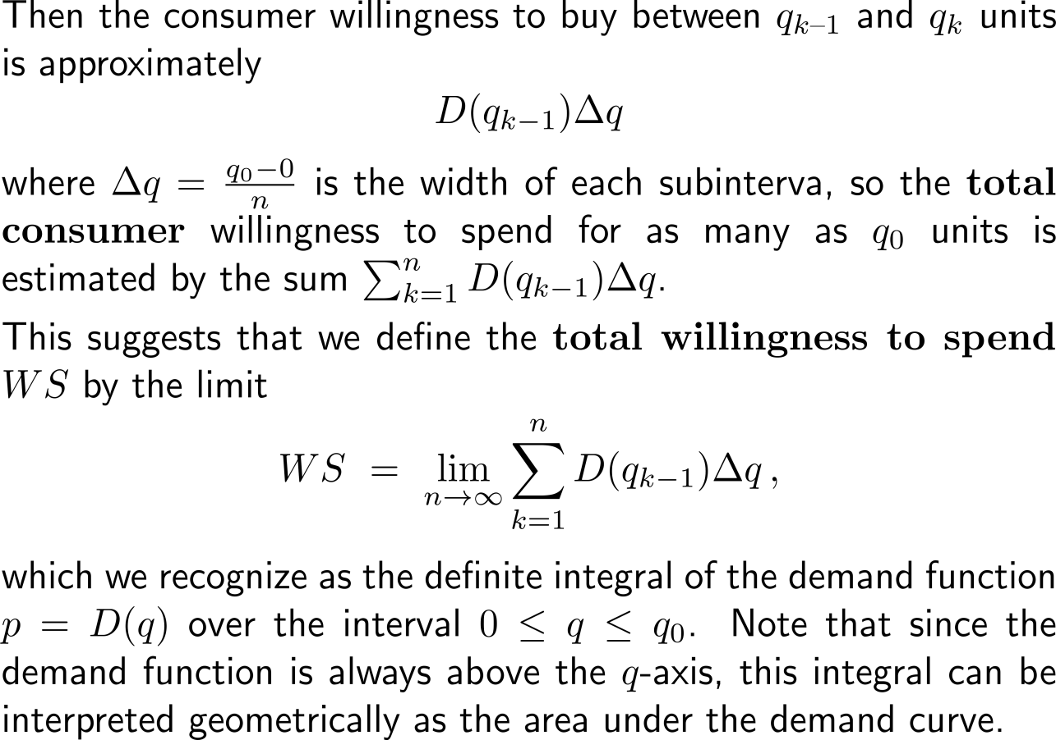
The total consumer willingness to spend describes the accumulated consumption behavior in terms of price and amount of units (3/4)

Slide 33
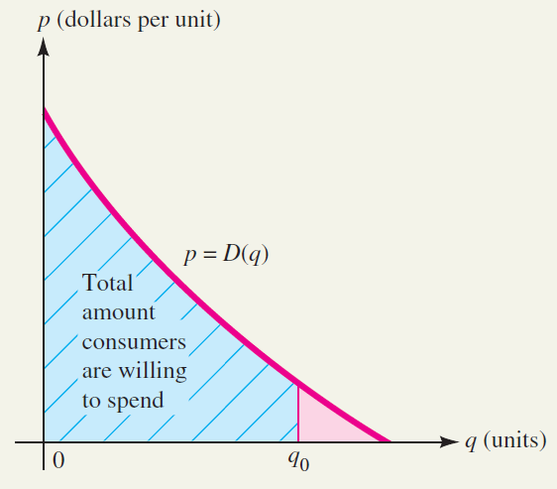
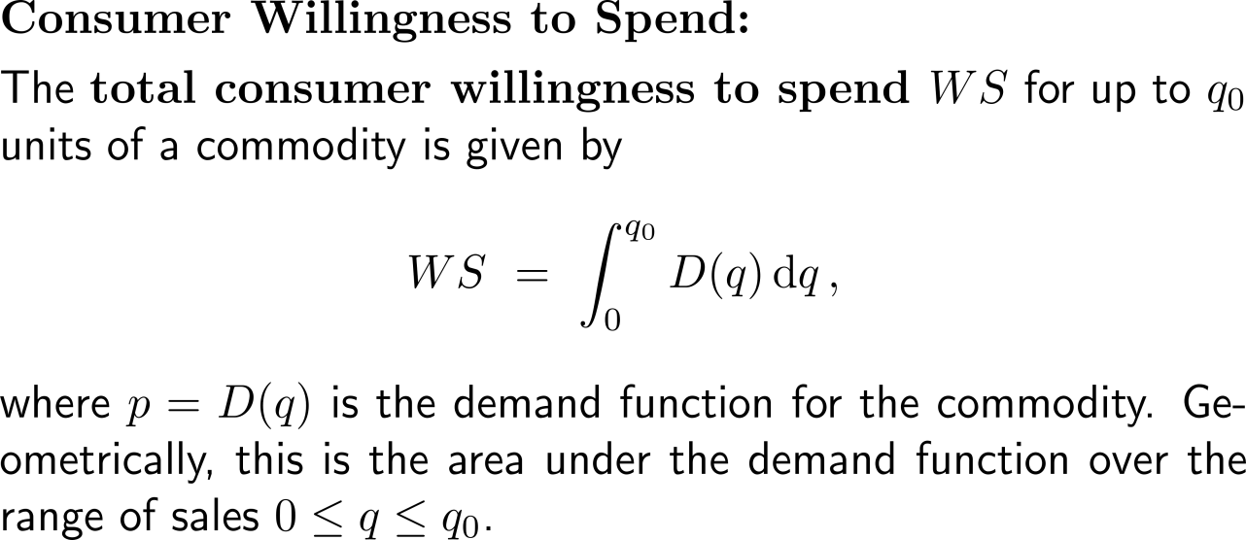
The total consumer willingness to spend describes the accumulated consumption behavior in terms of price and amount of units (4/4)

Slide 34
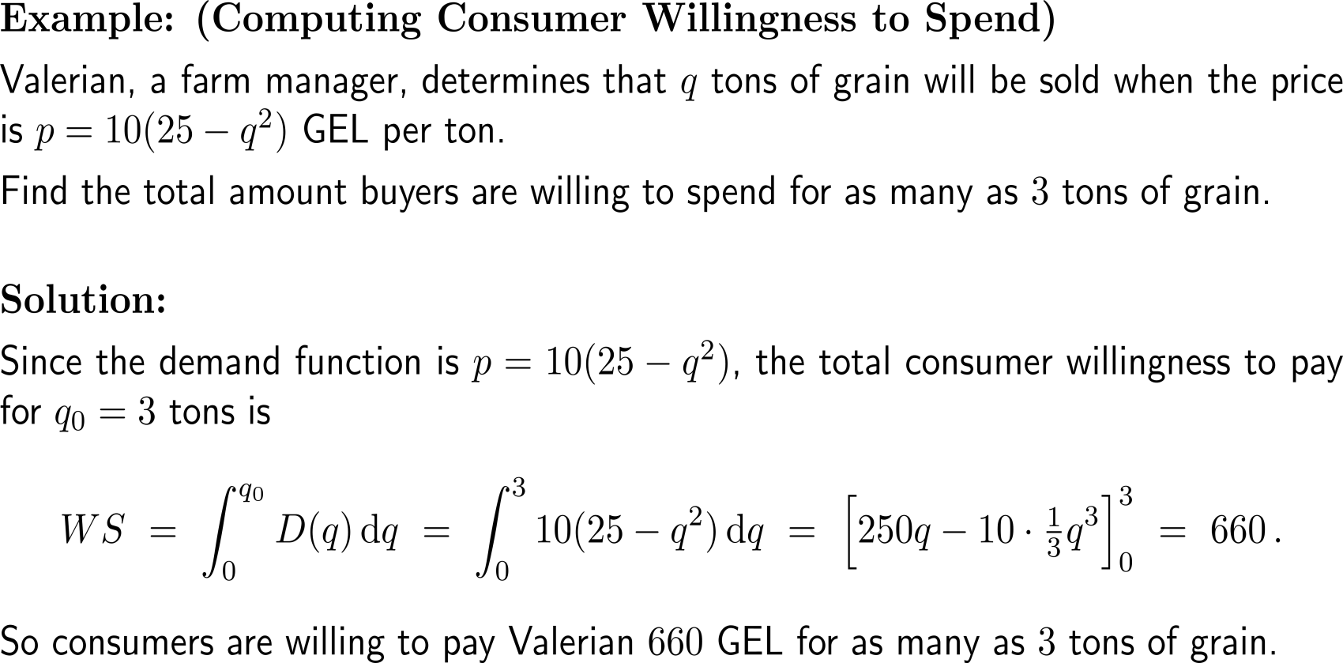
Example: Computing consumer willingness to spend

Slide 35
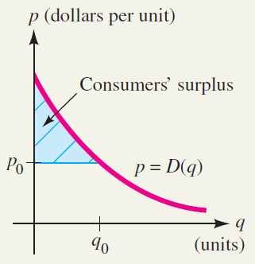
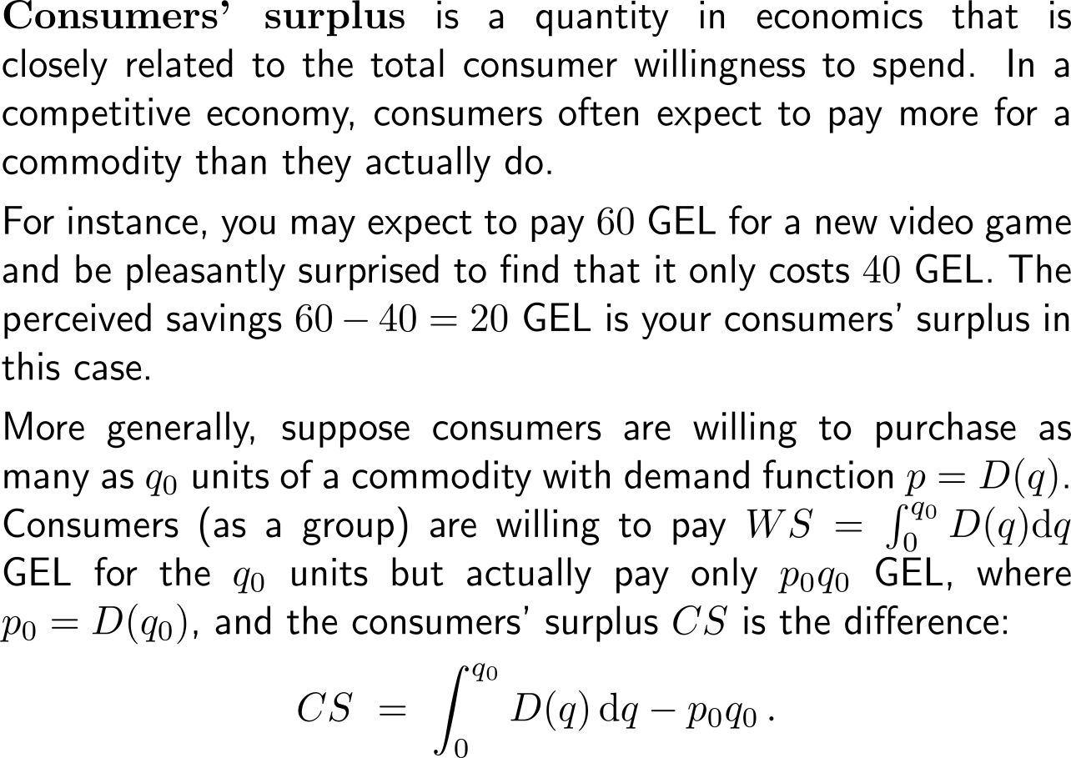
Consumer’s surplus is the total consumer willingness to spend (1/ 2)

Slide 36
Consumer’s surplus is the total consumer willingness to spend (2/ 2)

Slide 37
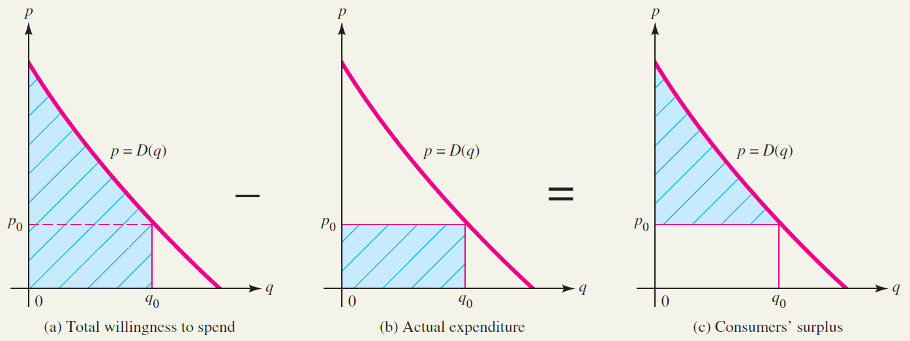
Geometric interpretation of consumers’ surplus

Slide 38
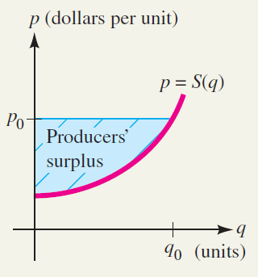
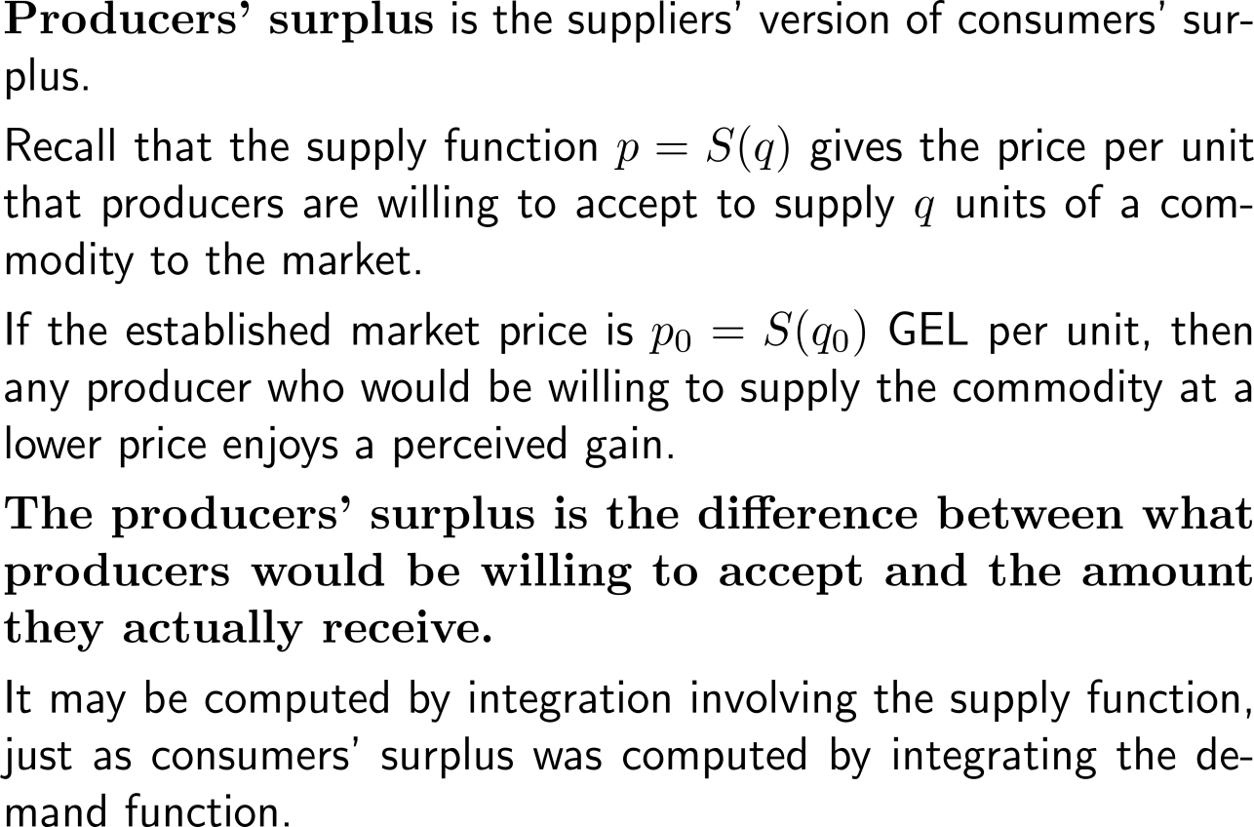
Producers’ surplus is the total supplier’s willingness to produce (1/ 2)

Slide 39
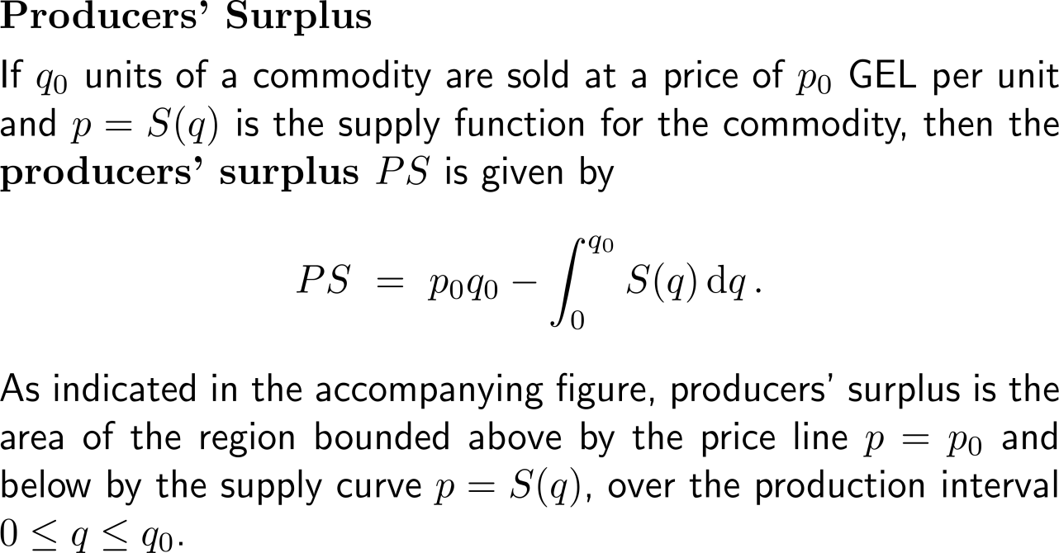
Producers’ surplus is the total supplier’s willingness to produce (2/ 2)

Slide 40
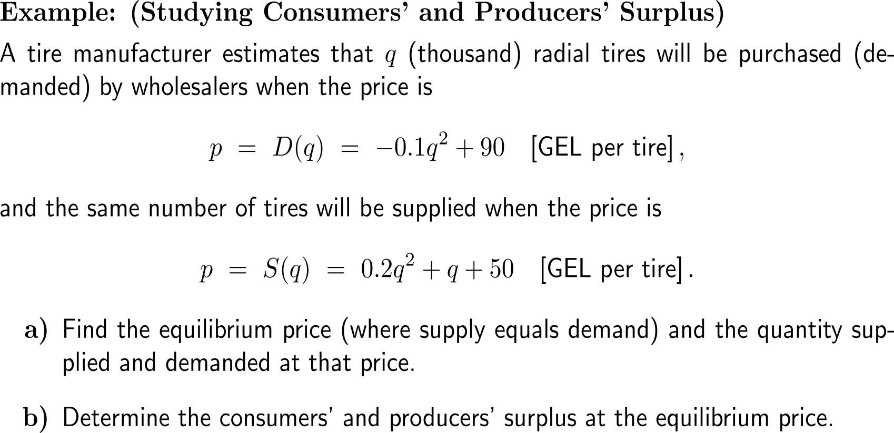
Example: Studying consumers’ and producers’ surplus

Slide 41
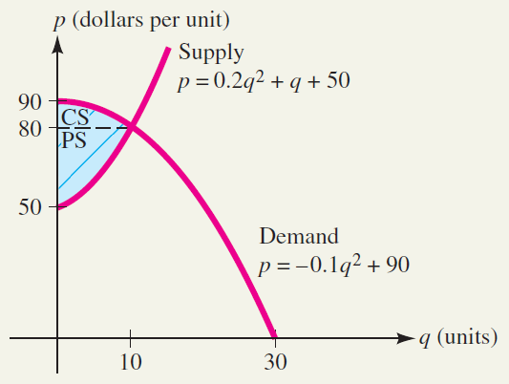
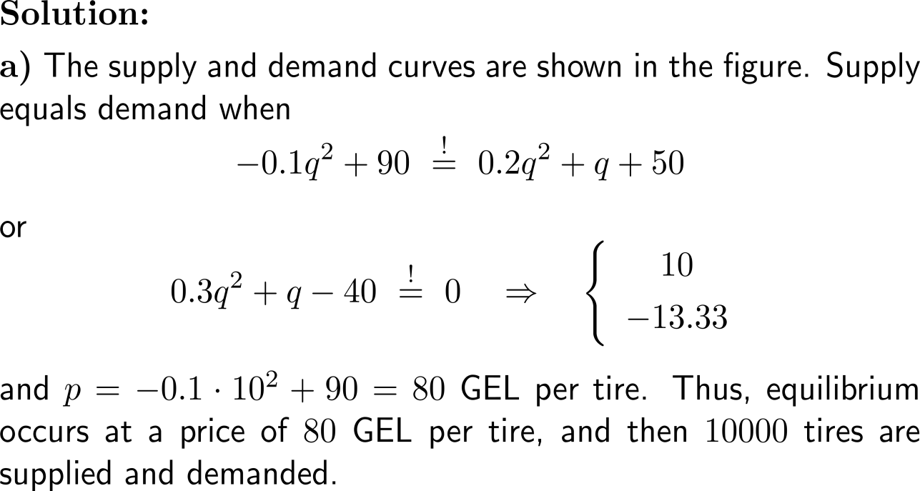
Example: Studying consumers’ and producers’ surplus

Slide 42
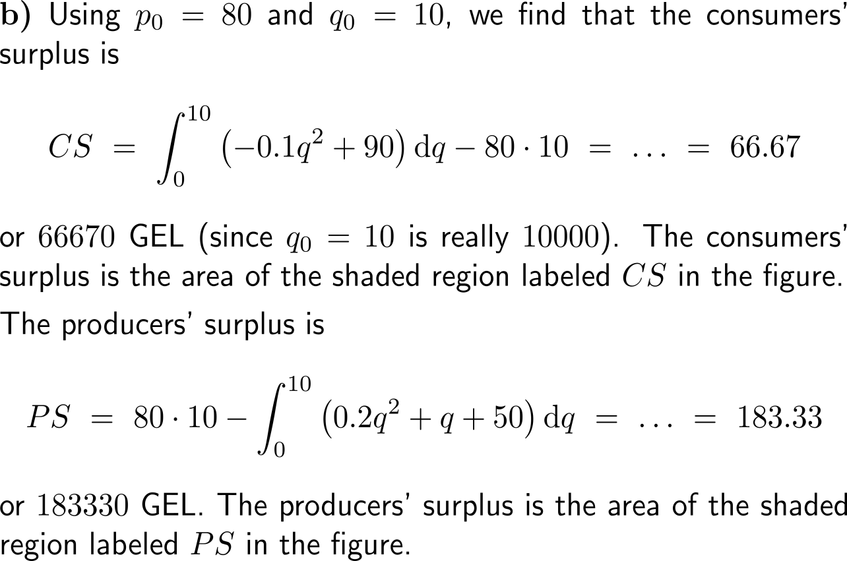
Example: Studying consumers’ and producers’ surplus

Slide 43
Further Worked-Out Exercises:
Calculus I for Management
Topics
Net excess profit & Lorenz curves
The average value of a function
Future value & present value of an income flow
Consumer willingness to spend & consumer’s surplus

Slide 44
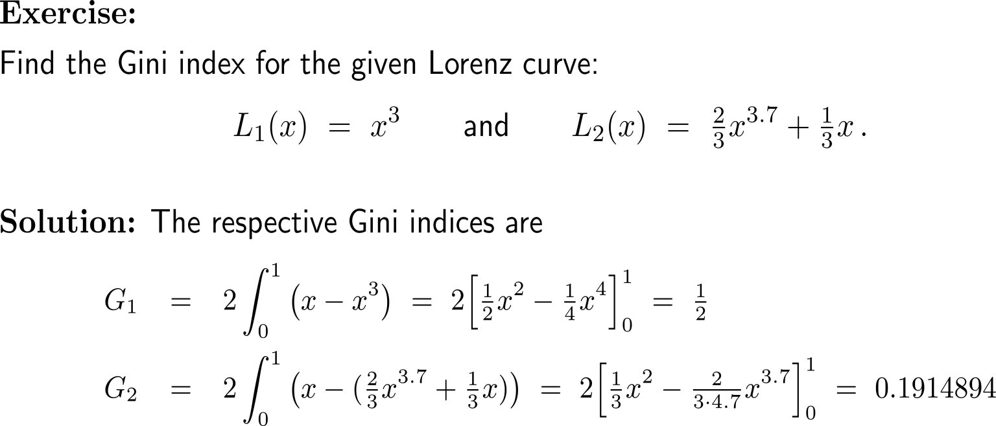
Exercise: Gini indices for given Lorenz curves

Slide 45
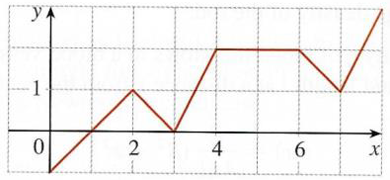
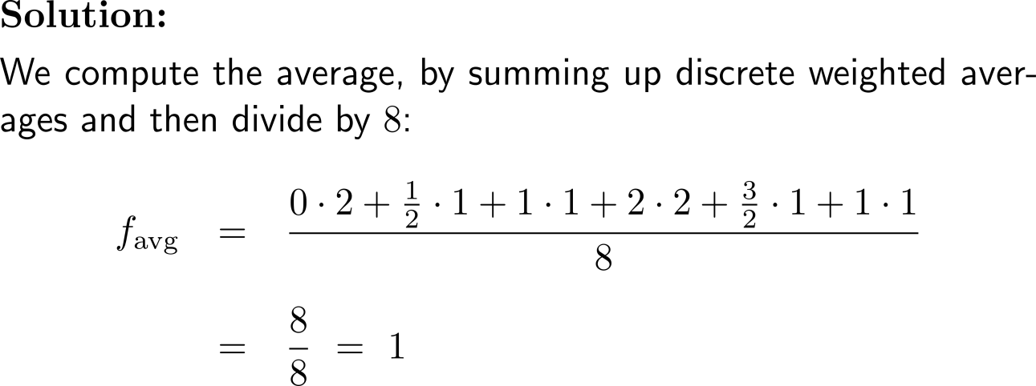
Exercise: The average of a function

Slide 46
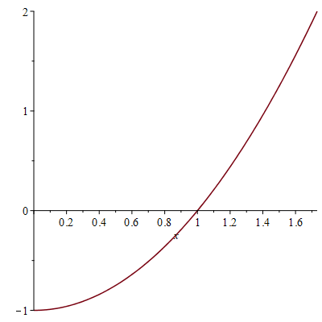
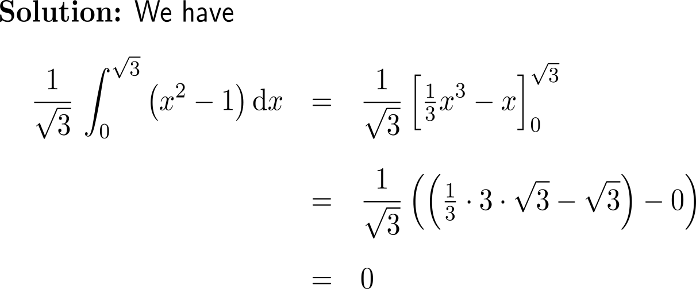
Exercise: Finding the average value
f(x) = x² – 1

Slide 47
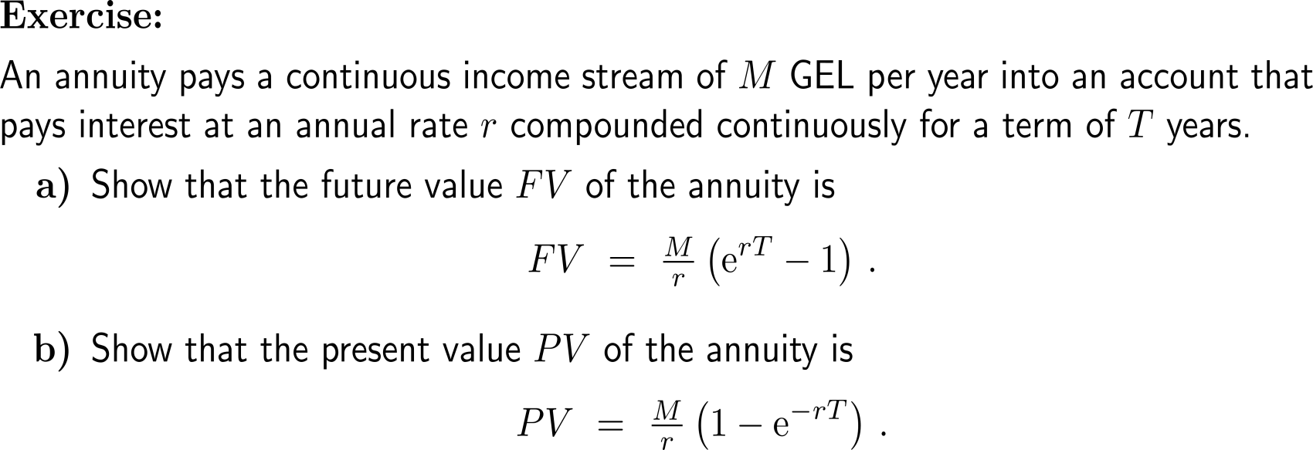
Exercise: Future and present value of an annuity

Slide 48
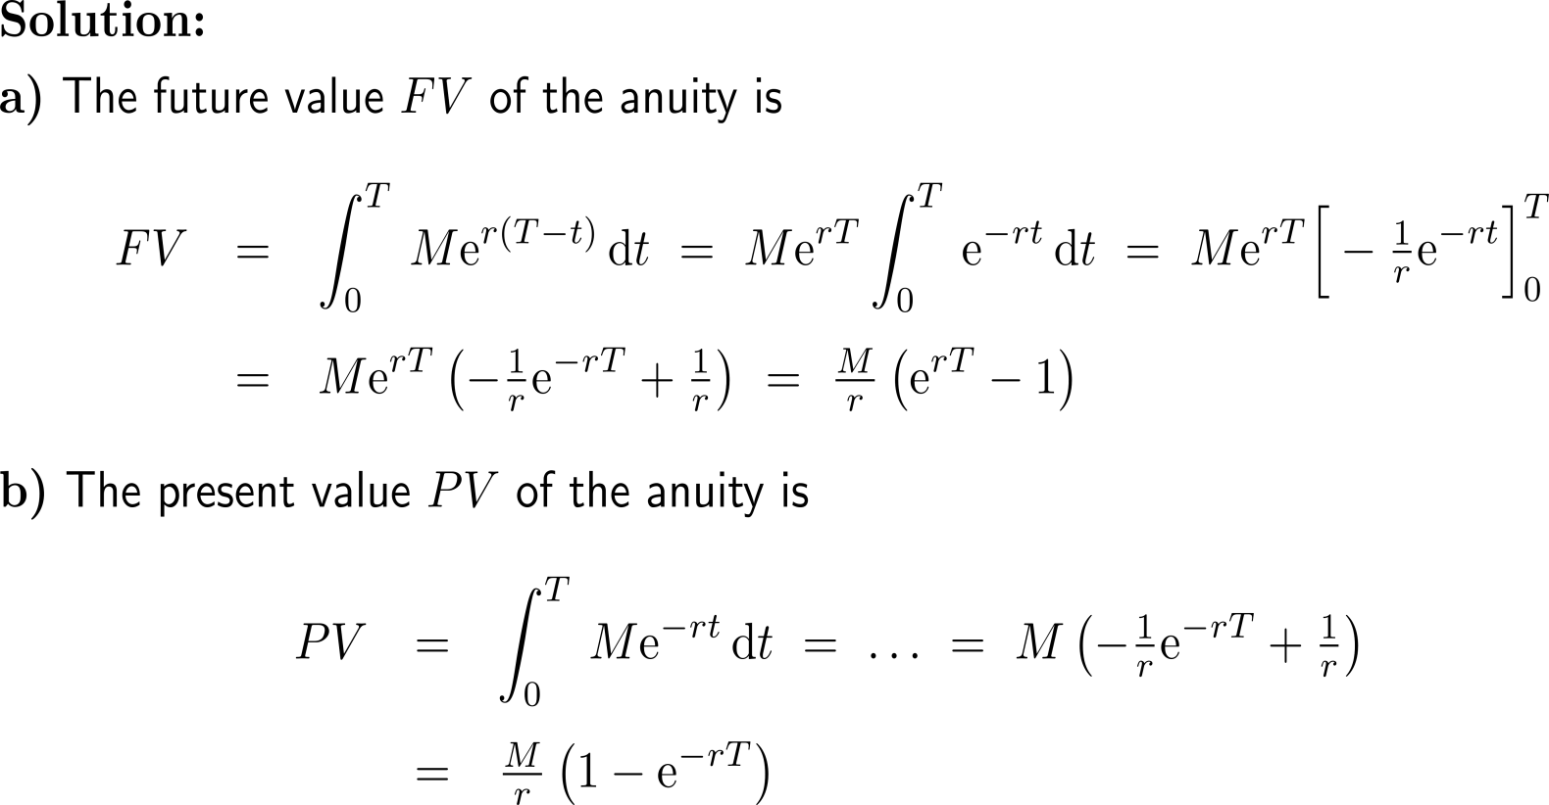
Exercise: Future and present value of an annuity

Slide 49
Exercise: Consumers’ willingness to spend

Slide 50
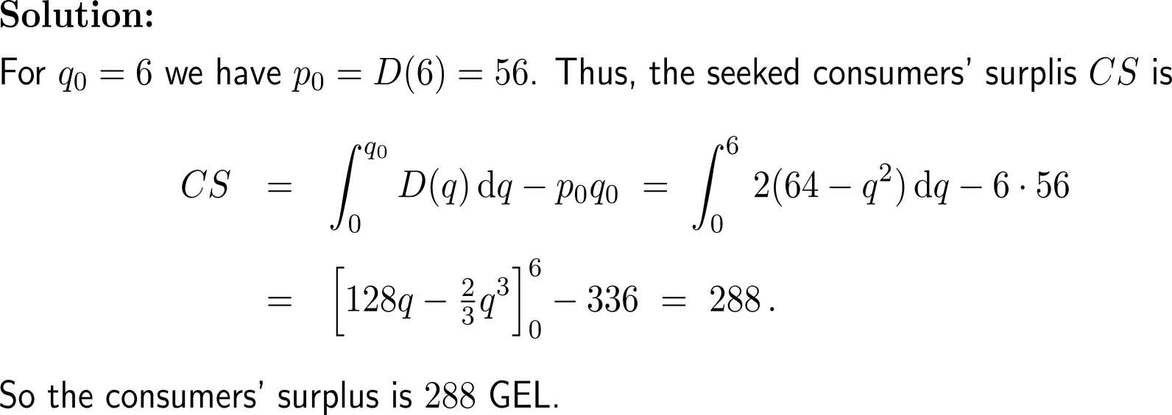
Exercise: Consumers’ surplus

Slide 51
Calculus I for Management

