Slide 1
Calculus I for MGMT – Integration Integration by Parts
Mathematics for Management
Supplementary Electronic Materials
Preliminaries
Integration by Parts (of indefinite integrals)
Definite Integration by Parts
Repeated Application of Integration by Parts
Using Integral Tables

Slide 2
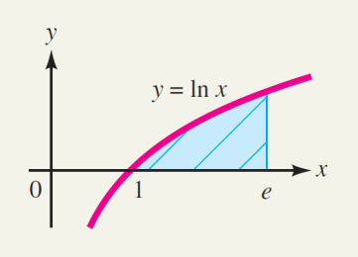
Definite integration by parts is used, for instance, to find an area

Slide 3
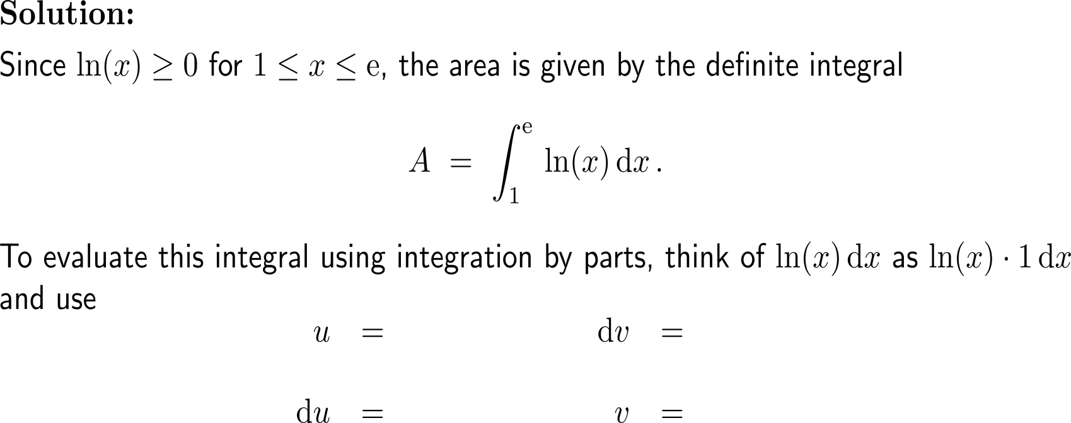
Example: Application of definite integration by parts
L-I-A-T-E

Slide 4
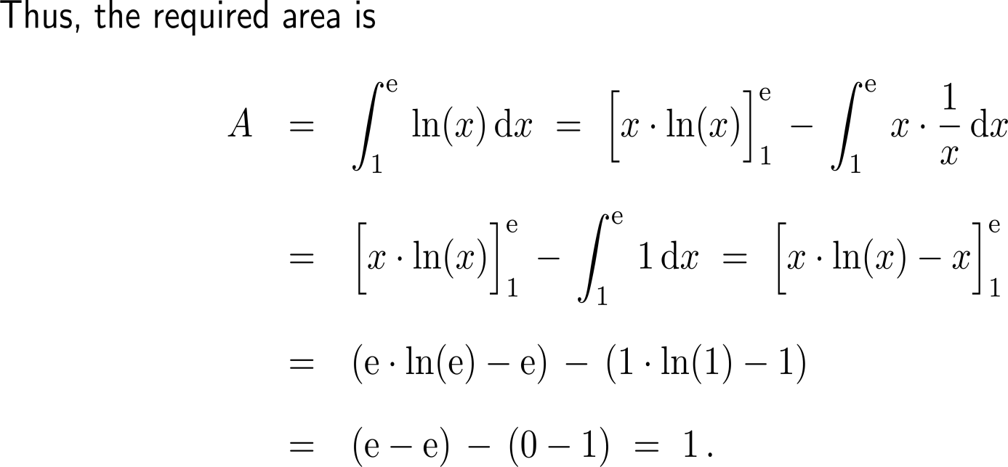
Example: Application of definite integration by parts

Slide 5
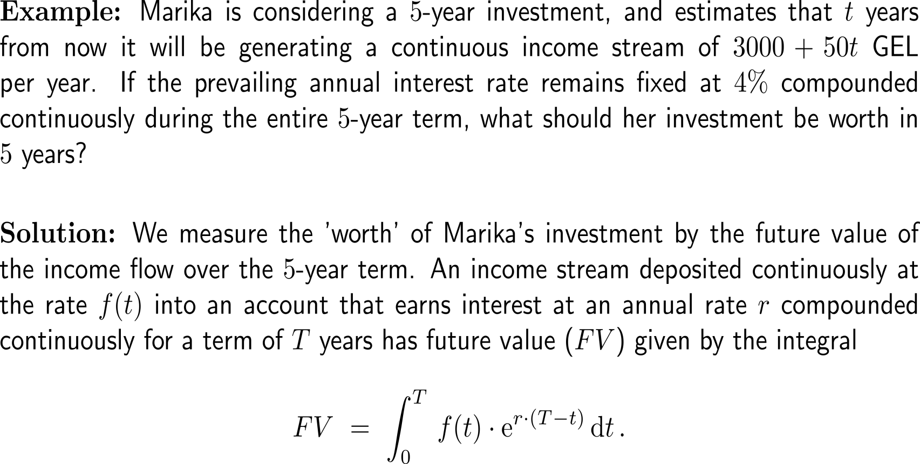
Example: Calculating the future vale of an investment

Slide 6
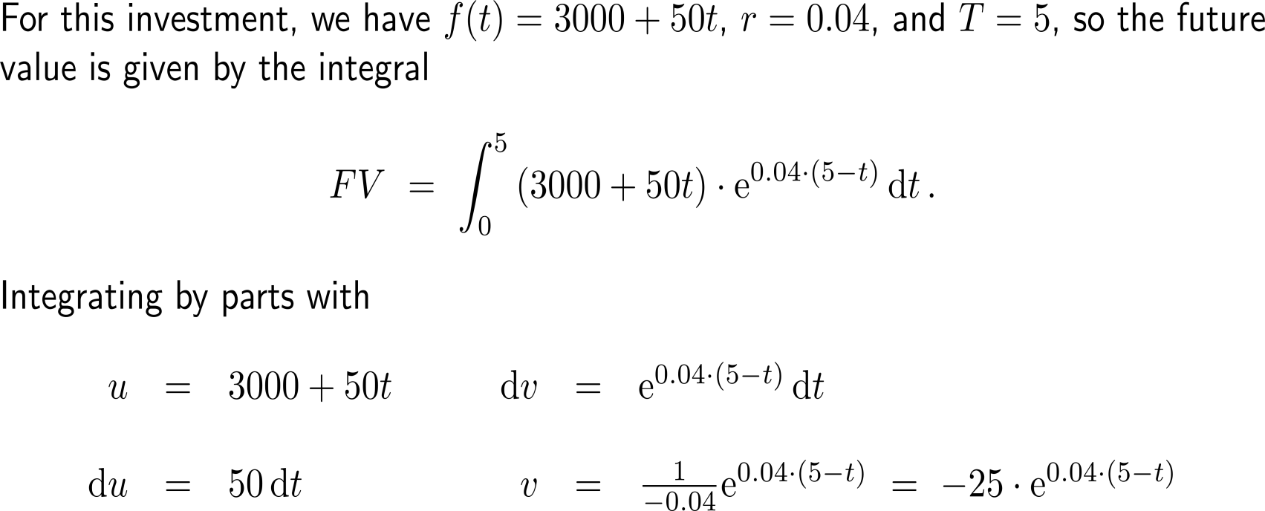
Example: Calculating the future vale of an investment
L-I-A-T-E

Slide 7
Example: Calculating the future vale of an investment

Slide 8
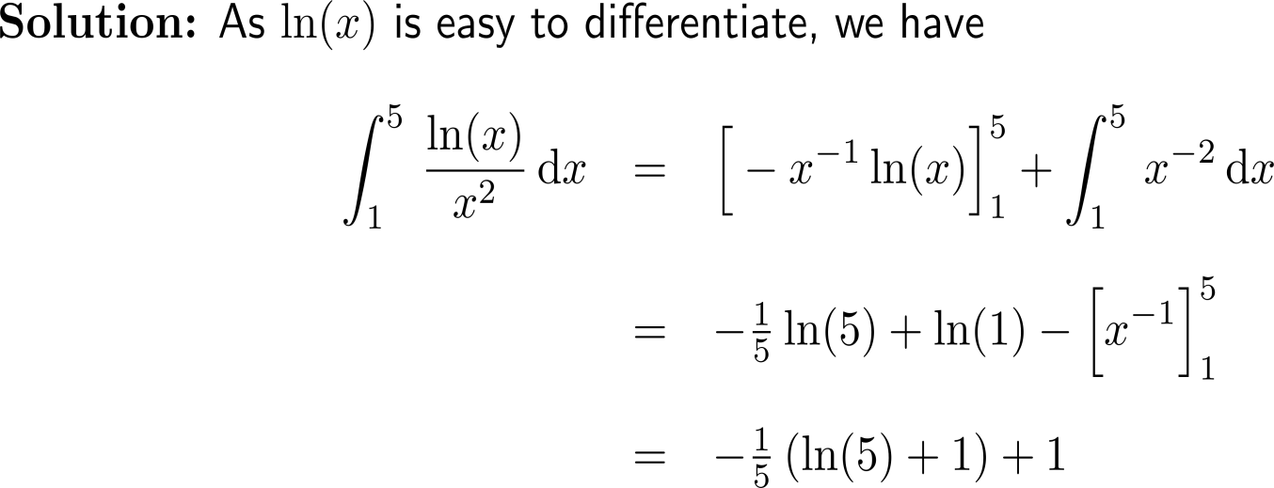
Now it’s your turn: Please, try to solve this question on your own
Discussion
5 minutes
self/ group work
please, upload your solutions to the chat

Slide 9
Calculus I for Management

