Slide 1
Calculus I for MGMT – Integration Integration by Parts
Mathematics for Management
Supplementary Electronic Materials
Preliminaries
Integration by Parts (of indefinite integrals)
Definite Integration by Parts
Repeated Application of Integration by Parts
Using Integral Tables

Slide 2
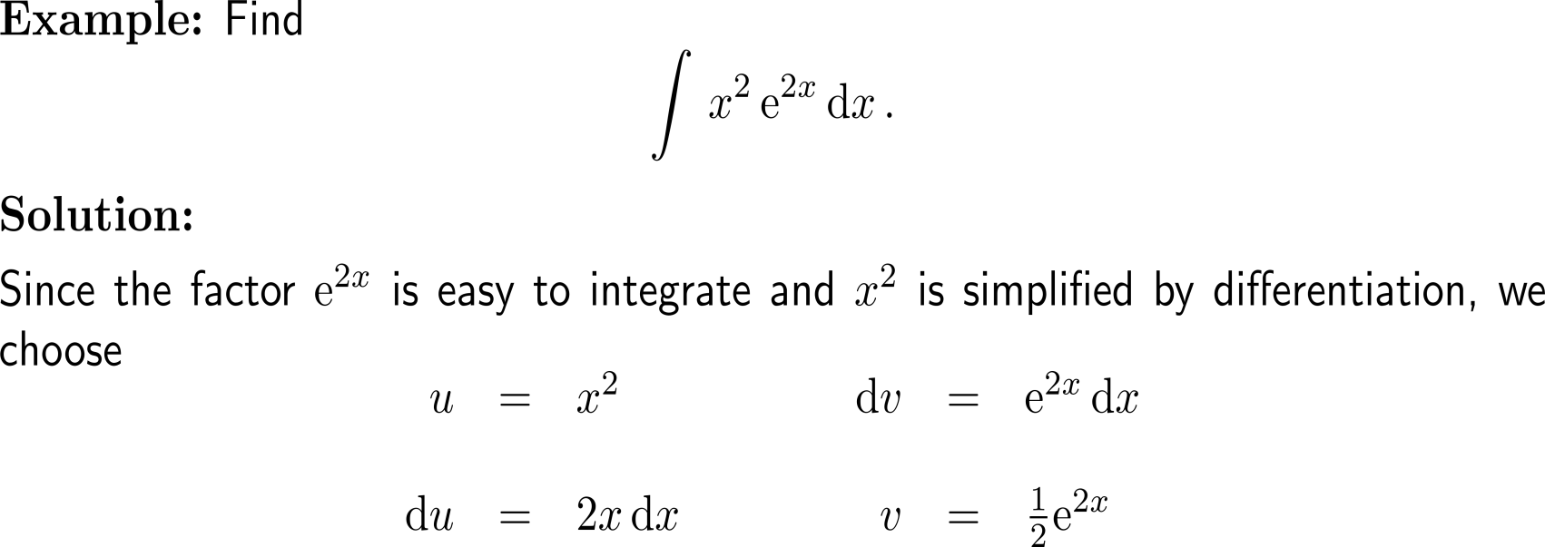
Example: Integrating by parts twice

Slide 3
Example: Integrating by parts twice

Slide 4
Calculus I for Management

