Slide 1
Calculus I for MGMT – Integration Integration by Parts
Mathematics for Management
Supplementary Electronic Materials
Preliminaries
Integration by Parts (of indefinite integrals)
Definite Integration by Parts
Repeated Application of Integration by Parts
Using Integral Tables

Slide 2
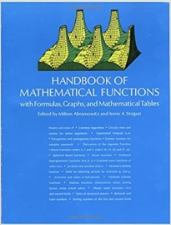
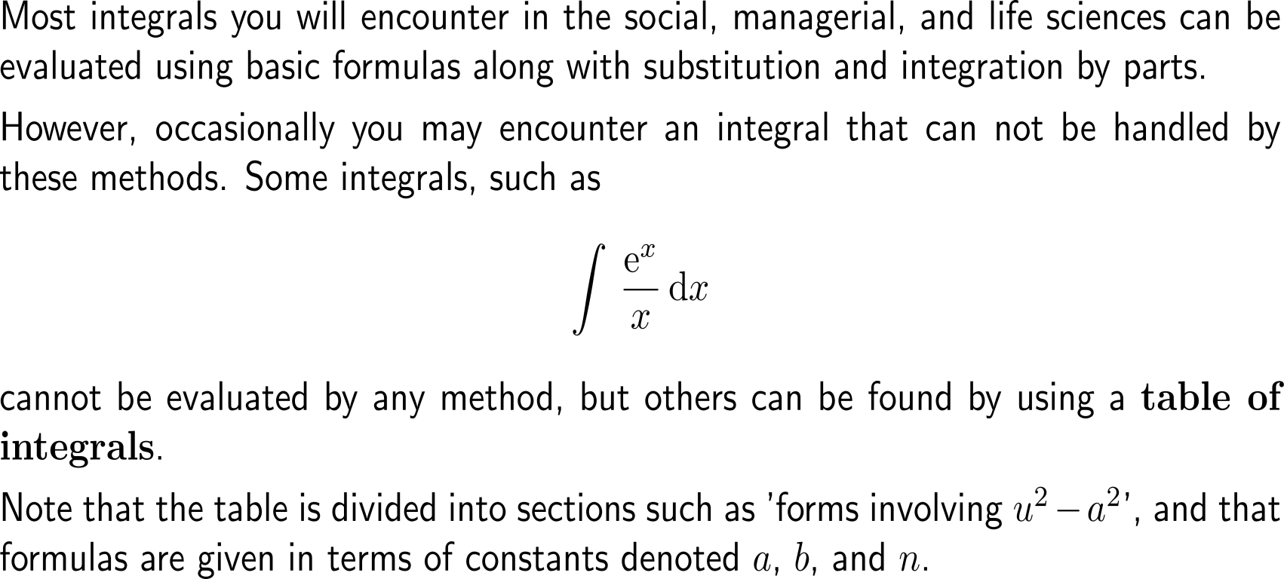
Using a table of integrals are often of great help to find the indefinite integrals of uncommon or complicated functions
online “tables”

Slide 3
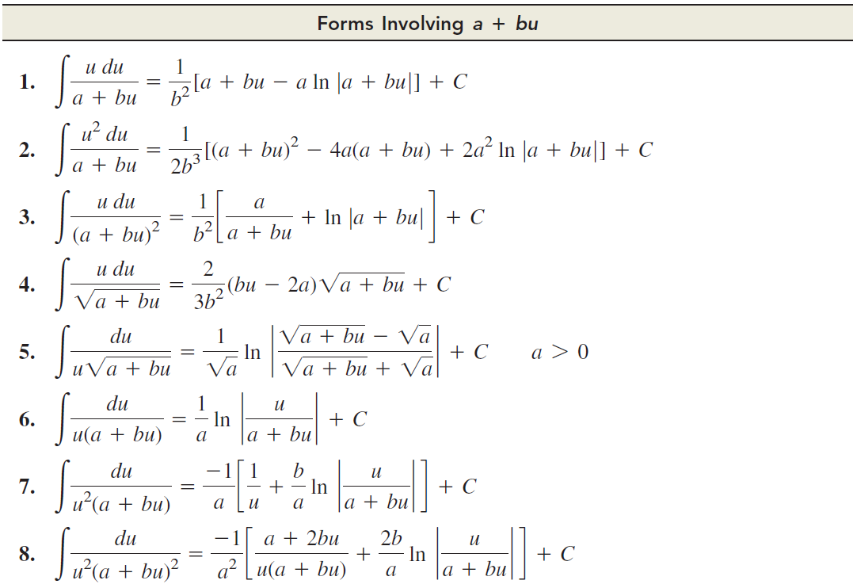
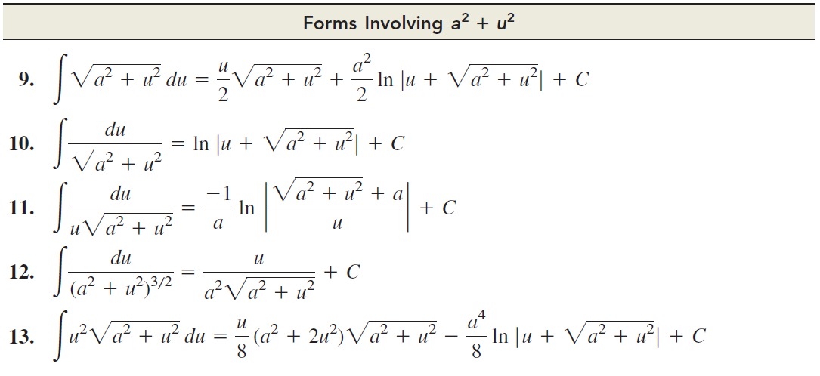
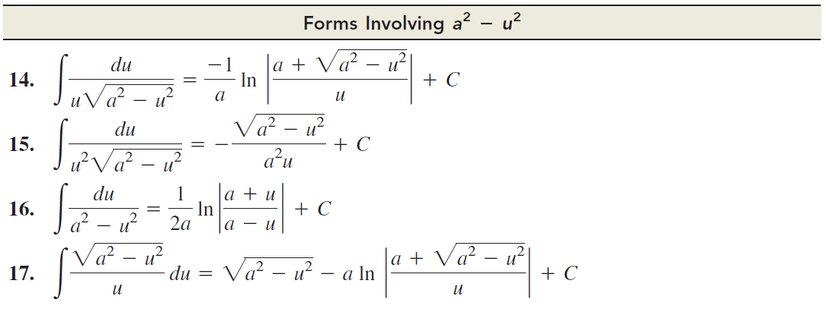
Important integral tables (1/ 2)

Slide 4
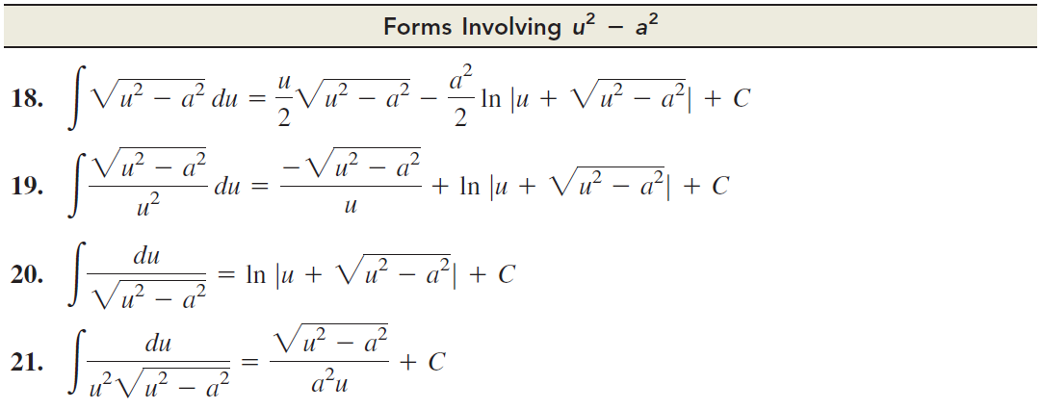
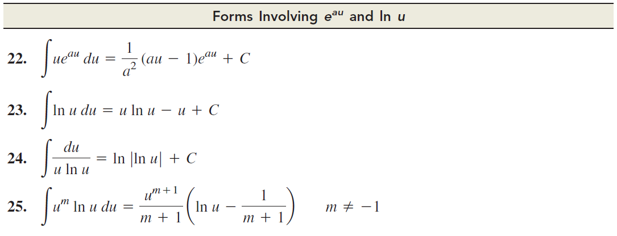
Important integral tables (2/ 2)

Slide 5
Example: Using a table of integrals

Slide 6
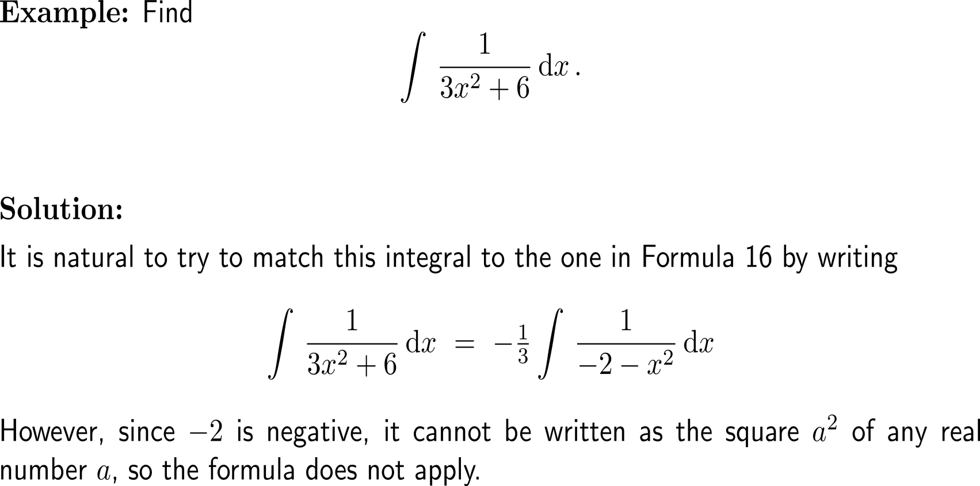
Example: An integral not in the table

Slide 7
Example: Using a table of integrals

Slide 8
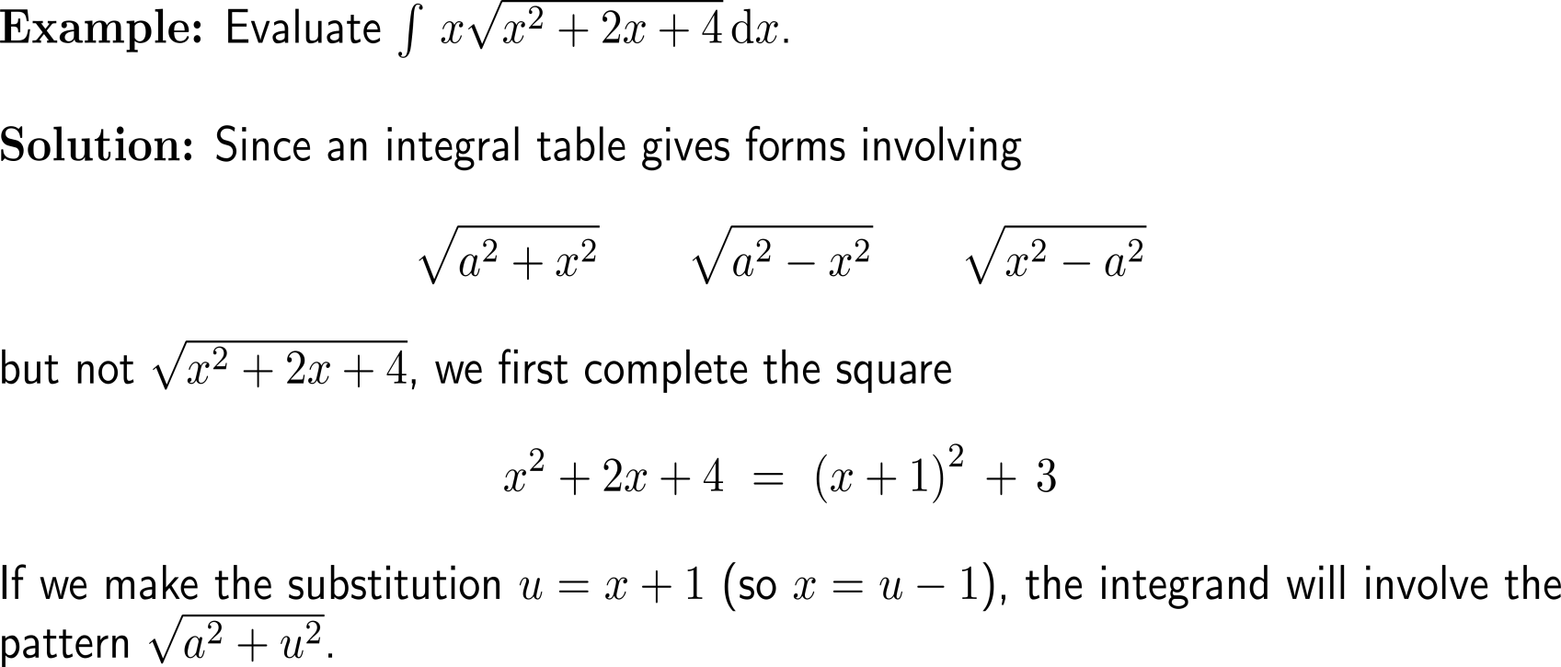
Example: Evaluating integrals with the aid of an integral table

Slide 9
Example: Evaluating integrals with the aid of an integral table

Slide 10
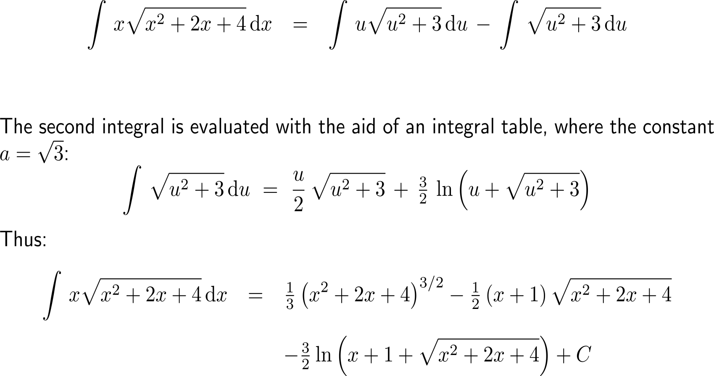
Example: Evaluating integrals with the aid of an integral table

Slide 11
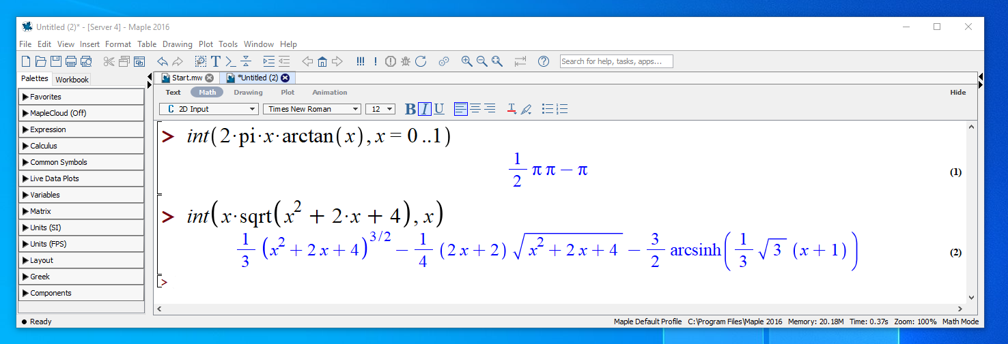
Additionally, Computer Algebra Systems (CAS) can help to evaluate a given integral (though the result needs to be validated, e.g. by differentiation)
here, we need to finally multiply to obtain π²
Example
here, we need the following identity:

Slide 12
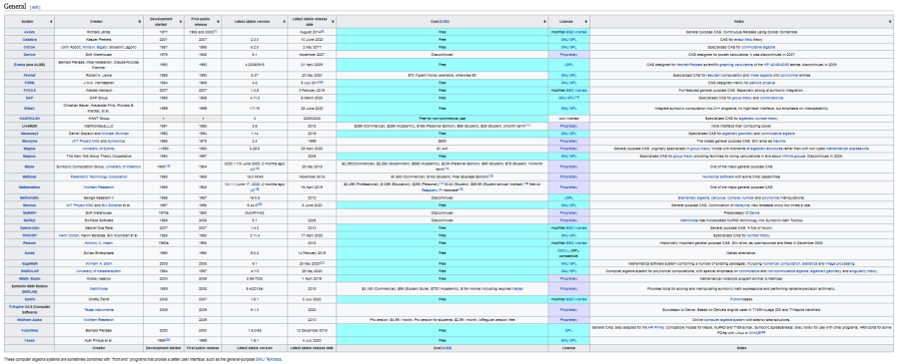
There is a huge list of free/ commercial and/ or specially targeted Computer Algebra Systems
Some Computer Algebra Systems:
Axiom
Cadabra
CoCoA
Derive
Erable (aka ALGB)
Fermat
FORM
FriCAS
GAP
GiNaC
KANT/ KASH
LiveMath
Macaulay2
Macsyma
Magma
Magnus
Maple
Mathcad
Mathematica
Mathomatic
Maxima
MuMATH
MuPAD
OpenAxiom
PARI/ GP
Reduce
Scilab
SageMath
SINGULAR
Smath Studio
Symbolic Math Toolbox (MATLAB)
SymPy
TI-Nspire CAS
Wolfram Alpha
Xcas/ Giac
Yacas
…
https://en.wikipedia.org/wiki/List_of_computer_algebra_systems

Slide 13
Calculus I for Management

