Slide 1
Calculus II for MGMT – Introduction to Vectors & Matrices Linear Systems of Equations
Mathematics for Management
Supplementary Electronic Materials
Linear Systems of Equations
Lines in the plane & systems of equations in 2 variables
Lines in space & systems of equations in 3 variables
N-variable systems &
Gaussian Elimination

Slide 2
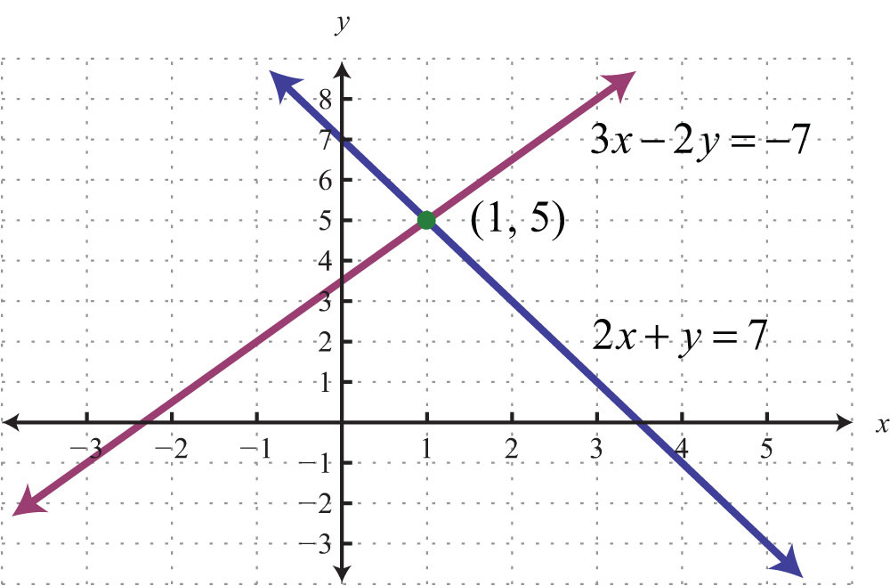
Determining the point of intersection of two lines, i.e. solving a system of two linear equations with two variables (1/ 4)

Slide 3
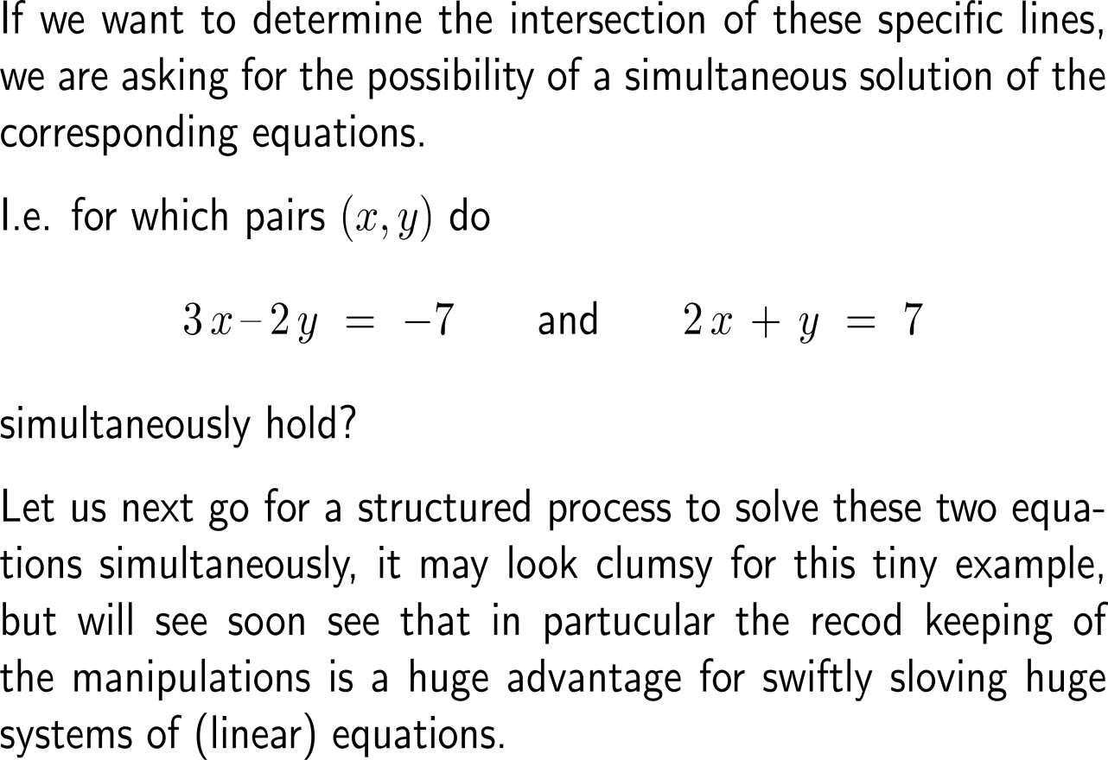
Determining the point of intersection of two lines, i.e. solving a system of two linear equations with two variables (2/ 4)

Slide 4
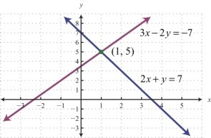
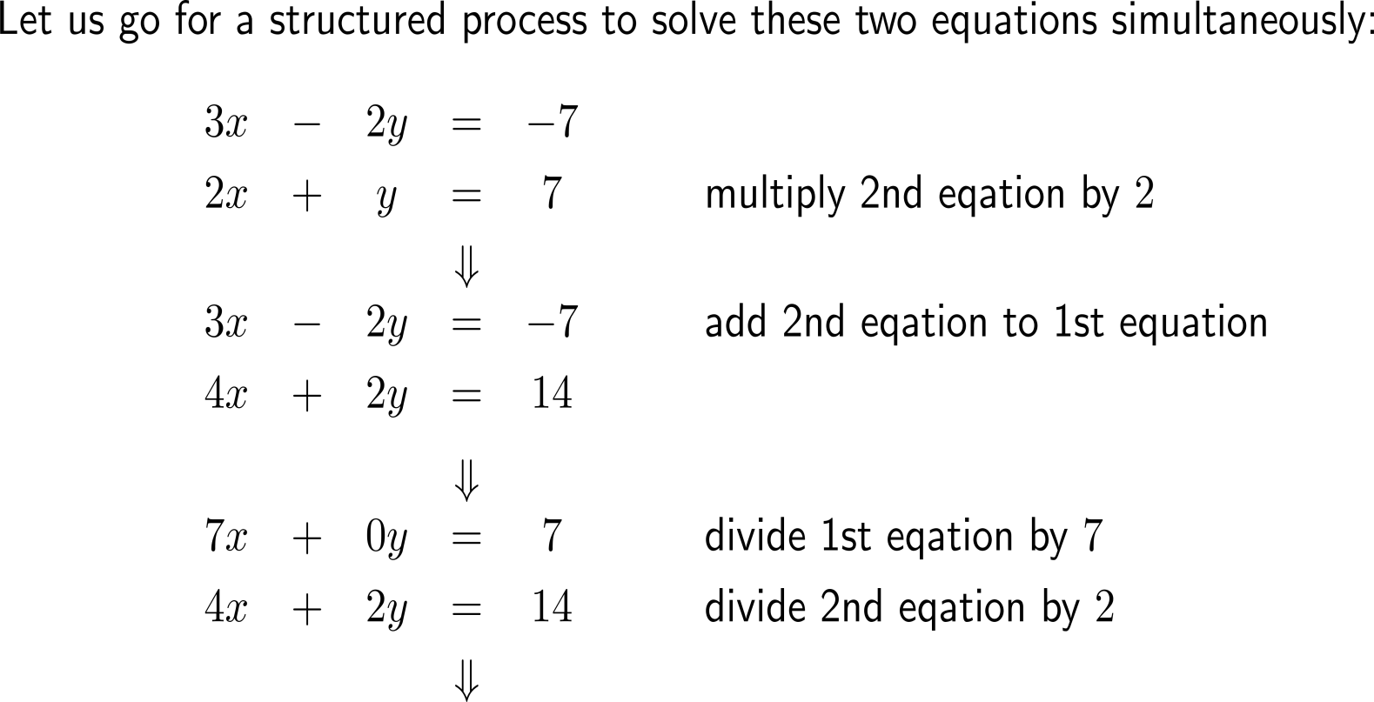
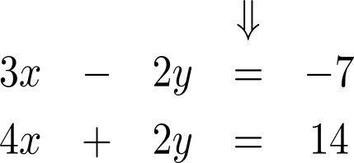
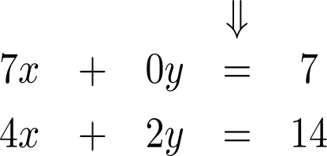
Determining the point of intersection of two lines, i.e. solving a system of two linear equations with two variables (3/ 4)

Slide 5
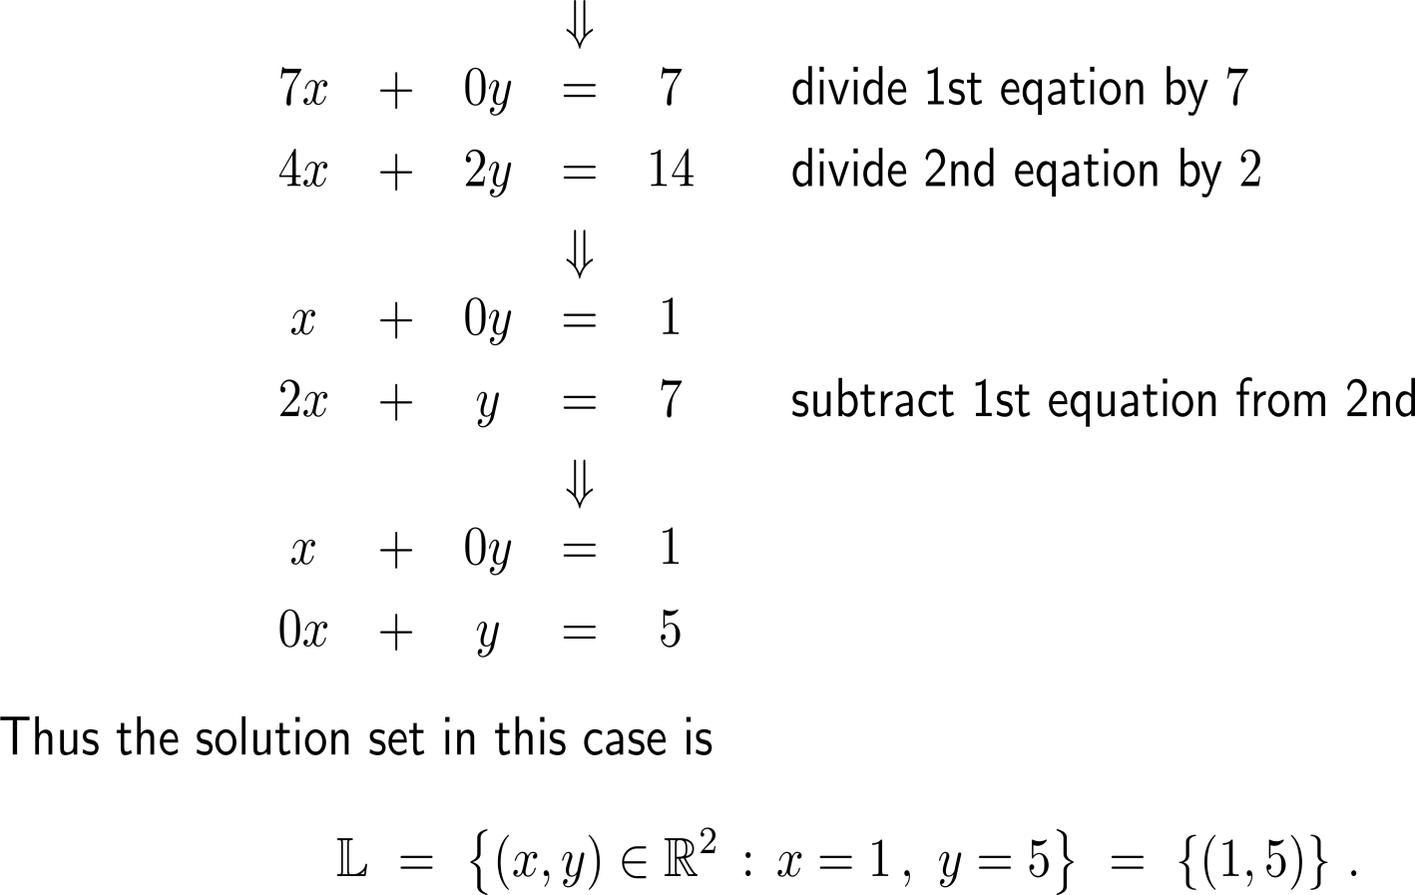
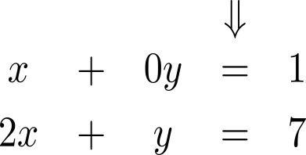
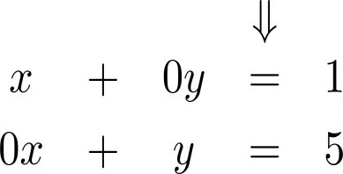
Determining the point of intersection of two lines, i.e. solving a system of two linear equations with two variables (4/ 4)
normalization
of a variable

Slide 6
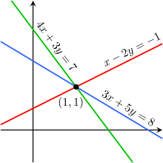
Example: Applying the elimination procedure

Slide 7
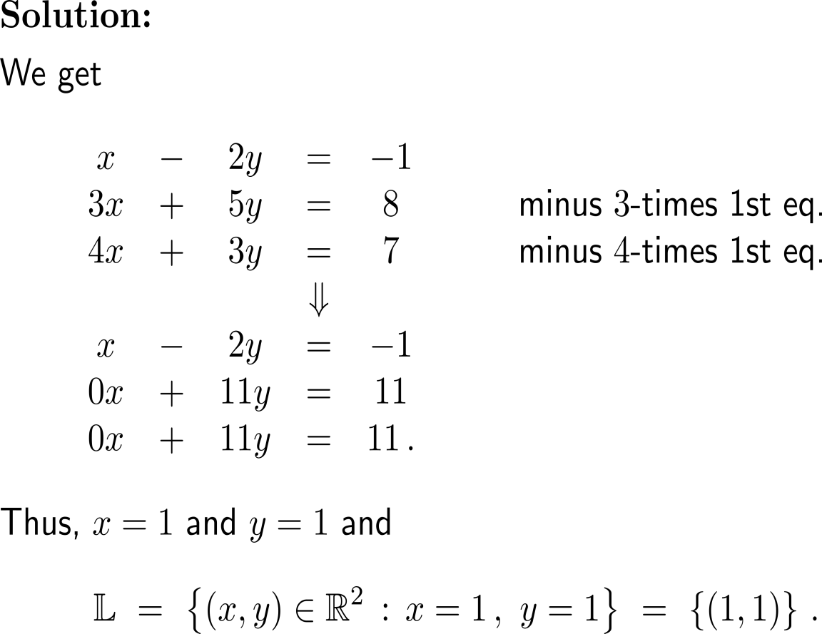
Example: Applying the elimination procedure

Slide 8
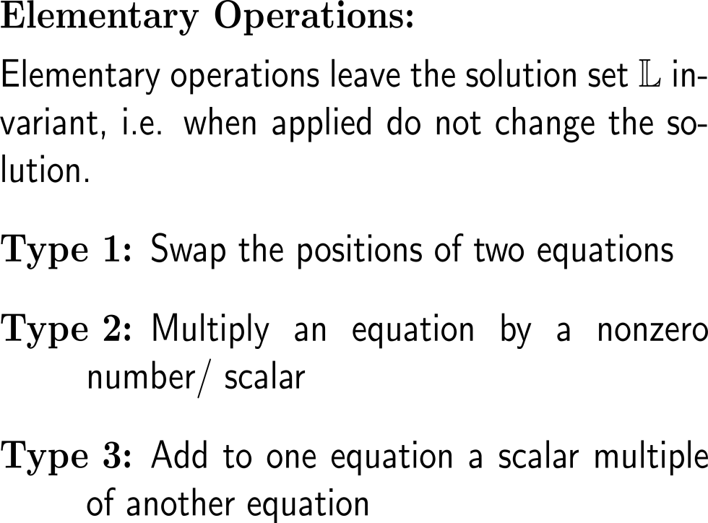
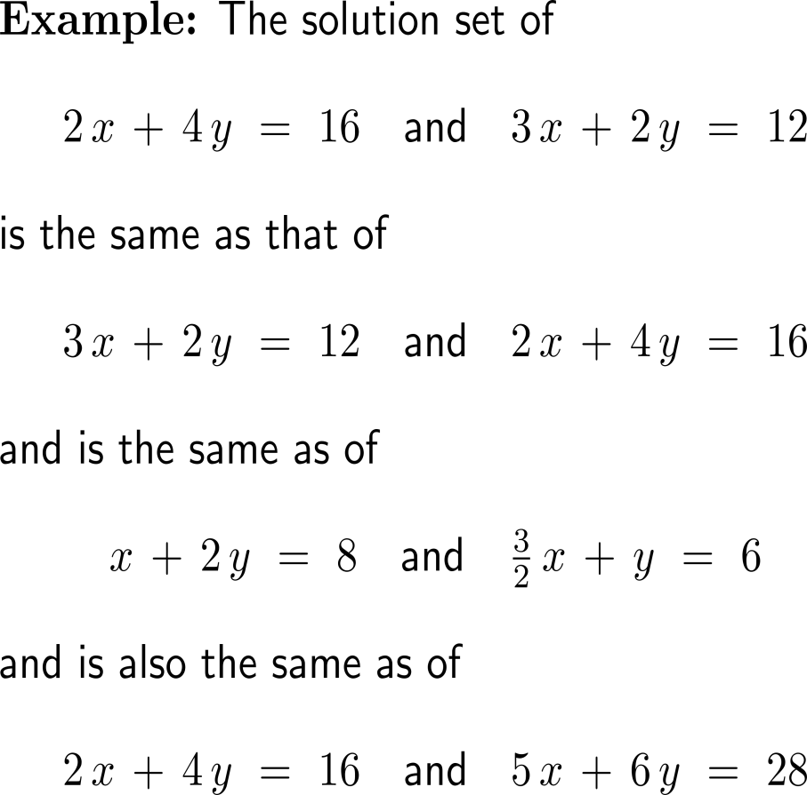
Summary: Elementary operations to gain the upper echelon form
Type 1
Type 2
Type 3

Slide 9
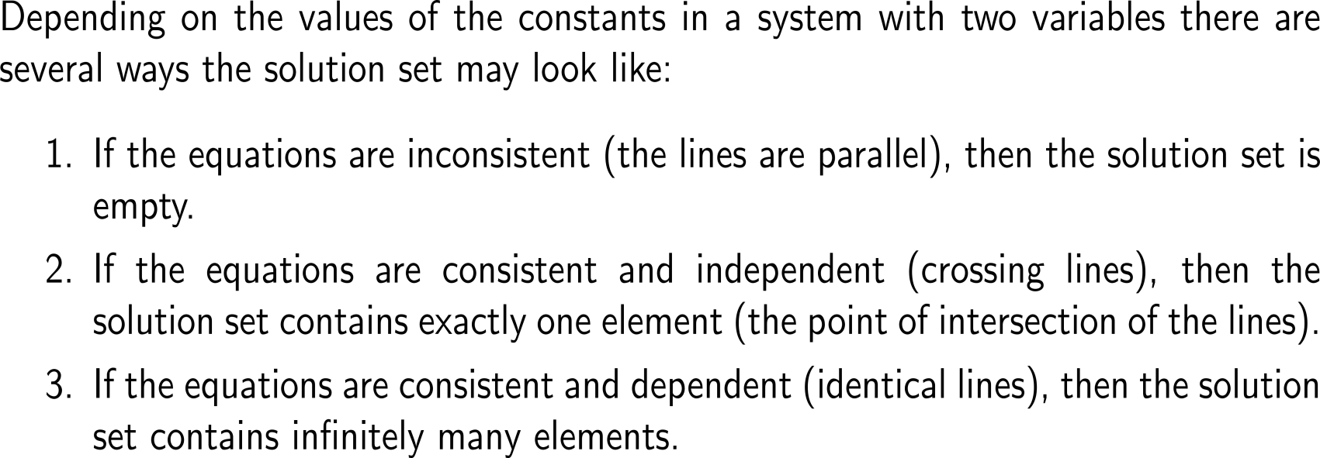
Of course, depending on the mutual position of the two lines there can as well be no or infinitely many points of intersection
consistent
inconsistent
independent
dependent
no solution
(parallel)
one solution
(intersect)
∞ solutions
(identical)

Slide 10
Example: The structure of the solution set

Slide 11
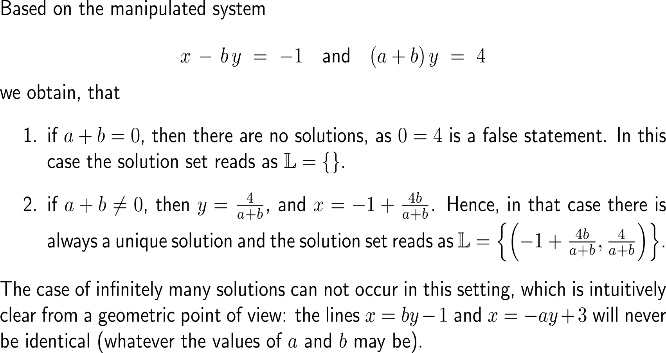
Example: The structure of the solution set
inconsistent
no solution
(parallel)
independent
one solution
(intersect)
dependent
∞ solutions
(identical)

Slide 12
Calculus II for Management

