Slide 1
Calculus II for MGMT – Introduction to Vectors & Matrices Linear Systems of Equations
Mathematics for Management
Supplementary Electronic Materials
Linear Systems of Equations
Lines in the plane & systems of equations in 2 variables
Lines in space & systems of equations in 3 variables
N-variable systems &
Gaussian Elimination

Slide 2
The rank of a linear system/ an augmented coefficient matrix is the number of pivot elements

Slide 3
Often it is convenient to write a linear system in the form Ax = b that allows the immediate determination of the augmented matrix (A | b)

Slide 4
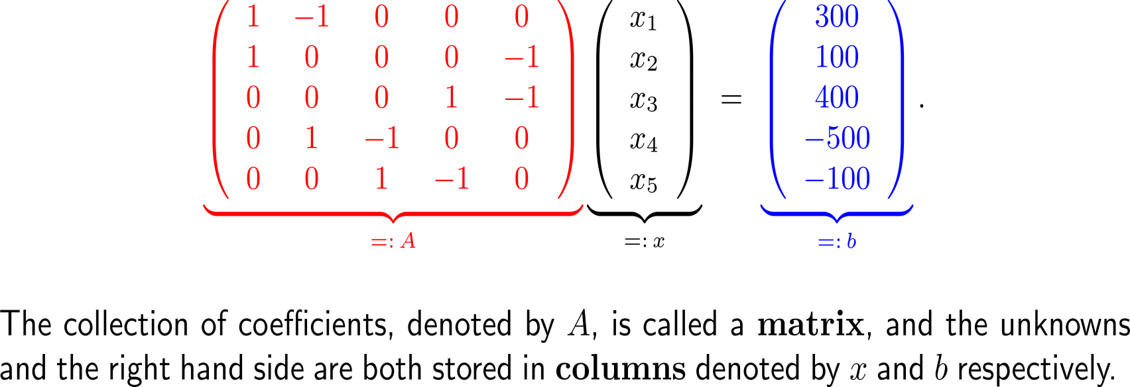
Often it is convenient to write a linear system in the form Ax = b that allows the immediate determination of the augmented matrix (A | b)

Slide 5
This matrix-column interpretation of a linear system of equation is possible for arbitrary numbers of equations and unknowns, …

Slide 6
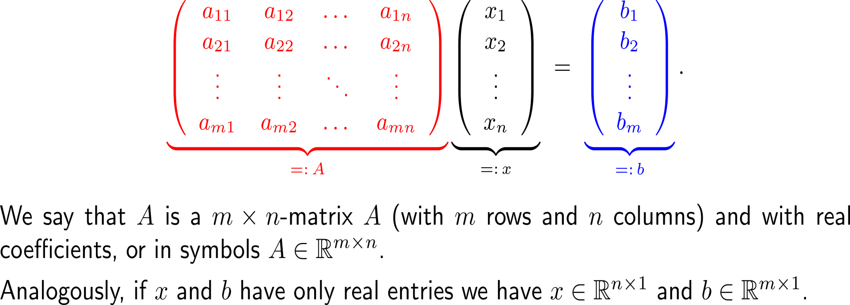
This matrix-column interpretation of a linear system of equation is possible for arbitrary numbers of equations and unknowns, …

Slide 7
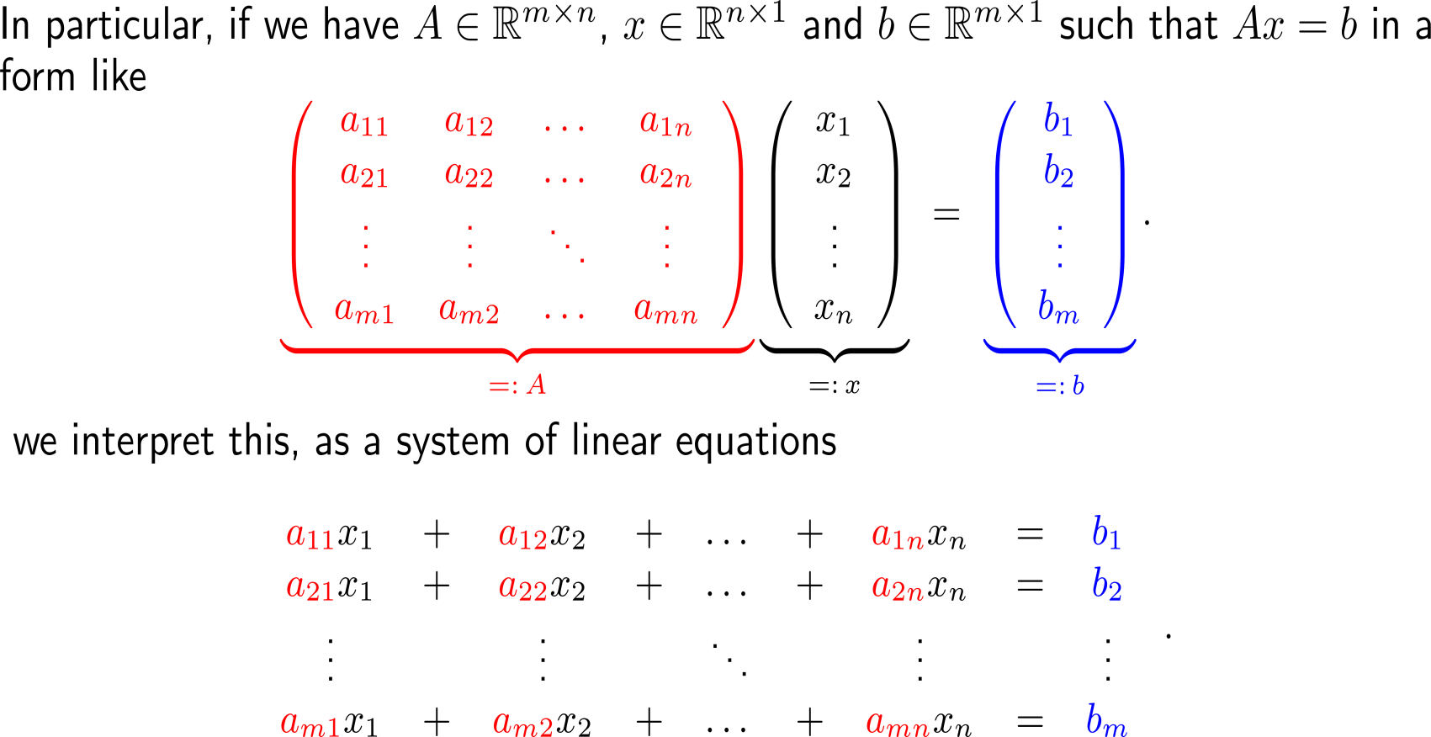
… in particular, given a matrix-column system, we interpret this as a system of linear equations

Slide 8
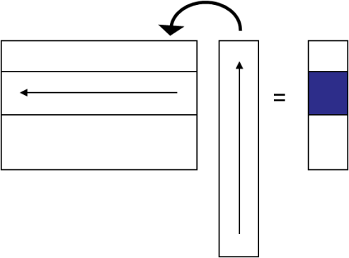
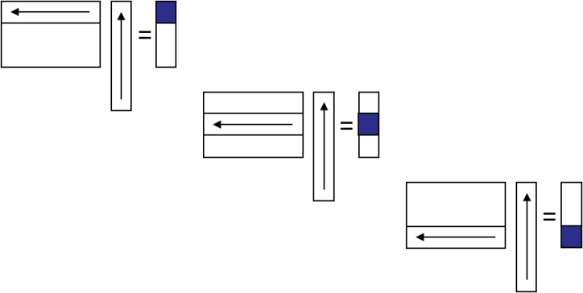
The multiplication of a matrix with a column is easily visualized in terms of overlaying, multiplication and summation of scalars
Illustratively, the computation of Ax follows these steps:

Slide 9
Note: Only the multiplication of a (m x n)-matrix with an n-column is well-defined

Slide 10
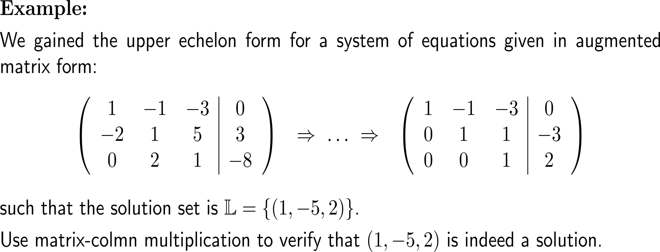
Example: Matrix-column multiplication to check a solution

Slide 11
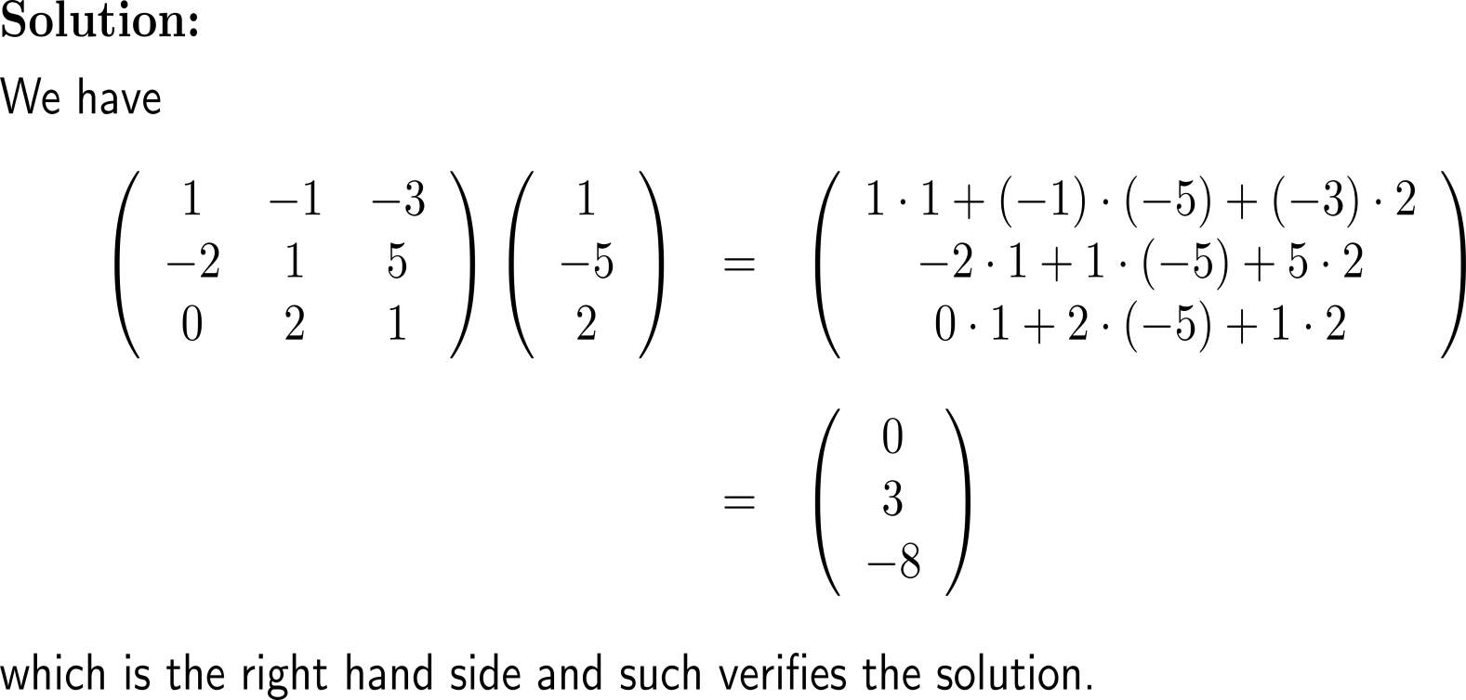
Example: Matrix-column multiplication to check a solution

Slide 12
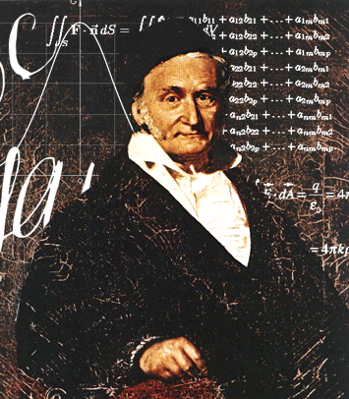
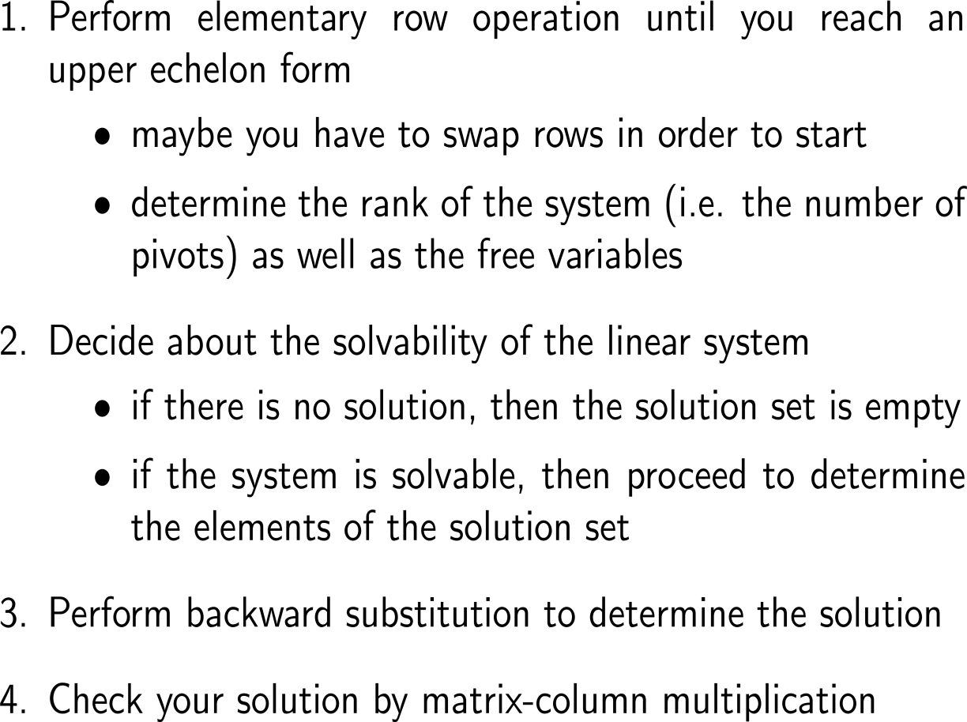
Summary: Gaussian Elimination in a nutshell

Slide 13
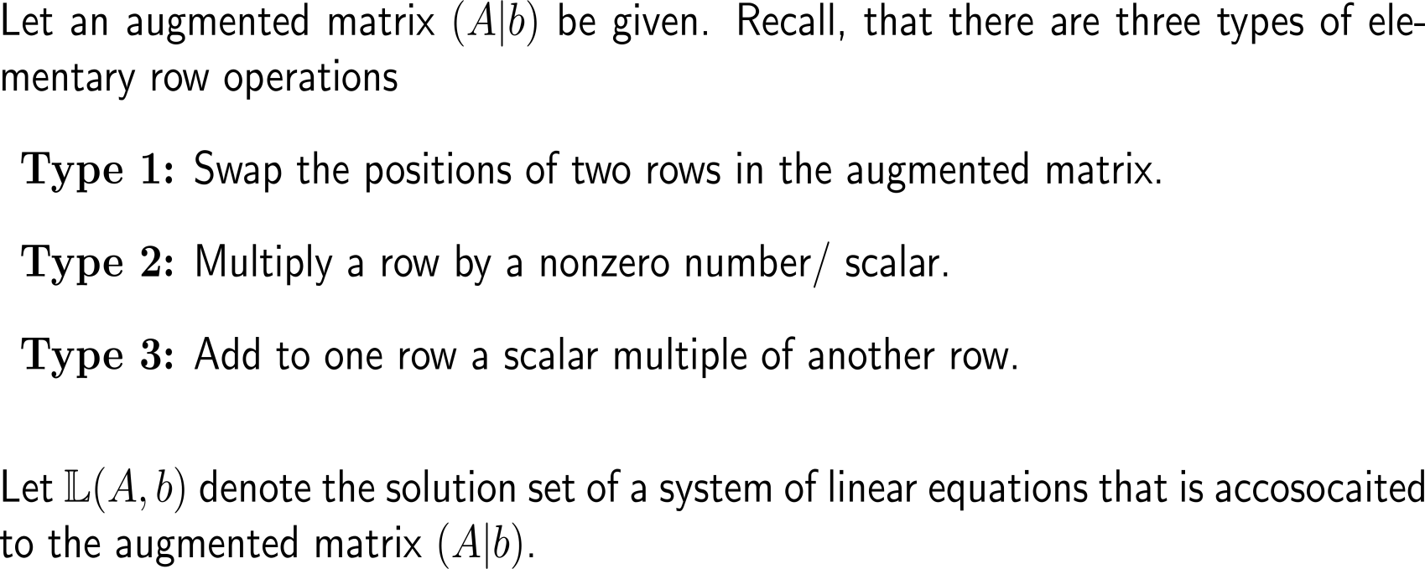
Based on elementary row operations …

Slide 14
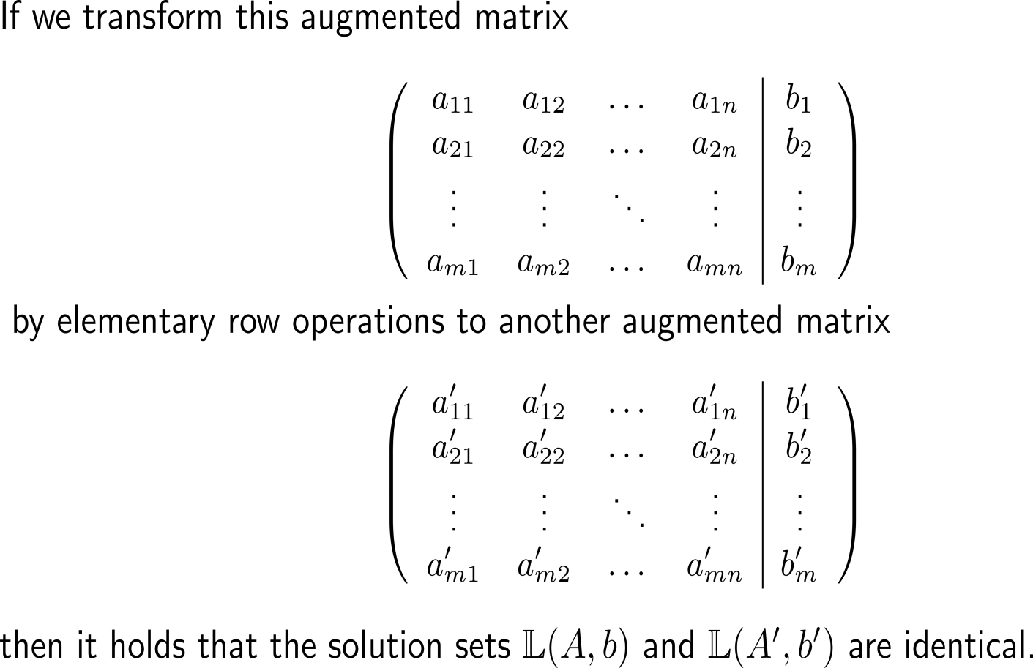
… we know that these do not alter the solution set of a linear system of equations (1/ 2)

Slide 15
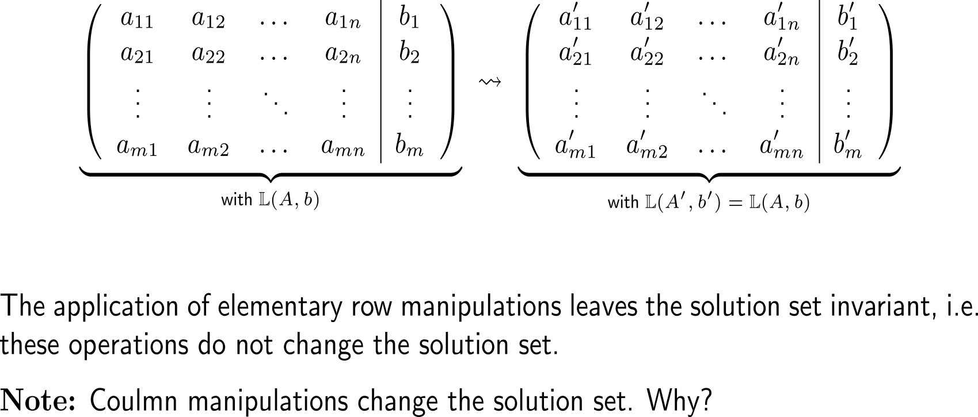
… we know that these do not alter the solution set of a linear system of equations (2/ 2)

Slide 16
Calculus II for Management

