Slide 1
Calculus II for MGMT – Introduction to Vectors & Matrices Determinants
Mathematics for Management
Supplementary Electronic Materials
Determinants
Motivation: The geometry of determinants
General properties &
computation rules

Slide 2
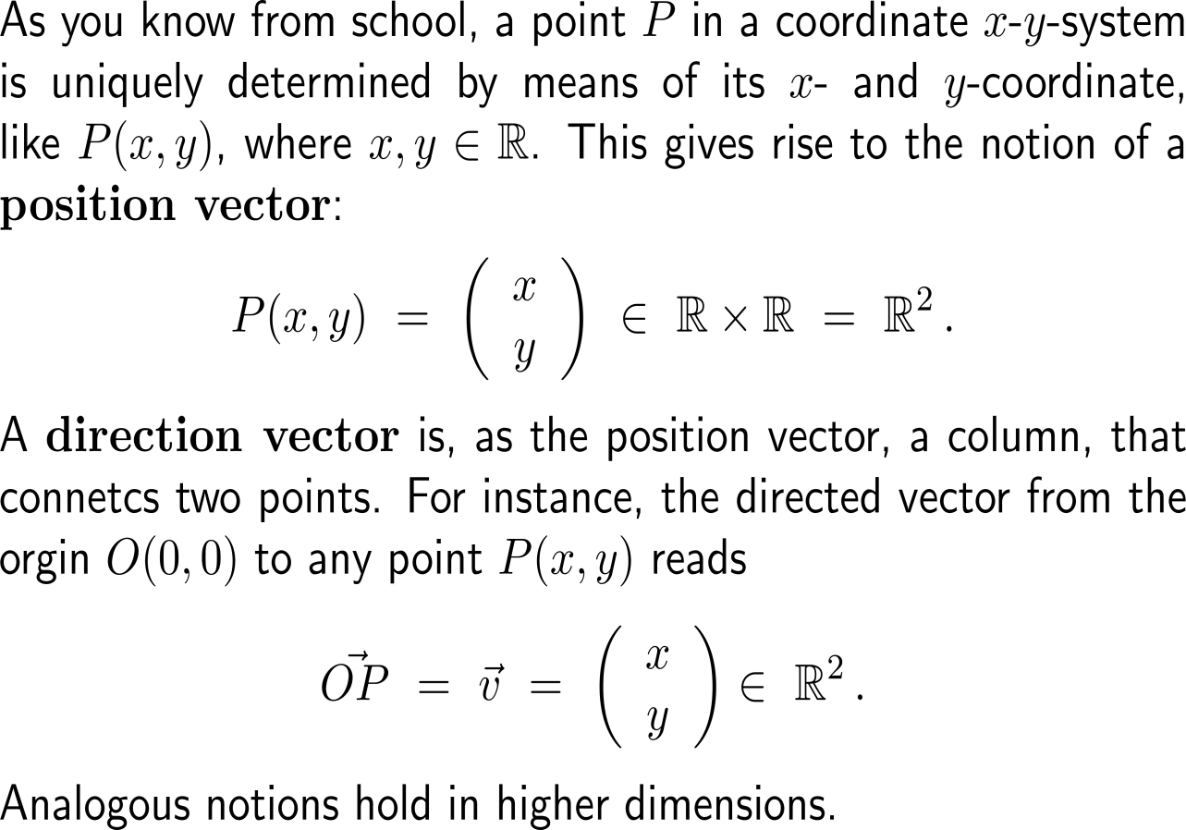
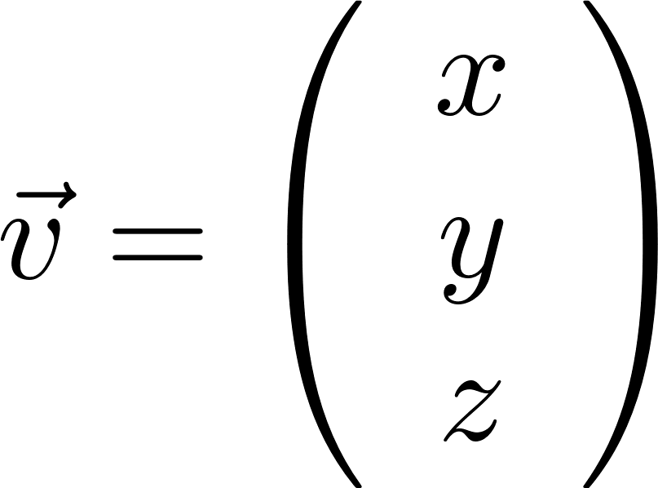
To have a vocabulary that allows us to express geometric quantities, let us recall the notions of position and direction vectors (1/ 2)
y-axis
P
O
x-axis
origin of the coordinate system
z-axis
y-axis
P
O
x-axis
origin of the coordinate system

Slide 3
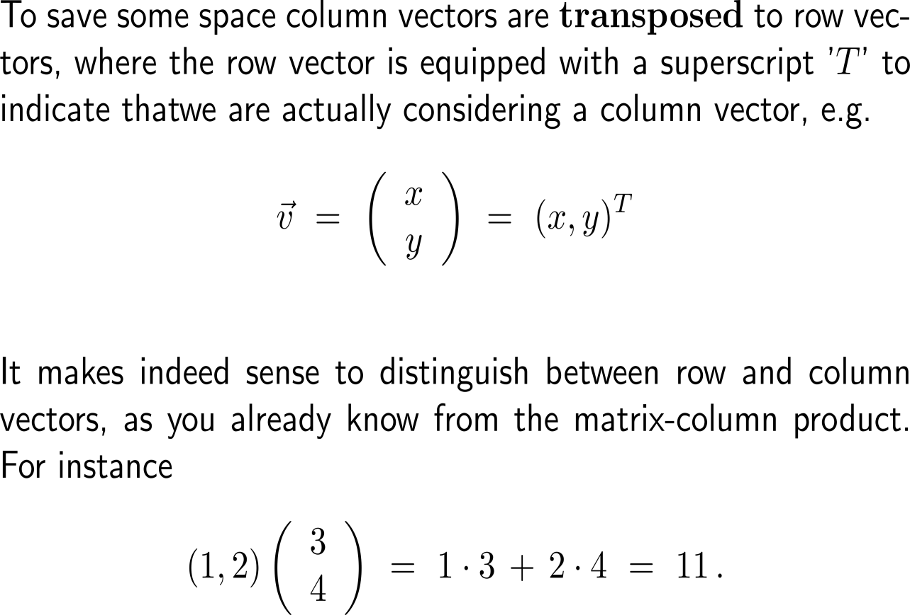
To have a vocabulary that allows us to express geometric quantities, let us recall the notions of position and direction vectors (2/ 2)
y-axis
P
O
x-axis
origin of the coordinate system
z-axis
y-axis
P
O
x-axis
origin of the coordinate system

Slide 4
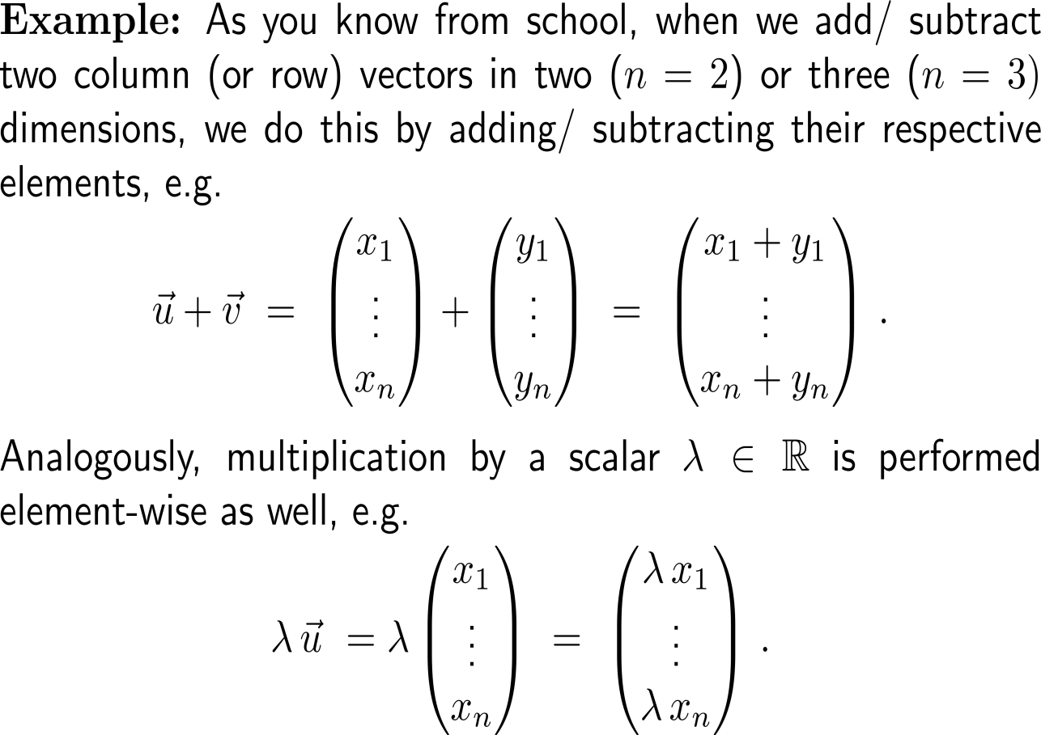
Addition of two vectors and multiplication by a scalar are performed element-wise

Slide 5
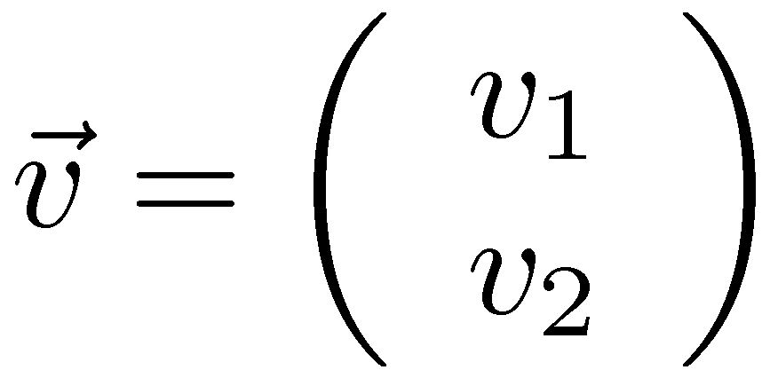
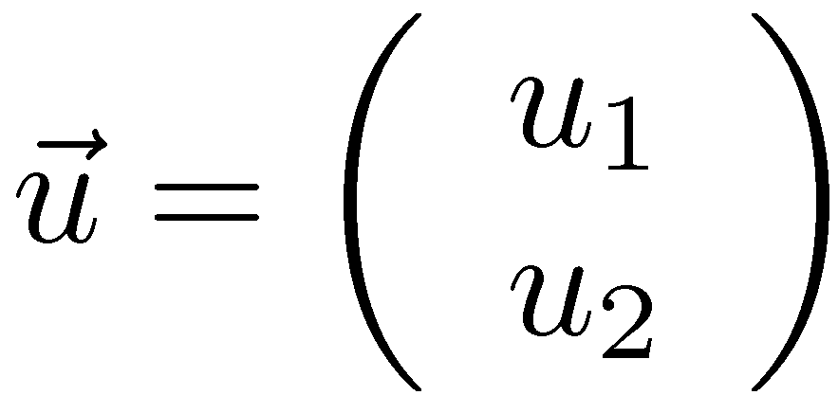
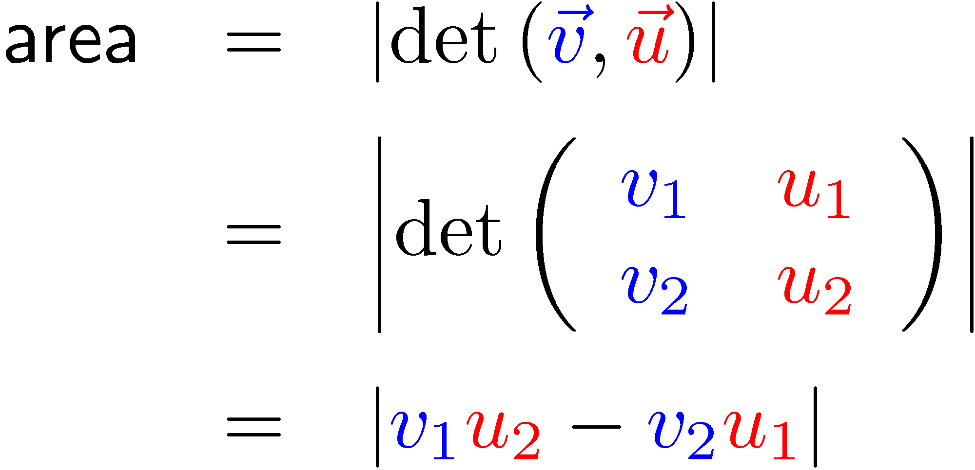
Geometrically, in 2D and 3D, we are introducing a new function – the determinant – to measure areas and volumes

Slide 6
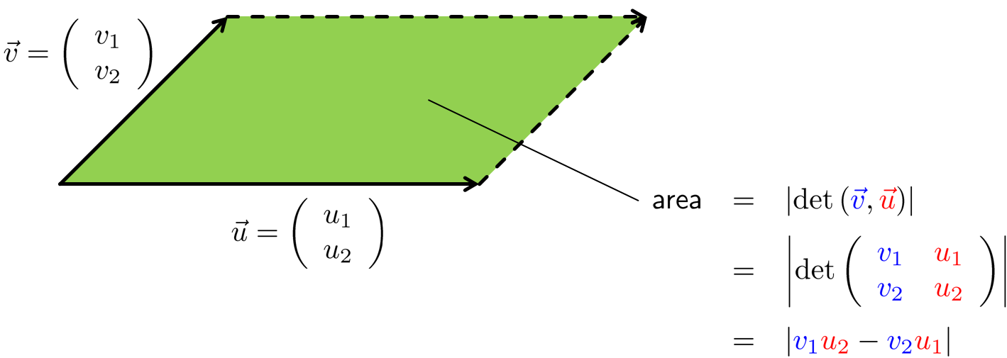
Definition: The determinant function in 2D

Slide 7
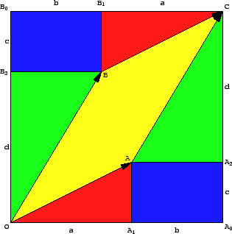
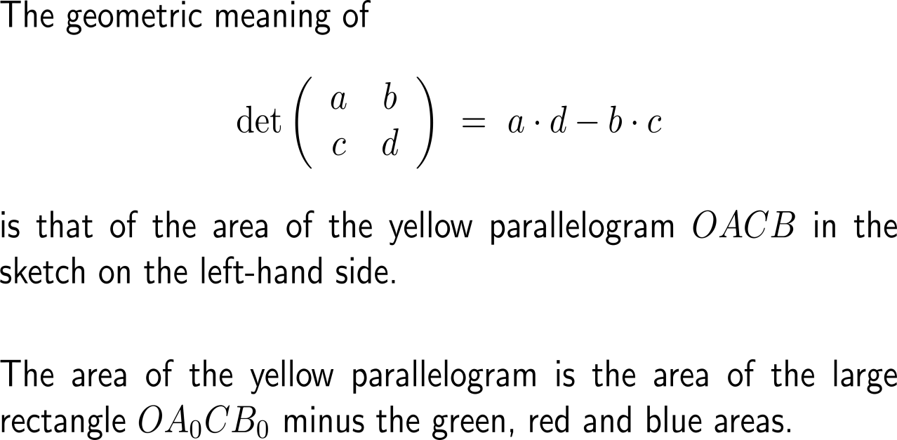
Geometrically, we can straightforwardly connect the value of a determinant with the area of the parallelogram spanned by its input vectors (1/ 2)
http://www.mat.univie.ac.at/~kriegl/Skripten/Math4Ilak1/node13.html

Slide 8
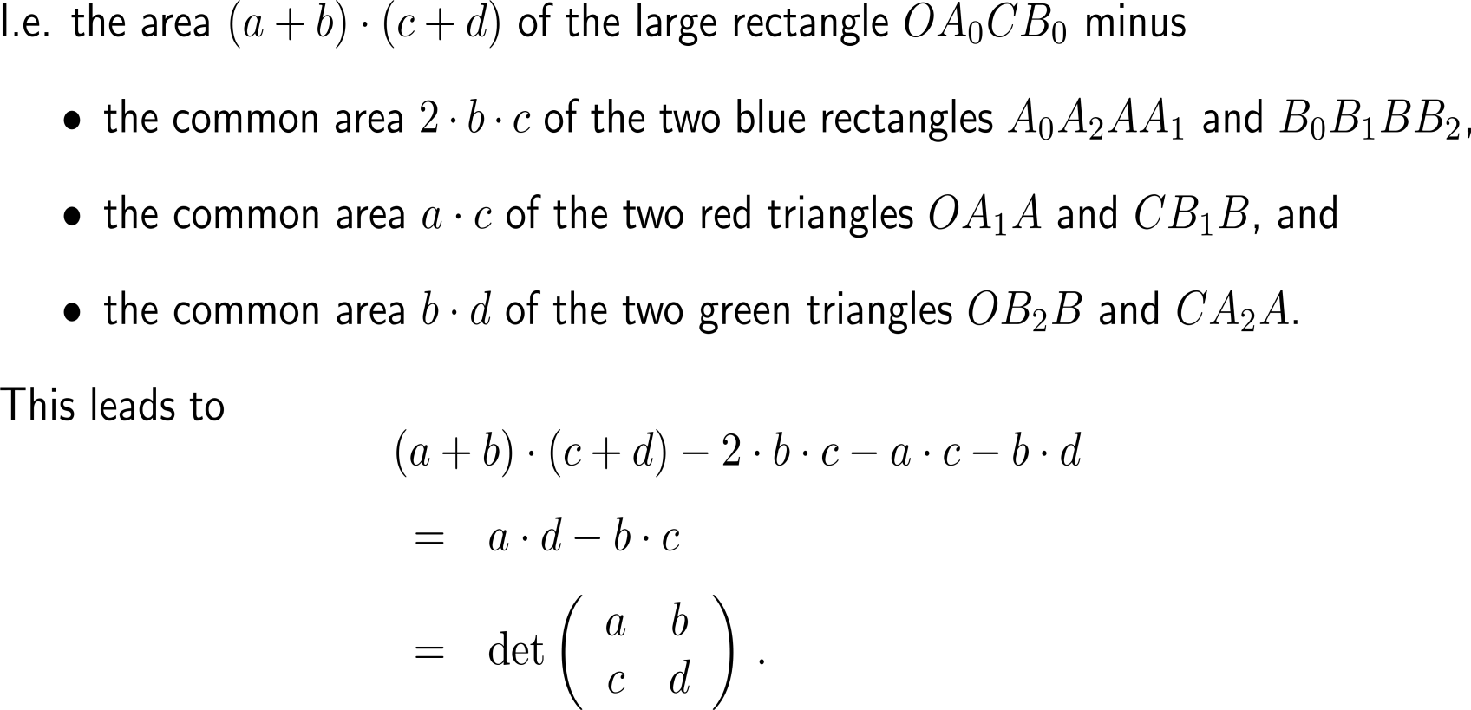
Geometrically, we can straightforwardly connect the value of a determinant with the area of the parallelogram spanned by its input vectors (1/ 2)

Slide 9
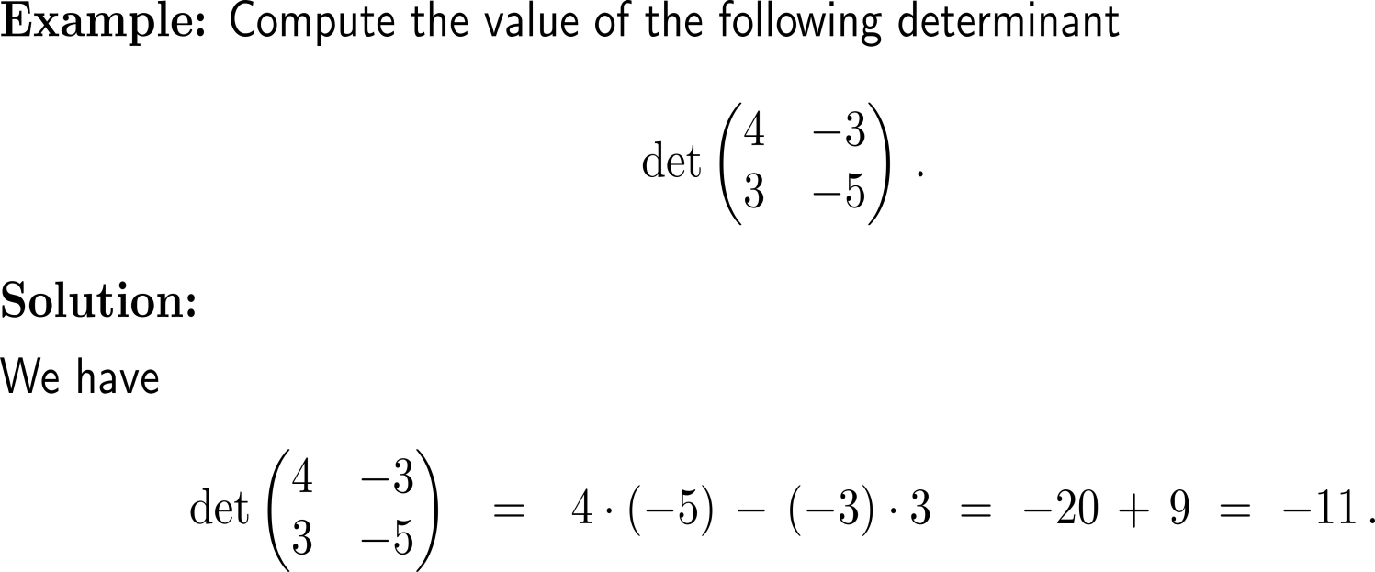
Example: The value of a determinant in 2D

Slide 10
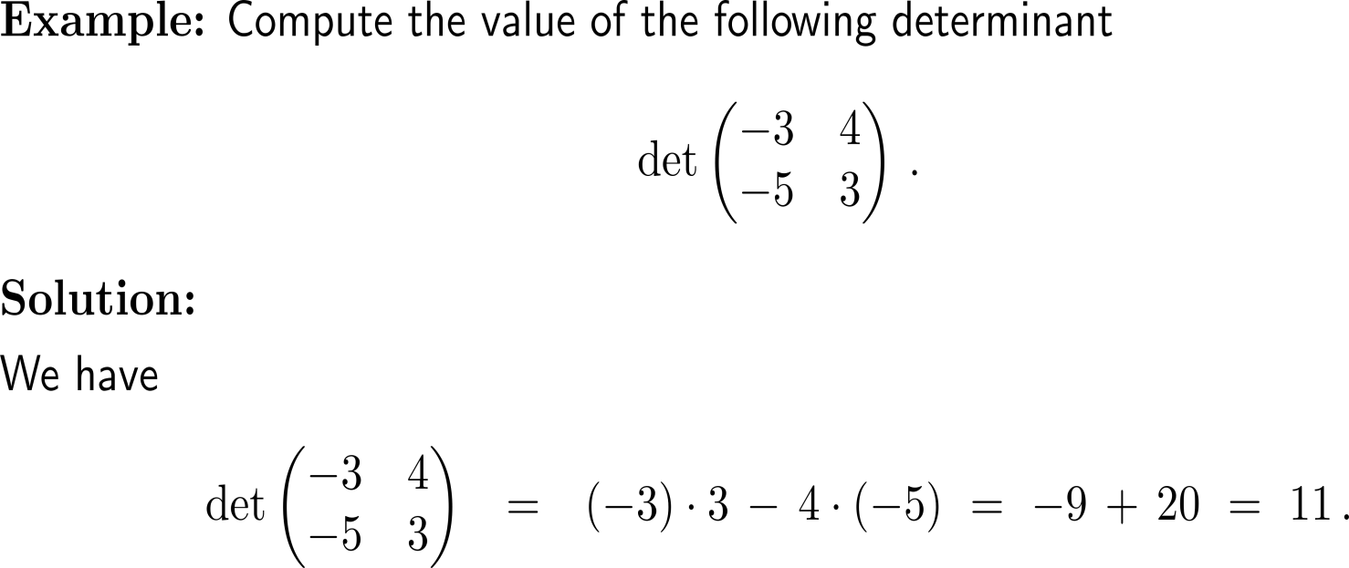
Example: The value of a determinant in 2D

Slide 11
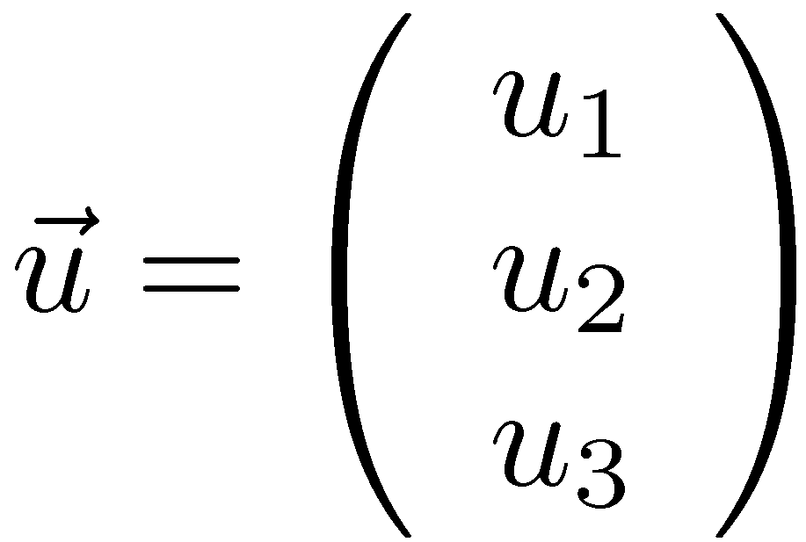
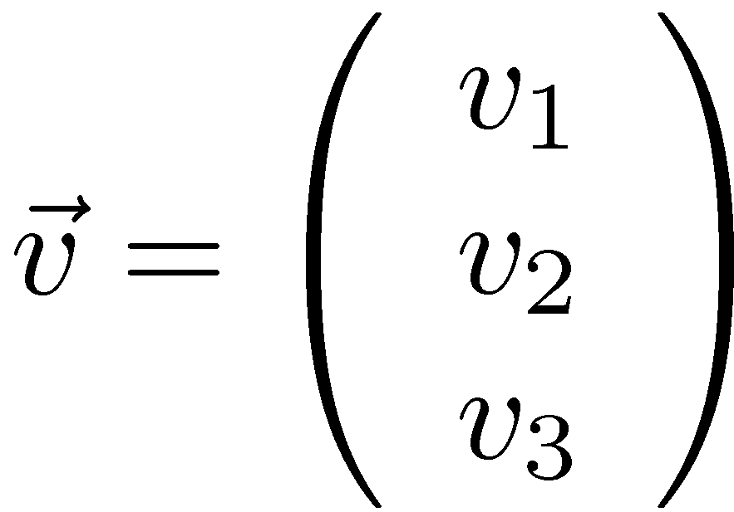
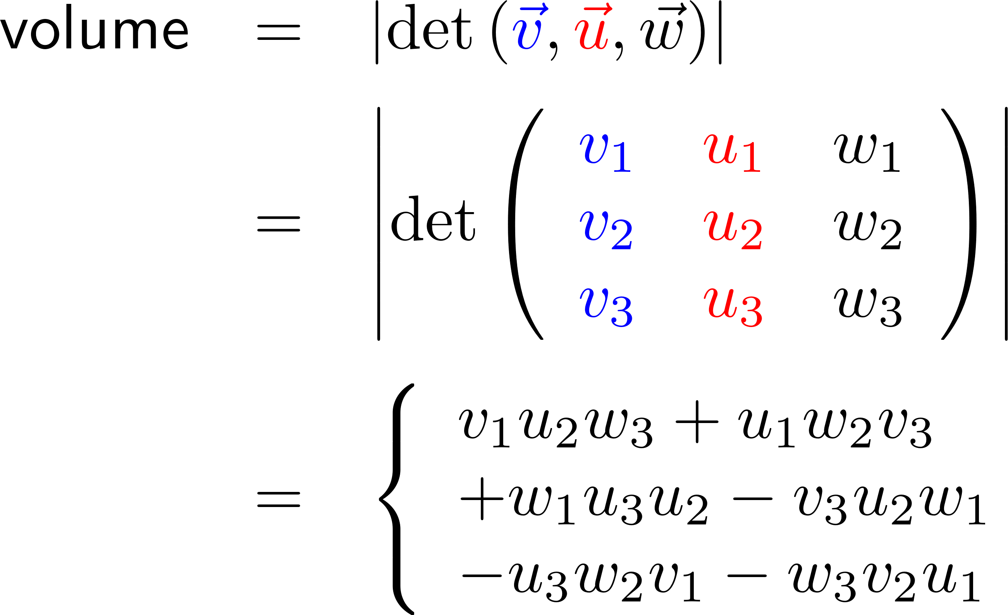
As in 2D the determinant in 3D can be connected with the volume of a spat spanned by three vectors

Slide 12
Definition: The determinant function in 3D

Slide 13
Only, in 2D and 3D can the determinate be computed by utilizing a diagonal crossing scheme

Slide 14
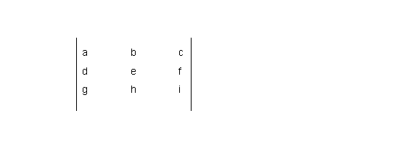
In 3D this diagonal crossing scheme (Sarrus’ rule) requires that the first two columns are attached at the end of the determinant

Slide 15
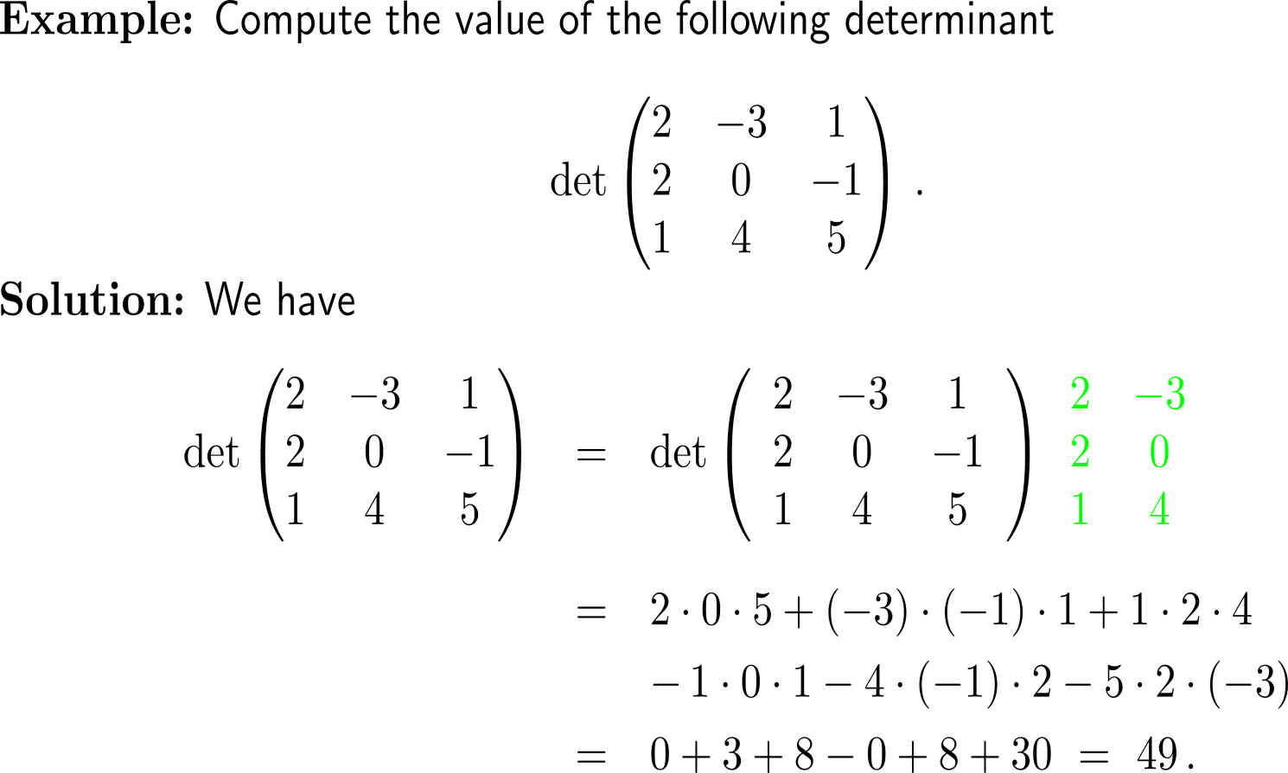
Example: The value of a determinant in 3D
+
-

Slide 16
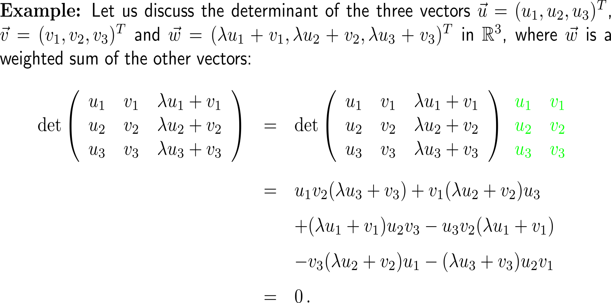
Example: The value of a determinant in 3D

Slide 17
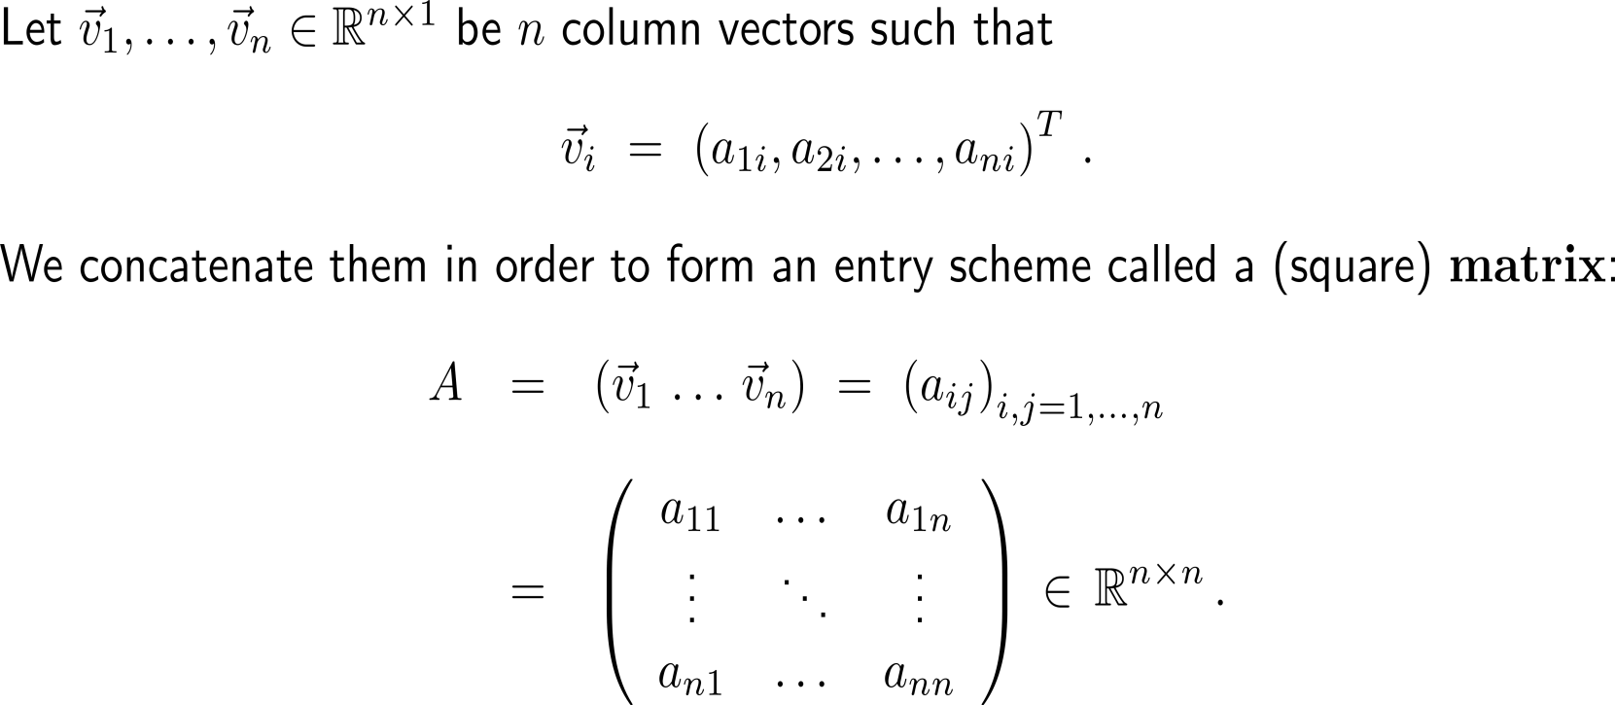
For convenience, we group vectors in special entry schemas that we call matrices (like in the case of linear systems)
rows
columns

Slide 18
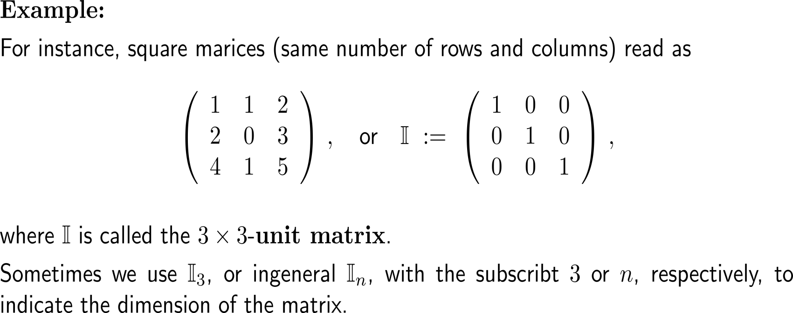
Example: Some matrices

Slide 19
Some first properties of matrices

Slide 20
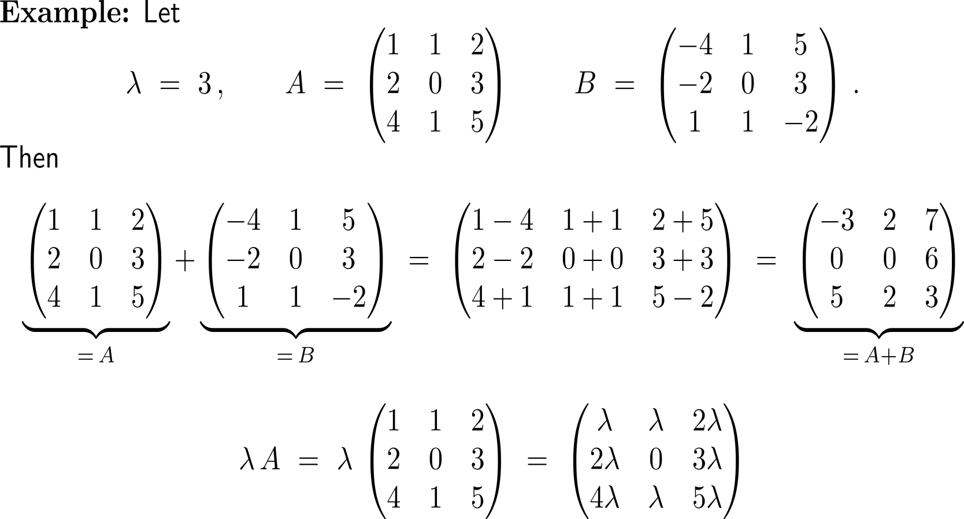
Example: Addition and scalar multiplication of a square matrix

Slide 21
Calculus II for Management

