Slide 1
Calculus II for MGMT – Introduction to Vectors & Matrices Linear Combinations of Vectors
Mathematics for Management
Supplementary Electronic Materials
Vectors & their linear combinations
Vectors & their linear combinations
Scalar-, vector-, and spat-product
Hessian Normal Form

Slide 2
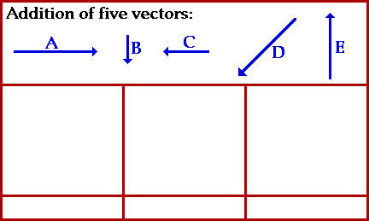
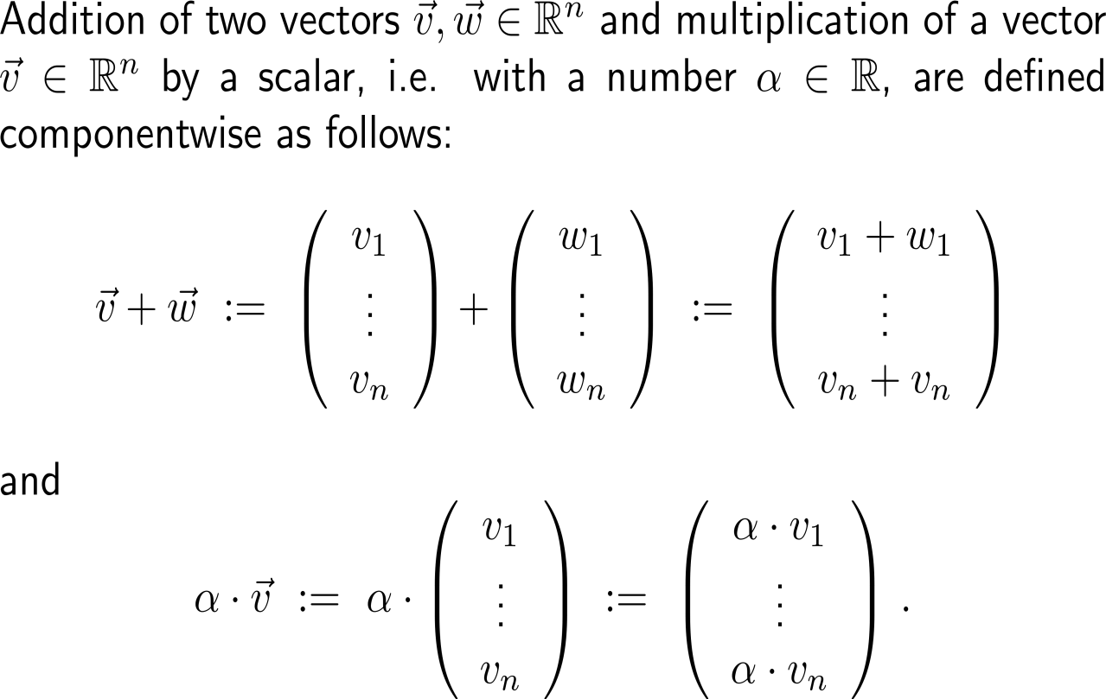
Let us summarize our knowledge on vectors by generalizing the concepts of addition of two vectors and multiplication of a vector with a scalar (1/ 3) …

Slide 3
Let us summarize our knowledge on vectors by generalizing the concepts of addition of two vectors and multiplication of a vector with a scalar (2/ 3) …

Slide 4
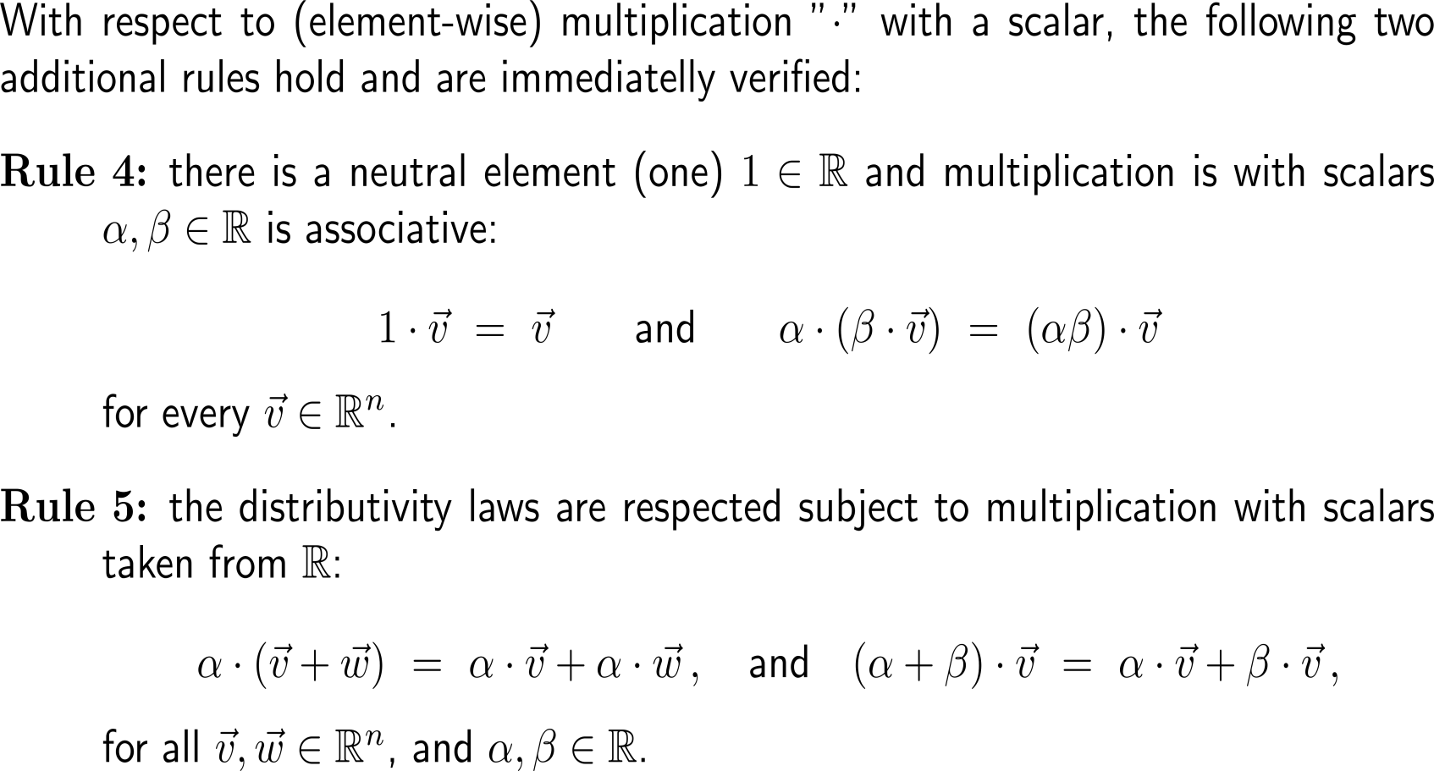
Let us summarize our knowledge on vectors by generalizing the concepts of addition of two vectors and multiplication of a vector with a scalar (3/ 3) …

Slide 5
… such that we obtain the notion of a “vector space”

Slide 6
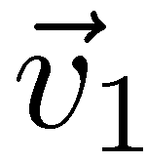
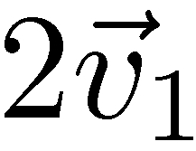
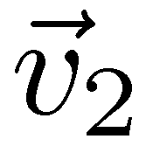
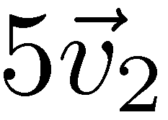
The notions of linear combination, …

Slide 7
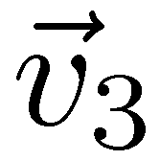
… linear hull/ span, …

Slide 8
… and linear independence/ dependence belong to the most fruitful insights into the structure of vector spaces
linearly dependent
linearly independent

Slide 9
For instance, a set of vectors is linearly independent if and only if none of these vectors is a linear combination of the other ones

Slide 10
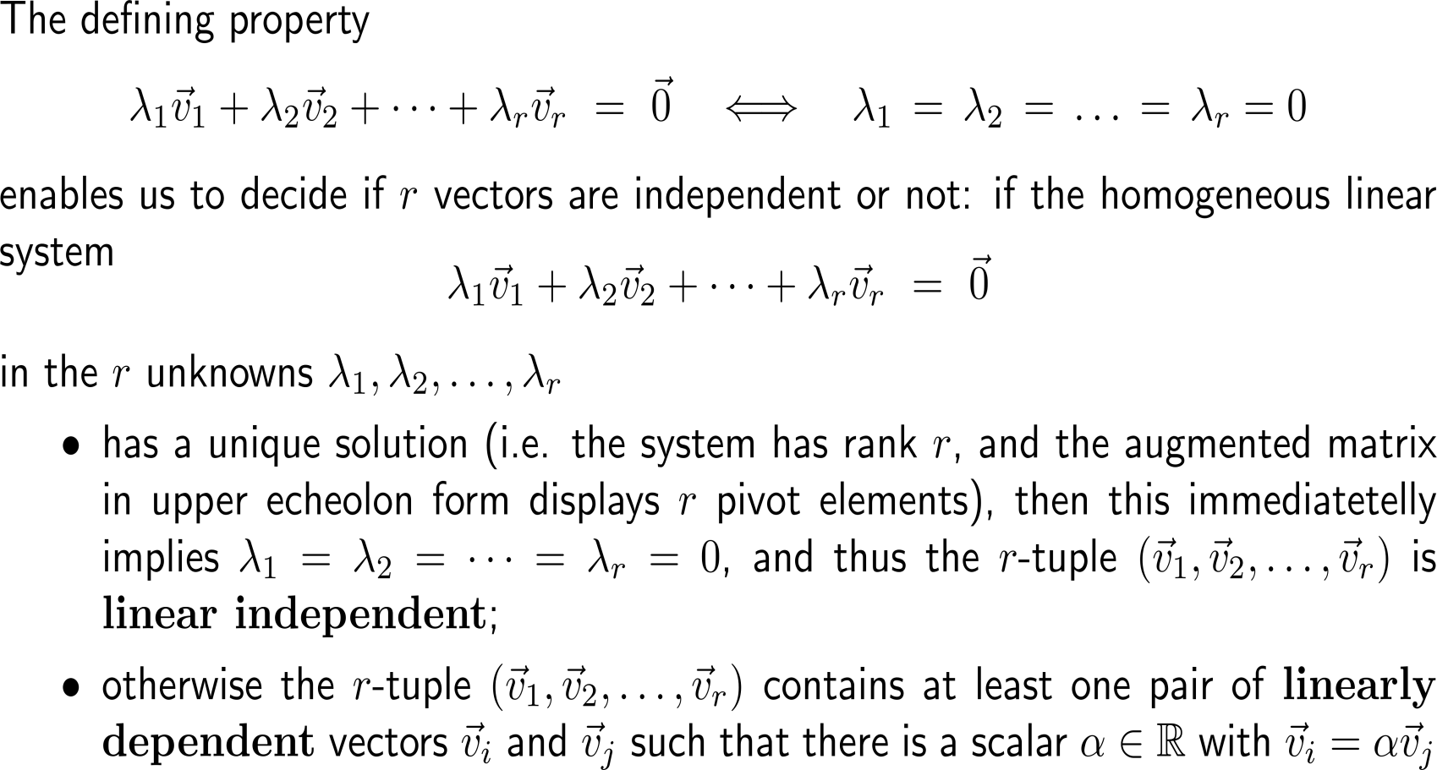
The method to decide upon linear independence/ dependence is to solve a linear system of equations

Slide 11
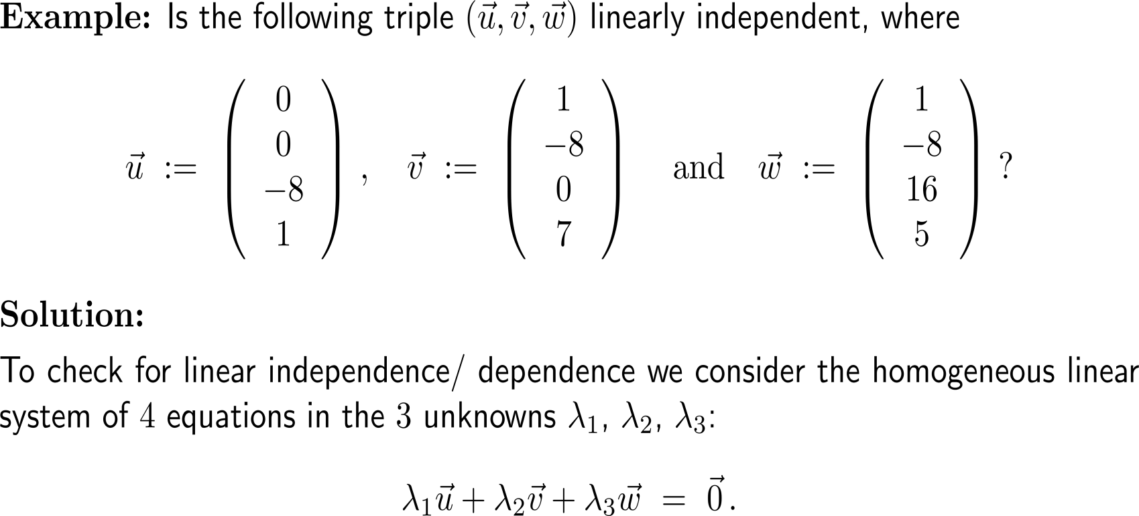
Example: Independence/ dependence of 3 vectors in 4D

Slide 12
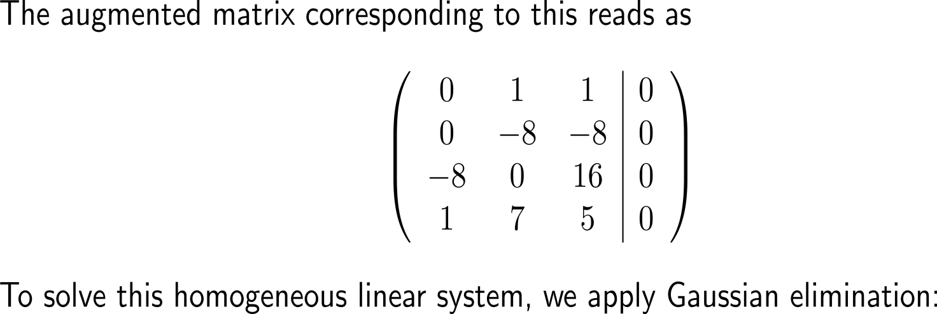
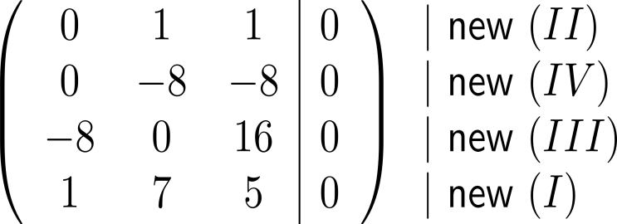
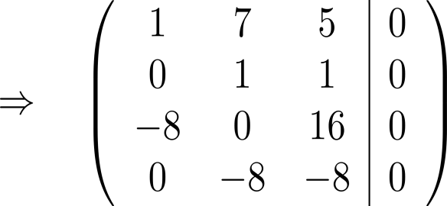
Example: Independence of 3 vectors in 4D

Slide 13
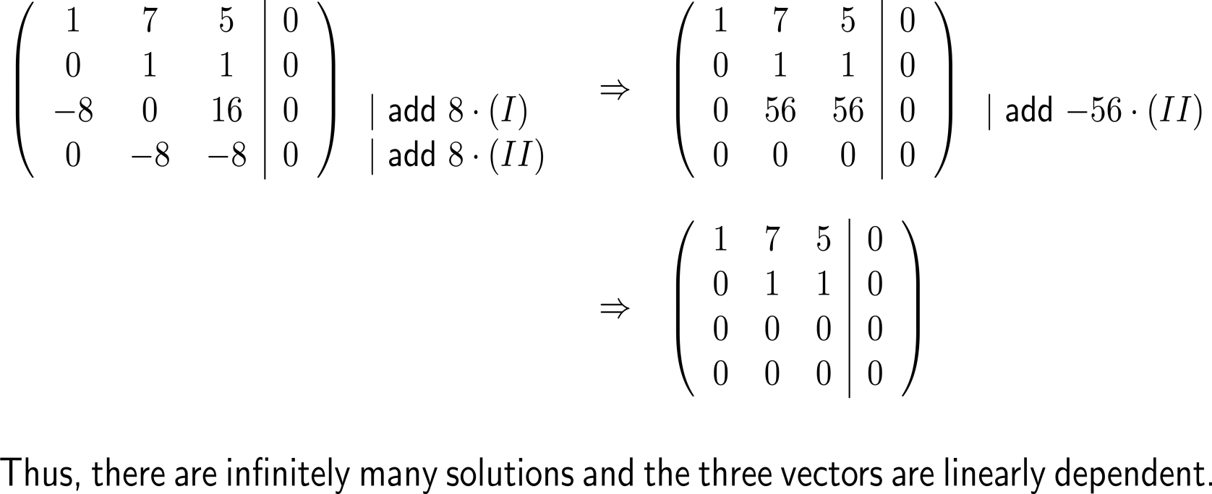
Example: Independence of 3 vectors in 4D

Slide 14
Remark: The determinant can serve as an easy test for linear independence/ dependence
linearly dependent
linearly independent
0

Slide 15
A basis of a vector space is a collection of linearly independent vectors that span the whole space

Slide 16
Example: The canonical basis
e₂ = (0, 1)^{T}
e₃ = (0, 0, 1)^{T}
0
e₁ = (1, 0, 0)^{T}
0
e₁ = 1
0
e₁ = (1, 0)^{T}
e₂ = (0, 1, 0)^{T}

Slide 17
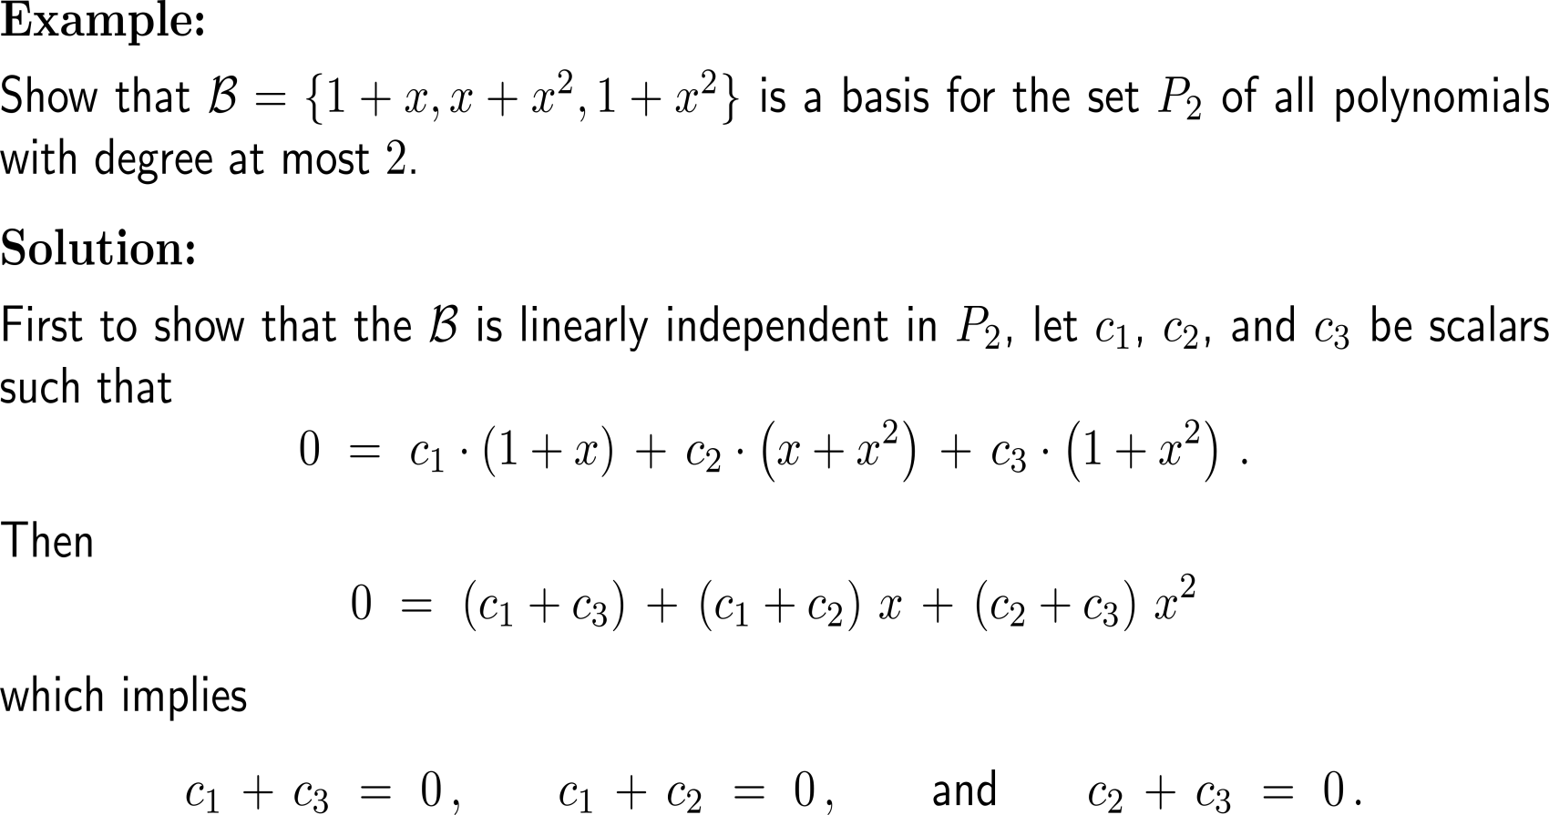
Example: A basis for the space P₂ of polynomials of degree of at most 2

Slide 18
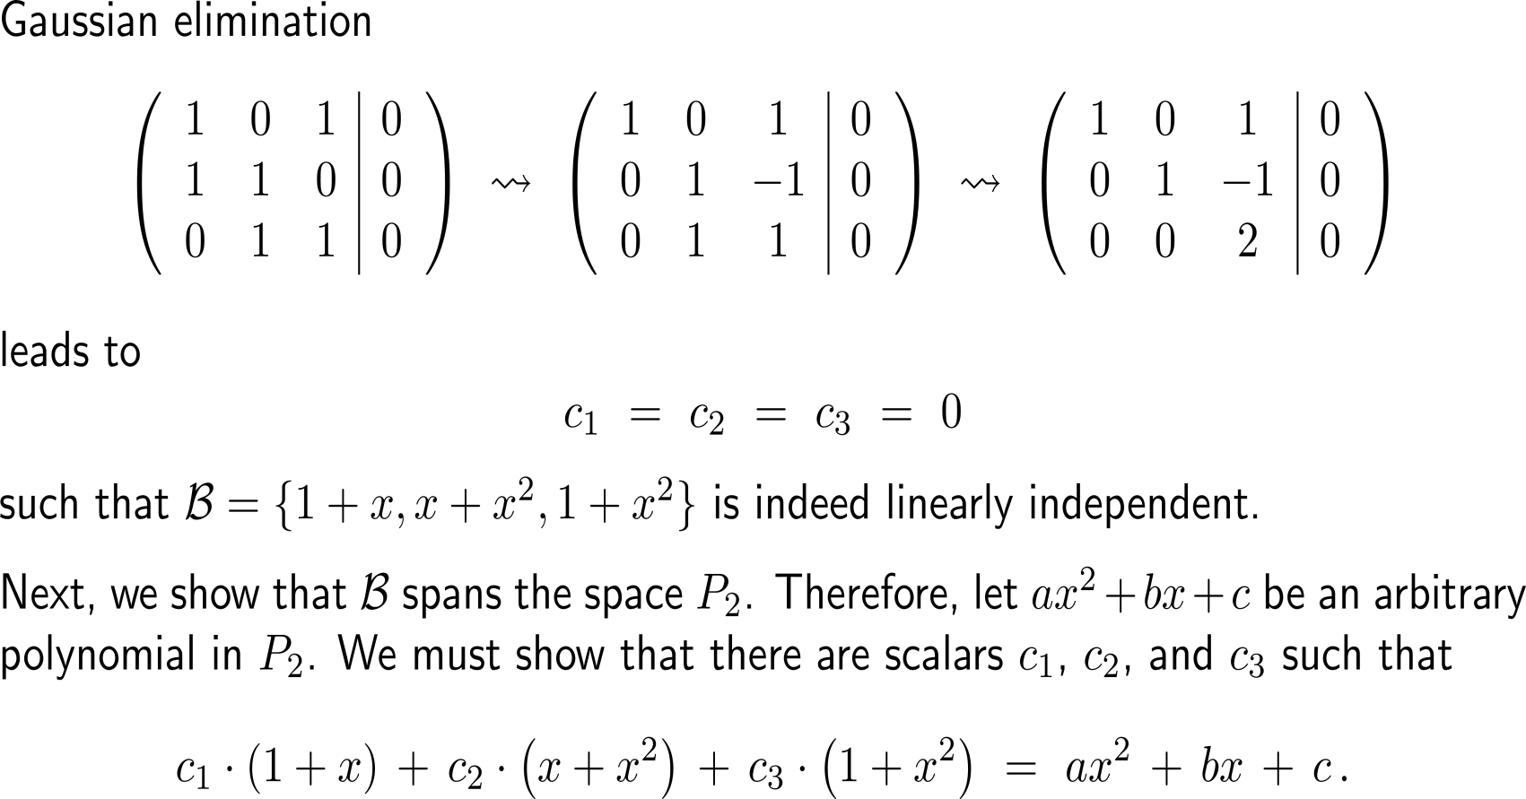
Example: A basis for the space P₂ of polynomials of degree of at most 2

Slide 19
Example: A basis for the space P₂ of polynomials of degree of at most 2

Slide 20
All basis sets of a vector space have the same lengths. This allows us to assign a dimension to each vector space

Slide 21
Calculus II for Management

