Slide 1
Calculus II for MGMT – Introduction to Vectors & Matrices Linear Combinations of Vectors
Mathematics for Management
Supplementary Electronic Materials
Vectors & their linear combinations
Vectors & their linear combinations
Scalar-, vector-, and spat-product
Hessian Normal Form

Slide 2
The (standard) scalar product is the same as a row-column vector multiplication

Slide 3
The norm of a vector is the square root of the scalar product of the vector with itself

Slide 4
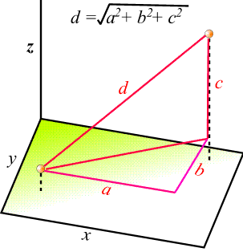
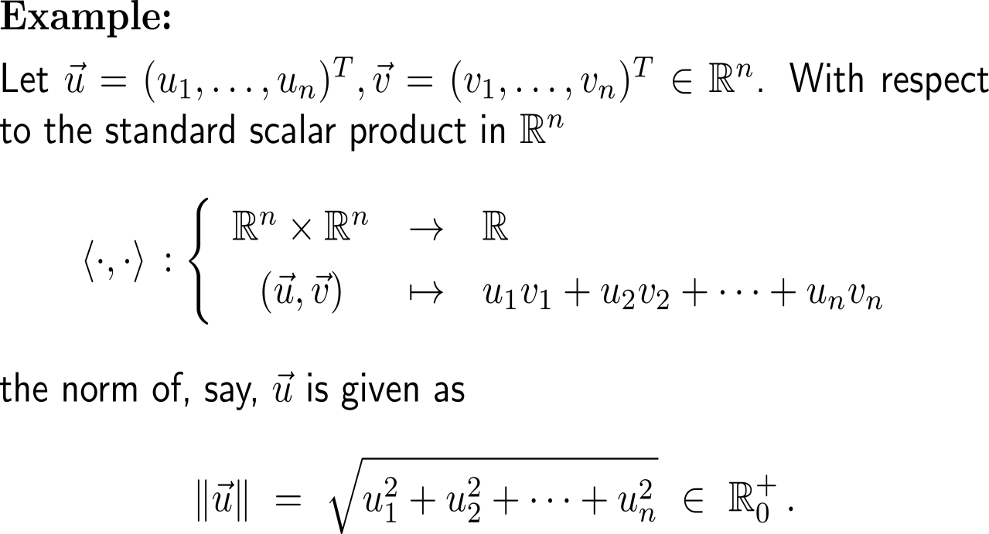
Example: Euclidean norm with respect to the scalar product

Slide 5
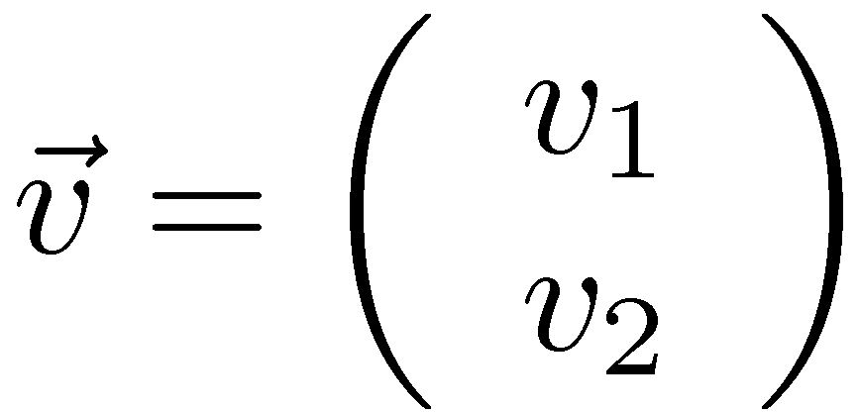
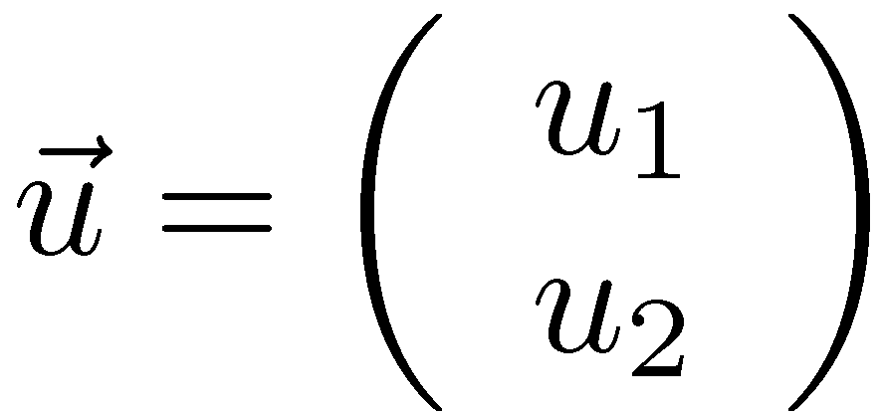
Geometric interpretation of the scalar product (1/ 3)
self study: do the computation

Slide 6
Geometric interpretation of the scalar product (2/ 3)

Slide 7
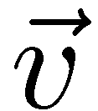
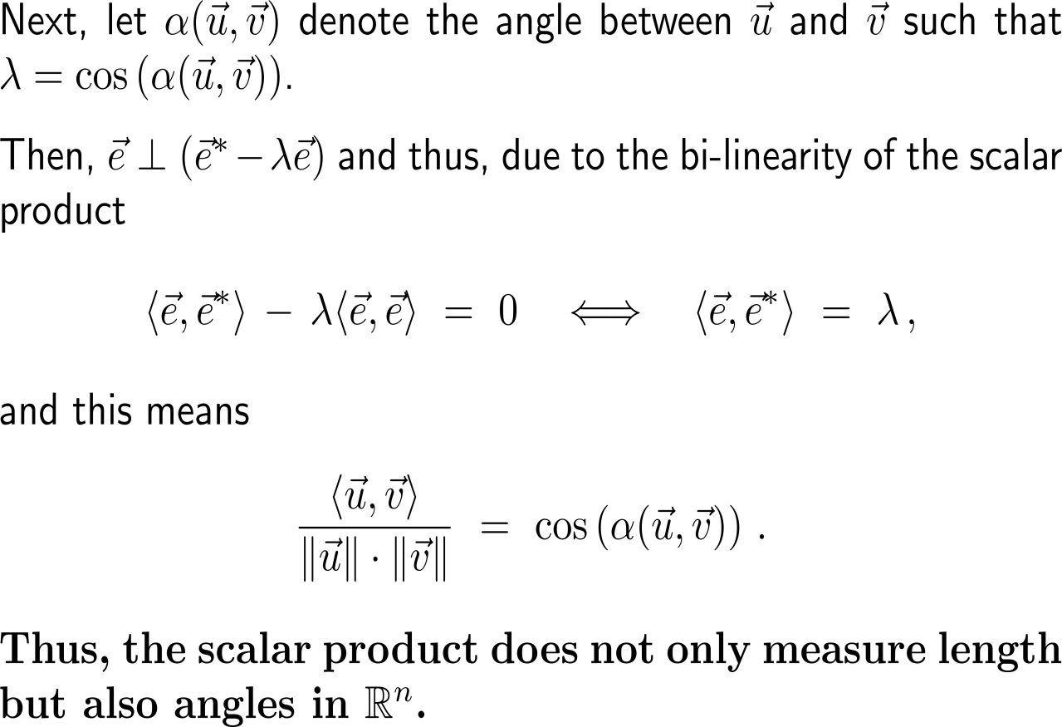
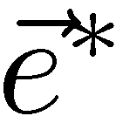
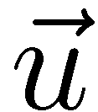
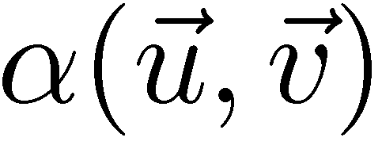
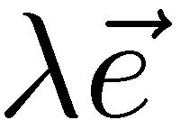
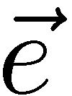
Geometric interpretation of the scalar product (3/ 3)

Slide 8
Consequently, we can defined the angle between two angles and especially have a way to see when two vectors are orthogonal to each other

Slide 9
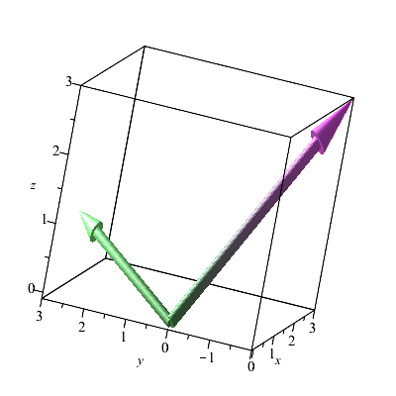
Example: Computing the area between two vectors
with(plots);
arrow({<1, 3, 1>, <3, -2, 3>});

Slide 10
For every two vectors in 3D their vector product gives a third vector that is orthogonal to both of them

Slide 11
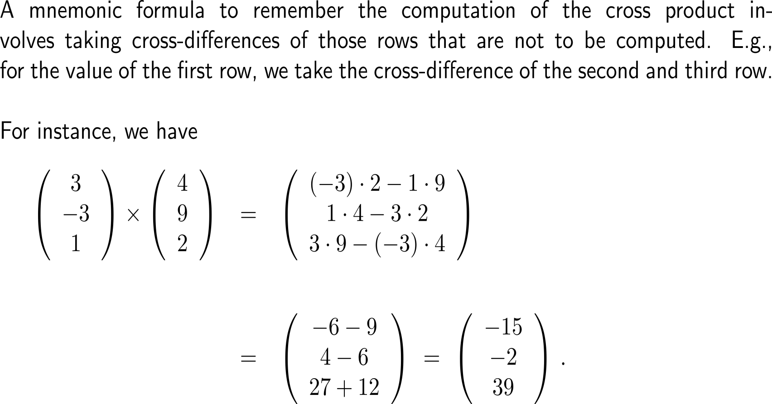
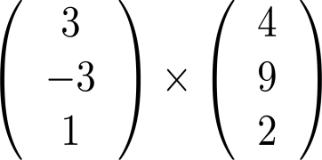
A mnemonic formula to remember the computation of the cross product involves taking cross-differences
+
-

Slide 12
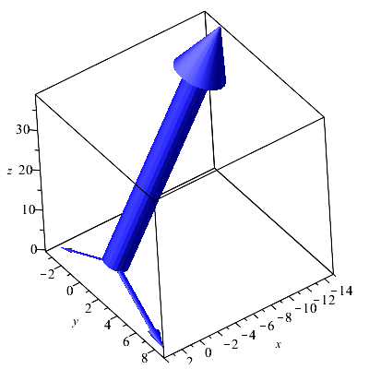
Example: Computing the vector product of two vectors

Slide 13
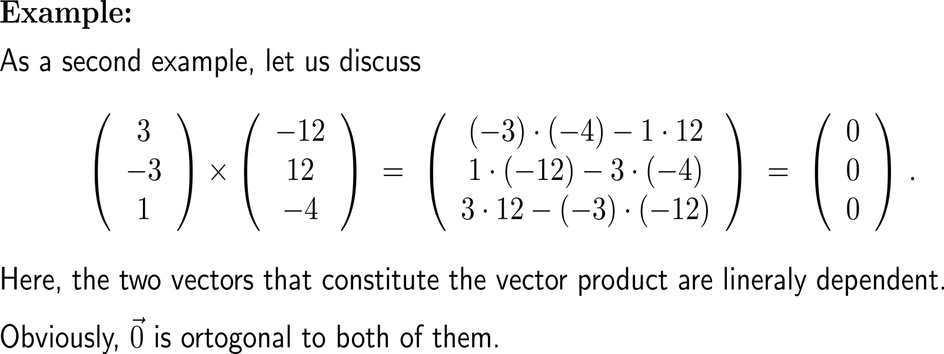
Example: Computing the vector product of two vectors

Slide 14
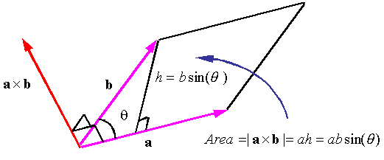
Geometrically, the magnitude of a vector product of two vectors can be interpreted as the area of the parallelogram spanned these vectors (1/ 2)

Slide 15
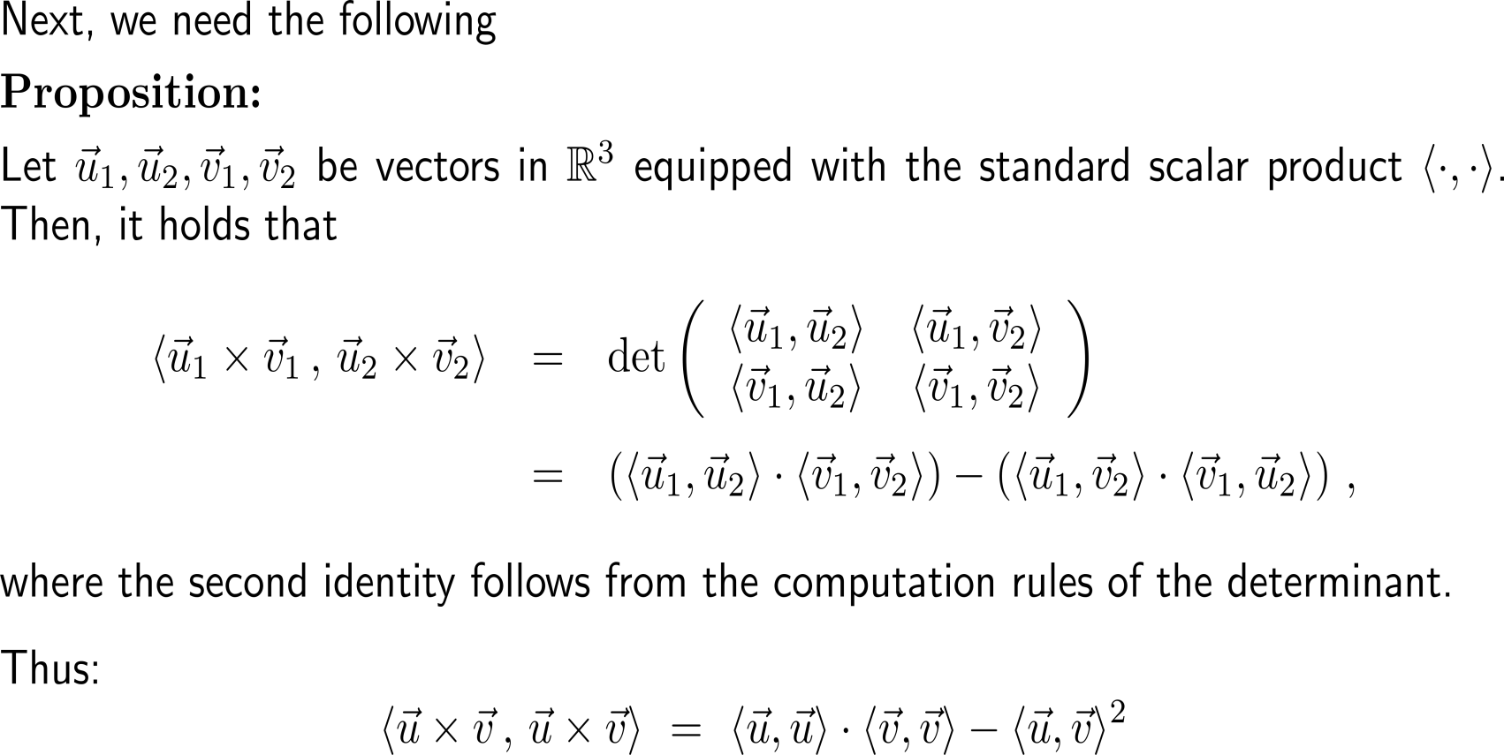
Geometrically, the magnitude of a vector product of two vectors can be interpreted as the area of the parallelogram spanned these vectors (2a/ 2)

Slide 16
Geometrically, the magnitude of a vector product of two vectors can be interpreted as the area of the parallelogram spanned these vectors (2b/ 2)
self study: do the computation

Slide 17
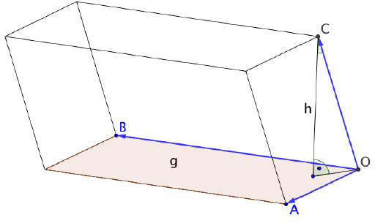
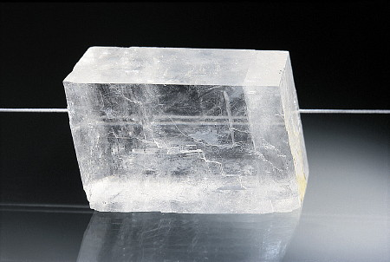
The volume of a parallelepiped (or spat) follows immediately from our previous discussions …
Calcite which is called “Feldspat” in German crystallizes in the form of parallelepipeds

Slide 18
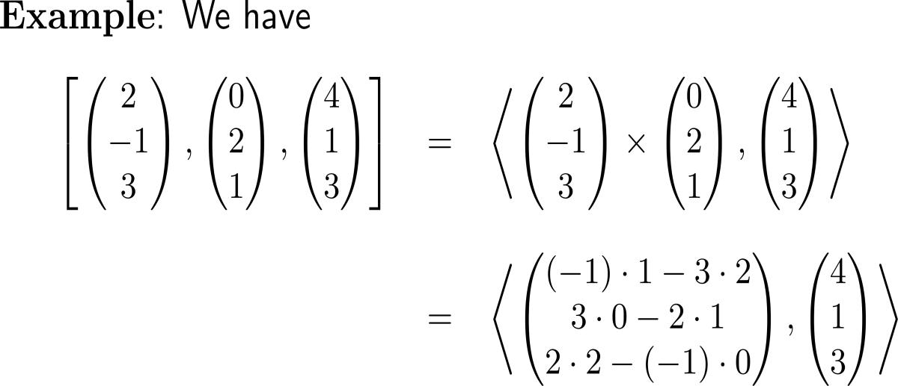
… and elementary geometric considerations (1/ 2)
Calcite which is called “Feldspat” in German crystallizes in the form of parallelepipeds

Slide 19
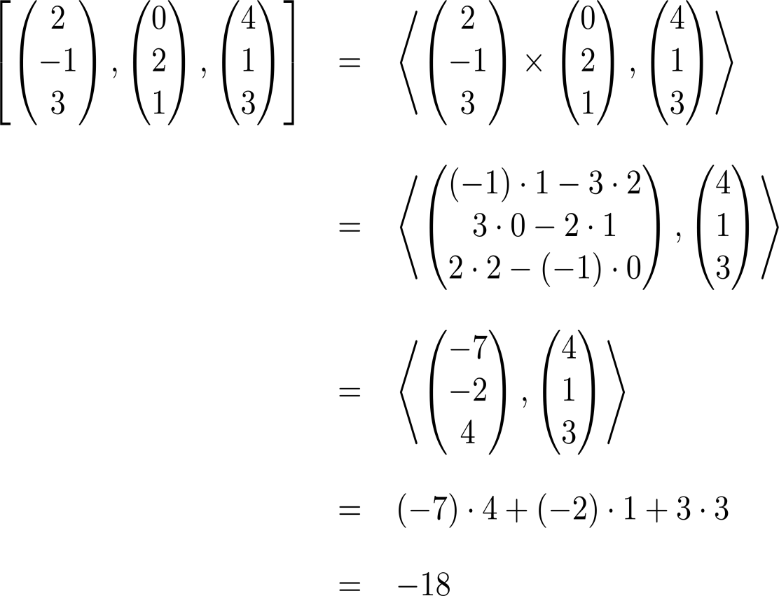
… and elementary geometric considerations (2/ 2)
Calcite which is called “Feldspat” in German crystallizes in the form of parallelepipeds

Slide 20
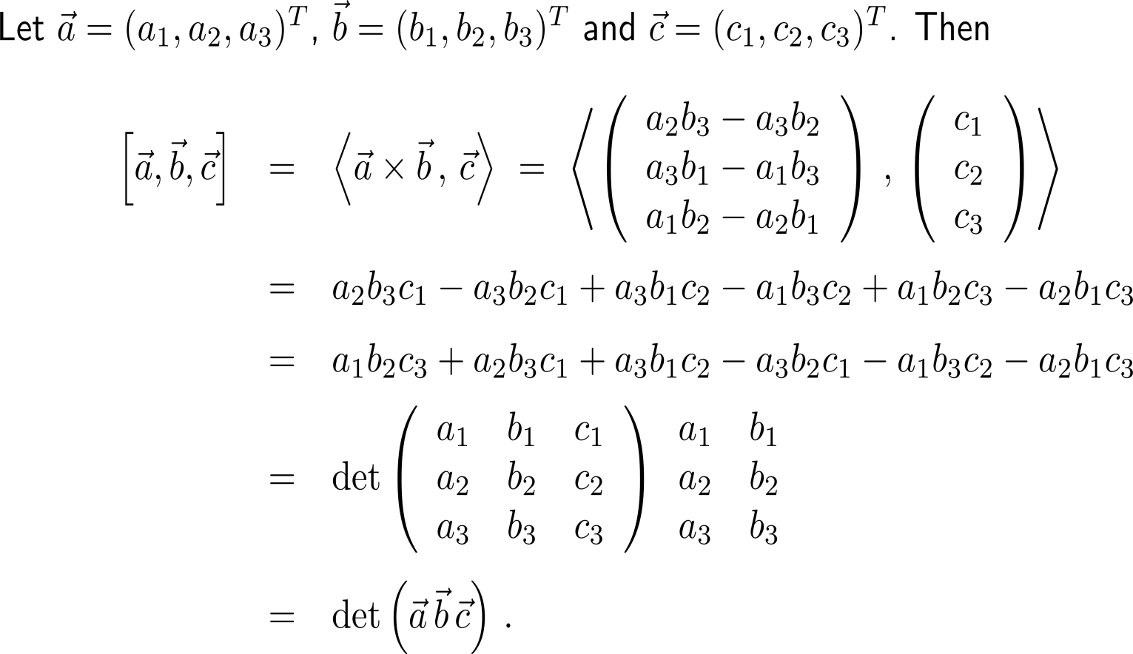
The spat product is the same as the determinant built of the spanning vectors
This actually verifies our previous geometric understanding of the determinant as a way to compute the area of a parallelepiped

Slide 21
Calculus II for Management

